Slide 1
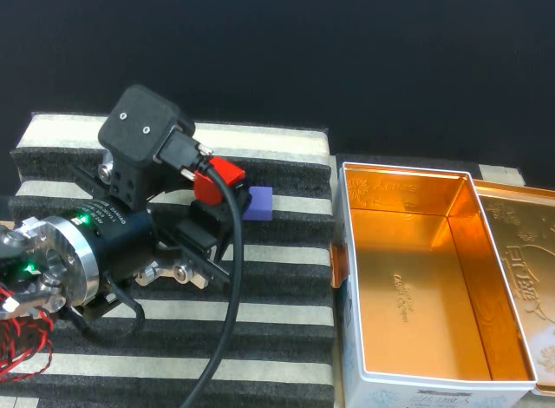
THE IDEA
IDEA + METHOD
CAST
Anchoring critic-guided fine-tuning
of generative robot policies
Improve the skill.
Keep what works.
OpenArm · staircase manipulation
Teleoperated demonstration frame
Persistent reference + useful adaptation
CAST / ICRA 2027 supplementary video
01 / 10
Notes:
00:00–00:10 | 10 seconds
NARRATION
A robot can position an object correctly, yet fail at release. CAST improves the skill while preserving behavior that already works.
VISUAL CUES
Static slide; no animation required.
SOURCES
_ICRA_2027__CAST/sections/01_introduction.tex

Slide 2
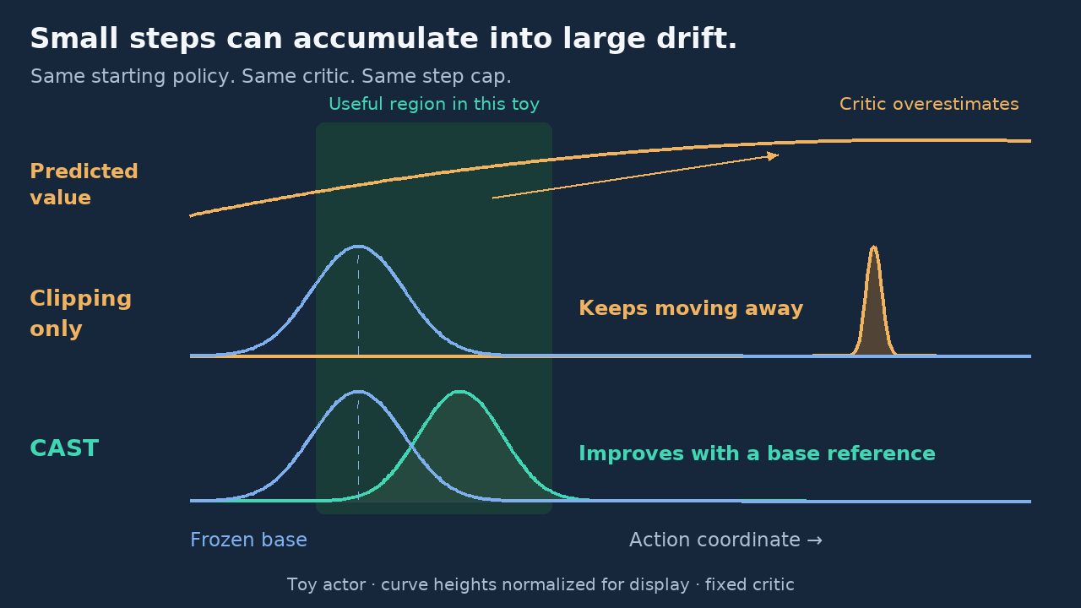
WHY ANCHORING MATTERS
IDEA + METHOD
Small steps can still drift.
An imperfect critic can turn local corrections into cumulative drift.
A01 / Accumulated drift
Clipping
Clipping only
With restoration
Limits each individual
correction.
Restoration
Responds to departure
already accumulated.
Frozen base
Frozen base
Illustrative action space · not a measured learning curve
STATIC PREVIEW · ANIMATION RESERVED
CAST / ICRA 2027 supplementary video
02 / 10
Notes:
00:10–00:30 | 20 seconds
NARRATION
A critic predicts which actions are valuable. Here, its predictions favor actions far from the useful region. Watch the action distributions shift during optimization. Clipping keeps each correction small, but repeated corrections still drift. CAST restores toward the frozen base while allowing a useful adjustment. This is an illustrative toy example.
VISUAL CUES
A01: Animate matched synthetic actions with clipping alone versus the exact CAST restoration and caps. Same base, critic, and step cap.
SOURCES
_ICRA_2027__CAST/sections/03_problem_statement.tex
_ICRA_2027__CAST/sections/04_analysis.tex

Slide 3
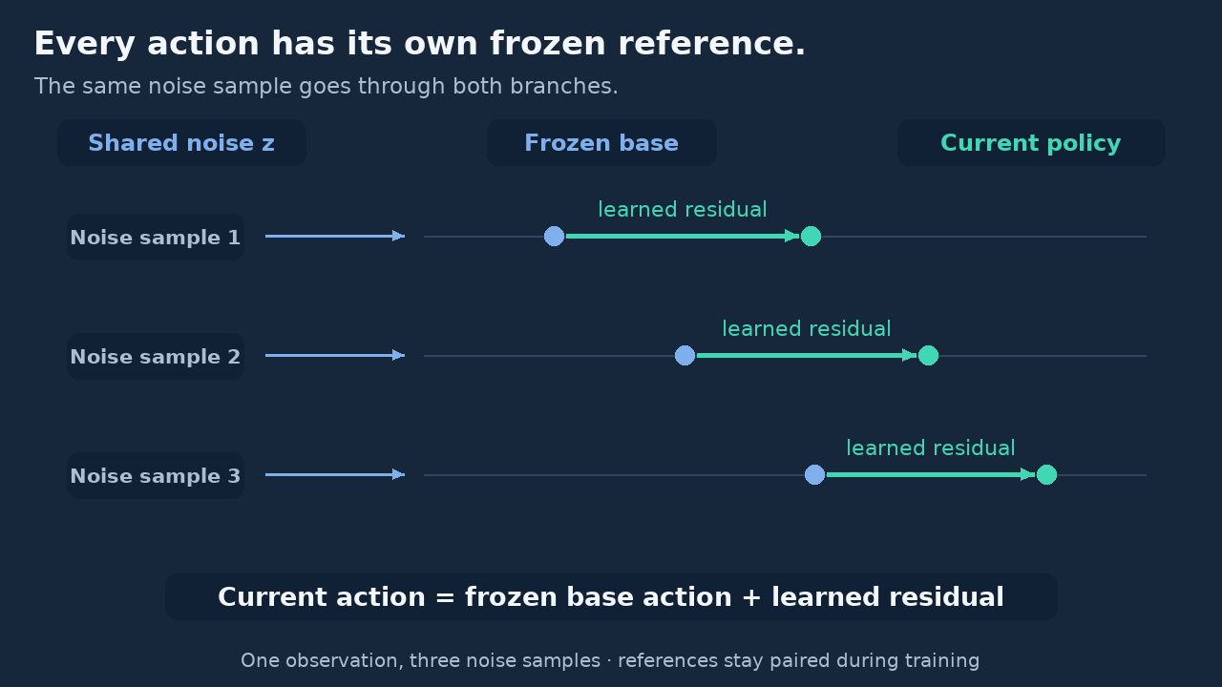
POLICY ARCHITECTURE
IDEA + METHOD
Freeze the base. Learn a correction.
Use the same observation and noise to pair the base and current action.
Observation s + shared noise z
A02 / Paired residual actions
Same noise → consistent reference
Base policy
Residual
Base action
Frozen
Learned
Residual
correction
Current action
The base supplies samples, not likelihoods.
STATIC PREVIEW · ANIMATION RESERVED
CAST / ICRA 2027 supplementary video
03 / 10
Notes:
00:30–00:45 | 15 seconds
NARRATION
We freeze the generative policy and learn an additive residual. The same observation and noise pair each current action with its base action, giving corrections a consistent reference without policy likelihoods.
VISUAL CUES
A02: Reveal base actions and learned residual arrows for the same noise samples. Keep the base fixed.
SOURCES
_ICRA_2027__CAST/sections/03_problem_statement.tex
_ICRA_2027__CAST/sections/04_method.tex

Slide 4
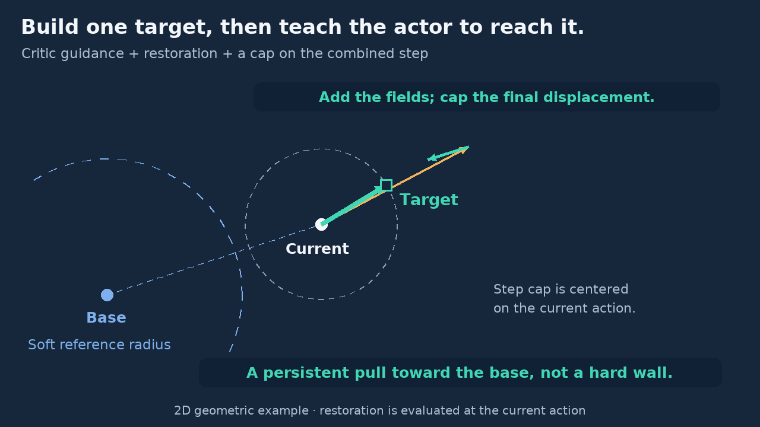
CONSTRUCT THE TARGET
IDEA + METHOD
Propose. Restore. Limit the step.
1 Critic guidance
A03 / Construct the action target
Normalize and cap the proposal;
then scale it.
Critic proposal
2 Restoration
Restoring
correction
Weak pull + stronger pull beyond
the reference radius.
Capped target
3 Combined cap
Current action
Limit the final target step from
the current action.
Paired base
STATIC PREVIEW · ANIMATION RESERVED
Targets are constrained; fitted outputs are not hard-bounded.
CAST / ICRA 2027 supplementary video
04 / 10
Notes:
00:45–01:10 | 25 seconds
NARRATION
First, the critic proposes an improvement. We normalize and cap its gradient, then scale the proposal. A weak pull always points toward the paired base action. Beyond a soft reference radius, an additional radial pull becomes active. We add these fields and cap the final step from the current action. The resulting target teaches the residual policy.
VISUAL CUES
A03: Animate the normalized critic proposal, paired weak/radial restoration, and combined displacement cap. Restoration is evaluated at the current action.
SOURCES
_ICRA_2027__CAST/sections/04_method.tex

Slide 5
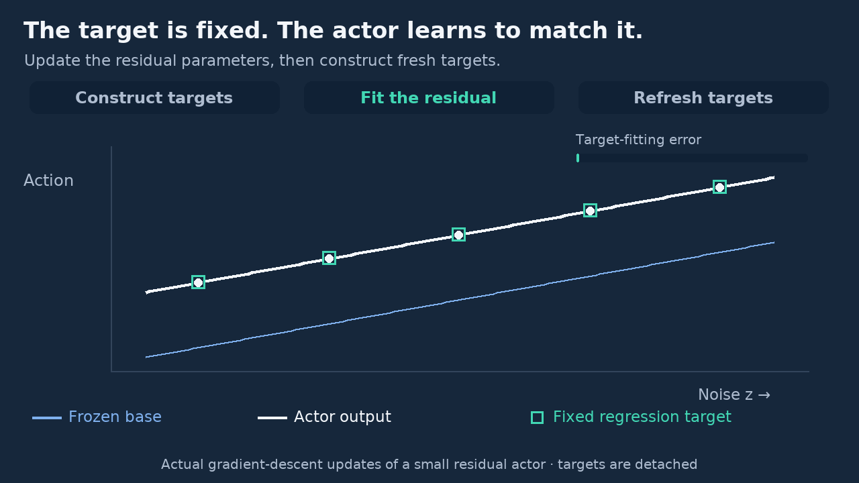
LEARN AND REPEAT
IDEA + METHOD
A soft reference, learned through fixed targets.
A04 / Fit → refresh targets
Restoration penalizes
departure from the base.
Targets stay fixed during the actor update.
Illustrative penalty U(r)
Regress the residual → build fresh targets
radius
Soft threshold, not a hard wall
STATIC PREVIEW · ANIMATION RESERVED
With inactive caps: the same local gradient direction as regularized critic optimization.
CAST / ICRA 2027 supplementary video
05 / 10
Notes:
01:10–01:32 | 22 seconds
NARRATION
The squares are fixed targets. The white actor learns to match them by regression; its fitting error decreases. Then we construct new targets and repeat. Restoration corresponds to a penalty on departure from the base. With clipping inactive, the first regression gradient follows regularized critic optimization. The reference stays soft, leaving room to improve.
VISUAL CUES
A04: Show fixed targets during regression; move the actor toward them, then recompute. Illustrate the soft restoration potential without claiming a hard policy-output bound.
SOURCES
_ICRA_2027__CAST/sections/04_method.tex
_ICRA_2027__CAST/sections/04_analysis.tex

Slide 6
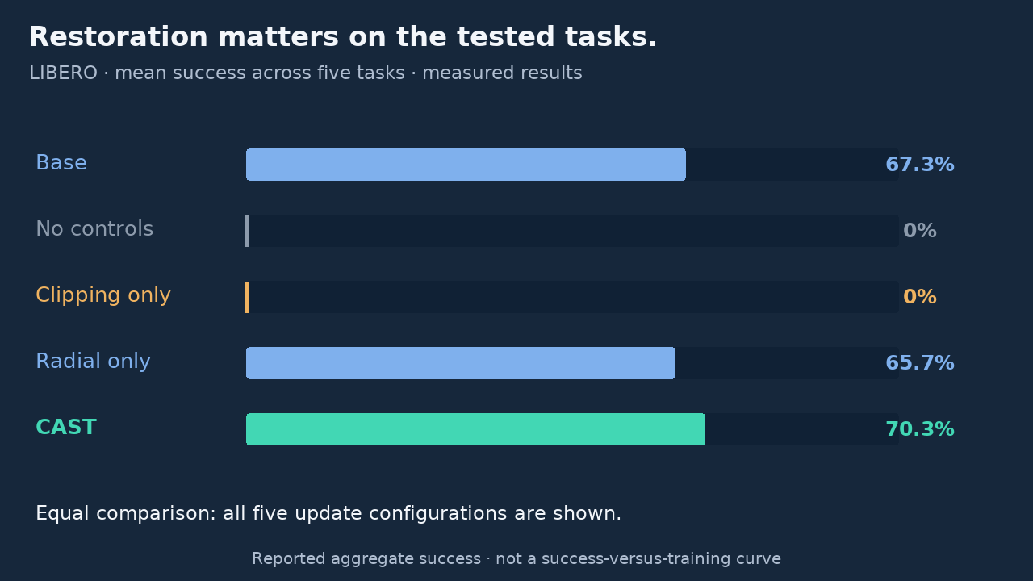
SIMULATION EVIDENCE
IDEA + METHOD
Reach useful performance with less experience.
A05 / Measured restoration ablation
Steps to 90% success
Success over training
CAST
149.3K
Insert measured evaluation
curves
DICE-RL
240.0K
Curve animation reserved
38%
fewer environment
steps on average
Environment steps
STATIC PREVIEW · ANIMATION RESERVED
Shared diffusion base · three runs
LIBERO: clipping without restoration loses all success on five tested tasks.
CAST / ICRA 2027 supplementary video
06 / 10
Notes:
01:32–02:00 | 28 seconds
NARRATION
On robomimic square, CAST reaches ninety percent success with thirty-eight percent fewer environment steps than DICE-RL, while final success is similar. In a separate five-task LIBERO study, both updates without restoration lose all task success, including clipping alone. Full CAST improves every task over its base, although radial restoration alone is better on two tasks.
VISUAL CUES
A05: Animate equal-status bars for the base and four component configurations using the five-task mean success from the submitted paper. This is an aggregate comparison, not a learning curve.
SOURCES
_ICRA_2027__CAST/sections/05_experiments.tex
_ICRA_2027__CAST/sections/tables/05_ablations.tex
_ICRA_2027__CAST/figures/experiment_chart_data.json

Slide 7
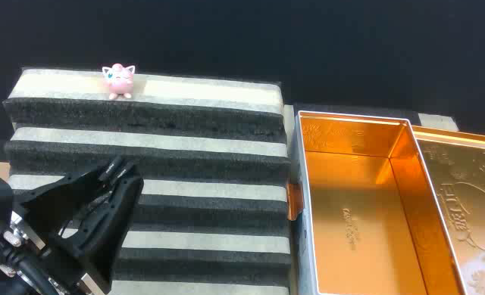
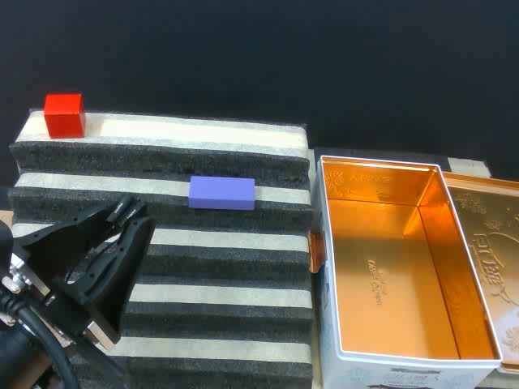
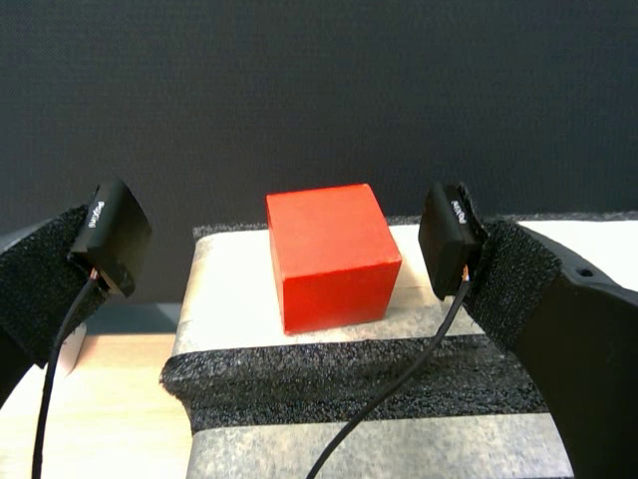
REAL ROBOT — SETUP
REAL ROBOT
From recorded experience to robot execution.
Chest RGB
Wrist RGB
RGB + joint / gripper state
OpenArm + parallel gripper
Flow policy + residual → action chunks
Recorded rollouts → offline refinement → autonomous evaluation
Scene images are teleoperated demonstration frames.
CAST / ICRA 2027 supplementary video
07 / 10
Notes:
02:00–02:16 | 16 seconds
NARRATION
We evaluate OpenArm with chest and wrist cameras, joint state, and a parallel gripper. A flow-matching policy predicts action chunks. Refinement trains offline on recorded successes and failures, then we evaluate placement and stacking autonomously on a staircase scene.
VISUAL CUES
Static slide; no animation required.
SOURCES
_ICRA_2027__CAST/sections/05_real_robot.tex
_ICRA_2027__CAST/sections/05_experimental_supplement.tex

Slide 8
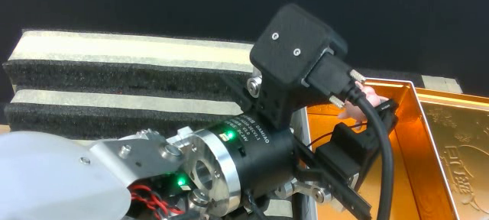
REAL ROBOT — PLACEMENT
REAL ROBOT
Place accurately across changing heights.
V01 / Autonomous placement
Autonomous success
PLACEHOLDER · teleoperation still
Base
55%
BC
80%
DICE-RL
90%
CAST
95%
+40 percentage points
STATIC PREVIEW · VIDEO RESERVED
over the pretrained base
Place the toy fully inside the case.
CAST / ICRA 2027 supplementary video
08 / 10
Notes:
02:16–02:32 | 16 seconds
NARRATION
Placement requires putting the toy fully inside the case. CAST raises success from fifty-five to ninety-five percent, compared with eighty percent for BC refinement and ninety percent for DICE-RL, all starting from the same base.
VISUAL CUES
V01: Insert an actual autonomous placement rollout. Current still is a labeled teleoperated illustration, not a CAST evaluation.
SOURCES
_ICRA_2027__CAST/sections/05_real_robot.tex
_ICRA_2027__CAST/real_robot_results.json

Slide 9
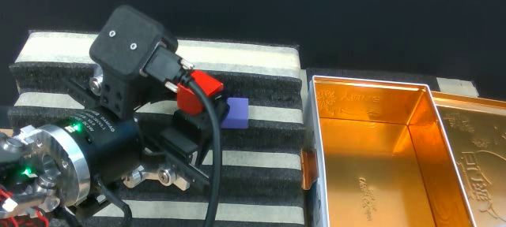
REAL ROBOT — STACKING
REAL ROBOT
Preserve the approach. Improve the finish.
V02 / Autonomous stacking
Autonomous success
PLACEHOLDER · teleoperation still
Base
35%
BC
65%
DICE-RL
60%
CAST
70%
+35 percentage points
STATIC PREVIEW · VIDEO RESERVED
over the pretrained base
A failed release does not make every earlier action wrong.
CAST / ICRA 2027 supplementary video
09 / 10
Notes:
02:32–02:52 | 20 seconds
NARRATION
Stacking requires alignment and a clean release. A common observed failure is reaching the correct position without releasing the cube. The failed outcome does not mean every preceding action was wrong. CAST reaches seventy percent success, versus thirty-five for the base, sixty-five for BC refinement, and sixty for DICE-RL.
VISUAL CUES
V02: Insert an actual autonomous stacking rollout showing release and stable final stack. Current still is teleoperated; no per-method clip is available here.
SOURCES
_ICRA_2027__CAST/sections/05_real_robot.tex
_ICRA_2027__CAST/real_robot_results.json

Slide 10
TAKEAWAY
REAL ROBOT
Improve the skill.
Keep a persistent reference.
Critic guidance
Soft restoration
Bounded target
steps
Propose an improvement
Retain a base reference
Moderate each correction
cast2027.github.io
CAST / ICRA 2027 supplementary video
10 / 10
Notes:
02:52–03:00 | 8 seconds
NARRATION
CAST combines critic guidance, soft restoration, and bounded target steps: improve the skill while keeping a persistent reference.
VISUAL CUES
Static slide; no animation required.
SOURCES
_ICRA_2027__CAST/sections/06_conclusion.tex

