Slide 1
CSC4240 · Data Spaces
HK Transport
Final
Project
Federated Dataspace
Federation, Policy, and Trust on EDC MVD
Team Zhao Yuxuan · 124090921 Li Chudikang · 122040057
INSTRUCTOR
DATE
Prof. George Polyzos
27 April 2026
Spring 2026 · CUHK-Shenzhen
Built on Eclipse Dataspace Components MVD

Slide 2
THE PROBLEM
Why a Hong Kong Transport Dataspace?
KMB
MTR
TD
Academia
Bus operator
Rail operator
Transport Dept.
Research labs
✕
✕
✕
Data silos: no shared trust, no shared protocol
Bilateral, ad-hoc
No policy, no audit
Academia locked out
Each pair exchanges API keys privately. No common protocol; integration cost grows O(N²).
Access control is server-side hard code. Who used what under which condition is invisible.
Research teams cannot legally obtain commercial real-time data without long contractual paperwork.
CSC4240 Data Spaces · HK Transport Federated Dataspace
2 / 16

Slide 3
DESIGN RATIONALE
Why a Dataspace Runtime?
DIMENSION
Plain HTTP / S3 sharing
Eclipse Dataspace Components
Identity
Shared API keys
DID + Verifiable Credentials
Contract
Implicit terms of service
ODRL + DSP negotiated
Policy
Hard-coded server-side
Composable in contract definition
Audit
Custom application logs
Built-in state machine (INITIAL → FINALIZED → TERMINATED)
Protocol
Ad hoc, vendor-specific
DSP + DCP open standards
EDC isn't another HTTP library — it makes "dataspace" a first-class runtime.
CSC4240 Data Spaces · HK Transport Federated Dataspace
3 / 16

Slide 4
PROJECT OVERVIEW
What We Built
PART 1
PART 2
PART 3 · BONUS
Real HK Data Flows
HKU Joins as Dual-Role
Custom ODRL in Java
5-participant dataspace on EDC MVD
4 real Hong Kong datasets
Pull + Push transfer (HttpData)
HKU Transport Lab — new participant
Acts as both consumer & provider
Federated catalog crawler aggregates 4 nodes
Extended EDC policy engine
Permission constraint: ParticipantTier
Duty constraint: Attribution whitelist
1,611
Dual
2
KMB routes pulled live
consumer + provider
new evaluation functions
Built on Eclipse MVD · Runs locally on k3d Kubernetes · 21 pods across 5 participants
CSC4240 Data Spaces · HK Transport Federated Dataspace
4 / 16

Slide 5
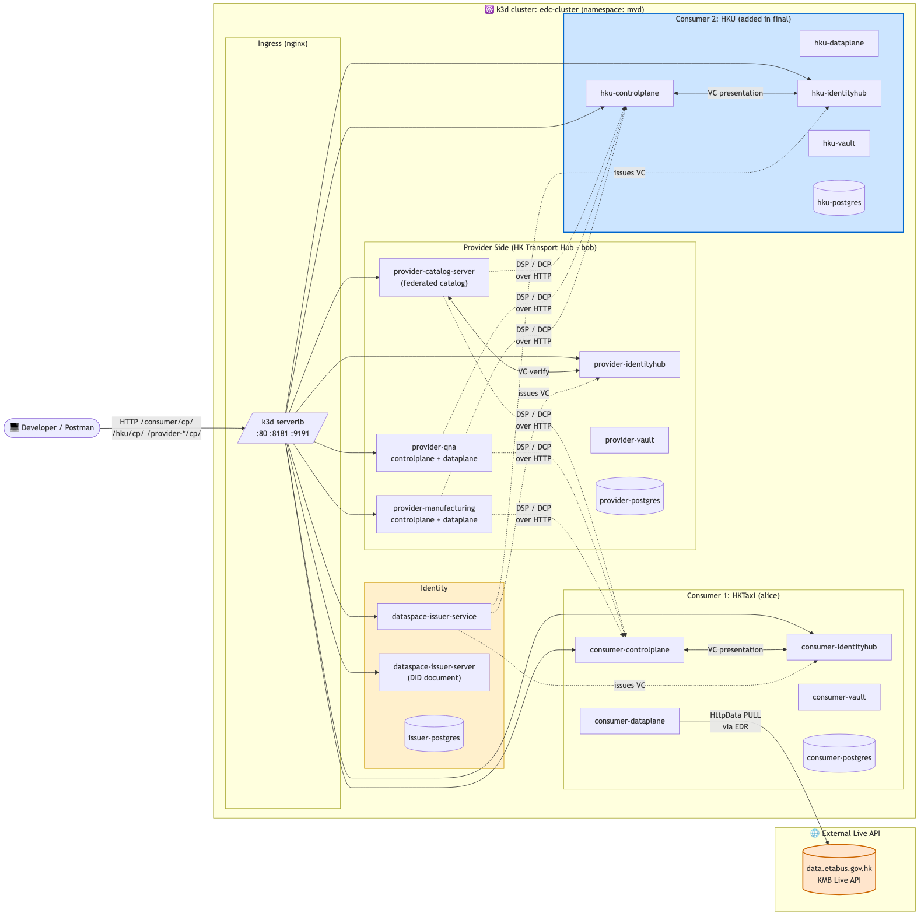
SYSTEM DESIGN
Federated Architecture · 5 Participants
Each participant runs its own stack
Control plane · contract & catalog Data plane · token-bound transfer Identity Hub · DID + VC presentation Vault · key material
Trust is built on standards
DID + Verifiable Credentials establish participant identity DSP (Dataspace Protocol) carries catalog + negotiation DCP (Decentralized Claims) carries credential presentation
Centralised only where needed
Dataspace Issuer issues VCs Catalog Server mirrors a federated index
CSC4240 Data Spaces · HK Transport Federated Dataspace
5 / 16

Slide 6
WHO AND WHAT
Actors & Datasets
ACTORS · 5 participants
DATASETS · real HK feeds
PROVIDER
KMB Routes
1,611
HK Transport Hub
data.etabus.gov.hk · LIVE
(bob) — KMB / MTR / Government feeds
KMB ETA
live
CONSUMER · COMMERCIAL
data.etabus.gov.hk
HKTaxi
(alice) — fleet routing platform
HK Traffic Incidents
feed
DUAL-ROLE · ACADEMIC
data.gov.hk
HKU Transport Lab
MTR Patronage
feed
consumer for KMB · provider of research data
opendata.mtr.com.hk
TRUST ROOT
Dataspace Issuer
HKU Transit Equity 2026
ACADEMIC
issues Verifiable Credentials to all parties
internal research dataset
CSC4240 Data Spaces · HK Transport Federated Dataspace
6 / 16

Slide 7
8 ENGINEERING CHANGES ON TOP OF UPSTREAM MVD
Implementation Highlights
01
Scenario reskin
02
Live KMB API integration
MVD alice/bob → HK Transport Hub / HKTaxi / HKU
Real 1,611 routes via dataplane HTTP source
brief, postman, identityhub seed
scripts/seed-hk-extra.sh
03
New HKU participant
04
Tier-based policy + asset split
Independent control plane + IdentityHub + vault
COMMERCIAL / ACADEMIC / PROVIDER on diverged catalogs
deployment/hku.tf (20 K8s resources)
scripts/seed-hk-extra.sh
05
S3 push backend (MinIO)
06
Live DCP credential issuance
edc-dataplane-aws-s3 wired to in-cluster MinIO
Issuer activated, runtime VC mint via state machine
minio-deploy.yaml · libs.versions.toml
scripts/demo-live-issuance.sh
07
Custom Permission (claim-based)
08
Custom Duty (Attribution)
ParticipantTier reads VC participantTier claim
Whitelist check on consumer-declared origin
ParticipantTierFunction.java + add-tier-claim.py
AttributionDutyFunction.java
ENGINEERING CAVEATS
• KinD → k3d migration: Traefik grabbed :80 → helm uninstall for ingress-nginx • host.docker.internal VPN-hijacked → switched to 127.0.0.1 • EDC dataplane chunked-transfer-encoding compat resolved
CSC4240 Data Spaces · HK Transport Federated Dataspace
7 / 16

Slide 8
PART 1 · PULL TRANSFER
Live Pull from KMB Public API
1,611
KMB routes pulled in 14 seconds
end-to-end through DSP catalog → negotiation → transfer → EDR → public endpoint
1 · Catalog
2 · Negotiation
3 · Agreement
4 · Transfer
5 · EDR
6 · Endpoint
7 · Data
Contract negotiation · FINALIZED
KMB route data · pulled via EDR
POST /v3/contractnegotiations { "state": "FINALIZED", "contractAgreementId":
"58c37388-c733-4013-94a8-69934833..."
}
{ "sample_count": 1611,
"sample_first_3": [{ "route": "1", "orig_en":
"CHUK YUEN ESTATE",
"dest_en": "STAR FERRY" }] }
CSC4240 Data Spaces · HK Transport Federated Dataspace
8 / 16

Slide 9
PART 1 · PUSH TRANSFER
Push Transfer to a Real S3 Destination
344 KiB
delivered to MinIO bucket edc-push-bucket
HK Hub dataplane → AmazonS3-PUSH transferType → MinIO (S3-compatible, in-cluster)
1 · Negotiate asset-1-push
2 · Submit S3 destination
3 · Provider dataplane PUSH
4 · Object lands in bucket
Transfer spec · AmazonS3-PUSH
MinIO bucket listing · object landed
{
"transferType": "AmazonS3-PUSH",
"dataDestination": {
"type": "AmazonS3",
"bucket": "edc-push-bucket",
"object": "kmb-routes-...",
"endpoint": "minio:9000",
"region": "us-east-1"
}
}
$ mc ls minio/edc-push-bucket
2026-04-27 14:11 344 KiB
kmb-routes-via-s3-...json
# object preview
{ "type": "RouteList",
"data": [{ "route": "1",
"orig_en": "CHUK YUEN ESTATE",
"dest_en": "STAR FERRY" }] }
CSC4240 Data Spaces · HK Transport Federated Dataspace
9 / 16

Slide 10
PART 2 · DUAL-ROLE PARTICIPANT
HKU as Both Consumer and Provider
HKU
Transport Lab
HK Hub
(provider)
CONSUME academic data
PROVIDE research data
HKTaxi /
researchers
ACADEMIC tier
HKU as PROVIDER · catalog & data pulled by alice
HKU as CONSUMER · academic-tier-only asset
# alice queries HKU catalog { "asset": "transit-equity-2026" } # negotiation { "state": "FINALIZED" } # data pulled { "district_count": 18 }
# negotiation { "state": "FINALIZED" } # academic data pulled { "asset":
"hk-academic-research-archive",
"tier_required":
"ACADEMIC" }
CSC4240 Data Spaces · HK Transport Federated Dataspace
10 / 16

Slide 11
PART 2 · CRAWLER
Federated Catalog Aggregation
qna
manufacturing
catalog-server
hku
Federated Crawler · parallel DSP catalog requests
Aggregated Federation Index
12 assets across 4 providers · 2 push-test variants hidden
PROVIDER | ASSET ID | NOTE
qna | asset-1 | KMB Routes (live)
qna | asset-2 | KMB ETA (live)
qna | asset-with-attribution | attribution-duty demo
manufacturing | asset-1 | independent same-id asset
manufacturing | asset-2 | independent same-id asset
manufacturing | hk-traffic-incidents | data.gov.hk
manufacturing | mtr-patronage | opendata.mtr.com.hk
manufacturing | hk-academic-research-archive | ACADEMIC tier · Part 3 demo
catalog-server | normal-asset-1 | federated mirror sample
hku | hku-transit-equity-2026 | HKU research dataset
CSC4240 Data Spaces · HK Transport Federated Dataspace
11 / 16

Slide 12
DECENTRALIZED CLAIMS PROTOCOL · END-TO-END
Live Credential Issuance
CredentialRequest
CREATED
REQUESTING
REQUESTED
ISSUED
HKU asks the issuer for a fresh FoobarCredential. The issuer signs now. HKU's wallet grows by 1. Trust root is operational at runtime — not just at boot.
HKU wallet · before vs after
Decoded JWT · signed at runtime
BEFORE · 3 VCs already in wallet
{
"iss": "did:web:dataspace-issuer-
service%3A10016:issuer",
"sub": "did:web:hku-identityhub
%3A7083:hku",
"iat": 1777301085, // signed now
"vc_type": ["FoobarCredential"]
}
// DID resolved via /.well-known/did.json
hku-live-1777301085 → ISSUED
DataProcessorCredential preloaded MembershipCredential preloaded FoobarCredential prior test
↓
AFTER · 4 VCs — newest issued during demo
DataProcessorCredential MembershipCredential FoobarCredential FoobarCredential ← signed seconds ago
CSC4240 Data Spaces · HK Transport Federated Dataspace
12 / 16

Slide 13
PART 3 · CUSTOM ODRL
Custom Permission Constraint · ParticipantTier
BEFORE DID-substring matching (hack) → AFTER VC claim lookup (issuer-attested, standards-aligned)
Java function in the EDC policy engine
Demo · alice attempts academic asset
ParticipantTierFunction.evaluate()
Negotiation TERMINATED
@Override
public boolean evaluate(Operator op, Object rhs,
Permission p, C ctx) {
if (op != Operator.EQ) return false;
var creds = getCredentialList(ctx.participantAgent());
if (creds.failed()) return false;
return creds.getContent().stream()
.filter(vc -> vc.getType().stream()
.anyMatch(t -> t.endsWith("MembershipCredential")))
.flatMap(vc -> vc.getCredentialSubject().stream())
.map(cs -> cs.getClaim(MVD_NAMESPACE, "participantTier"))
.filter(Objects::nonNull)
.anyMatch(t -> t.toString()
.equalsIgnoreCase(rhs.toString()));
}
✕ TERMINATED
Policy in scope contract.negotiation not fulfilled
{ "state": "TERMINATED", "errorDetail": Permission constraints: [Constraint 'ParticipantTier'
EQ
'ACADEMIC']
}
Source: extensions/dcp-impl/.../ParticipantTierFunction.java · Issuer-signed claim — no DID syntax assumed
CSC4240 Data Spaces · HK Transport Federated Dataspace
13 / 16

Slide 14
PART 3 · ODRL DUTY
Custom Duty Constraint · Attribution
ODRL distinguishes PERMISSION (allowed actions) and DUTY (must-do obligations). Consumers must declare data attribution against a whitelist.
✓ FINALIZED
✕ TERMINATED
Authorised attribution
Unauthorised attribution
alice declares:
alice declares:
attribution = "HK Transport Hub"
attribution = "Unauthorized Reseller"
Whitelist match AttributionDutyFunction.evaluate() ⇒ true Negotiation completes { "state": "FINALIZED" }
Whitelist miss AttributionDutyFunction.evaluate() ⇒ false Negotiation rejected { "state": "TERMINATED" }
Source: extensions/dcp-impl/.../AttributionDutyFunction.java
CSC4240 Data Spaces · HK Transport Federated Dataspace
14 / 16

Slide 15
WE IDENTIFIED GAPS — AND CLOSED THEM
Closing the Loop
WAS · GAP
WAS · GAP
WAS · GAP
HKU full DCP issuance flow not end-to-end
Push proven only on cluster-internal HTTP sink
ParticipantTier resolved by DID-substring matching
↓ SHIPPED
↓ SHIPPED
↓ SHIPPED
Issuer participant context activated, attestations seeded, DCP state machine drives CREATED → REQUESTING → REQUESTED → ISSUED
edc-dataplane-aws-s3 + MinIO; 344 KiB landed in edc-push-bucket via AmazonS3-PUSH transferType
All 3 MembershipCredentials carry a participantTier claim; evaluator reads VC, not DID syntax
scripts/demo-live-issuance.sh
minio-deploy.yaml + demo-push-s3.sh
ParticipantTierFunction.java + add-tier-claim.py
LESSONS LEARNED
Dataspace ≠ data API. the real abstraction is a policy-bound contract.
DCP and DSP are orthogonal. credentials and protocol layer cleanly.
LoadBalancer is the surprise. debug who owns :80 before debugging your app.
VC holder rebind matters. re-sign at the right boundary or get 401.
CSC4240 Data Spaces · HK Transport Federated Dataspace
15 / 16

Slide 16
SUMMARY
What we shipped
01
Extended EDC MVD into a 5-participant Hong Kong transport dataspace with real KMB live data.
02
HKU joins as a dual-role academic participant — exercising both consumer and provider flows.
03
Two custom Java ODRL constraints (Permission + Duty) prove the policy engine is extensible.
Q & A
Code · MinimumViableDataspace (HK fork)
Demo scripts · final/scripts/
Future work · official EDC FederatedCatalog component · dataplane mTLS · multi-cluster deployment
Thank you.

