Slide 1
5. Capital Market
Qi Wang

Slide 2
Agenda
Securities
Market participants
  Retail investors
  Institutional customers
  Exchanges
  Liquidity providers
Case study: Domeyard

Slide 3
Securities

Slide 4
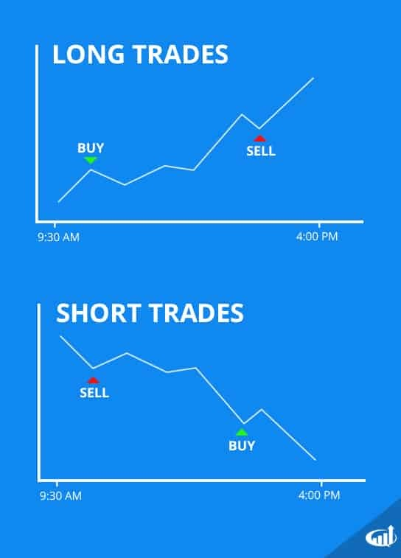

Long vs short
Long position: expect increase in value
Short position: expect decrease in value

Slide 5
Securities
Debt
  Fixed income products
  e.g., corporate and government bonds
Equity
  Stocks, shares of companies
Derivatives

Slide 6
Derivatives
A derivative is a contract that derives its values from the performance from its underlying entity.
Common derivatives:
  Forward
  Future
  Option
  Swap

Slide 7
Market Participants

Slide 8




Market Participants
Institutional Customers
Financial Intermediaries
Execution Venues
Liquidity Providers
Pension Funds
Clearing Brokers
Exchanges
Market Makers
Insurance Companies
Non-clearing Brokers
ECNs
Hedge Funds
Hedge Funds
Dark Pools
Prop Trading Operations
via financial
intermediaries
Mutual Funds & Unit Trusts
Other Participants
Clearing Houses
Central Counter-parties
Source: Duran, R. E., Financial Services Technology, Cengage Learning Asia, 2018
Custodians
Central Securities Depositories
Retail Customers
Regulators

Slide 9
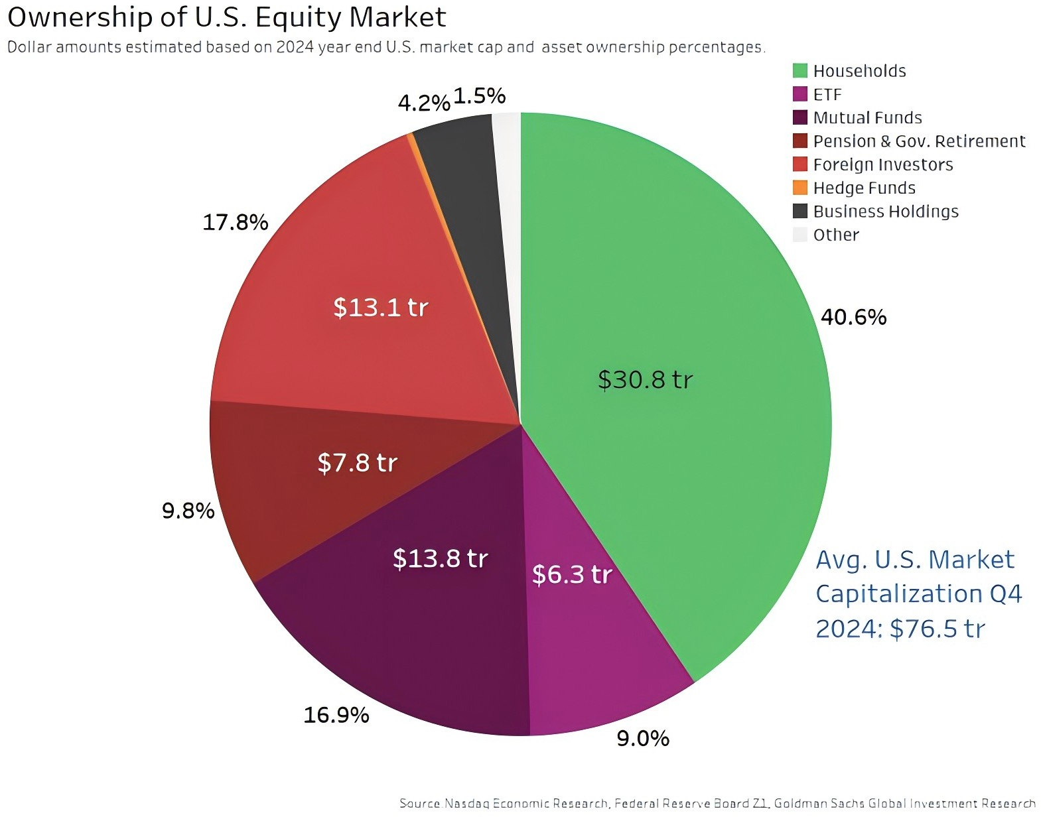
Investors

Slide 10
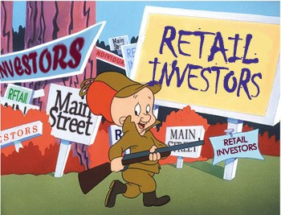
Retail investors
Retail investors are individual investors.
Retail investors collectively bought around $3.4 trillion worth of equities over the first half of 2025, according to data from Nasdaq. Also, they sold about $3.2 trillion worth — bringing the total traded to over $6.6 trillion.
Retail investors are often labelled as noise traders - do not trade rationally.

Slide 11
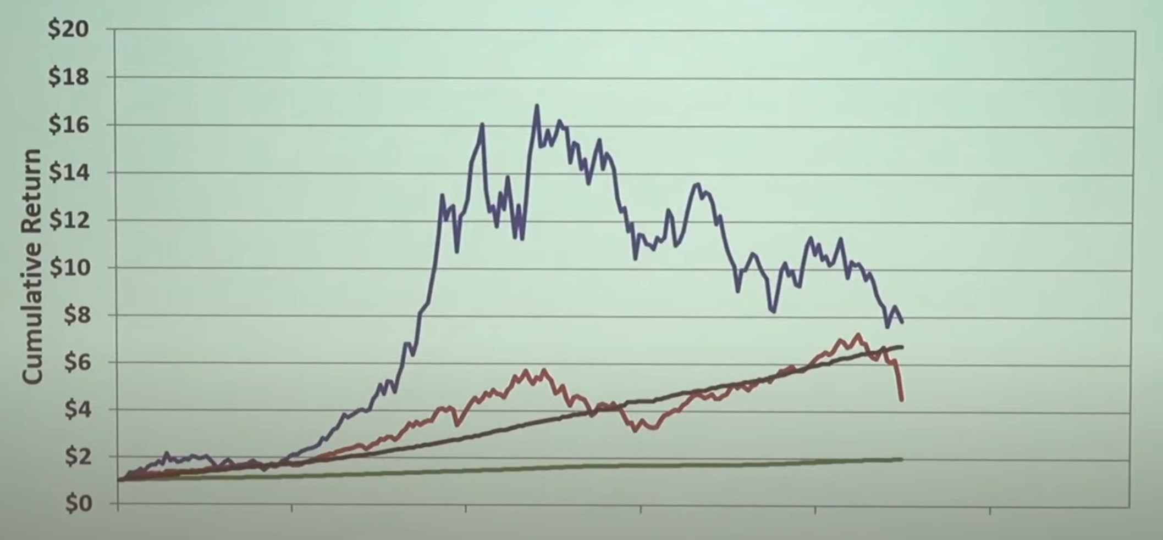
Poll Question
Which asset will you invest in?
fairfield(black) invest in a ponzi scheme
Kahoot
Please go to www.kahoot.it on your phone or computer.
Enter the game pin (see
projector) on your device.
When asked for your nickname,
enter your 8-digit student ID (E.g., 55123456) on your device.
Kahoot engagement (not
merit) will partially determine class participation scores.

Slide 12
Poll Question: Sharpe Ratio
Sharpe ratio helps us understand the return of an investment relative to its risk.
Porforlio return " risk−free return Standard deviation of the portfolio′s excess return
It is human nature to prefer a higher a Sharpe ratio – higher return with less variation.

Slide 13
Institutional Investors
Institutional investors trade securities on behalf of their clients.
Institutional investors are typically more informed than retail investors because of superior knowledge in finance, more resources, and more information.
In 2024, institutional investors account for over 90% of all trading volumes in the US.

Slide 14
Institutional investors
Banks
week2
Insurance companies
Pensions
ETFs
Mutual funds
Hedge funds
退休⾦

Slide 15

Pension
Pensions are funds that collect, invest, and distribute retirement income.
Largest pension in the world: Federal Old-age and Survivors Insurance Trust Fund (Social Security)
  US$2.57 trillion
The worldwide pension total: US$58.5 trillion in assets

Slide 16
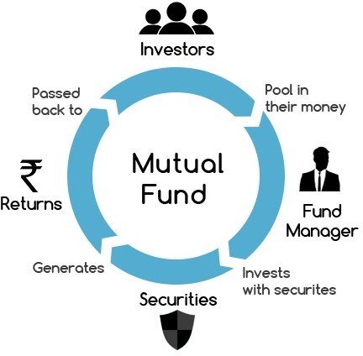
Mutual fund
共同基⾦
Mutual funds pool funds from many investors to invest in securities.
  Professionally managed
  Economy of scale
  Diversified investment
  Liquidity
Investments by mutual funds
  Money market
  Bond
  Stock market
  Hybrid

Slide 17


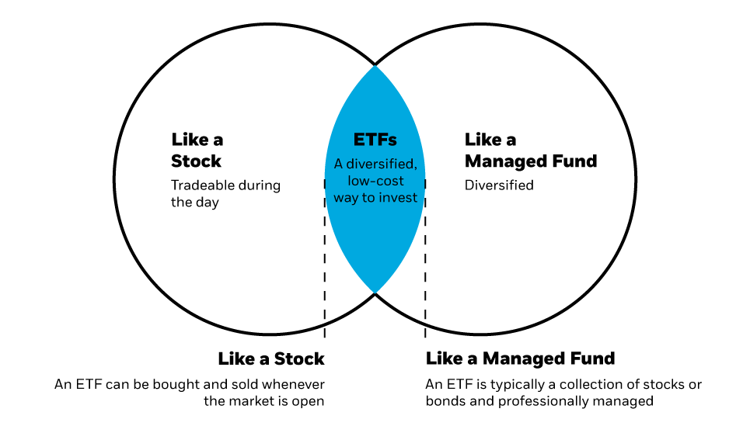
ETF
An exchange-traded fund (ETF) is like a mutual fund, except it can be traded in the stock market.
ETF is relatively new.
  Started out in the 1990s.
Most ETFs are index funds.

Slide 18


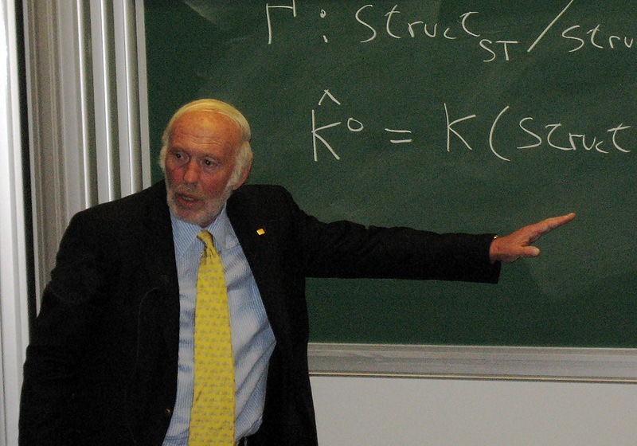

Hedge fund
Hedge funds
  Use more sophisticated investment strategies
  Serve institutional investors and high net- worth individuals
  Not open to small retail investors
Some well-known hedge fund managers
  George Soros
  Jim Simons

Slide 19
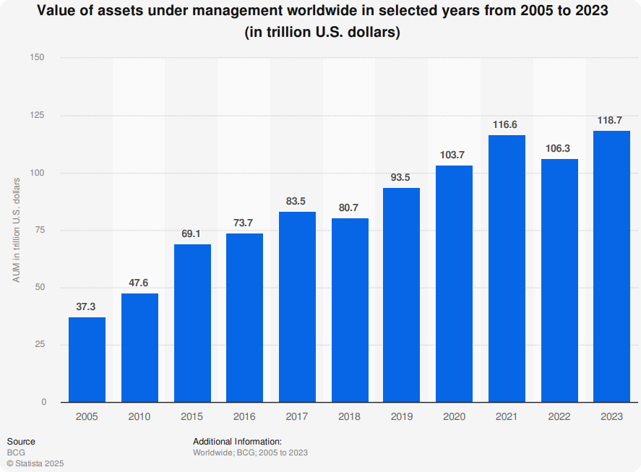
AUM
Value of assets under management worldwide in selected years from 2005 to 2023 (in trillion U.S. dollars)
In 2023, the total asset under management (AUM) in the world is US$118.7 trillion (Statista 2025).

Slide 20
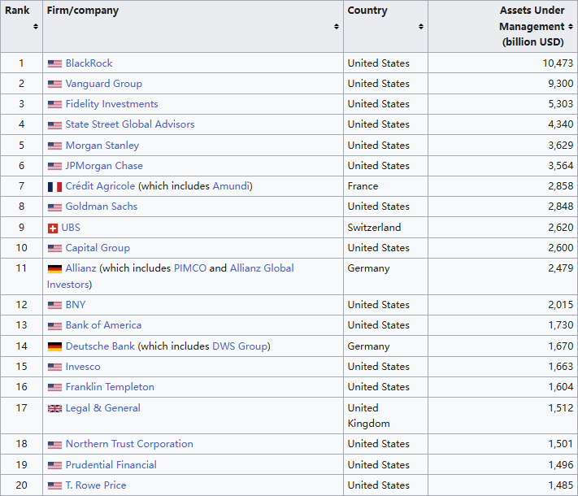

Slide 21
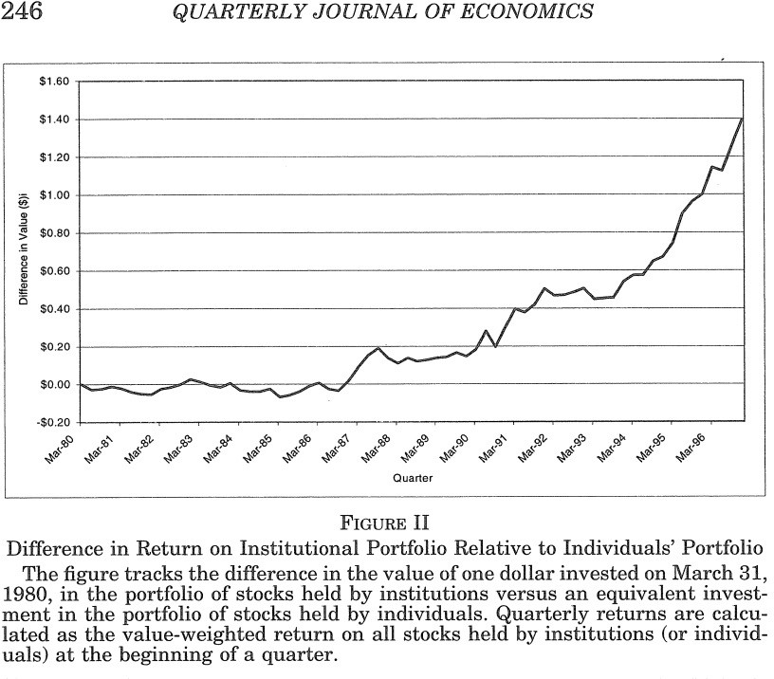
Performance of institutional investors

Slide 22
Algorithmic Trading

Slide 23
Algorithmic Order Execution
Concepts
  Large intuitional investor orders can take up all available liquidity at or near the current market price
  Therefore, large orders are sliced into smaller orders and executed over a period of time
  Historically, people (brokers) were used to “work” orders on the market over a period of time
  Their price execution performance would be measured against benchmarks such as Volume-weighted average (VWAP) pricing algorithms
  Gradually, computer-driven order execution algorithms (algos) have taken over this function

Slide 24
Institutional customers’ needs
Get good price for execution of large orders
Avoiding price slippage
  Causes of slippage
    Insufficient liquidity
    Front running
    Information leakage

Slide 25
Algorithmic Order Execution
Concepts
  Order execution algorithms address tactical concerns
    When orders should be placed in the market
    How large they should be
  Objectives
    Reduce orders’ market impact
    Achieve the best execution price
  Algorithms are usually parameterized
    Enables them to be tuned for different market conditions
  Different algorithms will be used to address different
    Customer trading requirements
    Market conditions

Slide 26
Algorithmic Order Execution
Time-weighted average pricing (TWAP) algorithms
  Schedule-driven algorithm
  Slices up an order evenly over a fixed period of time
  Easy to understand and implement
  Issues
    Does not take into account the pattern of trading volume during the day
    E.g. heaviest volume will be at market open and market close
    Orders placed during middle of the day may have more significant market impact due to their relative size

Slide 27
Algorithmic Order Execution
TWAP order execution example
80,000
70,000
60,000
_{Shares} 50,000
Traded 40,000
30,000
20,000
10,000
0
30-minute Time Intervals
Source: Duran, R. E.,
Financial Services Technology,
Cengage Learning Asia, 2018
09:30
10:00
10:30
11:00
11:30
12:00
12:30
13:00
13:30
14:00
14:30
15:00
15:30
16:00
Order Size Market Volume

Slide 28
Algorithmic Order Execution
Volume-weighted average (VWAP) pricing algorithms
  A type of volume participation algorithm
  Incorporates trading volumes into the order size calculations
  VWAP order sizes are proportional to the expected trading volume during a given time period
  Larger orders will be placed during time periods that have higher volumes traded
  Issues
    Estimating current day’s trading volumes
    Selling into high volume market selloffs
      E.g. the Flash Crash

Slide 29
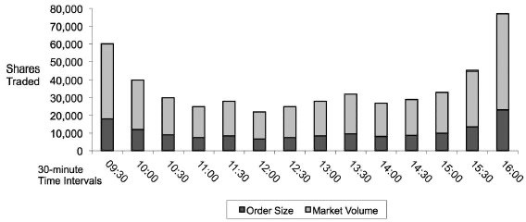
Algorithmic Order Execution
VWAP order execution example

Slide 30
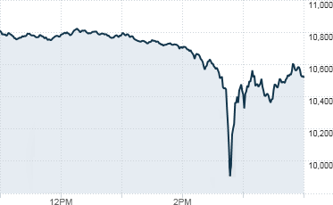
Mini Case: Alg trading and flash crash
On 6 May 2010, the S&P fell over 5% in a few minutes.
  Hundreds of stocks dropped more than 60%
Algo trading gone wild?
  Orders were set to be proportionate to market trading volume.
  More volatility -> more market volume
  The alg aggravated the problem.
https://www.youtube.com/watch?v=E1xqSZy9_4I

Slide 31
Algorithmic Order Execution
Liquidity-seeking algorithms
  TWAP and VWAP algorithm are good for flat markets
  Liquidity-seeking algos are better for market conditions when price is trending in a negative direction
  More of the order is executed earlier, at a better price
  Use depth-of-market information to try to capture as much liquidity as possible at decent price points

Slide 32
Algorithmic Order Execution
Smart order routing
  Applicable when an order can be executed on more than one execution venue
    E.g., North American and European markets
    Multiple exchanges and dark pools are available to trade highly liquid stocks
  Factors used to determine where to route orders
    Price
    Liquidity – available tradable volume at price
    Likelihood of execution at current price

Slide 33
Trading System Architecture

Slide 34
Trading System Architectures
Order routing system components
  Originally, high-touch order management systems
    Built to support manual order execution
    Days past when brokers “worked” customer orders
  Now, low-touch has become more popular
    Direct market access (DMA)
    Electronic order management
      No human intervention for most transactions

Slide 35














Trading System Architectures
Customers Broker
Exchanges
Trading Application
Trading Application (provided by broker)
Market Data
Market Access Gateways
Stock Exchange
Order Management System
Risk Management System
Market Access Gateways
Alternative Trading Network
Internet or Leased Lines
Execution Management System
Smart Order Router
Trading Application (customer's)
Market Access Gateway
Dark Pool
Market Data
Market Data
Connectivity Gateway
Order Management System
Market Access Gateways
Stock Exchange
Source: Duran, R. E.,
Financial Services Technology, Cengage Learning Asia, 2018

Slide 36
Trading System Architectures
Order routing system components
  Order management systems (OMS)
    Used by both brokers and customers
    Originally designed to perform electronic recordkeeping for orders placed over the telephone
    Provide order-capture and position keeping
    Support back-office functions
      Accounting
      Reporting
      Compliance

Slide 37
Trading System Architectures
Order routing system components
  Execution management systems (EMS)
    Designed for electronic trading
      Higher trading volumes
      Execution speed is critical
    Manage the execution of orders electronically
      No human intervention
      Use algorithms to execute orders over an extended period of time

Slide 38





Trading System Architectures
Order routing system components
Connectivity gateways
  Enable customers to send orders electronically to the broker
  Often use FIX as the communication standard
    FIX – Financial information eXchange protocol
Customers
Broker
Exchanges
Trading Application
Trading Application (provided by broker)
Market Data
Market Access
Stock Exchange
Order Management System
Risk Management System
Gateways
Risk management system
Market Access
Alternative Trading Network
Verifies that the customer orders will not exceed their margin or
Internet or Leased Lines
Gateways
cash limits.
Execution Management System
Smart Order Router
Trading Application (customer's)
Market Access Gateway
Smart order router
Dark Pool
Determine which execution venue(s) orders should be routed
Market Data
Market Data
(discussed more later)
Connectivity Gateway
Market Access
Order Management System
Source: Duran, R. E.,
Financial Services Technology, Cengage Learning Asia, 2018
Gateways
Stock Exchange
Market access gateways
  Connect with and communicate orders to different execution venues
  Each connection, or “line,” to the exchange will have a limited capacity – “throttle” limit

Slide 39
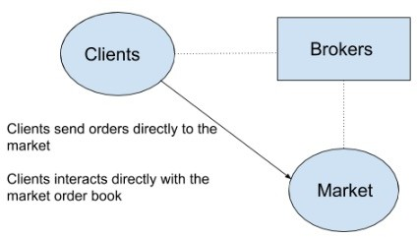
Trading System Architectures
Direct market access (DMA)
  Customers send orders electronically to the broker
  The broker electronically routes the order to the exchange
  There is no human intervention
    Want to minimize processing delay
  DMA orders do not go through the OMS on the way to the exchange
    Not visible to broker’s front office staff prior to execution
  After execution, trade details will be reported to the OMS by the EMS
  E.g., a marketing pitch by a broker: “Competitive” latency to Asian exchanges in the range of hundreds of microseconds

Slide 40
Trading System Architectures
Exchange Co-location
  Minimizes the delays due to physical distance
  Reduces the number of systems involved in processing orders
  Customer install its systems in a server rack in an exchange’s co-location facility
  Customer’s trading system receives market data directly from an exchange data feed in the co-location center
  Automated algorithms decide when to trade
  Orders are sent to an exchange access gateway that is also in the co- location center
  Trading system components are managed remotely by the customer

Slide 41
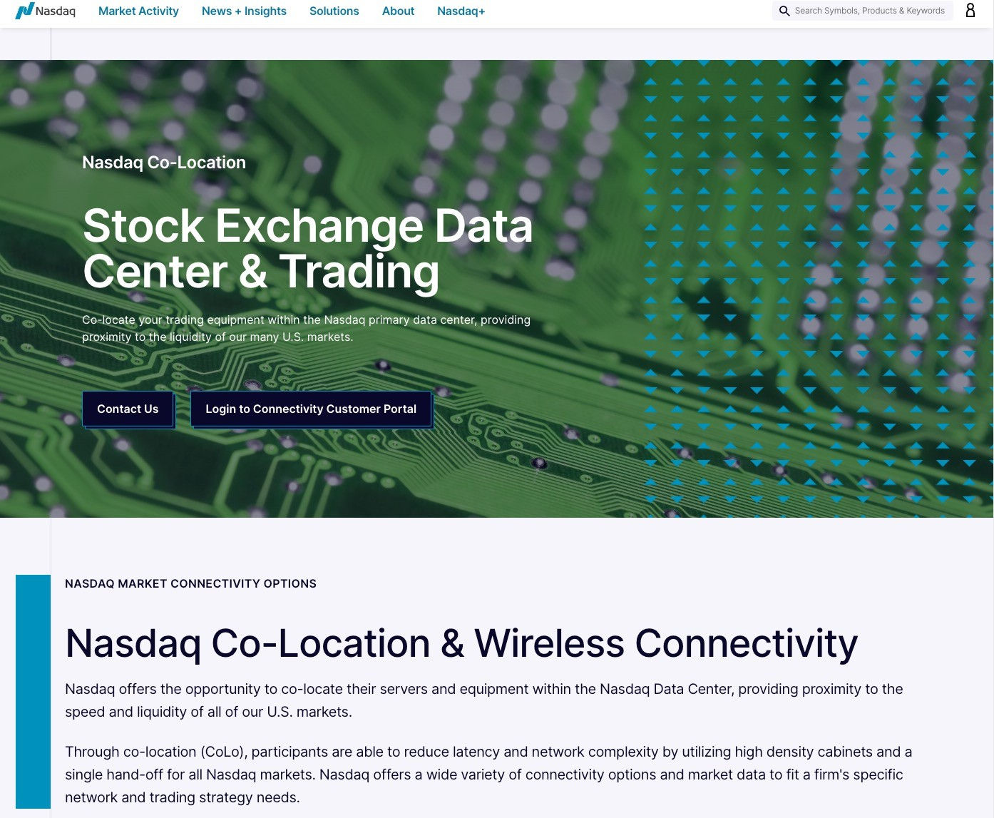

Slide 42
Exchanges

Slide 43
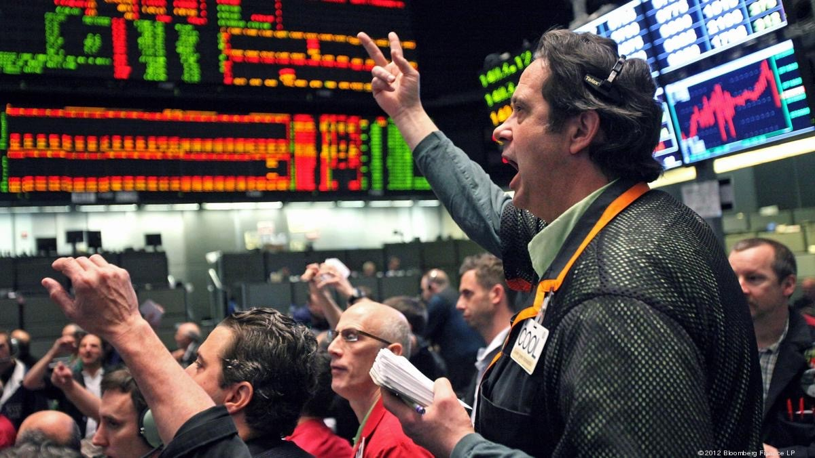
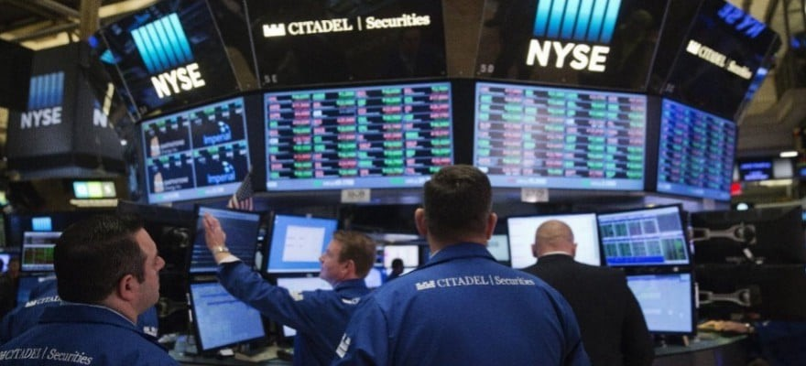
From open outcry to electronic matching

Slide 44
On and off-exchange
On exchange: transactions take place in exchange markets such as
  Stock exchange (NYSE, HKEx, NASDAQ)
  Future exchange (Chicago Mercantile Exchange)
  Foreign exchange
Off-exchange or over-the-counter (OTC): trading carried out between two parties.
  Mostly for professionals and institutional traders
  Counterparty risk
  40% of stock exchanges occur off-exchange

Slide 45
Exchanges processes and data: order messages
New order
  Buy / sell
  Order type (discussed in a few slides)
Order acknowledgement
Fill and partial fill execution responses
  Will be asynchronous

Slide 46
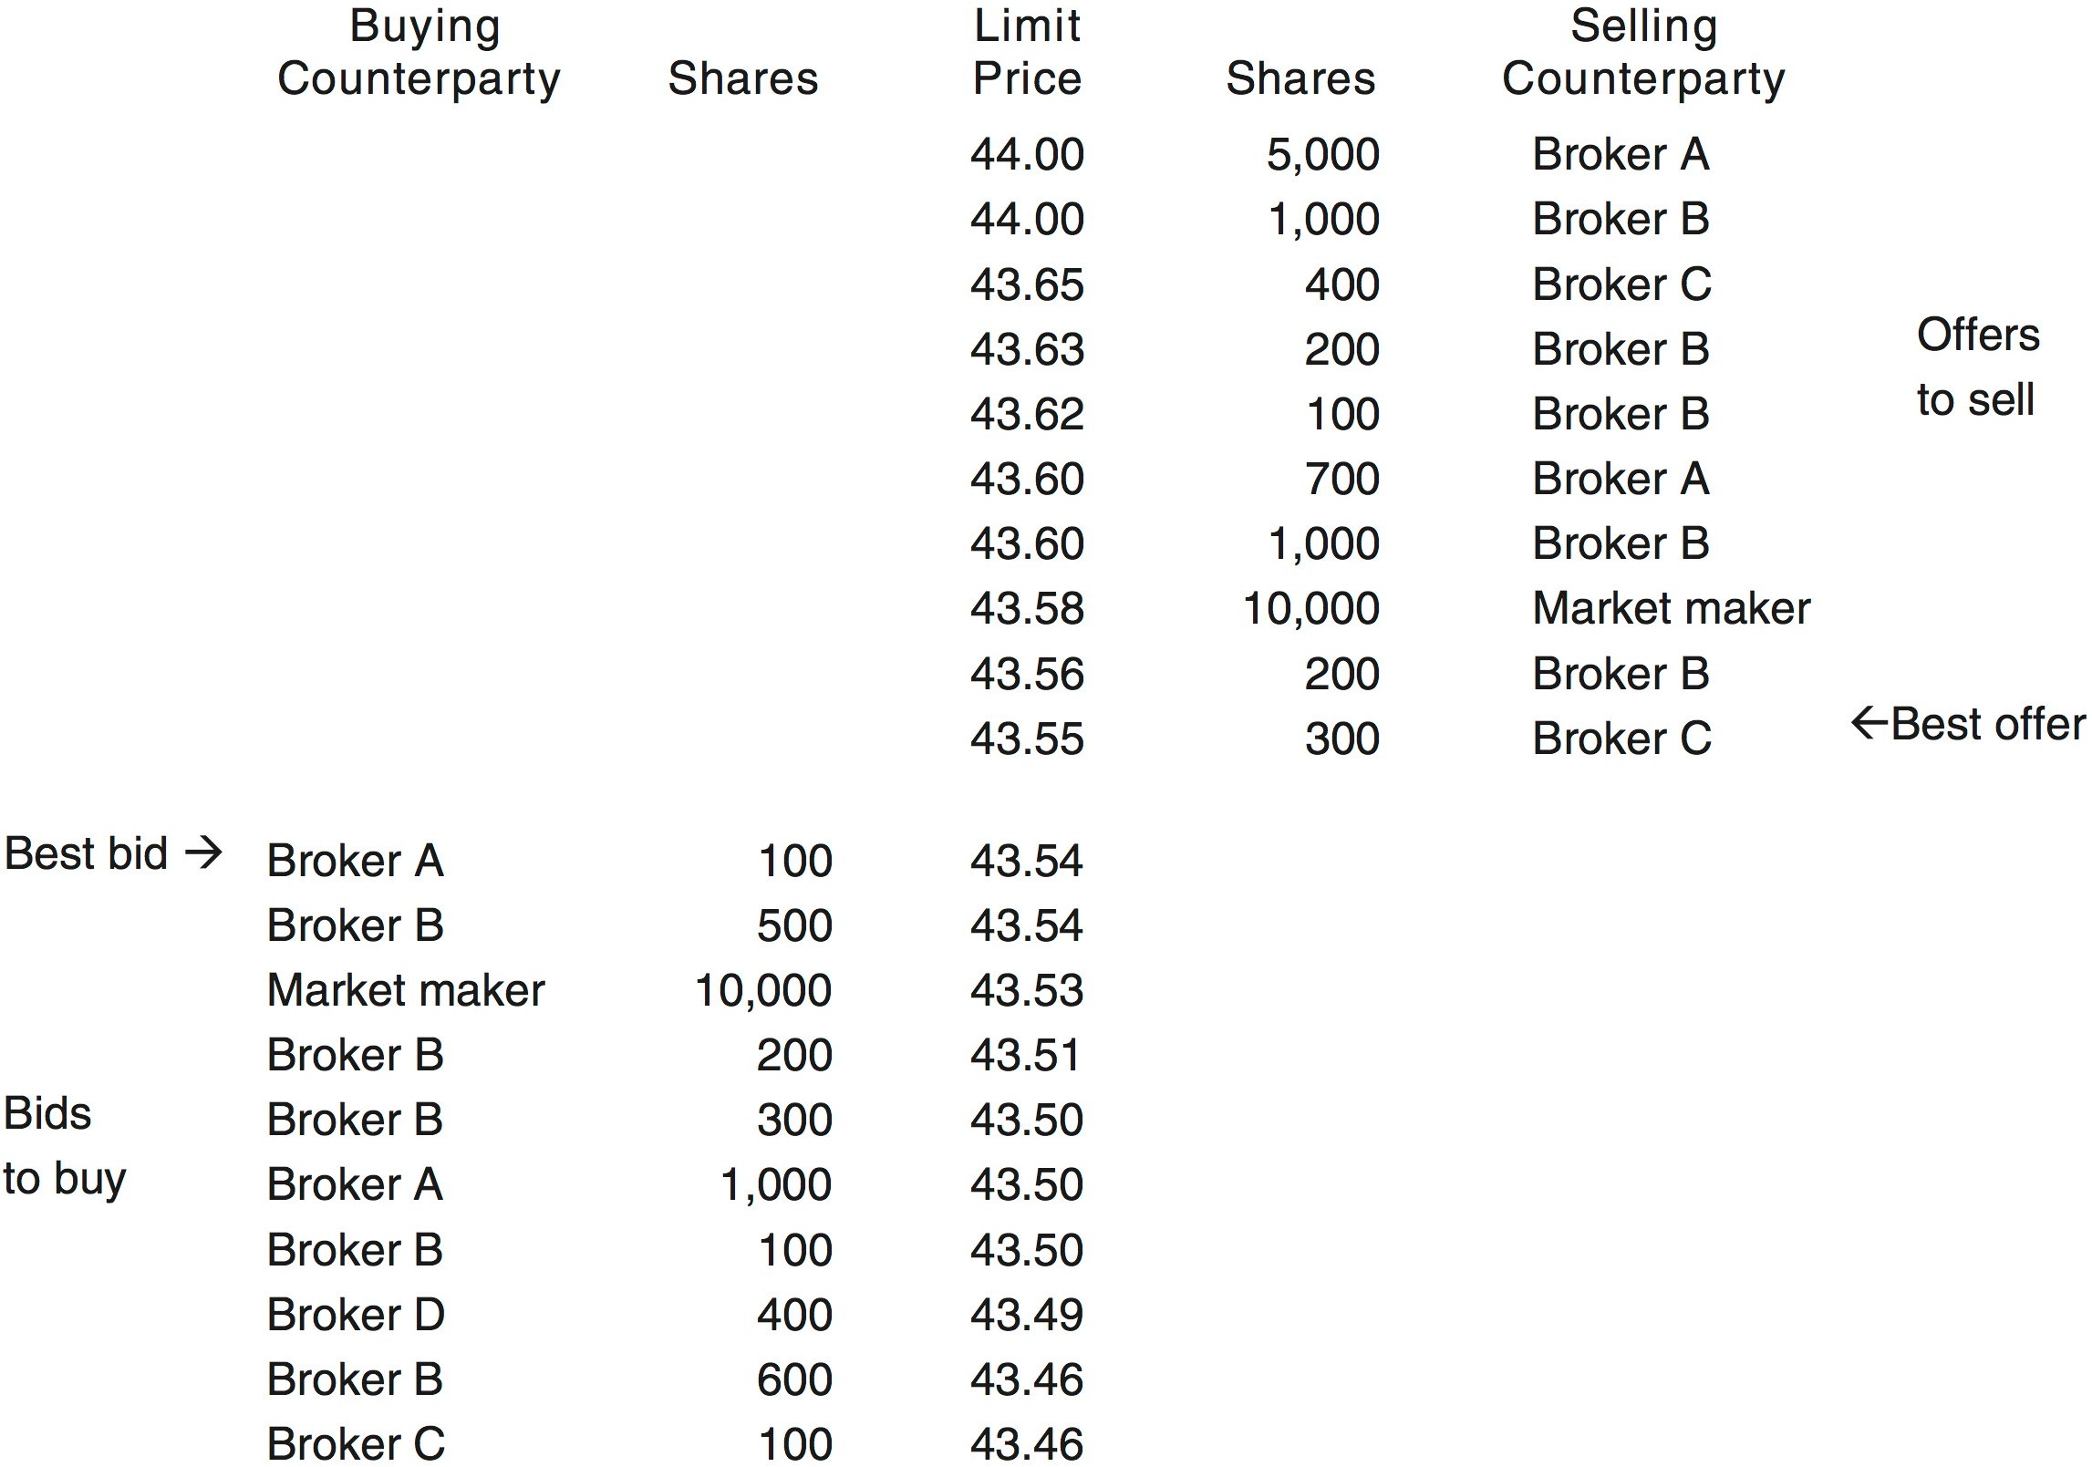
Exchange Processes and Data
Central limit order book example

Slide 47
Exchange processes and data: order types
Market order: trade at market price.
  The trading price is not fixed
Limit order: trade at a specific price (or better)

Slide 48
Exchanges processes and data: on exchange matching
Matched based on precedence rules defined by the exchange
“Price time priority” rules: price takes precedence over time.
Other factors:
  Order size
  Public orders versus floor orders
  Displayed versus hidden orders
Matching process can be quite complicated
  Complex rules
  Complex order types (e.g., iceberg)

Slide 49
Exchanges processes and data: off-exchange matching
Brokered matching (off-exchange block trades)
Why?
  Market makers are unwilling to provide liquidity for large trade volumes at a fixed price
  Insufficient liquidity in exchange(s) central limit order book(s)
Must be publicly reported through standard exchange facilities

Slide 50
Exchanges processes and data: circuit breakers
Circuit breakers
  Temporarily halt trading in cases of excessive movements in market prices
  Affects entire exchange
  In theory should help dampen price volatility
    Provides a cooling down period
Trading curbs
  Stock specific trading shutdowns

Slide 51
Exchanges processes and data: circuit breakers
Example: NYSE market circuit breaker Rule 80B
Type | Amount of Drop | Timing | Effect
Level 1 | 7% | 9:30 am–3:25 pm | 15 minutes halt
 |  | after 3:25 pm | no halt
Level 2 | 13% | 9:30 am–3:25 pm | 15 minutes halt
 |  | after 3:25 pm | no halt
Level 3 | 20% | any time | close for rest of day

Slide 52
Exchanges processes and data: surveillance
Exchanges’ responsibility to monitor market participants’ activities
Maintain fair and orderly markets
Examples: monitor for
  Brokers trading ahead of customer orders, a.k.a. “front running”
  Identifying trades based on insider information or ahead of released research
  Feigning activity by submitting orders then cancelling them
  Inflating volumes by making trades that generate little or no profit

Slide 53
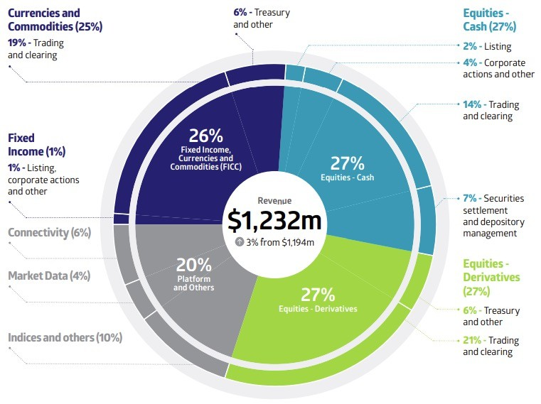
Exchange Services
Singapore Exchange (SGX)’s revenue breakup (FY2024)

Slide 54
Exchange services: market data
Trading is dependent on market data
  Level 1 – best bid / best offer
  Level 2 – full market depth
Real-time market data volumes are extremely large
Market data directly offered by exchange venues or aggregators such as Bloomberg, Thomson Reuters.
Trade reporting facilities (TRF)
  Consolidate order and execution information across multiple execution venues

Slide 55
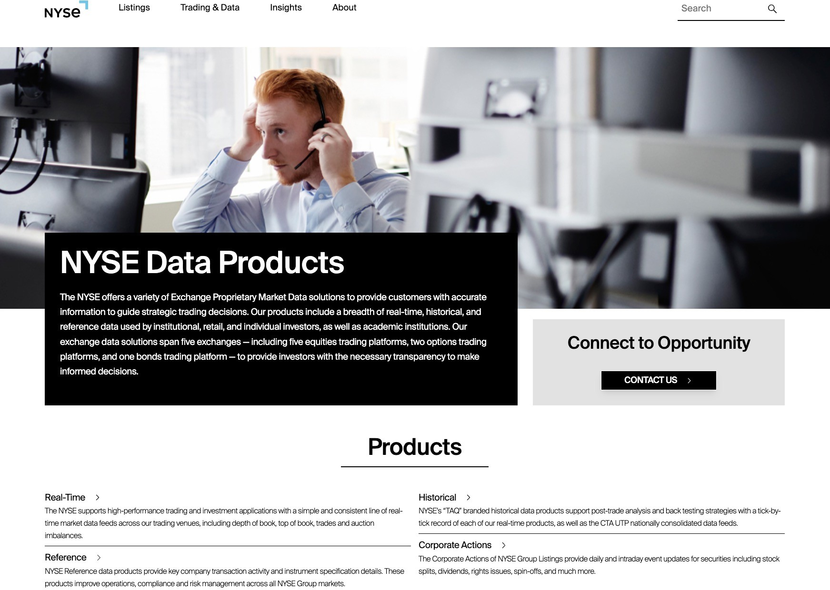

Slide 56
Exchange services: market access
Enable brokers to
  Connect to the exchange
  Send orders
  Receive order status information
Connectivity interfaces
  Financial Information eXchange (FIX)
  Proprietary interfaces

Slide 57
Market Participants
Institutional Customers
Financial Intermediaries
Execution Venues
Liquidity Providers
Pension Funds
Clearing Brokers
Exchanges
Market Makers
Insurance Companies
Non-clearing Brokers
ECNs
Hedge Funds
Hedge Funds
Dark Pools
Prop Trading Operations
via financial
intermediaries
Mutual Funds & Unit Trusts
Other Participants
Clearing Houses
Central Counter-parties
Source: Duran, R. E., Financial Services Technology, Cengage Learning Asia, 2018
Custodians
Central Securities Depositories
Retail Customers
Regulators

Slide 58
Liquidity Providers

Slide 59
Market liquidity
Market liquidity is the extent to which investors can buy or sell an asset without drastically shifting the asset price.
Liquidity is often measured by bid-ask spread, which is the difference between the bid price and ask price.
𝑆𝑝𝑟𝑒𝑎𝑑 = ^{𝑎𝑠𝑘 – 𝑏𝑖𝑑} ×100
𝑎𝑠𝑘+𝘣𝑖𝑑
2
The smaller the spread, the more liquid the market is.
Everyday example: The second-hand cell-phone market is more liquid than the second-hand housing market.

Slide 60
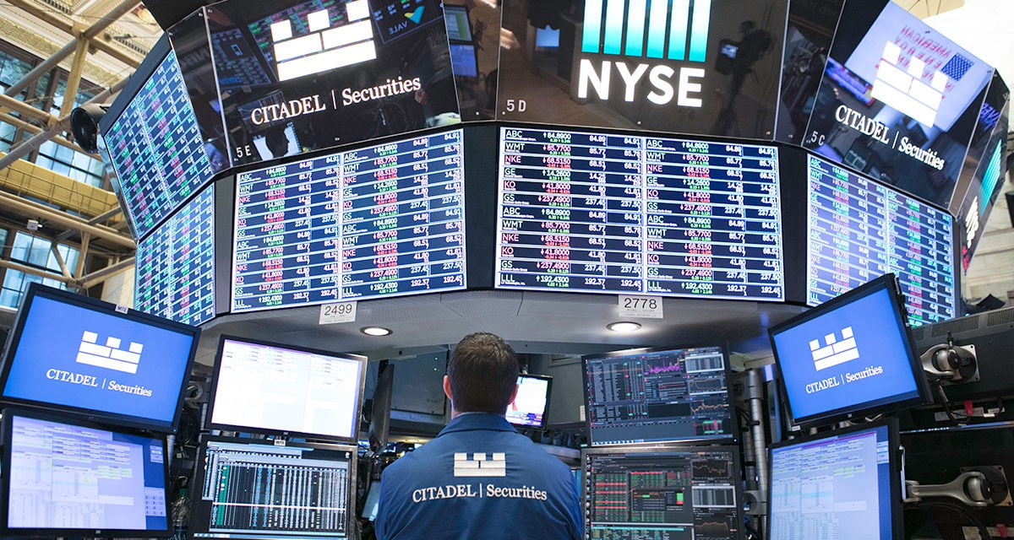
Liquidity providers
Designated market makers (DMM or specialists)
  Have market positioning advantages
  Have additional obligations and responsibilities
Proprietary traders
  E.g., banks and hedge funds
  Have no obligation to provide liquidity
  May leave the market in turbulent conditions
Citadel Securities is one of the DMMs on NYSE

Slide 61
High frequency trading (HFT)
Arguments for HFT
  Improved liquidity: reduced bid-ask spread
  Approximation to the perfect market
Arguments against HFT
  Unfair advantages
  Market manipulation
  Increased market volatility
Frequent Batch Auctions as a Market Design Response to HFT Arm Race
https://academic.oup.com/qje/article/130/4/1547/1916146
Is high frequency trading good for financial markets? https://www.youtube.com/watch?v=tyW6NCpVykI

Slide 62
Case study: Domeyard

Slide 63
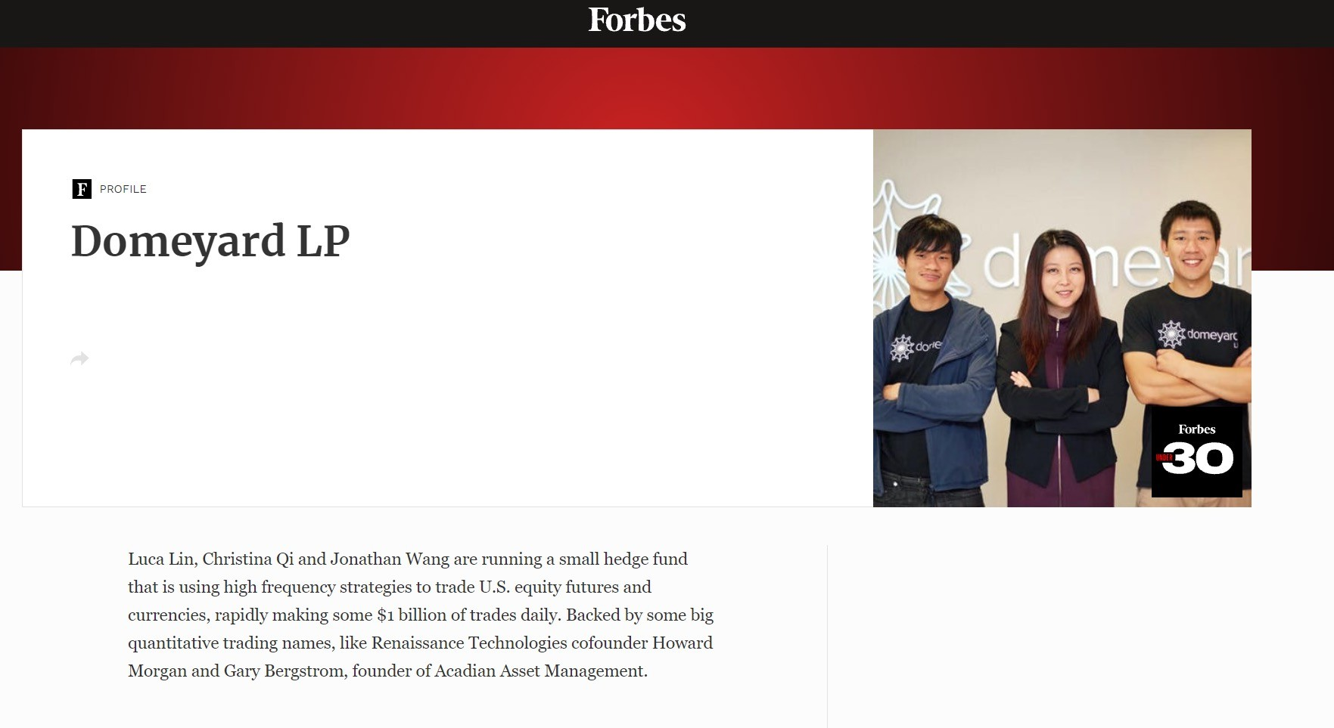

Slide 64
Christina Qi
https://www.youtube.com/watch?v=qxWObfV0IZM
https://www.youtube.com/watch?v=dk9fVo2bTbg
https://www.youtube.com/watch?v=5daXfre6sxE
What are the different low latency strategies
1. Exploiting Arbitrage Opportunities: Leveraging the Law of One Price, HFT firms identify and act on discrepancies in asset prices across different markets or exchanges, capitalizing on the time it takes for prices to equilibrate.2. Technology Advantages: HFT firms use proprietary data feeds and advanced technology to gain access to price information faster than what is available through standard market channels, allowing them to act on this information before other market participants.3. News Event Trading: Utilizing Natural Language Processing (NLP) and other technologies to analyze news releases and financial data in milliseconds, HFT firms can execute trades based on the information before the broader market has reacted.
4. Multi-Venue Low Latency Strategies: These strategies involve front-running large orders on one market by racing to other markets to buy or sell assets before the large orders impact the prices. This is exemplified by the construction of the Spread Networks fiber-optic cable tunnel to reduce latency between Chicago and New York.5. Order Book Analysis: HFT firms analyze the order book to predict short-term price movements based on the balance between potential buyers and sellers. They aim to collect the bid-ask spread and any rebates offered by exchanges for providing liquidity.6. Statistical Arbitrage:This strategy involves identifying and exploiting stable relationships between pairs of stocks or instruments using vast amounts of high-frequency data, aiming to capture profits from these relationships.7. Co- location: Placing servers in close proximity to exchange matching engines to minimize the time it takes for orders to be executed, reducing latency to microseconds.
8. High-Speed Data Feeds and APIs: Using high-speed data feeds and application programming interfaces (APIs) to process and act on market data as quickly as possible.9. Algorithmic Trading: Developing algorithms that can execute trades at speeds measured in milliseconds or microseconds, taking advantage of minor price discrepancies that may arise due to market inefficiencies.10. Risk Management and Execution Speed: Implementing risk management systems that can monitor and react to market conditions in real- time, allowing for the rapid adjustment of trading strategies to minimize₆₄losses and capitalize on opportunities.

Slide 65
Trading strategies
What are the different low latency strategies?
What is the basic idea behind high frequency strategies?
What is the basic idea behind high frequency strategies
Based on the case of Domeyard, the basic idea behind high-frequency trading (HFT) strategies revolves around leveraging technology, speed, and sophisticated algorithms to capitalize on minor price discrepancies and market inef ciencies that occur in the nancial markets.
Speed and Latency Reduction: HFT rms aim to minimize the time delay, or latency, in receiving market data, processing it, and executing trades. This is achieved through co-location of servers near exchange data centers and using the fastest possible network connections.
Exploiting Price Discrepancies: By rapidly identifying and acting on price differences of the same securities across different markets or venues, HFT strategies seek to capture arbitrage opportunities that may last only milliseconds.
Statistical Arbitrage:- Some HFT strategies use statistical analysis to identify
relationships between different nancial instruments and exploit these relationships to generate profits.
Order Book Analysis:- HFT firms analyze the order book to predict short-term price movements based on the balance between buyers and sellers. They aim to collect the bid-ask spread and any rebates offered by exchanges for providing liquidity.
Technology Advantages:- HFT firms invest in proprietary technology to gain a competitive edge. This includes faster data feeds, more accurate news event analysis, and the ability to execute trades more quickly than the market average.
Risk Management:- While pursuing rapid trading, HFT strategies also incorporate rigorous risk management to control potential losses. This includes setting limits on trade size, employing stop-loss orders, and using algorithms to monitor and adjust positions in real-time.
3. Algorithmic Trading:- HFT relies on complex algorithms that can analyze large volumes of
market data and execute trades at high speeds. These algorithms are designed to identify
4. High Turnover and Frequent Trading:- HFT strategies involve a high volume of trades with 9. Commodity of HFT: As hardware costs decrease and commercial software
solutions improve, HFT is becoming more commoditized, with firms competing on
very short holding periods. The goal is to accumulate small profits from a large number of trades, which can compound over time.
the basis of their ability to innovate and adapt their strategies to changin6g5 market conditions.

Slide 66
Dark pools
What are dark pools and why were they created
Dark pools are private forums or exchanges where large financial institutions and investors can trade securities away from the public eye. They are called "dark" because they do not publish quotes or trade prices, providing anonymity to traders.
Anonymity and Large Orders:- Dark pools were created to allow institutional investors to execute large orders without revealing their intentions to the public market, which can cause significant price movements that erode the value of the trade.
Price Impact Mitigation:- By trading in dark pools, institutions can minimize the market impact of their trades. If a large order were to be placed on a public exchange, it could move the price against the trader, making the execution less favorable.
Regulatory Pressure: The creation of dark pools was also a response to regulatory requirements that aimed to increase competition among market makers and reduce the dominance of traditional exchanges.
Protection from HFT Strategies: High-frequency trading (HFT) firms can front-run large orders by detecting their presence in the market. Dark pools provide a means for large traders to hide their orders from HFT firms and other market participants who might take advantage of the information.
Non-Display Orders: Dark pools allow for non-display orders, meaning orders can be executed without being broadcast to the wider market, which helps in maintaining the confidentiality of trading intentions.
Crossing Networks: They often act as crossing networks, where buyers and sellers of the same security can be matched directly without the need for a market maker, potentially reducing trading costs.
Regulatory Arbitrage: Some entities create dark pools to take advantage of regulatory differences across markets, allowing them to operate in a less regulated environment compared to public exchanges.
Market Microstructure: The evolution of market microstructure has led to a proliferation of trading venues, including dark pools, as market participants seek to optimize their trading strategies and reduce costs.

Slide 67
Regulatory responses
Circuit breakers
Dark pool regulations
Limiting order cancellations
  Tax cancellations, minimal time interval
Randomized auction timing
  Mitigate front-running
Code verification

Slide 68
Question
How do HFTs affect retail investors?
How do HFTs affect retail investors
Market Efficiency: HFTs can contribute to market efficiency by quickly incorporating new information into security prices. This can lead to more accurate pricing and reduced bid-ask spreads, which can benefit retail investors by providing better execution prices.
Liquidity Provision: HFT firms often act as market makers, providing liquidity in the market. This can be beneficial for retail investors as it ensures that their orders are more likely to be filled quickly, especially in less liquid stocks.
Price Volatility: While HFTs can contribute to more efficient price discovery, they can also potentially increase short-term price volatility due to the speed and scale of their trading activities. This might make it more difficult for retail investors to predict price movements.
Access to Information: HFTs have access to advanced technologies and data analytics that give them an edge in processing market information quickly. Retail investors, who typically have less access to such resources, might find it harder to compete on an equal footing.
Market Manipulation Concerns: Some critics argue that HFTs can engage in practices that may manipulate the market, such as spoofing and quote stuffing, which can create artificial liquidity and distort prices. This can potentially harm retail investors who rely on accurate market signals.
Transaction Costs: - The presence of HFTs can lead to narrower spreads, which reduces the cost of trading for retail investors. However, if retail investors are unable to access the same low-cost trading due to higher minimum commissions or other barriers, they might not benefit as much from these reduced spreads.
Fairness and Transparency: The use of dark pools and other private trading venues by institutional investors can lead to concerns about fairness and transparency in the market. Retail investors might feel that they are at a disadvantage because they cannot access these venues or the information that is traded on them.
Systemic Risk: The activities of HFTs can contribute to systemic risk, as seen in events like the Flash Crash. While retail investors are not directly involved in these high-speed trades, they can be affected by the broader market disruptions that can occur.
Education and Adaptation: As the market evolves with the influence of HFTs, retail investors need to adapt their strategies and become more
educated about the new market dynamics. This can be a challenge for those who are less tech-savvy or who do not have the resources to keep up with
the rapid changes.
68

Slide 69
Question
Should Domeyard become a 106J member or a 106H member at CME?
  106J: $6 million upfrount
  106H: $3800/month

Slide 70

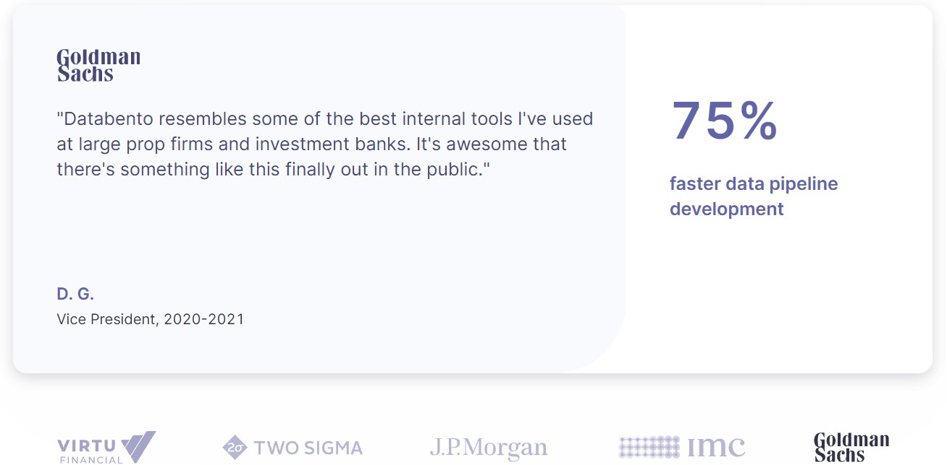
Update
After years of “making billionaires richer,” the founder of Domeyard, Christina Qi, started a new company – Databento, a market data provider, aiming to break down the barriers in finance.

Slide 71
