Slide 1
6. Retail Trading
Qi Wang

Slide 2
Agenda
Retail Investors
FinTech for retail investors
Brokerages
Case study: Charles Schwab

Slide 3
Retail Investors

Slide 4
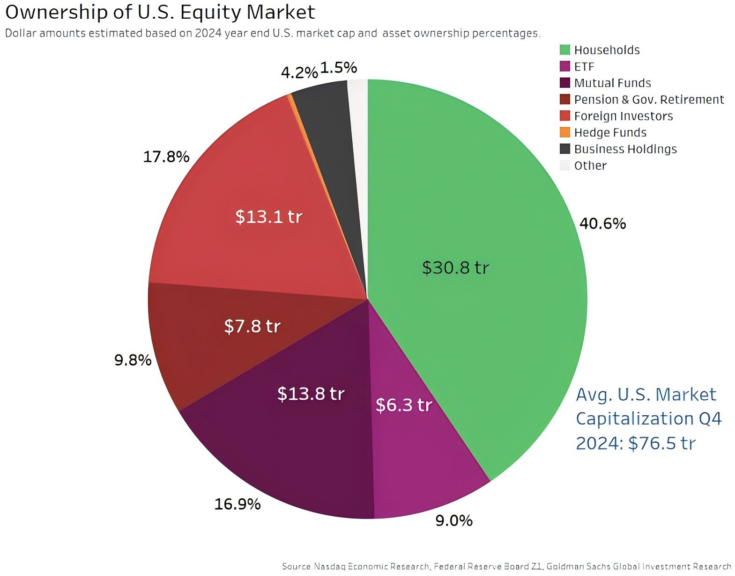
Retail investors
Retail investors are individuals who invest in the stock market for their own personal account rather than for an institution or organization.
Retail investors collectively bought around
$3.4 trillion worth of equities over the first half of 2025, according to data from Nasdaq.
Also, they sold about $3.2 trillion worth —
bringing the total traded to over $6.6 trillion.
SEC chairman Jay Clayton stated, “Our analysis starts and ends with the long-term interests of the Main Street investor [retail investor].”

Slide 5
Investment questions
Do you invest in the stock market?
Which brokerage app do you use?
Kahoot
Please go to www.kahoot.it on your phone or computer.
Enter the game pin (see projector) on your device.
When asked for your nickname,
enter your 8-digit student ID (E.g., 55123456) on your device.

Slide 6

An active retail investor
In Feb 2020, Milos Randelovic, an average citizen in B.C., started to engage in day-trading.
  Read some trading books, scrutinized how-to websites and browsed YouTube channels.
  “With all the research I did following the markets every day, I felt I could make some good money.”
Nearly a year out, the initial $10,000 sum he’d set aside to trade has shrunk by
$6,500, despite rocketing stock markets during that time.
  “I found out, obviously, it’s much harder than how it’s presented in the media.”
“Day trading is addictive, like gambling.”
  Research has shown that stock market trading and actual gambling (lottery) substitute one another (Gao and Lin 2015).

Slide 7
Performance of retail trades
Retail investors perform poorly in financial markets.
  By one estimate, an average retail investor in the US loses 3.7% annually (the most active quantile loses 10.4% annually)
  An average retail investor in Taiwan loses 9% annually.
    The loss is equal to 2.8% of total personal income, and 2.2% of Taiwan’s total GDP.
Men trade more than women and loses more as a result (Barber and Odean 2001).

Slide 8
Why do retail investors underperform?
Information asymmetry
Overconfidence:
  Belief that one knows more than one actually does.
  Belief that one is better than the median person.
Sensation seeking
e.g., retail trading is often substituted by lotteries – trading in Taiwan dropped by 25% when a legal lottery was introduced in 2002.
Familiarity
  Retail investors tend to overinvest in stocks of geographical and occupational familiarity.

Slide 9
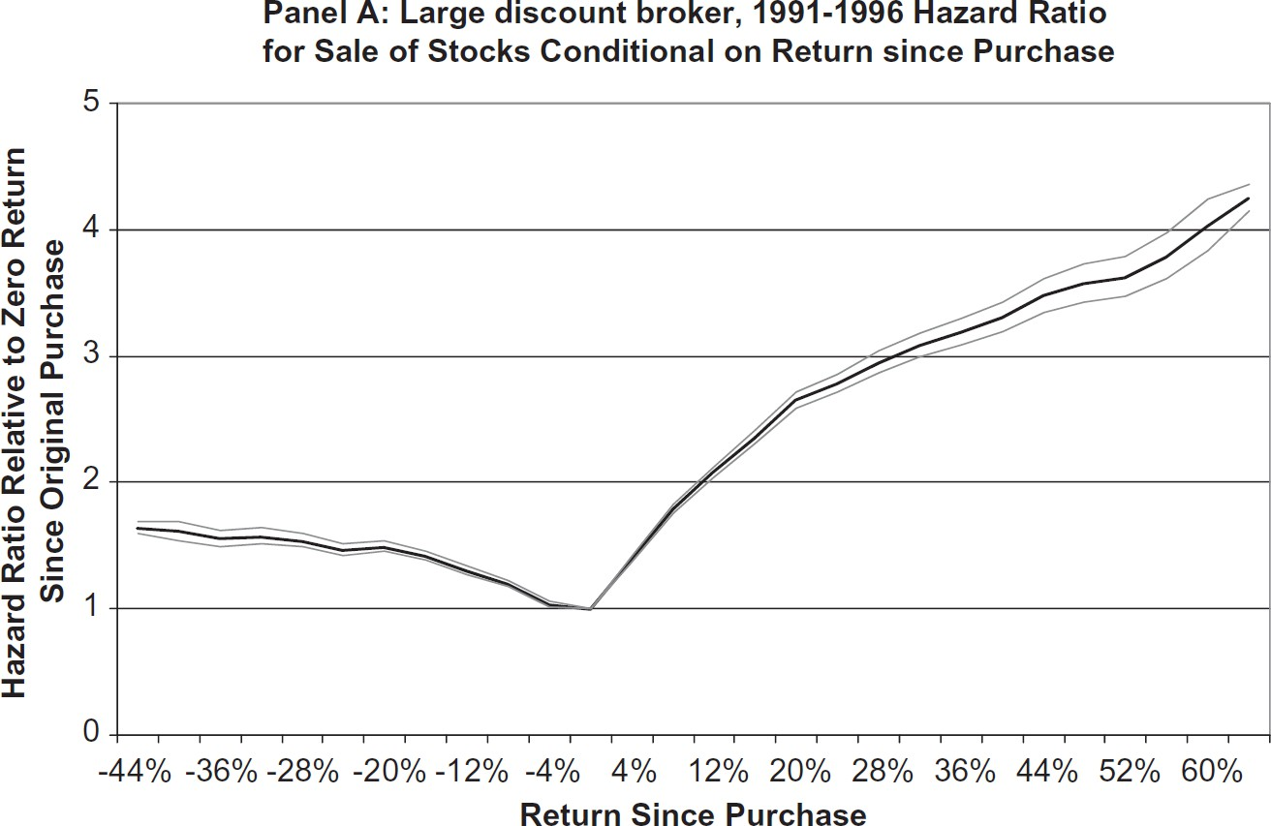
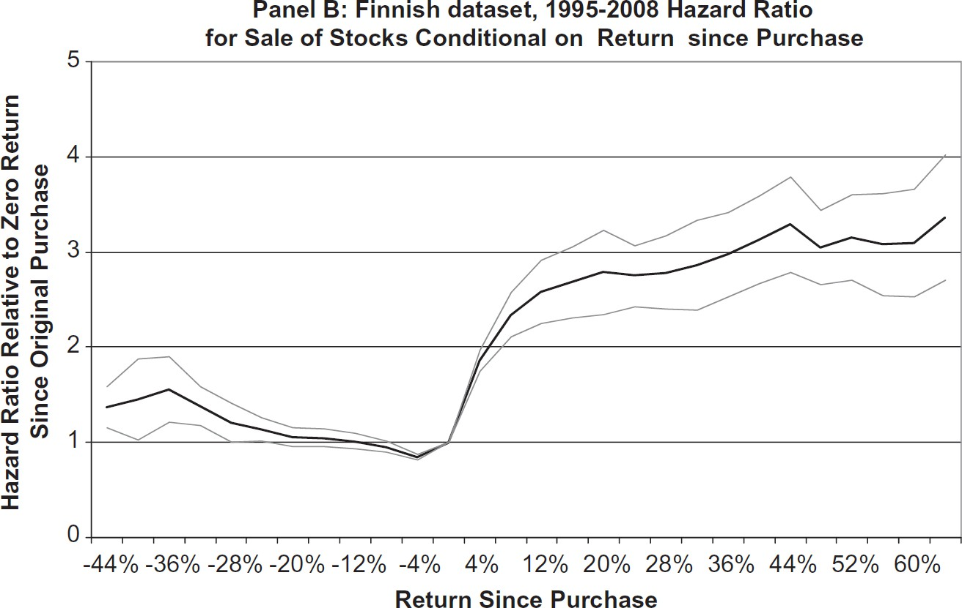
Trading patterns: disposition effects
Disposition effects: selling winners and holding losers
Grey lines represent 95% confidence intervals on estimated hazard ratios.
Barber, B. M., & Odean, T. (2013). The behavior of individual investors. In Handbook of the Economics of Finance (Vol. 2, pp. 1533-1570). Elsevier.

Slide 10
Trading patterns: reinforcement learning
Retail investors tend to repurchase stocks that they previously sold for a profit.
Retail investors tend to buy stocks in an industry if their previous investments in this industry have earned a high return than the market.
Retail investors tend to trade more frequently if the most recent trades are successful.
Investor age cohorts who have experienced high stock market returns throughout their lives are less risk averse and more likely to invest in stocks.

Slide 11
Trading patterns: limited attention
Individuals have a limited amount of attention that they can devote to investing.
Directing too little attention to important information
  Market reaction to earnings announcement is weaker on Fridays, when retail investors are more likely to be distracted.
Overreacting to attention-grabbing events
  Retail investors are more likely to invest in stocks in the news, stocks experiencing high abnormal trading volumes, and stocks with extreme one-day returns.

Slide 12
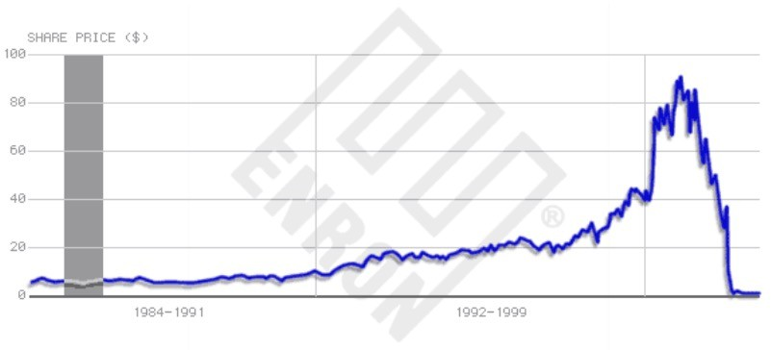
Trading patterns: under-diversification
On average, retail investors hold only four stocks (Barber and Odean 2000).
Retail investors tend to overinvest in local stocks.
  30% of retail investors’ portfolio in stocks headquartered within a 240 mile radius of their home.
Retail investors tend to overinvest in company stocks.
  Enron employees had 62% of their retirement plan assets invested in company stocks at the end of 2000.

Slide 13
FinTech for Retail Investors

Slide 14
FinTech for retail investors
Online trading
Robo-advisor
Tech-enabled information democratization

Slide 15
Online trading
Some ad slogans back then:
  “The slow die first.”
  “Trading at home? Slow can kill you.”
  “If your broker’s so great, how come he still has to work?”
  “I’m managing my portfolio better than my broker ever did.”
Discover: https://www.youtube.com/watch?v=P0dAqlP3Imc
Robinhood
  https://www.youtube.com/watch?v=Z_nsrcnwHQc

Slide 16
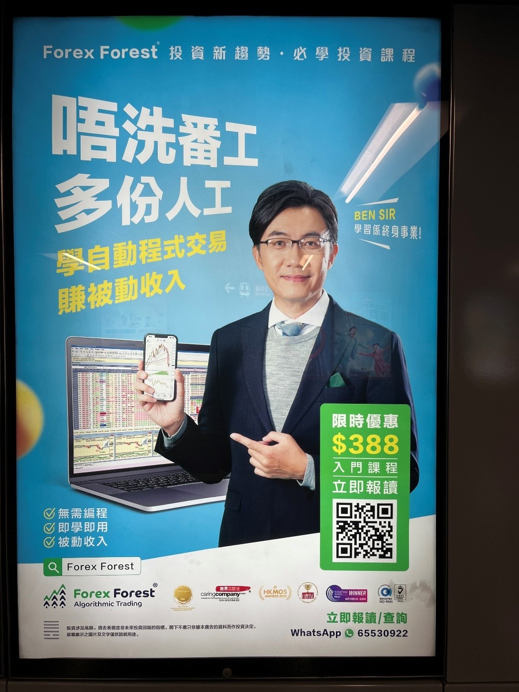
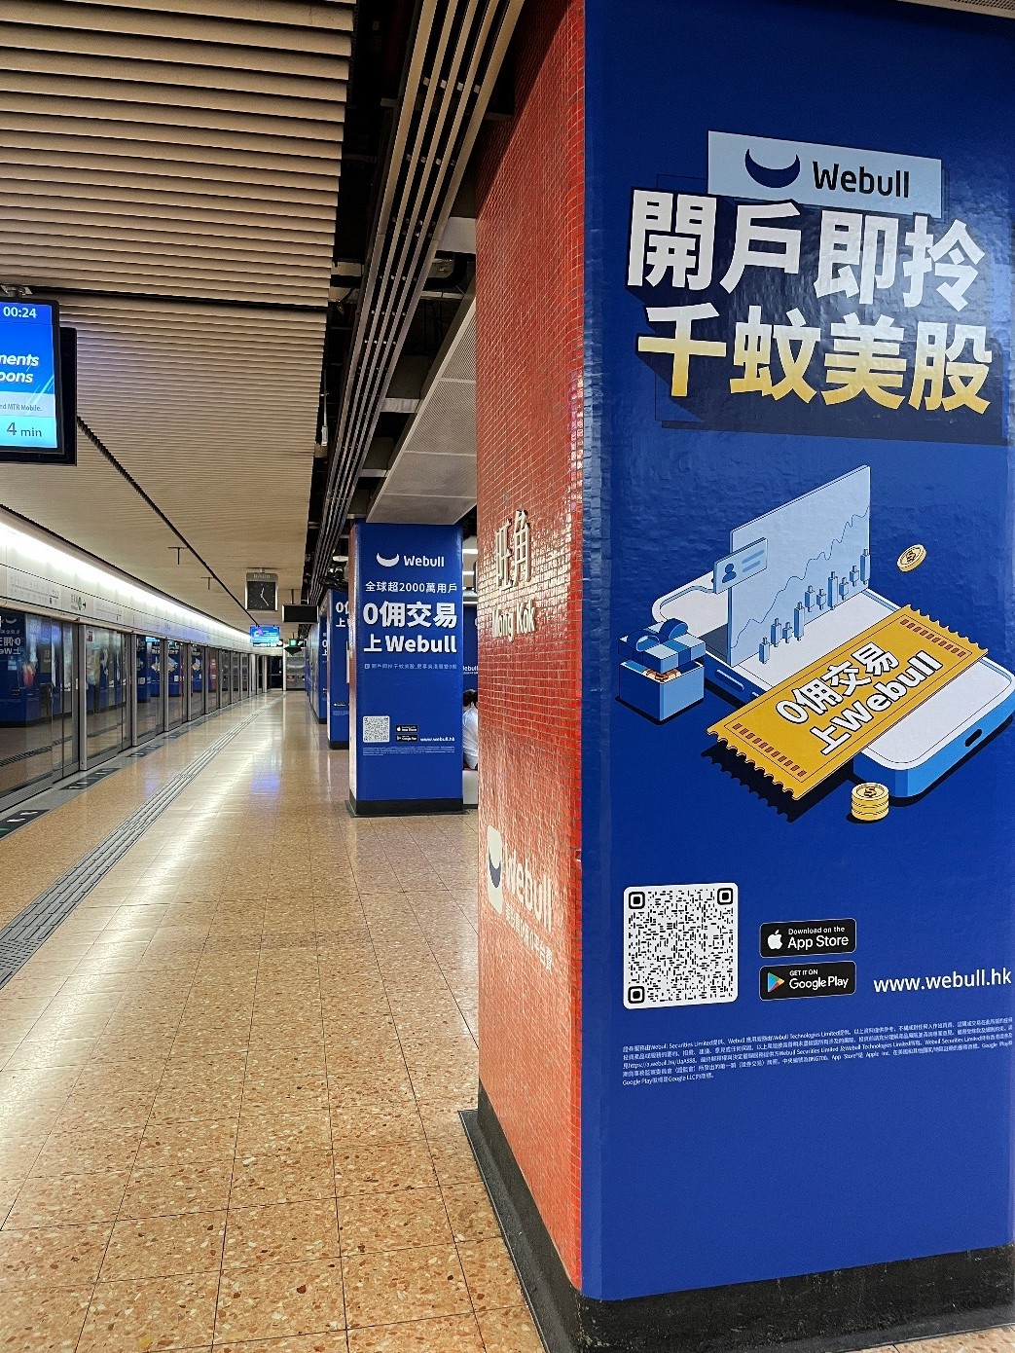

Slide 17
Speed can be a curse
Barber and Odean (2002)
  1,607 investors switched from phone-based to online trading during the 1990s.
  Those switch to online trading perform well prior to going online, beating the market by more than 2% annually.
  After going online, they trade more actively, more speculatively, and less profitably than before—lagging the market by more than 3% annually.
Eaton et al. (2021) similarly find that Robinhood ownership changes are unrelated with future returns.
Online trading gave retail investors illusions of knowledge and control.
Even speed for institutional trading can have adverse effects (Shkilko and Sokolov 2021).

Slide 18
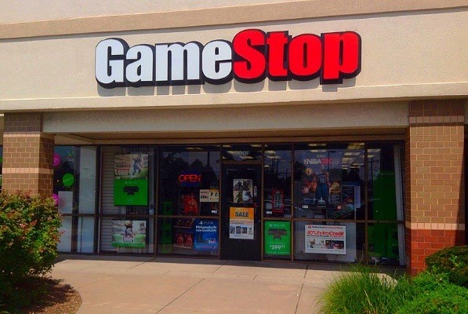
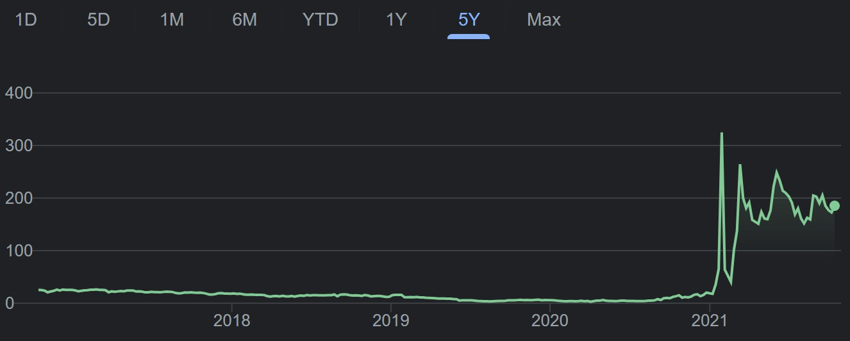
The GameStop, AMC incident
GameStop is a computer game retailer with around 4800 brick-and-mortar stores.
Declining sales since 2018, yet its stock price suddenly skyrocketed.
(US$ Millions) | 2021 | 2020 | 2019 | 2018
Net Income | -215 | -464 | -795 | 230
Sales Growth -21.28% -21.96% -3.06% -0.71%

Slide 19
The GameStop, AMC incident
In January 2021, Melvin Capital and other hedge funds shorted GameStop and several other securities.
Users on “wallstreetbets” subreddit soon rallied together and short squeezed the stocks.
Melvin Capital lost 30% of its value as a result. Other hedge funds, institutional investors, and existing shareholders gained substantially.
The high volatility also made many retail investors lost a fortune.

Slide 20
FinTech for retail investors
Online trading
Robo-advisor
Tech-enabled information democratization

Slide 21
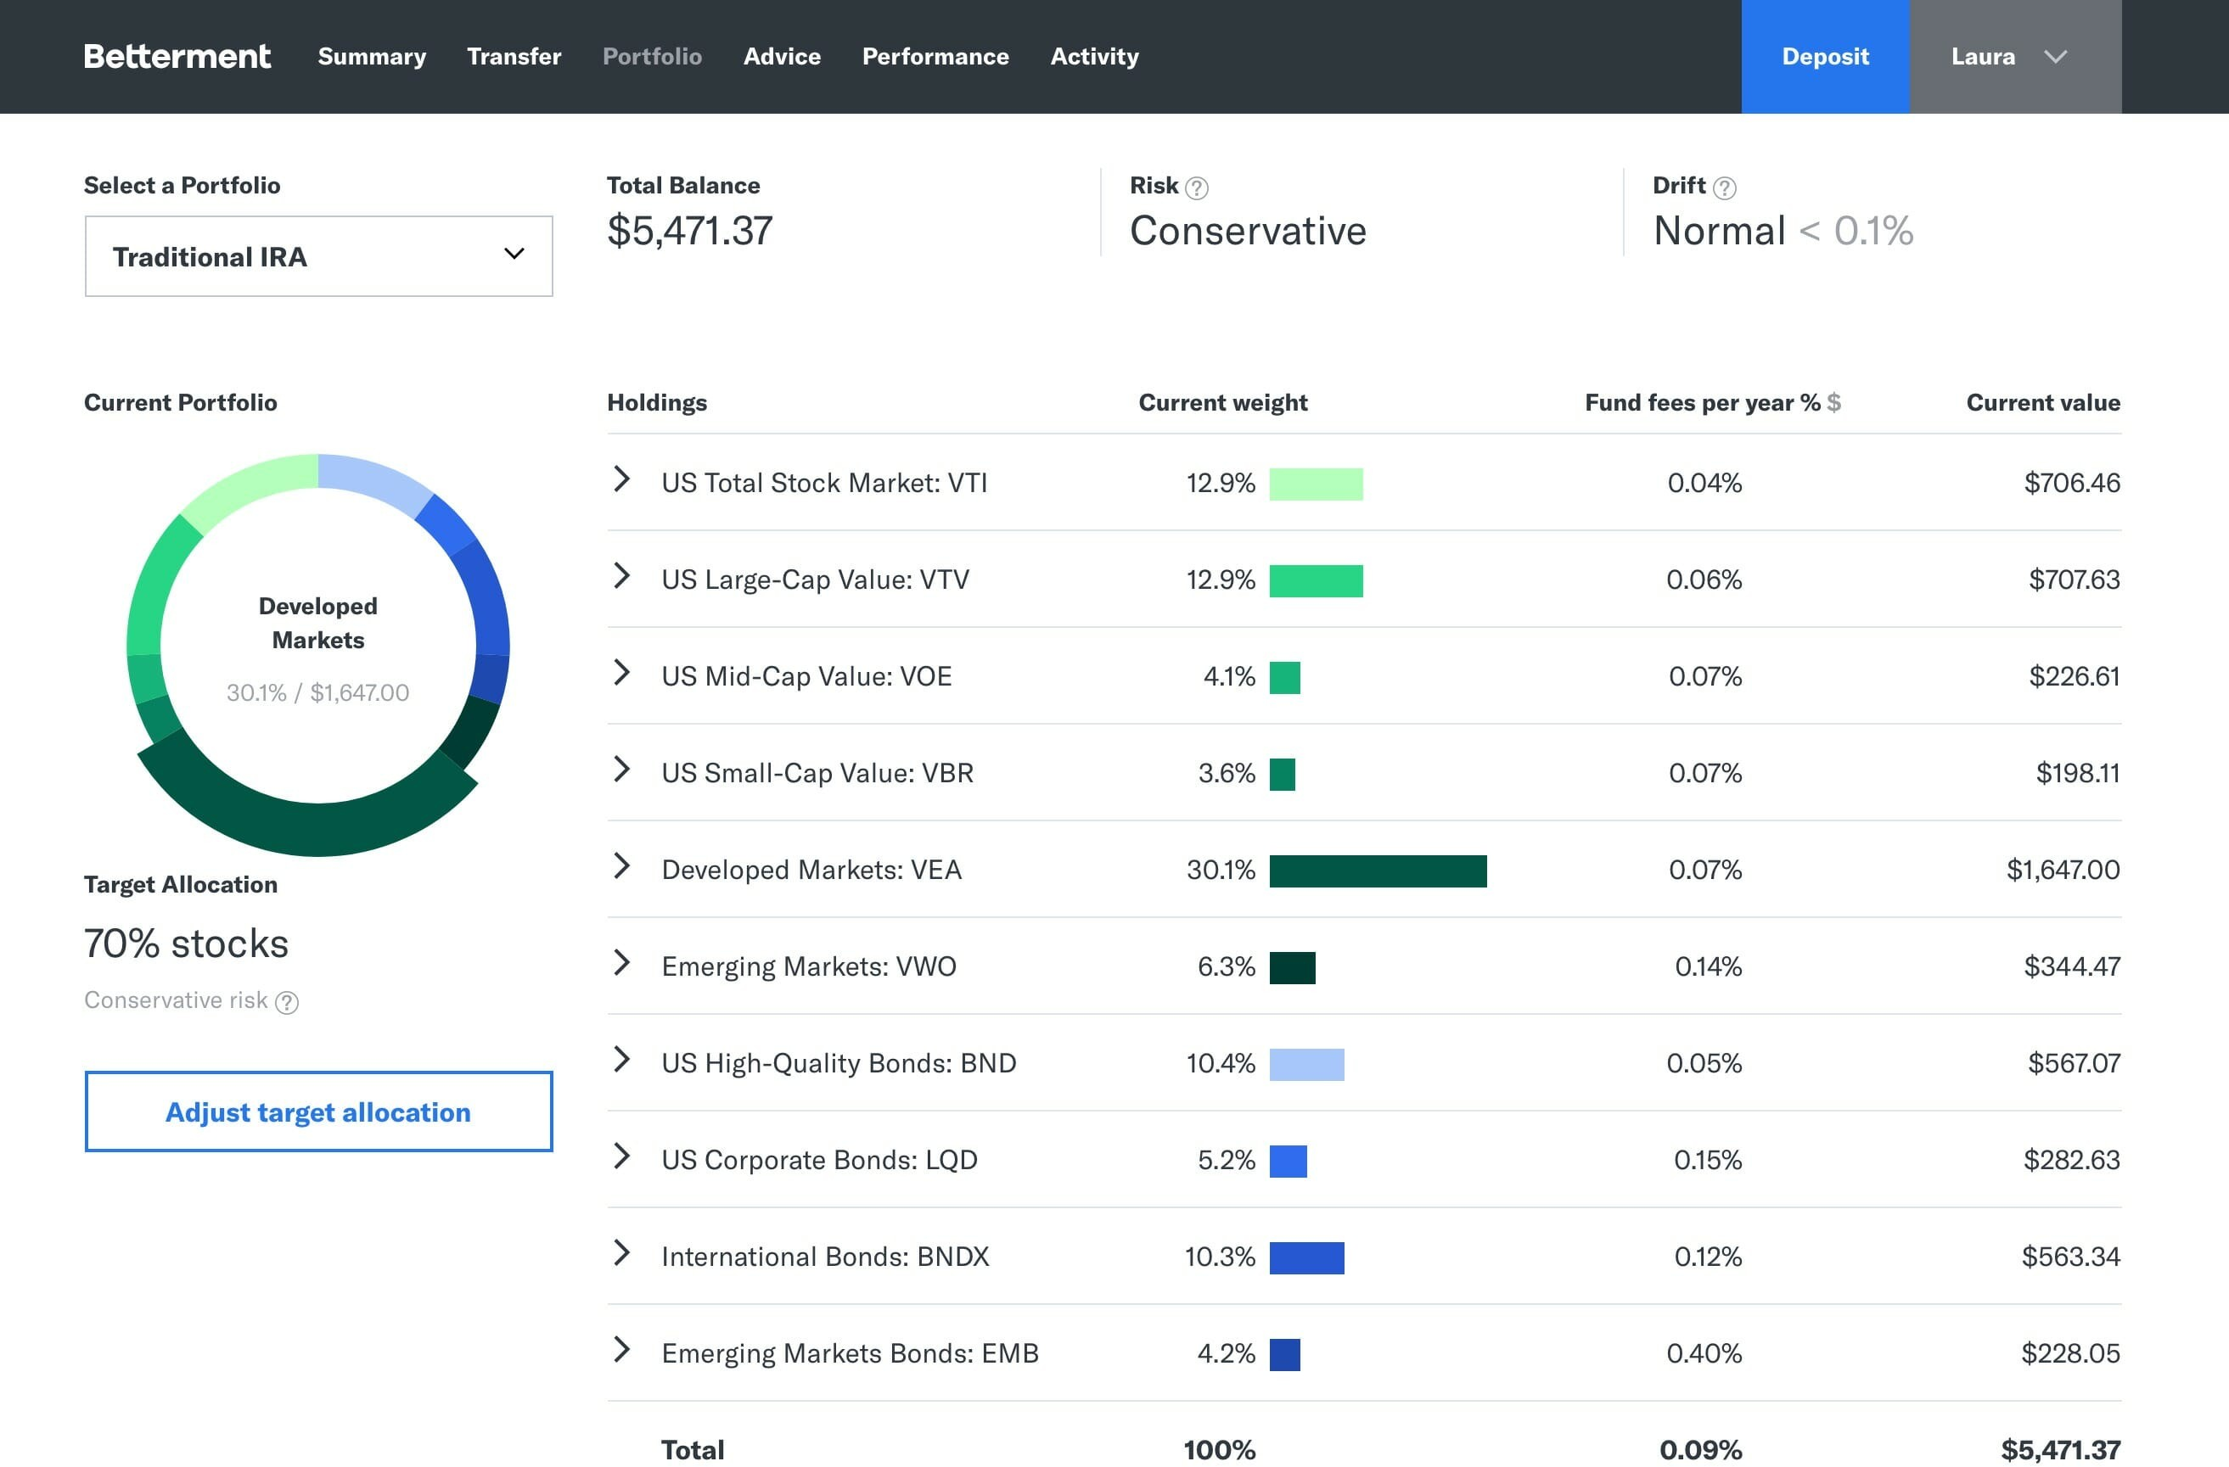
Robo-advisors
Robo-advisors are AI-enabled digitalized service agents that provide financial advice.
Typical functionality:
  Regular rebalancing of portfolio (mostly ETFs) with pre-set goals and risk levels.
  Tax harvesting
  Financial planning (retirement investment plans)

Slide 22
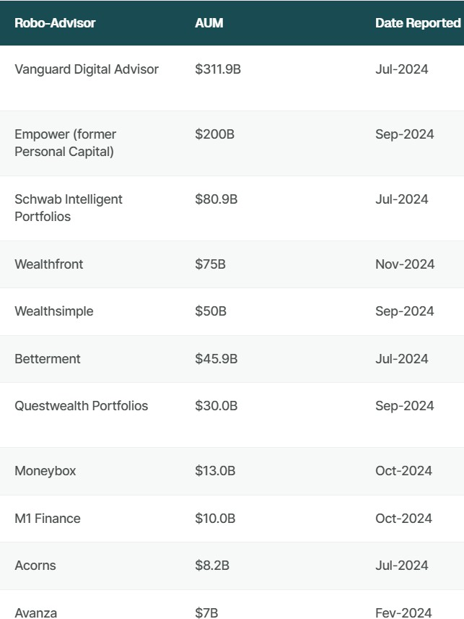
Robo-advisors: asset under management
According to Statista, the Robo-advisory market is expected to reach $2.06 trillion in AUM at the end of 2025.
https://investingintheweb.com/brokers/the-largest-robo-
advisors-by-aum/
22

Slide 23
Robo-advisor: Does it help?
Empirical findings are the quality of investment advice by robots are encouraging, but not yet conclusive.
Investors adopting robo-advising experience diversification benefits.
(D’Acunto et al. 2019).
Robo-advisors can potentially mitigate the disposition effect.

Slide 24
FinTech for retail investors
Online trading
Robo-advisor
Tech-enabled information democratization

Slide 25
Information democratization
Technology has democratized access to information.
Investment research
  Seeking Alpha research articles facilitates informed retail trading (Farrel et al. 2022).
Earnings information
  EDGAR system implementation increases informed retail trading (Gao and Huang 2020).
Market data
  Historical price data exacerbates excessive (uninformed) trading by retail investors
(Havakhor et al. 2020).

Slide 26




A representative rational traders
Data
Investment Decision
Complements
Financial Acumen
Active Retail Investors
Data
S^{C}uºb^{m}st^{p}itu^{le}te^{m}s^{e}?^{nts}
Investment InDvecstimsioennt Decision
Financial Acumen

Slide 27

Retail trading volumes around the Yahoo! Finance API shutdown
Retail trading volume among stocks favored by retail investors dropped significantly after the API shutdown.

Slide 28






Informativeness of retail trades around the Yahoo! Finance API shutdown
Informativeness of retail trades among stocks favored by retail investors increased after the API shutdown. Combined with the volume decrease, this reveals poorer quality for retail trades induced by API-enabled market data access.
One reason is that retail investors become overly confident after accessing the data, thus reducing their trade
informativeness for each trade they place. Hence, removing the data access increases the average trade quality.
Even if there is marginal improvement of trade informativeness (represented by the smaller light bulbs), the average quality per trade will still decrease.
  If the bigger lightbulbs equals 10 and the smaller light bulbs represent 2, then the average informativeness without API
access is 10/1=10. With the API access, the average informativeness per share among existing investors (represented in black) is (10+2)/2 = 6, already lower than 10. Adding the new participants, we have (10+2×4)/5=3.6.

Slide 29
Brokerages

Slide 30
Brokers vs dealer
risk explosure are different
the way they make money are different
broker need to have best execution, dealer need to maintain best capital levell
Broker
  An entity that facilitates transaction between a buyer and a seller.
  Typically gets commissions.
  e.g. retail brokerage firms such as Charles Schwab
Dealer
  An entity that transacts securities using its own account.
  Gets price differences
  e.g. market makers off-exchanges (wholesalers)

Slide 31


Broker-dealer
Many brokerage firms also act as dealers.
  Both agent and principal
Used to charge fees for each transaction.

Slide 32
Services by brokerages
Order management and execution
Research
Advice
Other services
  Securities lending
  Centralized clearing
  Global custody
  Provision of trading and order management systems
  Operational support and consulting services
  Leasing of office space
Customer relationship management

Slide 33
Services by brokerages: order management and execution
Retail investors place orders with brokerages.
Brokers find a dealer (sometimes themselves).
Wholesaler internalize it, or execute it off-exchange (sometimes on-exchange).
  Internalization and off-exchange transactions still need to be reported.

Slide 34
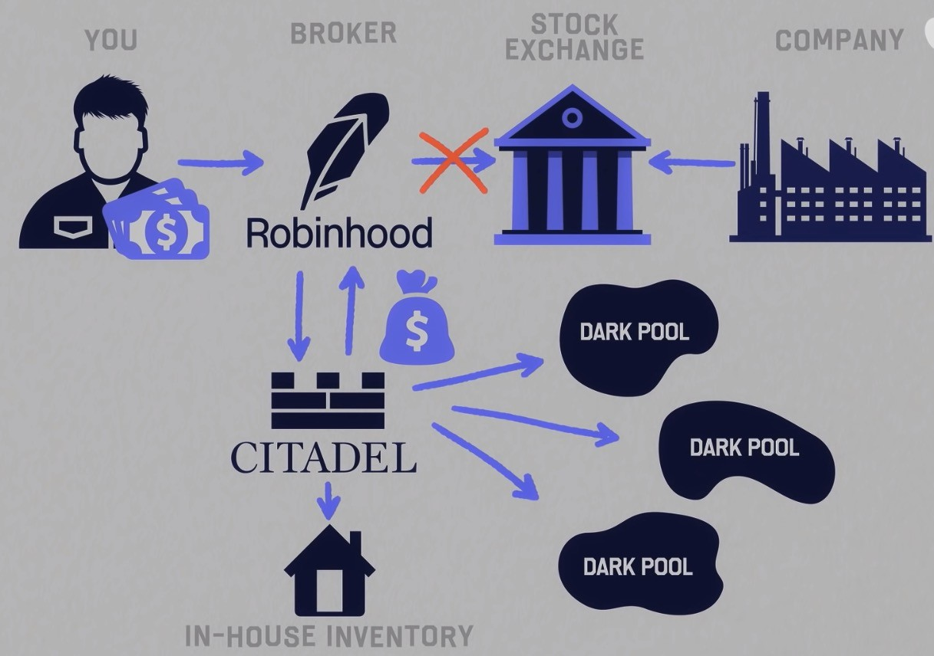


Payment for order flow
Payment for order flow (PFOF) – Payment from wholesalers to brokerages for order flows.
Zero commission. Hidden cost?
https://www.youtube.com/watch?v=2HSW M3fKldY
Consolidation of brokerage houses

Slide 35
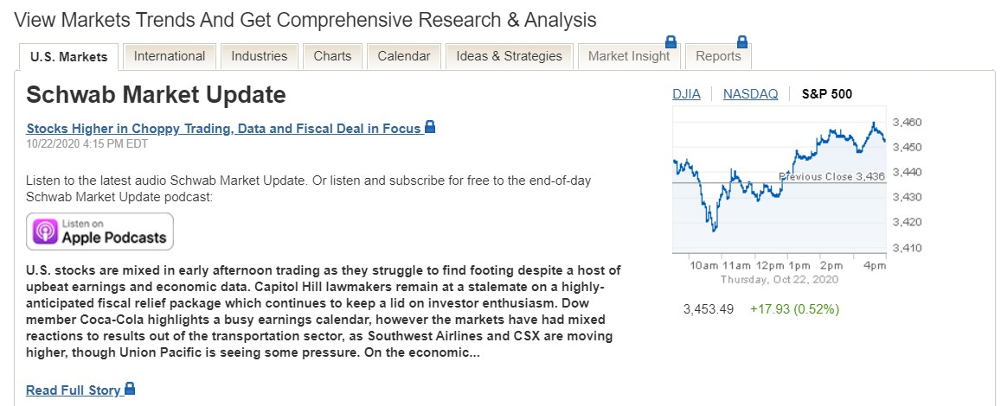
Services by brokerages: research
Internal research teams.
  Security analysts
  Economists
Distribute research report

Slide 36
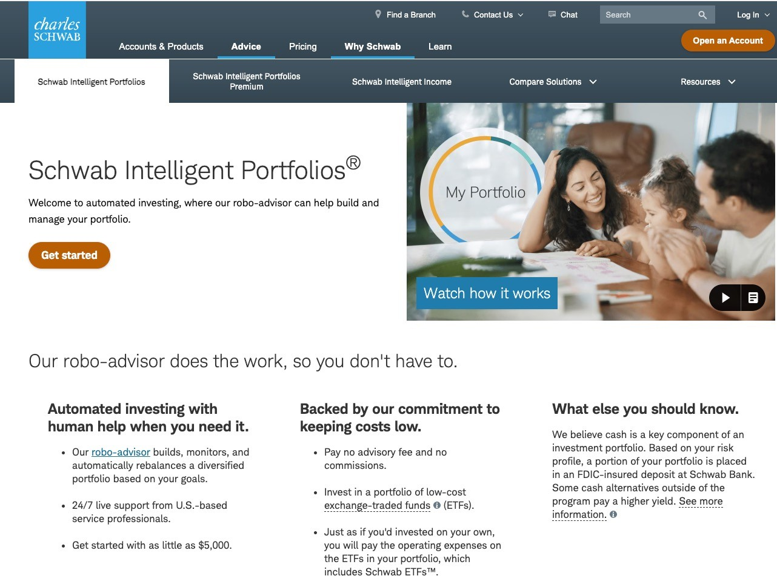
Services by brokerages: advice
High-level recommendations about allocation percentages
Detailed advice considering customers’ existing holdings and specific needs.
Some concerns
  Brokerages relationships with financial institutions.
  Fiduciary

Slide 37
Broker-dealer activities: Proprietary (“prop”) trading
Broker-dealers can trade in the market on their own accounts
Trade for the purpose of making a profit
Take views on relative valuations or direction of prices
Use leverage to magnify returns

Slide 38
Broker-dealer activities: Market making
Place limit orders in a market to buy at or near the bid price and sell at or near the ask price
Ideally, will buy and sell equal quantities so that no net position will be held
Profit gains are small, depends on the spread between the bid and ask prices
Transaction processing costs must also be low

Slide 39
Broker-dealer activities: Risk management
Management of margin trading accounts
  Calculating available margin
  Making margin calls
  Closing out positions if calls are not met
Market making
  Managing the size of net exposures and/or inventory of securities
Prop trading
  Managing trading limits
  Managing aggregate exposure to specific factors
  Avoiding over allocation to any one security or industry sector

Slide 40
Case 5:
Charles Schwab Corp. in 2017

Slide 41
Background
The regulatory change that prompted the creation of discount brokerages, including Charles Schwab, was the deregulation of brokerage commissions by the Securities and Exchange Commission (SEC) in 1975. This allowed for the emergence of discount brokerages that could offer low-cost trades, positioning themselves as impartial brokers and making stock trading more accessible to individual investors.
What regulatory changes prompted the creation of discount
brokerages (including Charles Schwab)?
Charles Schwab's business model is centered around providing a wide range of financial services and products at lower fees compared to traditional full-service brokerages.
The company offers services such as wealth management,
banking, custody, and brokerage. It provides a multitude of
What is Charles Schwab’s business model?
products including mutual funds, stocks, ETFs, options, futures, and other investment vehicles, as well as banking services like savings and checking accounts, mortgages, and insurance products.
Schwab emphasizes technology to lower fees and improve efficiency, positioning itself as a disruptor in the financial services industry. It also focuses on building trusted relationships with clients to attract and retain assets, driving a "virtuous cycle" of growth.
What is Charles Schwab’s AUM today?
As of August 31, 2017, Charles Schwab had a record $3.12 trillion in client assets under management (AUM).
Key challenges for Charles Schwab Corp. today?
Maintaining Trust in the Era of Cyber-Threats: How to maintain or improve trust with customers amidst increasing cyber threats and sophisticated technology that some find invasive.Product Simplicity and Customer Expectations: Ensuring that their products are elegant and simple enough to meet the rising expectations of customers in the era of Uber and Amazon.Competition from Tech Giants: The potential threat of big tech companies like Google or Amazon moving into Schwab’s territory.Technology Development and Security: Balancing the advancement of technology with the security of financial transactions, especially in the context of new technologies like voice-activated devices.Attracting New Customers: Engaging the next generation of customers and understanding their service preferences, which may differ significantly from previous generations.Regulatory and Competitive Landscape: Navigating a competitive landscape that includes traditional wire houses, online brokerages, and fintech startups, while also staying ahead of regulatory changes.Cultural and Operational Challenges: Preserving the company's₄₁culture of disruption and innovation as it grows and potentially faces leadership transitions in the future.

Slide 42
Disrupter?
Is Charles Schwab still a disruptor? Why or why not?
Is Charles Schwab still a disruptor? Why or why not
Discount Brokerage Model: Charles Schwab was one of the first to launch a discount brokerage model, which revolutionized the way individuals invested by offering low-cost trades and reducing the fees associated with traditional brokerage services.
Technology Adoption: The company was an early adopter of technology, being the first discount broker to bring automation in-house and develop an online order entry system, which significantly increased efficiency and reduced costs.
Client-Centric Approach: Schwab's focus on client experience and its "Through Clients' Eyes" strategy, which encourages decision-makers to consider the impact of their actions on customers, has been a key differentiator.
Innovation: The introduction of the robo-advisor product, Schwab Intelligent Portfolios, is an example of how the company has embraced new technologies to compete with fintech startups and offer lower-fee services, attracting new customers, particularly millennials.
Lower Fees and Objective Advisory Services: Positioning itself with lower fees and more objective advisory services has allowed Schwab to take market share from traditional wire houses.
However, to determine if Charles Schwab is still a disruptor, we must consider the following:
  Competition: The emergence of fintech companies and the potential entry of big tech players like Google or Amazon into the financial services space pose significant challenges. These new competitors could potentially disrupt the status quo and force established players like Schwab to respond.
  Regulatory Environment: The financial services industry is heavily regulated, which can limit the speed and nature of disruptive innovation. Schwab's ability to disrupt is influenced by its ability to navigate and comply with regulatory requirements.
  Customer Expectations: As customer expectations rise, particularly with the influence of technology companies setting new standards for user experience, Schwab must continuously improve its services to meet these expectations.
  Cultural and Strategic Consistency: The case mentions the importance of maintaining the company's culture of disruption. Changes in leadership or strategy could impact Schwab's ability to continue its disruptive path.

Slide 43
Growth?
Where should Schwab look for growth?
Based on the case study of Charles Schwab Corp. in 2017, the company had several avenues for growth. Here are some key areas where Schwab could look for growth opportunities:
Expanding Client Base: Attracting New Customers: Schwab could focus on attracting new customers by offering services that meet the needs of a broader demographic, including younger investors and those with lower investible assets. Wealthy Clients: The company could continue to target high-net-worth individuals and offer premium services to cater to their specific needs.
Product Diversification: New Insurance Lines: As mentioned in the case, Schwab could consider expanding into new insurance categories such as pet insurance, auto, travel, or life insurance to provide a more comprehensive suite of financial services. Bundling Services: Offering bundled services could help retain existing customers and attract new ones by providing a more holistic financial solution.
Geographic Expansion: International Markets: Entering new international markets, particularly in Europe, could provide significant growth opportunities. The case discusses the potential for a single pan-European license to facilitate expansion across multiple countries. Underpenetrated U.S. States: Schwab could also focus on expanding its operations in the U.S. states where it is not yet operational.
Technological Innovation: Improving Digital Services: Investing in technology to enhance the digital experience for customers, making interactions more efficient and user-friendly. Voice-activated Trading: Exploring the use of voice-activated devices like Amazon’s Echo speakers for delivering financial information and potentially secure trading.
Enhancing Trust and Security: Cybersecurity: Strengthening cybersecurity measures to maintain customer trust in the digital age. Data Privacy: Ensuring that data privacy is protected and that the company's use of customer data is transparent and compliant with regulations.
9. Partnerships and Acquisitions: Strategic Partnerships: Forming partnerships with non-competitive companies to reach new customer segments or offer additional services. Acquisitions: Although Schwab has been cautious about acquisitions, strategic purchases could help the company gain market share quickly.

Slide 44
Cannibalize oneself?
Schwab executives believe the willingness to “cannibalize” oneself is very important in the quest to stay ahead of the disruption curve. What organizational or structural factors make it more or less likely that Schwab can continue to execute on this?
1. Leadership Vision and Culture: Positive Factor: A strong leadership team with a clear vision and the ability to instill a culture of continuous innovation and self-disruption can drive the organization to embrace change. Walt Bettinger's early morning rituals and focus on key metrics demonstrate a leadership commitment to staying ahead of the curve. Challenge: If future leadership lacks the same level of commitment or vision, the culture may not support the necessary level of risk-taking and innovation.
Innovation Capabilities: Positive Factor: Schwab's investment in technology and its innovation budget increases its ability to develop new products and services that could disrupt its own business models. Challenge: If the company fails to keep up with rapid technological advancements or if its R&D efforts are not aligned with market needs, it may struggle to innovate effectively.
Customer-Centric Approach: Positive Factor: Schwab's focus on customer needs and its "Through Clients' Eyes" strategy can help identify areas where self-disruption could improve customer experience and satisfaction. Challenge: If the company loses sight of customer needs or fails to adapt its services to changing customer expectations, it may not be able to identify opportunities for self-disruption.
Financial Resources:Positive Factor: Schwab's financial stability and resources allow it to invest in new ventures and withstand the short-term losses that may come with cannibalizing existing products. Challenge: Overextension or misallocation of resources could jeopardize the company's ability to invest in necessary innovations.
Regulatory Environment: Positive Factor: A favorable regulatory environment can provide opportunities for new products and services that disrupt existing business models.Challenge: Heavy regulation can slow down innovation and make it difficult for Schwab to quickly respond to market changes.
Talent Management: Positive Factor: Attracting and retaining top talent with the skills necessary to drive innovation and disruption is crucial. Challenge: Competition for talent with tech giants and fintech startups could make it difficult for Schwab to maintain a skilled workforce.
Risk Management: Positive Factor: Effective risk management practices can help Schwab identify and mitigate the risks associated with self-disruption. Challenge: If risk management is too conservative, it may stifle the necessary level of innovation and risk-taking.

Slide 45
Competition from big techs?
Can US regulations sufficiently protect Charles Schwab from potential competitions from big technology companies?
U.S. regulations can create a fair, safe, and transparent financial system that benefits established firms like Charles Schwab, but they are not designed to erect a fortress around incumbents against competition from Big Tech. They can level parts of the playing field—especially around data use, consumer protection, and risk management—but the real pressure comes from innovation, customer preferences, and platform scale, which
regulations alone do not eliminate.

Slide 46
Strategy towards the young?
Do you believe Schwab’s strategy towards younger investors is the right one? If so, why? If not, why and what should Schwab do differently?
right strategy
Schwab's strategy towards younger investors, as outlined in the case, focuses on several key aspects, including financial literacy, the right product mix, pricing, branding, and life stage. Here's an analysis of whether this strategy is right and suggestions for potential improvements:
Why Schwab's Strategy Might Be Right:1. Targeting Life Stages: Schwab recognizes that younger investors often reach a point in their lives where they feel the need to start investing, such as when they get married, have children, or reach certain career milestones. This life-stage targeting is a smart approach as it aligns marketing efforts with times when the need for investment services becomes more pressing.2. Digital Engagement: Younger investors are generally more comfortable with technology and prefer digital interactions. Schwab's focus on improving its digital services and user experience is likely to resonate well with this demographic.3. Financial Literacy: By addressing the need for financial literacy, Schwab is not only educating potential customers but also building trust and brand loyalty from the ground up.4. Competitive Pricing: Offering competitive pricing and lower fees can be particularly attractive to younger investors who are often price-sensitive and have less disposable income to invest.Potential Shortcomings and Alternatives:1. Proactive Engagement: While Schwab waits for younger investors to reach a point where they feel the need to invest, a more proactive approach might be beneficial. This could involve educational campaigns targeting specific challenges faced by younger investors, such as student debt, and providing solutions or advice on how to start investing despite these challenges.2. Customized Solutions: Younger investors have different financial goals and risk tolerances compared to older investors. Schwab could develop more tailored products that cater specifically to the needs of millennials and Gen Z, such as micro-investment plans, socially responsible investing options, or goal-based investment strategies.5.
Simplified Investment Products: Younger investors often find traditional investment products complex and intimidating. Schwab could focus on simplifying its product
offerings and making them more accessible, which could lower the barrier to entry for new investors.
46

Slide 47
Future disruptions?
If in ten years, Schwab’s business has been disrupted, where do you think the disruption will have come from, and why?

Slide 48
Key takeaways
Retail investors suffer from various behavioral biases that make them underperform in the stock market.
Online trading, robo-advisors, and tech-enabled information democratization, can alleviate or exacerbate behavioural biases of retail investors.
Traditional low-cost brokerages need to disrupt themselves to stay ahead of the curve.

