Slide 1
8. Risk Management
Qi Wang

Slide 2
Agenda
Market risk
Operational risk
Compliance risk
Regulatory technologies
Case 6: Regtech at HSBC

Slide 3
Market Risk Management

Slide 4
Risk management
Risk must be managed, it cannot be eliminated
  Too little risk can lead to relative underperformance
  Too much risk can lead to catastrophic losses
Major risk management failures have persisted over time
Insitutional
Risk Management
Failures
Source: Duran, R. E.,
Financial Services Technology, Cengage Learning Asia, 2013
Kidder Peabody Loss = $350mil
Barings Collapse Loss = $1.4bn
LTCM Collapse Societe Generale AIG Bailout JP Morgan Loss = $4.6bn Loss = $7.1bn Loss = $60bn Loss = $5.8bn
1980
1985
1990
1995
2000
2005
2010
2015
Latin American Debt Crisis
US Savings and Loan Crisis
Asian Financial Crisis
Global Financial Crisis
European Sovereign-debt Crisis
Systemic
Risk Management Failures

Slide 5


Mini case
MF Global was a multinational futures broker and bond dealer.
  Filed for bankruptcy in 2011 with $40 billion in liabilities.
In 2008, Jon Corzine assumed CEO and chairman of MF Global.
  Jon Corzine was a bond trader and a managing partner at Goldman Sachs.
  Aimed to transform MF Global from a third-tier commodities broker to a high-flying investment bank.

Slide 6
Mini case
In 2008, a rogue trader’s bet on wheat futures led to market losses of $141.5 million and a regulatory fine of $10 million for poor risk management.
Losses on its traditional agency brokerage business.
Leverage its own capital to make bets by means of proprietary trading that exceeded $6 billion on the bonds of less secure Eurozone governments.
Before the bankruptcy, MF Global used customer funds to support its proprietary trading.

Slide 7
Mini case
MF Global employees later testified that the organization had inadequate risk control frameworks and IT capabilities.
When shifting from brokerage to prop trading, it did not upgrade its IT systems or the back-office infrastructure.
Drop in the European debt market

Slide 8
Business context: risk considerations
Risk must be managed so that the level taken is in line with the expected returned.
Consider worst-case scenarios
  Ensure that expected outcomes are acceptable
Is performance determined by luck or skill?
  Danger of having low-skilled, but lucky risk takers
  Eventually, luck runs out

Slide 9
Business context: types of risk
Market risk
  The risk that fluctuations in the value of assets and positions in financial instruments
  The primary focus of this section
Market liquidity risk
  The risk that a financial instrument may not have ready buyers or sellers
  Lack of liquidity may adversely affect an asset’s price
Credit risk
  The risk that a counterparty will default on its credit repayment obligations

Slide 10
Business context: types of risk
Settlement risk
  Risk that the institution makes payments to its counterparty but does not receive the corresponding payment or delivery of securities
Operational risk
  The risk of losses due to operational failures
  For example:
    Failure of controls that lead to fraud
    Downtime of critical systems
Compliance risk

Slide 11
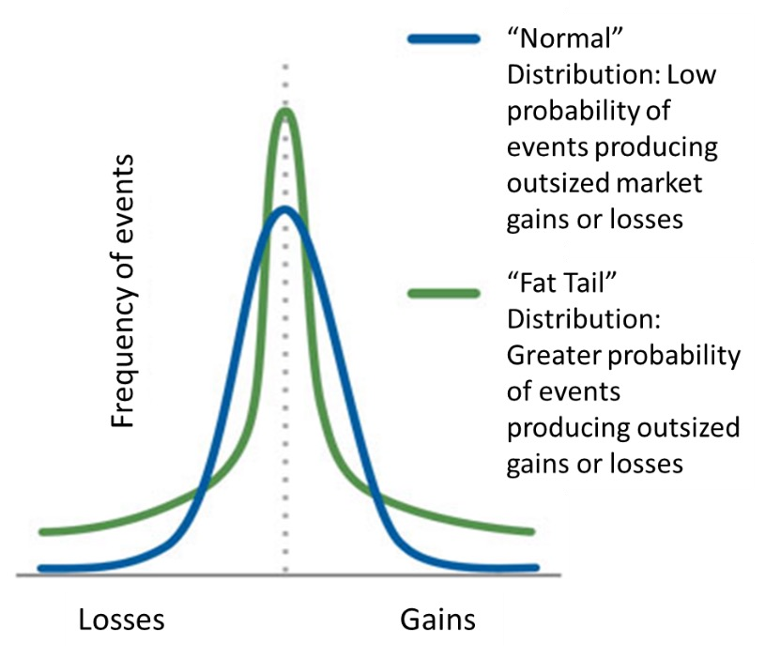
Market Risk Concepts
Non-normal return distributions (fat tails)
  Can lead to larger-than-expected losses

Slide 12
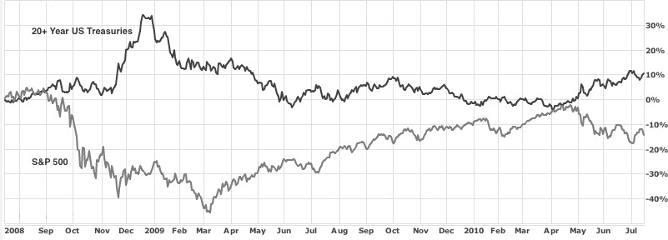
Market Risk Concepts
Correlation of asset prices
  Inverse price correlations can offset one another, reducing risk

Slide 13
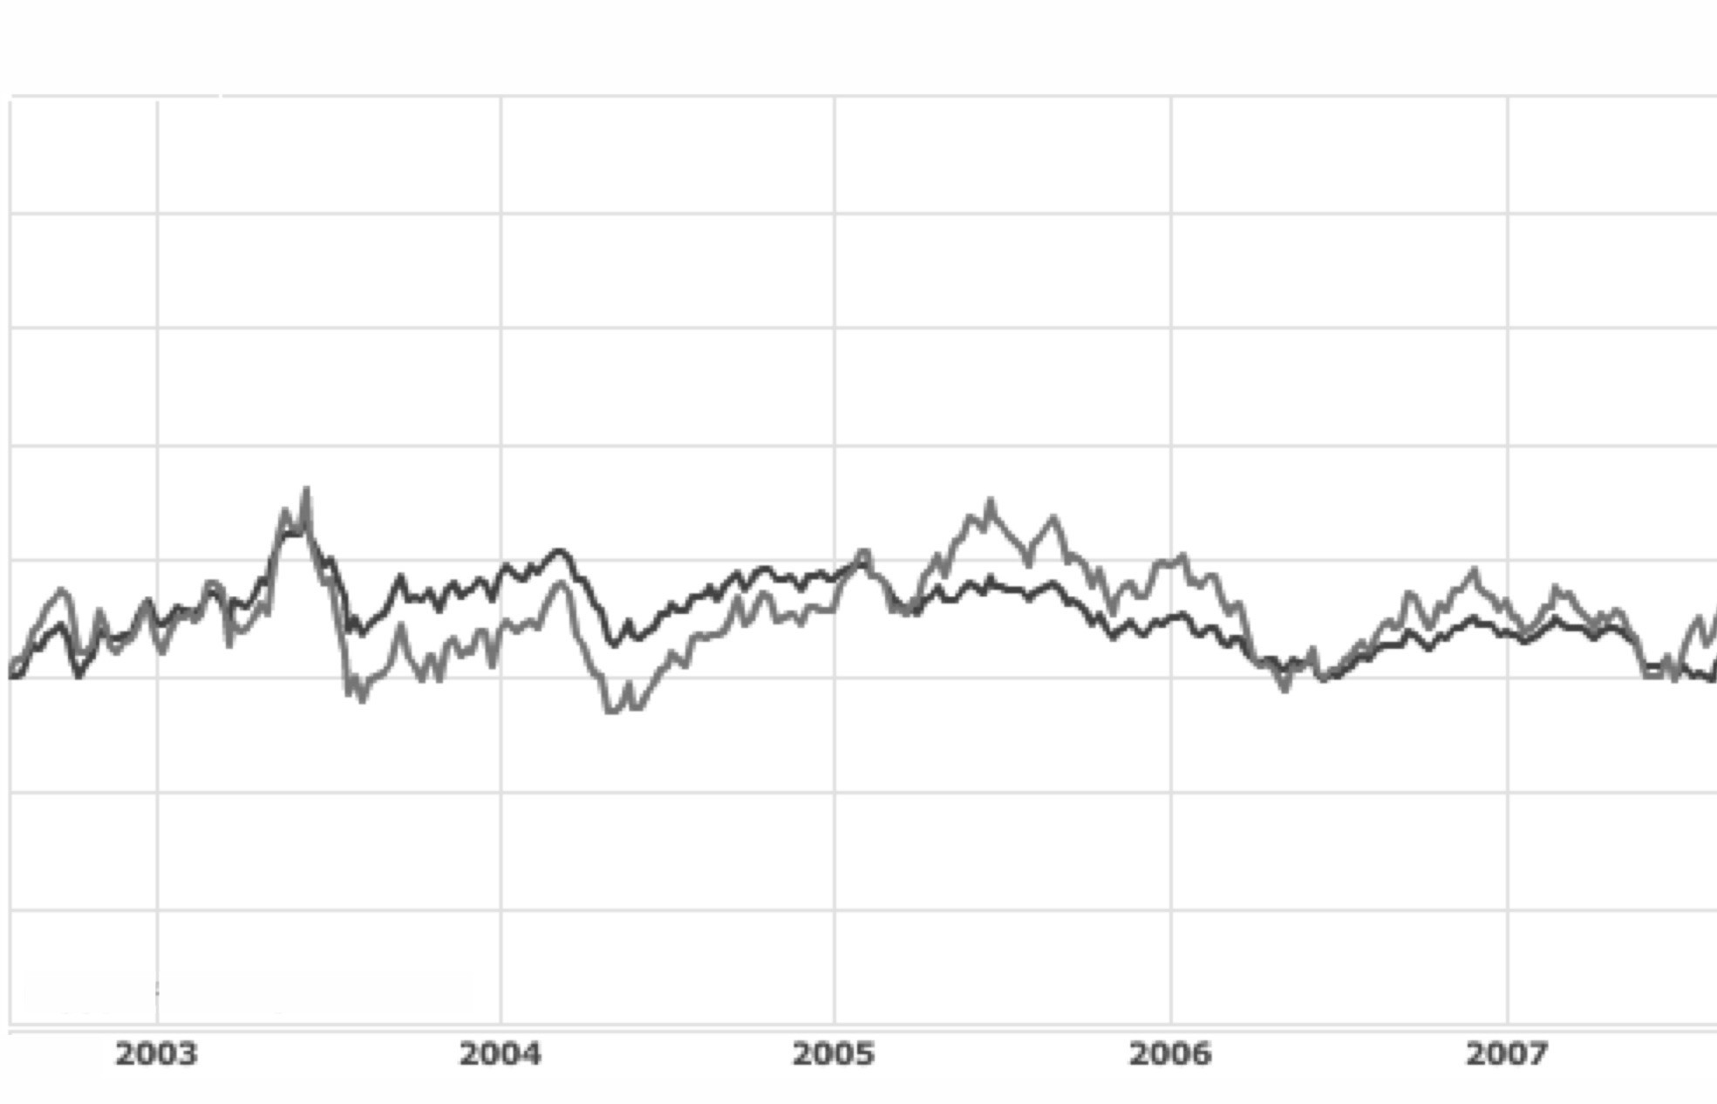
Market Risk Concepts
Real-world complications
  Unfortunately, correlations vary over time

Slide 14
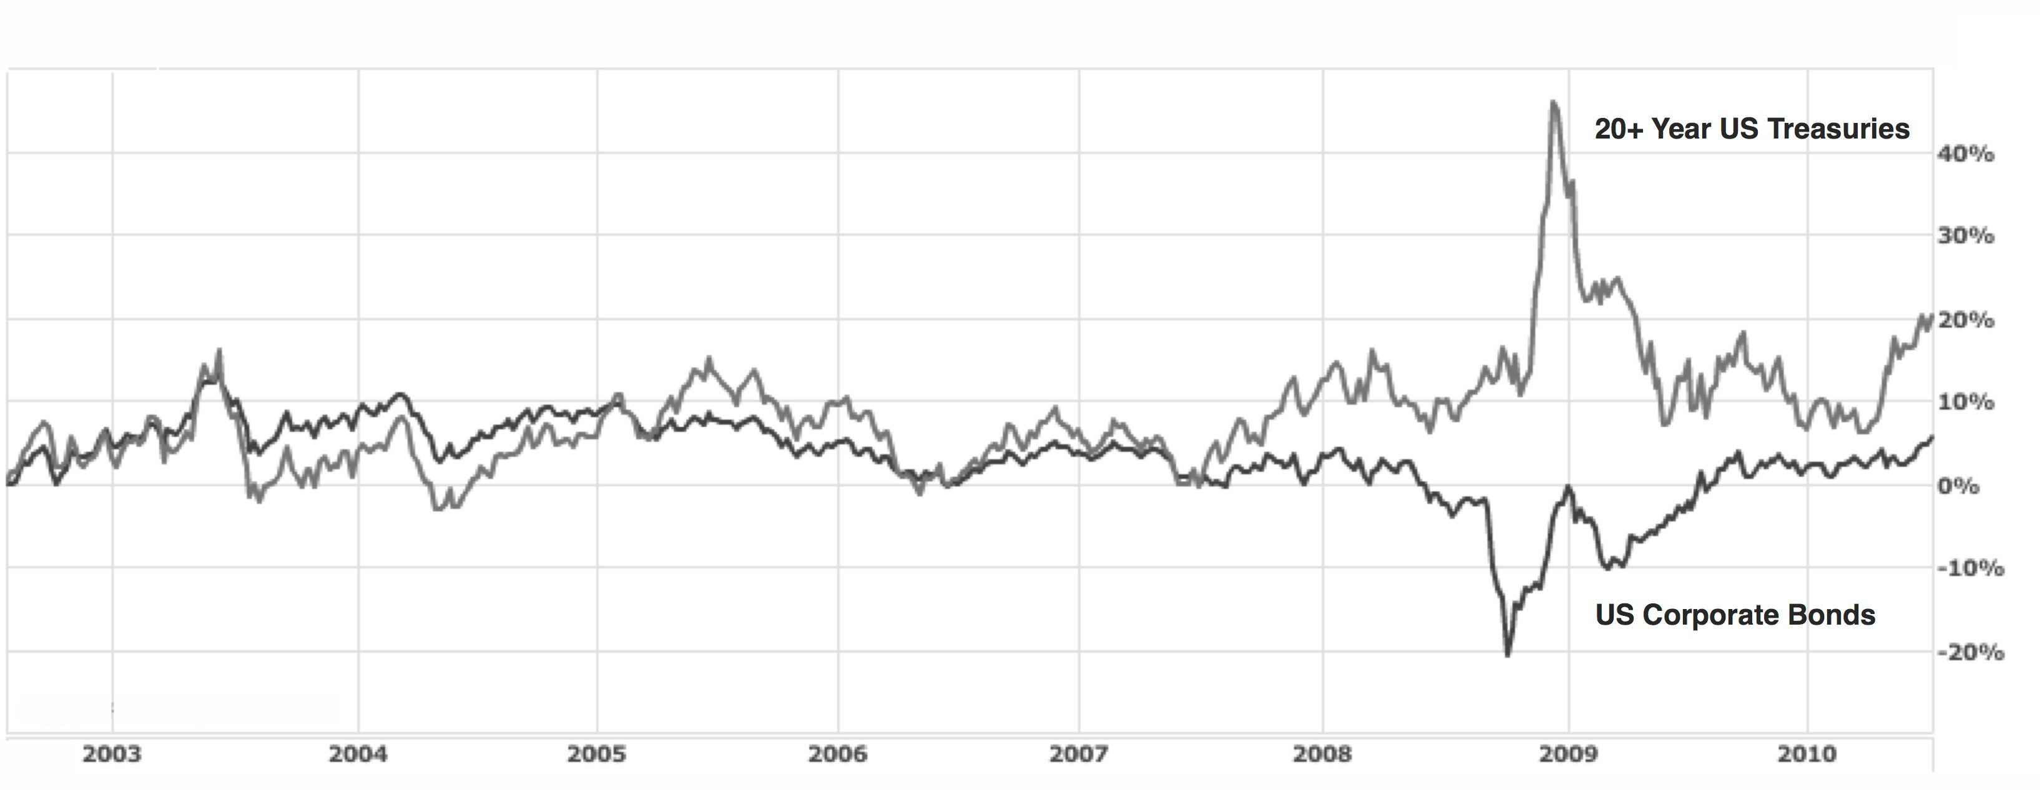
Market Risk Concepts
Real-world complications
  Using corporate bonds as a substitute for government bonds worked well until 2007

Slide 15
Measuring Market Risk: Value at Risk (VaR)
VaR is
  An expected loss expressed in monetary terms
  Within a specific timeframe
  At a certain probability
VaR is developed to help simplify and standardize how financial institutions quantify risk
Example:
  The daily VaR of a portfolio of assets with total value of $2 billion is $60 million at a 95% confidence level.
    i.e. on any given day, there is less than a 5% chance that the loss on the portfolio will exceed $60 million

Slide 16
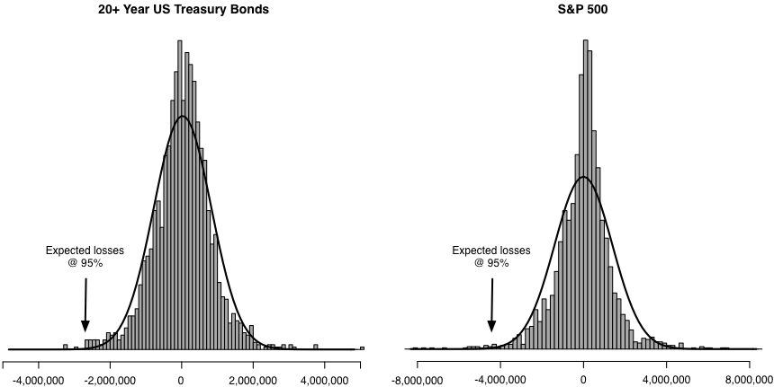
Measuring Market Risk: VaR
5% of the daily losses for the bond portfolio exceed $2.7 million
5% of the daily losses for the equity portfolio exceed $4.2 million

Slide 17
Measuring Market Risk: Limitations of VaR
Accuracy under variable market conditions
  Asset volatilities and price return correlations may deviate significantly in times of crisis
  Difficult to estimate the effect of weak market liquidity on prices
A very simple measure
  VaR amount does not reflect the maximum potential loss that may be incurred above the percentage threshold
  This may potentially lead to overconfidence regarding the safety of positions and the riskiness of holdings
Accuracy is highly dependent on inputs
  E.g., changing the historical period is used for estimating volatilities can significantly affect the VaR results

Slide 18
Business Opportunities
Financial institutions can leverage their risk management capabilities to provide advisory services
  Help customers assess and manage their risk
Provide capital protected products
Calculate risk exposure in real time
  VaR and other enterprise risk measures usually calculated overnight
  Near-real-time has been implemented using custom hardware implementations

Slide 19
Business Challenges
Operational failures
  Incorrect or false information used in risk calculations
Compensation structures misaligned with risk management objectives
Maintaining a balance between risk taking and prudence
Getting everyone in the transaction lifecycle to understand and help manage risk

Slide 20
Operational Risk Management

Slide 21

Operational risks
Operational risk is the risk of loss resulting from inadequate or failed internal processes, people and systems or from external events.

Slide 22


Mini case: Barings Bank
In 1993, the UK-based Baring Bank appointed 25-year-old Nick Leeson as the general manager of the new futures trading operation in Singapore.
Leeson was in charge of both front-office trading and back-office accounting and settlements.
When trading went sour, Leeson hid the loss through accounting manipulations.
  The headquarter was unaware until much later.
The accumulated losses amounted to £827 million.
  Bankruptcy

Slide 23
Operational Risk
Types of operational risks:
  internal fraud
  external fraud
  employment practices and workplace safety
  products and business practices
  damage to physical assets
  business disruption and system failure
  execution, delivery, and process management

Slide 24


Operational Risk
Internal Fraud
External Fraud
Business Disruption and System Failures
Execution, Delivery Management & Process
Unauthorised Activity
Theft and Fraud
Systems Security
IT Systems
Customer Intake and Documentation
Transaction Capture, Execution and Maintenance
Monitoring and Reporting
Vendors and Suppliers
Source: Duran, R. E.,
Financial Services Technology, Cengage Learning Asia, 2018

Slide 25
Operational Risk: Unauthorized Activity
Unauthorized activity
  Unauthorized activities, e.g. “rogue traders”
  Intentional mismarking of positions to hide losses
Exception-based monitoring can help identify inconsistencies and inaccuracies that result from unauthorized activities
Knowing that effective monitoring is in place can provide strong disincentive for unauthorized activity

Slide 26
Operational Risk: Theft and Fraud
A major source of operational risk for financial institutions
Insiders are able to more easily bypass controls that protect against theft and fraud
75% of fraud is perpetrated or facilitated by insiders
Customer information that has been leaked through data breaches enables external fraud via account takeovers and identity theft

Slide 27
Operational Risk
Motivations for fraud
For personal financial gain and greed
Eager/”Because I can”
Organizational culture driven
Meet targets/hide losses to receive bonus
Meet budgets/hide losses to retain job
Meet targets/hide losses to protect the company
Source: Duran, R. E.,
Financial Services Technology, Cengage Learning Asia, 2018
Other
0%
10%
20%
30%
40%
50%
60%
70%
80%
90%
100%
27

Slide 28
Operational Risk: Theft and fraud
Technology-based attacks have become an increasingly common avenue for fraud
Technology has made it easier for fraudsters to attack financial institutions remotely, often from foreign nations
Technology is used to implement many of the controls that are used to prevent fraud
Technology helps detect exceptions and anomalies that can be symptoms of fraudulent activity

Slide 29
Operational Risk: IT systems security
Operational risk related to hackers
  Denial of service attacks
  Malware that is designed to erase information or render IT systems unusable
Fraud risks related to hackers
  Issuing falsified payment instructions
  Sabotaging IT systems that have direct access to cash, e.g. ATMs
  Stealing customer contact and account information

Slide 30
Operational Risk: IT systems resilience
Failures and disruptions can occur at many different levels:
  Hardware
  Software
  Networks and telecommunications
  Power
Redundancy of IT systems and communications mitigates the risk of failures
Redundancy of skills and knowledge across operational staff is also necessary

Slide 31
Operational Risk: Information mismanagement
Examples:
  “Fat fingering” data entry, e.g. adding an extra zero
  Data updated in one system but not another
  Stale reference data, e.g. SWIFT bank identifier codes
  Failed transfer of batch file inputs used for processing
When designing IT solutions, it is important to think about the types of operational risk that could arise related to information management
  Design and build in safeguards to help avoid that risk

Slide 32
Operational Risk: Vendor and supplier risk
Dependencies on vendors and suppliers can lead to operational risk
A potential outage at a service provider is an operational risk for the bank
Recent technology trends can increase operational risk
  Third-party hosting, i.e. cloud-based services
  Use of remotely accessed third-party components via application programming interfaces (API)
Well-designed service level agreements and performance monitoring help mitigate vendor risk

Slide 33
Compliance Risk Management

Slide 34

Compliance risk
Compliance risk is the risk of losses or reputational damage that a financial institution may incur from failing to comply with laws, regulations, rules, and codes of conduct applicable to its activities.

Slide 35
Regulatory Objectives
Common goals
  Protecting depositors and consumers
  Maintaining financial stability
  Ensuring that the financial system is efficient
Protection of depositor funds from bank failures is a key concern
  Ensure that banks do not take excessive risks
An efficient payment system underpins the banking services and the financial markets
Banking and other financial services should be provided at competitive prices and high quality

Slide 36
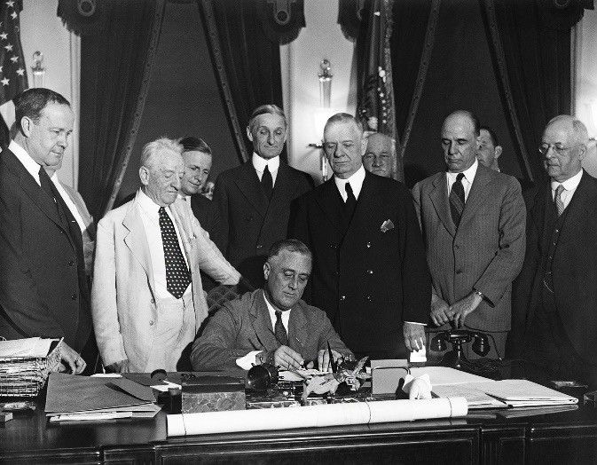

Glass-Steagall
Following the stock market crash in 1929, the US congress
enacted the Glass-Steagall Act in 1933.
One key provision bars commercial banks from underwriting
and dealing with securities, and investment banks from
taking deposits.
The Glass-Steagall Act restored public confidence in the US banking systems in the aftermath of the great depression.
In 1999, the law was repealed – commercial banks,
investment banks, and insurance companies are allowed to
consolidate.
Some argued it has contributed to the 2008 financial crisis.

Slide 37


Dodd–Frank
In 2010, the Dodd-Frank Wall Street Reform and Consumer Protection Act was signed into law as a response to the 2008 financial crisis.
Key provisions:
  Restricting banks from proprietary trading, derivates, and private equity businesses.
  Financial Stability Oversight Council
  Regulating credit rating agencies (e.g., S&P, Moody’s)
  Consumer Financial Protection Bureau (CFPB) protects consumers from predatory lending in mortgages, credit cards, etc.
In 2018, the Dodd-Frank Act was partially repealed.

Slide 38












Regulatory agencies
US
  Securities and Exchange Commission (SEC)
  Commodity Futures Trading Commission (CFTC)
  Federal Reserve System ("Fed")
  Federal Deposit Insurance Corporation (FDIC)
  Office of the Comptroller of the Currency (OCC)
  Consumer Financial Protection Bureau (CFPB)
China
  China Banking Regulatory Commission (CBRC)
  China Securities Regulatory Commission (CSRC)
  China Insurance Regulatory Commission (CIRC)
Hong Kong
  Hong Kong Monetary Authority (HKMA)
  Securities and Futures Commission (SFC)
  Mandatory Provident Fund Schemes Authority (MPFA)
  Insurance Authority (IA)

Slide 39
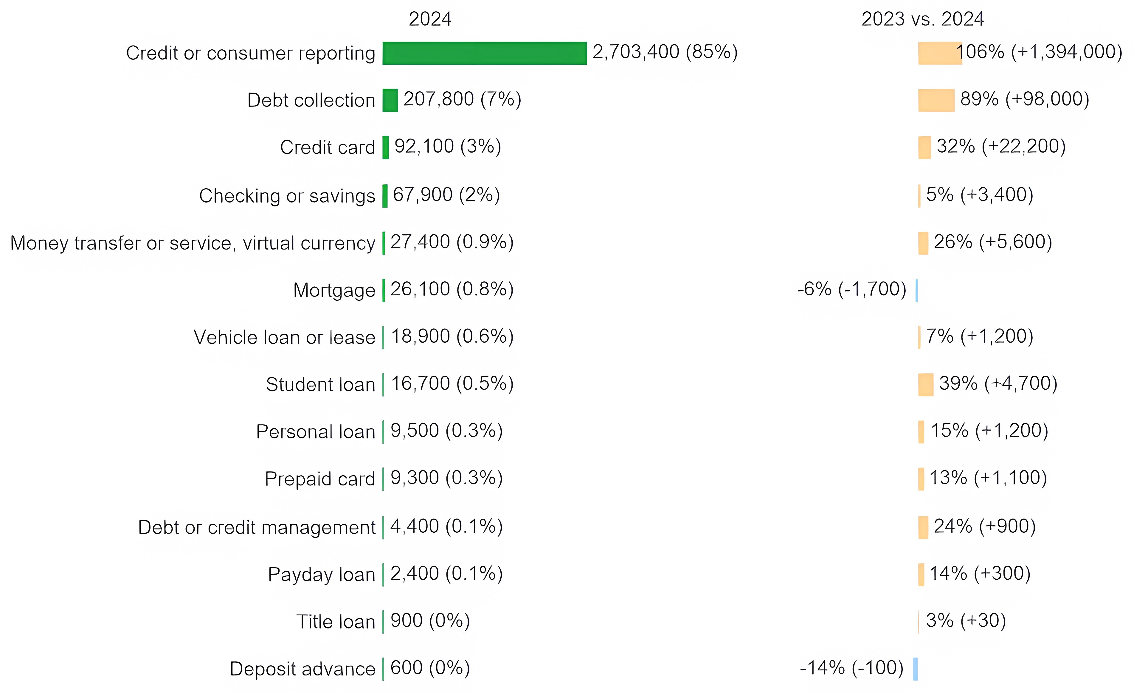
Compliance Risk
Complaint volume by financial product or service
https://www.consumerfina nce.gov/data-research/research-reports/2024-consumer-response-annual-report/

Slide 40
Regulatory responses to the 2008 financial crises
In the wake of the 2008 financial crises, governments across the world have started a wave of financial regulatory changes.
The number of regulatory changes per year has been steadily increasing
  A typical financial services organization deals with an average of 217 - at times conflicting - regulatory developments on a daily basis (Thomas Reuters).
US financial institutions that operate in foreign countries will also be supervised by regulators in those jurisdictions
Industry bodies may also regulate and supervise banks’ activities, i.e. Visa and Mastercard

Slide 41
Examples of laws and regulatory guidance
Name | Type / Enforcer
Americans with Disabilities Act (ADA) | Federal law/Department of Justice
Bank Secrecy Act (BSA) | Federal law/OCC
CAN-SPAM Act | Federal law/Federal Trade Commission
Credit Card Accountability Responsibility and Disclosure (CARD) Act | Federal law/CFPB
Equal Credit Opportunity Act (ECOA) | Federal law/multiple agencies
Fair Credit Reporting Act (FCRA) | Federal law/CFPB
Fair Debt Collection Practices Act (FDCPA) | Federal law/CFPB

Slide 42
Examples of laws and regulatory guidance
Name | Type / Enforcer
Gramm-Leach-Bliley Act (GLBA) | Federal law/Federal Trade Commission
Massachusetts Debt Collection Regulations, 940 CMR 7.00 | State law/Massachusetts Attorney General
Payment Card Industry Data Security Standard (PCI DSS) | Proprietary standard/card associations (e.g., Visa)
Servicemembers Civil Relief Act (SCRA) | Federal law
Telephone Consumer Protection Act (TCPA) | Federal law
Unfair, Deceptive, or Abusive Acts and Practices (UDAAP) | Federal law/CFPB and Federal Trade Commission

Slide 43
Compliance Risk: Vendor Management
Banks rely on third-party service providers to execute business processes and implement IT systems
From a regulatory perspective, third parties need to be factored into banks’ risk planning and must be effectively managed
Vendor management programs define roles, responsibilities, procedures, and reporting mechanisms for overseeing and managing the vendor relationship
Banks face the challenge of having limited visibility into their vendors’ technology operations and infrastructure

Slide 44
Compliance Risk: Regulation of Payments in USA
A wide range of laws and regulatory guidance apply to payments, examples:
  Processing of checks: Uniform Commercial Code (UCC) and Expedited Funds Availability Act (EFAA),
  Credit card payments: CARD act and PCI DSS
  Automated clearing house (ACH) payments: NACHA operating rules, UCC, Regulation E, and Code of Federal Regulations
  All payments must comply with the Bank Secrecy Act
Anti-money laundering (AML) compliance is a major area of concern for banks

Slide 45
Compliance Risk: Trade Reporting
Implemented after the financial crisis to provide visibility into risks presented by use of OTC derivatives
Details of OTC derivatives trades must be reported to sanctioned trade repositories
Each national jurisdiction has different requirements as to
  What asset classes need to be reported
  Which trade details needs to be reported
  The timeliness of reporting required
  Which market participants need to report

Slide 46
Regulatory Technologies

Slide 47
Regulatory technologies
Regulatory technology (RegTech) uses IT to enhance regulatory processes.
Strictly speaking, RegTech is not a subset of FinTech, as RegTech is applicable to non-financial institutions as well (e.g., healthcare industries).
RegTech is still at an early stage of development and adoption.

Slide 48
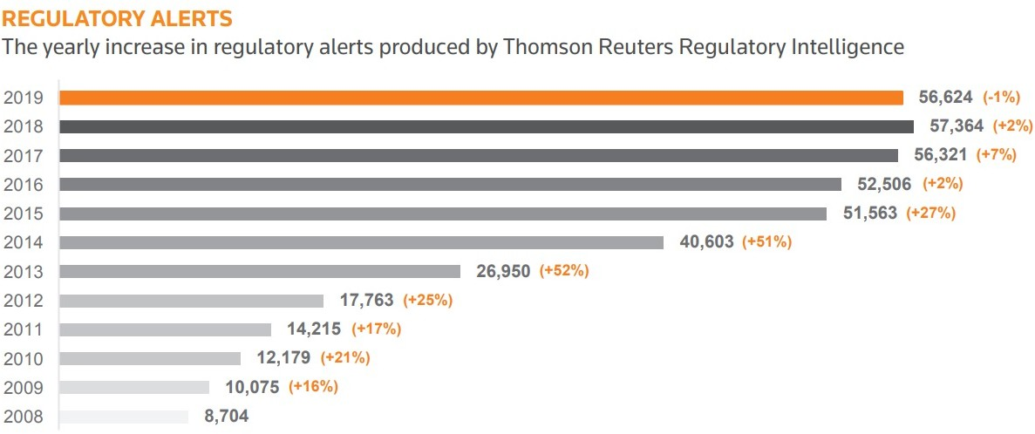
Number of regulatory alerts

Slide 49
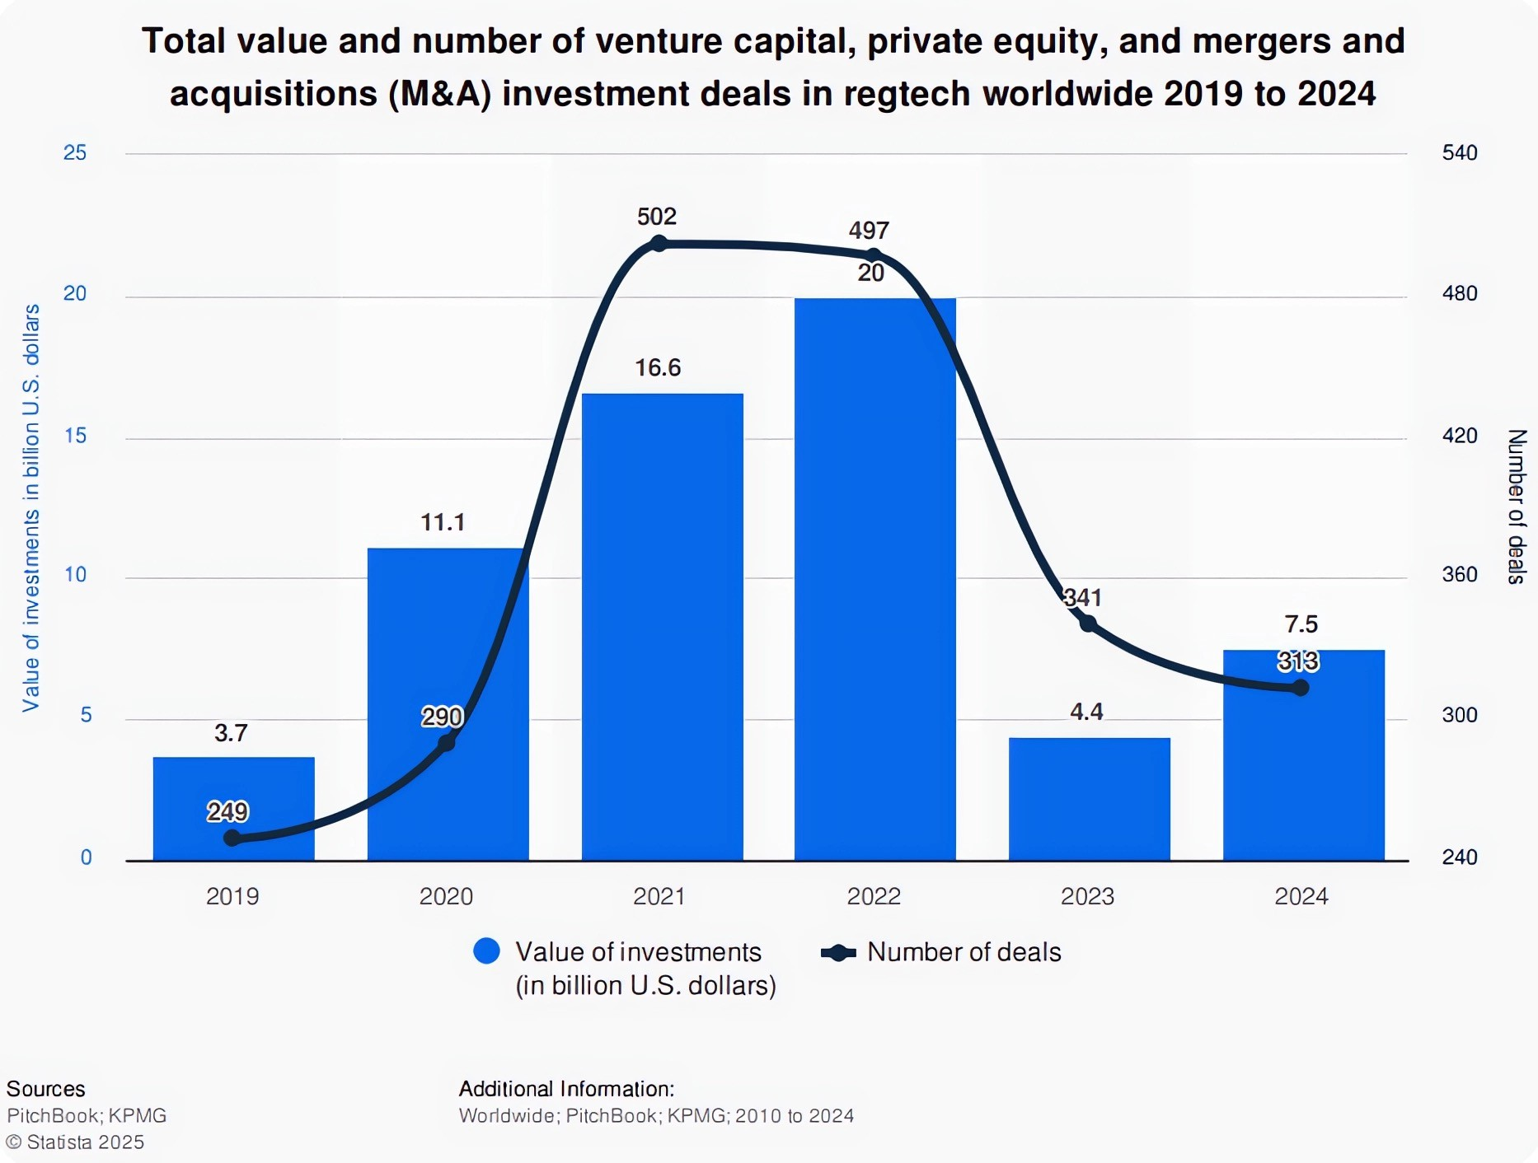

Investments in RegTech
https://www.statista.com/statistics/1313125/global-investment-activity-in-regtech/
https://www.statista.com/statistics/1226494/fintech-companies-deals-emea/

Slide 50
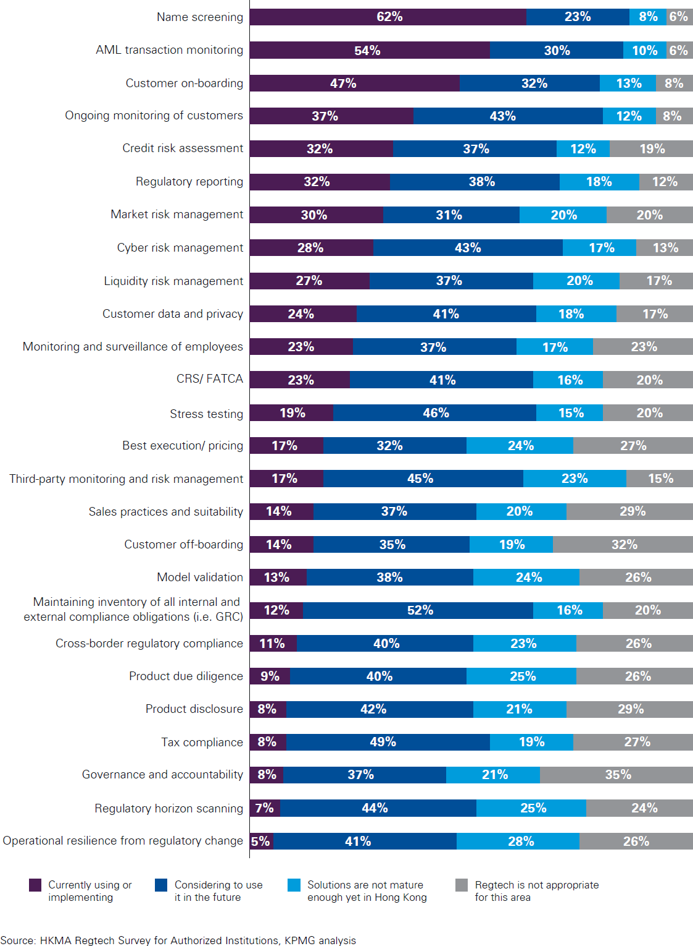

Slide 51
Main RegTech services
Client identification
  E.g., Know-Your-Customer (KYC), Due Diligence
Monitoring
  E.g., Anti-Money Laundering (AML), Combatting the Financing of Terrorism (CFT)
Reporting
  Organizations are compelled to submit data to exchanges and regulatory authorities.

Slide 52
Technologies in RegTech
AI, maching learning
Distributed Ledger Technology (DLT)
Biometrics
Cloud computing
Application programming interface (API)
Robotic process automation (RPA)

Slide 53
Takeaways
Market risk management is a tradeoff between risks and returns.
Operational and compliance risks are managed through the design of processes and business practices
IT can be used to implement mitigating controls and monitor operations and compliance
Technology can also be a source of operational and compliance risk

Slide 54
Case 6: RegTech at HSBC
Should Mark Cooke expand the use of RegTech solutions to HSBC’s control systems? Yes—but in a phased and controlled manner, not a full immediate rollout.
The pilot showed that RegTech can generate leading indicators of operational risk by revealing breakdowns in communication and collaboration across the Three Lines of Defense (3LoD), something traditional metrics cannot do
. This directly addresses the board’s concern about whether HSBC’s massive compliance spending is delivering results.
However, the technology is unproven at scale, relies on a small startup, and raises employee trust concerns. Therefore, Cooke should expand RegTech through multi-region pilots and selective scaling, positioning it as a complement to—not a replacement for—existing controls.
What are the main risks HSBC faces? What control failures has HSBC faced in the past, and why?Main risks:Operational and compliance risk (money laundering, sanctions breaches, tax evasion)Reputational risk from repeated regulatory failuresCultural risk—weak risk ownership and siloed behaviorRegulatory risk, including fines, DPAs, and oversight by monitorsPast control failures:HSBC experienced repeated failures in AML, sanctions compliance, and client due diligence, culminating in a $1.9 billion fine and a Deferred Prosecution Agreement with U.S. authorities Underlying causes:Rapid global expansion with insufficient centralized oversightFragmented communication across geographies and functionsWeak risk culture and unclear accountabilityOverreliance on manual, backward-looking controlsOutsourcing and operational distance reducing risk awareness
How does the 3LoD model work? What are its strengths and weaknesses?
How it works:First Line: Business units own and manage riskSecond Line: Risk and compliance functions set policy and provide oversightThird Line: Internal audit independently assesses effectiveness Strengths:Clear allocation of responsibilityEncourages risk ownership
Widely accepted by regulators as best practice Weaknesses:Heavy reliance on human behavior and cultureConflicts between revenue goals and risk responsibilities in the first lineTension between first and second linesLimited real-time visibility into whether collaboration is actually happeningEffectiveness measured indirectly and retrospectively
What are the strengths and weaknesses of the RegTech solution?Strengths:Provides forward-looking signals of risk
Quantifies cultural and behavioral dimensions of 3LoDHard to game due to continuous data collectionScales better than manual audits Helps identify areas needing support before failures occur Weaknesses:
Startup vendor risk (financial stability, scalability)Not a plug-and-play product—requires close calibrationPrivacy and employee surveillance concernsRisk of false positives or misinterpretation Uncertain regulatory and legal perceptions across jurisdictions
5. If Cooke rolls out RegTech globally, what should he do?
Key recommendations:Phased deploymenStart with high-risk regions and functions before global rollout.Clear governance and purposeExplicitly frame RegTech as a risk support and cultural tool, not employee surveillance.Transparency with employeesCommunicate clearly that only metadata—not content—is analyzed, and explain benefits.Integrate, don’t replaceEmbed RegTech insights into existing RCAs, audits, and management reporting.Vendor risk mitigationSecure IP rights, contingency plans, and possibly co-development arrangements.Board-level metricsTranslate RegTech outputs into understandable indicators tied to 3LoD effectiveness.
54

Slide 55
Case study objectives
Understand the operational risks that banks face and the traditional control systems they employ to mitigate these risks. In particular, understand the three lines of defence (3LoD) model in banks.
Understand the role of trust and communications between employees in enhancing internal controls, compliance, and culture.
Understand and assess the merits of emerging technologies in improving internal control systems and curtailing operational risk.

Slide 56
Overarching question
To what extent should HSBC adopt the RegTech?
HSBC should adopt RegTech incrementally but strategically, rather than through an immediate full-scale rollout.
Based on the case, the technology shows strong potential value: the pilot demonstrated that analyzing communication metadata can reveal meaningful patterns linked to operational risk, outsourcing gaps, and weaknesses in the Three Lines of Defense (3LoD) model. Importantly, RegTech offers something HSBC currently lacks—a forward-looking, data-driven indicator of risk culture and 3LoD effectiveness, rather than relying only on backward-looking metrics like losses or audit findings
However, HSBC should not adopt it wholesale at this stage for several reasons. First, the RegTech solution is unproven at scale: the pilot covered only one unit in one country, and HSBC’s operations span 70 countries with major cultural, regulatory, and operational differences. Second, the provider is a small startup with limited financial resilience, which creates vendor and continuity risk for a system that could become critical to risk management. Third, there are significant employee trust and privacy concerns, as large-scale monitoring—even of metadata—may be perceived as surveillance and could undermine the very risk culture HSBC is trying to strengthen
Therefore, the appropriate extent of adoption is a phased expansion:
Extend pilots to multiple regions and business lines to test robustness and generalizability.
Use RegTech as a complement, not a replacement, to existing governance, training, and human judgment in 3LoD.
Gradually formalize metrics from RegTech to support board-level assurance, while maintaining transparency with employees about purpose and limits.
In short, HSBC should adopt RegTech as an experimental but strategic layer on top of its existing risk framework, scaling only once effectiveness, trust, and organizational fit are clearly established. This balances innovation with the bank’s regulatory obligations, cultural challenges, and systemic risk exposure.

Slide 57
Main questions
往前看
1. Should Mark Cooke expand the use of RegTech solutions to HSBC’s
control systems?
2.
What are the main risks that HSBC faces? What are the control failures HSBC has faced in the past, and what factors gave rise to them?
3. How does the 3LoD model work? What are its strengths and
weaknesses?
4. What are the strengths and weaknesses of the RegTech solution?
5.
If Cooke decides to roll out RegTech across all HSBC branches, what are your recommendations to him on how to implement this strategy?

Slide 58
Roll out RegTech?
Arguments FOR rolling out RegTech
1. Provides forward-looking risk signals
For
Traditional controls are backward-looking (losses, audits, fines). RegTech uses communication patterns to detect early warning signs of breakdowns in the Three Lines of Defense (3LoD), allowing intervention before a risk event occurs.2.
Makes risk culture measurable
HSBC’s biggest weakness has been culture and behavior. RegTech directly addresses this by revealing whether risk owners, stewards, and control functions are actually collaborating, rather than just following formal processes.3.
Improves efficiency and scalability
HSBC spends billions annually on compliance. RegTech can scale across the organization at lower marginal cost than hiring more staff or expanding audits, improving cost efficiency.4. Hard to game
Because the system analyzes large volumes of continuous metadata, it is difficult for employees to manipulate behavior artificially over time.5. Competitive and regulatory advantage
Effective compliance has become a competitive factor. Stronger, data-driven controls reduce fines, regulatory scrutiny, and capital drag.
Arguments AGAINST rolling out RegTech1. Technology and vendor risk
The RegTech provider is a small startup with limited financial stability. Relying on it for a core control system creates operational and continuity risk.2. Limited proof at scale
The pilot covered only one unit in one country. HSBC operates in 70 countries with diverse cultures and regulations, making results uncertain when scaled globally.3. Employee trust and privacy concerns
Even metadata monitoring may be perceived as surveillance, potentially undermining trust and risk culture, the very thing RegTech aims to improve.4. Risk of false signals and misinterpretation
Correlation does not equal causation. Communication patterns may reflect workload or cultural differences rather than true risk, leading to false positives or managerial overreaction.5. Organizational resistance
HSBC is a conservative, bureaucratic organization. Adoption may face internal resistance from managers who prefer traditional, well-understood controls.
Against

Slide 59
Risks at HSBC
Financial Risks at HSBC
Regulatory fines and penalties
HSBC has paid over US$5 billion in fines related to AML failures, sanctions violations, and misconduct. These directly reduce profitability and shareholder value
Capital and profitability pressure
Stricter post-crisis regulations require HSBC to hold more regulatory capital. Capital tied up for compliance cannot be used for lending or growth, lowering return on equity
Revenue pressure from macro conditions
Low interest rates and increased competition from fintechs compress net interest margins and fee income, weakening financial performance.
Litigation and contingent liabilities
Deferred Prosecution Agreements (DPAs) and ongoing regulatory scrutiny expose HSBC to future legal and financial liabilities if compliance failures recur.
Operational Risks at HSBC
Compliance and AML failures
HSBC historically failed to prevent money laundering, sanctions breaches, and tax evasion, revealing weaknesses in controls, monitoring, and due diligence processes
Weak risk culture
Financial risks
Operational risks
Risk ownership was inconsistent across geographies. Employees often prioritized business goals over compliance, leading to control breakdowns.
Complex global operations
Operating in 70+ countries with diverse cultures, regulations, and outsourced functions reduced transparency and coordination, increasing operational risk.
Ineffective communication across the Three Lines of Defense (3LoD)
Poor collaboration between business units (first line), risk functions (second line), and internal audit (third line) weakened early detection of risks.
Overreliance on manual and backward-looking controls
Traditional audits and loss metrics detect problems after damage occurs, limiting HSBC’s ability to prevent emerging risks.
Outsourcing and operational distance
Shifting activities to lower-cost or external providers reduced engagement and o5v9ersight, increasing the likelihood of risk events.

Slide 60
Control failures at HSBC
What are the types of control failures that HSBC has been subject to?
Compliance and AML control failures
HSBC failed to maintain effective anti–money laundering (AML) and sanctions screening controls. This allowed money laundering by drug cartels, dealings with sanctioned countries, and weak customer due diligence, leading to major regulatory actions and fines (including the U.S. Deferred Prosecution Agreement)
Weak monitoring and detection controls
HSBC relied heavily on backward-looking, manual controls (audits, loss reports, RCAs), which detected problems only after violations occurred. There were insufficient early-warning mechanisms to identify emerging risks before they escalated
Governance and oversight failuresThere were breakdowns in oversight across the Three Lines of Defense (3LoD):First line prioritized business growth over complianceSecond line struggled to effectively challenge the businessThird line audits were resource-intensive and slowThis resulted in gaps, overlaps, and unclear accountability
Cultural and behavioral control failures
HSBC suffered from a weak risk culture, including poor risk ownership, insufficient “speaking up,” and limited curiosity about end-to-end risks. Regulators explicitly criticized HSBC’s culture as deficient, showing that formal controls existed but were not effectively embedded in behavior
Outsourcing and operational distance failures
As HSBC outsourced and globalized operations, control effectiveness weakened due to reduced engagement and communication between risk managers and operational teams, increasing the likelihood of unnoticed control breakdowns

Slide 61
Control failures at HSBC
What factors at HSBC do you think gave rise to these failures?
Pressure
Rationalization
Pressure
HSBC faced strong growth, profitability, and cost pressures in a low-interest, highly regulated environment. Front-line employees were expected to meet business targets while also managing complex compliance requirements, creating incentives to prioritize performance over controls.
Rationalization
The bank’s size and complexity allowed employees to rationalize weak compliance as “industry practice,” a local issue, or someone else’s responsibility. The distance from senior management and consequences reduced personal accountability for risk failures.
Opportunity
Gaps in coordination across the Three Lines of Defense, reliance on manual and backward-looking controls, and extensive outsourcing weakened oversight. These structural weaknesses created opportunities for control breakdowns to persist undetected.
Opportunity

Slide 62
The 3LoD Model
First Line of Defence
The business units that own and manage risk in their day-to-day activities. They are responsible for identifying risks, implementing controls, and operating within the bank’s risk appetite while pursuing business objectives.
Second Line of Defence
The risk management and compliance functions. They set policies and standards, provide guidance, monitor risk, and challenge the first line to ensure risks are properly managed, but they do not own the risks themselves.
First line of defence?
Third Line of Defence
Internal audit, which provides independent assurance to senior management and the board. It evaluates whether the first and second lines are functioning effectively and whether the overall risk management framework is working as intended.
Second line of defence?
Third line of defence?

Slide 63
The 3LoD Model
Does the 3LoD model effectively address the factors that gave rise to the control failures at HSBC?
Short answer: Partially—but not fully.
The 3LoD model addresses some root causes of HSBC’s control failures, but on its own it does not eliminate pressure, rationalization, or opportunity unless culture and execution are strong.
Does 3LoD address the failure factors? Pressure — Partially addressed
3LoD clarifies accountability and embeds risk ownership in the first line, which should counter business pressure.
However, first-line staff still face conflicting incentives (revenue vs. compliance), so pressure is reduced in theory but remains strong in practice.
Rationalization — Weakly addressed
3LoD defines roles and responsibilities, reducing ambiguity.
But it does not directly change mindset or culture. Employees can still rationalize non-compliance as “someone else’s problem,” especially in a large, complex organization like HSBC.
Opportunity — Better addressed, but imperfectly
Separation of duties and independent oversight reduce opportunities for control failures.
Yet HSBC’s experience shows that poor coordination, siloed communication, outsourcing, and backward-looking controls left gaps where failures persisted undetected.

Slide 64
RegTech solutions
RegTech Solutions
Pros
Pros
Provide forward-looking, early-warning signals of risk rather than backward-looking audits
Improve efficiency and scalability compared to manual compliance processes Help make risk culture and behavior observable through data
Cons
Reduce reliance on adding compliance staff, lowering long-term costs
Harder to manipulate due to continuous, large-scale data analysis
Cons
Unproven at scale, especially across countries with different cultures and regulations Vendor risk, as many RegTech firms are small startups
Privacy and employee trust concerns, even when only metadata is analyzed Risk of false positives or misinterpretation of data
Requires significant change management and organizational buy-in
64

Slide 65
Decision and implementation
Any recommendations to Cooke?
Decision:
Cooke should proceed with a phased rollout of RegTech, not a full immediate implementation.
Implementation recommendations:
Expand pilots gradually across multiple regions and business lines to test scalability and cultural differences.
Position RegTech as a support tool, not employee surveillance; communicate clearly that it analyzes metadata, not content.
Integrate RegTech with existing 3LoD processes, using insights to enhance RCAs, audits, and management reporting rather than replacing them.
Strengthen governance and oversight, with clear ownership of RegTech outputs and escalation procedures. Mitigate vendor risk through strong contracts, contingency plans, and possible co-development or IP safeguards.
Engage the board early, translating RegTech outputs into clear metrics that demonstrate control effectiveness and ROI.

Slide 66
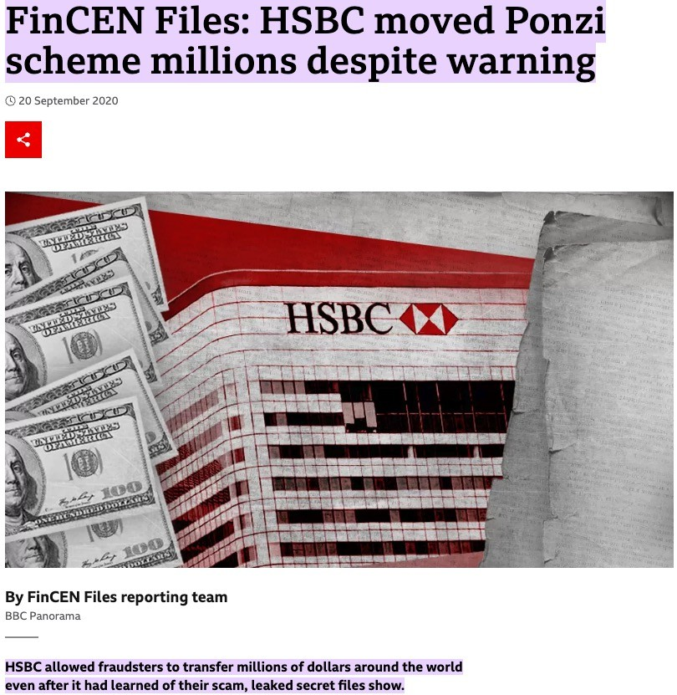
Update
HSBC decided to continue working with the RegTech provider.
New trouble.

Slide 67
Case takeaways
Understand the various type of risks at HSBC, especially operational risk.
The 3LoD model.
The merits and limitations of emerging technologies in compliance.

Slide 68
Afterword
Financial institutions are in the business of taking risks - risk management is crucial.
Compliance systems can be a strategic factor separating an organization from its competitors.
Compliance system is just one way of reducing operational risks. Other aspects include
  Ethics training
  Safe and interactive corporate culture
  Appropriate employee selection procedures

