Slide 1
9. Innovation
Qi Wang

Slide 2
Agenda
Innovation
  Strategies of innovation
  Regulations
Distributed ledger technology
  Cryptocurrency
Case 7: Deutsche Bank, Pursuing Blockchain Opportunities

Slide 3
Innovation

Slide 4
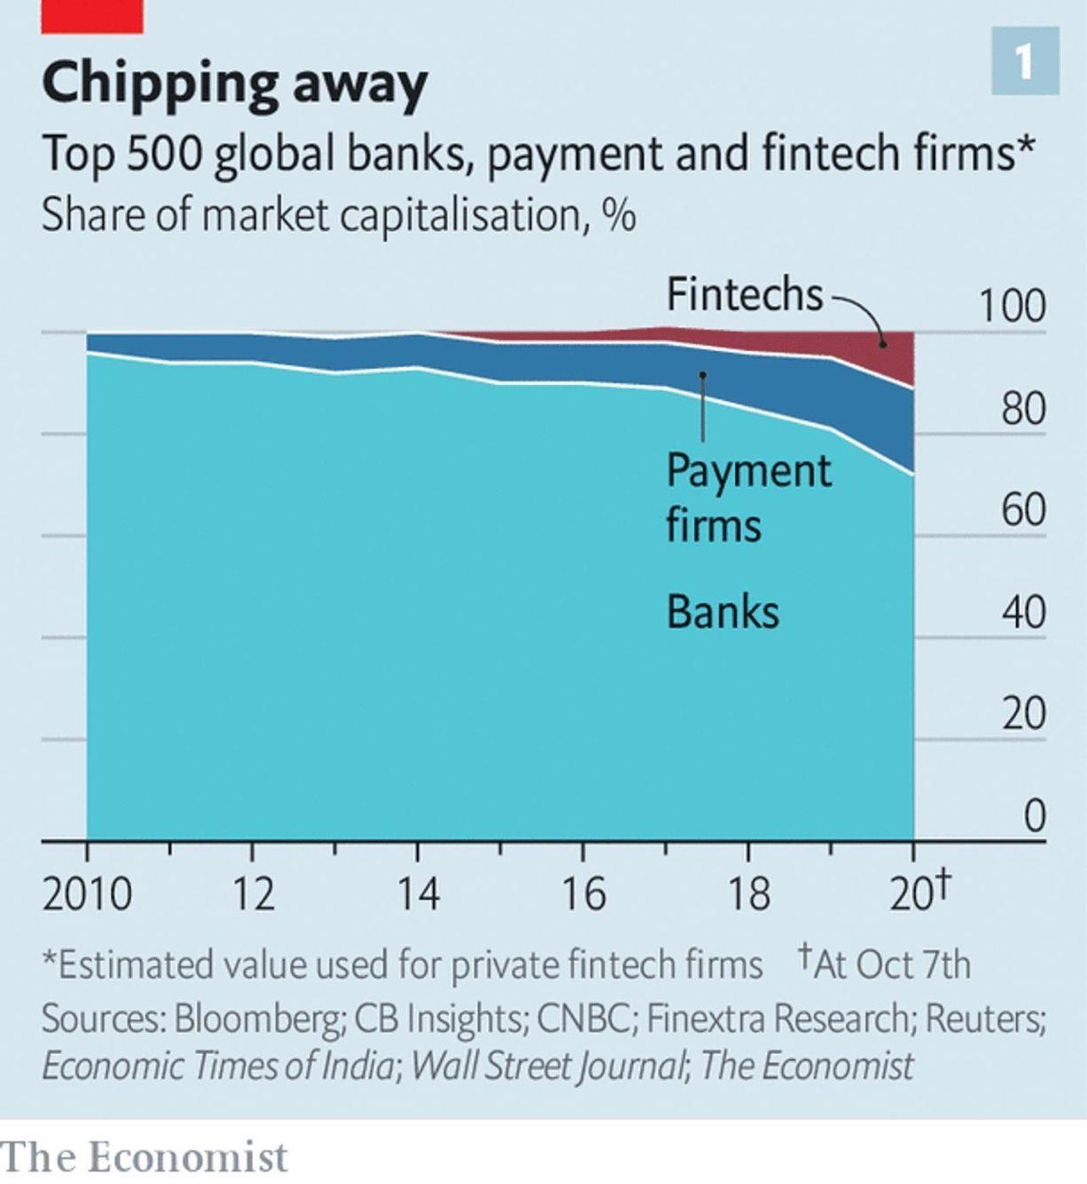
Innovation in finance

Slide 5
Innovation in finance
Financial institutions are under pressure to provide a wider range of products and services with higher quality and at lower costs.
FinTech competitors have used technology in ways that traditional financial institutions have been slow to take advantage of.
Financial institutions need to rethink how they deliver technology solutions and how their core businesses can be improved using technology .
Financial institutions need to innovate to maintain their position and to continue
growing.

Slide 6
Bank Innovation
Barriers for banks’ innovation
  Speed of delivery / time to market
  Scaling benefits to reach the mass market
  Attracting and keeping innovative thinkers
  Breaking away from standard operating models and performance assessment approaches
  Determining how to quantify the value delivered by innovation functions

Slide 7
FinTech Innovation
Fintech companies can outpace banks at innovation because
  FinTech firms have different operating models
  FinTech firms are unencumbered by some of the constraints that banks are bound by, e.g.
    Regulatory and audit requirements
    Ongoing operational issues
    Keeping in line with corporate technology standards
    Directives to increase efficiency and productivity

Slide 8
FinTech Innovation
Fintech companies are better matched to understand younger customer needs and preferences
Being smaller than banks, key decisions can be agreed quickly by just a few people
Technology transfer is often a core focus of banks’ innovation functions
Fintech firm’s strengths can complement banks’ weakness
Banks need to embrace Fintech to avoid being displaced by it

Slide 9
Trust in banks vs FinTech firms
100%
Source: Duran, R. E.,
Financial Services Technology,
Cengage Learning Asia, 2018
90%
80%
70%
60%
50%
40%
30%
20%
10%
0%
US
Australia
India
Brazil
Japan
Germany
Netherlands
Singapore
Trust with Primary Bank
Trust with Fintech Firms

Slide 10
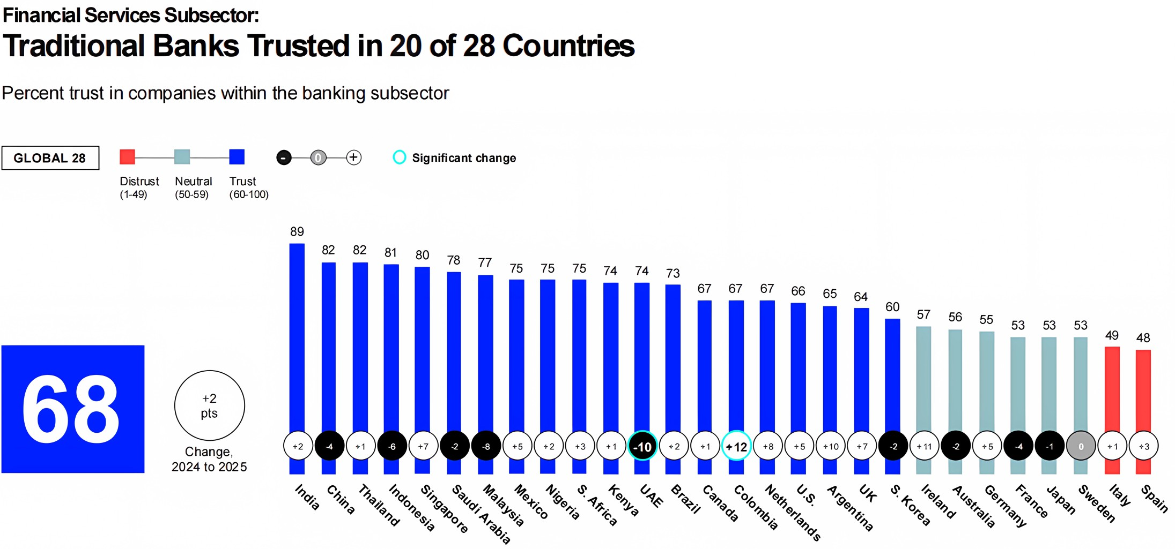
Trust in banks
https://www.edelmansmithfield.com/trust/2025/trus t-barometer/report-financial-sector

Slide 11
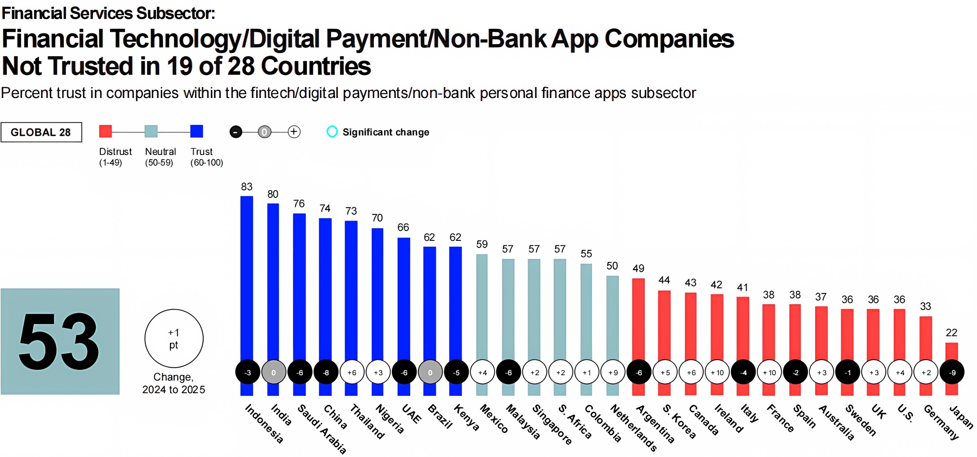
Trust in banks vs FinTech firms
https://www.edelmansmithfield.com/trust/2025/trus t-barometer/report-financial-sector

Slide 12
Innovation strategy
Innovation is a core principle of competitive strategy
Technology innovation supports the development of new products and services
Financial institutions’ innovation program needs to be aligned with their overall
technology strategy.
Financial institution’s innovation functions can be in-house or collaborate with Fintech companies.

Slide 13
In-house vs outsourced innovation
In-house R&D
Outsourcing innovation
  Collaboration with startups
  Acquisition
    Corporate venture capital (CVC)

Slide 14
Bank Innovation
Collaborate
46%
Invest
44%
Build Capabilities
43%
Acquire
18%
Do Nothing
4%
Source: Duran, R. E.,
Financial Services Technology, Cengage Learning Asia, 2018
0%
10%
20%
30%
40%
50%
60%

Slide 15
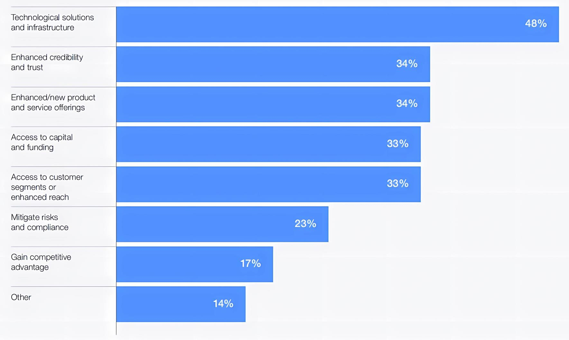
Motivation for collaboration
https://www.jbs.cam.ac.uk/faculty-research/centres/alternative-finance/publications/the-future-of-global-fintech-rapid-expansion-to-sustainable-growth/
15

Slide 16
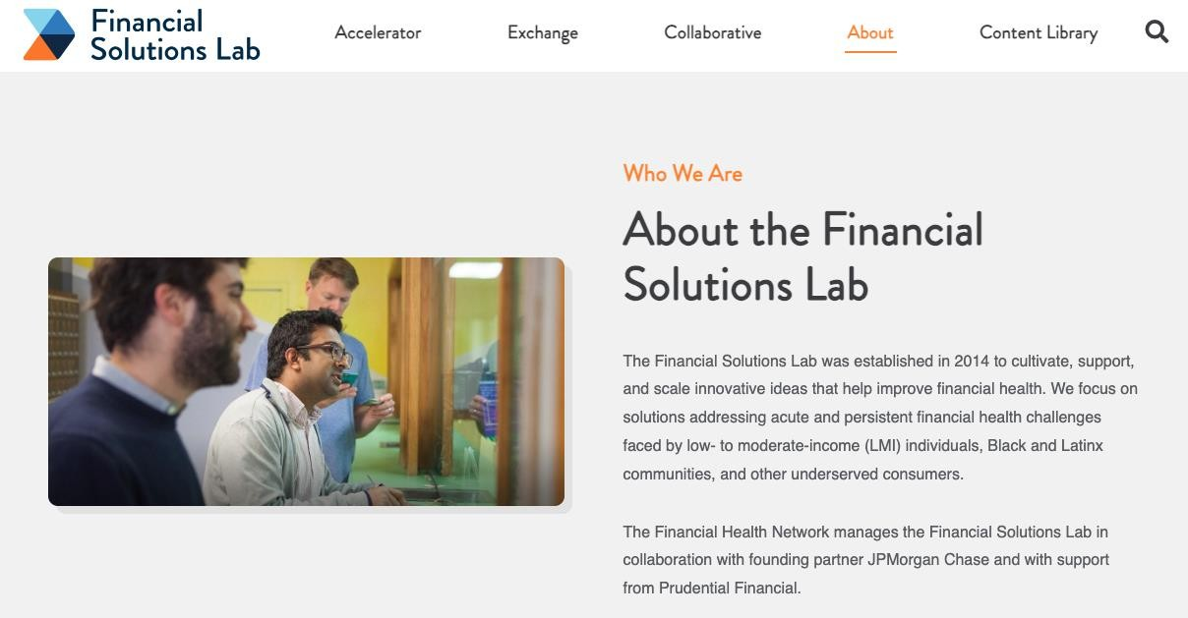
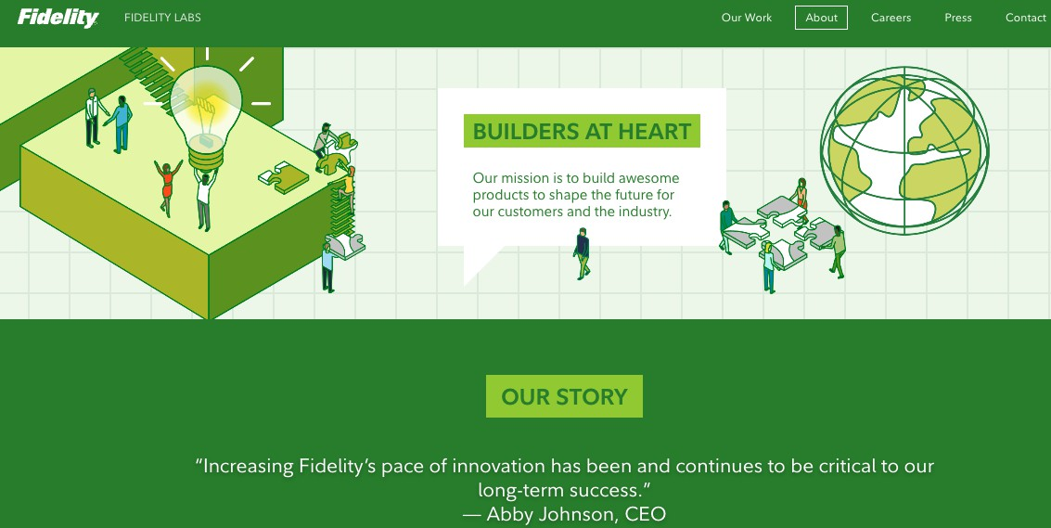
In-house innovations
Innovation labs

Slide 17
Outsourcing innovation: acquisition
Financial institutions can acquire innovations by acquiring another company (typically startups).
Corporate venture capital (CVC)
  Similar to VCs, but not by venture capitalist.
  Established corporations (non-VC firms) investing in startups, directly or
indirectly.

Slide 18


Outsourcing innovation: CVC
“Gaining a window on new technologies is a prominent motive for corporate venture capital (CVC) investing” (Benson and Ziedonis 2009).
“CVC entry concentrates in firms that experience deteriorations of internal innovation” (Ma 2020).
CVCs are terminated when the investing firms’ innovation recovers (Ma 2020).
Formerly: Citigroup Venture Capital Equity Partners

Slide 19
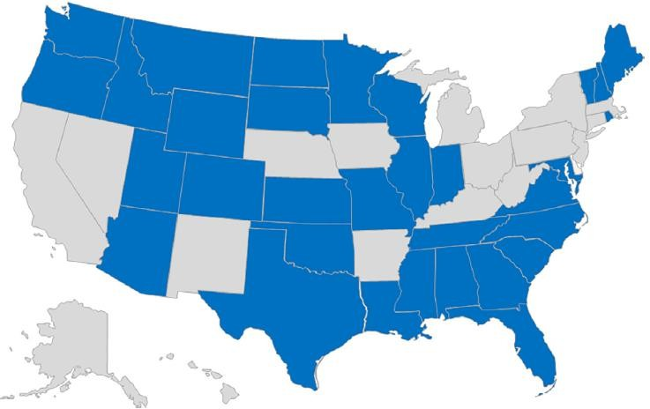
Anti patent troll law
Patent trolling are meritless legal claims of patent infringement.
  Typically filed by nonpracticing entities.
Anti-troll laws protect startups (Appel et
al. 2019).
  Increased access to financing: VC & patent-backed lending
  4.4% increase in employment at high-tech
startups.

Slide 20
Patent disclosure
American Inventor's Protection Act (AIPA)
  Accelerated the public disclosure of most patents in the U.S. by
two years.
AIPA facilitates technology diffusion (Hedge et al. 2019).
  AIPA increased patenting by 6.2% and increased firms’ R&D investment by up to 6%.

Slide 21
The value of innovation
Innovation is an intangible asset.
  Under the U.S. accounting rule, R&D is treated as an expense.
In house R&D leads to positive stock market reaction (Chan et al. 1990, Chan el al. 2002).
Outsourcing of R&D through acquisitions leads to positive stock market reaction (Higgins and Rodriguez 2006).

Slide 22
Distributed Ledgers Technology

Slide 23
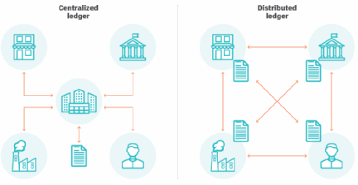
Distributed Leger Technology
Ledger: a permanent record of financial transactions
Traditionally, financial transactions rely on
centralized ledgers maintained by central counterparty.
Distributed ledger: keeps track of ownership
and transaction flows between participants
and is not managed and maintained by a central authority
  Maintained by multiple parties that perform the
recordkeeping and updating activities on
copies of the ledger in parallel
  A type of distributed database

Slide 24
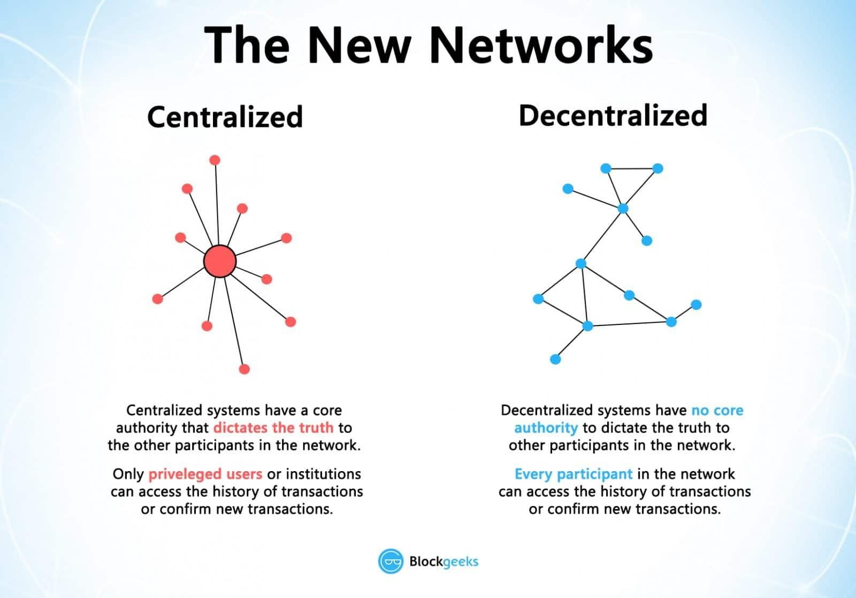

Slide 25
Distributed Leger Technology
In some applications, distributed ledgers enable users to demonstrate ownership of virtual assets
Typically, data structure and management process provides a permanent record that is immutable, transparent, and secure
Cryptography is commonly used to secure the information stored and authenticate the parties involved in the transactions
A distributed ledger is a chain of validated transaction records that grows with
each new set of transactions that is added to it

Slide 26
Distributed Leger Technology
Special Characteristics
  Decentralized – there is no “owner” of the blockchain and there
is no single point of failure
  Trust – is in the design of the system, not a central authority
  Immutability – ensures that verified transactions are final and irrevocable
  Fully automated – eliminates the potential of human error and eliminates discretionary decisions in transaction processing

Slide 27
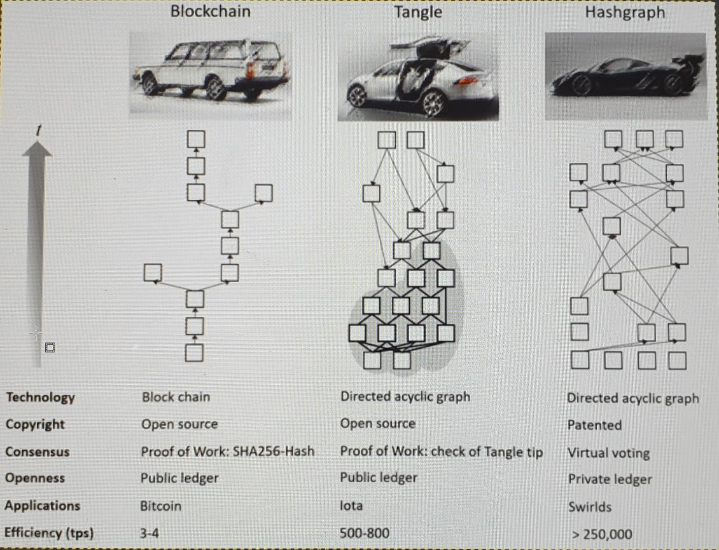
Blockchain
Blockchain is a type of DLT - an example of a new potential area for innovation
The key is to find ways to use it to create new and unique solutions
Much of the activity is driven by
  Fear of missing out
  Concerns that blockchain could quickly transform the existing business model for banks (like Uber did to the taxi industry)

Slide 28
Blockchain: structure and mechanics
Key components
  A network protocol that supports communication between participants
  A network of computers that store and manage transaction data
  A process for managing records that is based on achieving consensus between participants
Records are maintained on many different computers, “nodes”, within the network
Nodes coordinate with one another to maintain the consistency of the distributed ledger
Permissionless blockchain implementations allow open access to the distributed ledger
Permissioned blockchain implementations limit who can participate in the network

Slide 29
Blockchain: structure and mechanics
Initiator of the transaction distributes the transaction request to nodes on the network
Nodes validate the transaction’s digital signature and review previous transactions that have been
recorded by the blockchain to verify that the address transferring the funds actually owns them
The transaction is grouped with other verified transactions into a “block” that is proposed as an update to the distributed ledger
Miner nodes will perform computationally intensive verification of the block
When miner nodes reach a consensus that the transaction information is valid, the transaction is approved for inclusion in the ledger
The block is then distributed to all the nodes in the network for inclusion in their copy of the ledger

Slide 30
Blockchain: structure and mechanics
Nodes that contribute computing resources to validate transactions are rewarded with a small amount of its underlying digital currency
The consensus mechanism help prevent fraudulent activity by bad actors entering false information into the blockchain
Two consensus mechanisms used are
Proof-of-work: requires miners to solve computationally difficult problems to
“win” blocks
Proof-of-stake: participants must prove how much of the digital currency they
own.
Cryptographic hash functions are used to prevent tampering with transaction details

Slide 31
What is blockchain?
Blockchain is a and
ledger that tracks transactions among accounts.
  Anybody can obtain accounts
  Anybody can
  Transfers are and irreversible
No
central authority
to mediate disputes

Slide 32
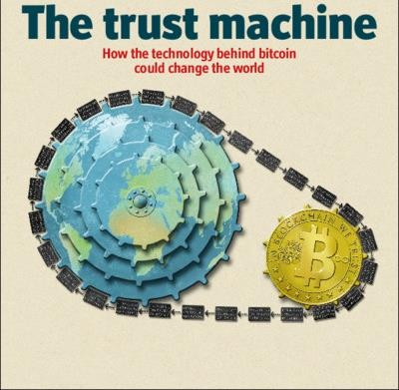
The Future of Trust?
Interesting readings:
https://www.coindesk.com/blockchain-rise-networked-trust
https://www.forbes.com/sites/jimblasingame/2019/07/18/blockchain-isnt-the-end-of-trust-its-the-future-of-trust/?sh=2de8bdf11596
32

Slide 33
Smart contracts
Smart Contracts is an offshoot of blockchain technology
  Computer programs that can execute the terms of an
agreement between users of the blockchain network
  Typically, the value to be transferred is held in escrow and delivered when specified conditions are met
  Transfers are automated
  Benefits: faster, lower cost, reduced risk of errors
  Ethereum

Slide 34
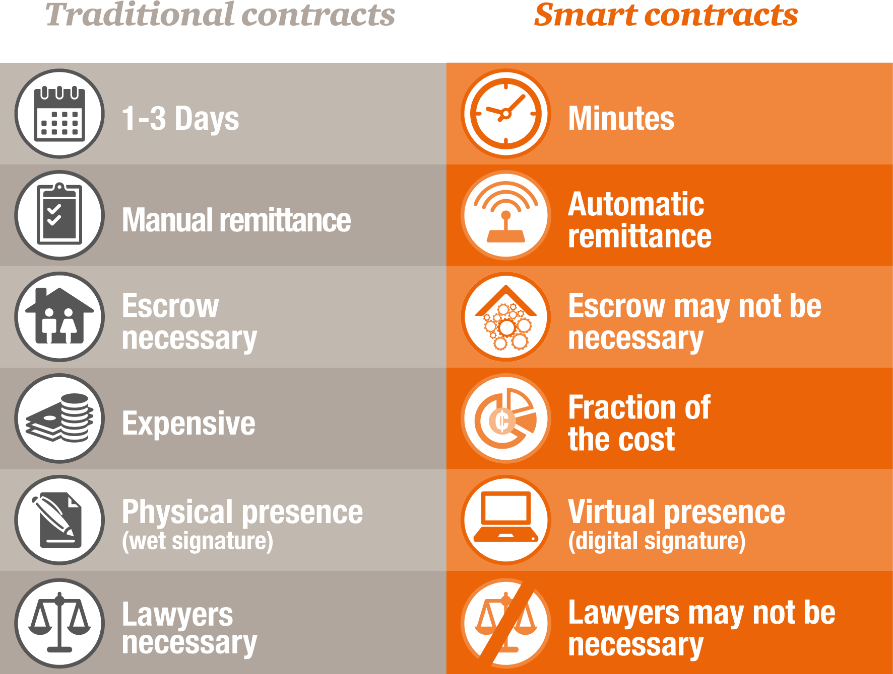

Slide 35
DLT Applications
DLT is a good fit for
  Multiple writers of information to a shared repository
  Eliminating the need for intermediaries in a transaction process
  Geographically distributed participants
Important to consider the context of problem and business process that
must be supported
Nontechnical implementation requirements that could be hinderances also need to be considered
  The need to replace infrastructure
  Significant changes to existing processes
  Alterations to legal or regulatory frameworks

Slide 36
Distributed Leger Technology
Application examples
  Digital currencies
  Payments
  Trade finance
  Property title registry
  Syndicated loans
  Settlement of securities

Slide 37
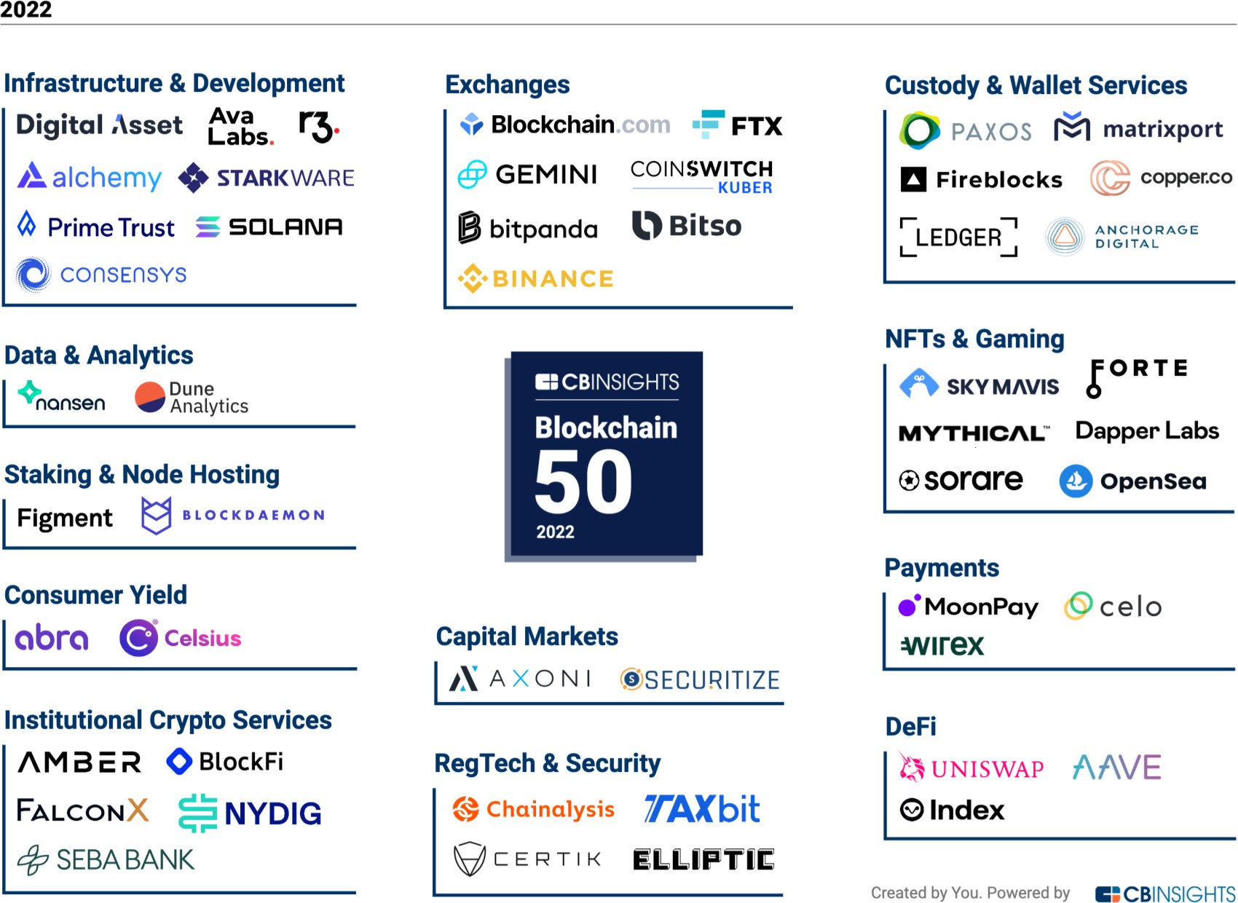
https://www.cbinsights.com/research/report/blockchain-technology-companies/

Slide 38
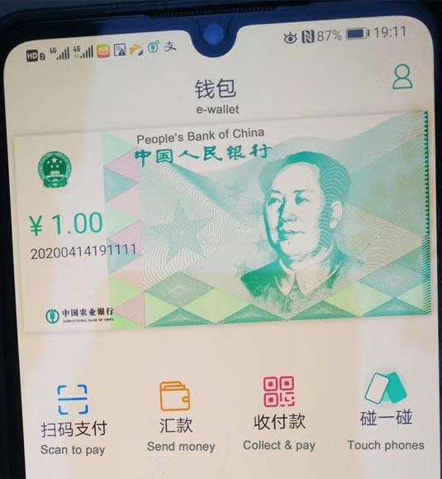
Mini Case
Central bank vs Commercial bank
What’s new about Central Bank Digital Currency (CBDC)?
References:
https://consensys.net/solutions/payments-and-money/cbdc/
https://en.wikipedia.org/wiki/Central_bank_digital_currency
https://thefintechtimes.com/how-suzhou-is-taking-steps-to-become-chinas-leading-blockchain-district/

Slide 39
Challenges of DLT
Competing standards
  Unclear which platforms will be viable and supported in the long run
Regulatory and legal uncertainty
  Particularly a concern for heavily regulated entities, i.e. banks

Slide 40
Prospects of DLT
Proprietary blockchain infrastructure can provide improved features in the areas of
  Privacy
  Performance
  Scalability
  Governance
The large investment in blockchain technology will produce some winners
To be seen which will be the “killer apps”

Slide 41
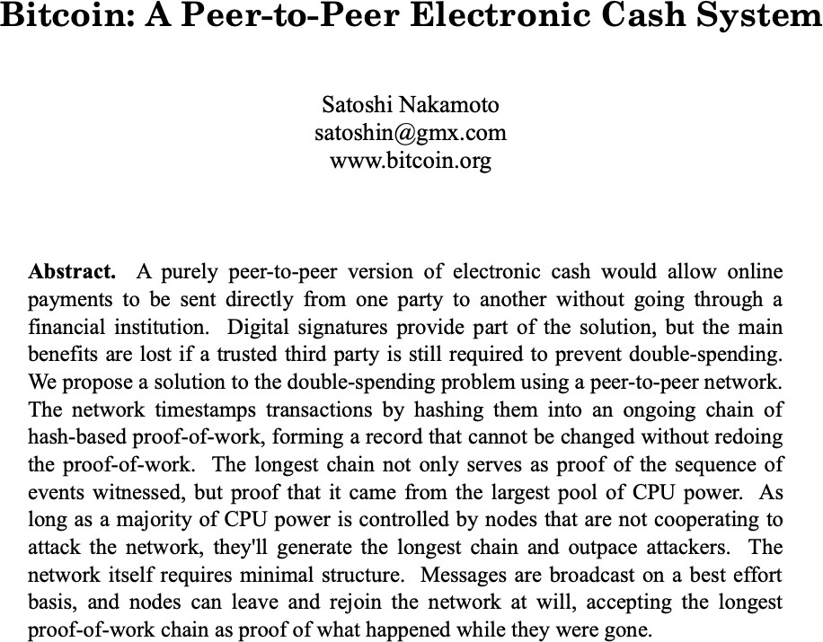
Bitcoin creation
Oct 31, 2008

Slide 42
Bitcoin
Who
  Satoshi Nakamoto (but a pseudonym)
What:
  No official definition but commonly known as a
decentralized digital currency
How?
  A data structure in the form of a chain of blocks that enables direct payment transfer between peer users without intermediaries.
Bitcoin blockchain demo
  https://andersbrownworth.com/blockchain/

Slide 43
Bitcoin VS Blockchain
Bitcoin is not built on protocols that (mostly) allow it to do anything more than be a cryptocurrency.
Projects like Ethereum and Hyperledger are working to collaboratively build an open- source, cross-industry blockchain platform for use beyond cryptocurrency, where you can program on top of blockchain to build businesses and create smart contracts.

Slide 44
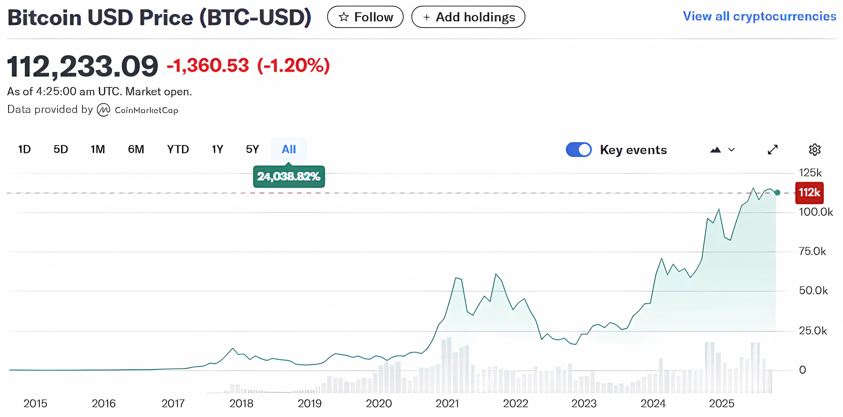
https://sg.finance.yahoo.com/quote/BTC-USD/

Slide 45
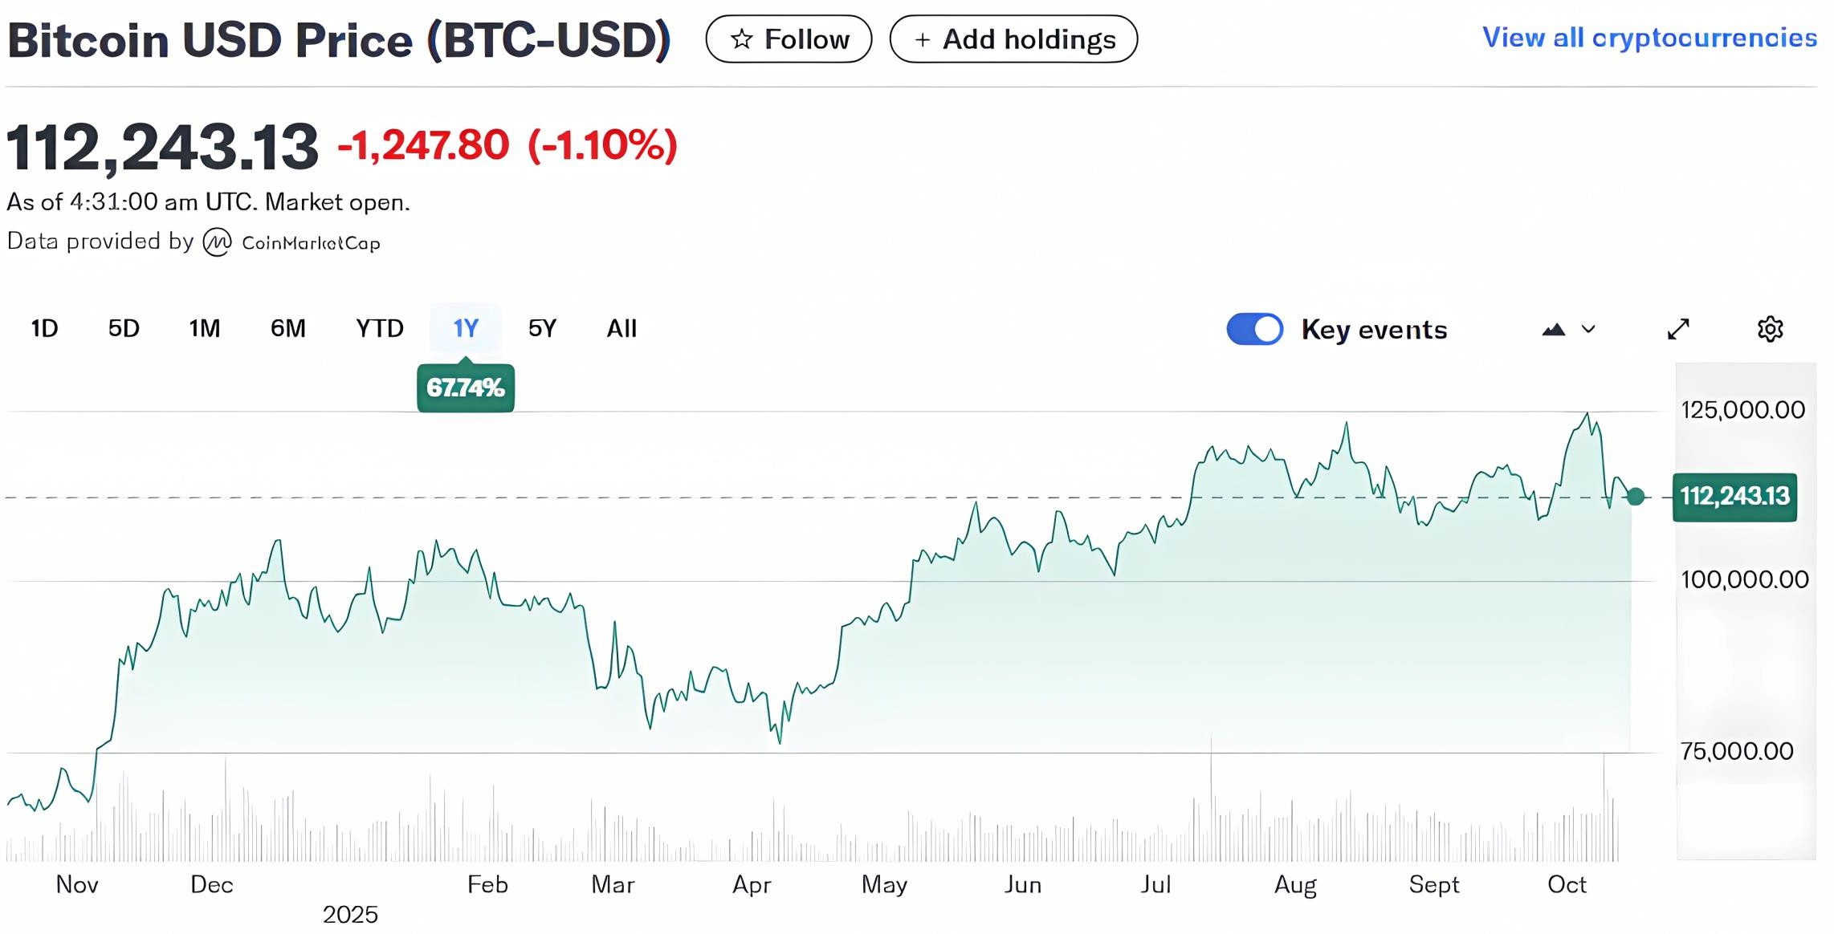
https://sg.finance.yahoo.com/quote/BTC-USD/

Slide 46
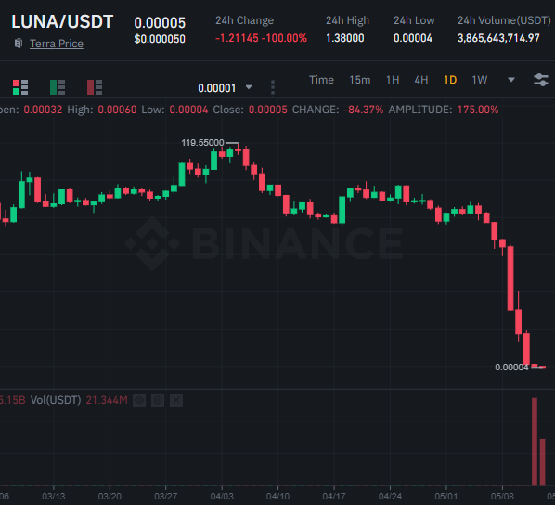

Slide 47




About cryptocurrency (not necessarily DLT)
“Stay away from it!”
Bitcoin is a ‘mirage’
“It is a bubble, there is no
question about it.”
“The central problem with Bitcoin …
is that it doesn’t really solve any
sensible economic problem.”

Slide 48




About cryptocurrency (not necessarily DLT)
“Bitcoin is exciting because it shows
how cheap it can be.”
It was a key technology that held revolutionary potential.
“The ability to create something which is not duplicable in the digital world has enormous value.”

Slide 49
Case 7. Deutsche Bank: Pursuing Blockchain Opportunities

Slide 50
Learning objectives
Describe and discuss blockchain and DLT and the importance of exploring its
application potential.
Reflect on the impact of blockchain technology on business models that are
based on trust and information asymmetries.
Elaborate on the importance of discovery, incubation, and acceleration
mechanisms within incumbent organizations to help them make sense of
disruptive innovations such as blockchain.
Characterize the role of executive leaders in designing and implementing
blockchain initiatives in large, established organizations and industries.
Recognize the importance of strategic cooperation and identify the associated
risks and opportunities.

Slide 51
Q: Where did Deutsche Bank apply blockchain technology?
Securities Settlement and ClearingPurpose: Blockchain was tested as a way to efficiently track and process securities transactions like bonds, equities, and loans.Objective: Reduce the time and cost of settlement and clearing processes, which traditionally involved multiple intermediaries Experiment: The team created a Proof-of-Concept (PoC) by issuing a simulated smart bond processed through blockchain. This involved: Testing the transfer of a financial asset (corporate bond) using blockchain.Using smart contracts to automate lifecycle events like ownership changes, coupon payments, and maturity triggers.Outcome: The experiment demonstrated technical feasibility for using blockchain in securities settlement.
Smart ContractsPurpose: To explore the use of blockchain-enabled smart contracts for automating transactions and reducing reliance on intermediaries.
Application: Smart contracts were tested for automating the execution of agreements (e.g., financial asset transfers).These contracts were modeled to handle lifecycle events of a corporate bond, such as payments and ownership changes.Objective: Use smart contracts to provide greater transparency, reduce legal and operational risks, and improve efficiency.
Payments and Trade FinancePurpose: Blockchain was evaluated as a potential solution for improving cross-border payment systems and trade finance processes.Objective: Address inefficiencies in traditional payment systems and explore new payment infrastructures using blockchain or digital currencies.Focus Areas: Cross-border payments (to reduce costs and processing time).Trade finance transactions (to streamline documentation and execution).
Post-Trade ProcessesPurpose: To improve the efficiency of back-office trading processes and infrastructure by using blockchain's Distributed Ledger Technology (DLT).Objective: Simplify settlement and clearing processes.Improve transparency and reduce operational risks in post-trade operations.
Example: Simulated corporate bond transactions were used to assess how blockchain could automate processes traditionally handled by clearing houses and exchanges.
Exploration of Crypto-Currencies and Digital WalletsWhile Deutsche Bank did not focus on Bitcoin as a business topic, they explored the broader potential of blockchain in the context of: Cryptocurrencies.Digital wallets for retail banking applications.

Slide 52
Disruption
Low-end disruption: making a product or platform more affordable
High-end disruption: entering a market with a superior product or platform
New-market disruption: creating a new category, or even a new industry.

Slide 53
What type of disruption is blockchain technology?
only high end, they are already used case in blockchain

Slide 54
Q: How did the Deutsche Bank managers lay the foundations for commercializing blockchain?
Awareness and Education: Deutsche Bank managers, starting with Rhomaios Ram and Paul Maley, recognized the potential of blockchain technology early on and initiated conversations and discussions within the bank to raise awareness. They used internal social media platforms to post blogs explaining blockchain and its potential applications in banking, generating interest among employees.
Internal Workshops and Communities:They hosted a Distributed Ledger Workshop to engage with interested parties from different departments within the bank, creating an internal community of enthusiasts.This community included individuals from various levels and units, fostering a diverse perspective on how blockchain could be leveraged.
Formal Organizational Structure:Recognizing the need for a more structured approach, Deutsche Bank established an official organizational structure to focus on blockchain activities.They secured funding and support from the bank’s Chief Operating Officer to run initial projects, indicating a commitment to exploring blockchain technology.
Deutsche Bank Labs:Deutsche Bank Labs were set up in London, Berlin, and Silicon Valley to serve as innovation platforms, partnering with tech startups and established firms to experiment with emerging technologies like blockchain.
The Labs provided updates on emergent themes from the innovation ecosystem and facilitated the exploration of how these could be applied to advance the bank's strategy.
Proof of Concept (PoC):The bank used the Deutsche Bank Lab in London to set up a Proof of Concept (PoC) for a smart contract-based corporate bond, testing the technical feasibility of blockchain in securities clearing and settlement.This PoC involved mapping the corporate bond lifecycle, originating and validating corporate bond smart contracts, and setting up a distributed ledger environment to execute smart contracts.
Multidisciplinary Approach:Deutsche Bank's blockchain team included investment bankers, lawyers, and coders, ensuring a diverse range of expertise to address the legal, technical, and business aspects of blockchain implementation.
Measuring Success and Expansion:The team measured the success of their experiments by validating the technical feasibility of using blockchain smart contracts for creating and executing corporate bonds.They planned to expand the experiments beyond the Deutsche Bank Labs, educating business, legal, and technical teams on the practical and technical challenges of leveraging blockchain.
Addressing Legal and Regulatory Challenges:Deutsche Bank managers recognized the need to address significant legal, political, and market obstacles to commercialize blockchain technology.They anticipated the need for standards and interoperability between different blockchains and considered the implications of regulatory requirements and reporting.
Organizational Engagement and Commitment:Ensuring engagement with the organization was critical, as the bank needed parts of the organization
to take responsibility for the technology and demonstrate its tangible value.
54

Slide 55
Q: How should Deutsche Bank move ahead to start creating value from blockchain?
Expand Pilot Programs: Build on the success of the initial Proof of Concept (PoC) by expanding pilot programs to more business units and real-world scenarios. This will help in understanding the practical implications and challenges of implementing blockchain at a larger scale. Educate and Train Staff:Invest in education and training programs to increase understanding of blockchain technology across different departments. This includes not only the technical aspects but also the legal, regulatory, and business implications.
Collaborate with Industry Partners:Partner with other financial institutions, technology companies, and industry consortia to share knowledge, develop standards, and create interoperable solutions. Collaboration can help in reducing costs, spreading risks, and accelerating innovation. Address Regulatory and Legal Challenges:Work closely with regulators to understand the legal and regulatory implications of blockchain technology. Engage in dialogue to help shape the regulatory environment and ensure compliance with existing and emerging regulations.
Develop a Clear Business Case:Identify specific use cases where blockchain can provide significant value, such as improving efficiency in cross-border payments, securities settlement, or trade finance. Develop a clear business case for each use case, outlining the benefits, costs, and potential ROI.
Invest in R&D:Continue to invest in research and development to refine the technology, address scalability issues, and enhance security features. Focus on creating solutions that meet the specific needs of the financial industry.
Create a Scalable Infrastructure:Develop a scalable blockchain infrastructure that can handle the volume and velocity of transactions in the financial sector. This includes ensuring the system can integrate with existing banking systems and processes.
Focus on Customer Needs:Understand and address the needs of customers, such as increased transparency, reduced transaction times, and improved security. Tailor blockchain solutions to enhance the customer experience and meet their specific requirements.
Manage Risks and Security:Implement robust risk management practices to address the unique risks associated with blockchain technology, including cybersecurity risks, data privacy concerns, and operational risks.
Monitor and Adapt to Technological Changes:Stay abreast of the latest developments in blockchain technology and be prepared to adapt strategies as the technology evolves. This includes monitoring advancements in cryptography, consensus mechanisms, and smart contract capabilities.
Measure and Demonstrate Value:Establish metrics to measure the success of blockchain initiatives, focusing on both quantitative (e.g., cost savings, transaction speed) and qualitative (e.g., customer satisfaction, risk reduction) outcomes.
Communicate and Engage Stakeholders:Communicate the value proposition of blockchain to internal and external stakeholders, including
employees, customers, investors, and regulators. Engage them in the journey and address any concerns or misconceptions.
55

