Slide 1

答辩
毕业答辩
When someone sleeps, you start off. When others struggle, you will arrive。
2018年度16级3班李朵朵

Slide 2
1
项目简介
xiaANNUAL WORK SUMMARY
目录
项目展示
COMPLETION OF WORK
2
CONTENTS
3
个人愿景
SUCCESSFUL PROJECT
4
毕业总结
NEXT YEAR WORK PLAN

Slide 3

01
CHAPTER
项目简介
个人网站
企业站点
响应式网站
微场景

Slide 4
项目简介
Project introduction
项目制作
1
Project production
特效
2
素材
80%
60%
素材
代码
Please replace text, click add relevant headline, modify the text content, also can copy your content to this directly.
Please replace text, click add relevant headline, modify the text content, also can copy your content to this directly.
3
灵感
93%
55%
4
代码
特效
灵感
Please replace text, click add relevant headline, modify the text content, also can copy your content to this directly.
Please replace text, click add relevant headline, modify the text content, also can copy your content to this directly.

Slide 5
02
CHAPTER
项目展示
添加相关标题文字
添加相关标题文字
添加相关标题文字
添加相关标题文字

Slide 6

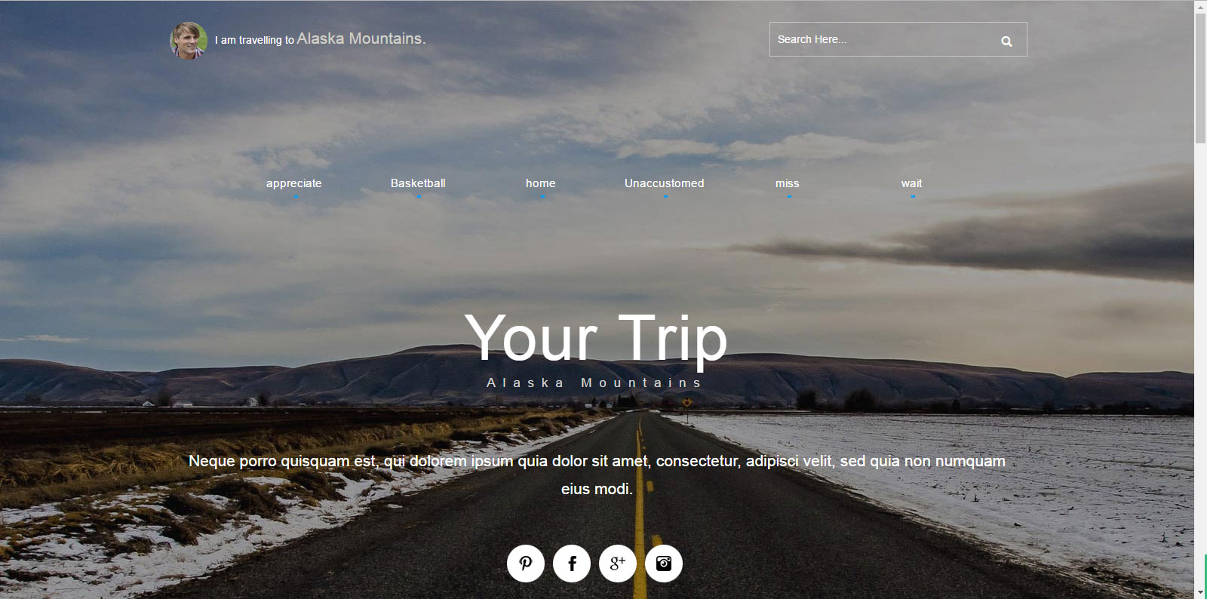


此处添加标题
CLICK TO ADD CAPTION TEXT
微场景
仿作凡科模板
个人网站
元祖企业站
响应式网站
个人设计，个人制作
仿作项目，原网站《元祖企业站》
仿作模板

Slide 7
03
CHAPTER
个人愿景
添加相关标题文字
添加相关标题文字
添加相关标题文字
添加相关标题文字

Slide 8
个人
personal
制作网页
JS,JQ
理念，逻辑思维
Please replace text, click add relevant headline, modify the text content, also can copy your content to this directly.。
Please replace text, click add relevant headline, modify the text content, also can copy your content to this directly.。
Please replace text, click add relevant headline, modify the text content, also can copy your content to this directly.。
2016
2017
2018
10%
20%
30%
40%
50%
60%
70%
80%
90%

Slide 9
愿景
Vision
做个很酷的人（坚持梦想并且很酷）
Please replace text, click add relevant headline, modify the text content, also can copy your content to this directly.。
80%
60%
珍惜当下
书写未来
Please replace text, click add relevant headline, modify the text content, also can copy your content to this directly.
Please replace text, click add relevant headline, modify the text content, also can copy your content to this directly.
93%
55%
提升小我
了解更多
Please replace text, click add relevant headline, modify the text content, also can copy your content to this directly.
Please replace text, click add relevant headline, modify the text content, also can copy your content to this directly.

Slide 10
04
CHAPTER
毕业总结
添加相关标题文字
添加相关标题文字
添加相关标题文字
添加相关标题文字

Slide 11
成长
CLICK TO ADD CAPTION TEXT
01
心态变化
Please replace text, click add relevant headline, modify the text content, also can copy your content to this directly.
享受生活
How to enjoy life, as long as you want to
How to enjoy life, as long as you want to
How to enjoy life, as long as you want to
How to enjoy life, as long as you want to
02
结识好友
Please replace text, click add relevant headline, modify the text content, also can copy your content to this directly.
80%
03
能力提升
Majority
Please replace text, click add relevant headline, modify the text content, also can copy your content to this directly.
PPT模板下载：www.1ppt.com/moban/ 行业PPT模板：www.1ppt.com/hangye/
节日PPT模板：www.1ppt.com/jieri/ PPT素材下载：www.1ppt.com/sucai/
PPT背景图片：www.1ppt.com/beijing/ PPT图表下载：www.1ppt.com/tubiao/
优秀PPT下载：www.1ppt.com/xiazai/ PPT教程： www.1ppt.com/powerpoint/
Word教程： www.1ppt.com/word/ Excel教程：www.1ppt.com/excel/
资料下载：www.1ppt.com/ziliao/ PPT课件下载：www.1ppt.com/kejian/
范文下载：www.1ppt.com/fanwen/ 试卷下载：www.1ppt.com/shiti/
教案下载：www.1ppt.com/jiaoan/
字体下载：www.1ppt.com/ziti/
20%
Very few

Slide 12
理想城市
Ideal city
目标上海
Please replace text, click add relevant headline, modify the text content, also can copy your content to this directly.Please replace text, click add relevant headline, modify the text content, also can copy your content to this directly.
上海
本命上海
上海梦
Please replace text, click add relevant headline, modify the text content, also can copy your content to this directly.
Please replace text, click add relevant headline, modify the text content, also can copy your content to this directly.
上海工作
上海生活
Please replace text, click add relevant headline, modify the text content, also can copy your content to this directly.
Please replace text, click add relevant headline, modify the text content, also can copy your content to this directly.

Slide 13
几句话
CLICK TO ADD CAPTION TEXT
感谢一边骂着我一边给我送药的朋友，感谢再累也陪我逛操场的人，感谢愿意陪我吃爱吃的东西的人，
感谢所有严格认真的老师，，感谢毕业了忍不住眼泪，平时多加照顾我的石越老师，感谢随时随地坐下来帮我解决问题的张迎雪老师，
感谢我自己正确的选择，不悔当初，珍惜当下，未来我们一定再会。
毕业了，感谢！

Slide 14
完结
THANK YOU
感谢聆听，批评指导

