Slide 1

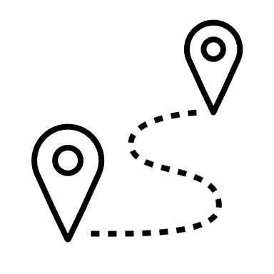







Spoken Dialog Systems:
Automated Smart Knowledge for Wilhelma
Institut für Maschinelle Sprachverarbeitung
Linnet Moxon
Miriam Segiet
Maximilian Schmidt
Lindsey Vanderlyn
Dirk Väth
Prof. Dr. Thang Vu
Domain
information about several animals in the Wilhelma (zoo in Stuttgart);
suggestion on how to visit them in the best order, according to their feeding time
Example
Welcome! How may I help you?
I am looking for a brown animal
What should the animal‘s
continent of origin be?
It should be south america
The animal called two toed sloth
is mainly brown and it comes from south america.
What is its main food?
The animal called two toed sloth mainly eats leaves, insects and fruits.
Tell me about its specialties
The animal called two toed sloth it is the slowest mammal.
Opening Hours
encoded as a SysActionType;
hard coded template opening(), containing information
Visiting Path
I want to visit the elefant
Which other animal do you want to visit?
The penguin and the anaconda
According to the feeding times, it would be best to first visit the green anaconda which is fed at 11:30 o'clock, then visit the asian elefant fed at 13:00 o'clock, and finally visit the african penguin to not miss its public feeding at 13:30 o'clock.
function for recognizing three animals and checking their feeding times (beliefstate)
function to sort the feeding times and add the corresponding animal for the output (policy)
the values "none" or overlapping feeding times are considered
Challenges
…in the system
“Africa” appears both in continent_of_origin and in location_in_wihelma
value for feeding_times can be the same for different animals
… in the process
tedious to keep track of all parts (files) while implementing new functions
linguistic abilities of the system
Conclusion
possible to get information
not completely based on real information
you have to know what you ask for
Future Work
machine learning approach
include park map for visiting path

