Slide 1
CS315 Project Proposal: libpmp
Notes:
1. introduction: advantages, structure, how work (hit case)
2. 2 ways

Slide 2
Hidden Issues in Intel MPK
Protection-key-use-after-free
Protection key limitation
Inter-thread synchronization for multi-thread programs
Notes:
1. introduction: advantages, structure, how work (hit case)
2. 2 ways

Slide 3
Hidden Issues in RISC-V PMP
Protection-key-use-after-free TO BE CONTINUED
Protection key limitation EXISTS
Inter-thread synchronization NOT EXIST
Notes:
1. introduction: advantages, structure, how work (hit case)
2. 2 ways

Slide 4
Protection-key-use-after-free in PMP
Protection-key-use-after-free TO BE CONTINUED
RISC-V PMP uses PMP entries instead of protection key.
When hart is reset, all PMP entries will be reset.
No specification on the interaction between PMP entry and PTE, depends on concrete implementation.
Notes:
1. introduction: advantages, structure, how work (hit case)
2. 2 ways

Slide 5
Protection key limitation in PMP
Protection key limitation EXISTS
Each hart only has 16 PMP entries.
If a hart request for 17 memory isolation request, one of the PMP entries will be overwritten.
Notes:
1. introduction: advantages, structure, how work (hit case)
2. 2 ways

Slide 6
Hidden Issues in RISC-V PMP
Inter-thread synchronization NOT EXIST
Each hart has its own 16 PMP entries.
All the software thread shares the same PMP entries.
Notes:
1. introduction: advantages, structure, how work (hit case)
2. 2 ways

Slide 7
Proposed New Solution to PKL
Notes:
1. introduction: advantages, structure, how work (hit case)
2. 2 ways

Slide 8
Future Research Plan
Notes:
1. introduction: advantages, structure, how work (hit case)
2. 2 ways

Slide 9
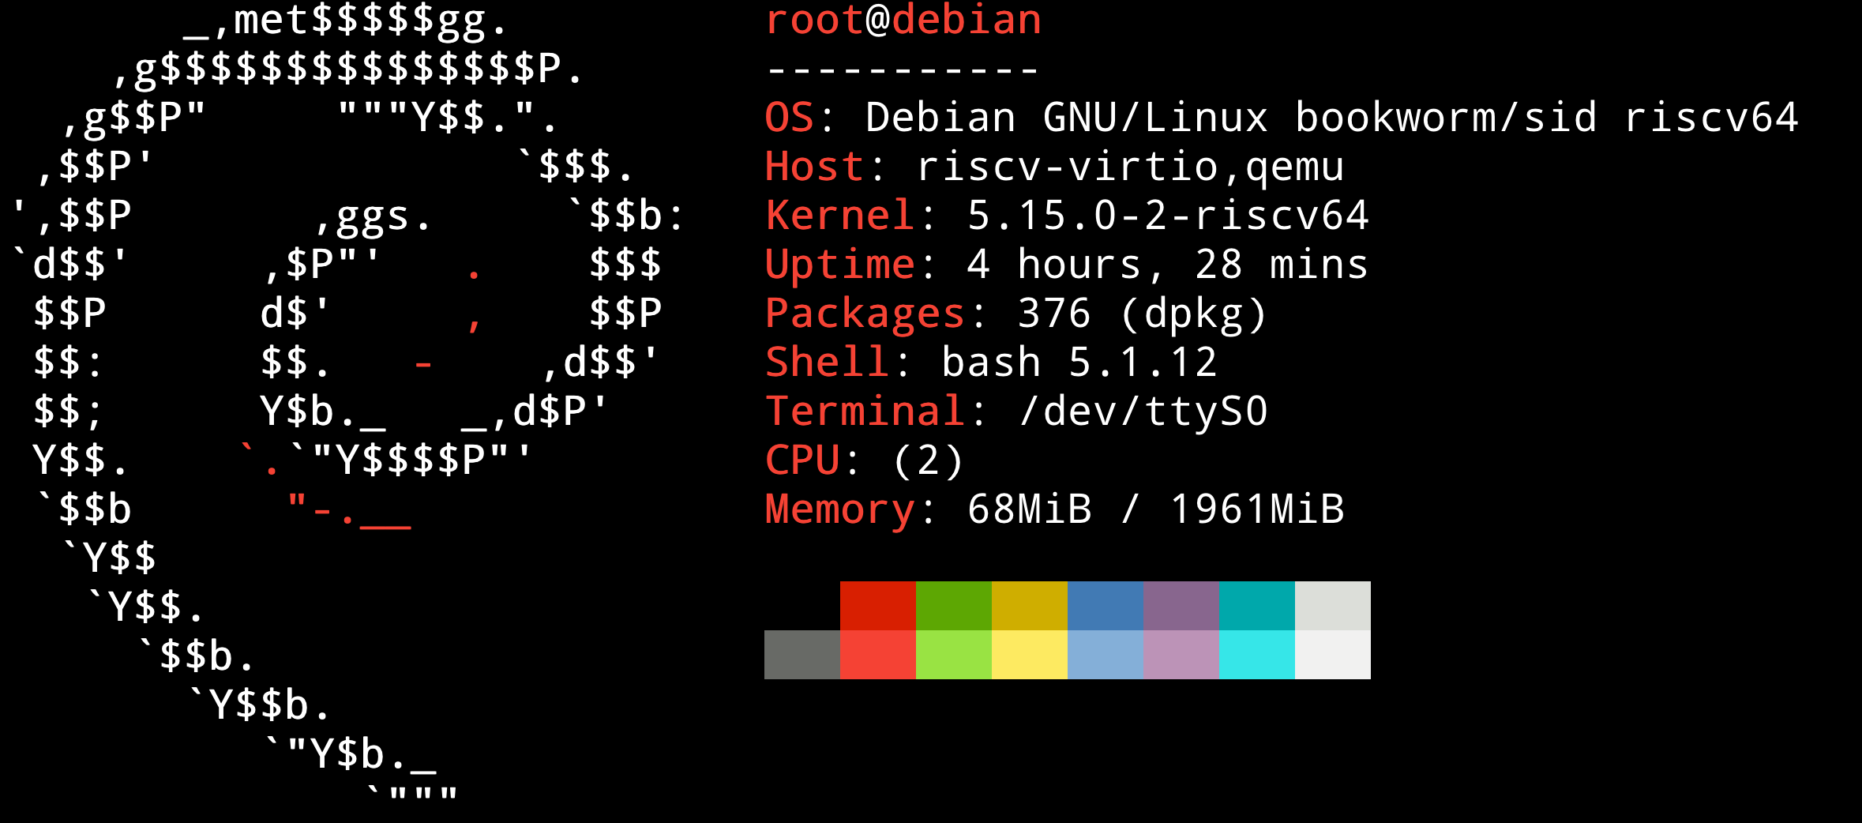
Current Work
We have prepared a docker image with RV64 architecture.
Notes:
1. introduction: advantages, structure, how work (hit case)
2. 2 ways

Slide 10
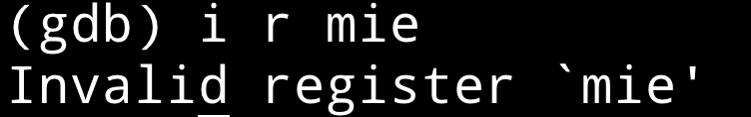
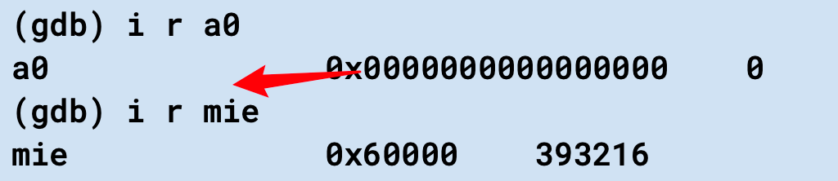
Current Difficulty
Cannot get CSR values on riscv-linux-gnu gdb.
However, on the riscv-linux-gnu gdb manual:
Notes:
1. introduction: advantages, structure, how work (hit case)
2. 2 ways

