Slide 1
CS315 Project Proposal: libpmp
Notes:
1. introduction: advantages, structure, how work (hit case)
2. 2 ways

Slide 2
Outline
Problem Statement
Related Work
Proposed New Solutions
Evaluation Plan
Future Research Plan
Current work and difficulty
Notes:
1. introduction: advantages, structure, how work (hit case)
2. 2 ways

Slide 3
Problem Statement
Notes:
1. introduction: advantages, structure, how work (hit case)
2. 2 ways

Slide 4
Memory Protection
Provide a mechanism to manage the privilege of memory access.
In Linux, mprotect is used to set access privilege of different memory segments.
Usually implemented by set the bits in PTE (low efficiency).
Notes:
1. introduction: advantages, structure, how work (hit case)
2. 2 ways

Slide 5
Intel MPK
Group several pages into a page group.
Use 16 memory protection keys (stored in a thread level PKRU register) to encode the privilege of one page group
Notes:
1. introduction: advantages, structure, how work (hit case)
2. 2 ways

Slide 6
Hidden issues in MPK
Protection-key-use-after-free
Protection key limitation
Inter-thread synchronization for multi-thread programs
Those issues have been fixed by libmpk.
Notes:
1. introduction: advantages, structure, how work (hit case)
2. 2 ways

Slide 7
RISC-V Physical Memory Protection (PMP)
Provide a per-hart level physical memory access privilege.
Use 16 PMP entries instead of protection key.
PMP entries consist of configuration registers and address registers
Configuration register: use several bits to encode privilege
Address register: Specify the managed memory region
Notes:
1. introduction: advantages, structure, how work (hit case)
2. 2 ways

Slide 8
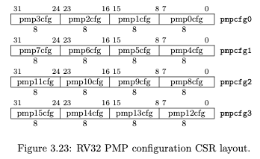

RISC-V Physical Memory Protection (PMP)
Notes:
1. introduction: advantages, structure, how work (hit case)
2. 2 ways

Slide 9
Whether those three issues exist in PMP?
Protection-key-use-after-free TO BE CONTINUED
Protection key limitation EXISTS
Inter-thread synchronization EXISTS
Notes:
1. introduction: advantages, structure, how work (hit case)
2. 2 ways

Slide 10
Protection-key-use-after-free in PMP
Protection-key-use-after-free TO BE CONTINUED
RISC-V PMP uses PMP entries instead of protection key.
No specification on the free for PMP entries, need experiments.
Notes:
1. introduction: advantages, structure, how work (hit case)
2. 2 ways

Slide 11
Protection key limitation in PMP
Protection key limitation EXISTS
Each hart only has 16 PMP entries.
If a hart request for 17 memory isolation request, one of the PMP entries will be overwritten.
Notes:
1. introduction: advantages, structure, how work (hit case)
2. 2 ways

Slide 12
Hidden Issues in RISC-V PMP
Inter-thread synchronization EXISTS
Each hart has its own 16 PMP entries.
One thread on a hart edits PMP entries, the other thread on another hart cannot be synchronized.
Notes:
1. introduction: advantages, structure, how work (hit case)
2. 2 ways

Slide 13
Why it is Important?
Protection key limitation
If one program issue 17 memory isolation request, current design cannot support it.
Inter-thread synchronization
Inconsistent behavior between threads in a process: one thread set memory region M to be not readable, if not synced, other thread can read M.
Notes:
1. introduction: advantages, structure, how work (hit case)
2. 2 ways

Slide 14
Related Work
Notes:
1. introduction: advantages, structure, how work (hit case)
2. 2 ways

Slide 15
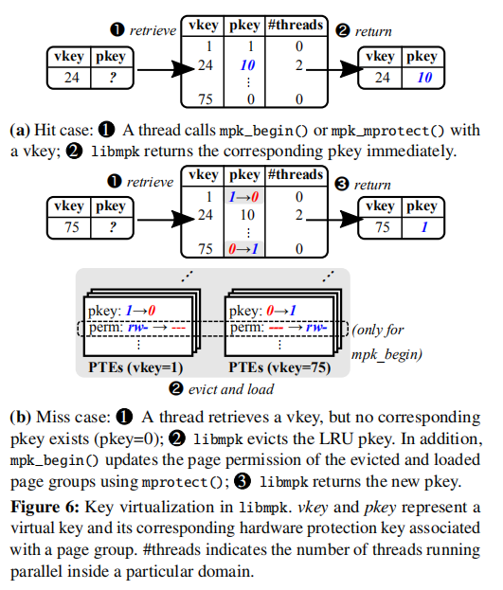
Protection Key Virtualization
Create more than 16 page groups
a cache-like structure
2 ways for mapping:
thread-local
mpk_begin() & mpk_end() by a calling thread
sleep when fail
page not be used -> evict and disable permission
global
mpk_mprotect() for all threads
LRU for replacement
reserves one key for execute-only pages
merge execute-only pages group
evicted when execute-only pages
Notes:
1. introduction: advantages, structure, how work (hit case)
2. 2 ways

Slide 16
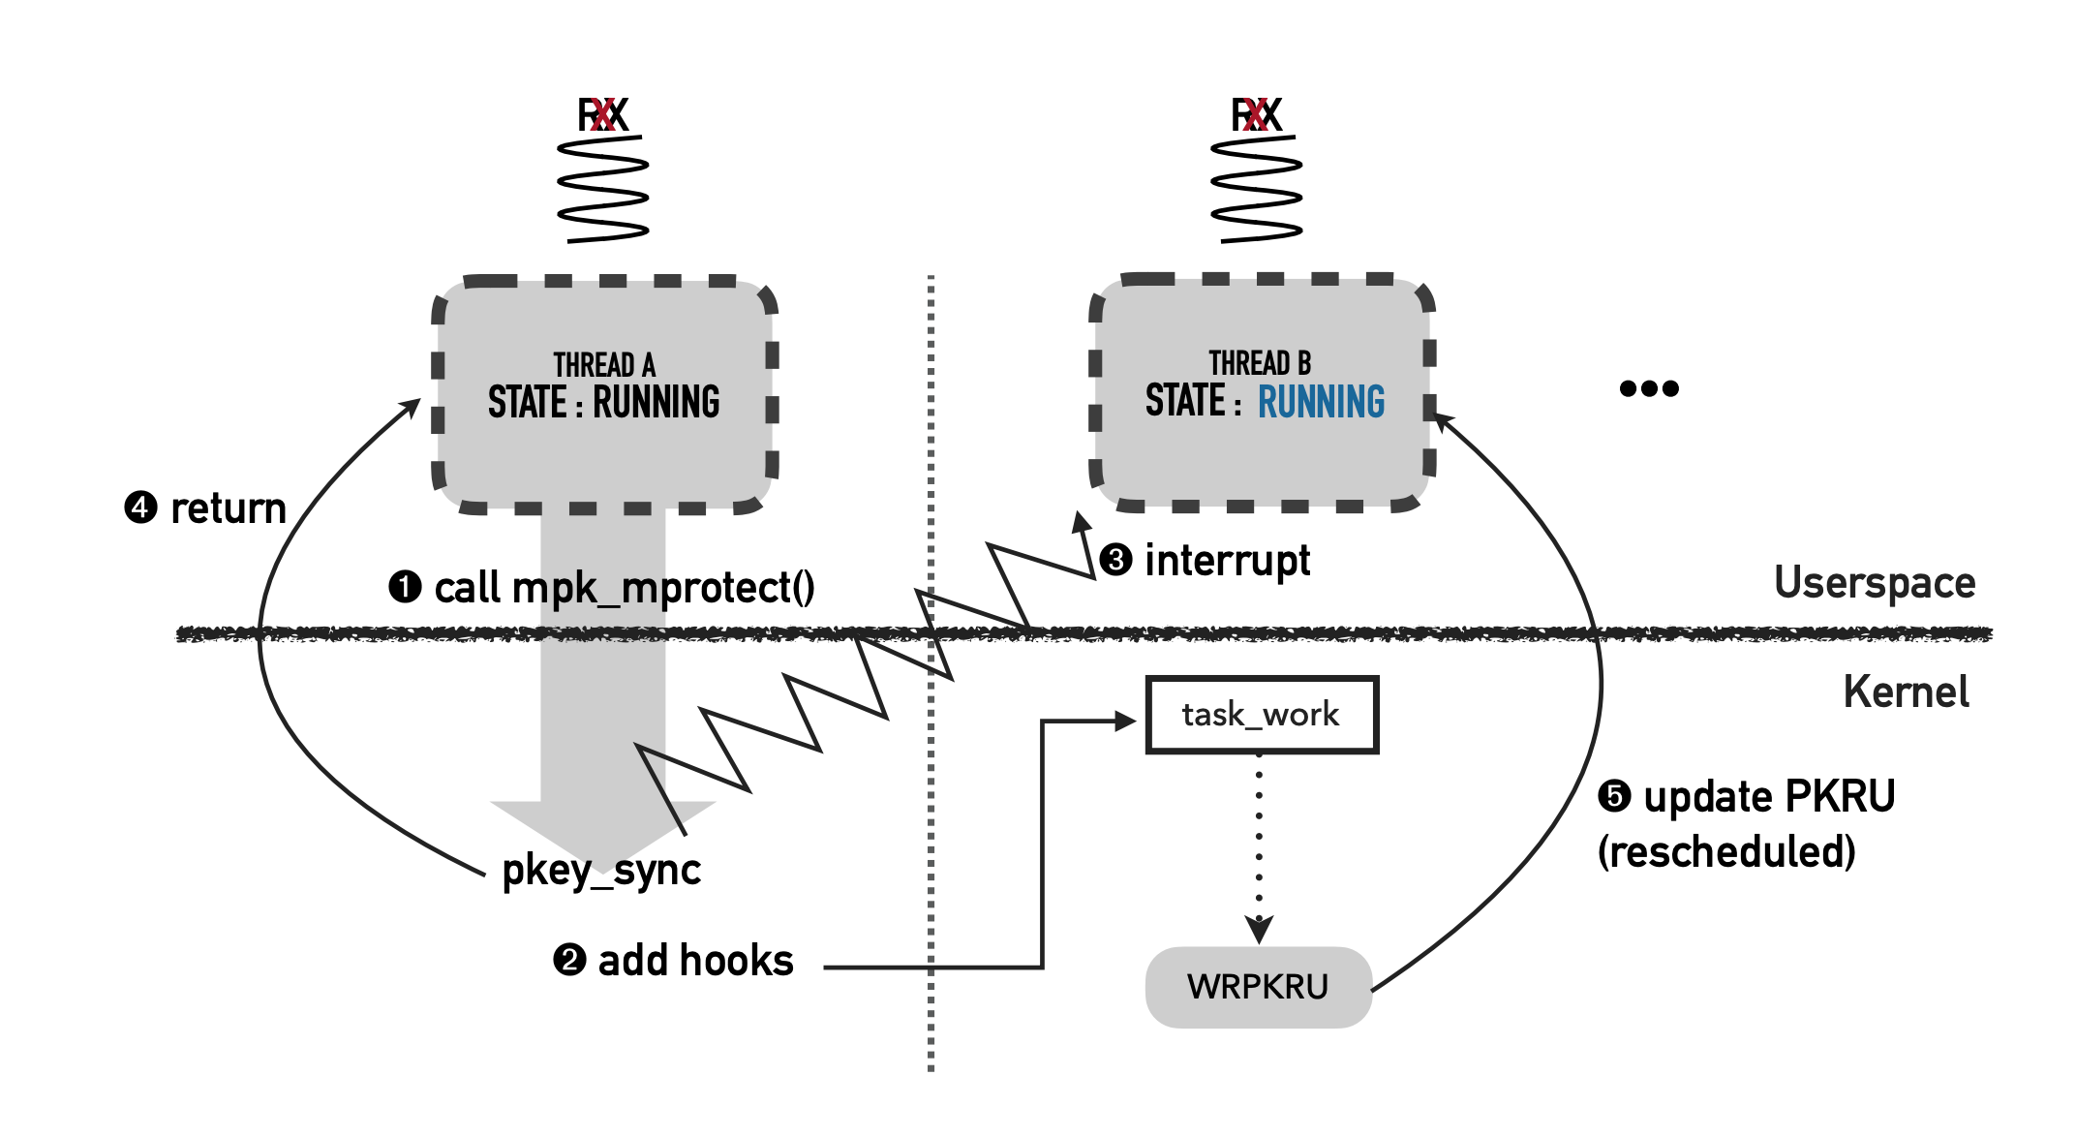
Inter-thread Key Synchronization in MPK
One thread calls mpk_mprotect()
mpk_mprotect() calls do_pkey_sync(pkey)
do_pkey_sync(key) sends interrupt to other threads
When other threads are scheduled, update PKRU by calling registered callback functions (callback functions are added by task_work_add())
Notes:
1. introduction: advantages, structure, how work (hit case)
2. 2 ways

Slide 17
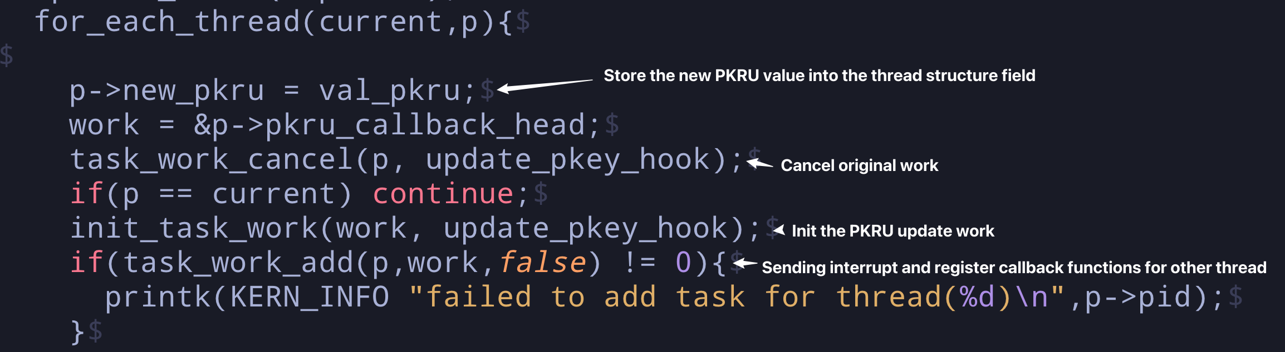
Source Code for Inter-thread sync
In /libmpk/kernel/mm/mprotect.c/do_pkey_sync(val_pkru)
Notes:
1. introduction: advantages, structure, how work (hit case)
2. 2 ways

Slide 18
Propose New Solutions
Notes:
1. introduction: advantages, structure, how work (hit case)
2. 2 ways

Slide 19
New Solution to Protection Key Limitation
Protection key limitation
Virtual key -> Hardware key -> Page group
Cache-like structure is used to map the virtual key to hardware key
The frequently updated virtual key will mapped to the hardare key, the limitation is hidden by the virtual key
Inter-thread synchronization
calling thread --interrupt (callback is to change the PKRU value) -> other threads
other threads are scheduled -> respond to the interrupt
-> synchronize PKRU
Notes:
1. introduction: advantages, structure, how work (hit case)
2. 2 ways

Slide 20
New Solution to Inter-thread Sync
Current Solution: Similar to MPK
Send interrupt to other threads.
Register callback function to sync PMP entries.
Notes:
1. introduction: advantages, structure, how work (hit case)
2. 2 ways

Slide 21
Evaluation Plan
Notes:
1. introduction: advantages, structure, how work (hit case)
2. 2 ways

Slide 22
Evaluation Plan
Similar to the evaluation plan of libmpk
Several aspects:
Security Evaluation
Microbenchmark
Macrobenchmark

Slide 23
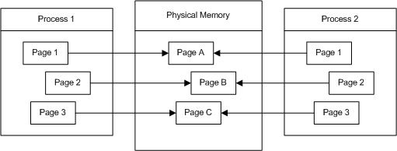
Security Evaluation
PMP: prevent the malicious code from executing privileged instructions
libpmp should implement the basic function of protecting the memory space

Slide 24



Microbenchmark
Cache performance
Determined by cache hit/eviction rate
Memory overhead
Decided by memory space and internal data structure
Synchronization
Affected by context switch
Compared with original PMP implementation

Slide 25
Macrobenchmark
Measure performance in several applications like libmpk
libmpk application benchmarks:
OpenSSL
JavaScript JIT Compilers
In-Memory Key-Value Store

Slide 26
Future Research Plan
Notes:
1. introduction: advantages, structure, how work (hit case)
2. 2 ways

Slide 27
Future Research Plan
Make a survey on RISC-V TEE: Keystone/Penglai
Explore the hardware extensions to support Unlimited PMP Entries
Investigate other virtualization techniques.
Notes:
1. introduction: advantages, structure, how work (hit case)
2. 2 ways

Slide 28
Current Work and Difficulty
Notes:
1. introduction: advantages, structure, how work (hit case)
2. 2 ways

Slide 29
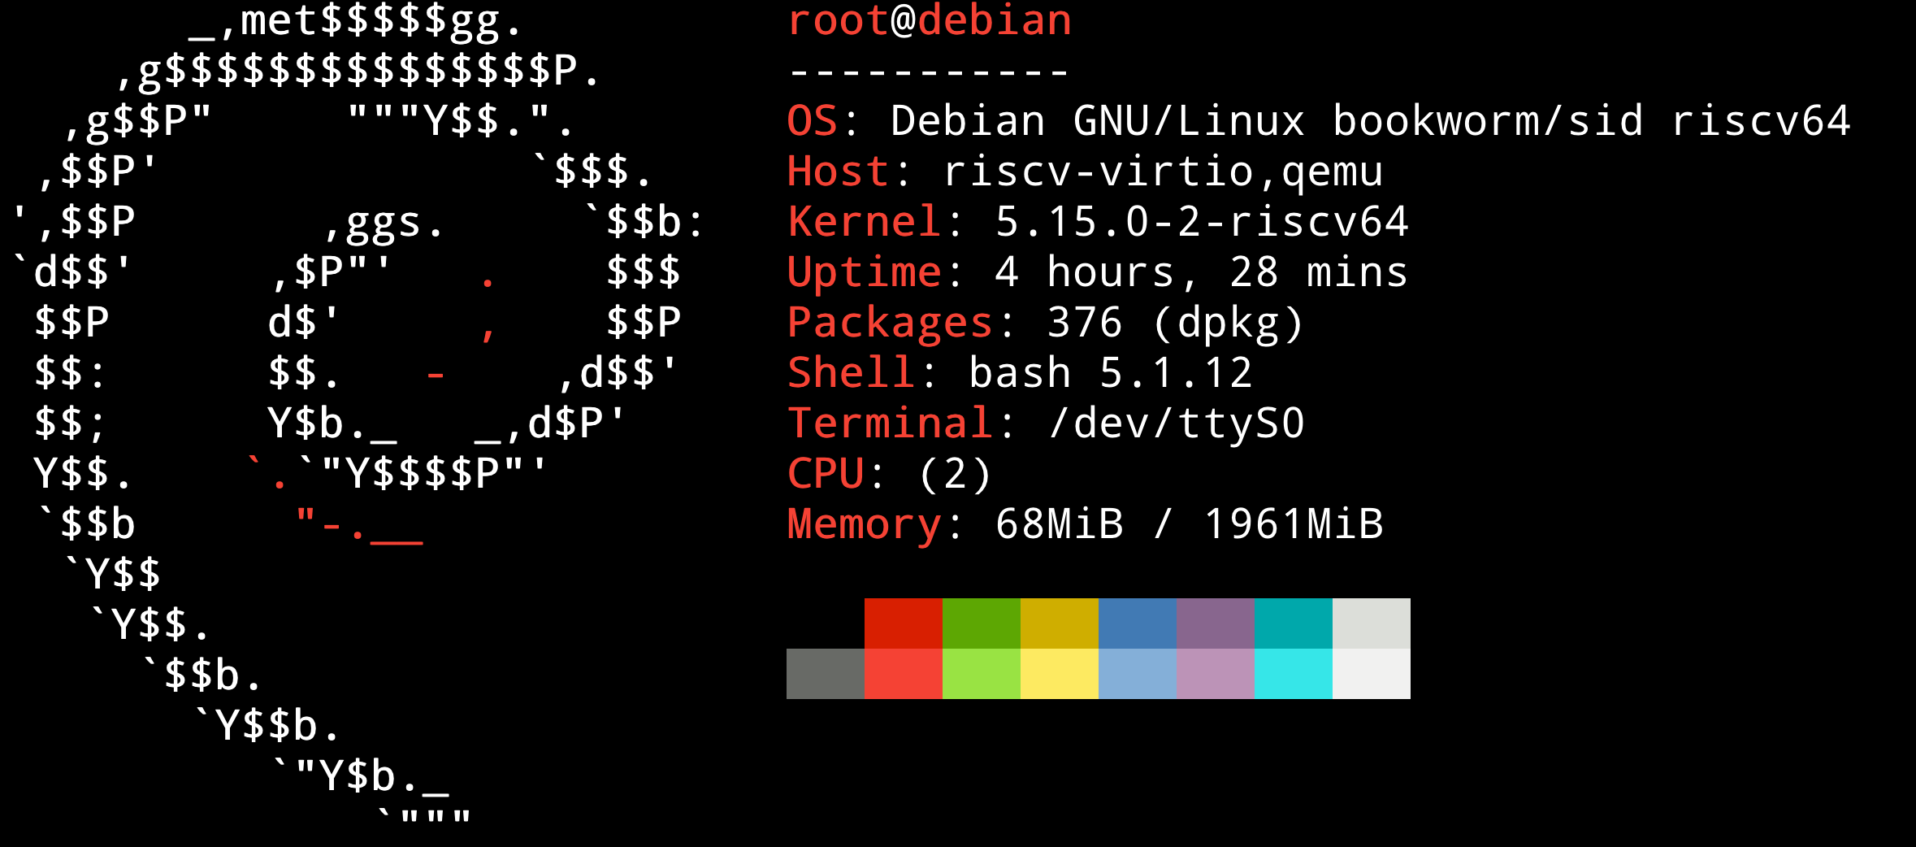
Current Work
We have prepared a docker image with RV64 architecture.
Notes:
1. introduction: advantages, structure, how work (hit case)
2. 2 ways

Slide 30

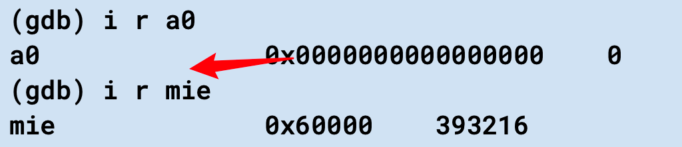
Current Difficulty
Cannot get the value of PMP CSRs on riscv-linux-gnu gdb.
However, on the riscv-linux-gnu gdb manual:
Notes:
1. introduction: advantages, structure, how work (hit case)
2. 2 ways

