Slide 1
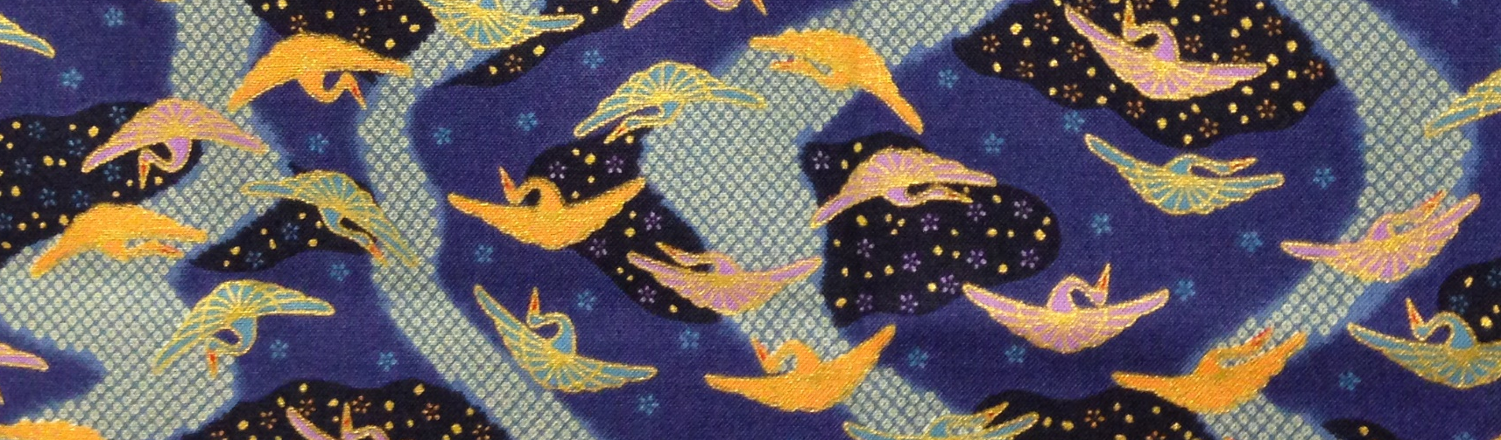

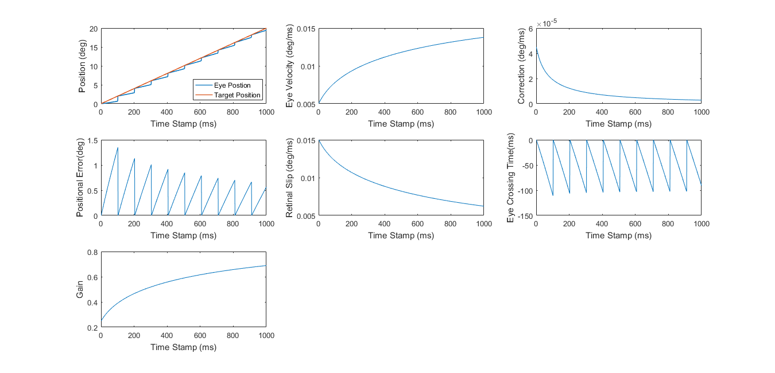
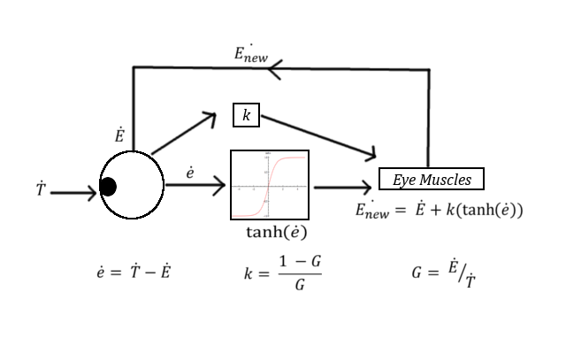
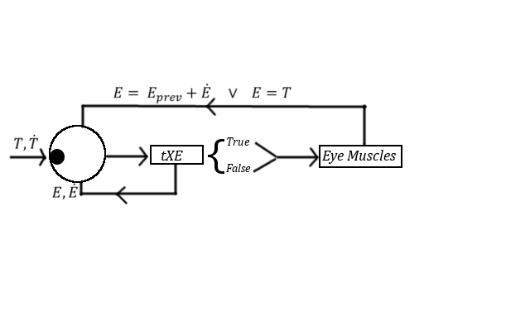
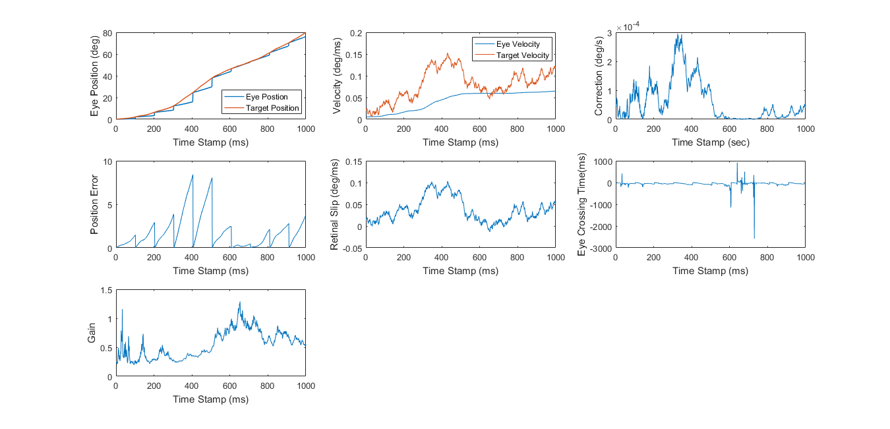
A Computational Model of Smooth Pursuit and Saccade
Ibrahim Y. Taher, Arash Yazdanbakhsh
OBJECTIVE
Center for Research in Sensory Communication and Emerging Neural Technology
Vision Laboratory, Psychological and Brain Sciences Department, Boston University
MODEL OUTPUT
THE MODEL
To create a computational model of the smooth pursuit system and analyze it’s dynamic relationship with the saccadic system.
Model with Constant Target Velocity
Smooth Pursuit Box Model
INTRODUCTION
Smooth Pursuit – How the eye follows a moving target by centering the image on the fovea.
Saccades – A quick shift in gaze when the eye falls too far behind while following a target.
When working dynamically, if the eye falls too far behind the moving target, the saccadic system initiates a catch-up saccade. The saccadic latency is 100 ms.
Retinal Slip – The error of the eye and target velocity.
Eye Crossing Time – A value determined by the positional error and retinal slip that determine whether a catch-up saccade occurs.
Model with Variable Target Velocity
Catch-up Saccade Model
Model simulates an eye fixating its on a horizontally moving target (Smooth Pursuit)
During this process if the eye falls too far behind or if there is a large difference in velocity, a catch up saccade occurs, in which the eye gaze position equals the target’s position.
Catch up saccades occur as expected: when eye gaze position falls too far behind
Even with variable target velocity the error
approaches 0 and the gain approaches 1.
APPLICATIONS
CONCLUSION
Manipulation of parameters in the model can simulate sensorimotor integration in systemic diseases with visual impairments (i.e. Parkinson’s Disease).
The smooth pursuit aspect of vision is velocity based.
The saccadic aspect is primarily position based.
Processes are parallel: saccadic shifts do not affect eye velocity.
Bibliography
Acknowledgements
White, Owen B., Jean A. Saint-Cyr, R. David Tomlinson, and James A. Sharpe. "Ocular Motor Deficits In Parkinson's Disease." Brain 106.3 (1983): 571-87. Web.
De Brouwer, Sophie, Demet Yuskel, Gunnar Blohm, Marcus Missal, and Phillipe Lefevere. "What Triggers Catch-Up Saccades During Visual Tracking?" Journal of Neurophysiology (2001): n. pag. Web. Dec. 2016.
Thier, Peter, and Uwe J. Ilg. "The Neural Basis of Smooth-pursuit Eye Movements." The Neural Basis of Smooth-pursuit Eye Movements (2005): n. pag. Science Direct. Web. Dec. 2016.
Thanks to members of the Visual Psychophysics Lab for supporting this project.
Notes:
Two components (SP and Saccade)
Horizontal Moving Target
Gain
Offset of Position
tXE = time between target
Methods
Graph method
Motivation:
Sensorimotor Integration of Systemic Diseases

