Slide 1
Analysis of Goldstandard
MTurk triples
(n=3,500)
Yes
(n=725)
No
(n=2,398)
Uncertain
(n=377)
Filter all instances with matches in
WebIsADB and delete uncertains
Yes
(n=5)
No
(n=134)

Slide 2
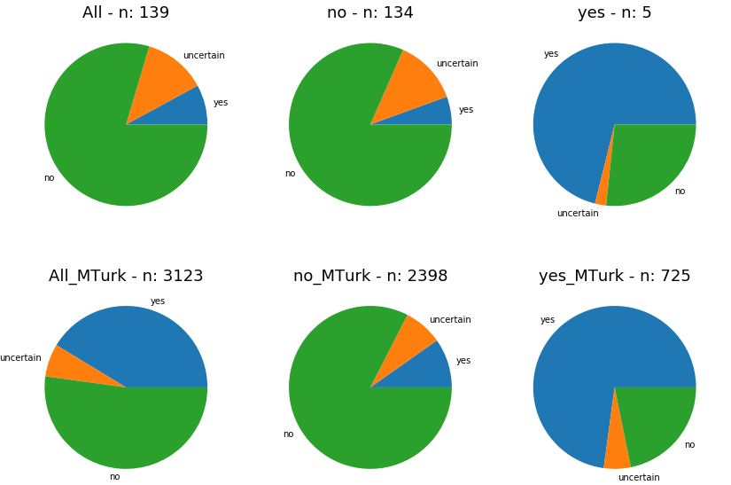
Analysis of MTurk votings- Mean of votes per label
- 9 voters per triple
- only 3.6% labelled as isA in MTurk dataset
with WebIsA overlap dataset
- for overlapped data, voting is similar to whole
Mturk dataset
- in overall dataset (for training, testing &
validation), only 1.73 % are labelled as ‘yes‘

Slide 3
Baseline prediction for goldstandard
 | actual_yes | actual_no
predicted_yes | 0 | 0
predicted_no | 5 | 134
Predicting majority class ‘negative‘:
- Accuracy: 134/(134+5)=96.4%
- Precision:0
- Recall:0
- F1:0

Slide 4
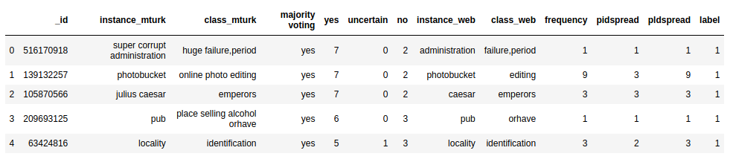
Instances labelled as ‚yes‘ by MTurk labellers
Not entirely unanimous
In WebIsA, you can only find the lemmas

Slide 5
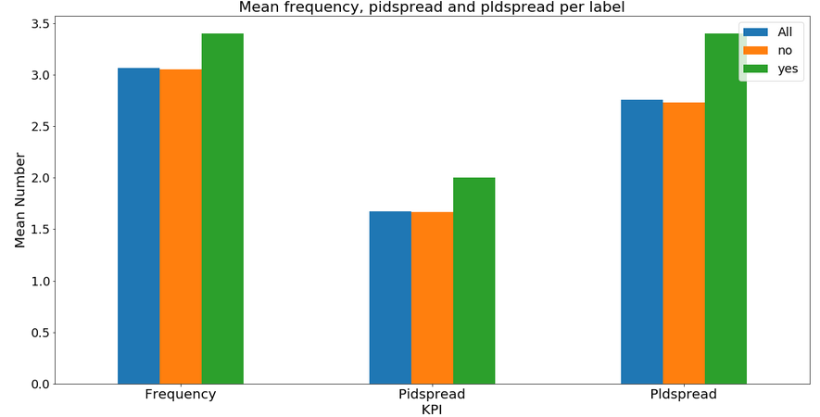
KPIs for matched goldstandard
Frequency, Pidspread and Pldspread
are similar for the labels
→ for training, these features were also not
very useful

