Slide 1
CS252
Graduate Computer Architecture
Lecture 2
Review of Cost, Integrated Circuits, Benchmarks, Moore’s Law, & Prerequisite Quiz
January 19, 2001
Prof. David A. Patterson
Computer Science 252
Spring 2001
Notes:
Review today, not so fast in future

Slide 2
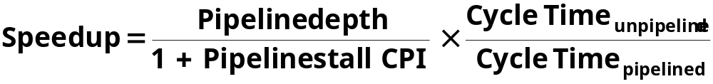
Review #1/3:
Pipelining & Performance
Just overlap tasks; easy if tasks are independent
Speed Up ≤ Pipeline Depth; if ideal CPI is 1, then:
Hazards limit performance on computers:
  Structural: need more HW resources
  Data (RAW,WAR,WAW): need forwarding, compiler scheduling
  Control: delayed branch, prediction
Time is measure of performance: latency or throughput
CPI Law:
CPU time = Seconds = Instructions x Cycles x Seconds
Program Program Instruction Cycle

Slide 3
Review #2/3: Caches
The Principle of Locality:
  Program access a relatively small portion of the address space at any instant of time.
    Temporal Locality: Locality in Time
    Spatial Locality: Locality in Space
Three Major Categories of Cache Misses:
  Compulsory Misses: sad facts of life. Example: cold start misses.
  Capacity Misses: increase cache size
  Conflict Misses: increase cache size and/or associativity.
Write Policy:
  Write Through: needs a write buffer.
  Write Back: control can be complex
Today CPU time is a function of (ops, cache misses) vs. just f(ops): What does this mean to
Compilers, Data structures, Algorithms?

Slide 4
Now, Review of Virtual Memory

Slide 5
Basic Issues in VM System Design
size of information blocks that are transferred from
secondary to main storage (M)
block of information brought into M, and M is full, then some region
of M must be released to make room for the new block -->
replacement policy
which region of M is to hold the new block --> placement policy
missing item fetched from secondary memory only on the occurrence
of a fault --> demand load policy
mem
disk
cache
reg
pages
frame
Paging Organization
virtual and physical address space partitioned into blocks of equal size
page frames
pages

Slide 6
Address Map
V = {0, 1, . . . , n - 1} virtual address space
M = {0, 1, . . . , m - 1} physical address space
MAP: V --> M U {0} address mapping function
n > m
MAP(a) = a' if data at virtual address a is present in physical
address a' and a' in M
= 0 if data at virtual address a is not present in M
a
missing item fault
Name Space V
fault
handler
Processor
0
Addr Trans
Mechanism
Main
Memory
Secondary
Memory
a
a'
physical address
OS performs
this transfer

Slide 7
Paging Organization
V.A.
P.A.
unit of
mapping
0
frame 0
1K
Addr
Trans
MAP
0
page 0
1K
1024
1
1K
1024
1
1K
also unit of
transfer from
virtual to
physical
memory
7168
7
1K
Physical
Memory
31744
31
1K
Virtual Memory
Address Mapping
10
VA
page no.
disp
Page Table
Page Table
Base Reg
V
Access
Rights
PA
+
actually, concatenation
is more likely
index
into
page
table
table located
in physical
memory
physical
memory
address

Slide 8
Virtual Address and a Cache
VA
PA
miss
Trans-
lation
Cache
Main
Memory
CPU
hit
data
It takes an extra memory access to translate VA to PA
This makes cache access very expensive, and this is the
"innermost loop" that you want to go as fast as possible
ASIDE: Why access cache with PA at all? VA caches have a problem!
  synonym / alias problem: two different virtual addresses map to same physical address => two different cache entries holding data for the same physical address!
  for update: must update all cache entries with same physical address
  or memory becomes inconsistent
  determining this requires significant hardware: essentially an
  associative lookup on the physical address tags to see if you have
  multiple hits
  or software enforced alias boundary: same lsb of VA & PA > cache size

Slide 9
TLBs
A way to speed up translation is to use a special cache of recently
used page table entries -- this has many names, but the most
frequently used is Translation Lookaside Buffer or TLB
Virtual Address Physical Address Dirty Ref Valid Access
Really just a cache on the page table mappings
TLB access time comparable to cache access time
(much less than main memory access time)

Slide 10
Translation Look-Aside Buffers
Just like any other cache, the TLB can be organized as fully associative,
set associative, or direct mapped
TLBs are usually small, typically not more than 128 - 256 entries even on
high end machines. This permits fully associative
lookup on these machines. Most mid-range machines use small
n-way set associative organizations.
hit
VA
PA
miss
TLB
Lookup
Cache
Main
Memory
CPU
Translation
with a TLB
miss
hit
Trans-
lation
data
1/2 t
t
20 t

Slide 11
Reducing Translation Time
Machines with TLBs go one step further to reduce # cycles/cache access
They overlap the cache access with the TLB access:
high order bits of the VA are used to look in the TLB while low order bits are used as index into cache

Slide 12
Overlapped Cache & TLB Access
TLB
Cache
assoc
lookup
index
1 K
32
4 bytes
10
2
00
PA
Hit/
Miss
PA
Data
Hit/
Miss
20
12
page #
disp
=
IF cache hit AND (cache tag = PA) then deliver data to CPU
ELSE IF [cache miss OR (cache tag = PA)] and TLB hit THEN
access memory with the PA from the TLB
ELSE do standard VA translation

Slide 13
Problems With Overlapped TLB Access
Overlapped access only works as long as the address bits used to
index into the cache do not change as the result of VA translation
This usually limits things to small caches, large page sizes, or high
n-way set associative caches if you want a large cache
Example: suppose everything the same except that the cache is
increased to 8 K bytes instead of 4 K:
11
2
cache
index
00
This bit is changed
by VA translation, but
is needed for cache
lookup
20
12
virt page #
disp
Solutions:
go to 8K byte page sizes;
go to 2 way set associative cache; or
SW guarantee VA[13]=PA[13]
1K
2 way set assoc cache
10
4
4

Slide 14
SPEC: System Performance Evaluation Cooperative
First Round 1989
  10 programs yielding a single number (“SPECmarks”)
Second Round 1992
  SPECInt92 (6 integer programs) and SPECfp92 (14 floating point programs)
    Compiler Flags unlimited. March 93 of DEC 4000 Model 610:
  spice: unix.c:/def=(sysv,has_bcopy,”bcopy(a,b,c)= memcpy(b,a,c)”
  wave5: /ali=(all,dcom=nat)/ag=a/ur=4/ur=200
  nasa7: /norecu/ag=a/ur=4/ur2=200/lc=blas
Third Round 1995
  new set of programs: SPECint95 (8 integer programs) and SPECfp95 (10 floating point)
  “benchmarks useful for 3 years”
  Single flag setting for all programs: SPECint_base95, SPECfp_base95

Slide 15
SPEC: System Performance Evaluation Cooperative
Fourth Round 2000: SPEC CPU2000
  12 Integer
  14 Floating Point
  2 choices on compilation; “aggressive” (SPECint2000,SPECfp2000), “conservative” (SPECint_base2000,SPECfp_base); flags same for all programs, no more than 4 flags, same compiler for conservative, can change for aggressive
  multiple data sets so that can train compiler if trying to collect data for input to compiler to improve optimization

Slide 16
How to Summarize Performance
Arithmetic mean (weighted arithmetic mean) tracks execution time:
Σ(T_{i})/n or Σ(W_{i}*T_{i})
Harmonic mean (weighted harmonic mean) of rates (e.g., MFLOPS) tracks execution time:
n/Σ(1/R_{i}) or n/Σ(W_{i}/R_{i})
Normalized execution time is handy for scaling performance (e.g., X times faster than SPARCstation 10)
But do not take the arithmetic mean of normalized execution time, use the geometric mean:
( Π T_{j} / N_{j} )^{1/n}

Slide 17
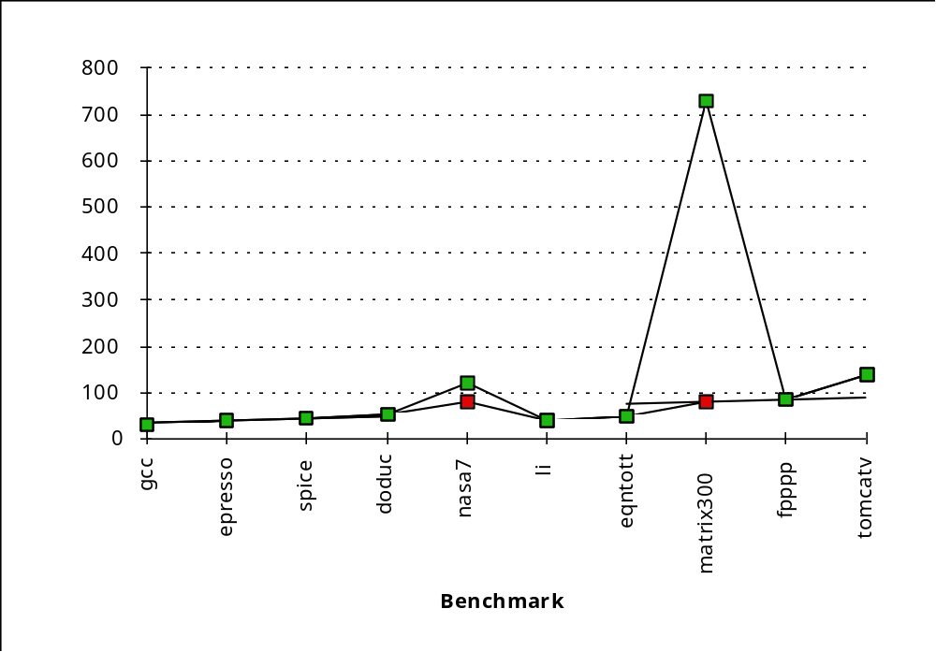
SPEC First Round
One program: 99% of time in single line of code
New front-end compiler could improve dramatically

Slide 18
Impact of Means on SPECmark89 for IBM 550
Ratio to VAX: Time: Weighted Time:
Program Before After Before After Before After
gcc 30 29 49 51 8.91 9.22
espresso 35 34 65 67 7.64 7.86
spice 47 47 510 510 5.69 5.69
doduc 46 49 41 38 5.81 5.45
nasa7 78 144 258 140 3.43 1.86
li 34 34 183 183 7.86 7.86
eqntott 40 40 28 28 6.68 6.68
matrix300 78 730 58 6 3.43 0.37
fpppp 90 87 34 35 2.97 3.07
tomcatv 33 138 20 19 2.01 1.94
Mean 54 72 124 108 54.42 49.99
Geometric Arithmetic Weighted Arith.
Ratio 1.33 Ratio 1.16 Ratio 1.09

Slide 19
Performance Evaluation
“For better or worse, benchmarks shape a field”
Good products created when have:
  Good benchmarks
  Good ways to summarize performance
Given sales is a function in part of performance relative to competition, investment in improving product as reported by performance summary
If benchmarks/summary inadequate, then choose between improving product for real programs vs. improving product to get more sales;
Sales almost always wins!
Execution time is the measure of computer performance!

Slide 20
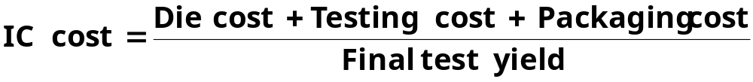

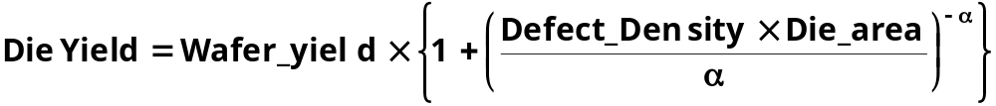
Integrated Circuits Costs
Die Cost goes roughly with die area⁴

Slide 21
Real World Examples
Chip Metal Line Wafer Defect Area Dies/ Yield Die Cost
layers width cost /cm² mm² wafer
386DX 2 0.90 $900 1.0 43 360 71% $4
486DX2 3 0.80 $1200 1.0 81 181 54% $12
PowerPC 601 4 0.80 $1700 1.3 121 115 28% $53
HP PA 7100 3 0.80 $1300 1.0 196 66 27% $73
DEC Alpha 3 0.70 $1500 1.2 234 53 19% $149
SuperSPARC 3 0.70 $1700 1.6 256 48 13% $272
Pentium 3 0.80 $1500 1.5 296 40 9% $417
  From "Estimating IC Manufacturing Costs,” by Linley Gwennap, Microprocessor Report, August 2, 1993, p. 15

Slide 22
Cost/Performance
What is Relationship of Cost to Price?
Component Costs
Direct Costs (add 25% to 40%) recurring costs: labor, purchasing, scrap, warranty
Gross Margin (add 82% to 186%) nonrecurring costs:
R&D, marketing, sales, equipment maintenance, rental, financing cost, pretax profits, taxes
Average Discount to get List Price (add 33% to 66%): volume discounts and/or retailer markup
List Price
Average
Discount
25% to 40%
Avg. Selling Price
Gross
Margin
34% to 39%
Direct Cost
6% to 8%
Component
Cost
15% to 33%

Slide 23
Chip Prices (August 1993)
Assume purchase 10,000 units
Chip Area Mfg. Price Multi- Comment
        mm² cost plier
386DX 43 $9 $31 3.4 Intense Competition
486DX2 81 $35 $245 7.0 No Competition
PowerPC 601 121 $77 $280 3.6
DEC Alpha 234 $202 $1231 6.1 Recoup R&D?
Pentium 296 $473 $965 2.0 Early in shipments

Slide 24
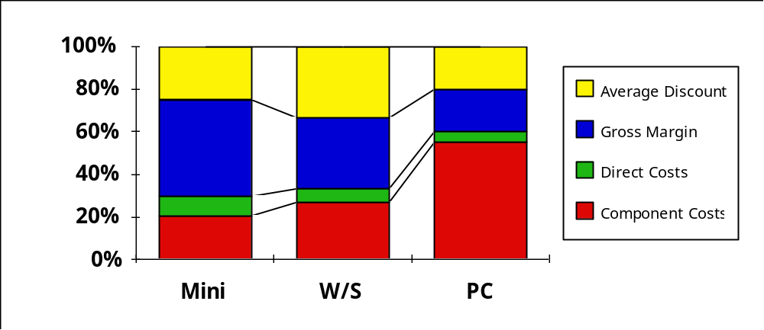
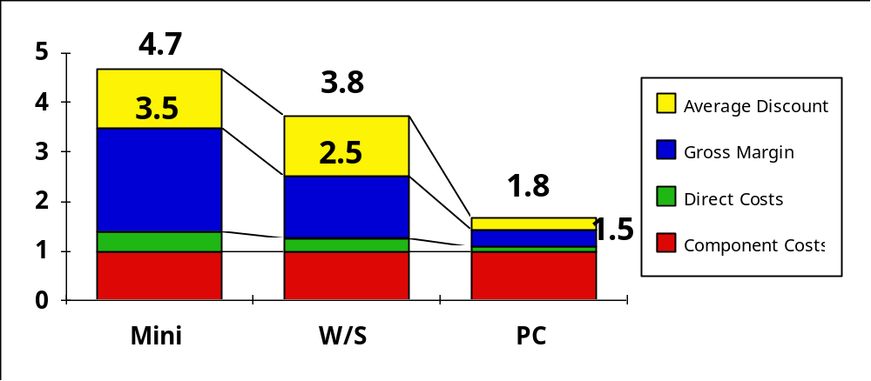
Summary: Price vs. Cost

Slide 25
CS 252 Course Focus
Understanding the design techniques, machine structures, technology factors, evaluation methods that will determine the form of computers in 21st Century
Technology
Parallelism
Programming
Languages
Applications
Interface Design
(ISA)
Computer Architecture:
• Instruction Set Design
• Organization
• Hardware/Software Boundary
Compilers
Operating
Measurement & Evaluation
Systems
History

Slide 26
Topic Coverage
Textbook: Hennessy and Patterson, Computer Architecture: A Quantitative Approach, 3rd Ed., 2001
Research Papers -- Handed out in class
1 week: Review: Fundamentals of Computer Architecture (Ch. 1), Pipelining, Performance, Caches, Virtual Memory, Cost, Ics
1 week: Memory Hierarchy (Chapter 5)
2 weeks: Fault Tolerance, Queuing Theory, Input/Output and Storage (Ch. 6)
2 weeks: Networks and Clusters (Ch. 7)
2 weeks: Multiprocessors (Ch. 8)
2 weeks: Instruction Sets, DSPs, SIMD (Ch. 2),
Vector Processors (Appendix B).
1 week: Dynamic Execution. (Ch 3)
1 week: Static Execution. (Ch 4)
Rest: Project stategy meetings, presentations, quizzes

Slide 27
Lecture style
1-Minute Review
20-Minute Lecture/Discussion
5- Minute Administrative Matters
25-Minute Lecture/Discussion
5- Minute Class Discussion or Break (water, stretch)
25-Minute Lecture/Discussion
Instructor will come to class early & stay after to answer questions
Attention
20 min.
Break
“In Conclusion, ...”
Time

Slide 28
Quizes
Reduce the pressure of taking quizes
  Only 2 Graded Quizes:
  Tentative: Wed Mar 7th and Wed. Apr 18th
  Our goal: test knowledge vs. speed writing
  3 hrs to take 1.5-hr test (5:30-8:30 PM, TBA location)
  Both mid-term quizes can bring summary sheet
    Transfer ideas from book to paper
  Last chance Q&A: during class time day of exam
Students/Faculty meet over free pizza/drinks at La Vals:
Wed Oct. 18th (8:30 PM) and Wed Apr 18th (8:30 PM)
Notes:
This is the 1st slide of the “Course Structure and Course Philosophy” section of the lecture.
Need to emphasis that for exams, our goal is the test your knowledge. It is not our goal to test how well your perform under time pressure.

Slide 29
Original
Big Fishes Eating Little Fishes

Slide 30
1988 Computer Food Chain
Mainframe
Work-
station
PC
Mini-
supercomputer
Mini-
computer
Supercomputer
Massively Parallel Processors

Slide 31
1998 Computer Food Chain
Mini-
supercomputer
Mini-
computer
Massively Parallel Processors
Mainframe
Work-
station
PC
Server
Supercomputer
Now who is eating whom?

Slide 32
Why Such Change in 10 years?
Performance
  Technology Advances
    CMOS VLSI dominates older technologies (TTL, ECL) in cost AND performance
  Computer architecture advances improves low-end
    RISC, superscalar, RAID, …
Price: Lower costs due to …
  Simpler development
    CMOS VLSI: smaller systems, fewer components
  Higher volumes
    CMOS VLSI : same dev. cost 10,000 vs. 10,000,000 units
  Lower margins by class of computer, due to fewer services
Function
  Rise of networking/local interconnection technology

Slide 33
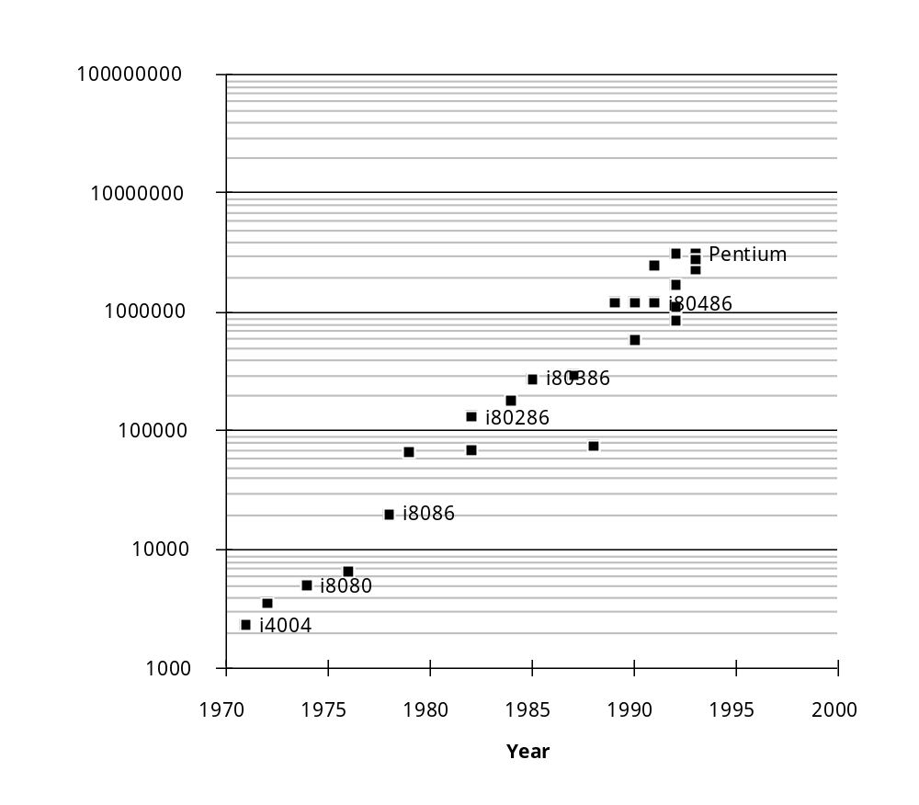
Technology Trends: Microprocessor Capacity
“Graduation Window”
Alpha 21264: 15 million
Pentium Pro: 5.5 million
PowerPC 620: 6.9 million
Alpha 21164: 9.3 million
Sparc Ultra: 5.2 million
Moore’s Law
CMOS improvements:
Die size: 2X every 3 yrs
Line width: halve / 7 yrs

Slide 34
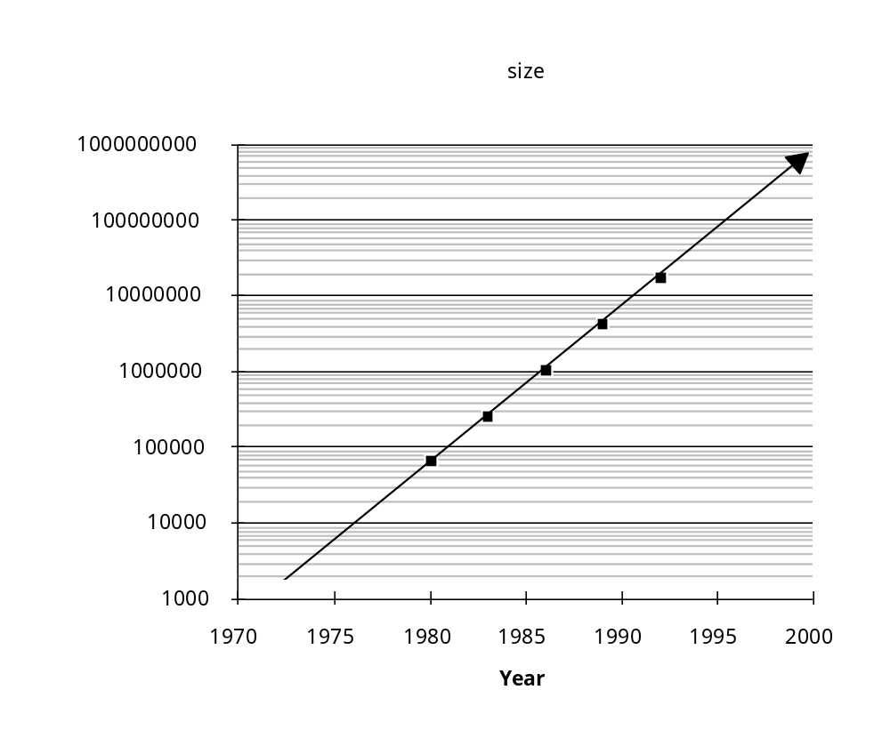
Memory Capacity
(Single Chip DRAM)
year size(Mb) cyc time
1980 0.0625 250 ns
1983 0.25 220 ns
1986 1 190 ns
1989 4 165 ns
1992 16 145 ns
1996 64 120 ns
2000 256 100 ns

Slide 35
Technology Trends
(Summary)
Capacity Speed (latency)
Logic 2x in 3 years 2x in 3 years
DRAM 4x in 3-4 years 2x in 10 years
Disk 4x in 2-3 years 2x in 10 years

Slide 36

Processor Performance
Trends
1000
100
Supercomputers
Mainframes
10
Minicomputers
1
Microprocessors
0.1
1965
1970
1975
1980
1985
1990
1995
2000
Year

Slide 37
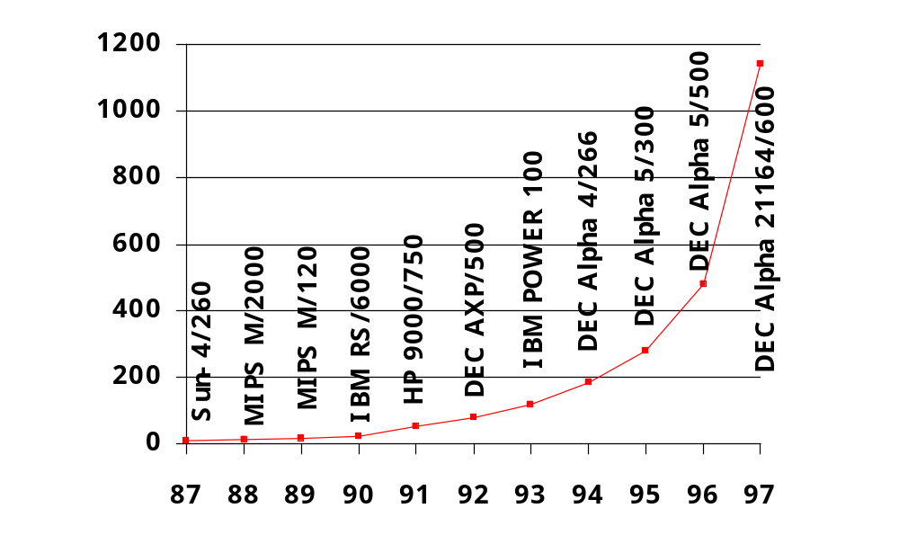
Processor Performance
(1.35X before, 1.55X now)
1.54X/yr

Slide 38
Performance Trends
(Summary)
Workstation performance (measured in Spec Marks) improves roughly 50% per year
(2X every 18 months)
Improvement in cost performance estimated at 70% per year

Slide 39
Moore’s Law Paper
Discussion
What did Moore predict?
35 years later, how did it hold up?
In your view, what was biggest surprise in paper?
Notes:
Notes on Moore's Law
Readings in Computer Architecture
G. MOORE, "Cramming More Components onto Integrated Circuits", Electronics,
p114-117, April 1965.
Assign Not only paper; 56-59, but also intro by editors, pp. 13-14
Predicted in 10 years 65K components per IC;
actually more like 15 years 1980,
Correctly predicted:
Home computer, automatic control of automobiles, palm pilots, watches
Emphasized reliability despite ICs being much smaller volume than individual transistors
Impacts society due to lower costs and simplified design
Yield affects cost of component as increase complexity, so there is an optimum design point;
1965 = 50 (!) components per IC
(And predicted 65,000 in 10 years; > 1000X or > 2.0/year; 2.05
Climed 1975 at 1000 components per IC
"The complexity of minimum components costs has increase at a rate of rougly a facotor of two per year. Certainly over the short term this rate can be expected to continue, if not to increase. ... there is no reason to believe that it will not remain nearly constant for at least 10 years."
1965 1 transistor = 2 mil² in 1975;
Wafer = 1 inch in diameter! => 250,000 in 1 square inch, or 1/4 inch squared = 65000
multilayer to avoid wasting space on interconnection
(mentions electron beams as the future, since optical can do it now!)
Heat was a concern of minimization
but 2D design so has surface area to cool them, and
most power is in the wires, which will be shorted and lower capacitance
Need to reduce cost of making a funcion:
CAD
Linear IC less impact
Figure 3 is Moore's Law
Figure 2 is cartoon on use
Moore
Berkeley Alumnus (recently named Alumnus of the Year)
Before Intel was created!
Article was in Trade magazine
Moore's Law:
Price per transistor decreases by 2X/year
3 corollaries:
)power of function as well as delay deaceases with scaling
)reliability of a function increases with scaling
)Semiconductor did 4X in 3 years => 1.59X per year (Moore Had only 4 data points)
N_{devices/chip} = 1.59^{(year-1959)}
(remember ; year 19xx, replace 9 by ".")
Better model is:
N_{devices/chip} = 50 x 1.59^{(year-1965)}
Makes over 25 predictions, and all come true!
preliferation of electronics
1965 looks like electromechanical switches, consumer electronics = AM radio, TVs have vacuum tubes
Home computers (1965 = first DEC minicomputer)
Automatic controls for automobiles
Personal portable communications decices (cell phones)
Electronic wristwatches - Intel did these until too cheap
Increasing reliability with greater size
GaAs not much to do
Power decreases with integration
Building large systems out of standard functions (TTL or libraries)
Linear ICs replaced by digital filters
Moore's Law continuation has made computer architcture dynamic field of study
1970 2000 transistors per chip
1971 4004 2200 transistors
Note Mazor had used the IBM 1620, which might have influenced the 4004

Slide 40
Review #3/3: TLB, Virtual Memory
Caches, TLBs, Virtual Memory all understood by examining how they deal with 4 questions: 1) Where can block be placed? 2) How is block found? 3) What block is repalced on miss? 4) How are writes handled?
Page tables map virtual address to physical address
TLBs make virtual memory practical
  Locality in data => locality in addresses of data, temporal and spatial
TLB misses are significant in processor performance
  funny times, as most systems can’t access all of 2nd level cache without TLB misses!
Today VM allows many processes to share single memory without having to swap all processes to disk; today VM protection is more important than memory hierarchy
Notes:
Let’s do a short review of what you learned last time.
Virtual memory was originally invented as another level of memory hierarchy such that programers, faced with main memory much smaller than their programs, do not have to manage the loading and unloading portions of their program in and out of memory.
It was a controversial proposal at that time because very few programers believed software can manage the limited amount of memory resource as well as human.
This all changed as DRAM size grows exponentially in the last few decades.
Nowadays, the main function of virtual memory is to allow multiple processes to share the same main memory so we don’t have to swap all the non-active processes to disk.
Consequently, the most important function of virtual memory these days is to provide memory protection.
The most common technique, but we like to emphasis not the only technique, to translate virtual memory address to physical memory address is to use a page table.
TLB, or translation lookaside buffer, is one of the most popular hardware techniques to reduce address translation time.
Since TLB is so effective in reducing the address translation time, what this means is that TLB misses will have a significant negative impact on processor performance.
+3 = 3 min. (X:43)

Slide 41
Summary
Performance Summary needs good benchmarks and good ways to summarize performancfe
Transistors/chip for microprocessors growing via “Moore’s Law” 2X 1.5/yrs
Disk capacity (so far) is at a faster rate last 4-5 years
DRAM capacity is at a slower rate last 4-5 years
In general, Bandwidth improving fast, latency improving slowly

