Slide 1
CS252
Graduate Computer Architecture
Lecture 4
Caches and Memory Systems
January 26, 2001
Prof. John Kubiatowicz

Slide 2
Review: Who Cares About the Memory Hierarchy?
Processor Only Thus Far in Course:
  CPU cost/performance, ISA, Pipelined Execution
CPU-DRAM Gap
1980: no cache in µproc; 1995 2-level cache on chip
(1989 first Intel µproc with a cache on chip)
1000
µProc
60%/yr.
CPU
“Moore’s Law”
100
Processor-Memory
Performance Gap:
(grows 50% / year)
Performance
10
“Less’ Law?”
DRAM
7%/yr.
DRAM
1
1980
1981
1982
1983
1984
1985
1986
1987
1988
1989
1990
1991
1992
1993
1994
1995
1996
1997
1998
1999
2000
Notes:
Y-axis is performance
X-axis is time
Latency
Cliché:
Not e that x86 didn’t have cache on chip until 1989

Slide 3
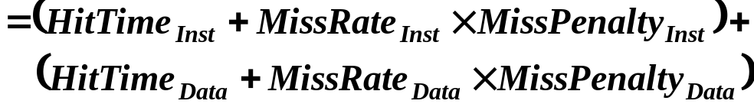
Review: Cache performance
Miss-oriented Approach to Memory Access:
  CPI_{Execution} includes ALU and Memory instructions
Separating out Memory component entirely
  AMAT = Average Memory Access Time
  CPI_{ALUOps} does not include memory instructions

Slide 4
Review: Reducing Misses
Classifying Misses: 3 Cs
  Compulsory—Misses in even an Infinite Cache
  Capacity—Misses in Fully Associative Size X Cache
  Conflict—Misses in N-way Associative, Size X Cache
More recent, 4th “C”:
  Coherence - Misses caused by cache coherence.
Notes:
Intuitive Model by Mark Hill

Slide 5
Review: Miss Rate Reduction
3 Cs: Compulsory, Capacity, Conflict
  1. Reduce Misses via Larger Block Size
  2. Reduce Misses via Higher Associativity
  3. Reducing Misses via Victim Cache
  4. Reducing Misses via Pseudo-Associativity
  5. Reducing Misses by HW Prefetching Instr, Data
  6. Reducing Misses by SW Prefetching Data
  7. Reducing Misses by Compiler Optimizations
Prefetching comes in two flavors:
  Binding prefetch: Requests load directly into register.
    Must be correct address and register!
  Non-Binding prefetch: Load into cache.
    Can be incorrect. Frees HW/SW to guess!

Slide 6
Improving Cache Performance
Continued
1. Reduce the miss rate,
2. Reduce the miss penalty, or
3. Reduce the time to hit in the cache.

Slide 7
What happens on a Cache miss?
For in-order pipeline, 2 options:
  Freeze pipeline in Mem stage (popular early on: Sparc, R4000)
  IF ID EX Mem stall stall stall … stall Mem Wr
  IF ID EX stall stall stall … stall stall Ex Wr
  Use Full/Empty bits in registers + MSHR queue
    MSHR = “Miss Status/Handler Registers” (Kroft)
    Each entry in this queue keeps track of status of outstanding memory requests to one complete memory line.
      Per cache-line: keep info about memory address.
      For each word: register (if any) that is waiting for result.
      Used to “merge” multiple requests to one memory line
    New load creates MSHR entry and sets destination register to “Empty”. Load is “released” from pipeline.
    Attempt to use register before result returns causes instruction to block in decode stage.
    Limited “out-of-order” execution with respect to loads.
    Popular with in-order superscalar architectures.
Out-of-order pipelines already have this functionality built in… (load queues, etc).

Slide 8
Write Policy:
Write-Through vs Write-Back
Write-through: all writes update cache and underlying memory/cache
  Can always discard cached data - most up-to-date data is in memory
  Cache control bit: only a valid bit
Write-back: all writes simply update cache
  Can’t just discard cached data - may have to write it back to memory
  Cache control bits: both valid and dirty bits
Other Advantages:
  Write-through:
    memory (or other processors) always have latest data
    Simpler management of cache
  Write-back:
    much lower bandwidth, since data often overwritten multiple times
    Better tolerance to long-latency memory?

Slide 9
Write Policy 2:
Write Allocate vs Non-Allocate
(What happens on write-miss)
Write allocate: allocate new cache line in cache
  Usually means that you have to do a “read miss” to fill in rest of the cache-line!
  Alternative: per/word valid bits
Write non-allocate (or “write-around”):
  Simply send write data through to underlying memory/cache - don’t allocate new cache line!

Slide 10
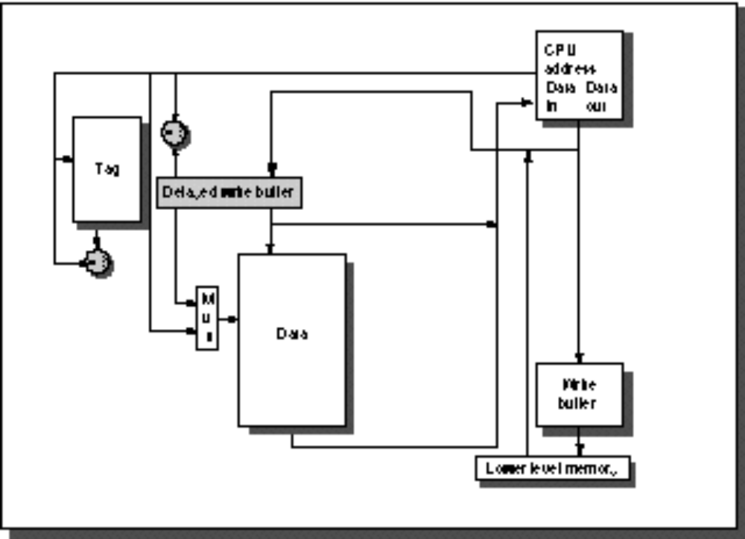
1. Reducing Miss Penalty:
Read Priority over Write on Miss
CPU
in out
Write Buffer
write
buffer
DRAM
(or lower mem)

Slide 11
1. Reducing Miss Penalty:
Read Priority over Write on Miss
Write-through with write buffers offer RAW conflicts with main memory reads on cache misses
  If simply wait for write buffer to empty, might increase read miss penalty (old MIPS 1000 by 50% )
  Check write buffer contents before read;
  if no conflicts, let the memory access continue
Write-back also want buffer to hold misplaced blocks
  Read miss replacing dirty block
  Normal: Write dirty block to memory, and then do the read
  Instead copy the dirty block to a write buffer, then do the read, and then do the write
  CPU stall less since restarts as soon as do read

Slide 12
2. Reduce Miss Penalty:
Early Restart and Critical Word First
Don’t wait for full block to be loaded before restarting CPU
  Early restart—As soon as the requested word of the block arrives, send it to the CPU and let the CPU continue execution
  Critical Word First—Request the missed word first from memory and send it to the CPU as soon as it arrives; let the CPU continue execution while filling the rest of the words in the block. Also called wrapped fetch and requested word first
Generally useful only in large blocks,
Spatial locality a problem; tend to want next sequential word, so not clear if benefit by early restart
block

Slide 13
3. Reduce Miss Penalty:
Non-blocking Caches to reduce stalls on misses
Non-blocking cache or lockup-free cache allow data cache to continue to supply cache hits during a miss
  requires F/E bits on registers or out-of-order execution
  requires multi-bank memories
“hit under miss” reduces the effective miss penalty by working during miss vs. ignoring CPU requests
“hit under multiple miss” or “miss under miss” may further lower the effective miss penalty by overlapping multiple misses
  Significantly increases the complexity of the cache controller as there can be multiple outstanding memory accesses
  Requires multiple memory banks (otherwise cannot support)
  Penium Pro allows 4 outstanding memory misses

Slide 14
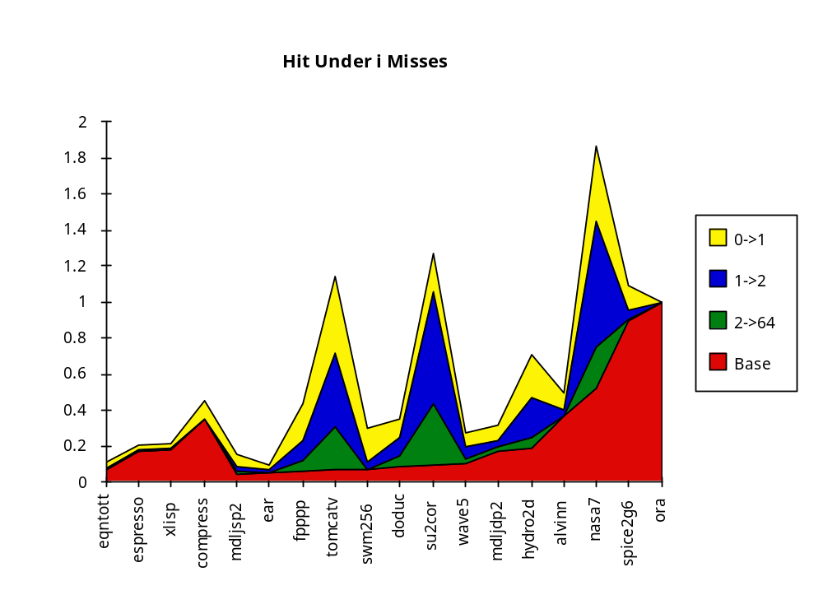
Value of Hit Under Miss for SPEC
(Normalized to blocking cache)
0->1
1->2
2->64
Base
“Hit under n Misses”
Integer
Floating Point
FP programs on average: AMAT= 0.68 -> 0.52 -> 0.34 -> 0.26
Int programs on average: AMAT= 0.24 -> 0.20 -> 0.19 -> 0.19
8 KB Data Cache, Direct Mapped, 32B block, 16 cycle miss

Slide 15
4. Second level cache
L2 Equations
AMAT = Hit Time_{L1} + Miss Rate_{L1} x Miss Penalty_{L1}
Miss Penalty_{L1} = Hit Time_{L2} + Miss Rate_{L2} x Miss Penalty_{L2}
AMAT = Hit Time_{L1} +
Miss Rate_{L1} x (Hit Time_{L2} + Miss Rate_{L2} + Miss Penalty_{L2})
Definitions:
  Local miss rate— misses in this cache divided by the total number of memory accesses to this cache (Miss rate_{L2})
  Global miss rate—misses in this cache divided by the total number of memory accesses generated by the CPU
  (Miss Rate_{L1} x Miss Rate_{L2})
  Global Miss Rate is what matters

Slide 16
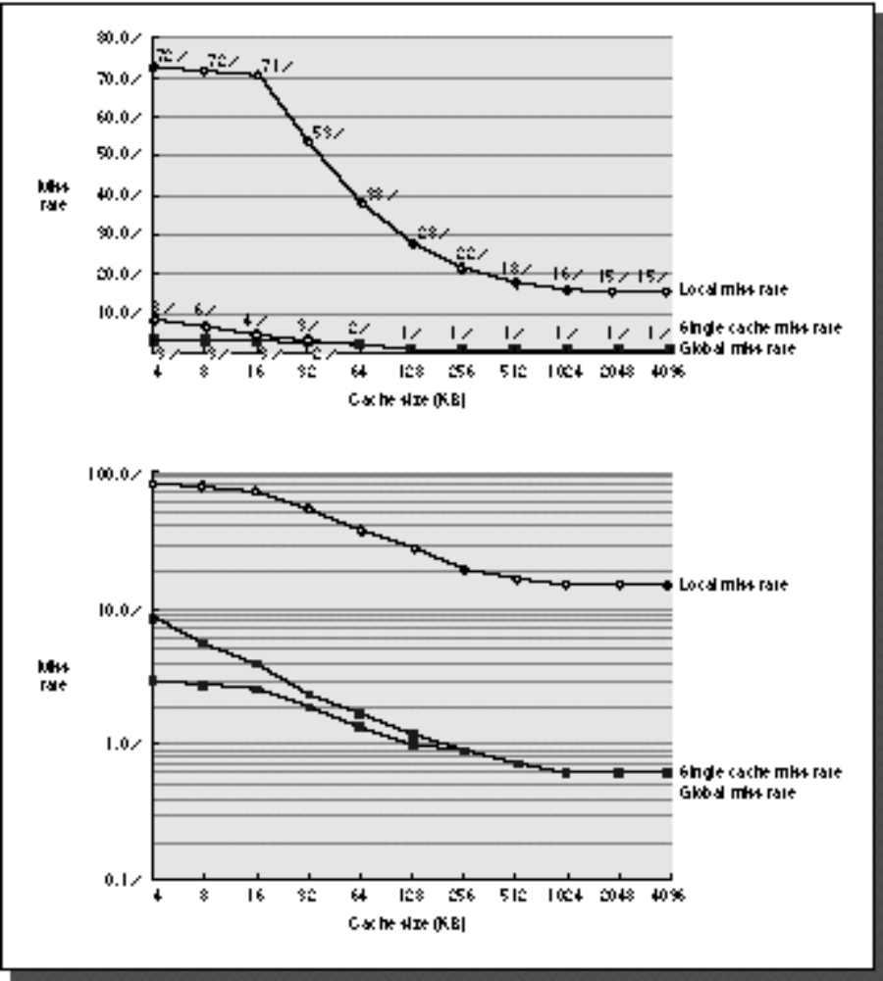
Comparing Local and Global Miss Rates
32 KByte 1st level cache;
Increasing 2nd level cache
Global miss rate close to single level cache rate provided L2 >> L1
Don’t use local miss rate
L2 not tied to CPU clock cycle!
Cost & A.M.A.T.
Generally Fast Hit Times and fewer misses
Since hits are few, target miss reduction
Linear
Cache Size
Log
Cache Size

Slide 17
Reducing Misses:
Which apply to L2 Cache?
Reducing Miss Rate
  1. Reduce Misses via Larger Block Size
  2. Reduce Conflict Misses via Higher Associativity
  3. Reducing Conflict Misses via Victim Cache
  4. Reducing Conflict Misses via Pseudo-Associativity
  5. Reducing Misses by HW Prefetching Instr, Data
  6. Reducing Misses by SW Prefetching Data
  7. Reducing Capacity/Conf. Misses by Compiler Optimizations

Slide 18
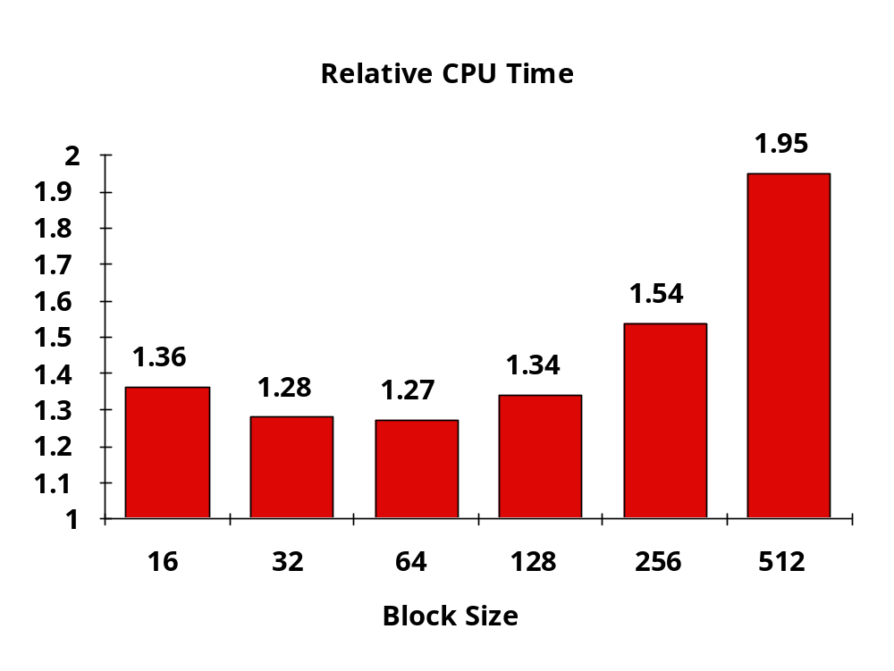
L2 cache block size & A.M.A.T.
32KB L1, 8 byte path to memory

Slide 19
Reducing Miss Penalty Summary
Four techniques
  Read priority over write on miss
  Early Restart and Critical Word First on miss
  Non-blocking Caches (Hit under Miss, Miss under Miss)
  Second Level Cache
Can be applied recursively to Multilevel Caches
  Danger is that time to DRAM will grow with multiple levels in between
  First attempts at L2 caches can make things worse, since increased worst case is worse

Slide 20
Main Memory Background
Performance of Main Memory:
  Latency: Cache Miss Penalty
    Access Time: time between request and word arrives
    Cycle Time: time between requests
  Bandwidth: I/O & Large Block Miss Penalty (L2)
Main Memory is DRAM: Dynamic Random Access Memory
  Dynamic since needs to be refreshed periodically (8 ms, 1% time)
  Addresses divided into 2 halves (Memory as a 2D matrix):
    RAS or Row Access Strobe
    CAS or Column Access Strobe
Cache uses SRAM: Static Random Access Memory
  No refresh (6 transistors/bit vs. 1 transistor
  Size: DRAM/SRAM ­ 4-8,
  Cost/Cycle time: SRAM/DRAM ­ 8-16

Slide 21
Main Memory Deep Background
“Out-of-Core”, “In-Core,” “Core Dump”?
“Core memory”?
Non-volatile, magnetic
Lost to 4 Kbit DRAM (today using 64Kbit DRAM)
Access time 750 ns, cycle time 1500-3000 ns

Slide 22






DRAM logical organization
(4 Mbit)
Column Decoder
…
1
Sense
Amps & I/O
D
1
A0…A1
Memory
Array
Q
0
(2,048 x 2,048)
Storage
W
ord Line
Cell
Square root of bits per RAS/CAS

Slide 23
4 Key DRAM Timing Parameters
t_{RAC}: minimum time from RAS line falling to the valid data output.
  Quoted as the speed of a DRAM when buy
  A typical 4Mb DRAM t_{RAC} = 60 ns
  Speed of DRAM since on purchase sheet?
t_{RC}: minimum time from the start of one row access to the start of the next.
  t_{RC} = 110 ns for a 4Mbit DRAM with a t_{RAC} of 60 ns
t_{CAC}: minimum time from CAS line falling to valid data output.
  15 ns for a 4Mbit DRAM with a t_{RAC} of 60 ns
t_{PC}: minimum time from the start of one column access to the start of the next.
  35 ns for a 4Mbit DRAM with a t_{RAC} of 60 ns

Slide 24
DRAM Read Timing
Every DRAM access begins at:
  The assertion of the RAS_L
  2 ways to read:
  early or late v. CAS
RAS_L
CAS_L
WE_L
OE_L
A
256K x 8
DRAM
D
9
8
DRAM Read Cycle Time
RAS_L
CAS_L
A
Row Address
Col Address
Junk
Row Address
Col Address
Junk
WE_L
OE_L
D
High Z
Junk
Data Out
High Z
Data Out
Read Access
Time
Output Enable
Delay
Early Read Cycle: OE_L asserted before CAS_L
Late Read Cycle: OE_L asserted after CAS_L
Notes:
Similar to DRAM write, DRAM read can also be a Early read or a Late read.
In the Early Read Cycle, Output Enable is asserted before CAS is asserted so the data lines will contain valid data one Read access time after the CAS line has gone low.
In the Late Read cycle, Output Enable is asserted after CAS is asserted so the data will not be available on the data lines until one read access time after OE is asserted.
Once again, notice that the RAS line has to remain asserted during the entire time. The DRAM read cycle time is defined as the time between the two RAS pulse.
Notice that the DRAM read cycle time is much longer than the read access time.
Q: RAS & CAS at same time? Yes, both must be low
+2 = 65 min. (Y:45)

Slide 25
DRAM Performance
A 60 ns (t_{RAC}) DRAM can
  perform a row access only every 110 ns (t_{RC})
  perform column access (t_{CAC}) in 15 ns, but time between column accesses is at least 35 ns (t_{PC}).
    In practice, external address delays and turning around buses make it 40 to 50 ns
These times do not include the time to drive the addresses off the microprocessor nor the memory controller overhead!

Slide 26
DRAM History
DRAMs: capacity +60%/yr, cost –30%/yr
  2.5X cells/area, 1.5X die size in ­3 years
‘98 DRAM fab line costs $2B
  DRAM only: density, leakage v. speed
Rely on increasing no. of computers & memory per computer (60% market)
  SIMM or DIMM is replaceable unit
  => computers use any generation DRAM
Commodity, second source industry
=> high volume, low profit, conservative
  Little organization innovation in 20 years
Order of importance: 1) Cost/bit 2) Capacity
  First RAMBUS: 10X BW, +30% cost => little impact

Slide 27
DRAM Future: 1 Gbit DRAM (ISSCC ‘96; production ‘02?)
Mitsubishi Samsung
Blocks 512 x 2 Mbit 1024 x 1 Mbit
Clock 200 MHz 250 MHz
Data Pins 64 16
Die Size 24 x 24 mm 31 x 21 mm
  Sizes will be much smaller in production
Metal Layers 3 4
Technology 0.15 micron 0.16 micron

Slide 28
Fast Memory Systems: DRAM specific
Multiple CAS accesses: several names (page mode)
  Extended Data Out (EDO): 30% faster in page mode
New DRAMs to address gap;
what will they cost, will they survive?
  RAMBUS: startup company; reinvent DRAM interface
    Each Chip a module vs. slice of memory
    Short bus between CPU and chips
    Does own refresh
    Variable amount of data returned
    1 byte / 2 ns (500 MB/s per chip)
    20% increase in DRAM area
  Synchronous DRAM: 2 banks on chip, a clock signal to DRAM, transfer synchronous to system clock (66 - 150 MHz)
  Intel claims RAMBUS Direct (16 b wide) is future PC memory?
    Possibly not true! Intel to drop RAMBUS?
Niche memory or main memory?
  e.g., Video RAM for frame buffers, DRAM + fast serial output

Slide 29
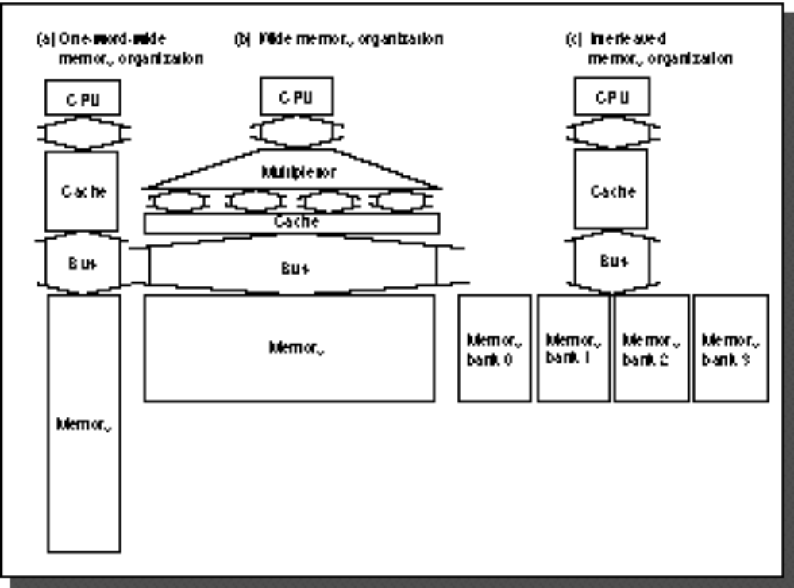
Main Memory Organizations
Simple:
  CPU, Cache, Bus, Memory same width
  (32 or 64 bits)
Wide:
  CPU/Mux 1 word; Mux/Cache, Bus, Memory N words (Alpha: 64 bits & 256 bits; UtraSPARC 512)
Interleaved:
  CPU, Cache, Bus 1 word: Memory N Modules
  (4 Modules); example is word interleaved

Slide 30
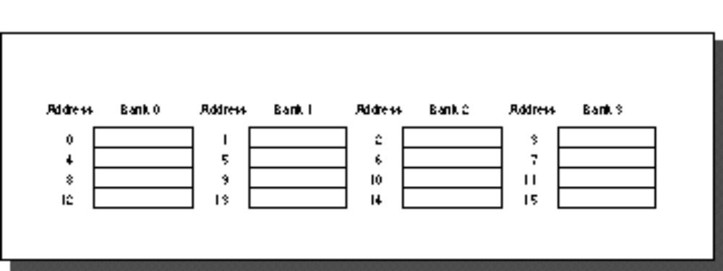
Main Memory Performance
Timing model (word size is 32 bits)
  1 to send address,
  6 access time, 1 to send data
  Cache Block is 4 words
Simple M.P. = 4 x (1+6+1) = 32
Wide M.P. = 1 + 6 + 1 = 8
Interleaved M.P. = 1 + 6 + 4x1 = 11

Slide 31

Independent Memory Banks
Memory banks for independent accesses
vs. faster sequential accesses
  Multiprocessor
  I/O
  CPU with Hit under n Misses, Non-blocking Cache
Superbank: all memory active on one block transfer (or Bank)
Bank: portion within a superbank that is word interleaved (or Subbank)
…
Superbank
Bank
Superbank Number
Superbank Offset
Bank Number
Bank Offset

Slide 32
Independent Memory Banks
How many banks?
number banks ≤ number clocks to access word in bank
  For sequential accesses, otherwise will return to original bank before it has next word ready
  (like in vector case)
Increasing DRAM => fewer chips => harder to have banks

Slide 33
Avoiding Bank Conflicts
Lots of banks
int x[256][512];
for (j = 0; j < 512; j = j+1)
for (i = 0; i < 256; i = i+1)
x[i][j] = 2 * x[i][j];
Even with 128 banks, since 512 is multiple of 128, conflict on word accesses
SW: loop interchange or declaring array not power of 2 (“array padding”)
HW: Prime number of banks
  bank number = address mod number of banks
  address within bank = address / number of words in bank
  modulo & divide per memory access with prime no. banks?
  address within bank = address mod number words in bank
  bank number? easy if 2^{N} words per bank

Slide 34
Fast Bank Number
Chinese Remainder Theorem
As long as two sets of integers ai and bi follow these rules
and that ai and aj are co-prime if i ≠ j, then the integer x has only one solution (unambiguous mapping):
  bank number = b₀, number of banks = a₀ (= 3 in example)
  address within bank = b₁, number of words in bank = a₁
  (= 8 in example)
  N word address 0 to N-1, prime no. banks, words power of 2
Seq. Interleaved Modulo Interleaved
Bank Number: 0 1 2 0 1 2 Address within Bank: 0 0 1 2 0 16 8 1 3 4 5 9 1 17
2 6 7 8 18 10 2 3 9 10 11 3 19 11 4 12 13 14 12 4 20 5 15 16 17 21 13 5 6 18 19 20 6 22 14 7 21 22 23 15 7 23

Slide 35
DRAMs per PC over Time
DRAM Generation
‘86 ‘89 ‘92 ‘96 ‘99 ‘02
1 Mb 4 Mb 16 Mb 64 Mb 256 Mb 1 Gb
4 MB
8 MB
16 MB
32 MB
64 MB
128 MB
256 MB
32
8
16
4
8
2
Minimum Memory Size
4
1
8
2
4
1
8
2

Slide 36
Need for Error Correction!
Motivation:
  Failures/time proportional to number of bits!
  As DRAM cells shrink, more vulnerable
Went through period in which failure rate was low enough without error correction that people didn’t do correction
  DRAM banks too large now
  Servers always corrected memory systems
Basic idea: add redundancy through parity bits
  Simple but wastful version:
    Keep three copies of everything, vote to find right value
    200% overhead, so not good!
  Common configuration: Random error correction
    SEC-DED (single error correct, double error detect)
    One example: 64 data bits + 8 parity bits (11% overhead)
    Papers up on reading list from last term tell you how to do these types of codes
  Really want to handle failures of physical components as well
    Organization is multiple DRAMs/SIMM, multiple SIMMs
    Want to recover from failed DRAM and failed SIMM!
    Requires more redundancy to do this
    All major vendors thinking about this in high-end machines

Slide 37
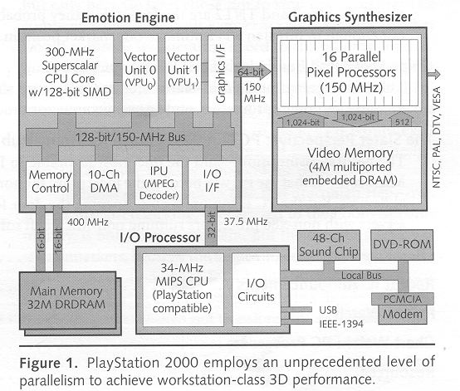
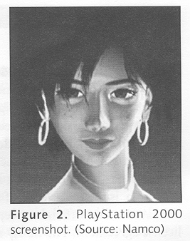
Architecture in practice
(as reported in Microprocessor Report, Vol 13, No. 5)
  Emotion Engine: 6.2 GFLOPS, 75 million polygons per second
  Graphics Synthesizer: 2.4 Billion pixels per second
  Claim: Toy Story realism brought to games!

Slide 38
More esoteric Storage Technologies?
Tunneling Magnetic Junction RAM (TMJ-RAM):
  Speed of SRAM, density of DRAM, non-volatile (no refresh)
  New field called “Spintronics”: combination of quantum spin and electronics
  Same technology used in high-density disk-drives
MEMs storage devices:
  Large magnetic “sled” floating on top of lots of little read/write heads
  Micromechanical actuators move the sled back and forth over the heads

Slide 39
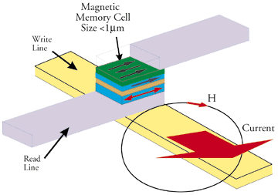
Tunneling Magnetic Junction

Slide 40
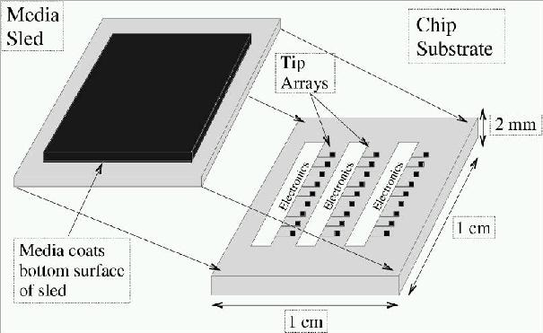
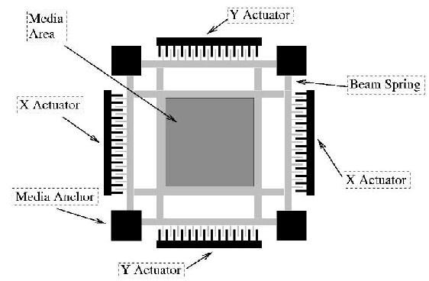
MEMS-based Storage
Magnetic “sled” floats
on array of read/write heads
  Approx 250 Gbit/in²
  Data rates:
  IBM: 250 MB/s w 1000 heads
  CMU: 3.1 MB/s w 400 heads
Electrostatic actuators move media around to
align it with heads
  Sweep sled ±50μm in < 0.5μs
Capacity estimated to be in the 1-10GB in 10cm²
See Ganger et all: http://www.lcs.ece.cmu.edu/research/MEMS

Slide 41
Main Memory Summary
Wider Memory
Interleaved Memory: for sequential or independent accesses
Avoiding bank conflicts: SW & HW
DRAM specific optimizations: page mode & Specialty DRAM
Need Error correction

Slide 42
Review: Improving Cache Performance
1. Reduce the miss rate,
2. Reduce the miss penalty, or
3. Reduce the time to hit in the cache.

Slide 43
1. Fast Hit times via Small and Simple Caches
Why Alpha 21164 has 8KB Instruction and 8KB data cache + 96KB second level cache?
  Small data cache and clock rate
Direct Mapped, on chip

Slide 44
2. Fast hits by Avoiding Address Translation
CPU
CPU
CPU
VA
VA
VA
TB
VA
Tags
$
PA
Tags
$
TB
PA
VA
PA
$
TB
L2 $
PA
PA
MEM
MEM
MEM
Overlap $ access
with VA translation:
requires $ index to
remain invariant
across translation
Conventional
Organization
Virtually Addressed Cache
Translate only on miss
Synonym Problem

Slide 45
2. Fast hits by Avoiding Address Translation
Send virtual address to cache? Called Virtually Addressed Cache or just Virtual Cache vs. Physical Cache
  Every time process is switched logically must flush the cache; otherwise get false hits
    Cost is time to flush + “compulsory” misses from empty cache
  Dealing with aliases (sometimes called synonyms);
  Two different virtual addresses map to same physical address
  I/O must interact with cache, so need virtual address
Solution to aliases
  HW guaranteess covers index field & direct mapped, they must be unique;
  called page coloring
Solution to cache flush
  Add process identifier tag that identifies process as well as address within process: can’t get a hit if wrong process

Slide 46
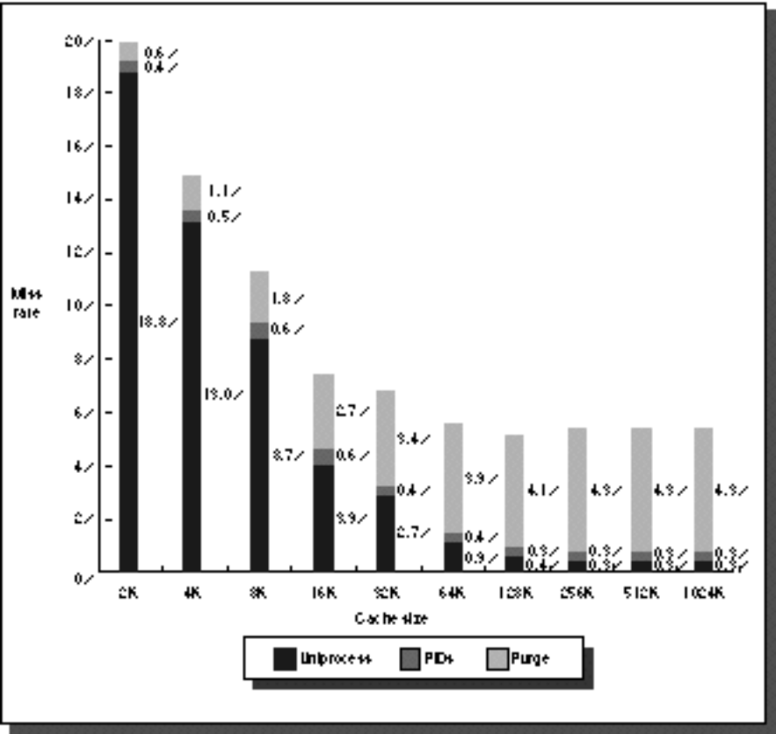
2. Fast Cache Hits by Avoiding Translation: Process ID impact
Black is uniprocess
Light Gray is multiprocess when flush cache
Dark Gray is multiprocess when use Process ID tag
Y axis: Miss Rates up to 20%
X axis: Cache size from 2 KB to 1024 KB

Slide 47
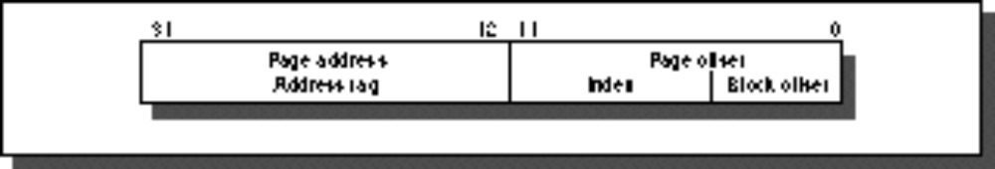
2. Fast Cache Hits by Avoiding Translation: Index with Physical Portion of Address
If index is physical part of address, can start tag access in parallel with translation so that can compare to physical tag
Limits cache to page size: what if want bigger caches and uses same trick?
  Higher associativity moves barrier to right
  Page coloring
Page Address
Page Offset
Address Tag
Index
Block Offset

Slide 48
3: Fast Hits by pipelining Cache
Case Study: MIPS R4000
8 Stage Pipeline:
  IF–first half of fetching of instruction; PC selection happens here as well as initiation of instruction cache access.
  IS–second half of access to instruction cache.
  RF–instruction decode and register fetch, hazard checking and also instruction cache hit detection.
  EX–execution, which includes effective address calculation, ALU operation, and branch target computation and condition evaluation.
  DF–data fetch, first half of access to data cache.
  DS–second half of access to data cache.
  TC–tag check, determine whether the data cache access hit.
  WB–write back for loads and register-register operations.
What is impact on Load delay?
  Need 2 instructions between a load and its use!
Notes:
Answer is 3 stages between branch and new instruction fetch and 2 stages between load and use (even though if looked at red insertions that it would be 3 for load and 2 for branch)
Reasons:
1) Load: TC just does tag check, data available after DS; thus supply the data & forward it, restarting the pipeline on a data cache miss
2) EX phase does the address calculation even though just added one phase; presumed reason is that since want fast clockc cycle don’t want to sitck RF phase with reading regisers AND testing for zero, so just moved it back on phase

Slide 49
Case Study: MIPS R4000
TWO Cycle
Load Latency
IF
IS
IF
RF
IS
IF
EX
RF
IS
IF
DF
EX
RF
IS
IF
DS
DF
EX
RF
IS
IF
TC
DS
DF
EX
RF
IS
IF
WB
TC
DS
DF
EX
RF
IS
IF
THREE Cycle
Branch Latency
IF
IS
IF
RF
IS
IF
EX
RF
IS
IF
DF
EX
RF
IS
IF
DS
DF
EX
RF
IS
IF
TC
DS
DF
EX
RF
IS
IF
WB
TC
DS
DF
EX
RF
IS
IF
(conditions evaluated
during EX phase)
Delay slot plus two stalls
Branch likely cancels delay slot if not taken

Slide 50
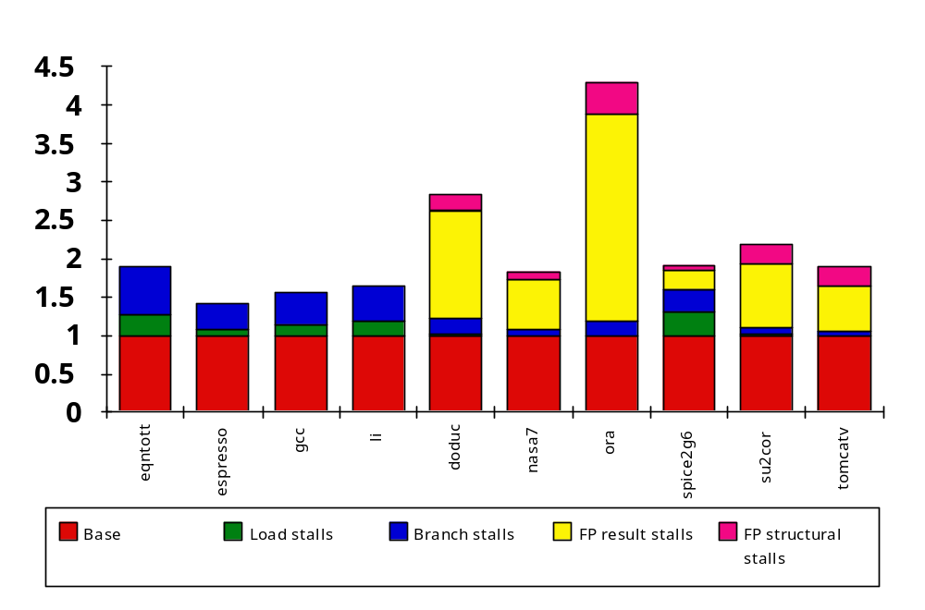
R4000 Performance
Not ideal CPI of 1:
  Load stalls (1 or 2 clock cycles)
  Branch stalls (2 cycles + unfilled slots)
  FP result stalls: RAW data hazard (latency)
  FP structural stalls: Not enough FP hardware (parallelism)
Notes:
Integer programs, major delay is branch stalls
FP its structural stalls

Slide 51
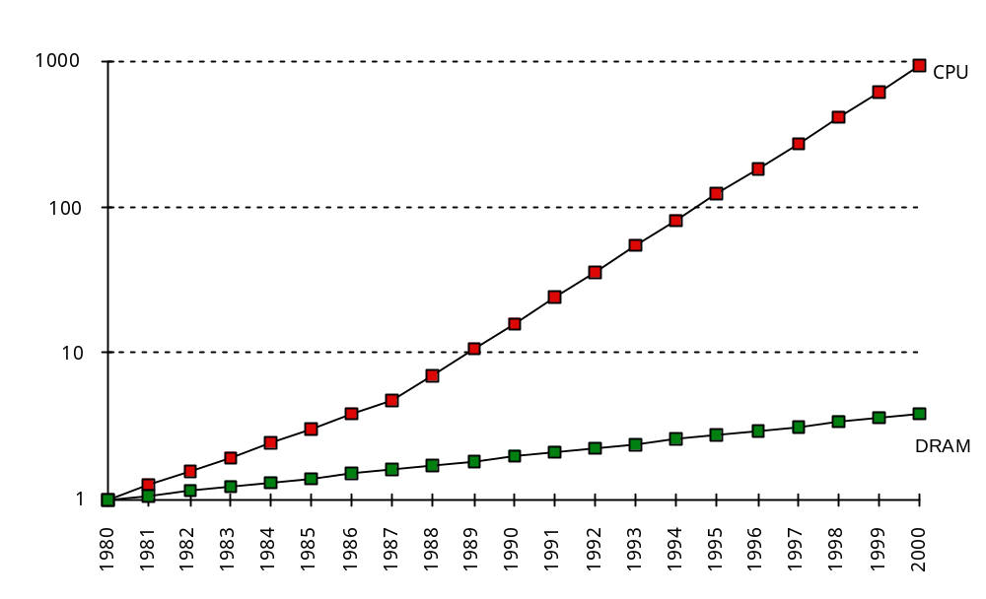
What is the Impact of What You’ve Learned About Caches?
1960-1985: Speed
= ƒ(no. operations)
1990
  Pipelined
  Execution &
  Fast Clock Rate
  Out-of-Order
  execution
  Superscalar
  Instruction Issue
1998: Speed =
ƒ(non-cached memory accesses)
What does this mean for
  Compilers?,Operating Systems?, Algorithms?
  Data Structures?

Slide 52
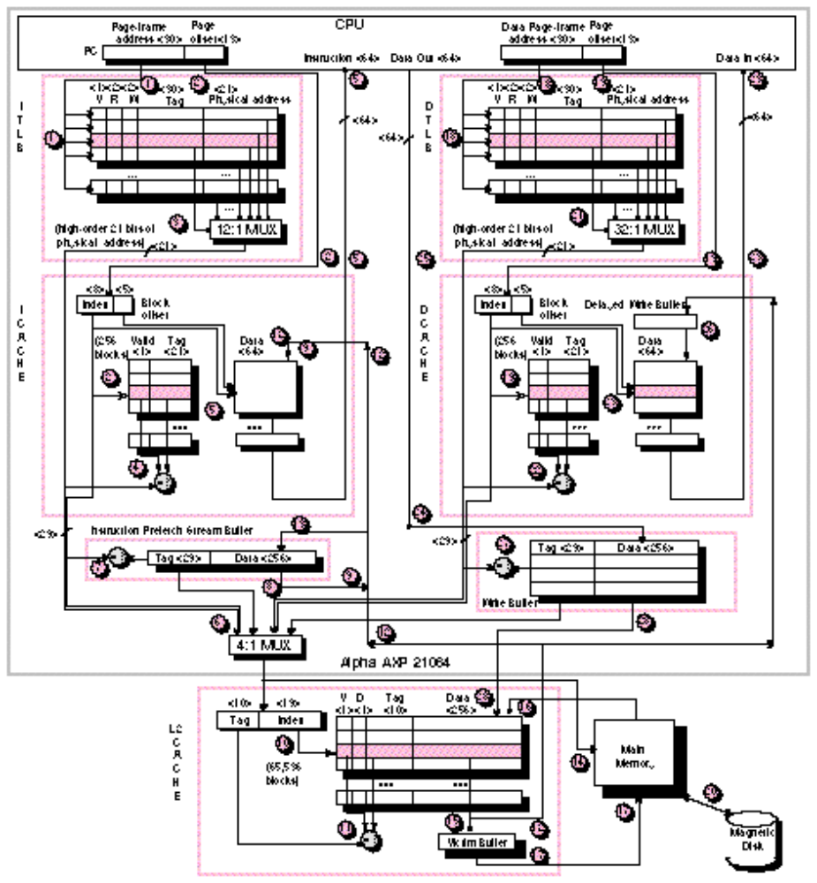
Alpha 21064
Separate Instr & Data TLB & Caches
TLBs fully associative
TLB updates in SW
(“Priv Arch Libr”)
Caches 8KB direct mapped, write thru
Critical 8 bytes first
Prefetch instr. stream buffer
2 MB L2 cache, direct mapped, WB (off-chip)
256 bit path to main memory, 4 x 64-bit modules
Victim Buffer: to give read priority over write
4 entry write buffer between D$ & L2$
Instr
Data
Write
Buffer
Stream
Buffer
Victim Buffer

Slide 53
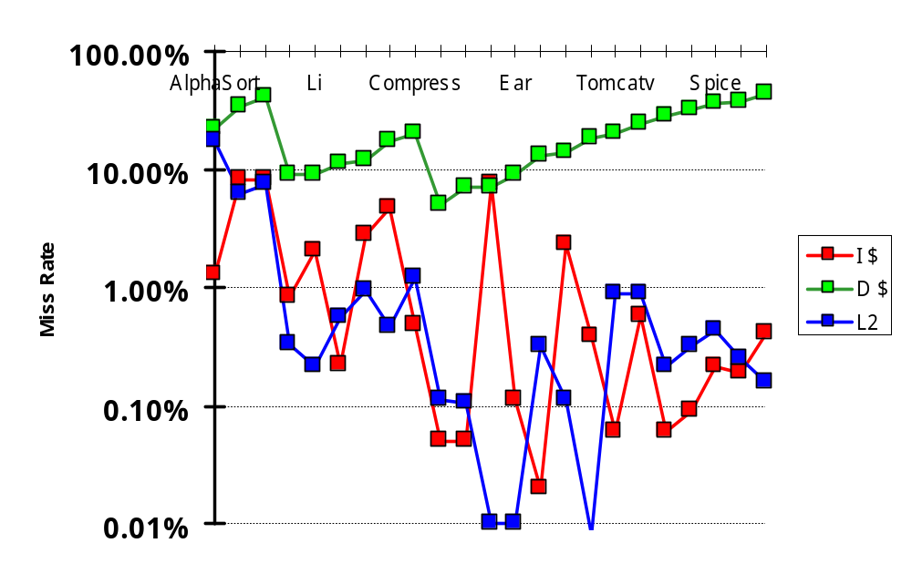
Alpha Memory Performance: Miss Rates of SPEC92
I$ miss = 6%
D$ miss = 32%
L2 miss = 10%
8K
8K
2M
I$ miss = 2%
D$ miss = 13%
L2 miss = 0.6%
I$ miss = 1%
D$ miss = 21%
L2 miss = 0.3%

Slide 54
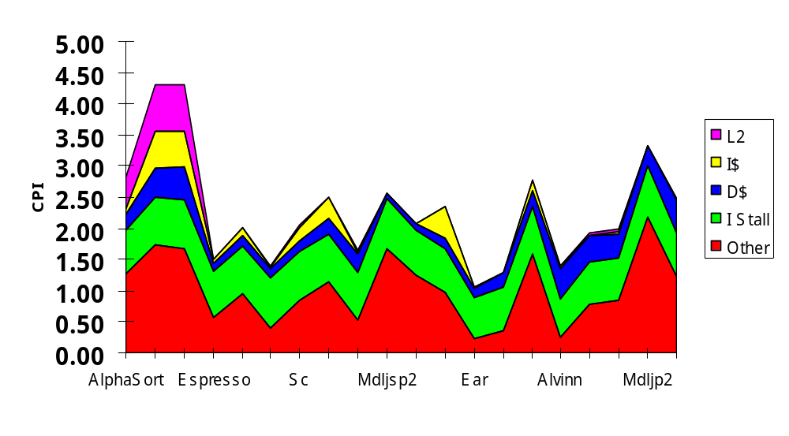
Alpha CPI Components
Instruction stall: branch mispredict (green);
Data cache (blue); Instruction cache (yellow); L2$ (pink)
Other: compute + reg conflicts, structural conflicts

Slide 55
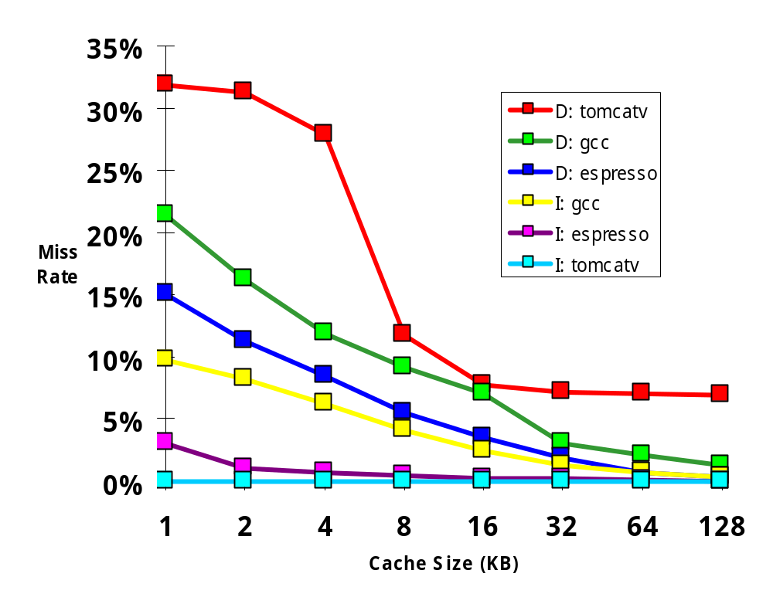
Pitfall: Predicting Cache Performance from Different Prog. (ISA, compiler, ...)
D$, Tom
4KB Data cache miss rate 8%,12%, or 28%?
1KB Instr cache miss rate 0%,3%,or 10%?
Alpha vs. MIPS
for 8KB Data $:
17% vs. 10%
Why 2X Alpha v. MIPS?
D$, gcc
D$, esp
I$, gcc
I$, esp
I$, Tom

Slide 56
Cache Optimization Summary
Technique MR MP HT Complexity
Larger Block Size + – 0
Higher Associativity + – 1
Victim Caches + 2
Pseudo-Associative Caches + 2
HW Prefetching of Instr/Data + 2
Compiler Controlled Prefetching + 3
Compiler Reduce Misses + 0
Priority to Read Misses + 1
Early Restart & Critical Word 1st + 2
Non-Blocking Caches + 3
Second Level Caches + 2
Better memory system + 3
Small & Simple Caches – + 0
Avoiding Address Translation + 2
Pipelining Caches + 2
miss rate
miss
penalty
hit time

