Slide 1
CS252
Graduate Computer Architecture
Lecture 5:
I/O Introduction: Storage Devices & RAID
January 31, 2001
Prof. David A. Patterson
Computer Science 252
Spring 2001

Slide 2
Motivation: Who Cares About I/O?
CPU Performance: 60% per year
I/O system performance limited by mechanical delays (disk I/O)
  < 10% per year (IO per sec)
Amdahl's Law: system speed-up limited by the slowest part!
  10% IO & 10x CPU => 5x Performance (lose 50%)
  10% IO & 100x CPU => 10x Performance (lose 90%)
I/O bottleneck:
  Diminishing fraction of time in CPU
  Diminishing value of faster CPUs
Notes:
Ancestor of Java had no I/O
CPU vs. Peripheral
Primary vs. Secondary
What maks portable, PDA exciting?

Slide 3
Big Picture: Who cares about CPUs?
Why still important to keep CPUs busy vs. IO devices ("CPU time"), as CPUs not costly?
  Moore's Law leads to both large, fast CPUs but also to very small, cheap CPUs
  2001 Hypothesis: 600 MHz PC is fast enough for Office Tools?
  PC slowdown since fast enough unless games, new apps?
People care more about about storing information and communicating information than calculating
  "Information Technology" vs. "Computer Science"
  1960s and 1980s: Computing Revolution
  1990s and 2000s: Information Age
Next 3 weeks on storage and communication

Slide 4
I/O Systems
interrupts
Processor
Cache
Memory - I/O Bus
Main
Memory
I/O
Controller
I/O
Controller
I/O
Controller
Disk
Disk
Graphics
Network

Slide 5
Storage Technology Drivers
Driven by the prevailing computing paradigm
  1950s: migration from batch to on-line processing
  1990s: migration to ubiquitous computing
    computers in phones, books, cars, video cameras, …
    nationwide fiber optical network with wireless tails
Effects on storage industry:
  Embedded storage
    smaller, cheaper, more reliable, lower power
  Data utilities
    high capacity, hierarchically managed storage

Slide 6
Outline
Disk Basics
Disk History
Disk options in 2000
Disk fallacies and performance
Tapes
RAID

Slide 7
Disk Device Terminology
Inner
Track
Arm
Head
Sector
Outer
Track
Actuator
Platter
Several platters, with information recorded magnetically on both surfaces (usually)
Bits recorded in tracks, which in turn divided into sectors (e.g., 512 Bytes)
Actuator moves head (end of arm,1/surface) over track (“seek”), select surface, wait for sector rotate under head, then read or write
  “Cylinder”: all tracks under heads

Slide 8
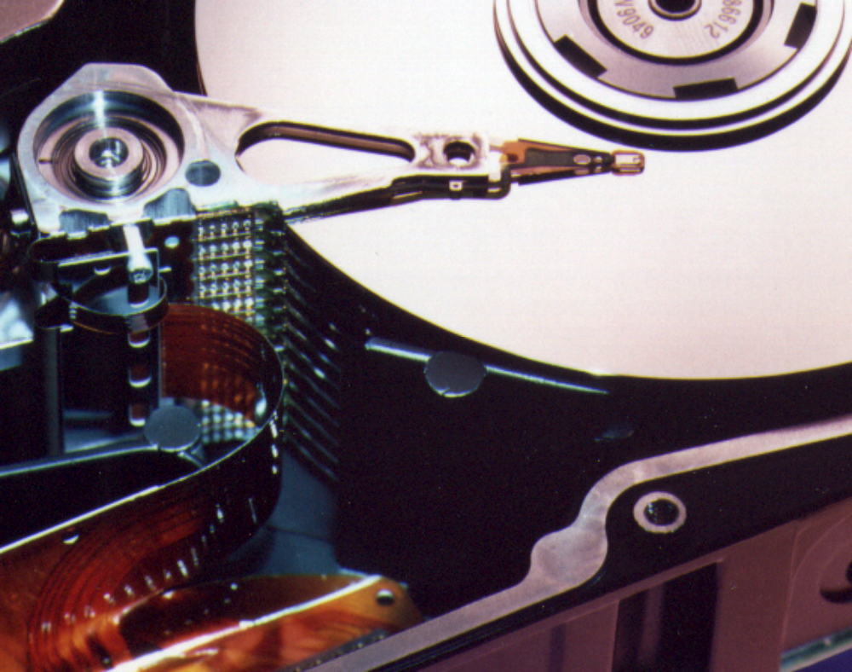
Photo of Disk Head, Arm, Actuator
Spindle
Arm
Head
Actuator
{
Platters (12)

Slide 9
Disk Device Performance
Outer
Track
Inner
Track
Sector
Head
Arm
Controller
Spindle
Platter
Actuator
Disk Latency = Seek Time + Rotation Time + Transfer Time + Controller Overhead
Seek Time? depends no. tracks move arm, seek speed of disk
Rotation Time? depends on speed disk rotates, how far sector is from head
Transfer Time? depends on data rate (bandwidth) of disk (bit density), size of request

Slide 10
Disk Device Performance
Average distance sector from head?
1/2 time of a rotation
  10000 Revolutions Per Minute ⇒ 166.67 Rev/sec
  1 revolution = 1/ 166.67 sec ⇒ 6.00 milliseconds
  1/2 rotation (revolution) ⇒ 3.00 ms
Average no. tracks move arm?
  Sum all possible seek distances
  from all possible tracks / # possible
    Assumes average seek distance is random
  Disk industry standard benchmark

Slide 11
Data Rate: Inner vs. Outer Tracks
To keep things simple, orginally kept same number of sectors per track
  Since outer track longer, lower bits per inch
Competition ⇒ decided to keep BPI the same for all tracks (“constant bit density”)
  ⇒ More capacity per disk
  ⇒ More of sectors per track towards edge
  ⇒ Since disk spins at constant speed,
  outer tracks have faster data rate
Bandwidth outer track 1.7X inner track!
  Inner track highest density, outer track lowest, so not really constant
  2.1X length of track outer / inner, 1.7X bits outer / inner

Slide 12
Devices: Magnetic Disks
Purpose:
  Long-term, nonvolatile storage
  Large, inexpensive, slow level in the storage hierarchy
Characteristics:
  Seek Time (~8 ms avg)
    positional latency
    rotational latency
Transfer rate
  10-40 MByte/sec
  Blocks
Capacity
  Gigabytes
  Quadruples every 2 years
  (aerodynamics)
Track
Sector
Cylinder
Platter
Head
7200 RPM = 120 RPS => 8 ms per rev
ave rot. latency = 4 ms
128 sectors per track => 0.25 ms per sector
1 KB per sector => 16 MB / s
Response time
= Queue + Controller + Seek + Rot + Xfer
Service time

Slide 13
Disk Performance Model /Trends
Capacity
  + 100%/year (2X / 1.0 yrs)
Transfer rate (BW)
  + 40%/year (2X / 2.0 yrs)
Rotation + Seek time
  – 8%/ year (1/2 in 10 yrs)
MB/$
  > 100%/year (2X / 1.0 yrs)
  Fewer chips + areal density

Slide 14
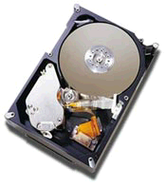
State of the Art: Barracuda 180
  181.6 GB, 3.5 inch disk
  12 platters, 24 surfaces
  24,247 cylinders
  7,200 RPM; (4.2 ms avg. latency)
  7.4/8.2 ms avg. seek (r/w)
  64 to 35 MB/s (internal)
  0.1 ms controller time
  10.3 watts (idle)
Track
Sector
Cylinder
Track
Buffer
Arm
Platter
Head
Latency =
Queuing Time +
Controller time +
Seek Time +
Rotation Time +
Size / Bandwidth
{
per access
+
per byte
source: www.seagate.com
Notes:
47 to 26 MB/s (external)

Slide 15
Disk Performance Example (will fix later)
Calculate time to read 64 KB (128 sectors) for Barracuda 180 X using advertised performance; sector is on outer track
Disk latency = average seek time + average rotational delay + transfer time + controller overhead
= 7.4 ms + 0.5 * 1/(7200 RPM)
+ 64 KB / (65 MB/s) + 0.1 ms
= 7.4 ms + 0.5 /(7200 RPM/(60000ms/M))
+ 64 KB / (65 KB/ms) + 0.1 ms
= 7.4 + 4.2 + 1.0 + 0.1 ms = 12.7 ms

Slide 16
CS 252 Administrivia
We have a TA! Yu-jia Jin: yujia@ic.eecs
Please send 1-2 paragraph summary of papers to him BEFORE CLASS Friday
  J.GRAY, Turing Award Lecture: "What Next? A dozen remaining IT problems"; We will discuss Friday
  Should have already turned in
    G. MOORE, "Cramming More Components onto Integrated Circuits"
    J. S. LIPTAY, "Structural Aspects of the System/360 Model 85, Part II: The Cache"
Please fill out Third Edition chapter surveys for 1, 5, 6; 1,5 before Friday, 6 by next Wednesday
  Link from 252 Web page (click on survey)
Project suggestions are on web site; start looking
  http://www.cs.berkeley.edu/~pattrsn/252S01/suggestions.html
Office hours Wednesdays 11-12

Slide 17
Areal Density
Bits recorded along a track
  Metric is Bits Per Inch (BPI)
Number of tracks per surface
  Metric is Tracks Per Inch (TPI)
Disk Designs Brag about bit density per unit area
  Metric is Bits Per Square Inch
  Called Areal Density
  Areal Density = BPI x TPI

Slide 18
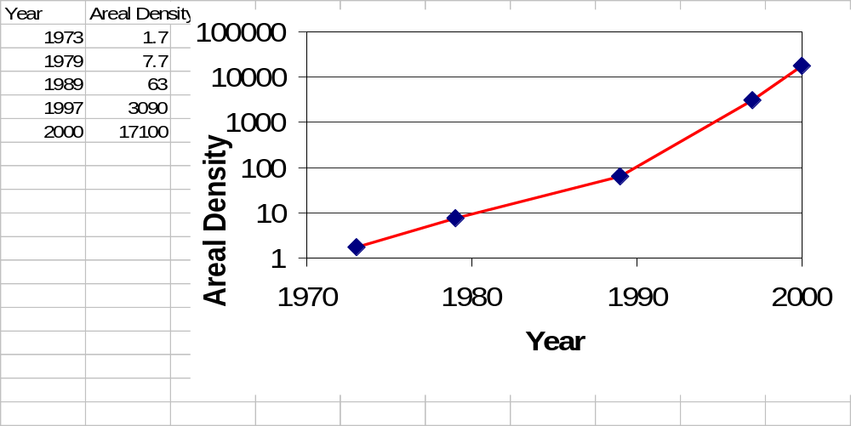
Areal Density
  Areal Density = BPI x TPI
  Change slope 30%/yr to 60%/yr about 1991

Slide 19
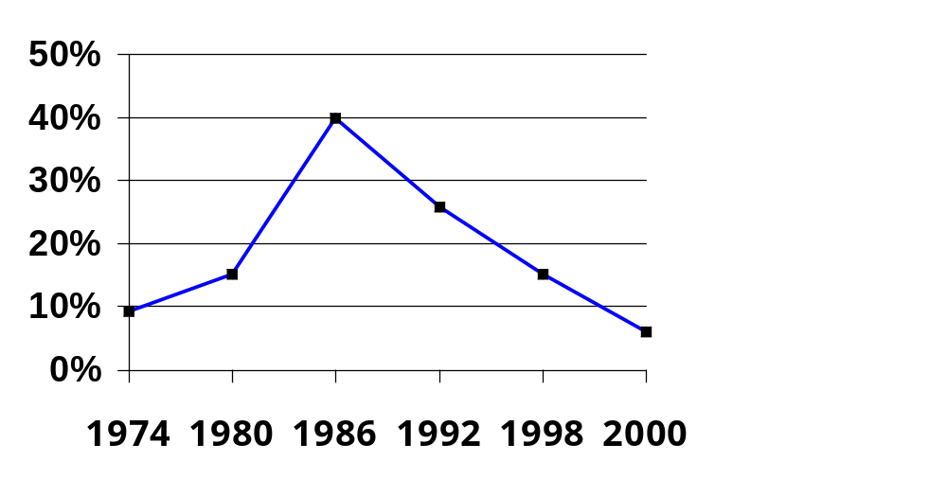
MBits per square inch:
DRAM as % of Disk over time
9 v. 22 Mb/si
470 v. 3000 Mb/si
0.2 v. 1.7 Mb/si
source: New York Times, 2/23/98, page C3,
“Makers of disk drives crowd even mroe data into even smaller spaces”

Slide 20
Historical Perspective
1956 IBM Ramac — early 1970s Winchester
  Developed for mainframe computers, proprietary interfaces
  Steady shrink in form factor: 27 in. to 14 in
Form factor and capacity drives market, more than performance
1970s: Mainframes ⇒ 14 inch diameter disks
1980s: Minicomputers,Servers ⇒ 8”,5 1/4” diameter
PCs, workstations Late 1980s/Early 1990s:
  Mass market disk drives become a reality
    industry standards: SCSI, IPI, IDE
  Pizzabox PCs ⇒ 3.5 inch diameter disks
  Laptops, notebooks ⇒ 2.5 inch disks
  Palmtops didn’t use disks,
  so 1.8 inch diameter disks didn’t make it
2000s:
  1 inch for cameras, cell phones?

Slide 21
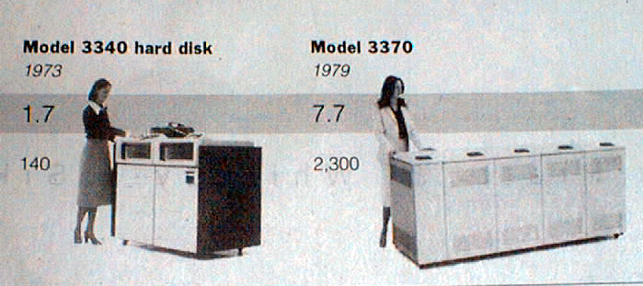
Disk History
Data
density
Mbit/sq. in.
Capacity of
Unit Shown
Megabytes
1973:
1. 7 Mbit/sq. in
140 MBytes
1979:
7. 7 Mbit/sq. in
2,300 MBytes
source: New York Times, 2/23/98, page C3,
“Makers of disk drives crowd even more data into even smaller spaces”

Slide 22
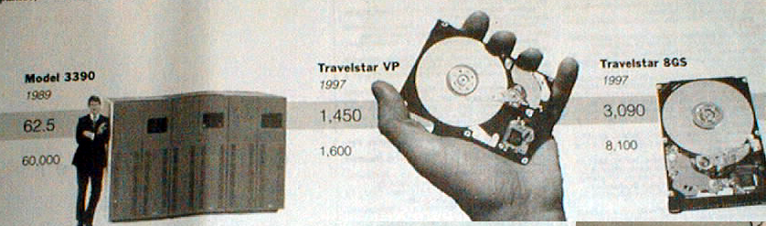
Disk History
1989:
63 Mbit/sq. in
60,000 MBytes
1997:
1450 Mbit/sq. in
2300 MBytes
1997:
3090 Mbit/sq. in
8100 MBytes
source: New York Times, 2/23/98, page C3,
“Makers of disk drives crowd even mroe data into even smaller spaces”

Slide 23

1 inch disk drive!
2000 IBM MicroDrive:
  1.7” x 1.4” x 0.2”
  1 GB, 3600 RPM,
  5 MB/s, 15 ms seek
  Digital camera, PalmPC?
2006 MicroDrive?
9 GB, 50 MB/s!
  Assuming it finds a niche
  in a successful product
  Assuming past trends continue

Slide 24
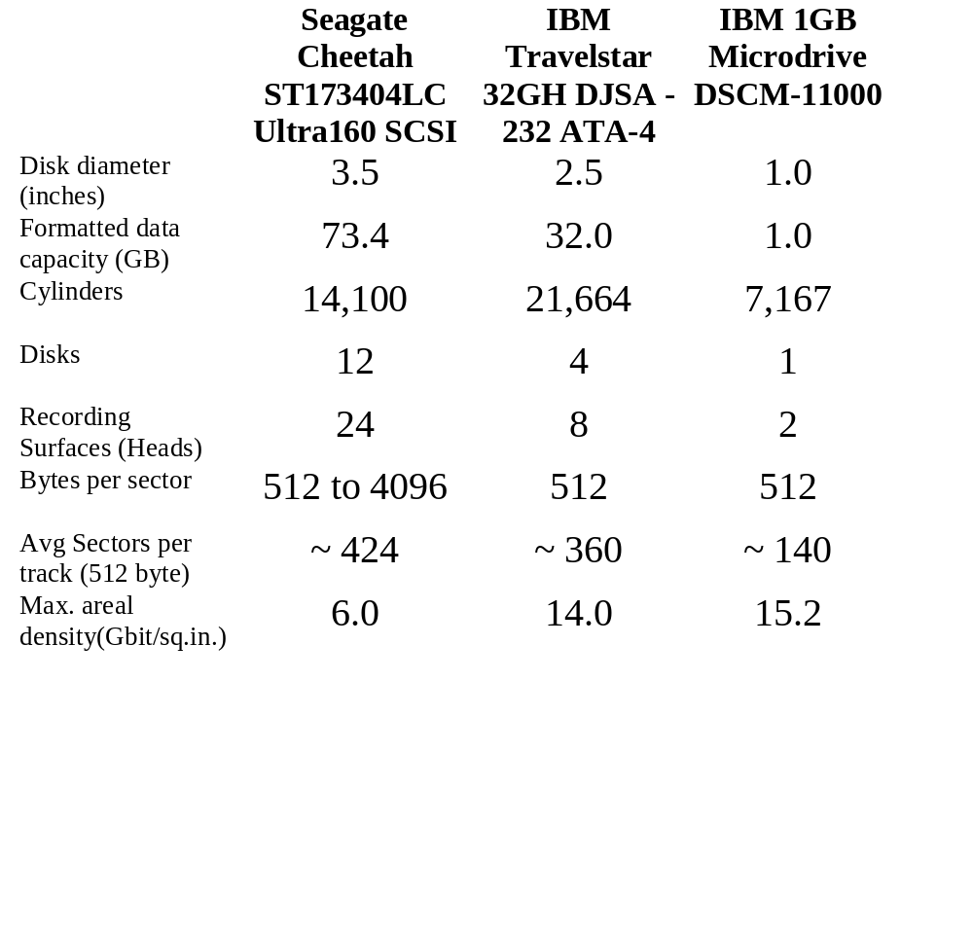
Disk Characteristics in 2000
$828
$447
$435

Slide 25
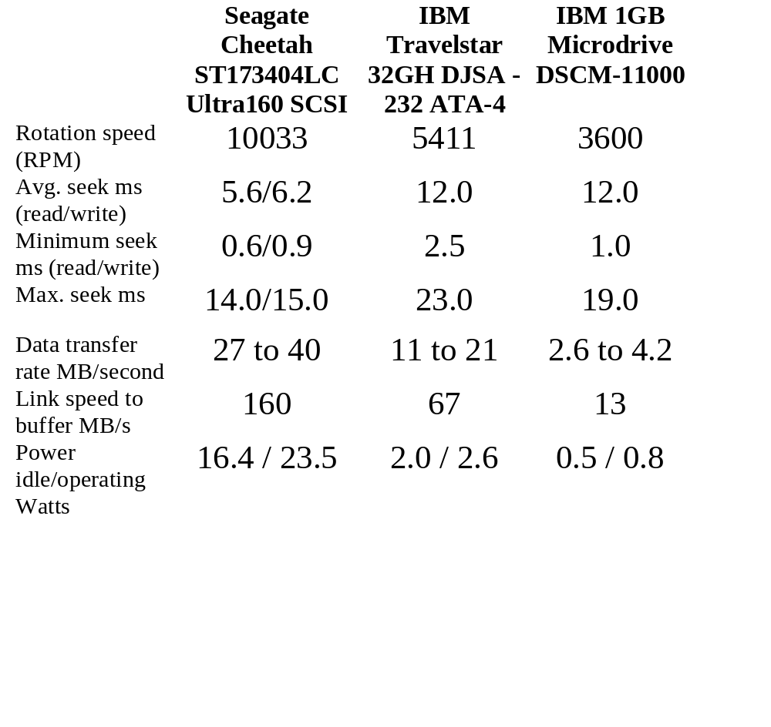
Disk Characteristics in 2000

Slide 26
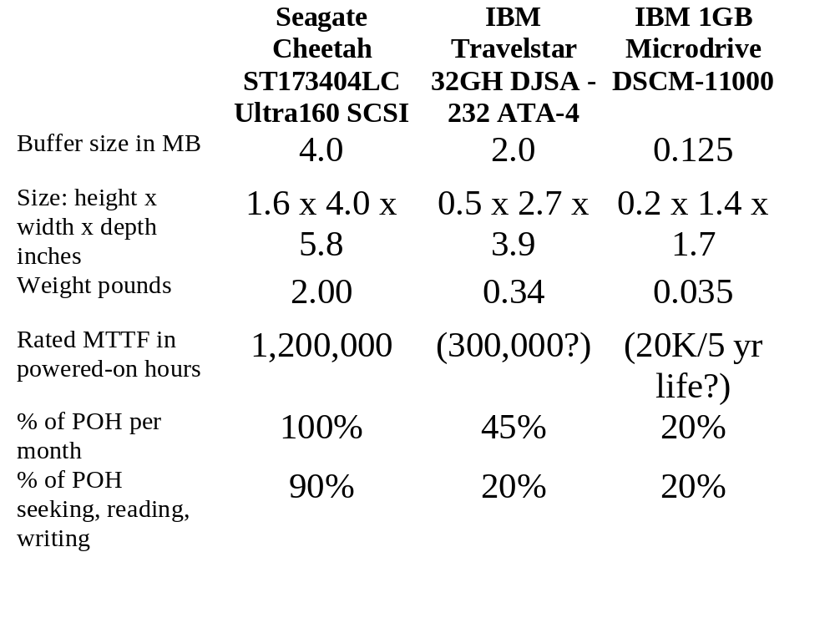
Disk Characteristics in 2000

Slide 27
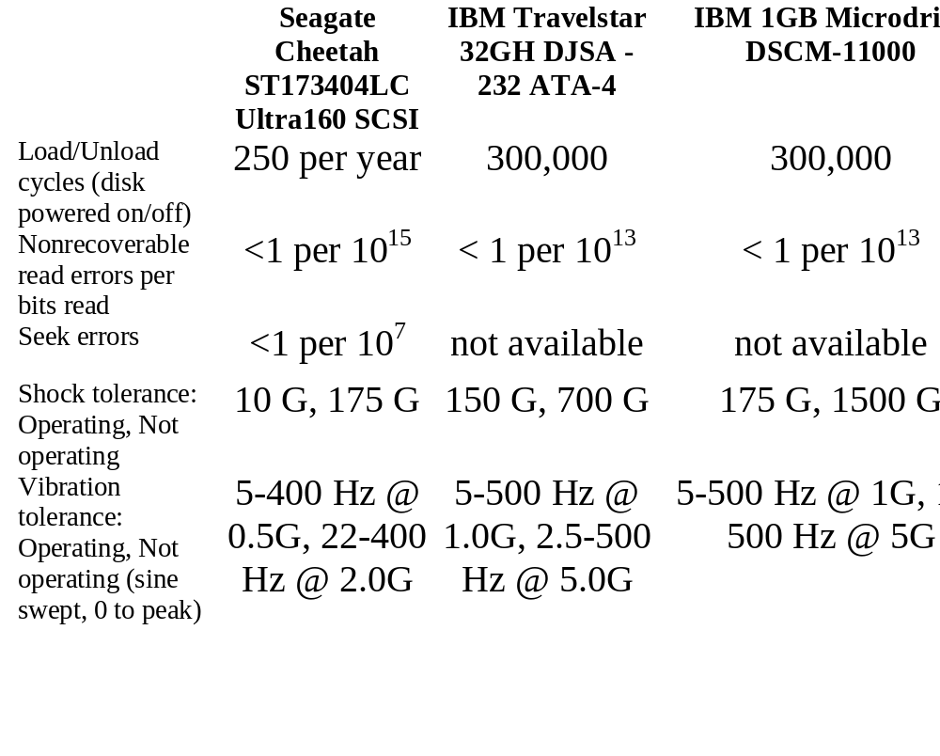
Disk Characteristics in 2000

Slide 28
Fallacy: Use Data Sheet “Average Seek” Time
Manufacturers needed standard for fair comparison (“benchmark”)
  Calculate all seeks from all tracks, divide by number of seeks => “average”
Real average would be based on how data laid out on disk, where seek in real applications, then measure performance
  Usually, tend to seek to tracks nearby, not to random track
Rule of Thumb: observed average seek time is typically about 1/4 to 1/3 of quoted seek time (i.e., 3X-4X faster)
  Barracuda 180 X avg. seek: 7.4 ms ⇒ 2.5 ms

Slide 29
Fallacy: Use Data Sheet Transfer Rate
Manufacturers quote the speed off the data rate off the surface of the disk
Sectors contain an error detection and correction field (can be 20% of sector size) plus sector number as well as data
There are gaps between sectors on track
Rule of Thumb: disks deliver about 3/4 of internal media rate (1.3X slower) for data
For example, Barracuda 180X quotes
64 to 35 MB/sec internal media rate
⇒ 47 to 26 MB/sec external data rate (74%)

Slide 30
Disk Performance Example
Calculate time to read 64 KB for UltraStar 72 again, this time using 1/3 quoted seek time, 3/4 of internal outer track bandwidth; (12.7 ms before)
Disk latency = average seek time + average rotational delay + transfer time + controller overhead
= (0.33 * 7.4 ms) + 0.5 * 1/(7200 RPM)
+ 64 KB / (0.75 * 65 MB/s) + 0.1 ms
= 2.5 ms + 0.5 /(7200 RPM/(60000ms/M))
+ 64 KB / (47 KB/ms) + 0.1 ms
= 2.5 + 4.2 + 1.4 + 0.1 ms = 8.2 ms (64% of 12.7)

Slide 31
Future Disk Size and Performance
Continued advance in capacity (60%/yr) and bandwidth (40%/yr)
Slow improvement in seek, rotation (8%/yr)
Time to read whole disk
Year Sequentially Randomly
(1 sector/seek)
1990 4 minutes 6 hours
2000 12 minutes 1 week(!)
3.5” form factor make sense in 5 yrs?
  What is capacity, bandwidth, seek time, RPM?
  Assume today 80 GB, 30 MB/sec, 6 ms, 10000 RPM
Notes:
Capacity: 80 GB * 2^5 = 2.5 TB
BW 30 MB/s * 1.4^5 = 160 MB/s
seek 6 / 1.1^5 = 4 ms
RPM 10000 => 20000? (3 to 1.5)
to read sequentially = 260 minutes or 4.4 hours!
To read randomly = 316 days or 1 year

Slide 32
Tape vs. Disk
• Longitudinal tape uses same technology as
hard disk; tracks its density improvements
Disk head flies above surface, tape head lies on surface
Disk fixed, tape removable
• Inherent cost-performance based on geometries:
fixed rotating platters with gaps
(random access, limited area, 1 media / reader)
vs.
removable long strips wound on spool
(sequential access, "unlimited" length, multiple / reader)
• Helical Scan (VCR, Camcoder, DAT)
Spins head at angle to tape to improve density

Slide 33
Current Drawbacks to Tape
Tape wear out:
  Helical 100s of passes to 1000s for longitudinal
Head wear out:
  2000 hours for helical
Both must be accounted for in economic / reliability model
Bits stretch
Readers must be compatible with multiple generations of media
Long rewind, eject, load, spin-up times;
not inherent, just no need in marketplace
Designed for archival

Slide 34
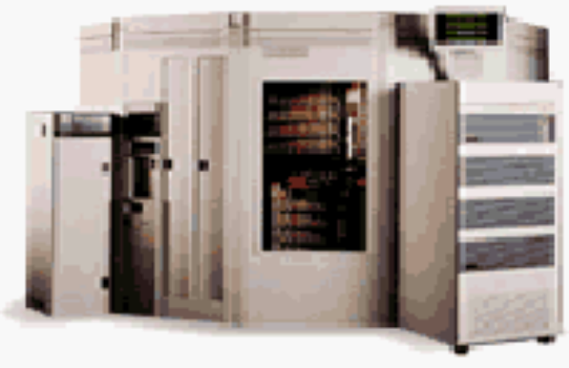
Automated Cartridge System: StorageTek Powderhorn 9310
7.7 feet
8200 pounds,
1.1 kilowatts
10.7 feet
6000 x 50 GB 9830 tapes = 300 TBytes in 2000 (uncompressed)
  Library of Congress: all information in the world; in 1992, ASCII of all books = 30 TB
  Exchange up to 450 tapes per hour (8 secs/tape)
1.7 to 7.7 Mbyte/sec per reader, up to 10 readers

Slide 35
Library vs. Storage
Getting books today as quaint as the way I learned to program
  punch cards, batch processing
  wander thru shelves, anticipatory purchasing
Cost $1 per book to check out
$30 for a catalogue entry
30% of all books never checked out
Write only journals?
Digital library can transform campuses

Slide 36
Whither tape?
Investment in research:
  90% of disks shipped in PCs; 100% of PCs have disks
  ~0% of tape readers shipped in PCs; ~0% of PCs have disks
Before, N disks / tape; today, N tapes / disk
  40 GB/DLT tape (uncompressed)
  80 to 192 GB/3.5" disk (uncompressed)
Cost per GB:
  In past, 10X to 100X tape cartridge vs. disk
  Jan 2001: 40 GB for $53 (DLT cartridge), $2800 for reader
  $1.33/GB cartridge, $2.03/GB 100 cartridges + 1 reader
  ($10995 for 1 reader + 15 tape autoloader, $10.50/GB)
  Jan 2001: 80 GB for $244 (IDE,5400 RPM), $3.05/GB
  Will $/GB tape v. disk cross in 2001? 2002? 2003?
Storage field is based on tape backup; what should we do? Discussion if time permits?

Slide 37
Use Arrays of Small Disks?
Katz and Patterson asked in 1987:
  Can smaller disks be used to close gap in performance between disks and CPUs?
Conventional: 4 disk designs
3.5”
5.25”
10”
14”
Low End
High End
Disk Array: 1 disk design
3.5”

Slide 38
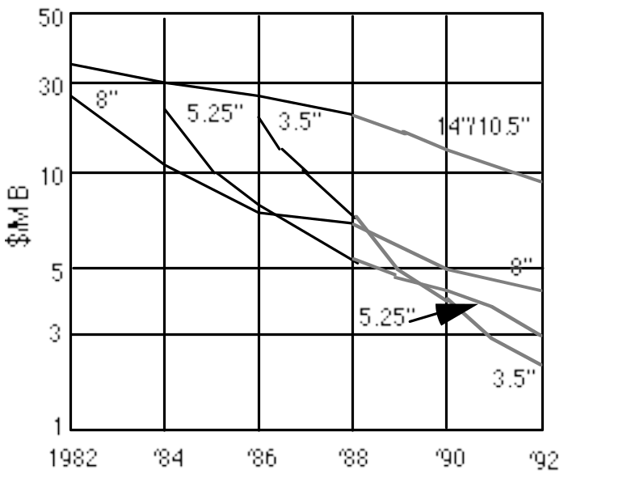
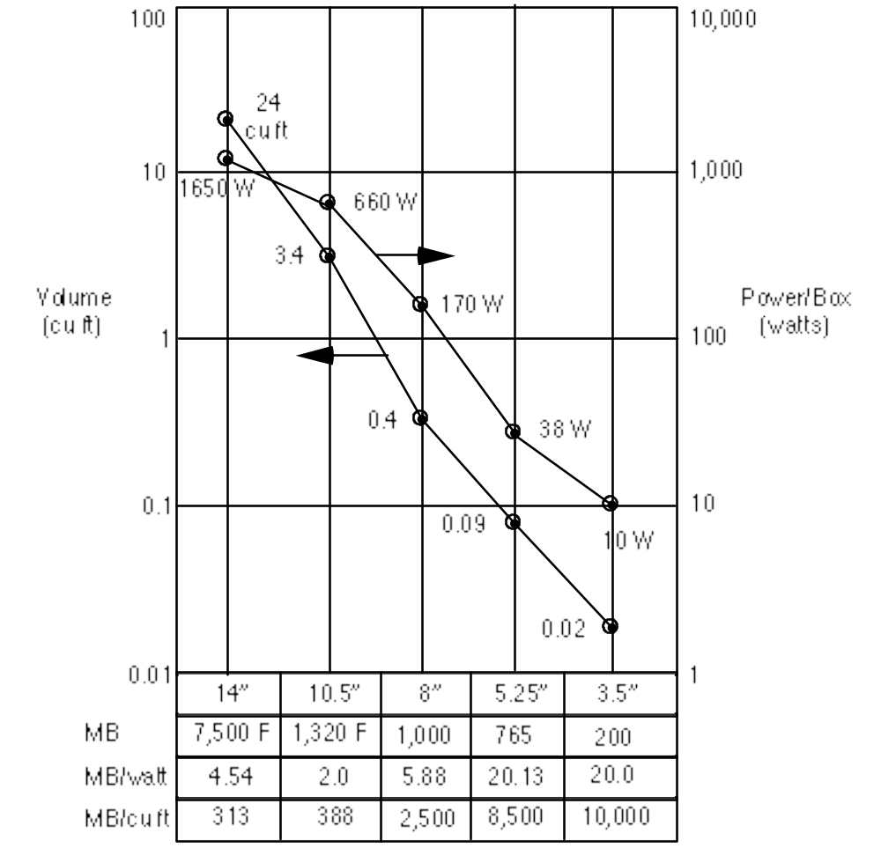
Advantages of Small Formfactor Disk Drives
Low cost/MB
High MB/volume
High MB/watt
Low cost/Actuator
Cost and Environmental Efficiencies

Slide 39
Replace Small Number of Large Disks with Large Number of Small Disks! (1988 Disks)
IBM 3390K
20 GBytes
97 cu. ft.
3 KW
15 MB/s
600 I/Os/s
250 KHrs
$250K
IBM 3.5" 0061
320 MBytes
0.1 cu. ft.
11 W
1.5 MB/s
55 I/Os/s
50 KHrs
$2K
x70
23 GBytes
11 cu. ft.
1 KW
120 MB/s
3900 IOs/s
??? Hrs
$150K
Capacity
Volume
Power
Data Rate
I/O Rate
MTTF
Cost
9X
3X
8X
6X
Disk Arrays have potential for large data and I/O rates, high MB per cu. ft., high MB per KW, but what about reliability?

Slide 40
Array Reliability
Reliability of N disks = Reliability of 1 Disk ÷ N
  50,000 Hours ÷ 70 disks = 700 hours
Disk system MTTF: Drops from 6 years to 1 month!
• Arrays (without redundancy) too unreliable to be useful!
Hot spares support reconstruction in parallel with
access: very high media availability can be achieved

Slide 41
Redundant Arrays of (Inexpensive) Disks
Files are "striped" across multiple disks
Redundancy yields high data availability
  Availability: service still provided to user, even if some components failed
Disks will still fail
Contents reconstructed from data redundantly stored in the array
  ⇒ Capacity penalty to store redundant info
  ⇒ Bandwidth penalty to update redundant info

Slide 42
Redundant Arrays of Inexpensive Disks
RAID 1: Disk Mirroring/Shadowing
recovery
group
• Each disk is fully duplicated onto its “mirror”
Very high availability can be achieved
• Bandwidth sacrifice on write:
Logical write = two physical writes
  • Reads may be optimized
• Most expensive solution: 100% capacity overhead
(RAID 2 not interesting, so skip)

Slide 43
Redundant Array of Inexpensive Disks RAID 3: Parity Disk
10010011
11001101
10010011
. . .
P
logical record
1
0
1
0
0
0
1
1
1
1
0
0
1
1
0
1
1
0
1
0
0
0
1
1
1
1
0
0
1
1
0
1
Striped physical
records
P contains sum of
other disks per stripe
mod 2 (“parity”)
If disk fails, subtract
P from sum of other
disks to find missing information

Slide 44
RAID 3
Sum computed across recovery group to protect against hard disk failures, stored in P disk
Logically, a single high capacity, high transfer rate disk: good for large transfers
Wider arrays reduce capacity costs, but decreases availability
33% capacity cost for parity in this configuration

Slide 45
Inspiration for RAID 4
RAID 3 relies on parity disk to discover errors
on Read
But every sector has an error detection field
Rely on error detection field to catch errors on read, not on the parity disk
Allows independent reads to different disks simultaneously

Slide 46

Redundant Arrays of Inexpensive Disks RAID 4: High I/O Rate Parity
Increasing
Logical
Disk
Address
D0
D1
D2
D3
P
Insides of 5 disks
D4
D5
D6
D7
P
D8
D9
D10
D11
P
Example:
small read D0 & D5,
large write D12-D15
D12
D13
D14
D15
P
Stripe
D16
D17
D18
D19
P
D20
D21
D22
D23
P
.
.
.
.
.
.
.
.
.
.
.
.
.
.
.
Disk Columns

Slide 47
Inspiration for RAID 5
RAID 4 works well for small reads
Small writes (write to one disk):
  Option 1: read other data disks, create new sum and write to Parity Disk
  Option 2: since P has old sum, compare old data to new data, add the difference to P
Small writes are limited by Parity Disk: Write to D0, D5 both also write to P disk
D0
D1
D2
D3
P
D4
D5
D6
D7
P

Slide 48
Redundant Arrays of Inexpensive Disks RAID 5: High I/O Rate Interleaved Parity
D0
D1
D2
D3
P
Increasing
Logical
Disk
Addresses
Independent writes
possible because of
interleaved parity
D4
D5
D6
P
D7
D8
D9
P
D10
D11
D12
P
D13
D14
D15
Example: write to D0, D5 uses disks 0, 1, 3, 4
P
D16
D17
D18
D19
D20
D21
D22
D23
P
.
.
.
.
.
.
.
.
.
.
.
.
.
.
.
Disk Columns

Slide 49
Problems of Disk Arrays:
Small Writes
RAID-5: Small Write Algorithm
1 Logical Write = 2 Physical Reads + 2 Physical Writes
D0'
D0
D1
D2
D3
P
new
data
old
data
old
parity
(1. Read)
(2. Read)
+
XOR
+
XOR
(3. Write)
(4. Write)
D0'
D1
D2
D3
P'

Slide 50

System Availability: Orthogonal RAIDs
Array
Controller
String
Controller
. . .
String
Controller
. . .
String
Controller
. . .
String
Controller
. . .
String
Controller
. . .
String
Controller
. . .
Data Recovery Group: unit of data redundancy
Redundant Support Components: fans, power supplies, controller, cables
End to End Data Integrity: internal parity protected data paths

Slide 51
System-Level Availability
host
host
I/O Controller
Fully dual redundant
I/O Controller
Array Controller
Array Controller
. . .
. . .
. . .
Goal: No Single
Points of
Failure
. . .
. . .
.
.
.
with duplicated paths, higher performance can be
obtained when there are no failures
Recovery
Group

Slide 52
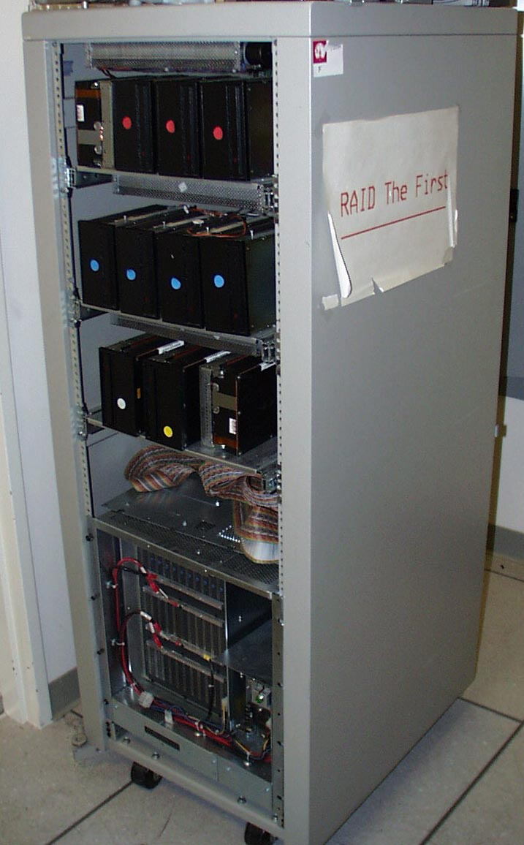
Berkeley History: RAID-I
RAID-I (1989)
  Consisted of a Sun 4/280 workstation with 128 MB of DRAM, four dual-string SCSI controllers, 28 5.25-inch SCSI disks and specialized disk striping software
Today RAID is $19 billion dollar industry, 80% nonPC disks sold in RAIDs

Slide 53
Summary: RAID Techniques: Goal was performance, popularity due to reliability of storage
• Disk Mirroring, Shadowing (RAID 1)
1
0
0
1
0
0
1
1
1
0
0
1
0
0
1
1
Each disk is fully duplicated onto its "shadow"
Logical write = two physical writes
100% capacity overhead
• Parity Data Bandwidth Array (RAID 3)
1
0
0
1
0
0
1
1
1
1
0
0
1
1
0
1
1
0
0
1
0
0
1
1
0
0
1
1
0
0
1
0
Parity computed horizontally
Logically a single high data bw disk
• High I/O Rate Parity Array (RAID 5)
Interleaved parity blocks
Independent reads and writes
Logical write = 2 reads + 2 writes

Slide 54
Summary Storage
Disks:
  Extraodinary advance in capacity/drive, $/GB
  Currently 17 Gbit/sq. in. ; can continue past 100 Gbit/sq. in.?
  Bandwidth, seek time not keeping up: 3.5 inch form factor makes sense? 2.5 inch form factor in near future? 1.0 inch form factor in long term?
Tapes
  No investment, must be backwards compatible
  Are they already dead?
  What is a tapeless backup system?

