Slide 1
CS252
Graduate Computer Architecture
Lecture 7:
I/O 3: a little Queueing Theory and I/O benchmarks
February 7, 2001
Prof. David A. Patterson
Computer Science 252
Spring 2001

Slide 2
Summary: Dependability
Fault => Latent errors in system => Failure in service
Reliability: quantitative measure of time to failure (MTTF)
  Assuming expoentially distributed independent failures, can calculate MTTF system from MTTF of components
Availability: quantitative measure % of time delivering desired service
Can improve Availability via greater MTTF or smaller MTTR (such as using standby spares)
No single point of failure a good hardware guideline, as everything can fail
Components often fail slowly
Real systems: problems in maintenance, operation as well as hardware, software

Slide 3
Review: Disk I/O Performance
Metrics:
Response Time
Throughput
300
Response
Time (ms)
200
100
0
100%
0%
Throughput
(% total BW)
Queue
Proc
IOC
Device
Response time = Queue + Device Service time

Slide 4
Introduction to
Queueing Theory
Arrivals
Departures
More interested in long term, steady state than in startup => Arrivals = Departures
Little’s Law:
Mean number tasks in system = arrival rate x mean reponse time
  Observed by many, Little was first to prove
Applies to any system in equilibrium,
as long as nothing in black box
is creating or destroying tasks
Notes:
Old and New Testament by Kleirock
Regret skipping as grad student

Slide 5
A Little Queuing Theory: Notation
System
Queue
server
Proc
IOC
Device
Queuing models assume state of equilibrium:
input rate = output rate
Notation:
r average number of arriving customers/second
T_{ser} average time to service a customer (tradtionally µ = 1/ T_{ser} )
u server utilization (0..1): u = r x T_{ser} (or u = r / T_{ser} )
T_{q} average time/customer in queue
T_{sys} average time/customer in system: T_{sys} = T_{q} + T_{ser}
L_{q} average length of queue: L_{q} = r x T_{q}
L_{sys} average length of system: L_{sys} = r x T_{sys}
Little’s Law: Length_{server} = rate x Time_{server}
(Mean number customers = arrival rate x mean service time)
Notes:
Sometimes Queue called waiting line, System called Queue

Slide 6
A Little Queuing Theory
System
Queue
server
Proc
IOC
Device
Service time completions vs. waiting time for a busy server: randomly arriving event joins a queue of arbitrary length when server is busy,
otherwise serviced immediately
  Unlimited length queues key simplification
A single server queue: combination of a servicing facility that accomodates 1 customer at a time (server) + waiting area (queue): together called a system
Server spends a variable amount of time with customers; how do you characterize variability?
  Distribution of a random variable: histogram? curve?
Notes:
Characterize randomness
Request are random from processor
Nothing in queue gets immediate service

Slide 7
A Little Queuing Theory
System
Queue
server
Proc
IOC
Device
Server spends variable amount of time with customers
  Weighted mean m1 = (f1 x T1 + f2 x T2 +...+ fn x Tn)/F (F=f1 + f2...)
  variance = (f1 x T1² + f2 x T2² +...+ fn x Tn²)/F – m1²
    Must keep track of unit of measure (100 ms² vs. 0.1 s² )
  Squared coefficient of variance: C² = variance/m1²
    Unitless measure (100 ms² vs. 0.1 s²)
Exponential distribution C² = 1 : most short relative to average, few others long; 90% < 2.3 x average, 63% < average
Hypoexponential distribution C² < 1 : most close to average,
C²=0.5 => 90% < 2.0 x average, only 57% < average
Hyperexponential distribution C² > 1 : further from average
C² =2.0 => 90% < 2.8 x average, 69% < average
Avg.

Slide 8
A Little Queuing Theory: Variable Service Time
System
Queue
server
Proc
IOC
Device
Server spends a variable amount of time with customers
  Weighted mean m1 = (f1xT1 + f2xT2 +...+ fnXTn)/F (F=f1+f2+...)
Usually pick C = 1.0 for simplicity
Another useful value is average time
must wait for server to complete task: m1(z)
  Not just 1/2 x m1 because doesn’t capture variance
  Can derive m1(z) = 1/2 x m1 x (1 + C²)
  No variance => C² = 0 => m1(z) = 1/2 x m1
Notes:
Power of queing theory
Would guess variance is 1/2 average
Gives a more realistic model
How well does it work; reserach papers WHY it works so well

Slide 9
A Little Queuing Theory:
Average Wait Time
Calculating average wait time in queue T_{q}
  If something at server, it takes to complete on average m1(z)
  Chance server is busy = u; average delay is u x m1(z)
  All customers in line must complete; each avg T_{ser}
  T_{q} = u x m1(z) + L_{q} x T_{s er}= 1/2 x u x T_{ser} x (1 + C) + L_{q} x T_{s er}
  T_{q} = 1/2 x u x T_{s er} x (1 + C) + r x T_{q} x T_{s er}
  T_{q} = 1/2 x u x T_{s er} x (1 + C) + u x T_{q}
  T_{q} x (1 – u) = T_{s er} x u x (1 + C) /2
  T_{q} = T_{s er} x u x (1 + C) / (2 x (1 – u))
Notation:
r average number of arriving customers/second
T_{ser} average time to service a customer
u server utilization (0..1): u = r x T_{ser}
T_{q} average time/customer in queue
L_{q} average length of queue:L_{q}= r x T_{q}

Slide 10
A Little Queuing Theory:
M/G/1 and M/M/1
Assumptions so far:
  System in equilibrium, number sources of requests unlimited
  Time between two successive arrivals in line are exponentially distrib.
  Server can start on next customer immediately after prior finishes
  No limit to the queue: works First-In-First-Out "discipline"
  Afterward, all customers in line must complete; each avg T_{ser}
Described “memoryless” or Markovian request arrival
(M for C=1 exponentially random), General service distribution (no restrictions), 1 server: M/G/1 queue
When Service times have C = 1, M/M/1 queue
T_{q} = T_{ser} x u x (1 + C) /(2 x (1 – u)) = T_{ser} x u / (1 – u)
T_{ser} average time to service a customer
u server utilization (0..1): u = r x T_{ser}
T_{q} average time/customer in queue

Slide 11
A Little Queuing Theory:
An Example
processor sends 10 x 8KB disk I/Os per second, requests & service exponentially distrib., avg. disk service = 20 ms
On average, how utilized is the disk?
  What is the number of requests in the queue?
  What is the average time spent in the queue?
  What is the average response time for a disk request?
Notation:
r average number of arriving customers/second = 10
T_{ser} average time to service a customer = 20 ms (0.02s)
u server utilization (0..1): u = r x T_{ser}= 10/s x .02s = 0.2
T_{q} average time/customer in queue = T_{ser} x u / (1 – u)
= 20 x 0.2/(1-0.2) = 20 x 0.25 = 5 ms (0 .005s)
T_{sys} average time/customer in system: T_{sys} =T_{q} +T_{ser}= 25 ms
L_{q} average length of queue:L_{q}= r x T_{q}
= 10/s x .005s = 0.05 requests in queue
L_{sys} average # tasks in system: L_{sys} = r x T_{sys} = 10/s x .025s = 0.25

Slide 12
A Little Queuing Theory: Another Example
processor sends 20 x 8KB disk I/Os per sec, requests & service exponentially distrib., avg. disk service = 12 ms
On average, how utilized is the disk?
  What is the number of requests in the queue?
  What is the average time a spent in the queue?
  What is the average response time for a disk request?
Notation:
r average number of arriving customers/second= 20
T_{ser} average time to service a customer= 12 ms
u server utilization (0..1): u = r x T_{ser}= /s x . s =
T_{q} average time/customer in queue = T_{s er} x u / (1 – u)
= x /( ) = x = ms
T_{sys} average time/customer in system: T_{sys} =T_{q} +T_{ser}= 16 ms
L_{q} average length of queue:L_{q}= r x T_{q}
= /s x s = requests in queue
L_{sys} average # tasks in system : L_{sys} = r x T_{sys} = /s x s =

Slide 13
A Little Queuing Theory: Another Example
processor sends 20 x 8KB disk I/Os per sec, requests & service exponentially distrib., avg. disk service = 12 ms
On average, how utilized is the disk?
  What is the number of requests in the queue?
  What is the average time a spent in the queue?
  What is the average response time for a disk request?
Notation:
r average number of arriving customers/second= 20
T_{ser} average time to service a customer= 12 ms
u server utilization (0..1): u = r x T_{ser}= 20/s x .012s = 0.24
T_{q} average time/customer in queue = T_{s er} x u / (1 – u)
= 12 x 0.24/(1-0.24) = 12 x 0.32 = 3.8 ms
T_{sys} average time/customer in system: T_{sys} =T_{q} +T_{ser}= 15.8 ms
L_{q} average length of queue:L_{q}= r x T_{q}
= 20/s x .0038s = 0.076 requests in queue
L_{sys} average # tasks in system : L_{sys} = r x T_{sys} = 20/s x .016s = 0.32

Slide 14
Pitfall of Not using
Queuing Theory
1st 32-bit minicomputer (VAX-11/780)
How big should write buffer be?
  Stores 10% of instructions, 1 MIPS
Buffer = 1
=> Avg. Queue Length = 1
vs. low response time

Slide 15
Summary: A Little Queuing Theory
System
Queue
server
Proc
IOC
Device
Queuing models assume state of equilibrium:
input rate = output rate
Notation:
r average number of arriving customers/second
T_{ser} average time to service a customer (tradtionally µ = 1/ T_{ser} )
u server utilization (0..1): u = r x T_{ser}
T_{q} average time/customer in queue
T_{sys} average time/customer in system: T_{sys} = T_{q} + T_{ser}
L_{q} average length of queue: L_{q} = r x T_{q}
L_{sys} average length of system : L_{sys} = r x T_{sys}
Little’s Law: Length_{system} = rate x Time_{system}
(Mean number customers = arrival rate x mean service time)

Slide 16
I/O Benchmarks
For better or worse, benchmarks shape a field
  Processor benchmarks classically aimed at response time for fixed sized problem
  I/O benchmarks typically measure throughput, possibly with upper limit on response times (or 90% of response times)
What if fix problem size, given 60%/year increase in DRAM capacity?
Benchmark Size of Data % Time I/O Year
I/OStones 1 MB 26% 1990
Andrew 4.5 MB 4% 1988
  Not much time in I/O
  Not measuring disk (or even main memory)

Slide 17
I/O Benchmarks: Transaction Processing
Transaction Processing (TP) (or On-line TP=OLTP)
  Changes to a large body of shared information from many terminals, with the TP system guaranteeing proper behavior on a failure
  If a bank’s computer fails when a customer withdraws money, the TP system would guarantee that the account is debited if the customer received the money and that the account is unchanged if the money was not received
  Airline reservation systems & banks use TP
Atomic transactions makes this work
Each transaction => 2 to 10 disk I/Os & 5,000 and 20,000 CPU instructions per disk I/O
  Efficiency of TP SW & avoiding disks accesses by keeping information in main memory
Classic metric is Transactions Per Second (TPS)
  Under what workload? how machine configured?

Slide 18
I/O Benchmarks: Transaction Processing
Early 1980s great interest in OLTP
  Expecting demand for high TPS (e.g., ATM machines, credit cards)
  Tandem’s success implied medium range OLTP expands
  Each vendor picked own conditions for TPS claims, report only CPU times with widely different I/O
  Conflicting claims led to disbelief of all benchmarks=> chaos
1984 Jim Gray of Tandem distributed paper to Tandem employees and 19 in other industries to propose standard benchmark
Published “A measure of transaction processing power,” Datamation, 1985 by Anonymous et. al
  To indicate that this was effort of large group
  To avoid delays of legal department of each author’s firm
  Still get mail at Tandem to author

Slide 19
I/O Benchmarks: TP1 by Anon et. al
DebitCredit Scalability: size of account, branch, teller, history function of throughput
  TPS Number of ATMs Account-file size
  10 1,000 0.1 GB
  100 10,000 1.0 GB
  1,000 100,000 10.0 GB
  10,000 1,000,000 100.0 GB
  Each input TPS =>100,000 account records, 10 branches, 100 ATMs
  Accounts must grow since a person is not likely to use the bank more frequently just because the bank has a faster computer!
Response time: 95% transactions take Š 1 second
Configuration control: just report price (initial purchase price + 5 year maintenance = cost of ownership)
By publishing, in public domain

Slide 20
I/O Benchmarks: TP1 by Anon et. al
Problems
  Often ignored the user network to terminals
  Used transaction generator with no think time; made sense for database vendors, but not what customer would see
Solution: Hire auditor to certify results
  Auditors soon saw many variations of ways to trick system
Proposed minimum compliance list (13 pages); still,
DEC tried IBM test on different machine with poorer results than claimed by auditor
Created Transaction Processing Performance Council in 1988: founders were CDC, DEC, ICL, Pyramid, Stratus, Sybase, Tandem, and Wang; ~40 companies today
Led to TPC standard benchmarks in 1990,www.tpc.org

Slide 21
Unusual Characteristics of TPC
Price is included in the benchmarks
  cost of HW, SW, and 5-year maintenance agreements included => price-performance as well as performance
The data set generally must scale in size as the throughput increases
  trying to model real systems, demand on system and size of the data stored in it increase together
The benchmark results are audited
  Must be approved by certified TPC auditor, who enforces TPC rules => only fair results are submitted
Throughput is the performance metric but response times are limited
  eg, TPC-C: 90% transaction response times < 5 seconds
An independent organization maintains the benchmarks
  COO ballots on changes, meetings, to settle disputes...

Slide 22
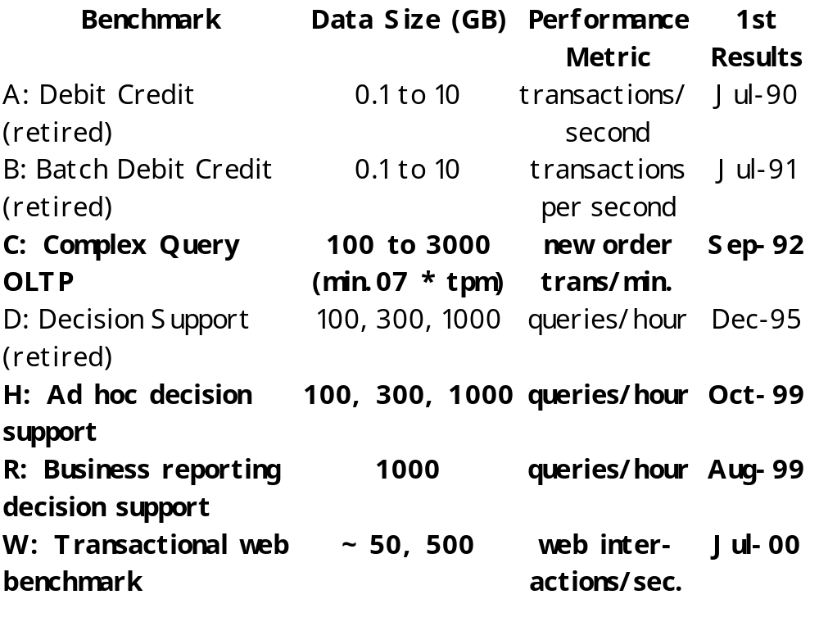
TPC Benchmark History/Status

Slide 23
I/O Benchmarks: TPC-C Complex OLTP
Models a wholesale supplier managing orders
Order-entry conceptual model for benchmark
Workload = 5 transaction types
Users and database scale linearly with throughput
Defines full-screen end-user interface
Metrics: new-order rate (tpmC)
and price/performance ($/tpmC)
Approved July 1992

Slide 24
I/O Benchmarks: TPC-W
Transactional Web Benchmark
Represent any business (retail store, software distribution, airline reservation, ...) that markets and sells over the Internet/ Intranet
Measure systems supporting users browsing, ordering, and conducting transaction oriented business activities.
Security (including user authentication and data encryption) and dynamic page generation are important
Before: processing of customer order by terminal operator working on LAN connected to database system
Today: customer accesses company site over Internet connection, browses both static and dynamically generated Web pages, and searches the database for product or customer information. Customer also initiate, finalize & check on product orders & deliveries
Started 1/97; hoped to release Fall, 1998?Jul 2000!

Slide 25
1998 TPC-C Performance tpm(c)
Rank Config tpmC $/tpmC Database
1 IBM RS/6000 SP (12 node x 8-way) 57,053.80 $147.40 Oracle8 8.0.4
2 HP HP 9000 V2250 (16-way) 52,117.80 $81.17 Sybase ASE
3 Sun Ultra E6000 c/s (2 node x 22-way) 51,871.62 $134.46 Oracle8 8.0.3
4 HP HP 9000 V2200 (16-way) 39,469.47 $94.18 Sybase ASE
5 Fujitsu GRANPOWER 7000 Model 800 34,116.93 $57,883.00 Oracle8
6 Sun Ultra E6000 c/s (24-way) 31,147.04 $108.90 Oracle8 8.0.3
7Digital AlphaS8400 (4 node x 8-way) 30,390.00 $305.00 Oracle7 V7.3
8 SGI Origin2000 Server c/s (28-way) 25,309.20 $139.04 INFORMIX
9 IBM AS/400e Server (12-way) 25,149.75 $128.00 DB2
10 Digital AlphaS8400 5/625 (10-way) 24,537.00 $110.48 Sybase SQL
Notes: 7 SMPs , 3 clusters of SMPs,
avg 30 CPUs/system

Slide 26
1998 TPC-C Price/Performance $/tpm(c)
Rank Config $/tpmC tpmC Database
1 Acer AcerAltos 19000Pro4 $27.25 11,072.07 M/S SQL 6.5
2 Dell PowerEdge 6100 c/s $29.55 10,984.07 M/S SQL 6.5
3 Compaq ProLiant 5500 c/s $33.37 10,526.90 M/S SQL 6.5
4 ALR Revolution 6x6 c/s $35.44 13,089.30 M/S SQL 6.5
5 HP NetServer LX Pro $35.82 10,505.97 M/S SQL 6.5
6 Fujitsu teamserver M796i $37.62 13,391.13 M/S SQL 6.5
7 Fujitsu GRANPOWER 5000 Model 670 $37.62 13,391.13 M/S SQL 6.5
8 Unisys Aquanta HS/6 c/s $37.96 13,089.30 M/S SQL 6.5
9 Compaq ProLiant 7000 c/s $39.25 11,055.70 M/S SQL 6.5
10 Unisys Aquanta HS/6 c/s $39.39 12,026.07 M/S SQL 6.5
Notes: all Microsoft SQL Server Database
All uniprocessors?

Slide 27
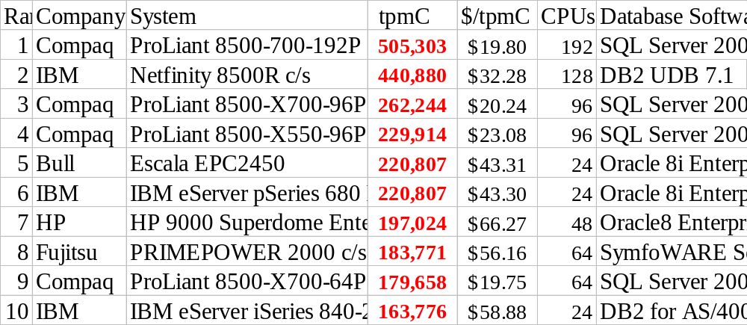
2001 TPC-C Performance Results
Notes: 4 SMPs, 6 clusters of SMPs: 76 CPUs/system
3 years => Peak Performance 8.9X, 2X/yr

Slide 28
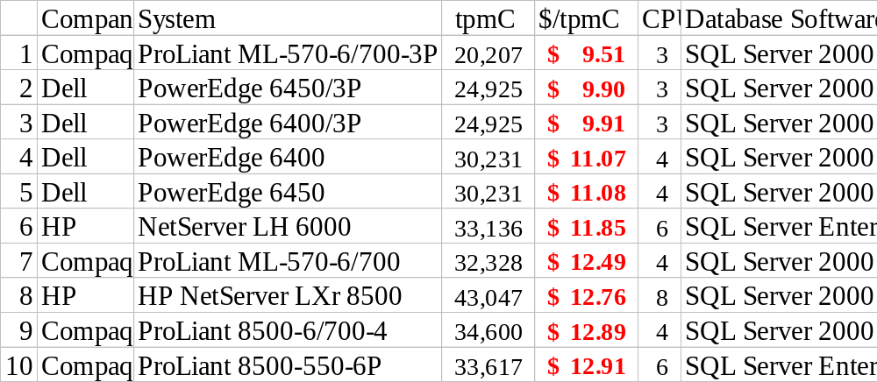
2001 TPC-C Price Performance Results
Notes: All small SMPs, all running M/S SQL server
3 years => Cost Performance 2.9X, 1.4X/yr

Slide 29
SPEC SFS/LADDIS
1993 Attempt by NFS companies to agree on standard benchmark: Legato, Auspex, Data General, DEC, Interphase, Sun. Like NFSstones but
  Run on multiple clients & networks (to prevent bottlenecks)
  Same caching policy in all clients
  Reads: 85% full block & 15% partial blocks
  Writes: 50% full block & 50% partial blocks
  Average response time: 50 ms
  Scaling: for every 100 NFS ops/sec, increase capacity 1GB
  Results: plot of server load (throughput) vs. response time & number of users
    Assumes: 1 user => 10 NFS ops/sec

Slide 30
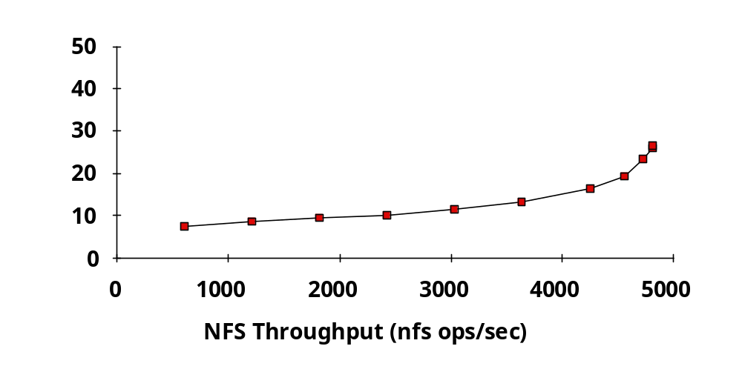
1998 Example SPEC SFS Result: DEC Alpha
200 MHz 21064: 8KI + 8KD + 2MB L2; 512 MB; 1 Gigaswitch
DEC OSF1 v2.0
4 FDDI networks; 32 NFS Daemons, 24 GB file size
88 Disks, 16 controllers, 84 file systems
4817

Slide 31
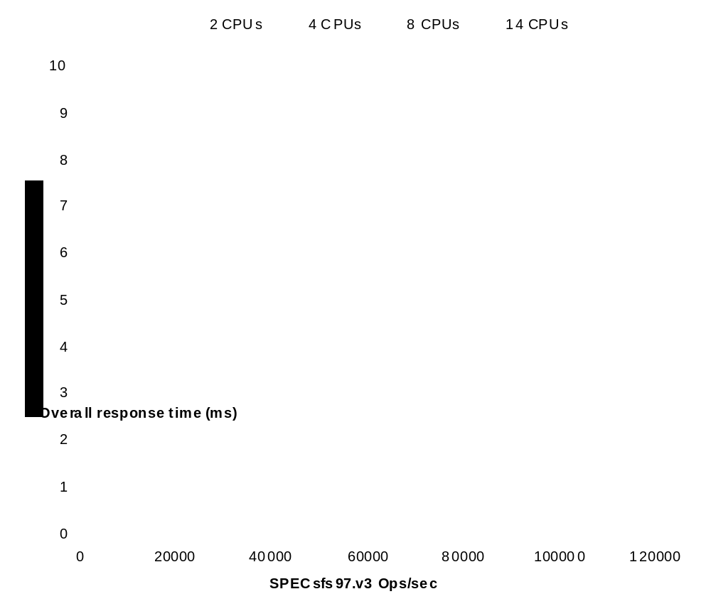
SPEC sfs97 for EMC Celera NFS servers: 2, 4, 8, 14 CPUs; 67, 133, 265, 433 disks
15,700, 32,000, 61,800 104,600 ops/sec

Slide 32
SPEC WEB99
Simulates accesses to web service provider, supports home pages for several organizations. File sizes:
  less than 1 KB, representing an small icon: 35% of activity
  1 to 10 KB: 50% of activity
  10 to 100 KB: 14% of activity
  100 KB to 1 MB: a large document and image,1% of activity
Workload simulates dynamic operations: rotating advertisements on a web page, customized web page creation, and user registration.
workload gradually increased until server software is saturated with hits and response time degrades significantly.

Slide 33
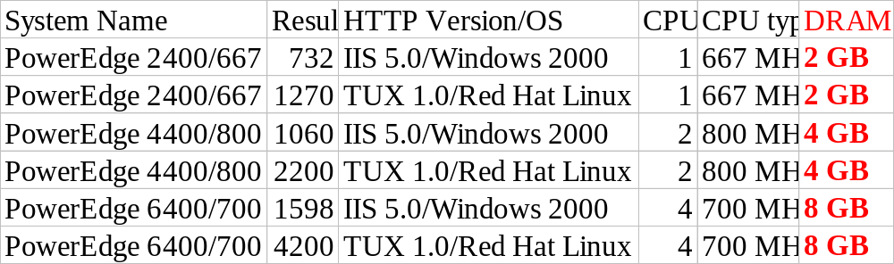
SPEC WEB99 for Dells in 2000
Each uses 5 9GB, 10,000 RPM disks except the 5th system, which had 7 disks, and the first 4 have 0.25 MB of L2 cache while the last 2 have 2 MB of L2 cache
Appears that the large amount of DRAM is used as a large file cache to reduce disk I/O, so not really an I/O benchmark

Slide 34
Availability benchmark methodology
Goal: quantify variation in QoS metrics as events occur that affect system availability
Leverage existing performance benchmarks
  to generate fair workloads
  to measure & trace quality of service metrics
Use fault injection to compromise system
  hardware faults (disk, memory, network, power)
  software faults (corrupt input, driver error returns)
  maintenance events (repairs, SW/HW upgrades)
Examine single-fault and multi-fault workloads
  the availability analogues of performance micro- and macro-benchmarks

Slide 35
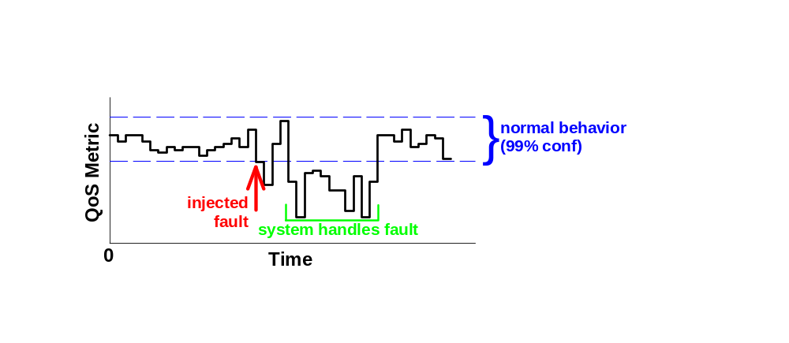
Benchmark Availability?
Methodology for reporting results
Results are most accessible graphically
  plot change in QoS metrics over time
  compare to “normal” behavior
    99% confidence intervals calculated from no-fault runs

Slide 36
Case study
Availability of software RAID-5 & web server
  Linux/Apache, Solaris/Apache, Windows 2000/IIS
Why software RAID?
  well-defined availability guarantees
    RAID-5 volume should tolerate a single disk failure
    reduced performance (degraded mode) after failure
    may automatically rebuild redundancy onto spare disk
  simple system
  easy to inject storage faults
Why web server?
  an application with measurable QoS metrics that depend on RAID availability and performance

Slide 37
Benchmark environment: faults
Focus on faults in the storage system (disks)
Emulated disk provides reproducible faults
  a PC that appears as a disk on the SCSI bus
  I/O requests intercepted and reflected to local disk
  fault injection performed by altering SCSI command processing in the emulation software
Fault set chosen to match faults observed in a long-term study of a large storage array
  media errors, hardware errors, parity errors, power failures, disk hangs/timeouts
  both transient and “sticky” faults

Slide 38
Single-fault experiments
“Micro-benchmarks”
Selected 15 fault types
  8 benign (retry required)
  2 serious (permanently unrecoverable)
  5 pathological (power failures and complete hangs)
An experiment for each type of fault
  only one fault injected per experiment
  no human intervention
  system allowed to continue until stabilized or crashed

Slide 39
Multiple-fault experiments
“Macro-benchmarks” that require human intervention
Scenario 1: reconstruction
  (1) disk fails
  (2) data is reconstructed onto spare
  (3) spare fails
  (4) administrator replaces both failed disks
  (5) data is reconstructed onto new disks
Scenario 2: double failure
  (1) disk fails
  (2) reconstruction starts
  (3) administrator accidentally removes active disk
  (4) administrator tries to repair damage

Slide 40
Comparison of systems
Benchmarks revealed significant variation in failure-handling policy across the 3 systems
  transient error handling
  reconstruction policy
  double-fault handling
Most of these policies were undocumented
  yet they are critical to understanding the systems’ availability

Slide 41
Transient error handling
Transient errors are common in large arrays
  example: Berkeley 368-disk Tertiary Disk array, 11mo.
    368 disks reported transient SCSI errors (100%)
    13 disks reported transient hardware errors (3.5%)
    2 disk failures (0.5%)
  isolated transients do not imply disk failures
  but streams of transients indicate failing disks
    both Tertiary Disk failures showed this behavior
Transient error handling policy is critical in long-term availability of array

Slide 42
Transient error handling (2)
Linux is paranoid with respect to transients
  stops using affected disk (and reconstructs) on any error, transient or not
    fragile: system is more vulnerable to multiple faults
    disk-inefficient: wastes two disks per transient
    but no chance of slowly-failing disk impacting perf.
Solaris and Windows are more forgiving
  both ignore most benign/transient faults
    robust: less likely to lose data, more disk-efficient
    less likely to catch slowly-failing disks and remove them
Neither policy is ideal!
  need a hybrid that detects streams of transients

Slide 43
Reconstruction policy
Reconstruction policy involves an availability tradeoff between performance & redundancy
  until reconstruction completes, array is vulnerable to second fault
  disk and CPU bandwidth dedicated to reconstruction is not available to application
    but reconstruction bandwidth determines reconstruction speed
  policy must trade off performance availability and potential data availability

Slide 44
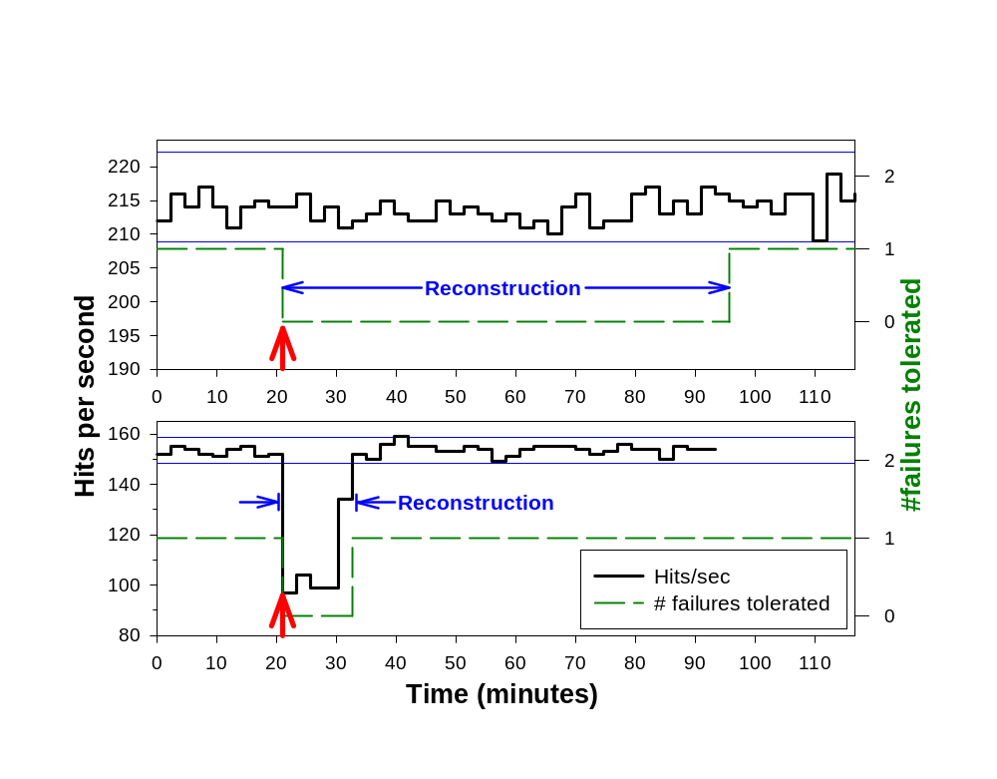
Example single-fault result
Linux
Solaris
Compares Linux and Solaris reconstruction
  Linux: minimal performance impact but longer window of vulnerability to second fault
  Solaris: large perf. impact but restores redundancy fast

Slide 45
Reconstruction policy (2)
Linux: favors performance over data availability
  automatically-initiated reconstruction, idle bandwidth
  virtually no performance impact on application
  very long window of vulnerability (>1hr for 3GB RAID)
Solaris: favors data availability over app. perf.
  automatically-initiated reconstruction at high BW
  as much as 34% drop in application performance
  short window of vulnerability (10 minutes for 3GB)
Windows: favors neither!
  manually-initiated reconstruction at moderate BW
  as much as 18% app. performance drop
  somewhat short window of vulnerability (23 min/3GB)

Slide 46
Double-fault handling
A double fault results in unrecoverable loss of some data on the RAID volume
Linux: blocked access to volume
Windows: blocked access to volume
Solaris: silently continued using volume, delivering fabricated data to application!
  clear violation of RAID availability semantics
  resulted in corrupted file system and garbage data at the application level
  this undocumented policy has serious availability implications for applications

Slide 47
Availability Conclusions: Case study
RAID vendors should expose and document policies affecting availability
  ideally should be user-adjustable
Availability benchmarks can provide valuable insight into availability behavior of systems
  reveal undocumented availability policies
  illustrate impact of specific faults on system behavior
We believe our approach can be generalized well beyond RAID and storage systems
  the RAID case study is based on a general methodology

Slide 48
Conclusions: Availability benchmarks
Our methodology is best for understanding the availability behavior of a system
  extensions are needed to distill results for automated system comparison
A good fault-injection environment is critical
  need realistic, reproducible, controlled faults
  system designers should consider building in hooks for fault-injection and availability testing
Measuring and understanding availability will be crucial in building systems that meet the needs of modern server applications
  our benchmarking methodology is just the first step towards this important goal

Slide 49
Summary: I/O Benchmarks
Scaling to track technological change
TPC: price performance as nomalizing configuration feature
Auditing to ensure no foul play
Throughput with restricted response time is normal measure
Benchmarks to measure Availability, Maintainability?

Slide 50
Summary: A Little Queuing Theory
System
Queue
server
Proc
IOC
Device
Queuing models assume state of equilibrium:
input rate = output rate
Notation:
r average number of arriving customers/second
T_{ser} average time to service a customer (tradtionally µ = 1/ T_{ser} )
u server utilization (0..1): u = r x T_{ser}
T_{q} average time/customer in queue
T_{sys} average time/customer in system: T_{sys} = T_{q} + T_{ser}
L_{q} average length of queue: L_{q} = r x T_{q}
L_{sys} average length of system : L_{sys} = r x T_{sys}
Little’s Law: Length_{system} = rate x Time_{system}
(Mean number customers = arrival rate x mean service time)

