Slide 1
CS252
Graduate Computer Architecture
Lecture 8:
Network 1: Definitions, Metrics, 252 Projects
February 9, 2001
Prof. David A. Patterson
Computer Science 252
Spring 2001

Slide 2
Review: A Little Queuing Theory
System
Queue
server
Proc
IOC
Device
Queuing models assume state of equilibrium:
input rate = output rate
Notation:
r average number of arriving customers/second
T_{ser} average time to service a customer (tradtionally µ = 1/ T_{ser} )
u server utilization (0..1): u = r x T_{ser}
T_{q} average time/customer in queue
T_{sys} average time/customer in system: T_{sys} = T_{q} + T_{ser}
L_{q} average length of queue: L_{q} = r x T_{q}
L_{sys} average length of system : L_{sys} = r x T_{sys}
Little’s Law: Length_{system} = rate x Time_{system}
(Mean number customers = arrival rate x mean service time)

Slide 3
Review: I/O Benchmarks
Scaling to track technological change
TPC: price performance as nomalizing configuration feature
Auditing to ensure no foul play
Throughput with restricted response time is normal measure
Benchmarks to measure Availability, Maintainability?

Slide 4
Review: Availability benchmarks
Availability benchmarks can provide valuable insight into availability behavior of systems
  reveal undocumented availability policies
  illustrate impact of specific faults on system behavior
Methodology is best for understanding the availability behavior of a system
  extensions are needed to distill results for automated system comparison
A good fault-injection environment is critical
  need realistic, reproducible, controlled faults
  system designers should consider building in hooks for fault-injection and availability testing
Measuring and understanding availability will be crucial in building systems that meet the needs of modern server applications
  this benchmarking methodology is just 1st step towards goal

Slide 5
Networks
Goal: Communication between computers
Eventual Goal: treat collection of computers as if one big computer, distributed resource sharing
Theme: Different computers must agree on many things
  Overriding importance of standards and protocols
  Error tolerance critical as well
Warning: Terminology-rich environment
Notes:
Obvious goal
1 big coherent file system as future goal?
Standards critical

Slide 6
Networks
Facets people talk a lot about:
  direct (point-to-point) vs. indirect (multi-hop)
  topology (e.g., bus, ring, DAG)
  routing algorithms
  switching (aka multiplexing)
  wiring (e.g., choice of media, copper, coax, fiber)
What really matters:
  latency
  bandwidth
  cost
  reliability

Slide 7
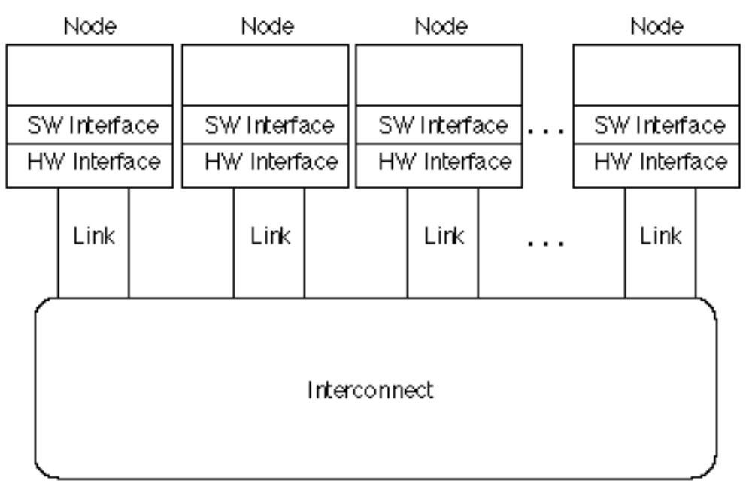
Interconnections (Networks)
Examples (see Figure 7.19, page 633):
  Wide Area Network (ATM): 100-1000s nodes; ~ 5,000 kilometers
  Local Area Networks (Ethernet): 10-1000 nodes; ~ 1-2 kilometers
  System/Storage Area Networks (FC-AL): 10-100s nodes;
  ~ 0.025 to 0.1 kilometers per link
a.k.a.
end systems,
hosts
a.k.a.
network,
communication
subnet
Interconnection Network

Slide 8
SAN: Storage vs. System
Storage Area Network (SAN): A block I/O oriented network between application servers and storage
  Fibre Channel is an example
Usually high bandwidth requirements, and less concerned about latency
  in 2001: 1 Gbit bandwidth and millisecond latency OK
Commonly a dedicated network
(that is, not connected to another network)
May need to work gracefully when saturated
Given larger block size, may have higher bit error rate (BER) requirement than LAN

Slide 9
SAN: Storage vs. System
System Area Network (SAN): A network aimed at connecting computers
  Myrinet is an example
Aimed at High Bandwidth AND Low Latency.
  in 2001: > 1 Gbit bandwidth and ~ 10 microsecond
May offer in order delivery of packets
Given larger block size, may have higher bit error rate (BER) requirement than LAN

Slide 10
More Network Background
Connection of 2 or more networks: Internetworking
3 cultures for 3 classes of networks
  WAN: telecommunications, Internet
  LAN: PC, workstations, servers cost
  SAN: Clusters, RAID boxes: latency (System A.N.) or bandwidth (Storage A.N.)
Try for single terminology
Motivate the interconnection complexity incrementally

Slide 11
ABCs of Networks
Starting Point: Send bits between 2 computers
Queue (FIFO) on each end
Information sent called a “message”
Can send both ways (“Full Duplex”)
Rules for communication? “protocol”
  Inside a computer:
    Loads/Stores: Request (Address) & Response (Data)
    Need Request & Response signaling

Slide 12
A Simple Example
What is the format of mesage?
  Fixed? Number bytes?
Request/
Response
Address/Data
1 bit
32 bits
0: Please send data from Address
1: Packet contains data corresponding to request
Header/Trailer: information to deliver a message
Payload: data in message (1 word above)

Slide 13
Questions About Simple Example
What if more than 2 computers want to communicate?
  Need computer “address field” (destination) in packet
What if packet is garbled in transit?
  Add “error detection field” in packet (e.g., Cyclic Redundancy Chk)
What if packet is lost?
  More “elaborate protocols” to detect loss
  (e.g., NAK, ARQ, time outs)
What if multiple processes/machine?
  Queue per process to provide protection
Simple questions such as these lead to more complex protocols and packet formats => complexity

Slide 14
A Simple Example Revisted
What is the format of packet?
  Fixed? Number bytes?
Request/
Response
Address/Data
CRC
1 bit
32 bits
4 bits
00: Request—Please send data from Address
01: Reply—Packet contains data corresponding to request
10: Acknowledge request
11: Acknowledge reply

Slide 15
Software to Send and Receive
SW Send steps
  1: Application copies data to OS buffer
  2: OS calculates checksum, starts timer
  3: OS sends data to network interface HW and says start
SW Receive steps
  3: OS copies data from network interface HW to OS buffer
  2: OS calculates checksum, if matches send ACK; if not, deletes message (sender resends when timer expires)
  1: If OK, OS copies data to user address space and signals application to continue
Sequence of steps for SW: protocol
  Example similar to UDP/IP protocol in UNIX

Slide 16
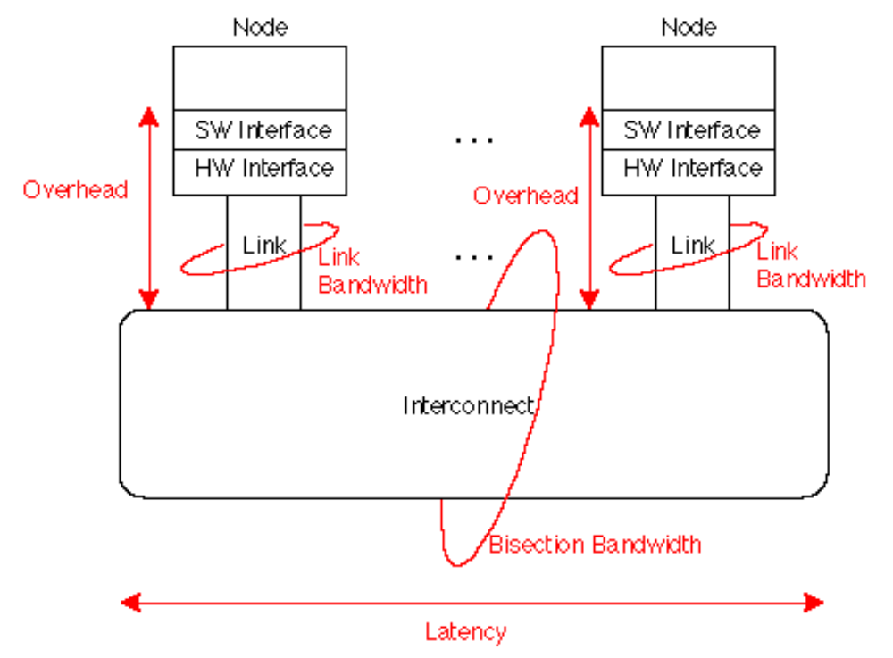
Network Performance Measures
Overhead: latency of interface vs. Latency: network
Notes:
Link bandwidth: 10 Mbit Ethernet
What is interconnet BW?
bus => link speed
switch => 100 * link speed
What gets quoted? link BW?
What is latency? Interconnect?

Slide 17
CS 252 Administrivia
HW #1 due Saturday: send electronically to TA
Pick a partner, project by Monday; send electronically to me, TA
I'll be available Monday afternoon to talk

Slide 18
Universal Performance Metrics
Sender
Overhead
Transmission time
(size ÷ bandwidth)
Sender
(processor
busy)
Time of
Flight
Transmission time
(size ÷ bandwidth)
Receiver
Overhead
Receiver
Transport Latency
(processor
busy)
Total Latency
Total Latency = Sender Overhead + Time of Flight +
Message Size ÷ BW + Receiver Overhead
Includes header/trailer in BW calculation?
Notes:
Easy to get these things confused! Colors should help
Min (link BW, bisection BW)
Assumes no congestion
Receiver usually longer
Better to send then receive
Store Like send
Read like Receive

Slide 19
Total Latency Example
1000 Mbit/sec., sending overhead of 80 µsec & receiving overhead of 100 µsec.
a 10000 byte message (including the header), allows 10000 bytes in a single message
3 situations: distance 1000 km v. 0.5 km v. 0.01
Speed of light ~ 300,000 km/sec (1/2 in media)
Latency_{0.01km} =
Latency_{0.01km} =
Latency_{1000km} =

Slide 20
Total Latency Example
1000 Mbit/sec., sending overhead of 80 µsec & receiving overhead of 100 µsec.
a 10000 byte message (including the header), allows 10000 bytes in a single message
2 situations: distance 100 m vs. 1000 km
Speed of light ~ 300,000 km/sec
Latency_{0.01km} = 80 + 0.01km / (50% x 300,000)
+ 10000 x 8 / 1000 + 100 = 260 µsec
Latency_{0.5km} = 80 + 0.5km / (50% x 300,000)
+ 10000 x 8 / 1000 + 100 = 263 µsec
Latency_{1000km} = 80 + 1000 km / (50% x 300,000)
+ 10000 x 8 / 1000 + 100 = 6931
Long time of flight => complex WAN protocol

Slide 21
Universal Metrics
Apply recursively to all levels of system
inside a chip, between chips on a board, between computers in a cluster, …
Look at WAN v. LAN v. SAN

Slide 22
Simplified Latency Model
Total Latency ­ Overhead + Message Size / BW
Overhead = Sender Overhead + Time of Flight +
Receiver Overhead
Example: show what happens as vary
  Overhead: 1, 25, 500 µsec
  BW: 10,100, 1000 Mbit/sec (factors of 10)
  Message Size: 16 Bytes to 4 MB (factors of 4)
If overhead 500 µsec,
how big a message > 10 Mb/s?

Slide 23
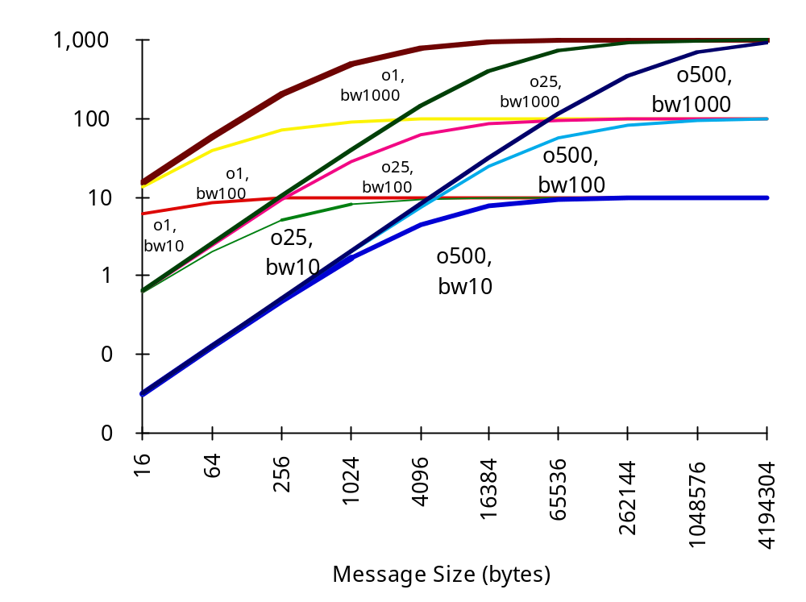
Overhead, BW, Size
Delivered BW
Msg Size
How big are
real messages?

Slide 24
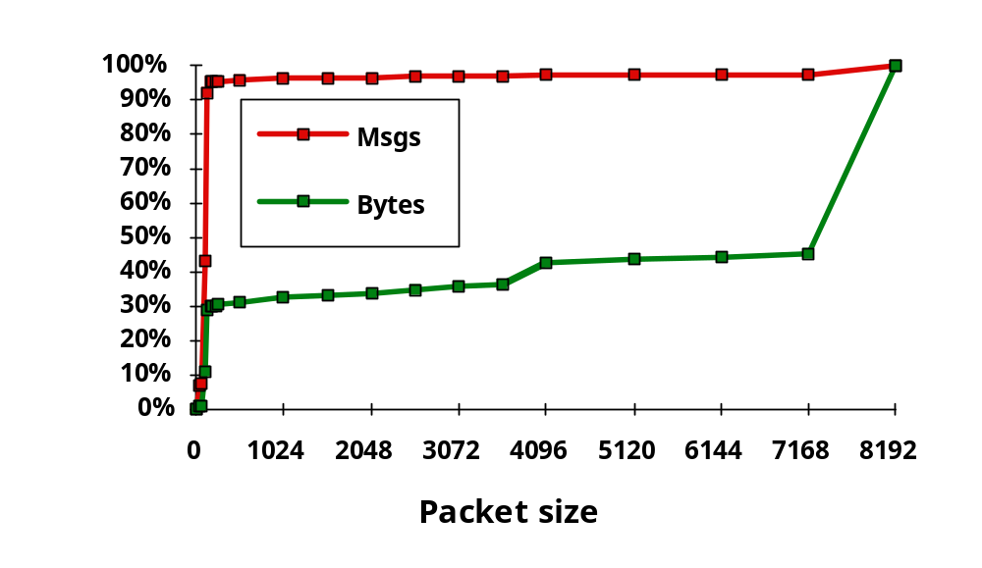
Measurement:
Sizes of Message for NFS
Why?
95% Msgs, 30% bytes for packets ~ 200 bytes
> 50% data transfered in packets = 8KB

Slide 25
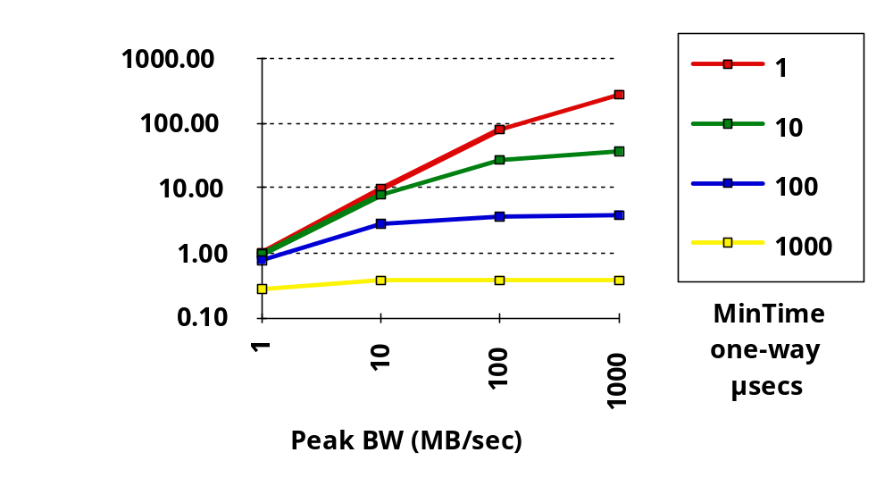
Impact of Overhead on Delivered BW
BW model: Time = overhead + msg size/peak BW

Slide 26
Interconnect Issues
Performance Measures
Network Media

Slide 27
Network Media
Twisted Pair:
Copper, 1mm think, twisted to avoid
attenna effect (telephone)
"Cat 5" is 4 twisted pairs in bundle
Coaxial Cable:
Plastic Covering
Insulator
Used by cable companies: high BW, good noise immunity
Copper core
Braided outer conductor
Buffer
Light: 3 parts are cable, light source, light detector.
Note fiber is unidirectional; need 2 for full duplex
Cladding
Fiber Optics
Total internal
Transmitter
reflection
– L.E.D
Receiver
– Laser Diode
– Photodiode
light
source
Silica core
Cladding
Buffer

Slide 28
Fiber
Multimode fiber: ~ 62.5 micron diameter vs. the 1.3 micron wavelength of infrared light. Since wider it has more dispersion problems, limiting its length at 1000 Mbits/s for 0.1 km, and 1-3 km at 100 Mbits/s. Uses LED as light
Single mode fiber: "single wavelength" fiber (8-9 microns) uses laser diodes, 1-5 Gbits/s for 100s kms
  Less reliable and more expensive, and restrictions on bending
  Cost, bandwidth, and distance of single-mode fiber affected by power of the light source, the sensitivity of the light detector, and the attenuation rate (loss of optical signal strength as light passes through the fiber) per kilometer of the fiber cable.
  Typically glass fiber, since has better characteristics than the less expensive plastic fiber

Slide 29
Wave Division Multiplexing Fiber
Send N independent streams on single fiber!
Just use different wavelengths to send and demultiplex at receiver
WDM in 2000: 40 Gbit/s using 8 wavelengths
Plan to go to 80 wavelengths => 400 Gbit/s!
A figure of merit: BW* max distance
(Gbit-km/sec)
10X/4 years, or 1.8X per year

Slide 30
Compare Media
Assume 40 2.5" disks, each 25 GB, Move 1 km
Compare Cat 5 (100 Mbit/s), Multimode fiber (1000 Mbit/s), single mode (2500 Mbit/s), and car
Cat 5: 1000 x 1024 x 8 Mb / 100 Mb/s = 23 hrs
MM: 1000 x 1024 x 8 Mb / 1000 Mb/s = 2.3 hrs
SM: 1000 x 1024 x 8 Mb / 2500 Mb/s = 0.9 hrs
Car: 5 min + 1 km / 50 kph + 10 min = 0.25 hrs
Car of disks = high BW media

Slide 31
Interconnect Issues
Performance Measures
Network Media
Connecting Multiple Computers

Slide 32
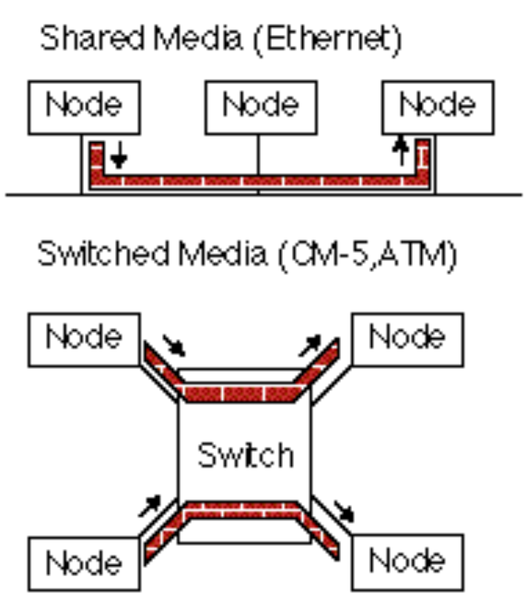
Connecting Multiple Computers
Shared Media vs. Switched: pairs communicate at same time: “point-to-point” connections
Aggregate BW in switched network is many times shared
  point-to-point faster since no arbitration, simpler interface
Arbitration in Shared network?
  Central arbiter for LAN?
  Listen to check if being used (“Carrier Sensing”)
  Listen to check if collision
  (“Collision Detection”)
  Random resend to avoid repeated collisions; not fair arbitration;
  OK if low utilization
(A. K. A. data switching
interchanges, multistage
interconnection networks,
interface message processors)

Slide 33
Summary: Interconnections
Communication between computers
Packets for standards, protocols to cover normal and abnormal events
Performance issues: HW & SW overhead, interconnect latency, bisection BW
Media sets cost, distance
Shared vs. Swicthed Media determines BW

Slide 34
Projects
See
www.cs/~pattrsn/252S01/suggestions.html

Slide 35
If time permits
Discuss Hennessy paper. "The future of systems research." Computer, vol.32, (no.8), IEEE Comput. Soc, Aug. 1999
Microprocessor Performance via ILP Analogy?
What is key metric if services via servers is killer app?
What is new focus for PostPC Era?
How does he define availability vs. textbook?
Notes:
Notes on 2/7/01 Wed: Hennessy, J. "The future of systems research." Computer, vol.32, (no.8), IEEE Comput. Soc, Aug. 1999.
Amazing performance results, but evolutionary path for 15 to 20 years
Forms of parallelism?
Loop to task level integrated
Cache aware algorithms
Explicit memory hierarchy
ILP: keep pushing rock up the hill, but its getting bigger and hill getting steeper, so need more people. some design teams getting crushed when roll backwards
Sisyphus: Greek mythology (except just short of the top, rock always slipped and fell to bottom)
Performance should share spotlight with other forms
PostDesktop Era
Information appliances
Ubiqitous comuting: >> 2 compuers per person
1) Information services must be reliable
2) Must scale with demand: Etrade when market is crazy
3) Embedded MPUs > Desktop MPUs in 1998; future 3:1
New Focus:
Availability, Maintainability, Scalability
Availability def: traditional availability + get the job done
How build reliable systems from unlreliable compoenents?
If access to services on servers is killer app, availability is key metric
HW fails slowly, yet systems hide the small errors
Need to confine and recover from errors
(HW) maintainability
1. Keep on
2. infant mortality
3. maintenance schedule (replace before break)
SW upgrade a pain; what about at Yahoo?
Scalability:
1) Modularity: subsystems that can scale
2) Composability: put together compoents so reliable
Microprocessor design, for example, doesn't scale
PostPC more interested in cost and power

