Slide 1
CS252
Graduate Computer Architecture
Lecture 9:
Network 2: Protocols, Routing, Wireless
February 14, 2001
Prof. David A. Patterson
Computer Science 252
Spring 2001

Slide 2
Review: Network Basics
0110
0110
Link made of some physical media
  wire, fiber, air
with a transmitter (tx) on one end
  converts digital symbols to analog signals and drives them down the link
and a receiver (rx) on the other
  captures analog signals and converts them back to digital signals
tx+rx called a transceiver

Slide 3
Review: Performance Metrics
Sender
Overhead
Transmission time
(size ÷ bandwidth)
Sender
(processor
busy)
Time of
Flight
Transmission time
(size ÷ bandwidth)
Receiver
Overhead
Receiver
Transport Latency
(processor
busy)
Total Latency
Total Latency = Sender Overhead + Time of Flight +
Message Size ÷ BW + Receiver Overhead
Includes header/trailer in BW calculation?
Notes:
Easy to get these things confused! Colors should help
Min (link BW, bisection BW)
Assumes no congestion
Receiver usually longer
Better to send then receive
Store Like send
Read like Receive

Slide 4
Review: Interconnections
Communication between computers
Packets for standards, protocols to cover normal and abnormal events
Performance issues: HW & SW overhead, interconnect latency, bisection BW
Media sets cost, distance

Slide 5
Compare Media
Assume 40 2.5" disks @ 25 GB (1 TB), Move 1 km
Compare Cat 5 (100 Mbit/s), Multimode fiber (1000 Mbit/s), single mode (5000 Mbit/s), and car
Cat 5: 1000 x 1024 x 8 Mb / 100 Mb/s = 23 hrs
MM: 1000 x 1024 x 8 Mb / 1000 Mb/s = 2.3 hrs
SM: 1000 x 1024 x 8 Mb / 5000 Mb/s = 0.5 hrs
Car: 5 min + 1 km / 50 kph + 10 min = 0.25 hrs
Car of disks = high BW media

Slide 6
Interconnect Issues
Performance Measures
Network Media
Connecting Multiple Computers

Slide 7
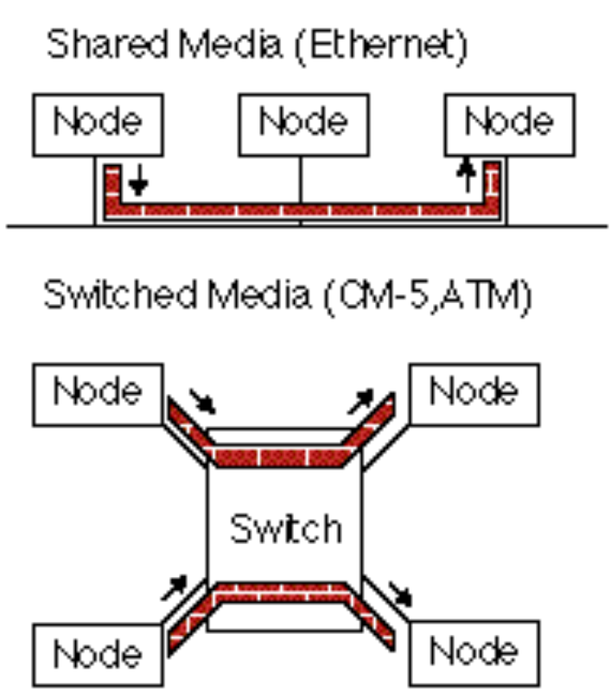
Connecting Multiple Computers
Shared Media vs. Switched: pairs communicate at same time: “point-to-point” connections
Aggregate BW in switched network is many times shared
  point-to-point faster since no arbitration, simpler interface
Arbitration in Shared network?
  Central arbiter for LAN?
  Listen to check if being used (“Carrier Sensing”)
  Listen to check if collision
  (“Collision Detection”)
  Random resend to avoid repeated collisions; not fair arbitration;
  OK if low utilization
(A. K. A. data switching
interchanges, multistage
interconnection networks,
interface message processors)

Slide 8
Connection-Based vs. Connectionless
Telephone: operator sets up connection between the caller and the receiver
  Once the connection is established, conversation can continue for hours
Share transmission lines over long distances by using switches to multiplex several conversations on the same lines
  “Time division multiplexing” divide B/W transmission line into a fixed number of slots, with each slot assigned to a conversation
Problem: lines busy based on number of conversations, not amount of information sent
Advantage: reserved bandwidth
Notes:
Before computers
How share lines for multiple conversation
Works until today;
Continuous

Slide 9
Connection-Based vs. Connectionless
Connectionless: every package of information must have an address => packets
  Each package is routed to its destination by looking at its address
  Analogy, the postal system (sending a letter)
  also called “Statistical multiplexing”
  Note: “Split phase buses” are sending packets
Notes:
Analogy: post

Slide 10
Routing Messages
Shared Media
  Broadcast to everyone
Switched Media needs real routing. Options:
  Source-based routing: message specifies path to the destination (changes of direction)
  Virtual Circuit: circuit established from source to destination, message picks the circuit to follow
  Destination-based routing: message specifies destination, switch must pick the path
    deterministic: always follow same path
    adaptive: pick different paths to avoid congestion, failures
    Randomized routing: pick between several good paths to balance network load
Notes:
Effect of a connection without it (not reserved)
Adaptive leads to deadlocks; 2 nodes waiting for other

Slide 11
Deterministic Routing Examples
mesh: dimension-order routing
  (x₁, y₁) -> (x₂, y₂)
  first Δx = x₂ - x₁,
  then Δy = y₂ - y₁,
hypercube: edge-cube routing
  X = x_{o}x₁x_{2 . . .}x_{n} -> Y = y_{o}y₁y_{2 . . .}y_{n}
  R = X xor Y
  Traverse dimensions of differing address in order
tree: common ancestor
Deadlock free?
010
110
111
011
100
000
001
101

Slide 12
Store and Forward vs. Cut-Through
Store-and-forward policy: each switch waits for the full packet to arrive in switch before sending to the next switch (good for WAN)
Cut-through routing or worm hole routing: switch examines the header, decides where to send the message, and then starts forwarding it immediately
  In worm hole routing, when head of message is blocked, message stays strung out over the network, potentially blocking other messages (needs only buffer the piece of the packet that is sent between switches).
  Cut through routing lets the tail continue when head is blocked, accordioning the whole message into a single switch. (Requires a buffer large enough to hold the largest packet).

Slide 13
Cut-Through vs. Store and Forward
Advantage
  Latency reduces from function of:
  number of intermediate switches X by the size of the packet
  to
  time for 1st part of the packet to negotiate the switches
  + the packet size ÷ interconnect BW

Slide 14
Congestion Control
Packet switched networks do not reserve bandwidth; this leads to contention (connection based limits input)
Solution: prevent packets from entering until contention is reduced
(e.g., freeway on-ramp metering lights)
Options:
  Packet discarding: If packet arrives at switch and no room in buffer, packet is discarded (e.g., UDP)
  Flow control: between pairs of receivers and senders;
  use feedback to tell sender when allowed to send next packet
    Back-pressure: separate wires to tell to stop
    Window: give original sender right to send N packets before getting permission to send more; overlapslatency of interconnection with overhead to send & receive packet (e.g., TCP), adjustable window
  Choke packets: aka “rate-based”; Each packet received by busy switch in warning state sent back to the source via choke packet. Source reduces traffic to that destination by a fixed % (e.g., ATM)
Notes:
Mother’s day: “all circuits are busy”
ATM packet: trying to avoid FDDI problem
Hope that ATM used for local area packets
Rate based for WAN
Back pressure for LAN
Telelecommunications is standards based: makes decision to ensure that no one has an advantage; all have a disadvantage
Europe used 32 B and US 64B => 48B payload

Slide 15
Protocols: HW/SW Interface
Internetworking: allows computers on independent and incompatible networks to communicate reliably and efficiently;
  Enabling technologies: SW standards that allow reliable communications without reliable networks
  Hierarchy of SW layers, giving each layer responsibility for portion of overall communications task, called
  protocol families or protocol suites
Transmission Control Protocol/Internet Protocol (TCP/IP)
  This protocol family is the basis of the Internet
  IP makes best effort to deliver; TCP guarantees delivery
  TCP/IP used even when communicating locally: NFS uses IP even though communicating across homogeneous LAN
Notes:
WS companies used TCP/IP even over LAN
Because early Ethernet controllers were cheap, but not reliable

Slide 16
CS 252 Administrivia
Select partner, project?
Read Amdahl's Law paper

Slide 17
Network/Routers Berkeley/Stanford
2. gig10-cnr1.EECS.Berkeley.EDU (169.229.3.65)
| full-duplex 1000baseSX
3. gigE5-0-0.inr-210-cory.Berkeley.EDU (169.229.1.45)
[cisco 7513/RSP4]
| full-duplex 100baseFX (1 of 2)
4. fast4-0-0.inr-002-eva.Berkeley.EDU (128.32.0.34)
[cisco 7507/RSP4]
| OC-3 PoS (1 of 2; 132 Mbit/sec)
5. pos0-2.inr-000-eva.Berkeley.EDU (128.32.0.73)
[cisco 12008 (GSR)]
| OC-12 PoS (628 Mbit/sec)
6. pos3-0.c2-berk-gsr.Berkeley.EDU (128.32.0.90)
[cisco 12012 (GSR)]

Slide 18
Network/Routers Berkeley/Stanford II
6. pos3-0.c2-berk-gsr.Berkeley.EDU (128.32.0.90)
[cisco 12012 (GSR)]
| OC-12 PoS (628 Mbit/sec)
7. SUNV--BERK.POS.calren2.net (198.32.249.14)
[cisco 12008 (GSR)]
| OC-12 PoS (628 Mbit/sec)
8. STAN--SUNV.POS.calren2.net (198.32.249.74)
[cisco 12008 (GSR)]
| OC-12 PoS (628 Mbit/sec)
9. i2-gateway.Stanford.EDU (171.64.1.214)
[cisco 120xx (GSR)]
10. Core4-gateway.Stanford.EDU (171.64.1.226)
11. 171.64.3.89 (171.64.3.89)
12. CS.Stanford.EDU (171.64.64.64)

Slide 19
TraceRoute Berkeley to Stanford, I
(round trip times for 3 probes)
1 fast1-1.snr1.CS.Berkeley.EDU (128.32.131.1)
1.12 ms 0.593 ms 0.546 ms
2 gig10-cnr1.EECS.Berkeley.EDU (169.229.3.65)
0.695 ms 0.615 ms 0.662 ms
3 gigE5-0-0.inr-210-cory.Berkeley.EDU (169.229.1.45) 0.783 ms 0.741 ms 0.708 ms
4 fast4-0-0.inr-002-eva.Berkeley.EDU (128.32.0.34)
1.89 ms 1.3 ms 1.24 ms
5 pos0-2.inr-000-eva.Berkeley.EDU (128.32.0.73)
1.34 ms 1.99 ms 1.51 ms
6 pos3-0.c2-berk-gsr.Berkeley.EDU (128.32.0.90)
1.82 ms 1.65 ms 2.18 ms
7 SUNV--BERK.POS.calren2.net (198.32.249.14)
2.34 ms 2.78 ms 3.18 ms

Slide 20
TraceRoute Berkeley to Stanford, II
7 SUNV--BERK.POS.calren2.net (198.32.249.14)
2.34 ms 2.78 ms 3.18 ms
8 STAN--SUNV.POS.calren2.net (198.32.249.74)
3.36 ms 3.36 ms 2.91 ms
9 i2-gateway.Stanford.EDU (171.64.1.214)
3.73 ms 3.50 ms 2.98 ms
10 Core4-gateway.Stanford.EDU (171.64.1.226)
3.52 ms 3.69 ms 3.34 ms
11 171.64.3.89 (171.64.3.89)
5.46 ms 4.38 ms 4.13 ms
12 CS.Stanford.EDU (171.64.64.64)
4.23 ms * ms 4.37 ms

Slide 21
Protocol Family Concept
Message
Logical
Message
Actual
Actual
Logical
H
Message
T
H
Message
T
Actual
Actual
H
H
Message
T
T
H
H
Message
T
T
Physical

Slide 22
Protocol Family Concept
Key to protocol families is that communication occurs logically at the same level of the protocol, called peer-to-peer,
but is implemented via services at the next lower level
Encapsulation: carry higher level information within lower level “envelope”
Fragmentation: break packet into multiple smaller packets and reassemble
Danger is each level increases latency if implemented as hierarchy (e.g., multiple check sums)

Slide 23
TCP/IP packet, Ethernet packet, protocols
Application sends message
Ethernet Hdr
TCP breaks into 64KB segments, adds 20B header
IP Header
TCP Header
EH
IP Data
IP adds 20B header, sends to network
TCP data
If Ethernet, broken into 1500B packets with headers, trailers (24B)
Message
Ethernet Hdr
All Headers, trailers have length field, destination, ...

Slide 24
Example Networks
Ethernet: shared media 10 Mbit/s proposed in 1978, carrier sensing with expotential backoff on collision detection
15 years with no improvement; higher BW?
Multiple Ethernets with devices to allow Ehternets to operate in parallel!
10 Mbit Ethernet successors?
  FDDI: shared media (too late)
  ATM (too late?)
  Switched Ethernet
  100 Mbit Ethernet (Fast Ethernet)
  Gigabit Ethernet
  10 Gigabit Ethernet in 2002?

Slide 25
Connecting Networks
Bridges: connect LANs together, passing traffic from one side to another depending on the addresses in the packet.
  operate at the Ethernet protocol level
  usually simpler and cheaper than routers
Routers or Gateways: these devices connect LANs to WANs or WANs to WANs and resolve incompatible addressing.
  Generally slower than bridges, they operate at the internetworking protocol (IP) level
  Routers divide the interconnect into separate smaller subnets, which simplifies manageability and improves security
Cisco is major supplier;
basically special purpose computers

Slide 26
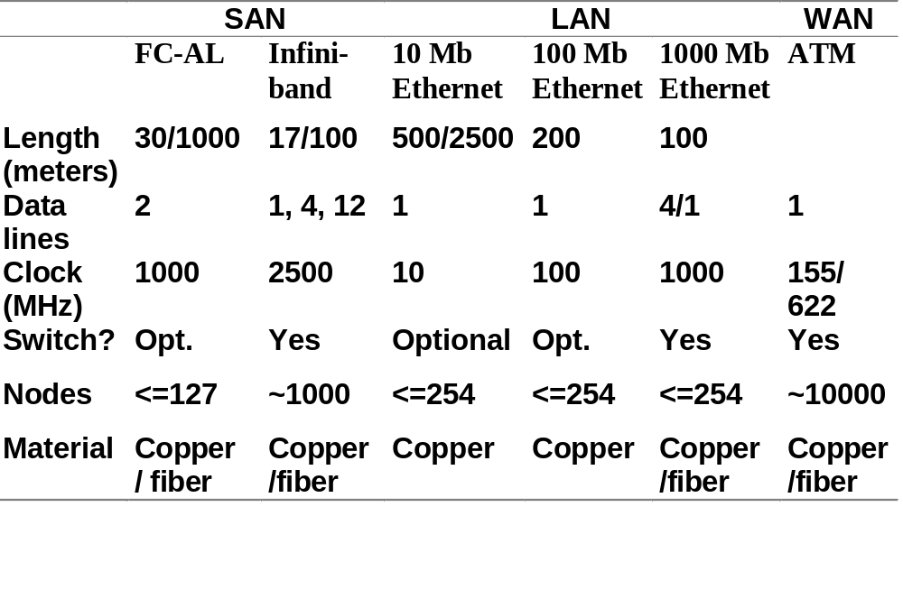
Comparing Networks

Slide 27
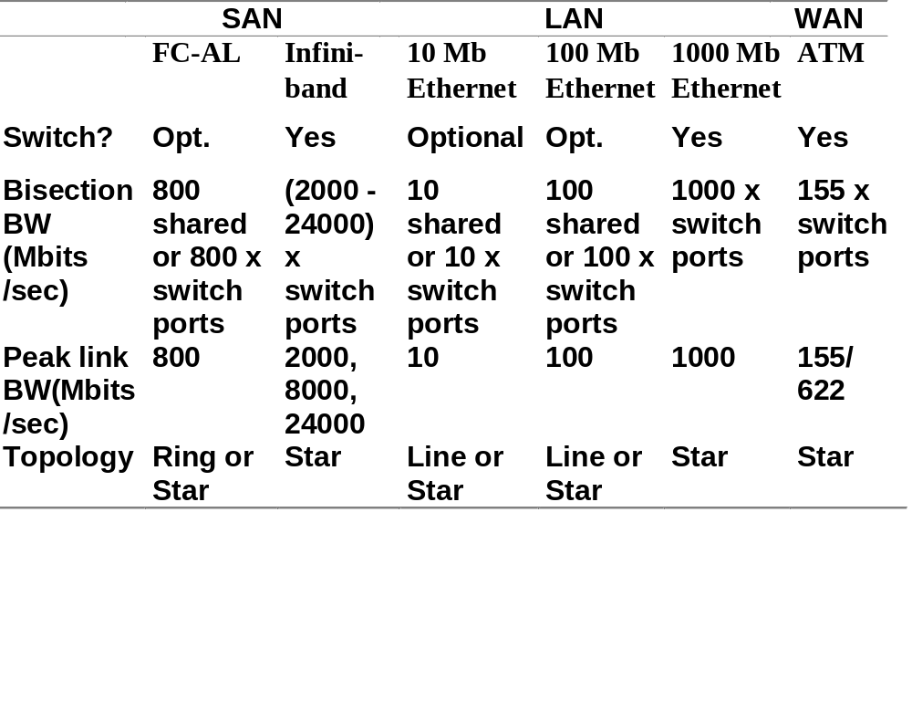
Comparing Networks

Slide 28
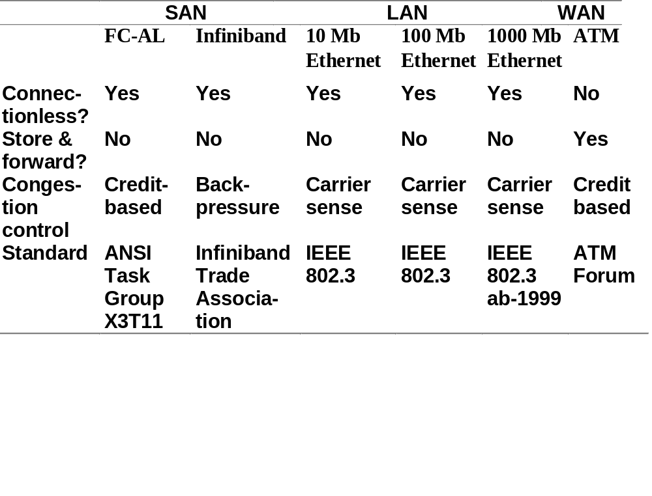
Comparing Networks

Slide 29
Packet Formats
See Fig 7.20 on page 634

Slide 30
Wireless Networks
Media can be air as well as glass or copper
Radio wave is electromagnetic wave propagated by an antenna
Radio waves are modulated: sound signal superimposed on stronger radio wave which carries sound signal, called carrier signal
Radio waves have a wavelength or frequency: measure either length of wave
or number of waves per second (MHz):
long waves => low frequencies,
short waves => high frequencies
Tuning to different frequencies => radio receiver pick up a signal.
  FM radio stations transmit on band of 88 MHz to 108 MHz using frequency modulations (FM) to record the sound signal

Slide 31
Issues in Wireless
Wireless often => mobile => network must rearrange itself dynamically
Subject to jamming and eavesdropping
  No physical tape
  Cannot detect interception
Power
  devices tend to be battery powered
  antennas radiate power to communicate and little of it reaches the receiver
As a result, raw bit error rates are typically a thousand to a million times higher than copper wire

Slide 32
Reliability of Wires Transmission
bit error rate (BER) of wireless link determined by received signal power, noise due to interference caused by the receiver hardware, interference from other sources, and characteristics of the channel
  Path loss: power to overcome interference
  Shadow fading: blocked by objects (walls, buildings)
  Multipath fading: interference between multiple version of signals arriving different times
  Interference: reuse of frequency or from adjacent channels

Slide 33
2 Wireless Architectures
Base-station architectures
  Connected by land lines for longer distance communication, and the mobile units communicate only with a single local base station
  More reliable since 1-hop from land lines
  Example: cell phones
Peer-to-peer architectures
  Allow mobile units to communicate with each other, and messages hop from one unit to the next until delivered to the desired unit
  More reconfigurable

Slide 34
Cellular Telephony
Exploit exponential path loss to reuse same frequency at spatially separated locations, thereby greatly increasing customers served
Divide region into nonoverlaping hexagonal cells (2-10 mi. diameter) which use different frequencies if nearby, reusing a frequency when cells far apart so that mutual interference OK
Intersection of three hexagonal cells is a base station with transmitters and antennas
Handset selects a cell based on signal strength and then picks an unused radio channel
To properly bill for cellular calls, each cellular phone handset has an electronic serial number

Slide 35
Cellular Telephony II
Orginal analog design frequencies set for each direction: pair called a channel
  869.04 to 893.97 MHz, called the forward path
  824.04 MHz to 848.97 MHz, called the reverse path
  Cells might have had between 4 and 80 channels
Several digital successors:
  Code division multiple access (CDMA) uses a wider radio frequency band
  time division multiple access (TDMA)
  global system for mobile communication (GSM)
  International Mobile Telephony 2000 (IMT-2000) which is based primarily on two competing versions of CDMA and one TDMA, called Third Generation (3G)

Slide 36
Practical Issues for Inteconnection Networks
Connectivity: max number of machines affects complexity of network and protocols since protocols must target largest size
Connection Network Interface to computer
  Where in bus hierarchy? Memory bus? Fast I/O bus? Slow I/O bus? (Ethernet to Fast I/O bus, Inifiband to Memory bus since it is the Fast I/O bus)
  SW Interface: does software need to flush caches for consistency of sends or receives?
  Programmed I/O vs. DMA? Is NIC in uncachable address space?

Slide 37
Practical Issues for Inteconnection Networks
Standardization advantages:
  low cost (components used repeatedly)
  stability (many suppliers to chose from)
Standardization disadvantages:
  Time for committees to agree
  When to standardize?
    Before anything built? => Committee does design?
    Too early suppresses innovation
Reliability (vs. availability) of interconnect

Slide 38
Practical Issues
Interconnection SAN LAN WAN
Example Inifiband Ethernet ATM
Standard Yes Yes Yes
Fault Tolerance? Yes Yes Yes
Hot Insert? Yes Yes Yes
Standards: required for WAN, LAN, and likely SAN!
Fault Tolerance: Can nodes fail and still deliver messages to other nodes?
Hot Insert: If the interconnection can survive a failure, can it also continue operation while a new node is added to the interconnection?

Slide 39
Cross-Cutting Issues for Networking
Efficient Interface to Memory Hierarchy vs. to Network
  SPEC ratings => fast to memory hierarchy
  Writes go via write buffer, reads via L1 and L2 caches
Example: 40 MHz SPARCStation(SS)-2 vs 50 MHz SS-20, no L2$ vs 50 MHz SS-20 with L2$ I/O bus latency; different generations
SS-2: combined memory, I/O bus => 200 ns
SS-20, no L2$: 2 busses +300ns => 500ns
SS-20, w L2$: cache miss+500ns => 1000ns

Slide 40
Crosscutting: Smart Switch vs. Smart Network Interface Card
 | Less Intelligent | More Intelligent
Switch | Small Ethernet Myrinet Inifiband | Large Ethernet
NIC | Ethernet Infiniband Target Channel Adapter | Myrinet Inifiband Host Channel Adapter
Inexpensive NIC => Ethernet standard in all computers
Inexpensive switch => Ethernet used in home networks

Slide 41
Summary: Networking
Protocols allow hetereogeneous networking
  Protocols allow operation in the presense of failures
  Internetworking protocols used as LAN protocols
  => large overhead for LAN
Integrated circuit revolutionizing networks as well as processors
  Switch is a specialized computer
  Faster networks and slow overheads violate of Amdahl’s Law

