Slide 1
CS252
Graduate Computer Architecture
Lecture 10:
Network 3: Clusters, Examples
February 16, 2001
Prof. David A. Patterson
Computer Science 252
Spring 2001

Slide 2
Review: Networking
Protocols allow hetereogeneous networking
  Protocols allow operation in the presense of failures
  Internetworking protocols used as LAN protocols
  => large overhead for LAN
Integrated circuit revolutionizing networks as well as processors
  Switch is a specialized computer
  Faster networks and slow overheads violate of Amdahl’s Law
Wireless Networking offers new challenges in bandwidth, mobility, reliability, ...

Slide 3
Cluster
LAN switches => high network bandwidth and scaling was available from off the shelf components
2001 Cluster = collection of independent computers using switched network to provide a common service
Many mainframe applications run more "loosely coupled" machines than shared memory machines (next chapter/week)
  databases, file servers, Web servers, simulations, and multiprogramming/batch processing
  Often need to be highly available, requiring error tolerance and repairability
  Often need to scale

Slide 4
Cluster Drawbacks
Cost of administering a cluster of N machines
~ administering N independent machines
vs. cost of administering a shared address space N processors multiprocessor
~ administering 1 big machine
Clusters usually connected using I/O bus, whereas multiprocessors usually connected on memory bus
Cluster of N machines has N independent memories and N copies of OS, but a shared address multi-processor allows 1 program to use almost all memory
  DRAM prices has made memory costs so low that this multiprocessor advantage is much less important in 2001

Slide 5
Cluster Advantages
Error isolation: separate address space limits contamination of error
Repair: Easier to replace a machine without bringing down the system than in an shared memory multiprocessor
Scale: easier to expand the system without bringing down the application that runs on top of the cluster
Cost: Large scale machine has low volume => fewer machines to spread development costs vs. leverage high volume off-the-shelf switches and computers
Amazon, AOL, Google, Hotmail, Inktomi, WebTV, and Yahoo rely on clusters of PCs to provide services used by millions of people every day

Slide 6
Addressing Cluster Weaknesses
Network performance: SAN, especially Inifiband, may tie cluster closer to memory
Maintenance: separate of long term storage and computation
Computation maintenance:
  Clones of identical PCs
  3 steps: reboot, reinstall OS, recycle
  At $1000/PC, cheaper to discard than to figure out what is wrong and repair it?
Storage maintenance:
  If separate storage servers or file servers, cluster is no worse?

Slide 7
Clusters and TPC Benchmarks
“Shared Nothing” database (not memory, not disks) is a match to cluster
2/2001: Top 10 TPC performance 6/10 are clusters (4 / top 5)

Slide 8
Putting it all together: Google
Google: search engine that scales at growth Internet growth rates
Search engines: 24x7 availability
Google 12/2000: 70M queries per day, or AVERAGE of 800 queries/sec all day
Response time goal: < 1/2 sec for search
Google crawls WWW and puts up new index every 4 weeks
Stores local copy of text of pages of WWW (snippet as well as cached copy of page)
3 collocation sites (2 CA + 1 Virginia)
6000 PCs, 12000 disks: almost 1 petabyte!

Slide 9
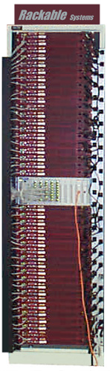
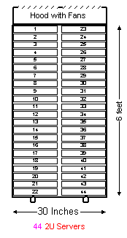
Hardware Infrastructure
VME rack 19 in. wide, 6 feet tall, 30 inches deep
Per side: 40 1 Rack Unit (RU) PCs +1 HP Ethernet switch (4 RU): Each blade can contain 8 100-Mbit/s EN or a single 1-Gbit Ethernet interface
Front+back => 80 PCs +
2 EN switches/rack
Each rack connects to 2 128 1-Gbit/s EN switches
Dec 2000: 40 racks at most recent site

Slide 10
Google PCs
2 IDE drives, 256 MB of SDRAM, modest Intel microprocessor, a PC mother-board, 1 power supply and a few fans.
Each PC runs the Linix operating system
Buy over time, so upgrade components:
populated between March and November 2000
  microprocessors: 533 MHz Celeron to an 800 MHz Pentium III,
  disks: capacity between 40 and 80 GB, speed 5400 to 7200 RPM
  bus speed is either 100 or 133 MH
  Cost: ~ $1300 to $1700 per PC
PC operates at about 55 Watts
Rack => 4500 Watts , 60 amps

Slide 11
Reliability
For 6000 PCs, 12000s, 200 EN switches
~ 20 PCs will need to be rebooted/day
~ 2 PCs/day hardware failure, or 2%-3% / year
  5% due to problems with motherboard, power supply, and connectors
  30% DRAM: bits change + errors in transmission (100 MHz)
  30% Disks fail
  30% Disks go very slow (10%-3% expected BW)
200 EN switches, 2-3 fail in 2 years
6 Foundry switches: none failed, but 2-3 of 96 blades of switches have failed (16 blades/switch)
Collocation site reliability:
  1 power failure,1 network outage per year per site
  Bathtub for occupancy

Slide 12
CS 252 Administrivia
Signup for meetings 12:00 to 2 Wed Feb 21
Email project questionnaire Monday
No lecture next Wednesday Feb 21

Slide 13
Google Performance: Serving
How big is a page returned by Google? ~16KB
Average bandwidth to serve searches
70,000,000/day x 16,750 B x 8 bits/B
24 x 60 x 60
=9,378,880 Mbits/86,400 secs
= 108 Mbit/s

Slide 14
Google Performance: Crawling
How big is a text of a WWW page? ~4000B
1 Billion pages searched
Assume 7 days to crawl
Average bandwidth to crawl
1,000,000,000/pages x 4000 B x 8 bits/B
24 x 60 x 60 x 7
=32,000,000 Mbits/604,800 secs
= 59 Mbit/s

Slide 15
Google Performance: Replicating Index
How big is Google index? ~5 TB
Assume 7 days to replicate to 2 sites, implies BW to send + BW to receive
Average bandwidth to replicate new index
2 x 2 x 5,000,000 MB x 8 bits/B
24 x 60 x 60 x 7
=160,000,000 Mbits/604,800 secs
= 260 Mbit/s

Slide 16
Colocation Sites
Allow scalable space, power, cooling and network bandwidth plus provide physical security
charge about $500 to $750 per Mbit/sec/month
  if your continuous use measures 1- 2 Gbits/second
to $1500 to $2000 per Mbit/sec/month
  if your continuous use measures 1-10 Mbits/second
Rack space: costs $800 -$1200/month, and drops by 20% if > 75 to 100 racks (1 20 amp circuit)
  Each additional 20 amp circuit per rack costs another $200 to $400 per month
PG&E: 12 megawatts of power, 100,000 sq. ft./building, 10 sq. ft./rack => 1000 watts/rack

Slide 17
Google Performance: Total
Serving pages: 108 Mbit/sec/month
Crawling: 59 Mbit/sec/week, 15 Mbit/s/month
Replicating: 260 Mbit/sec/week, 65 Mb/s/month
Total: roughly 200 Mbit/sec/month
Google’s Collocation sites have OC48
(2488 Mbit/sec) link to Internet
Bandwidth cost per month?
~$150,000 to $200,000
1/2 BW grows at 20%/month

Slide 18
Google Costs
Collocation costs: 40 racks @ $1000 per month + $500 per month for extra circuits
= ~$60,000 per site, * 3 sites
~$180,000 for space
Machine costs:
Rack = $2k + 80 * $1500/pc + 2 * $1500/EN
= ~$125k
40 racks + 2 Foundry switches @$100,000
= ~$5M
3 sites = $15M
Cost today is $10,000 to $15,000 per TB

Slide 19
Comparing Storage Costs: 1/2001
Google site, including 3200 processors and 0.8 TB of DRAM, 500 TB (40 racks)
$10k - $15k/ TB
Compaq Cluster with 192 processors,
0.2 TB of DRAM, 45 TB of SCSI Disks (17+ racks) $115k/TB (TPC-C)
HP 9000 Superdome: 48 processors,
0.25 TB DRAM, 19 TB of SCSI disk =
(23+ racks) $360k/TB (TPC-C)

Slide 20
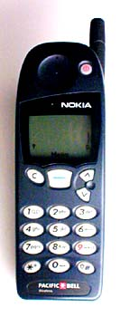
Putting It All Together: Cell Phones
1999 280M handsets sold; 2001 500M
Radio steps/components: Receive/transmit
  Antenna
  Amplifier
  Mixer
  Filter
  Demodulator
  Decoder

Slide 21
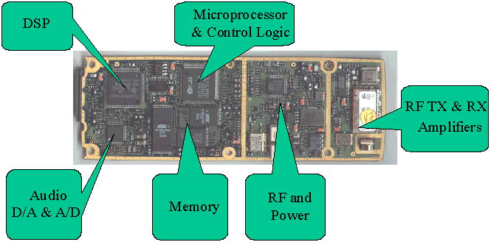
Putting It All Together: Cell Phones
about 10 chips in 2000, which should shrink, but likely separate MPU and DSP
Emphasis on energy efficiency
From “How Stuff Works” on cell phones: www.howstuffworks.com

Slide 22
Cell phone steps (protocol)
Find a cell
  Scans full BW to find stronger signal every 7 secs
Local switching office registers call
  records phone number, cell phone serial number, assigns channel
  sends special tone to phone, which cell acks if correct
  Cell times out after 5 sec if doesn't get supervisory tone
Communicate at 9600 b/s digitally (modem)
  Old style: message repeated 5 times
  AMPS had 2 power levels depending on distance (0.6W and 3W)

Slide 23
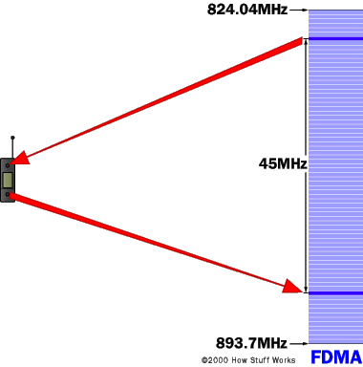
Frequency Division Multiple Access (FDMA)
FDMA separates the spectrum into distinct voice channels by splitting it into uniform chunks of bandwidth
!st generation analog
From “How Stuff Works” on cell phones: www.howstuffworks.com

Slide 24
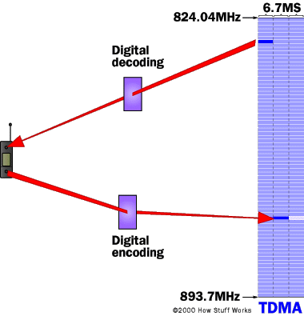
Time Division Multiple Access (TDMA)
a narrow band that is 30 kHz wide and 6.7 ms long is split time-wise into 3 time slots.
Each conversation gets the radio for 1/3 of time.
Possible because voice data converted to digital information is compressed so
Therefore, TDMA has 3 times capacity of analog
GSM implements TDMA in a somewhat different and incompatible way from US (IS-136); also encrypts the call
From “How Stuff Works” on cell phones: www.howstuffworks.com

Slide 25
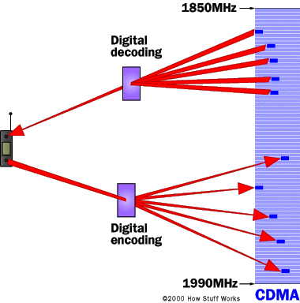
Code Division Multiple Access (CDMA)
CDMA, after digitizing data, spreads it out over the entire bandwidth it has available.
Multiple calls are overlaid over each other on the channel, with each assigned a unique sequence code.
CDMA is a form of spread spectrum; All the users transmit in the same wide-band chunk of spectrum.
Each user's signal is spread over the entire bandwidth by a unique spreading code. same unique code is used to recover the signal.
GPS for time stamp
. Between 8 and 10 separate calls space as 1 analog call
From “How Stuff Works” on cell phones: www.howstuffworks.com

Slide 26
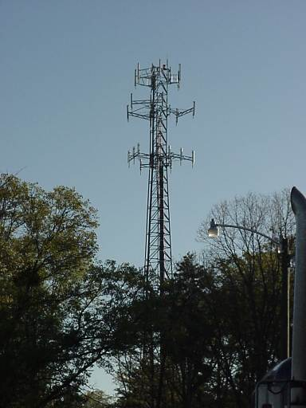
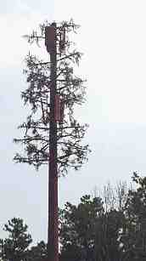
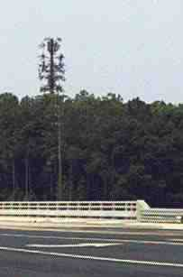
Cell Phone Towers
From “How Stuff Works” on cell phones: www.howstuffworks.com

Slide 27
If time permits
Discuss Hennessy paper. "The future of systems research." Computer, vol.32, (no.8), IEEE Comput. Soc, Aug. 1999
Microprocessor Performance via ILP Analogy?
What is key metric if services via servers is killer app?
What is new focus for PostPC Era?
How does he define availability vs. textbook definition?
Notes:
Notes on 2/7/01 Wed: Hennessy, J. "The future of systems research." Computer, vol.32, (no.8), IEEE Comput. Soc, Aug. 1999.
Amazing performance results, but evolutionary path for 15 to 20 years
Forms of parallelism?
Loop to task level integrated
Cache aware algorithms
Explicit memory hierarchy
ILP: keep pushing rock up the hill, but its getting bigger and hill getting steeper, so need more people. some design teams getting crushed when roll backwards
Sisyphus: Greek mythology (except just short of the top, rock always slipped and fell to bottom)
Performance should share spotlight with other forms
PostDesktop Era
Information appliances
Ubiqitous comuting: >> 2 compuers per person
1) Information services must be reliable
2) Must scale with demand: Etrade when market is crazy
3) Embedded MPUs > Desktop MPUs in 1998; future 3:1
New Focus:
Availability, Maintainability, Scalability
Availability def: traditional availability + get the job done
How build reliable systems from unlreliable compoenents?
If access to services on servers is killer app, availability is key metric
HW fails slowly, yet systems hide the small errors
Need to confine and recover from errors
(HW) maintainability
1. Keep on
2. infant mortality
3. maintenance schedule (replace before break)
SW upgrade a pain; what about at Yahoo?
Scalability:
1) Modularity: subsystems that can scale
2) Composability: put together compoents so reliable
Microprocessor design, for example, doesn't scale
PostPC more interested in cost and power

Slide 28
Amdahl’s Law Paper
What was Amdahl’s Observation?
What is Amdahl’s Law?

