Slide 1
CS252
Graduate Computer Architecture
Lecture 11:
Multiprocessor 1: Reasons, Classifications, Performance Metrics, Applications
February 23, 2001
Prof. David A. Patterson
Computer Science 252
Spring 2001

Slide 2
Review: Networking
Clusters +: fault isolation and repair, scaling, cost
Clusters -: maintenance, network interface performance, memory efficiency
Google as cluster example:
  scaling (6000 PCs, 1 petabyte storage)
  fault isolation (2 failures per day yet available)
  repair (replace failures weekly/repair offline)
  Maintenance: 8 people for 6000 PCs
Cell phone as portable network device
  # Handsets >> # PCs
  Univerisal mobile interface?
Is future services built on Google-like clusters delivered to gadgets like cell phone handset?

Slide 3
Parallel Computers
Definition: “A parallel computer is a collection of processiong elements that cooperate and communicate to solve large problems fast.”
  Almasi and Gottlieb, Highly Parallel Computing ,1989
Questions about parallel computers:
  How large a collection?
  How powerful are processing elements?
  How do they cooperate and communicate?
  How are data transmitted?
  What type of interconnection?
  What are HW and SW primitives for programmer?
  Does it translate into performance?

Slide 4
Parallel Processors “Religion”
The dream of computer architects since 1950s: replicate processors to add performance vs. design a faster processor
Led to innovative organization tied to particular programming models since
“uniprocessors can’t keep going”
  e.g., uniprocessors must stop getting faster due to limit of speed of light: 1972, … , 1989
  Borders religious fervor: you must believe!
  Fervor damped some when 1990s companies went out of business: Thinking Machines, Kendall Square, ...
Argument instead is the “pull” of opportunity of scalable performance, not the “push” of uniprocessor performance plateau?

Slide 5
What level Parallelism?
Bit level parallelism: 1970 to ~1985
  4 bits, 8 bit, 16 bit, 32 bit microprocessors
Instruction level parallelism (ILP):
~1985 through today
  Pipelining
  Superscalar
  VLIW
  Out-of-Order execution
  Limits to benefits of ILP?
Process Level or Thread level parallelism; mainstream for general purpose computing?
  Servers are parallel
  Highend Desktop dual processor PC soon??
  (or just the sell the socket?)

Slide 6
Why Multiprocessors?
Microprocessors as the fastest CPUs
  Collecting several much easier than redesigning 1
Complexity of current microprocessors
  Do we have enough ideas to sustain 1.5X/yr?
  Can we deliver such complexity on schedule?
Slow (but steady) improvement in parallel software (scientific apps, databases, OS)
Emergence of embedded and server markets driving microprocessors in addition to desktops
  Embedded functional parallelism, producer/consumer model
  Server figure of merit is tasks per hour vs. latency

Slide 7
Parallel Processing Intro
Long term goal of the field: scale number processors to size of budget, desired performance
Machines today: Sun Enterprise 10000 (8/00)
  64 400 MHz UltraSPARC® II CPUs,64 GB SDRAM memory, 868 18GB disk,tape
  $4,720,800 total
  64 CPUs 15%,64 GB DRAM 11%, disks 55%, cabinet 16%
  ($10,800 per processor or ~0.2% per processor)
  Minimal E10K - 1 CPU, 1 GB DRAM, 0 disks, tape ~$286,700
  $10,800 (4%) per CPU, plus $39,600 board/4 CPUs (~8%/CPU)
Machines today: Dell Workstation 220 (2/01)
  866 MHz Intel Pentium® III (in Minitower)
  0.125 GB RDRAM memory, 1 10GB disk, 12X CD, 17” monitor, nVIDIA GeForce 2 GTS,32MB DDR Graphics card, 1yr service
  $1,600; for extra processor, add $350 (~20%)

Slide 8
Whither Supercomputing?
Linpack (dense linear algebra) for
Vector Supercomputers vs. Microprocessors
“Attack of the Killer Micros”
  (see Chapter 1, Figure 1-10, page 22 of [CSG99])
  100 x 100 vs. 1000 x 1000
MPPs vs. Supercomputers when rewrite linpack to get peak performance
  (see Chapter 1, Figure 1-11, page 24 of [CSG99])
1997, 500 fastest machines in the world:
319 MPPs, 73 bus-based shared memory (SMP), 106 parallel vector processors (PVP)
  (see Chapter 1, Figure 1-12, page 24 of [CSG99])
2000, 381 of 500 fastest: 144 IBM SP (~cluster), 121 Sun (bus SMP), 62 SGI (NUMA SMP), 54 Cray (NUMA SMP)
  [CSG99] = Parallel computer architecture : a hardware/ software approach, David E. Culler, Jaswinder Pal Singh, with Anoop Gupta. San Francisco : Morgan Kaufmann, c1999.

Slide 9
Popular Flynn Categories
(e.g., ~RAID level for MPPs)
SISD (Single Instruction Single Data)
  Uniprocessors
MISD (Multiple Instruction Single Data)
  ???; multiple processors on a single data stream
SIMD (Single Instruction Multiple Data)
  Examples: Illiac-IV, CM-2
    Simple programming model
    Low overhead
    Flexibility
    All custom integrated circuits
  (Phrase reused by Intel marketing for media instructions ~ vector)
MIMD (Multiple Instruction Multiple Data)
  Examples: Sun Enterprise 5000, Cray T3D, SGI Origin
    Flexible
    Use off-the-shelf micros
MIMD current winner: Concentrate on major design emphasis <= 128 processor MIMD machines

Slide 10
Major MIMD Styles
Centralized shared memory ("Uniform Memory Access" time or "Shared Memory Processor")
Decentralized memory (memory module with CPU)
  get more memory bandwidth, lower memory latency
  Drawback: Longer communication latency
  Drawback: Software model more complex

Slide 11
Decentralized Memory versions
Shared Memory with "Non Uniform Memory Access" time (NUMA)
Message passing "multicomputer" with separate address space per processor
  Can invoke software with Remote Procedue Call (RPC)
  Often via library, such as MPI: Message Passing Interface
  Also called "Syncrohnous communication" since communication causes synchronization between 2 processes

Slide 12
Performance Metrics:
Latency and Bandwidth
Bandwidth
  Need high bandwidth in communication
  Match limits in network, memory, and processor
  Challenge is link speed of network interface vs. bisection bandwidth of network
Latency
  Affects performance, since processor may have to wait
  Affects ease of programming, since requires more thought to overlap communication and computation
  Overhead to communicate is a problem in many machines
Latency Hiding
  How can a mechanism help hide latency?
  Increases programming system burdern
  Examples: overlap message send with computation, prefetch data, switch to other tasks

Slide 13
CS 252 Administrivia
Meetings this week
Next Wednesday guest lecture
Flash vs. Flash paper reading
Quiz #1 Wed March 7 5:30-8:30 306 Soda
La Val's afterward quiz: free food and drink

Slide 14
Parallel Architecture
Parallel Architecture extends traditional computer architecture with a communication architecture
  abstractions (HW/SW interface)
  organizational structure to realize abstraction efficiently

Slide 15
Parallel Framework
Layers:
  (see Chapter 1, Figure 1-13, page 27 of [CSG99])
  Programming Model:
    Multiprogramming : lots of jobs, no communication
    Shared address space: communicate via memory
    Message passing: send and recieve messages
    Data Parallel: several agents operate on several data sets simultaneously and then exchange information globally and simultaneously (shared or message passing)
  Communication Abstraction:
    Shared address space: e.g., load, store, atomic swap
    Message passing: e.g., send, recieve library calls
    Debate over this topic (ease of programming, scaling)
    => many hardware designs 1:1 programming model

Slide 16
Shared Address Model Summary
Each processor can name every physical location in the machine
Each process can name all data it shares with other processes
Data transfer via load and store
Data size: byte, word, ... or cache blocks
Uses virtual memory to map virtual to local or remote physical
Memory hierarchy model applies: now communication moves data to local processor cache (as load moves data from memory to cache)
  Latency, BW, scalability when communicate?

Slide 17
Shared Address/Memory Multiprocessor Model
Communicate via Load and Store
  Oldest and most popular model
Based on timesharing: processes on multiple processors vs. sharing single processor
process: a virtual address space
and ~ 1 thread of control
  Multiple processes can overlap (share), but ALL threads share a process address space
Writes to shared address space by one thread are visible to reads of other threads
  Usual model: share code, private stack, some shared heap, some private heap

Slide 18
SMP Interconnect
Processors to Memory AND to I/O
Bus based: all memory locations equal access time so SMP = “Symmetric MP”
  Sharing limited BW as add processors, I/O
  (see Chapter 1, Figs 1-17, page 32-33 of [CSG99])

Slide 19
Message Passing Model
Whole computers (CPU, memory, I/O devices) communicate as explicit I/O operations
  Essentially NUMA but integrated at I/O devices vs. memory system
Send specifies local buffer + receiving process on remote computer
Receive specifies sending process on remote computer + local buffer to place data
  Usually send includes process tag
  and receive has rule on tag: match 1, match any
  Synch: when send completes, when buffer free, when request accepted, receive wait for send
Send+receive => memory-memory copy, where each each supplies local address,
AND does pairwise sychronization!

Slide 20
Data Parallel Model
Operations can be performed in parallel on each element of a large regular data structure, such as an array
1 Control Processsor broadcast to many PEs (see Ch. 1, Fig. 1-25, page 45 of [CSG99])
  When computers were large, could amortize the control portion of many replicated PEs
Condition flag per PE so that can skip
Data distributed in each memory
Early 1980s VLSI => SIMD rebirth:
32 1-bit PEs + memory on a chip was the PE
Data parallel programming languages lay out data to processor

Slide 21
Data Parallel Model
Vector processors have similar ISAs,
but no data placement restriction
SIMD led to Data Parallel Programming languages
Advancing VLSI led to single chip FPUs and whole fast µProcs (SIMD less attractive)
SIMD programming model led to
Single Program Multiple Data (SPMD) model
  All processors execute identical program
Data parallel programming languages still useful, do communication all at once:
“Bulk Synchronous” phases in which all communicate after a global barrier

Slide 22
Advantages shared-memory communication model
Compatibility with SMP hardware
Ease of programming when communication patterns are complex or vary dynamically during execution
Ability to develop apps using familiar SMP model, attention only on performance critical accesses
Lower communication overhead, better use of BW for small items, due to implicit communication and memory mapping to implement protection in hardware, rather than through I/O system
HW-controlled caching to reduce remote comm. by caching of all data, both shared and private.

Slide 23
Advantages message-passing communication model
The hardware can be simpler (esp. vs. NUMA)
Communication explicit => simpler to understand; in shared memory it can be hard to know when communicating and when not, and how costly it is
Explicit communication focuses attention on costly aspect of parallel computation, sometimes leading to improved structure in multiprocessor program
Synchronization is naturally associated with sending messages, reducing the possibility for errors introduced by incorrect synchronization
Easier to use sender-initiated communication, which may have some advantages in performance

Slide 24
Communication Models
Shared Memory
  Processors communicate with shared address space
  Easy on small-scale machines
  Advantages:
    Model of choice for uniprocessors, small-scale MPs
    Ease of programming
    Lower latency
    Easier to use hardware controlled caching
Message passing
  Processors have private memories,
  communicate via messages
  Advantages:
    Less hardware, easier to design
    Focuses attention on costly non-local operations
Can support either SW model on either HW base

Slide 25
3 Parallel Applications
Commercial Workload
Multiprogramming and OS Workload
Scientific/Technical Applications

Slide 26
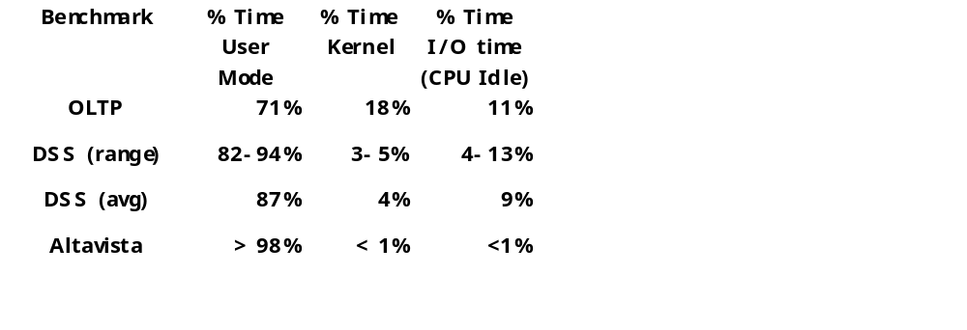
Parallel App: Commercial Workload
Online transaction processing workload (OLTP) (like TPC-B or -C)
Decision support system (DSS) (like TPC-D)
Web index search (Altavista)

Slide 27
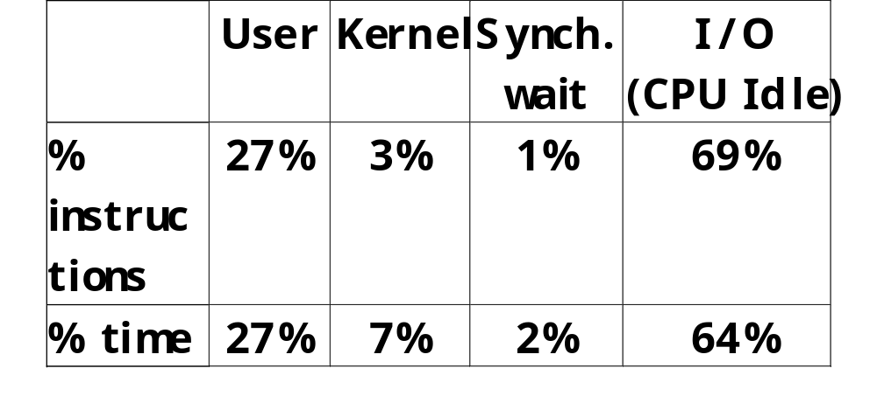
Parallel App: Multiprogramming and OS
2 independent copies of the compile phase of the Andrew benchmark (parallel make 8 CPUs)
3 phases: compiling the benchmarks; installing the object files in a library; removing the object files (I/O little, lot, almost all)

Slide 28
Parallel App: Scientific/Technical
FFT Kernel: 1D complex number FFT
  2 matrix transpose phases => all-to-all communication
  Sequential time for n data points: O(n log n)
  Example is 1 million point data set
LU Kernel: dense matrix factorization
  Blocking helps cache miss rate, 16x16
  Sequential time for nxn matrix: O(n³)
  Example is 512 x 512 matrix

Slide 29
Parallel App: Scientific/Technical
Barnes App: Barnes-Hut n-body algorithm solving a problem in galaxy evolution
  n-body algs rely on forces drop off with distance;
  if far enough away, can ignore (e.g., gravity is 1/d²)
  Sequential time for n data points: O(n log n)
  Example is 16,384 bodies
Ocean App: Gauss-Seidel multigrid technique to solve a set of elliptical partial differential eq.s’
  red-black Gauss-Seidel colors points in grid to consistently update points based on previous values of adjacent neighbors
  Multigrid solve finite diff. eq. by iteration using hierarch. Grid
  Communication when boundary accessed by adjacent subgrid
  Sequential time for nxn grid: O(n²)
  Input: 130 x 130 grid points, 5 iterations

Slide 30
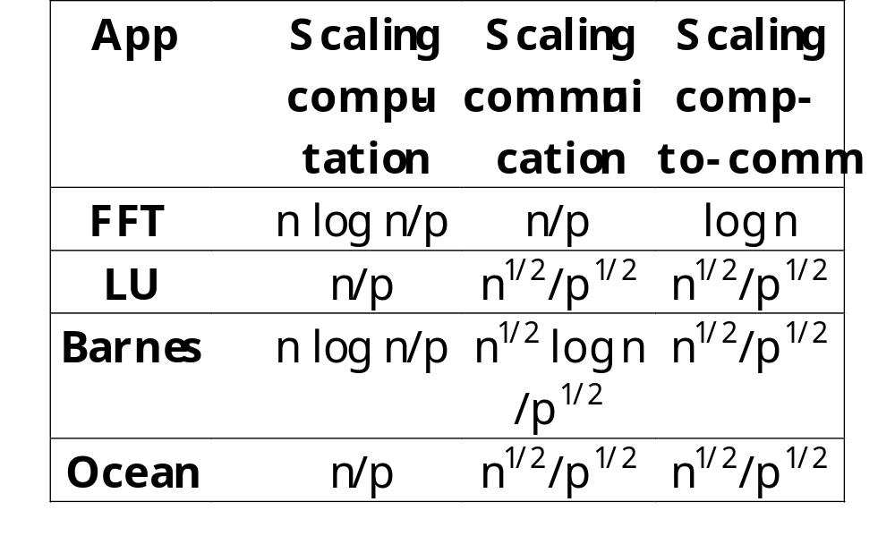
Parallel Scientific App: Scaling
p is # processors
n is + data size
Computation scales up with n by O( ), scales down linearly as p is increased
Communication
  FFT all-to-all so n
  LU, Ocean at boundary, so n^{1/2}
  Barnes complex:
  n^{1/2} greater distance,
  x log n to maintain bodies relationships
  All scale down 1/p^{1/2}
Keep n same, but inc. p?
Inc. n to keep comm. same w. +p?
Notes:
The overall computation-to-communication ratio is computed from the individual growth rate in computation and communication. In general, this rate rises slowly with an increase in data set size and decreases as we add processors. This reminds us that performing a fixed-size problem with more processors leads to increasing inefficiencies because the amount of communication among processors grows. It also tells us how quickly we must scale data set size as we add processors, to keep the fraction of time in communication fixed
Basically, double data set size to double number processors if want to keep computation to communication ratios the same.

Slide 31
Amdahl’s Law and Parallel Computers
Amdahl’s Law (FracX: original % to be speed up)
Speedup = 1 / [(FracX/SpeedupX + (1-FracX)]
A portion is sequential => limits parallel speedup
  Speedup <= 1/ (1-FracX)
Ex. What fraction sequetial to get 80X speedup from 100 processors? Assume either 1 processor or 100 fully used
80 = 1 / [(FracX/100 + (1-FracX)]
0.8*FracX + 80*(1-FracX) = 80 - 79.2*FracX = 1
FracX = (80-1)/79.2 = 0.9975
Only 0.25% sequential!

Slide 32
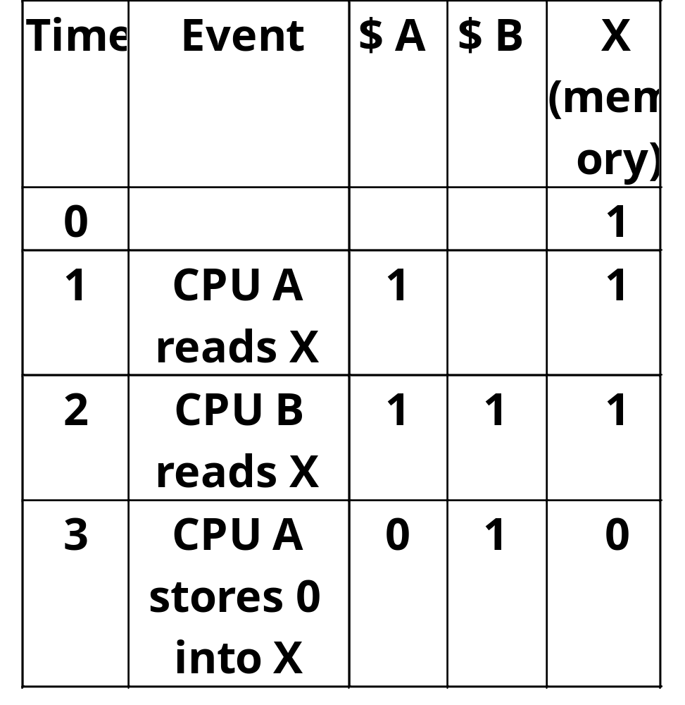
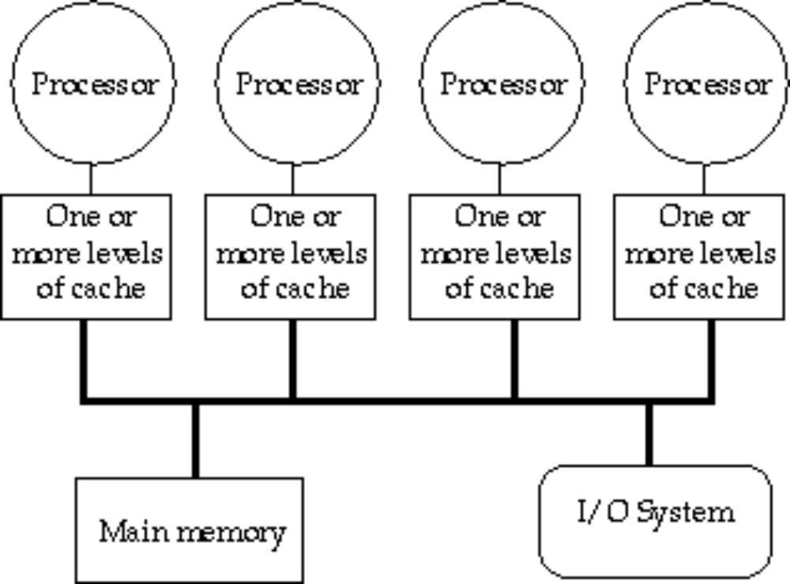
Small-Scale—Shared Memory
Caches serve to:
  Increase bandwidth versus bus/memory
  Reduce latency of access
  Valuable for both private data and shared data
What about cache consistency?

Slide 33
What Does Coherency Mean?
Informally:
  “Any read must return the most recent write”
  Too strict and too difficult to implement
Better:
  “Any write must eventually be seen by a read”
  All writes are seen in proper order (“serialization”)
Two rules to ensure this:
  “If P writes x and P1 reads it, P’s write will be seen by P1 if the read and write are sufficiently far apart”
  Writes to a single location are serialized:
  seen in one order
    Latest write will be seen
    Otherewise could see writes in illogical order
    (could see older value after a newer value)

Slide 34
Potential HW Cohernecy Solutions
Snooping Solution (Snoopy Bus):
  Send all requests for data to all processors
  Processors snoop to see if they have a copy and respond accordingly
  Requires broadcast, since caching information is at processors
  Works well with bus (natural broadcast medium)
  Dominates for small scale machines (most of the market)
Directory-Based Schemes (discuss later)
  Keep track of what is being shared in 1 centralized place (logically)
  Distributed memory => distributed directory for scalability
  (avoids bottlenecks)
  Send point-to-point requests to processors via network
  Scales better than Snooping
  Actually existed BEFORE Snooping-based schemes

Slide 35
Basic Snoopy Protocols
Write Invalidate Protocol:
  Multiple readers, single writer
  Write to shared data: an invalidate is sent to all caches which snoop and invalidate any copies
  Read Miss:
    Write-through: memory is always up-to-date
    Write-back: snoop in caches to find most recent copy
Write Broadcast Protocol (typically write through):
  Write to shared data: broadcast on bus, processors snoop, and update any copies
  Read miss: memory is always up-to-date
Write serialization: bus serializes requests!
  Bus is single point of arbitration

Slide 36
Basic Snoopy Protocols
Write Invalidate versus Broadcast:
  Invalidate requires one transaction per write-run
  Invalidate uses spatial locality: one transaction per block
  Broadcast has lower latency between write and read

Slide 37
Snooping Cache Variations
Basic
Protocol
Exclusive
Shared
Invalid
Berkeley
Protocol
Owned Exclusive
Owned Shared
Shared
Invalid
Illinois
Protocol
Private Dirty
Private Clean
Shared
Invalid
MESI
Protocol
Modfied (private,!=Memory)
eXclusive (private,=Memory)
Shared (shared,=Memory)
Invalid
Owner can update via bus invalidate operation
Owner must write back when replaced in cache
If read sourced from memory, then Private Clean
if read sourced from other cache, then Shared
Can write in cache if held private clean or dirty

Slide 38
An Example Snoopy Protocol
Invalidation protocol, write-back cache
Each block of memory is in one state:
  Clean in all caches and up-to-date in memory (Shared)
  OR Dirty in exactly one cache (Exclusive)
  OR Not in any caches
Each cache block is in one state (track these):
  Shared : block can be read
  OR Exclusive : cache has only copy, its writeable, and dirty
  OR Invalid : block contains no data
Read misses: cause all caches to snoop bus
Writes to clean line are treated as misses

Slide 39
Snoopy-Cache State Machine-I
CPU Read hit
State machine
for CPU requests
for each
cache block
CPU Read
Shared
(read/only)
Invalid
Place read miss
on bus
CPU Write
Place Write
Miss on bus
CPU read miss
Write back block,
Place read miss
on bus
CPU Read miss
Place read miss
on bus
CPU Write
Place Write Miss on Bus
Cache Block
State
Exclusive
(read/write)
CPU read hit
CPU write hit
CPU Write Miss
Write back cache block
Place write miss on bus
Notes:
Invalid:
read => shared
write => dirty
shared looks the same

Slide 40
Snoopy-Cache State Machine-II
State machine
for bus requests
for each
cache block
Appendix E? gives details of bus requests
Write miss
for this block
Invalid
Shared
(read/only)
Write miss
for this block
Write Back
Block; (abort
memory access)
Read miss
for this block
Write Back
Block; (abort
memory access)
Exclusive
(read/write)

Slide 41
Snoopy-Cache State Machine-III
CPU Read hit
State machine
for CPU requests
for each
cache block and
for bus requests
for each
cache block
Write miss
for this block
CPU Read
Shared
(read/only)
Invalid
Place read miss
on bus
CPU Write
Place Write
Miss on bus
Write miss
for this block
CPU read miss
Write back block,
Place read miss
on bus
CPU Read miss
Place read miss
on bus
Write Back
Block; (abort
memory access)
CPU Write
Place Write Miss on Bus
Cache Block
State
Write Back
Block; (abort
memory access)
Read miss
for this block
Exclusive
(read/write)
CPU read hit
CPU write hit
CPU Write Miss
Write back cache block
Place write miss on bus
Notes:
Invalid:
read => shared
write => dirty
shared looks the same

Slide 42
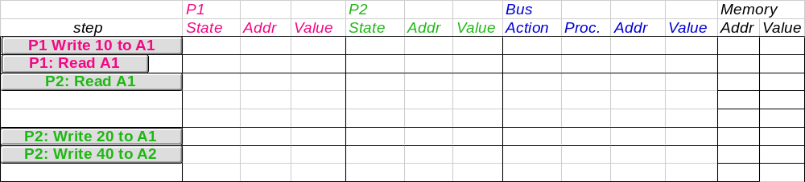
Example
Assumes A1 and A2 map to same cache block,
initial cache state is invalid

Slide 43
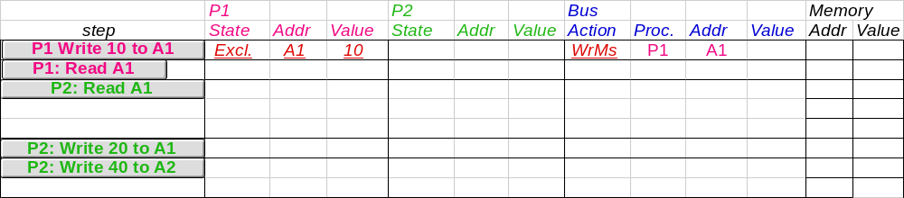
Example
Assumes A1 and A2 map to same cache block

Slide 44
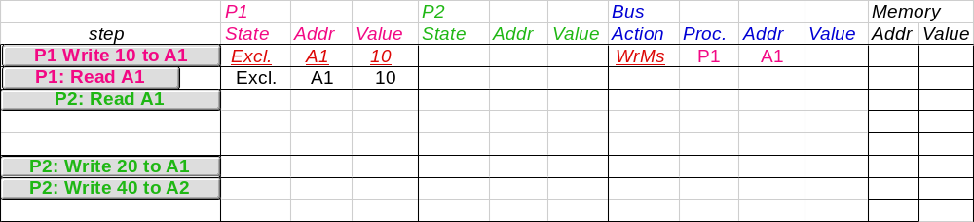
Example
Assumes A1 and A2 map to same cache block

Slide 45
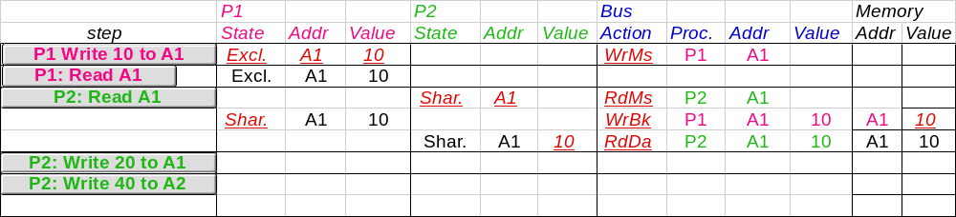
Example
Assumes A1 and A2 map to same cache block

Slide 46
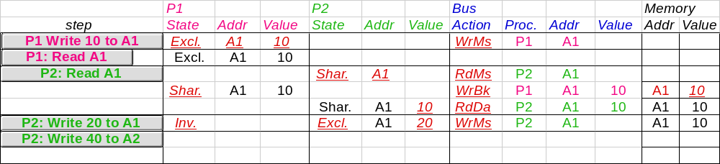
Example
Assumes A1 and A2 map to same cache block

Slide 47
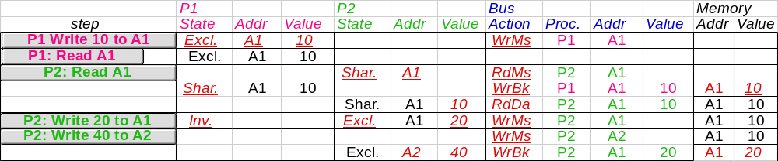
Example
Assumes A1 and A2 map to same cache block,
but A1 != A2
Notes:
Why write miss first?
Because in general, only write a piece of block, may need to read it first so that can have a full vblock; therefore, need to get
Write back is low priority event.

Slide 48
Implementation Complications
Write Races:
  Cannot update cache until bus is obtained
    Otherwise, another processor may get bus first,
    and then write the same cache block!
  Two step process:
    Arbitrate for bus
    Place miss on bus and complete operation
  If miss occurs to block while waiting for bus,
  handle miss (invalidate may be needed) and then restart.
  Split transaction bus:
    Bus transaction is not atomic:
    can have multiple outstanding transactions for a block
    Multiple misses can interleave,
    allowing two caches to grab block in the Exclusive state
    Must track and prevent multiple misses for one block
Must support interventions and invalidations

Slide 49
Implementing Snooping Caches
Multiple processors must be on bus, access to both addresses and data
Add a few new commands to perform coherency,
in addition to read and write
Processors continuously snoop on address bus
  If address matches tag, either invalidate or update
Since every bus transaction checks cache tags,
could interfere with CPU just to check:
  solution 1: duplicate set of tags for L1 caches just to allow checks in parallel with CPU
  solution 2: L2 cache already duplicate,
  provided L2 obeys inclusion with L1 cache
    block size, associativity of L2 affects L1

Slide 50
Implementing Snooping Caches
Bus serializes writes, getting bus ensures no one else can perform memory operation
On a miss in a write back cache, may have the desired copy and its dirty, so must reply
Add extra state bit to cache to determine shared or not
Add 4th state (MESI)

Slide 51
Fundamental Issues
3 Issues to characterize parallel machines
1) Naming
2) Synchronization
3) Performance: Latency and Bandwidth (covered earlier)

Slide 52
Fundamental Issue #1: Naming
Naming: how to solve large problem fast
  what data is shared
  how it is addressed
  what operations can access data
  how processes refer to each other
Choice of naming affects code produced by a compiler; via load where just remember address or keep track of processor number and local virtual address for msg. passing
Choice of naming affects replication of data; via load in cache memory hierarchy or via SW replication and consistency

Slide 53
Fundamental Issue #1: Naming
Global physical address space:
any processor can generate, address and access it in a single operation
  memory can be anywhere:
  virtual addr. translation handles it
Global virtual address space: if the address space of each process can be configured to contain all shared data of the parallel program
Segmented shared address space:
locations are named
<process number, address>
uniformly for all processes of the parallel program

Slide 54
Fundamental Issue #2: Synchronization
To cooperate, processes must coordinate
Message passing is implicit coordination with transmission or arrival of data
Shared address
=> additional operations to explicitly coordinate:
e.g., write a flag, awaken a thread, interrupt a processor

Slide 55
Summary: Parallel Framework
  Programming Model
  Communication Abstraction
  Interconnection SW/OS
  Interconnection HW
Layers:
  Programming Model:
    Multiprogramming : lots of jobs, no communication
    Shared address space: communicate via memory
    Message passing: send and recieve messages
    Data Parallel: several agents operate on several data sets simultaneously and then exchange information globally and simultaneously (shared or message passing)
  Communication Abstraction:
    Shared address space: e.g., load, store, atomic swap
    Message passing: e.g., send, recieve library calls
    Debate over this topic (ease of programming, scaling)
    => many hardware designs 1:1 programming model

