Slide 1
CS252
Graduate Computer Architecture
Lecture 12:
Multiprocessor 2: Snooping Protocol, Directory Protocol, Synchronization, Consistency
February 28, 2001
Prof. David A. Patterson
Guess Lecturer: Yujia Jin
Computer Science 252
Spring 2001

Slide 2
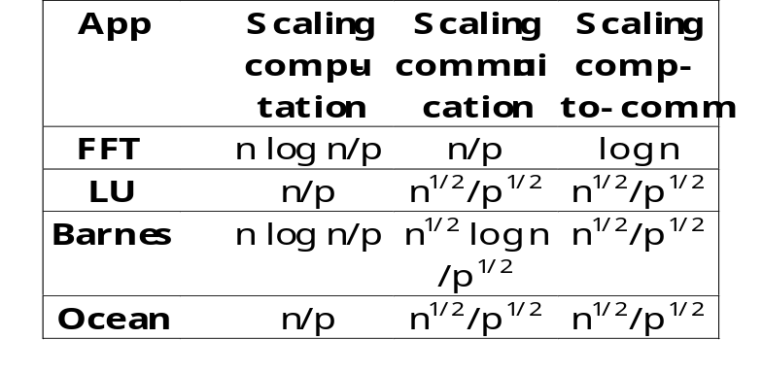
Review: Multiprocessor
Basic issues and terminology
Communication: share memory, message passing
Parallel Application:
  Commercial workload: OLTP, DSS, Web index search
  Multiprogramming and OS
  Scientific/Technical
Amdahl’s Law: Speedup <= 1 / Sequential_Frac
Cache Coherence: serialization

Slide 3
Potential HW Cohernecy Solutions
Snooping Solution (Snoopy Bus):
  Send all requests for data to all processors
  Processors snoop to see if they have a copy and respond accordingly
  Requires broadcast, since caching information is at processors
  Works well with bus (natural broadcast medium)
  Dominates for small scale machines (most of the market)
Directory-Based Schemes (discuss later)
  Keep track of what is being shared in 1 centralized place (logically)
  Distributed memory => distributed directory for scalability
  (avoids bottlenecks)
  Send point-to-point requests to processors via network
  Scales better than Snooping
  Actually existed BEFORE Snooping-based schemes

Slide 4
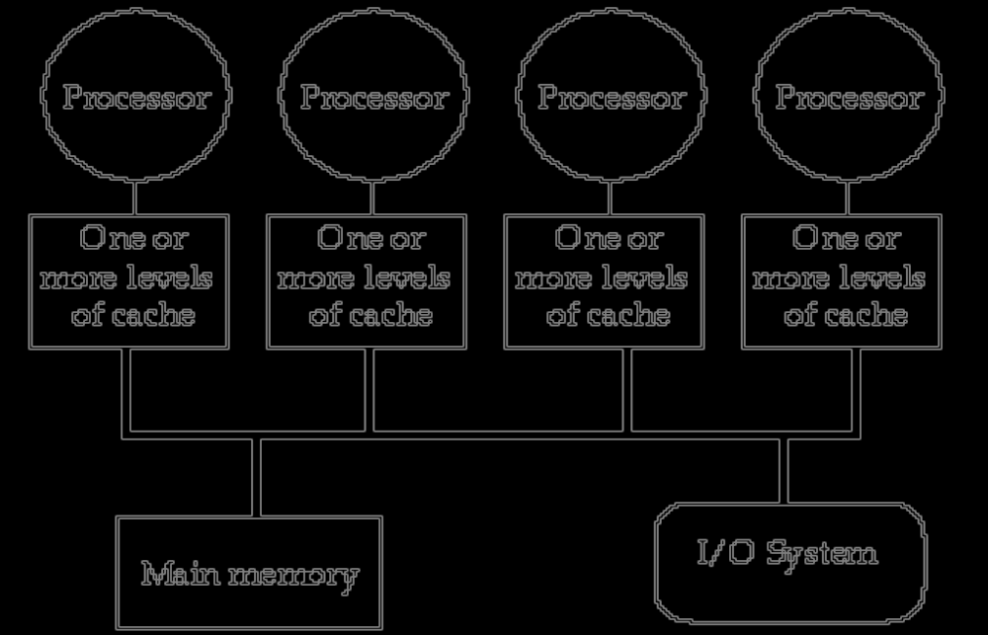
Bus Snooping Topology
Memory: centralized with uniform access time (“uma”) and bus interconnect
Examples: Sun Enterprise 5000 , SGI Challenge, Intel SystemPro

Slide 5
Basic Snoopy Protocols
Write Invalidate Protocol:
  Multiple readers, single writer
  Write to shared data: an invalidate is sent to all caches which snoop and invalidate any copies
  Read Miss:
    Write-through: memory is always up-to-date
    Write-back: snoop in caches to find most recent copy
Write Broadcast Protocol (typically write through):
  Write to shared data: broadcast on bus, processors snoop, and update any copies
  Read miss: memory is always up-to-date
Write serialization: bus serializes requests!
  Bus is single point of arbitration

Slide 6
Basic Snoopy Protocols
Write Invalidate versus Broadcast:
  Invalidate requires one transaction per write-run
  Invalidate uses spatial locality: one transaction per block
  Broadcast has lower latency between write and read

Slide 7
An Example Snoopy Protocol
Invalidation protocol, write-back cache
Each block of memory is in one state:
  Clean in all caches and up-to-date in memory (Shared)
  OR Dirty in exactly one cache (Exclusive)
  OR Not in any caches
Each cache block is in one state (track these):
  Shared : block can be read
  OR Exclusive : cache has only copy, its writeable, and dirty
  OR Invalid : block contains no data
Read misses: cause all caches to snoop bus
Writes to clean line are treated as misses

Slide 8
Snoopy-Cache State Machine-I
CPU Read hit
State machine
for CPU requests
for each
cache block
CPU Read
Shared
(read/only)
Invalid
Place read miss
on bus
CPU Write
Place Write
Miss on bus
CPU read miss
Write back block,
Place read miss
on bus
CPU Read miss
Place read miss
on bus
CPU Write
Place Write Miss on Bus
Cache Block
State
Exclusive
(read/write)
CPU read hit
CPU write hit
CPU Write Miss
Write back cache block
Place write miss on bus
Notes:
Invalid:
read => shared
write => dirty
shared looks the same

Slide 9
Snoopy-Cache State Machine-II
State machine
for bus requests
for each
cache block
Appendix E? gives details of bus requests
Write miss
for this block
Invalid
Shared
(read/only)
Write miss
for this block
Write Back
Block; (abort
memory access)
Read miss
for this block
Write Back
Block; (abort
memory access)
Exclusive
(read/write)

Slide 10
Snoopy-Cache State Machine-III
CPU Read hit
State machine
for CPU requests
for each
cache block and
for bus requests
for each
cache block
Write miss
for this block
CPU Read
Shared
(read/only)
Invalid
Place read miss
on bus
CPU Write
Place Write
Miss on bus
Write miss
for this block
CPU read miss
Write back block,
Place read miss
on bus
CPU Read miss
Place read miss
on bus
Write Back
Block; (abort
memory access)
CPU Write
Place Write Miss on Bus
Cache Block
State
Write Back
Block; (abort
memory access)
Read miss
for this block
Exclusive
(read/write)
CPU read hit
CPU write hit
CPU Write Miss
Write back cache block
Place write miss on bus
Notes:
Invalid:
read => shared
write => dirty
shared looks the same

Slide 11
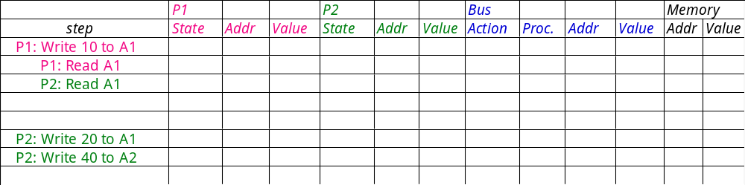
Example
Processor 1
Processor 2
Bus
Memory
Assumes initial cache state
is invalid and A1 and A2 map
to same cache block,
but A1 != A2
Remote Write
CPU Read hit
Invalid
Shared
CPU Read Miss
Read
miss on bus
Write
miss on bus
Remote
Write
Write Back
CPU Write
Place Write
Miss on Bus
Remote Read
Write Back
Exclusive
CPU read hit
CPU write hit
CPU Write Miss
Write Back

Slide 12
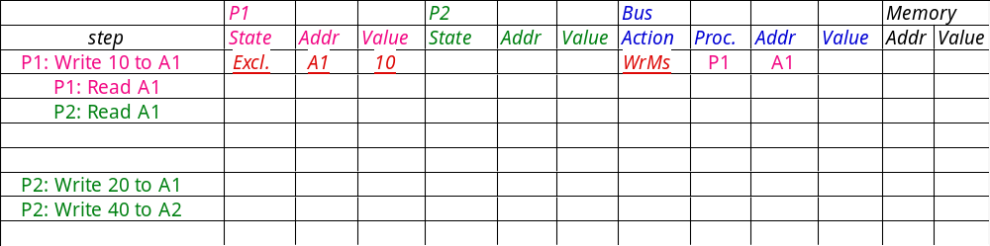
Example: Step 1
Assumes initial cache state
is invalid and A1 and A2 map
to same cache block,
but A1 != A2.
Active arrow =
Remote Write
CPU Read hit
Invalid
Shared
CPU Read Miss
Read
miss on bus
Write
miss on bus
Remote
Write
Write Back
CPU Write
Place Write
Miss on Bus
Remote Read
Write Back
Exclusive
CPU read hit
CPU write hit
CPU Write Miss
Write Back

Slide 13
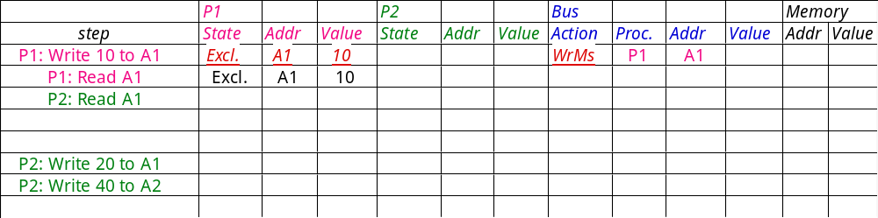
Example: Step 2
Assumes initial cache state
is invalid and A1 and A2 map
to same cache block,
but A1 != A2
Remote Write
CPU Read hit
Invalid
Shared
CPU Read Miss
Read
miss on bus
Write
miss on bus
Remote
Write
Write Back
CPU Write
Place Write
Miss on Bus
Remote Read
Write Back
Exclusive
CPU read hit
CPU write hit
CPU Write Miss
Write Back

Slide 14
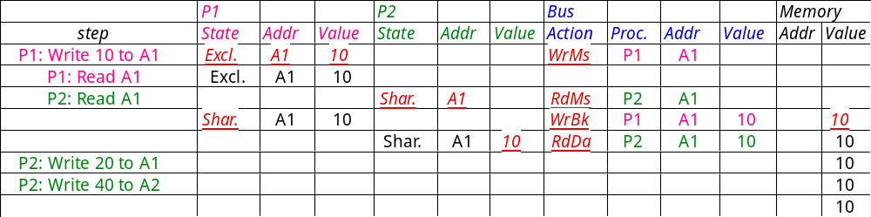
Example: Step 3
A1
A1
Assumes initial cache state
is invalid and A1 and A2 map
to same cache block,
but A1 != A2.
Remote Write
CPU Read hit
Invalid
Shared
CPU Read Miss
Read
miss on bus
Write
miss on bus
Remote
Write
Write Back
CPU Write
Place Write
Miss on Bus
Remote Read
Write Back
Exclusive
CPU read hit
CPU write hit
CPU Write Miss
Write Back

Slide 15
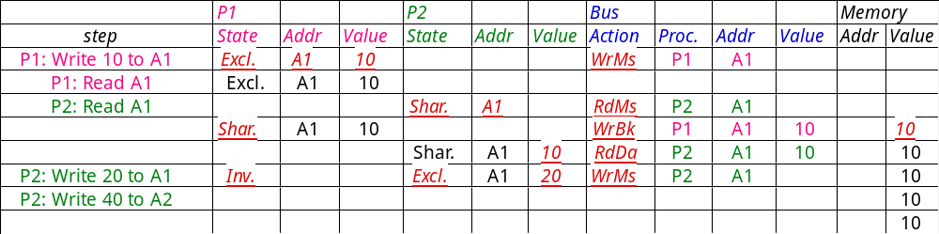
Example: Step 4
A1
A1
A1
Assumes initial cache state
is invalid and A1 and A2 map
to same cache block,
but A1 != A2
Remote Write
CPU Read hit
Invalid
Shared
CPU Read Miss
Read
miss on bus
Write
miss on bus
Remote
Write
Write Back
CPU Write
Place Write
Miss on Bus
Remote Read
Write Back
Exclusive
CPU read hit
CPU write hit
CPU Write Miss
Write Back

Slide 16
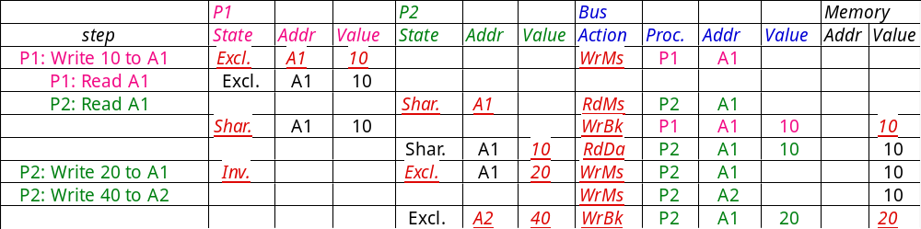
Example: Step 5
A1
A1
A1
A1
A1
Assumes initial cache state
is invalid and A1 and A2 map
to same cache block,
but A1 != A2
Remote Write
CPU Read hit
Invalid
Shared
CPU Read Miss
Read
miss on bus
Write
miss on bus
Remote
Write
Write Back
CPU Write
Place Write
Miss on Bus
Remote Read
Write Back
Exclusive
CPU read hit
CPU write hit
CPU Write Miss
Write Back
Notes:
Why write miss first?
Because in general, only write a piece of block, may need to read it first so that can have a full vblock; therefore, need to get
Write back is low priority event.

Slide 17
Snooping Cache Variations
Basic
Protocol
Exclusive
Shared
Invalid
Berkeley
Protocol
Owned Exclusive
Owned Shared
Shared
Invalid
Illinois
Protocol
Private Dirty
Private Clean
Shared
Invalid
MESI
Protocol
Modfied (private,!=Memory)
Exclusive (private,=Memory)
Shared (shared,=Memory)
Invalid
Owner can update via bus invalidate operation
Owner must write back when replaced in cache
If read sourced from memory, then Private Clean
if read sourced from other cache, then Shared
Can write in cache if held private clean or dirty

Slide 18
Snoop Cache Extensions
CPU Read hit
Extensions:
  Fourth State: Ownership
Remote Write or
Miss due to
address conflict
Shared
(read/only)
  Shared-> Modified,
  need invalidate only (upgrade request), don’t read memory
  Berkeley Protocol
Invalid
CPU Read
Place read miss
on bus
CPU Write
Place Write
Miss on bus
Remote
Write
or Miss due to
address conflict
Write back block
Remote
Read
Place Data
on Bus?
Remote Read
Write back
block
  Clean exclusive state (no miss for private data on write)
  MESI Protocol
CPU Write
Place Write
Miss on
Bus
Exclusive (read/only)
  Cache supplies data when shared state
  (no memory access)
  Illinois Protocol
Modified
(read/write)
CPU read hit
CPU write hit
CPU Write
Place Write
Miss on Bus?
CPU Read hit

Slide 19
Implementation Complications
Write Races:
  Cannot update cache until bus is obtained
    Otherwise, another processor may get bus first,
    and then write the same cache block!
  Two step process:
    Arbitrate for bus
    Place miss on bus and complete operation
  If miss occurs to block while waiting for bus,
  handle miss (invalidate may be needed) and then restart.
  Split transaction bus:
    Bus transaction is not atomic:
    can have multiple outstanding transactions for a block
    Multiple misses can interleave,
    allowing two caches to grab block in the Exclusive state
    Must track and prevent multiple misses for one block
Must support interventions and invalidations

Slide 20
Implementing Snooping Caches
Multiple processors must be on bus, access to both addresses and data
Add a few new commands to perform coherency,
in addition to read and write
Processors continuously snoop on address bus
  If address matches tag, either invalidate or update
Since every bus transaction checks cache tags,
could interfere with CPU cache access:
  solution 1: duplicate set of tags for L1 caches just to allow checks in parallel with CPU
  solution 2: L2 cache already duplicate,
  provided L2 obeys inclusion with L1 cache
    block size, associativity of L2 affects L1

Slide 21
Implementing Snooping Caches
Bus serializes writes, getting bus ensures no one else can perform memory operation
On a miss in a write back cache, may have the desired copy and its dirty, so must reply
Add extra state bit to cache to determine shared or not
Add 4th state (MESI)

Slide 22
CS 252 Administrivia
Chapter 8 survey
Quiz #1 Wed March 7 5:30-8:30 306 Soda
La Val's afterward quiz: free food and drink

Slide 23
Larger MPs
Separate Memory per Processor
Local or Remote access via memory controller
1 Cache Coherency solution: non-cached pages
Alternative: directory per cache that tracks state of every block in every cache
  Which caches have a copies of block, dirty vs. clean, ...
Info per memory block vs. per cache block?
  PLUS: In memory => simpler protocol (centralized/one location)
  MINUS: In memory => directory is ƒ(memory size) vs. ƒ(cache size)
Prevent directory as bottleneck?
distribute directory entries with memory, each keeping track of which Procs have copies of their blocks

Slide 24
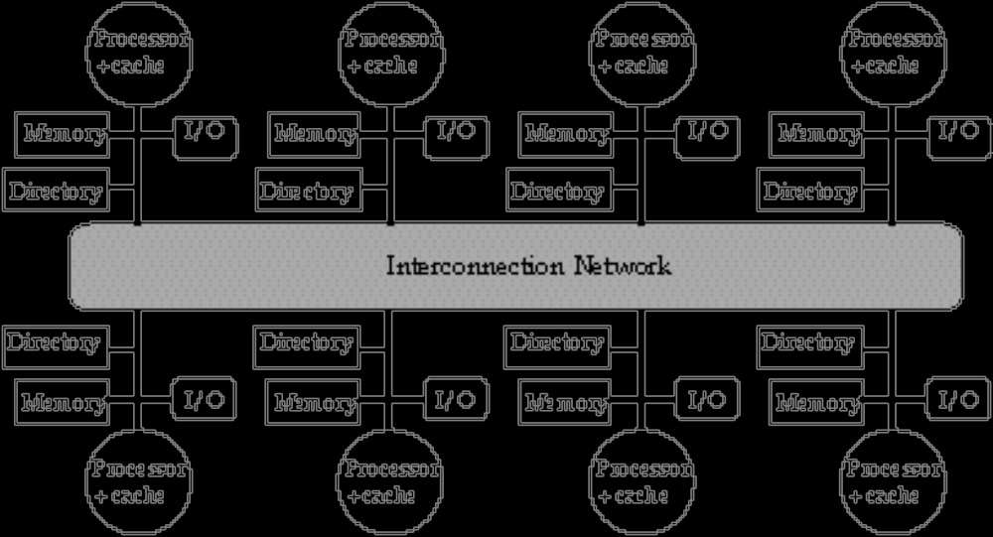
Distributed Directory MPs

Slide 25
Directory Protocol
Similar to Snoopy Protocol: Three states
  Shared: ≥ 1 processors have data, memory up-to-date
  Uncached (no processor hasit; not valid in any cache)
  Exclusive: 1 processor (owner) has data;
  memory out-of-date
In addition to cache state, must track which processors have data when in the shared state (usually bit vector, 1 if processor has copy)
Keep it simple(r):
  Writes to non-exclusive data
  => write miss
  Processor blocks until access completes
  Assume messages received
  and acted upon in order sent

Slide 26
Directory Protocol
No bus and don’t want to broadcast:
  interconnect no longer single arbitration point
  all messages have explicit responses
Terms: typically 3 processors involved
  Local node where a request originates
  Home node where the memory location
  of an address resides
  Remote node has a copy of a cache
  block, whether exclusive or shared
Example messages on next slide:
P = processor number, A = address

Slide 27
Directory Protocol Messages
Message type Source Destination Msg Content
Read miss Local cache Home directory P, A
  Processor P reads data at address A;
  make P a read sharer and arrange to send data back
Write miss Local cache Home directory P, A
  Processor P writes data at address A;
  make P the exclusive owner and arrange to send data back
Invalidate Home directory Remote caches A
  Invalidate a shared copy at address A.
Fetch Home directory Remote cache A
  Fetch the block at address A and send it to its home directory
Fetch/Invalidate Home directory Remote cache A
  Fetch the block at address A and send it to its home directory; invalidate the block in the cache
Data value reply Home directory Local cache Data
  Return a data value from the home memory (read miss response)
Data write-back Remote cache Home directory A, Data
  Write-back a data value for address A (invalidate response)

Slide 28
State Transition Diagram for an Individual Cache Block in a Directory Based System
States identical to snoopy case; transactions very similar.
Transitions caused by read misses, write misses, invalidates, data fetch requests
Generates read miss & write miss msg to home directory.
Write misses that were broadcast on the bus for snooping => explicit invalidate & data fetch requests.
Note: on a write, a cache block is bigger, so need to read the full cache block

Slide 29
CPU -Cache State Machine
CPU Read hit
State machine
for CPU requests
for each
memory block
Invalid state
if in
memory
Invalidate
Shared
(read/only)
Invalid
CPU Read
Send Read Miss
message
CPU read miss:
Send Read Miss
CPU Write:
Send Write Miss
msg to h.d.
CPU Write:Send
Write Miss message
to home directory
Fetch/Invalidate
send Data Write Back message
to home directory
Fetch: send Data Write Back message to home directory
CPU read miss: send Data Write Back message and read miss to home directory
Exclusive
(read/writ)
CPU read hit
CPU write hit
CPU write miss:
send Data Write Back message
and Write Miss to home
directory
Notes:
Invalid:
read => shared
write => dirty
shared looks the same

Slide 30
State Transition Diagram for the Directory
Same states & structure as the transition diagram for an individual cache
2 actions: update of directory state & send msgs to statisfy requests
Tracks all copies of memory block.
Also indicates an action that updates the sharing set, Sharers, as well as sending a message.

Slide 31
Directory State Machine
Read miss:
Sharers += {P};
send Data Value Reply
State machine
for Directory requests for each
memory block
Uncached state
if in memory
Read miss:
Sharers = {P}
send Data Value
Reply
Shared
(read only)
Uncached
Write Miss:
Sharers = {P};
send Data
Value Reply
msg
Write Miss:
send Invalidate
to Sharers;
then Sharers = {P};
send Data Value
Reply msg
Data Write Back:
Sharers = {}
(Write back block)
Read miss:
Sharers += {P};
send Fetch;
send Data Value Reply
msg to remote cache
(Write back block)
Write Miss:
Sharers = {P};
send Fetch/Invalidate;
send Data Value Reply
msg to remote cache
Exclusive
(read/writ)
Notes:
Invalid:
read => shared
write => dirty
shared looks the same

Slide 32
Example Directory Protocol
Message sent to directory causes two actions:
  Update the directory
  More messages to satisfy request
Block is in Uncached state: the copy in memory is the current value; only possible requests for that block are:
  Read miss: requesting processor sent data from memory &requestor made only sharing node; state of block made Shared.
  Write miss: requesting processor is sent the value & becomes the Sharing node. The block is made Exclusive to indicate that the only valid copy is cached. Sharers indicates the identity of the owner.
Block is Shared => the memory value is up-to-date:
  Read miss: requesting processor is sent back the data from memory & requesting processor is added to the sharing set.
  Write miss: requesting processor is sent the value. All processors in the set Sharers are sent invalidate messages, & Sharers is set to identity of requesting processor. The state of the block is made Exclusive.

Slide 33
Example Directory Protocol
Block is Exclusive: current value of the block is held in the cache of the processor identified by the set Sharers (the owner) => three possible directory requests:
  Read miss: owner processor sent data fetch message, causing state of block in owner’s cache to transition to Shared and causes owner to send data to directory, where it is written to memory & sent back to requesting processor.
  Identity of requesting processor is added to set Sharers, which still contains the identity of the processor that was the owner (since it still has a readable copy). State is shared.
  Data write-back: owner processor is replacing the block and hence must write it back, making memory copy up-to-date
  (the home directory essentially becomes the owner), the block is now Uncached, and the Sharer set is empty.
  Write miss: block has a new owner. A message is sent to old owner causing the cache to send the value of the block to the directory from which it is sent to the requesting processor, which becomes the new owner. Sharers is set to identity of new owner, and state of block is made Exclusive.

Slide 34
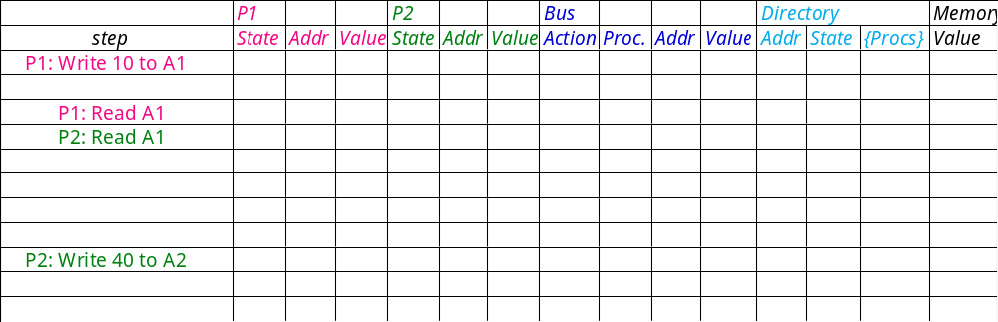
Example
Processor 1
Processor 2
Interconnect
Directory
Memory
P2: Write 20 to A1
A1 and A2 map to the same cache block

Slide 35
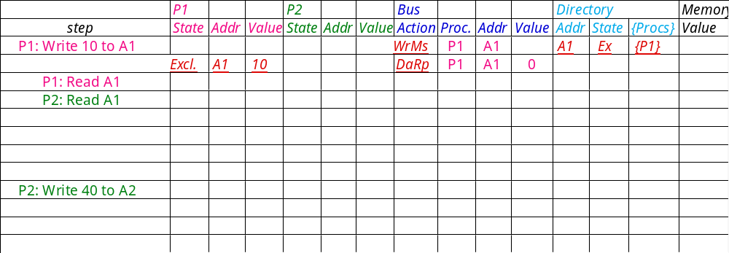
Example
Processor 1
Processor 2
Interconnect
Directory
Memory
P2: Write 20 to A1
A1 and A2 map to the same cache block

Slide 36
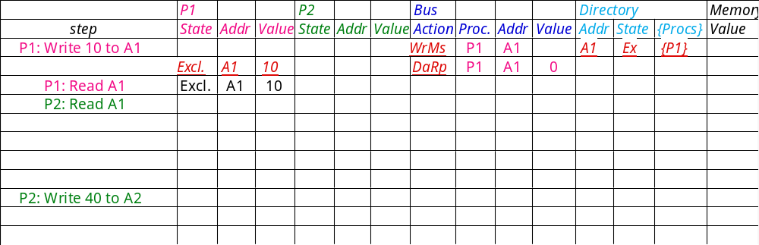
Example
Processor 1
Processor 2
Interconnect
Directory
Memory
P2: Write 20 to A1
A1 and A2 map to the same cache block

Slide 37
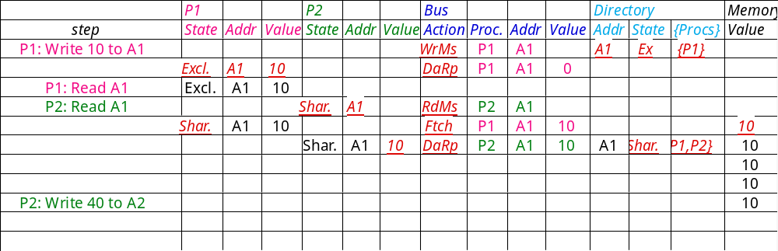
Example
Processor 1
Processor 2
Interconnect
Directory
Memory
A1
A1
P2: Write 20 to A1
Write Back
A1 and A2 map to the same cache block

Slide 38
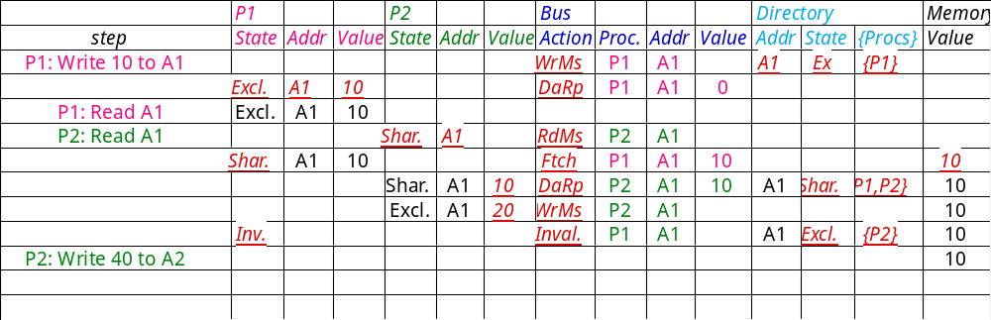
Example
Processor 1
Processor 2
Interconnect
Directory
Memory
A1
A1
P2: Write 20 to A1
A1 and A2 map to the same cache block

Slide 39
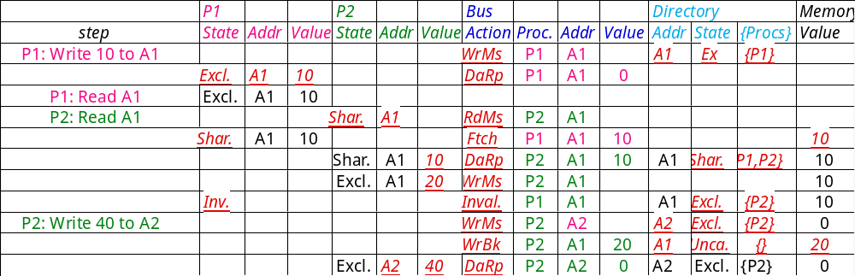
Example
Processor 1
Processor 2
Interconnect
Directory
Memory
A1
A1
P2: Write 20 to A1
A1 and A2 map to the same cache block

Slide 40
Implementing a Directory
We assume operations atomic, but they are not; reality is much harder; must avoid deadlock when run out of bufffers in network (see Appendix E)
Optimizations:
  read miss or write miss in Exclusive: send data directly to requestor from owner vs. 1st to memory and then from memory to requestor

Slide 41
Synchronization
Why Synchronize? Need to know when it is safe for different processes to use shared data
Issues for Synchronization:
  Uninterruptable instruction to fetch and update memory (atomic operation);
  User level synchronization operation using this primitive;
  For large scale MPs, synchronization can be a bottleneck; techniques to reduce contention and latency of synchronization

Slide 42
Uninterruptable Instruction to Fetch and Update Memory
Atomic exchange: interchange a value in a register for a value in memory
  0 => synchronization variable is free
  1 => synchronization variable is locked and unavailable
  Set register to 1 & swap
  New value in register determines success in getting lock 0 if you succeeded in setting the lock (you were first)
  1 if other processor had already claimed access
  Key is that exchange operation is indivisible
Test-and-set: tests a value and sets it if the value passes the test
Fetch-and-increment: it returns the value of a memory location and atomically increments it
  0 => synchronization variable is free

Slide 43
Uninterruptable Instruction to Fetch and Update Memory
Hard to have read & write in 1 instruction: use 2 instead
Load linked (or load locked) + store conditional
  Load linked returns the initial value
  Store conditional returns 1 if it succeeds (no other store to same memory location since preceeding load) and 0 otherwise
Example doing atomic swap with LL & SC:
try: mov R3,R4 ; mov exchange value
ll R2,0(R1) ; load linked
sc R3,0(R1) ; store conditional
beqz R3,try ; branch store fails (R3 = 0)
mov R4,R2 ; put load value in R4
Example doing fetch & increment with LL & SC:
try: ll R2,0(R1) ; load linked
addi R2,R2,#1 ; increment (OK if reg–reg)
sc R2,0(R1) ; store conditional
beqz R2,try ; branch store fails (R2 = 0)

Slide 44
User Level Synchronization—Operation Using this Primitive
Spin locks: processor continuously tries to acquire, spinning around a loop trying to get the lock
li R2,#1
lockit: exch R2,0(R1) ;atomic exchange
bnez R2,lockit ;already locked?
What about MP with cache coherency?
  Want to spin on cache copy to avoid full memory latency
  Likely to get cache hits for such variables
Problem: exchange includes a write, which invalidates all other copies; this generates considerable bus traffic
Solution: start by simply repeatedly reading the variable; when it changes, then try exchange (“test and test&set”):
try: li R2,#1
lockit: lw R3,0(R1) ;load var
bnez R3,lockit ;not free=>spin
exch R2,0(R1) ;atomic exchange
bnez R2,try ;already locked?

Slide 45
Another MP Issue:
Memory Consistency Models
What is consistency? When must a processor see the new value? e.g., seems that
P1: A = 0; P2: B = 0;
..... .....
A = 1; B = 1;
L1: if (B == 0) ... L2: if (A == 0) ...
Impossible for both if statements L1 & L2 to be true?
  What if write invalidate is delayed & processor continues?
Memory consistency models:
what are the rules for such cases?
Sequential consistency: result of any execution is the same as if the accesses of each processor were kept in order and the accesses among different processors were interleaved => assignments before ifs above
  SC: delay all memory accesses until all invalidates done

Slide 46
Memory Consistency Model
Schemes faster execution to sequential consistency
Not really an issue for most programs;
they are synchronized
  A program is synchronized if all access to shared data are ordered by synchronization operations
  write (x)
  ...
  release (s) {unlock}
  ...
  acquire (s) {lock}
  ...
  read(x)
Only those programs willing to be nondeterministic are not synchronized: “data race”: outcome f(proc. speed)
Several Relaxed Models for Memory Consistency since most programs are synchronized; characterized by their attitude towards: RAR, WAR, RAW, WAW
to different addresses

Slide 47
Summary
Caches contain all information on state of cached memory blocks
Snooping and Directory Protocols similar; bus makes snooping easier because of broadcast (snooping => uniform memory access)
Directory has extra data structure to keep track of state of all cache blocks
Distributing directory => scalable shared address multiprocessor
=> Cache coherent, Non uniform memory access

