Slide 1
CS252
Graduate Computer Architecture
Lecture 13:
Multiprocessor 3: Measurements, Crosscutting Issues, Examples,
Fallacies & Pitfalls
March 2, 2001
Prof. David A. Patterson
Computer Science 252
Spring 2001

Slide 2
Review
Caches contain all information on state of cached memory blocks
Snooping and Directory Protocols similar
Bus makes snooping easier because of broadcast
(snooping => Uniform Memory Access)
Directory has extra data structure to keep track of state of all cache blocks
Distributing directory
=> scalable shared address multiprocessor
=> Cache coherent, Non Uniform Memory Access (NUMA)

Slide 3
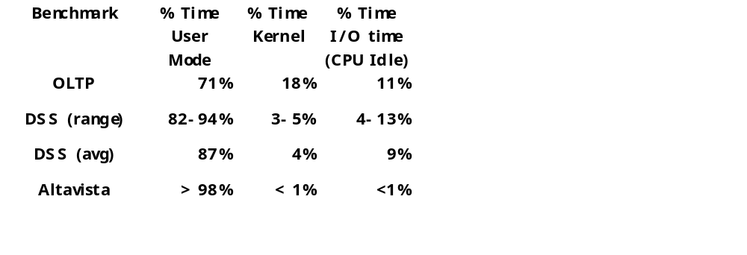
Parallel App: Commercial Workload
Online transaction processing workload (OLTP) (like TPC-B or -C)
Decision support system (DSS) (like TPC-D)
Web index search (Altavista)

Slide 4
Alpha 4100 SMP
4 CPUs
300 MHz Apha 211264 @ 300 MHz
L1$ 8KB direct mapped, write through
L2$ 96KB, 3-way set associative
L3$ 2MB (off chip), direct mapped
Memory latency 80 clock cycles
Cache to cache 125 clock cycles

Slide 5
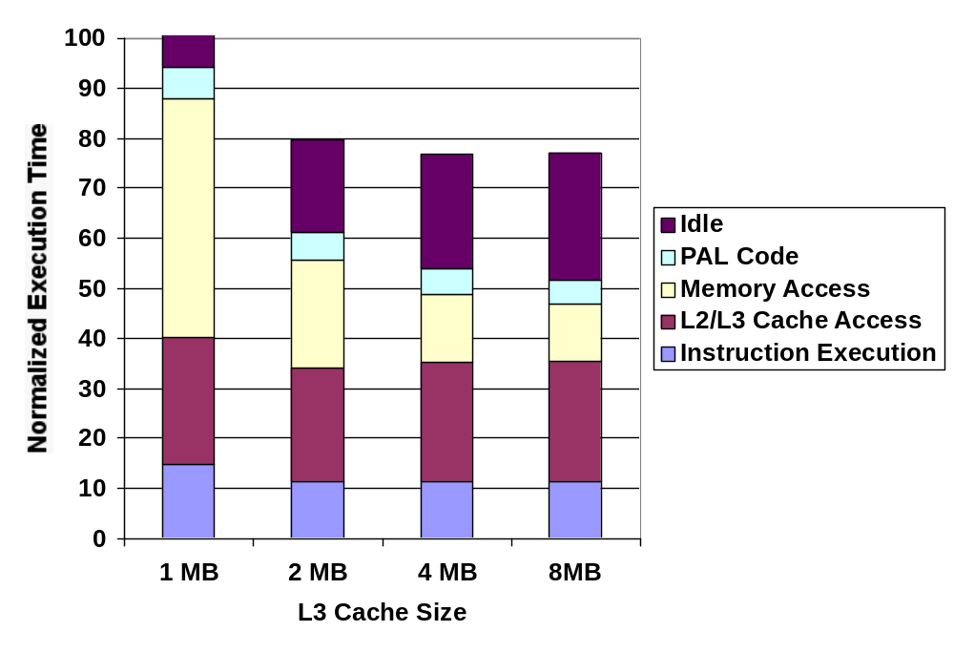
OLTP Performance as vary L3$ size

Slide 6
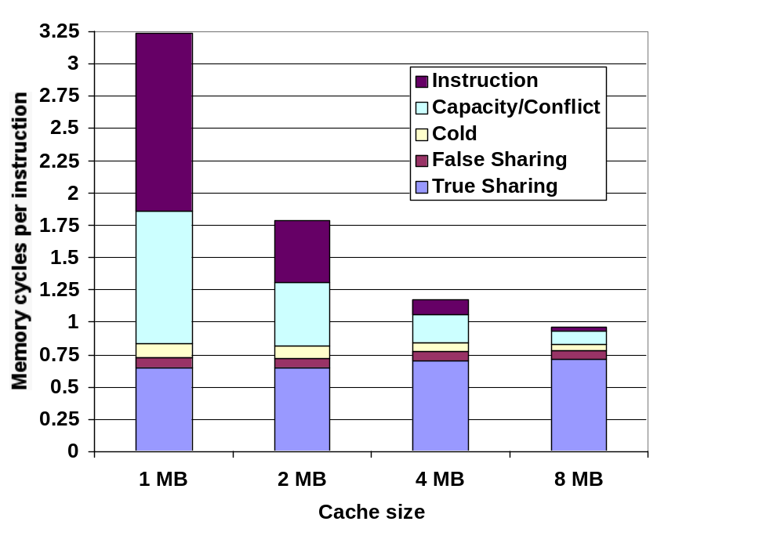
L3 Miss Breakdown

Slide 7
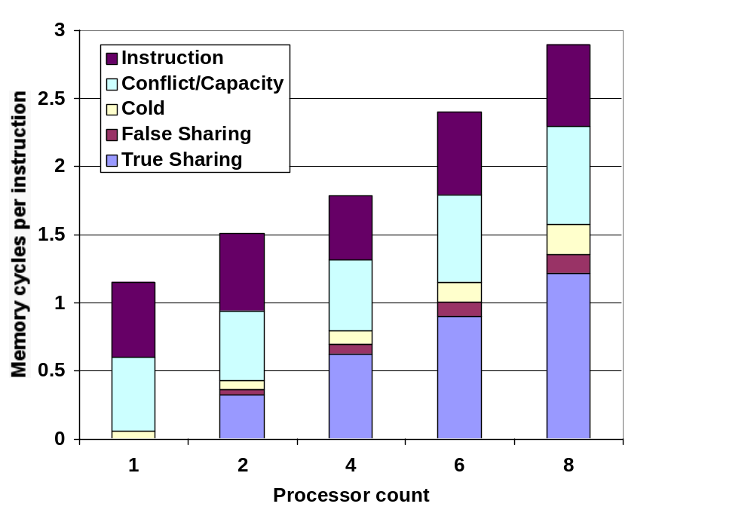
Memory CPI as increase CPUs

Slide 8
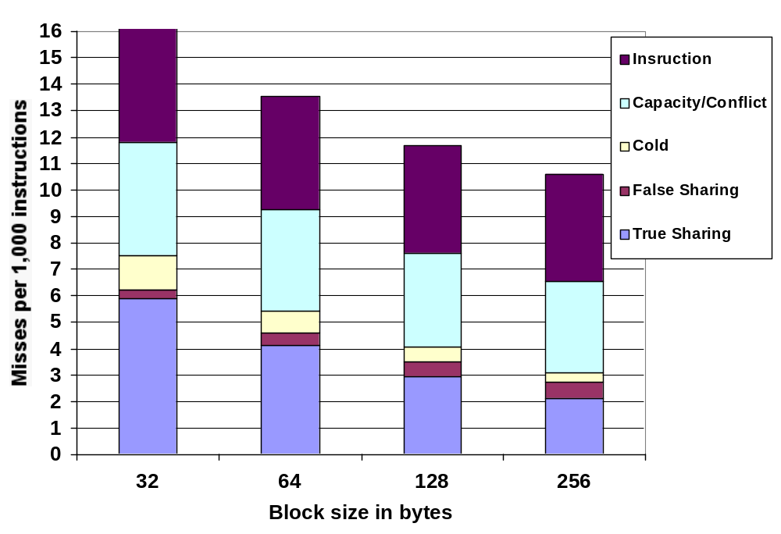
OLTP Performance as vary L3$ size

Slide 9
NUMA Memory performance for Scientific Apps on SGI Origin 2000
Show average cycles per memory reference in 4 categories:
Cache Hit
Miss to local memory
Remote miss to home
3-network hop miss to remote cache

Slide 10
CS 252 Administrivia
Quiz #1 Wed March 7 5:30-8:30 306 Soda
  No Lecture
La Val's afterward quiz: free food and drink
3 questions
Bring pencils
Bring sheet of paper with notes on 2 sides
Bring calculator (but don’t store notes in calculator)

Slide 11
SGI Origin 2000
a pure NUMA
2 CPUs per node,
Scales up to 2048 processors
Design for scientific computation vs. commercial processing
Scalable bandwidth is crucial to Origin

Slide 12
Parallel App: Scientific/Technical
FFT Kernel: 1D complex number FFT
  2 matrix transpose phases => all-to-all communication
  Sequential time for n data points: O(n log n)
  Example is 1 million point data set
LU Kernel: dense matrix factorization
  Blocking helps cache miss rate, 16x16
  Sequential time for nxn matrix: O(n³)
  Example is 512 x 512 matrix

Slide 13
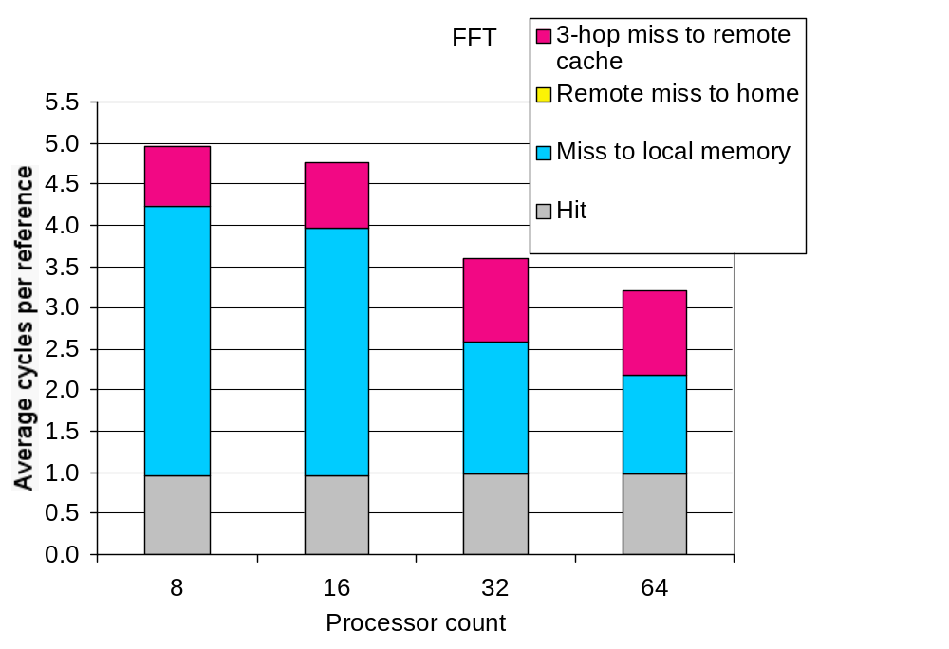
FFT Kernel

Slide 14
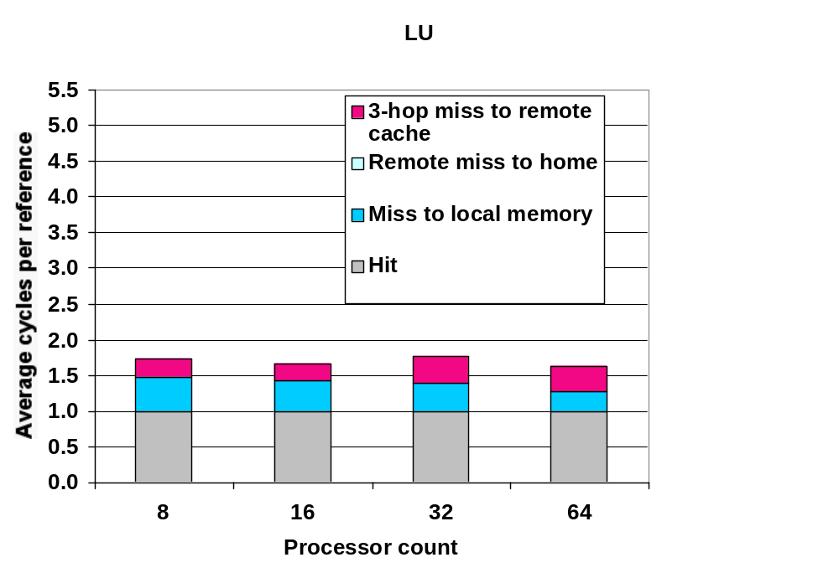
LU kernel

Slide 15
Parallel App: Scientific/Technical
Barnes App: Barnes-Hut n-body algorithm solving a problem in galaxy evolution
  n-body algs rely on forces drop off with distance;
  if far enough away, can ignore (e.g., gravity is 1/d²)
  Sequential time for n data points: O(n log n)
  Example is 16,384 bodies
Ocean App: Gauss-Seidel multigrid technique to solve a set of elliptical partial differential eq.s’
  red-black Gauss-Seidel colors points in grid to consistently update points based on previous values of adjacent neighbors
  Multigrid solve finite diff. eq. by iteration using hierarch. Grid
  Communication when boundary accessed by adjacent subgrid
  Sequential time for nxn grid: O(n²)
  Input: 130 x 130 grid points, 5 iterations

Slide 16
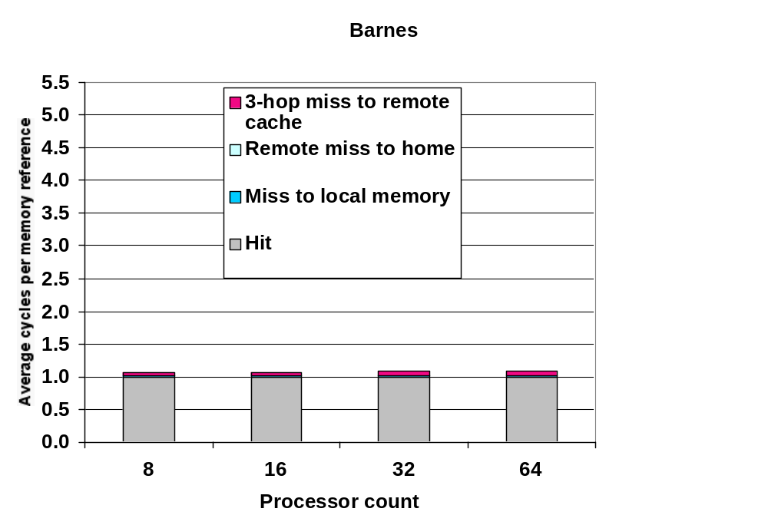
Barnes App

Slide 17
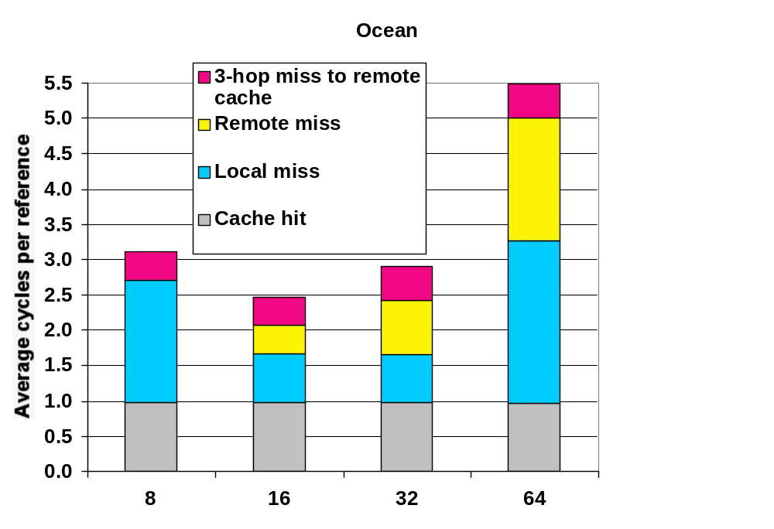
Ocean App

Slide 18
Cross Cutting Issues: Performance Measurement of Parallel Processors
Performance: how well scale as increase Proc
Speedup fixed as well as scaleup of problem
  Assume benchmark of size n on p processors makes sense: how scale benchmark to run on m * p processors?
  Memory-constrained scaling: keeping the amount of memory used per processor constant
  Time-constrained scaling: keeping total execution time, assuming perfect speedup, constant
Example: 1 hour on 10 P, time ~ O(n³), 100 P?
  Time-constrained scaling: 1 hour, => 10^{1/3}n => 2.15n scale up
  Memory-constrained scaling: 10n size => 10³/10 => 100X or 100 hours! 10X processors for 100X longer???
  Need to know application well to scale: # iterations, error tolerance

Slide 19
Cross Cutting Issues:
Memory System Issues
Multilevel cache hierarchy + multilevel inclusion—every level of cache hierarchy is a subset of next level—then can reduce contention between coherence traffic and processor traffic
  Hard if cache blocks different sizes
Also issues in memory consistency model and speculation, nonblocking caches, prefetching

Slide 20
Example: Sun Wildfire Prototype
Connect 2-4 SMPs via optional NUMA technology
  Use “off-the-self” SMPs as building block
For example, E6000 up to 15 processor or I/O boards (2 CPUs/board)
  Gigaplane bus interconnect, 3.2 Gbytes/sec
Wildfire Interface board (WFI) replace a CPU board => up to 112 processors (4 x 28),
  WFI board supports one coherent address space across 4 SMPs
  Each WFI has 3 ports connect to up to 3 additional nodes, each with a dual directional 800 MB/sec connection
  Has a directory cache in WFI interface: local or clean OK, otherwise sent to home node
  Multiple bus transactions

Slide 21
Example: Sun Wildfire Prototype
To reduce contention for page, has Coherent Memory Replication (CMR)
Page-level mechanisms for migrating and replicating pages in memory, coherence is still maintained at the cache-block level
Page counters record misses to remote pages and to migrate/replicate pages with high count
Migrate when a page is primarily used by a node
Replicate when multiple nodes share a page

Slide 22
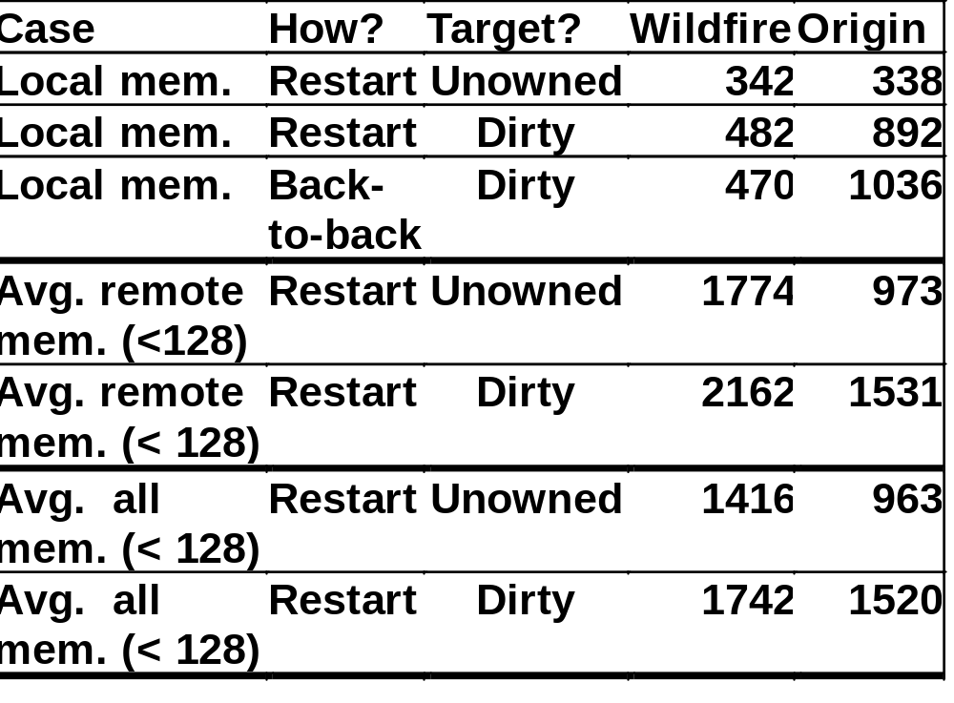
Memory Latency Wildfire v. Origin (nanoseconds)

Slide 23
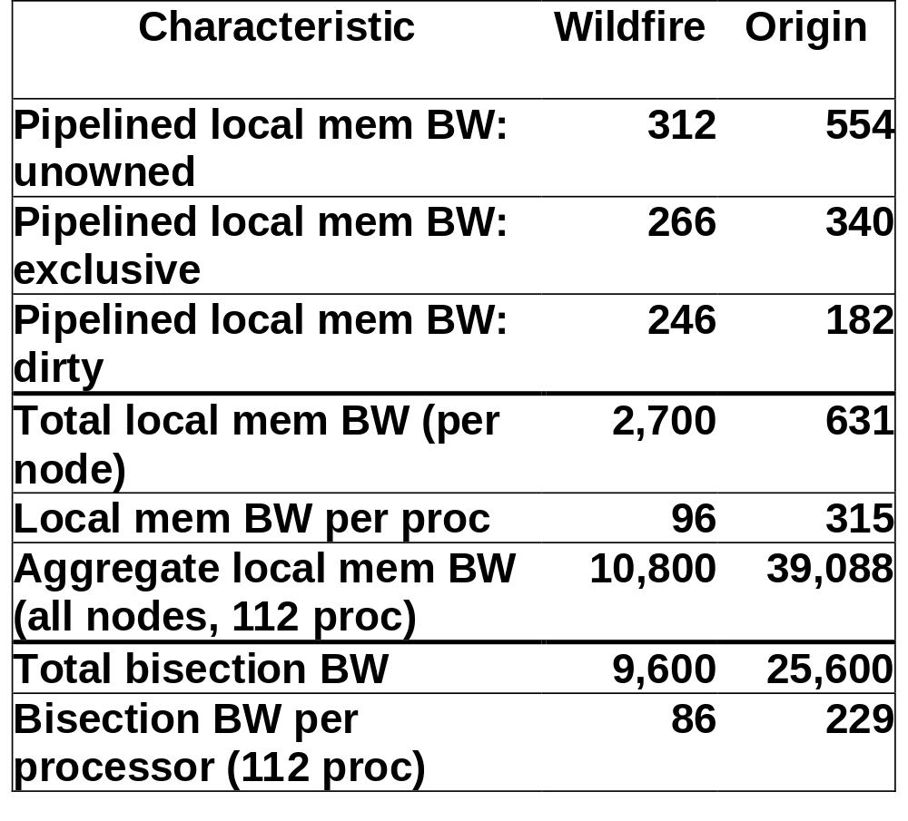
Memory Bandwidth Wildfire v. Origin (Mbytes/second)

Slide 24
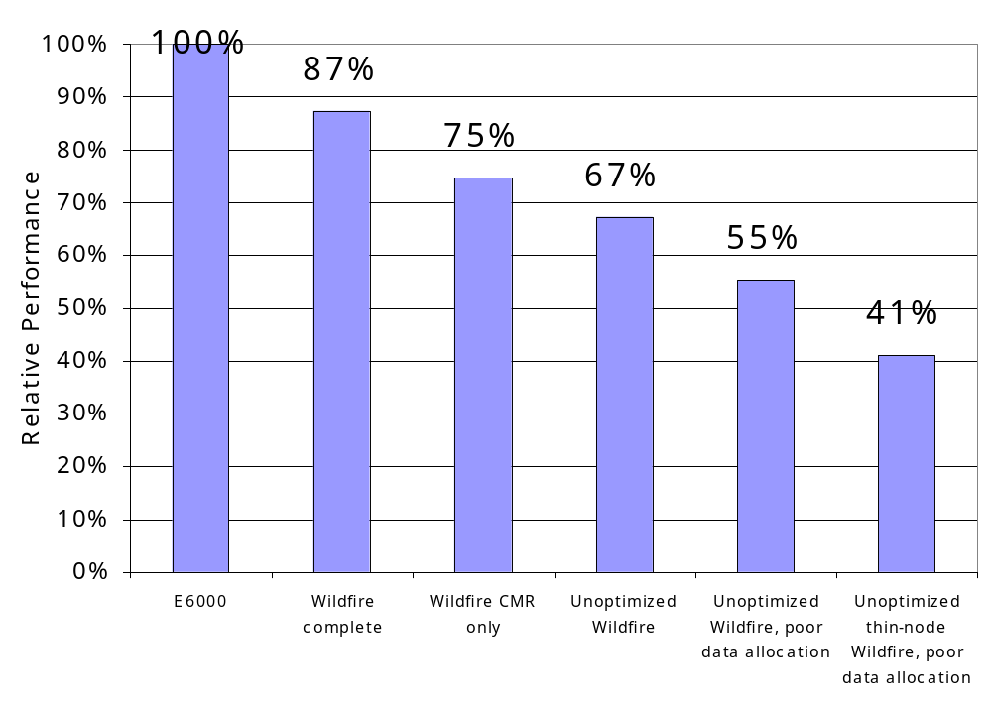
E6000 v. Wildfire variations:
OLTP Performance for 16 procs
Ideal, Optimized with CMR & locality scheduling, CMR only, unoptimized, poor data placement, thin nodes (2 v. 8 / node)

Slide 25
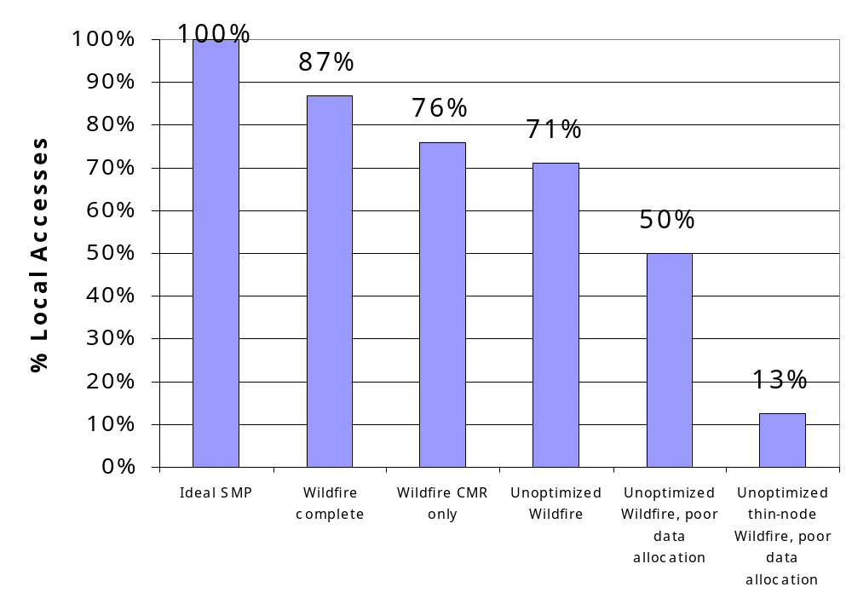
E6000 v. Wildfire variations:
% local memory access (within node)
Ideal, Optimized with CMR & locality scheduling, CMR only, unoptimized, poor data placement, thin nodes (2 v. 8 / node)

Slide 26
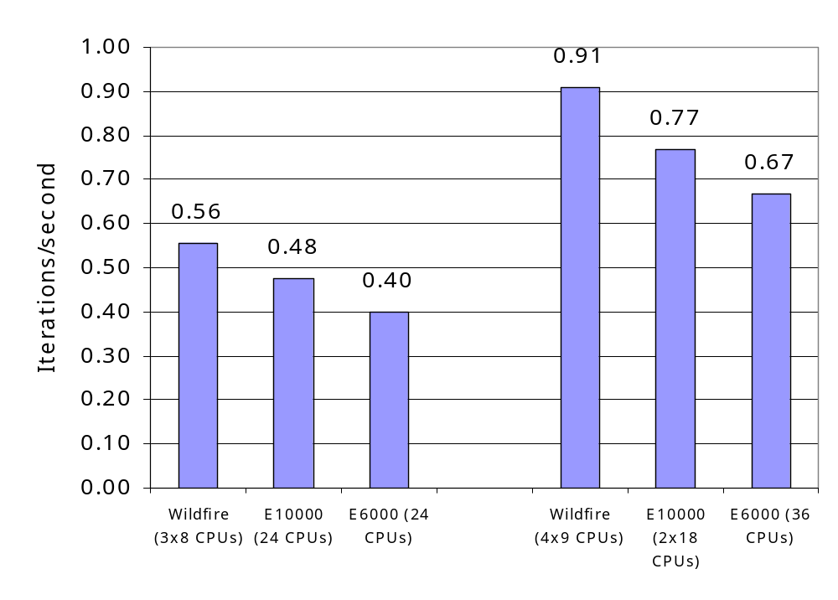
E10000 v. E6000 v. Wildfire: Red_Black Solver 24 and 36 procs
Greater performance due to separate busses?
  24 proc E6000 bus utilization 90%-100%
  36 proc E10000 more caches => 1.7X perf v. 1.5X procs

Slide 27
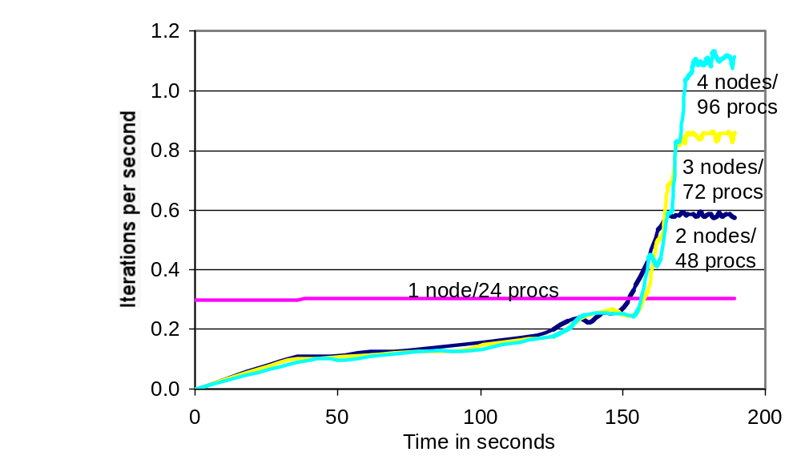
Wildfire CMR: Red_Black Solver
Start with all data on 1 node:
500 iterations to converge (120-180 secs); what if memory allocation varied over time?

Slide 28
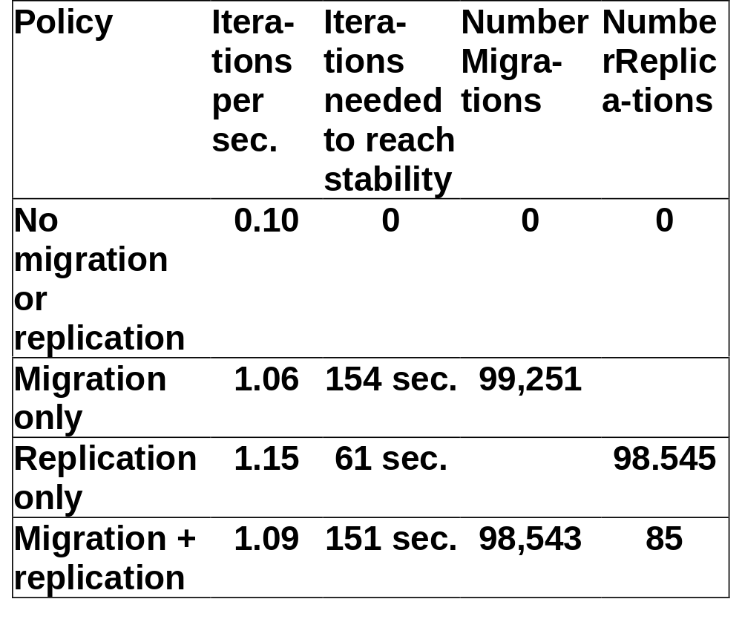
Wildfire CMR benefit:
Migration vs. Replication Red_Black Solver
Migration only has much lower HW costs (no reverse memory maps)

Slide 29
Wildfire Remarks
Fat nodes (8-24 way SMP) vs. Thin nodes (2-to 4-way like Origin)
Market shift from scientific apps to database and web apps may favor a fat-node design with 8 to 16 CPUs per node
  Scalability up to 100 CPUs may be of interest, but “sweet spot” of server market is 10s of CPUs. No customer interest in 1000 CPU machines key part of supercomputer marketplace
  Memory access patterns of commercial apps have less sharing + less predictable sharing and data access
  => matches fat node design which have lower bisection BW per CPU than a thin-node design
  => as fat-node design less dependence on exact memory allocation an data placement, perform better for apps with irregular or changing data access patterns
  => fat-nodes make it easier for migration and replication

Slide 30
Embedded Multiprocessors
EmpowerTel MXP, for Voice over IP
  4 MIPS processors, each with 12 to 24 KB of cache
  13.5 million transistors, 133 MHz
  PCI master/slave + 100 Mbit Ethernet pipe
Embedded Multiprocessing more popular in future as apps demand more performance
  No binary compatability; SW written from scratch
  Apps often have natural parallelism: set-top box, a network switch, or a game system
  Greater sensitivity to die cost (and hence efficient use of silicon)

Slide 31
Pitfall: Measuring MP performance by linear speedup v. execution time
“linear speedup” graph of perf as scale CPUs
Compare best algorithm on each computer
Relative speedup - run same program on MP and uniprocessor
  But parallel program may be slower on a uniprocessor than a sequential version
  Or developing a parallel program will sometimes lead to algorithmic improvements, which should also benefit uni
True speedup - run best program on each machine
Can get superlinear speedup due to larger effective cache with more CPUs

Slide 32
Fallacy: Amdahl’s Law doesn’t apply to parallel computers
Since some part linear, can’t go 100X?
1987 claim to break it, since 1000X speedup
  researchers scaled the benchmark to have a data set size that is 1000 times larger and compared the uniprocessor and parallel execution times of the scaled benchmark. For this particular algorithm the sequential portion of the program was constant independent of the size of the input, and the rest was fully parallel—hence, linear speedup with 1000 processors
Usually sequential scale with data too

Slide 33
Fallacy: Linear speedups are needed to make multiprocessors cost-effective
Mark Hill & David Wood 1995 study
Compare costs SGI uniprocessor and MP
Uniprocessor = $38,400 + $100 * MB
MP = $81,600 + $20,000 * P + $100 * MB
1 GB, uni = $138k v. mp = $181k + $20k * P
What speedup for better MP cost performance?
8 proc = $341k; $341k/138k => 2.5X
16 proc => need only 3.6X, or 25% linear speedup
Even if need some more memory for MP, not linear

Slide 34
Fallacy: Multiprocessors are “free.”
“Since microprocessors contain support for snooping caches, can build small-scale, bus-based multiprocessors for no additional cost”
Need more complex memory controller (coherence) than for uniprocessor
Memory access time always longer with more complex controller
Additional software effort: compilers, operating systems, and debuggers all must be adapted for a parallel system

Slide 35
Fallacy: Scalability is almost free
“build scalability into a multiprocessor and then simply offer the multiprocessor at any point on the scale from a small number of processors to a large number”
Cray T3E scales to 2,048 CPUs vs 4 CPU Alpha
  At 128 CPUs, it delivers a peak bisection BW of 38.4 GB/s, or 300 MB/s per CPU (uses Alpha microprocessor)
  Compaq Alphaserver ES40 up to 4 CPUs and has 5.6 GB/s of interconnect BW, or 1400 MB/s per CPU
Build appls that scale requires significantly more attention to load balance, locality, potential contention, and serial (or partly parallel) portions of program. 10X is very hard

Slide 36
Pitfall: Not developing the software to take advantage of, or optimize for, a multiprocessor architecture
SGI OS protects the page table data structure with a single lock, assuming that page allocation is infrequent
Suppose a program uses a large number of pages that are initialized at start-up
program parallelized so that multiple processes allocate the pages
But page allocation requires lock of page table data structure, so even an OS kernel that allows multiple threads will be serialized at initilization (even if separate processes)

Slide 37
Multiprocessor Conclusion
Some optimism about future
  Parallel processing beginning to be understood in some domains
  More performance than that achieved with a single-chip microprocessor
  MPs are highly effective for multiprogrammed workloads
  MPs proved effective for intensive commercial workloads, such as OLTP (assuming enough I/O to be CPU-limited), DSS applications (where query optimization is critical), and large-scale, web searching applications
  On-chip MPs appears to be growing
  1) embedded market where natural parallelism often exists an obvious alternative to faster less silicon efficient, CPU.
  2) diminishing returns in high-end microprocessor encourage designers to pursue on-chip multiprocessing

Slide 38
Synchronization
Why Synchronize? Need to know when it is safe for different processes to use shared data
Issues for Synchronization:
  Uninterruptable instruction to fetch and update memory (atomic operation);
  User level synchronization operation using this primitive;
  For large scale MPs, synchronization can be a bottleneck; techniques to reduce contention and latency of synchronization

Slide 39
Uninterruptable Instruction to Fetch and Update Memory
Atomic exchange: interchange a value in a register for a value in memory
  0 => synchronization variable is free
  1 => synchronization variable is locked and unavailable
  Set register to 1 & swap
  New value in register determines success in getting lock 0 if you succeeded in setting the lock (you were first)
  1 if other processor had already claimed access
  Key is that exchange operation is indivisible
Test-and-set: tests a value and sets it if the value passes the test
Fetch-and-increment: it returns the value of a memory location and atomically increments it
  0 => synchronization variable is free

Slide 40
Uninterruptable Instruction to Fetch and Update Memory
Hard to have read & write in 1 instruction: use 2 instead
Load linked (or load locked) + store conditional
  Load linked returns the initial value
  Store conditional returns 1 if it succeeds (no other store to same memory location since preceeding load) and 0 otherwise
Example doing atomic swap with LL & SC:
try: mov R3,R4 ; mov exchange value
ll R2,0(R1) ; load linked
sc R3,0(R1) ; store conditional
beqz R3,try ; branch store fails (R3 = 0)
mov R4,R2 ; put load value in R4
Example doing fetch & increment with LL & SC:
try: ll R2,0(R1) ; load linked
addi R2,R2,#1 ; increment (OK if reg–reg)
sc R2,0(R1) ; store conditional
beqz R2,try ; branch store fails (R2 = 0)

Slide 41
User Level Synchronization—Operation Using this Primitive
Spin locks: processor continuously tries to acquire, spinning around a loop trying to get the lock
li R2,#1
lockit: exch R2,0(R1) ;atomic exchange
bnez R2,lockit ;already locked?
What about MP with cache coherency?
  Want to spin on cache copy to avoid full memory latency
  Likely to get cache hits for such variables
Problem: exchange includes a write, which invalidates all other copies; this generates considerable bus traffic
Solution: start by simply repeatedly reading the variable; when it changes, then try exchange (“test and test&set”):
try: li R2,#1
lockit: lw R3,0(R1) ;load var
bnez R3,lockit ;not free=>spin
exch R2,0(R1) ;atomic exchange
bnez R2,try ;already locked?

Slide 42
Another MP Issue:
Memory Consistency Models
What is consistency? When must a processor see the new value? e.g., seems that
P1: A = 0; P2: B = 0;
..... .....
A = 1; B = 1;
L1: if (B == 0) ... L2: if (A == 0) ...
Impossible for both if statements L1 & L2 to be true?
  What if write invalidate is delayed & processor continues?
Memory consistency models:
what are the rules for such cases?
Sequential consistency: result of any execution is the same as if the accesses of each processor were kept in order and the accesses among different processors were interleaved => assignments before ifs above
  SC: delay all memory accesses until all invalidates done

Slide 43
Memory Consistency Model
Schemes faster execution to sequential consistency
Not really an issue for most programs;
they are synchronized
  A program is synchronized if all access to shared data are ordered by synchronization operations
  write (x)
  ...
  release (s) {unlock}
  ...
  acquire (s) {lock}
  ...
  read(x)
Only those programs willing to be nondeterministic are not synchronized: “data race”: outcome f(proc. speed)
Several Relaxed Models for Memory Consistency since most programs are synchronized; characterized by their attitude towards: RAR, WAR, RAW, WAW
to different addresses

