Slide 1
CS252
Graduate Computer Architecture
Lecture 16:
Instruction Level Parallelism and Dynamic Execution #1:
March 16, 2001
Prof. David A. Patterson
Computer Science 252
Spring 2001

Slide 2
Recall from Pipelining Review
Pipeline CPI = Ideal pipeline CPI + Structural Stalls + Data Hazard Stalls + Control Stalls
  Ideal pipeline CPI: measure of the maximum performance attainable by the implementation
  Structural hazards: HW cannot support this combination of instructions
  Data hazards: Instruction depends on result of prior instruction still in the pipeline
  Control hazards: Caused by delay between the fetching of instructions and decisions about changes in control flow (branches and jumps)

Slide 3
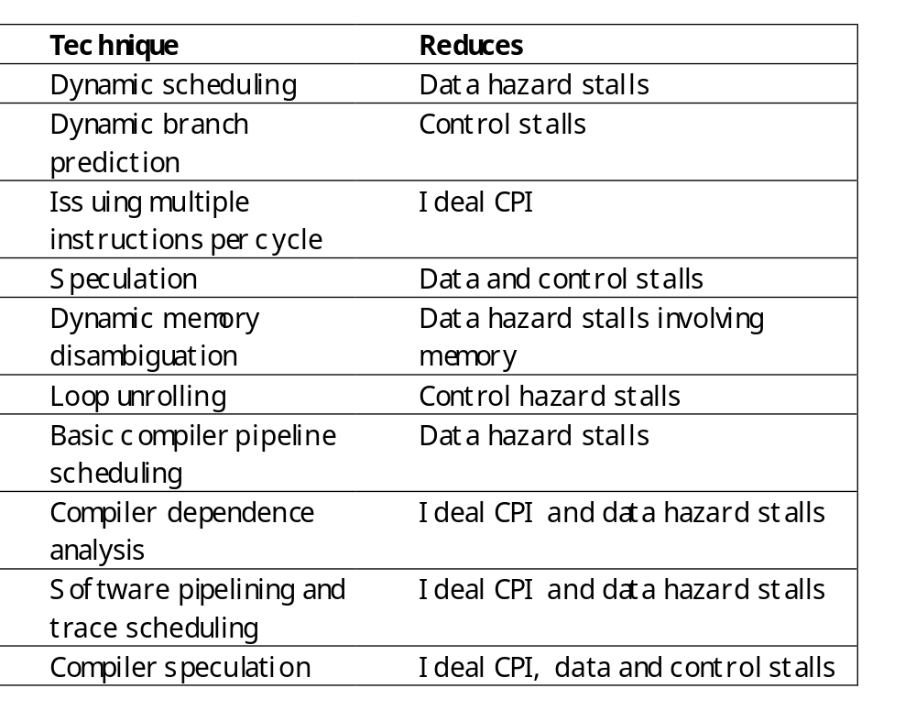
Ideas to Reduce Stalls
Chapter 3
Chapter 4

Slide 4
Instruction-Level Parallelism (ILP)
Basic Block (BB) ILP is quite small
  BB: a straight-line code sequence with no branches in except to the entry and no branches out except at the exit
  average dynamic branch frequency 15% to 25%
  => 4 to 7 instructions execute between a pair of branches
  Plus instructions in BB likely to depend on each other
To obtain substantial performance enhancements, we must exploit ILP across multiple basic blocks
Simplest: loop-level parallelism to exploit parallelism among iterations of a loop
  Vector is one way
  If not vector, then either dynamic via branch prediction or static via loop unrolling by compiler

Slide 5
Data Dependence and Hazards
Instr_{J} is data dependent on Instr_{I}
Instr_{J} tries to read operand before Instr_{I} writes it
or Instr_{J} is data dependent on Instr_{K} which is dependent on Instr_{I}
Caused by a “True Dependence” (compiler term)
If true dependence caused a hazard in the pipeline, called a Read After Write (RAW) hazard
I: add r1,r2,r3
J: sub r4,r1,r3

Slide 6
Data Dependence and Hazards
Dependences are a property of programs
Presence of dependence indicates potential for a hazard, but actual hazard and length of any stall is a property of the pipeline
Importance of the data dependencies
1) indicates the possibility of a hazard
2) determines order in which results must be calculated
3) sets an upper bound on how much parallelism can possibly be exploited
Today looking at HW schemes to avoid hazard

Slide 7
Name Dependence #1:
Anti-dependence
Name dependence: when 2 instructions use same register or memory location, called a name, but no flow of data between the instructions associated with that name; 2 versions of name dependence
Instr_{J} writes operand before Instr_{I} reads it
Called an “anti-dependence” by compiler writers.
This results from reuse of the name “r1”
If anti-dependence caused a hazard in the pipeline, called a Write After Read (WAR) hazard
I: sub r4,r1,r3
J: add r1,r2,r3
K: mul r6,r1,r7

Slide 8
Name Dependence #2:
Output dependence
Instr_{J} writes operand before Instr_{I} writes it.
Called an “output dependence” by compiler writers
This also results from the reuse of name “r1”
If anti-dependence caused a hazard in the pipeline, called a Write After Write (WAW) hazard
I: sub r1,r4,r3
J: add r1,r2,r3
K: mul r6,r1,r7

Slide 9
ILP and Data Hazards
HW/SW must preserve program order:
order instructions would execute in if executed sequentially 1 at a time as determined by original source program
HW/SW goal: exploit parallelism by preserving program order only where it affects the outcome of the program
Instructions involved in a name dependence can execute simultaneously if name used in instructions is changed so instructions do not conflict
  Register renaming resolves name dependence for regs
  Either by compiler or by HW

Slide 10
Control Dependencies
Every instruction is control dependent on some set of branches, and, in general, these control dependencies must be preserved to preserve program order
  if p1 {
  S1;
  };
  if p2 {
  S2;
  }
S1 is control dependent on p1, and S2 is control dependent on p2 but not on p1.

Slide 11
Control Dependence Ignored
Control dependence need not be preserved
  willing to execute instructions that should not have been executed, thereby violating the control dependences, if can do so without affecting correctness of the program
Instead, 2 properties critical to program correctness are exception behavior and data flow

Slide 12
Exception Behavior
Preserving exception behavior => any changes in instruction execution order must not change how exceptions are raised in program (=> no new exceptions)
Example:
DADDU R2,R3,R4
BEQZ R2,L1
LW R1,0(R2)
L1:
Problem with moving LW before BEQZ?

Slide 13
Data Flow
Data flow: actual flow of data values among instructions that produce results and those that consume them
  branches make flow dynamic, determine which instruction is supplier of data
Example:
DADDU R1,R2,R3
BEQZ R4,L
DSUBU R1,R5,R6
L: …
OR R7,R1,R8
OR depends on DADDU or DSUBU?
Must preserve data flow on execution

Slide 14
CS 252 Administrivia
Project Group Meetings Next Wed March 21
  No lecture next Wednesday
Email Project Survey #2 by Monday evening
Fill out signup sheet for Wednesday discussion

Slide 15
Advantages of
Dynamic Scheduling
Handles cases when dependences unknown at compile time
  (e.g., because they may involve a memory reference)
It simplifies the compiler
Allows code that compiled for one pipeline to run efficiently on a different pipeline
Hardware speculation, a technique with significant performance advantages, that builds on dynamic scheduling

Slide 16
HW Schemes: Instruction Parallelism
Key idea: Allow instructions behind stall to proceed
DIVD F0,F2,F4
ADDD F10,F0,F8
SUBD F12,F8,F14
Enables out-of-order execution
and allows out-of-order completion
Will distinguish when an instruction begins execution and when it completes execution; between 2 times, the instruction is in execution
In a dynamically scheduled pipeline, all instructions pass through issue stage in order (in-order issue)

Slide 17
Dynamic Scheduling Step 1
Simple pipeline had 1 stage to check both structural and data hazards: Instruction Decode (ID), also called Instruction Issue
Split the ID pipe stage of simple 5-stage pipeline into 2 stages:
Issue—Decode instructions, check for structural hazards
Read operands—Wait until no data hazards, then read operands

Slide 18
A Dynamic Algorithm:
Tomasulo’s Algorithm
For IBM 360/91 (before caches!)
Goal: High Performance without special compilers
Small number of floating point registers (4 in 360) prevented interesting compiler scheduling of operations
  This led Tomasulo to try to figure out how to get more effective registers — renaming in hardware!
Why Study 1966 Computer?
The descendants of this have flourished!
  Alpha 21264, HP 8000, MIPS 10000, Pentium III, PowerPC 604, …

Slide 19
Tomasulo Algorithm
Control & buffers distributed with Function Units (FU)
  FU buffers called “reservation stations”; have pending operands
Registers in instructions replaced by values or pointers to reservation stations(RS); called register renaming ;
  avoids WAR, WAW hazards
  More reservation stations than registers, so can do optimizations compilers can’t
Results to FU from RS, not through registers, over Common Data Bus that broadcasts results to all FUs
Load and Stores treated as FUs with RSs as well
Integer instructions can go past branches, allowing
FP ops beyond basic block in FP queue

Slide 20
Tomasulo Organization
From Mem
FP Op
Queue
FP Registers
Load Buffers
Load1
Load2
Load3
Load4
Load5
Load6
Store
Buffers
Add1
Add2
Add3
Mult1
Mult2
Reservation
Stations
To Mem
FP adders
FP multipliers
Common Data Bus (CDB)
Notes:
Resolve RAW memory conflict? (address in memory buffers)
Integer unit executes in parallel

Slide 21
Reservation Station Components
Op: Operation to perform in the unit (e.g., + or –)
Vj, Vk: Value of Source operands
  Store buffers has V field, result to be stored
Qj, Qk: Reservation stations producing source registers (value to be written)
  Note: Qj,Qk=0 => ready
  Store buffers only have Qi for RS producing result
Busy: Indicates reservation station or FU is busy
Register result status—Indicates which functional unit will write each register, if one exists. Blank when no pending instructions that will write that register.
Notes:
What you might have thought
1. 4 stages of instruction executino
2.Status of FU: Normal things to keep track of (RAW & structura for busyl):
Fi from instruction format of the mahine (Fi is dest)
Add unit can Add or Sub
Rj, Rk - status of registers (Yes means ready)
Qj,Qk - If a no in Rj, Rk, means waiting for a FU to write result; Qj, Qk means wihch FU waiting for it
3.Status of register result (WAW &WAR)s:
which FU is going to write into registers
Scoreboard on 6600 = size of FU
6.7, 6.8, 6.9, 6.12, 6.13, 6.16, 6.17
FU latencies: Add 2, Mult 10, Div 40 clocks

Slide 22
Three Stages of Tomasulo Algorithm
1. Issue—get instruction from FP Op Queue
  If reservation station free (no structural hazard),
  control issues instr & sends operands (renames registers).
2. Execute—operate on operands (EX)
  When both operands ready then execute;
  if not ready, watch Common Data Bus for result
3. Write result—finish execution (WB)
  Write on Common Data Bus to all awaiting units;
  mark reservation station available
Normal data bus: data + destination (“go to” bus)
Common data bus: data + source (“come from” bus)
  64 bits of data + 4 bits of Functional Unit source address
  Write if matches expected Functional Unit (produces result)
  Does the broadcast
Example speed:
3 clocks for Fl .pt. +,-; 10 for * ; 40 clks for /

Slide 23
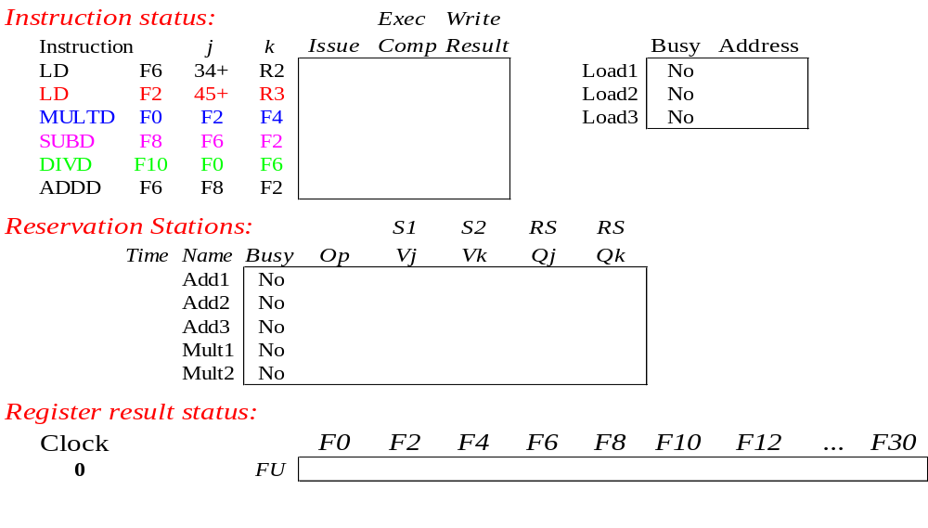
Tomasulo Example
Instruction stream
3 Load/Buffers
FU count
down
3 FP Adder R.S.
2 FP Mult R.S.
Clock cycle
counter

Slide 24
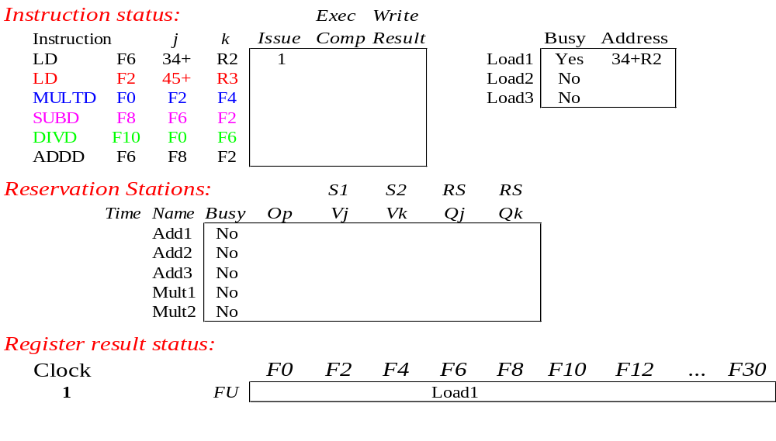
Tomasulo Example Cycle 1

Slide 25
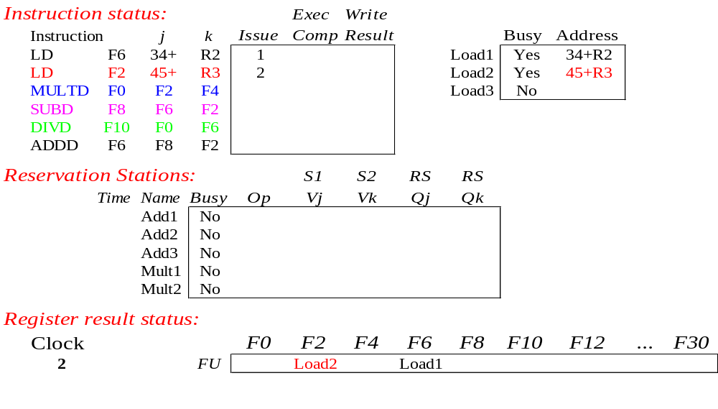
Tomasulo Example Cycle 2
Note: Can have multiple loads outstanding

Slide 26
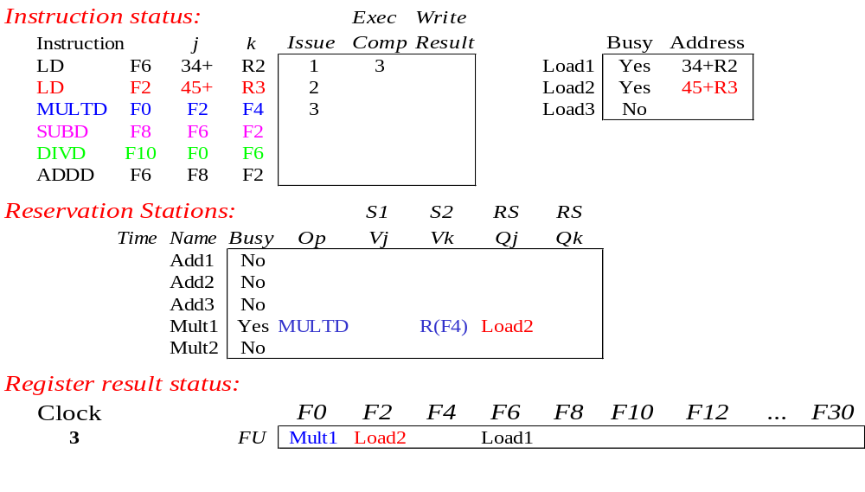
Tomasulo Example Cycle 3
Note: registers names are removed (“renamed”) in Reservation Stations; MULT issued
Load1 completing; what is waiting for Load1?

Slide 27
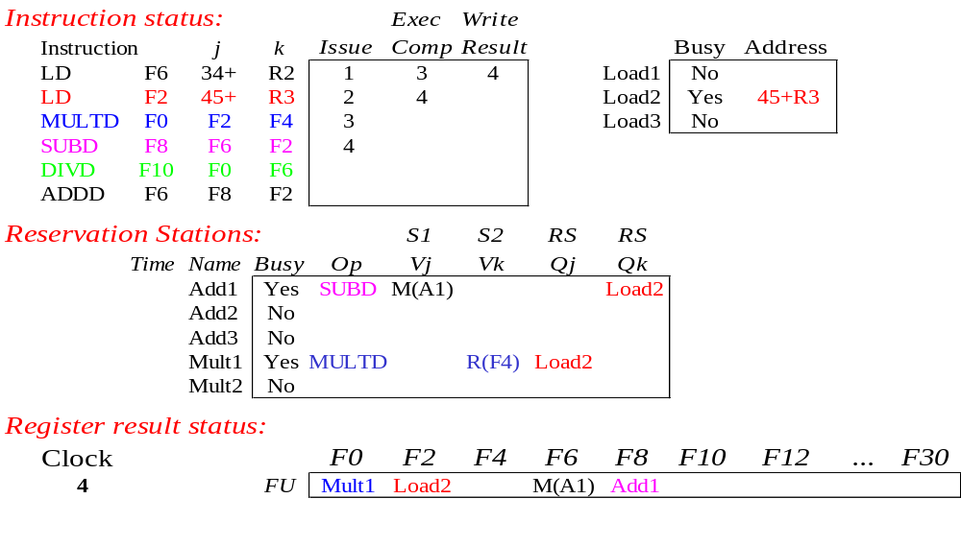
Tomasulo Example Cycle 4
Load2 completing; what is waiting for Load2?

Slide 28
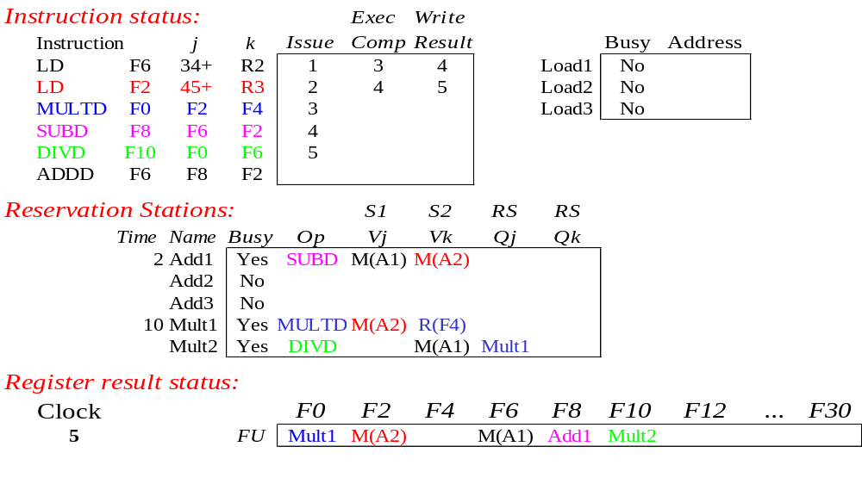
Tomasulo Example Cycle 5
Timer starts down for Add1, Mult1

Slide 29
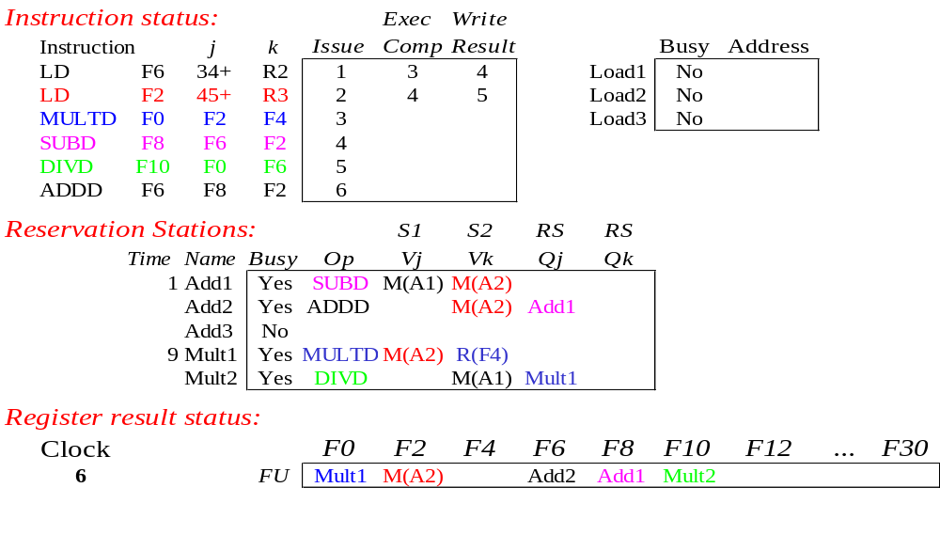
Tomasulo Example Cycle 6
Issue ADDD here despite name dependency on F6?

Slide 30

Tomasulo Example Cycle 7
Add1 (SUBD) completing; what is waiting for it?

Slide 31
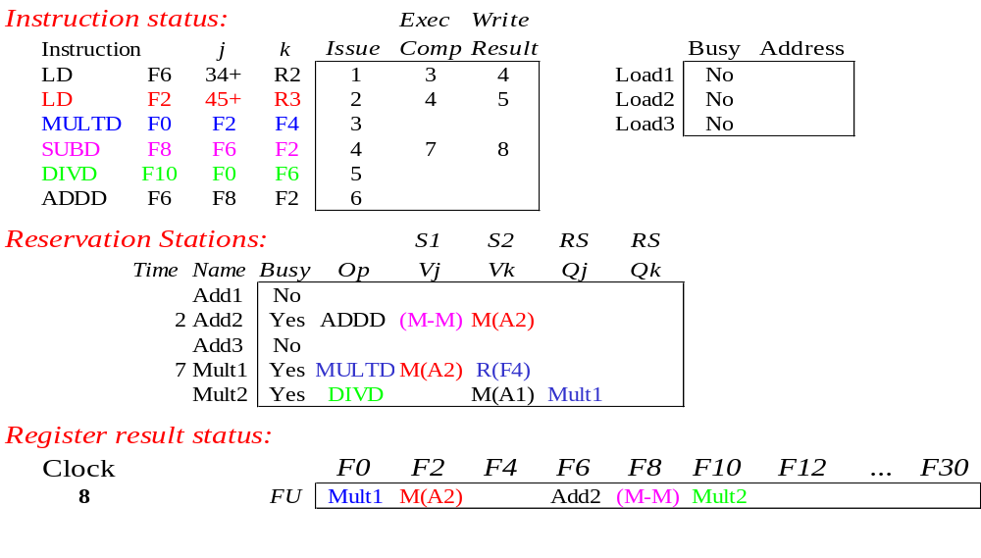
Tomasulo Example Cycle 8

Slide 32

Tomasulo Example Cycle 9

Slide 33

Tomasulo Example Cycle 10
Add2 (ADDD) completing; what is waiting for it?

Slide 34
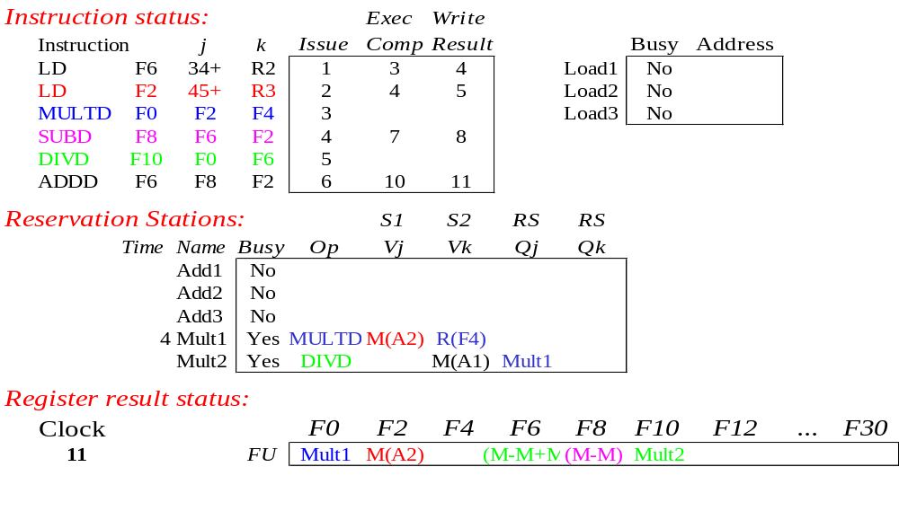
Tomasulo Example Cycle 11
Write result of ADDD here?
All quick instructions complete in this cycle!

Slide 35

Tomasulo Example Cycle 12

Slide 36

Tomasulo Example Cycle 13

Slide 37

Tomasulo Example Cycle 14

Slide 38
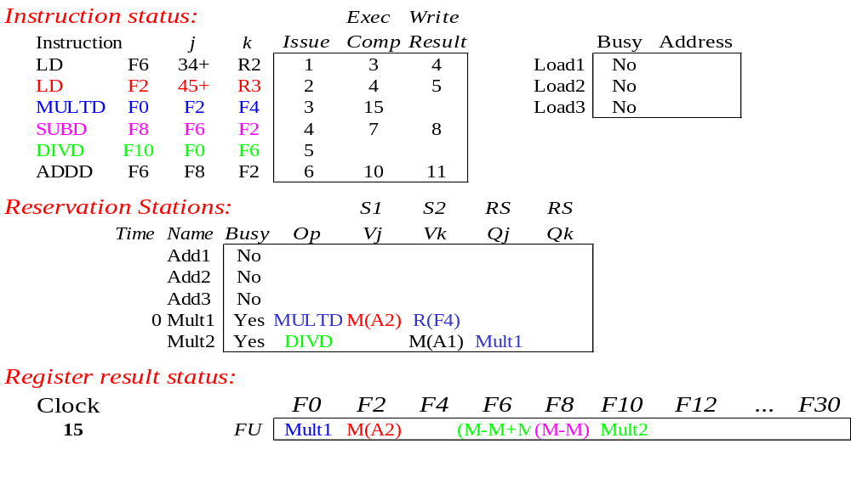
Tomasulo Example Cycle 15
Mult1 (MULTD) completing; what is waiting for it?

Slide 39
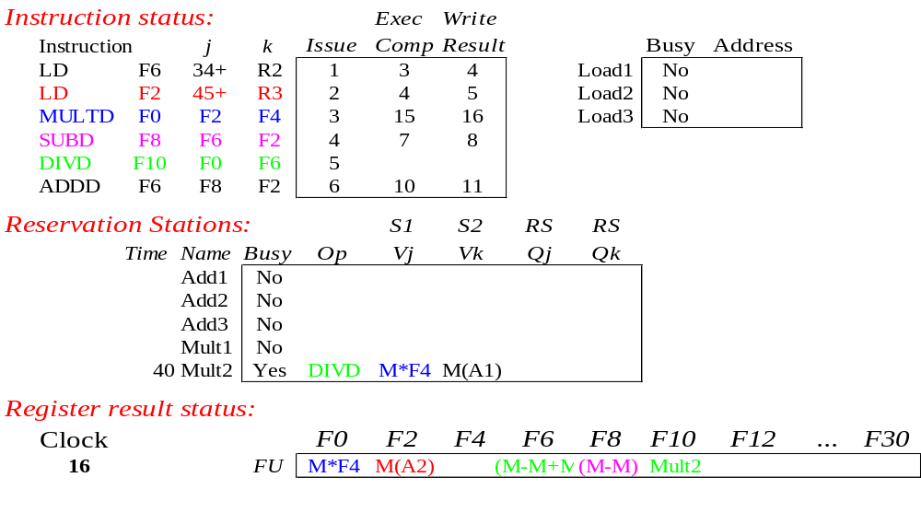
Tomasulo Example Cycle 16
Just waiting for Mult2 (DIVD) to complete

Slide 40
Faster than light computation
(skip a couple of cycles)

Slide 41
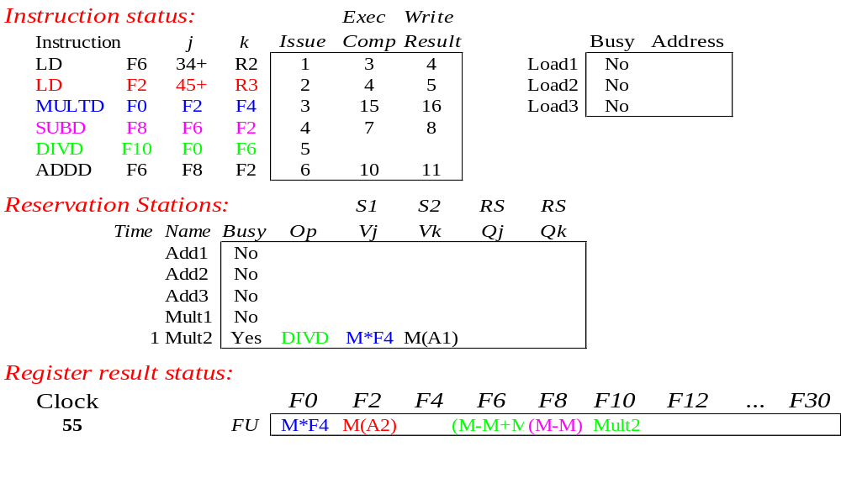
Tomasulo Example Cycle 55

Slide 42
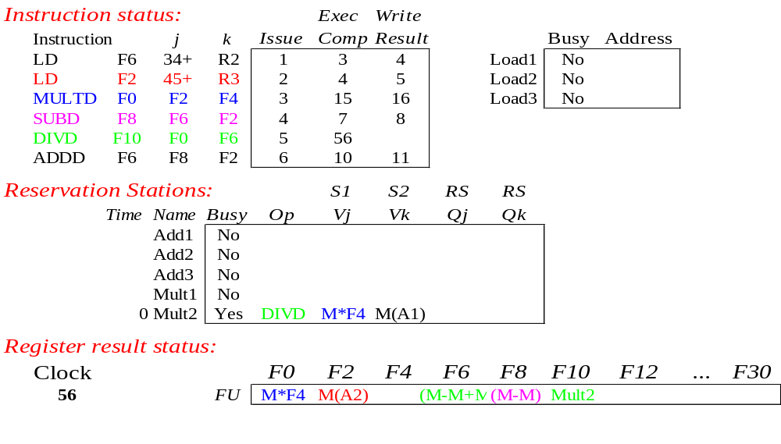
Tomasulo Example Cycle 56
Mult2 (DIVD) is completing; what is waiting for it?

Slide 43
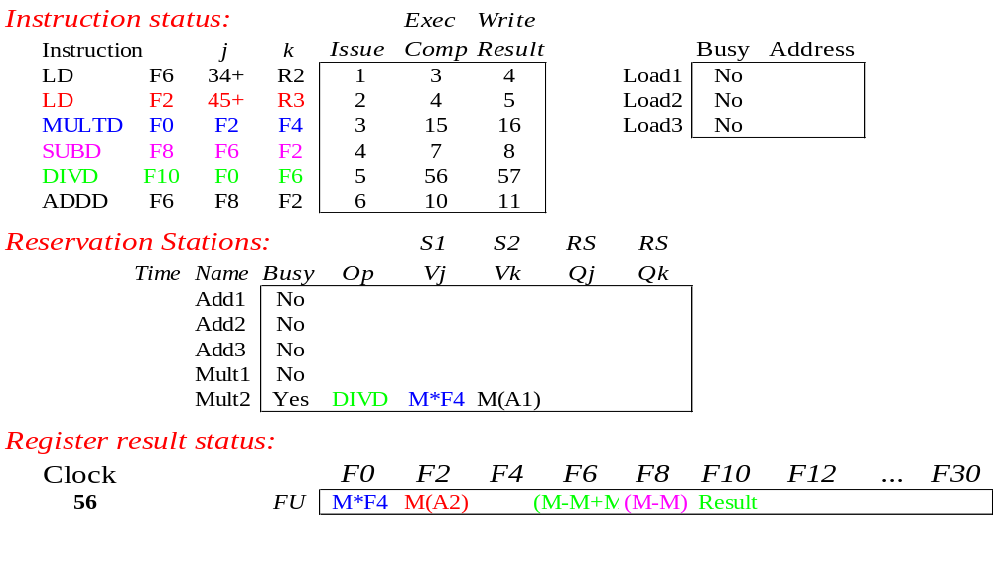
Tomasulo Example Cycle 57
Once again: In-order issue, out-of-order execution and out-of-order completion.

Slide 44
Tomasulo Drawbacks
Complexity
  delays of 360/91, MIPS 10000, Alpha 21264,
  IBM PPC 620 in CA:AQA 2/e, but not in silicon!
Many associative stores (CDB) at high speed
Performance limited by Common Data Bus
  Each CDB must go to multiple functional units
  ⇒high capacitance, high wiring density
  Number of functional units that can complete per cycle limited to one!
    Multiple CDBs ⇒ more FU logic for parallel assoc stores
Non-precise interrupts!
  We will address this later

Slide 45
Tomasulo Loop Example
Loop: LD F0 0 R1
MULTD F4 F0 F2
SD F4 0 R1
SUBI R1 R1 #8
BNEZ R1 Loop
This time assume Multiply takes 4 clocks
Assume 1st load takes 8 clocks
(L1 cache miss), 2nd load takes 1 clock (hit)
To be clear, will show clocks for SUBI, BNEZ
  Reality: integer instructions ahead of Fl. Pt. Instructions
Show 2 iterations

Slide 46
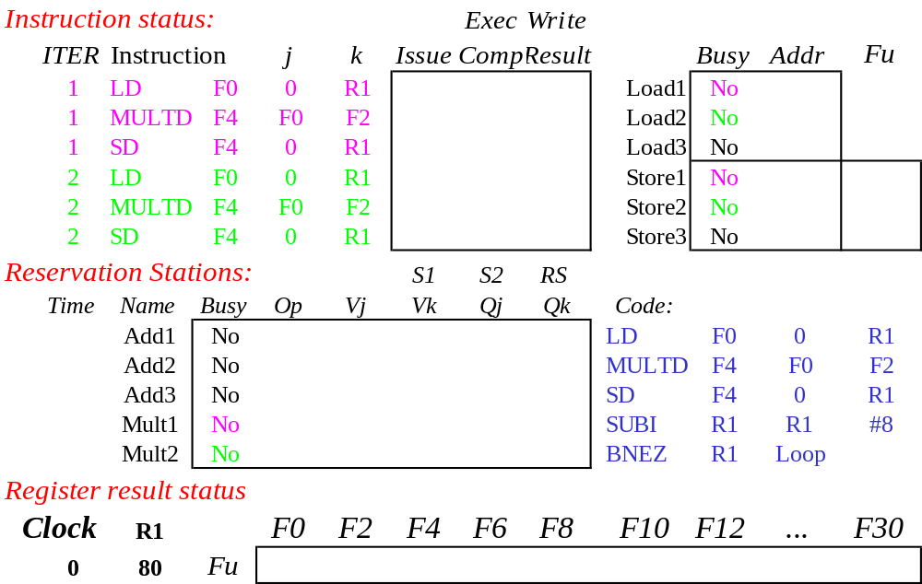
Loop Example
Iter-
ation
Count
Added Store Buffers
Instruction Loop
Value of Register used for address, iteration control

Slide 47
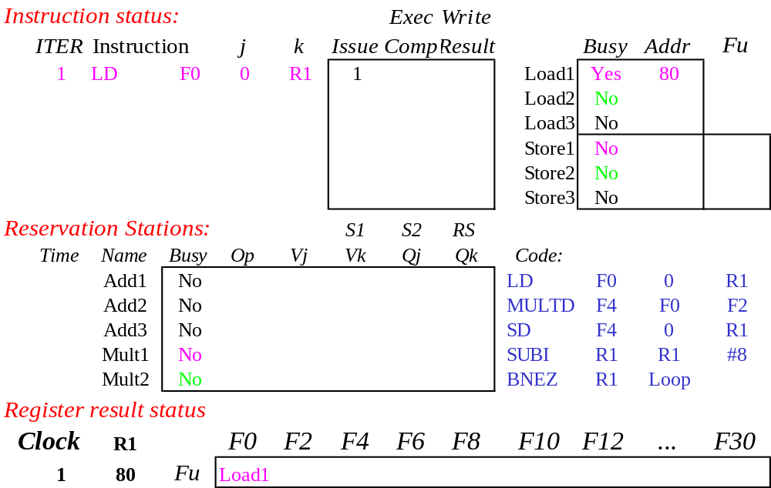
Loop Example Cycle 1

Slide 48
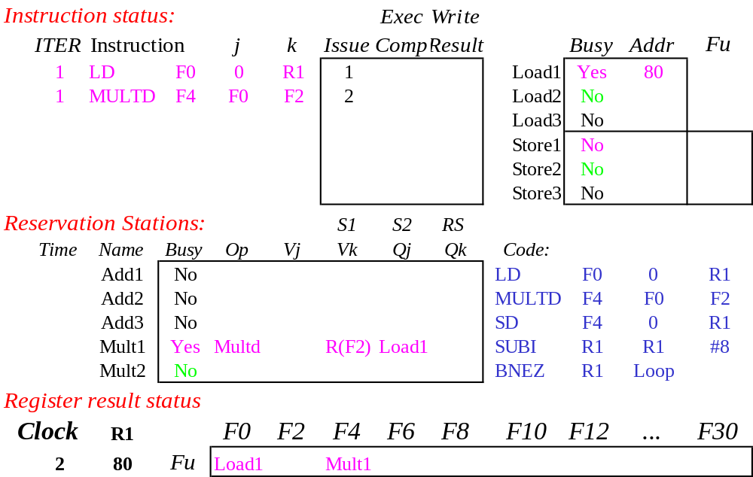
Loop Example Cycle 2

Slide 49
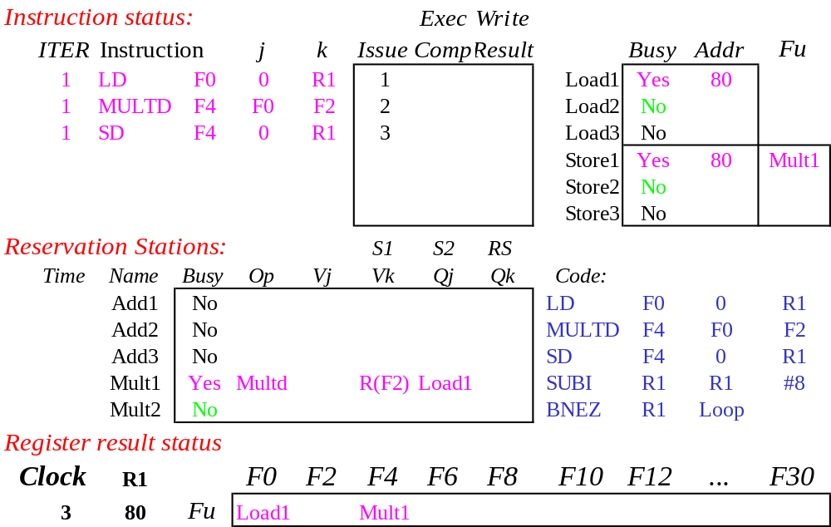
Loop Example Cycle 3
Implicit renaming sets up data flow graph

Slide 50

Loop Example Cycle 4
Dispatching SUBI Instruction (not in FP queue)

Slide 51

Loop Example Cycle 5
And, BNEZ instruction (not in FP queue)

Slide 52
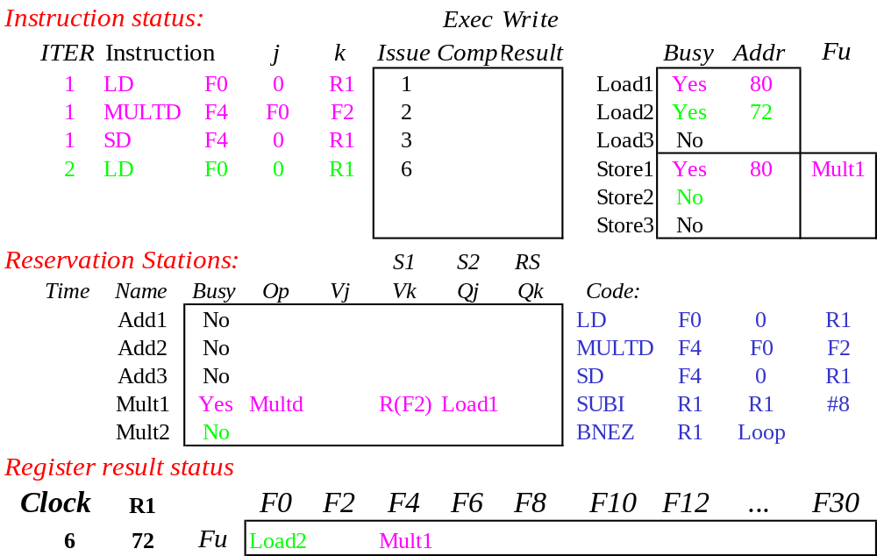
Loop Example Cycle 6
Notice that F0 never sees Load from location 80

Slide 53
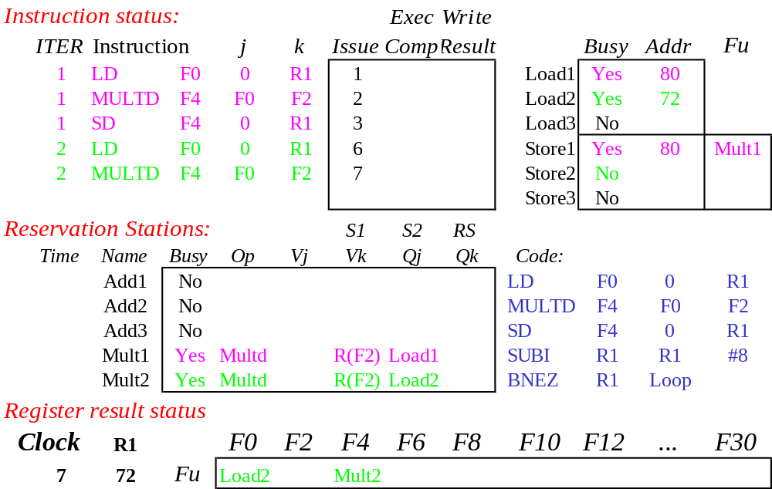
Loop Example Cycle 7
Register file completely detached from computation
First and Second iteration completely overlapped

Slide 54

Loop Example Cycle 8

Slide 55
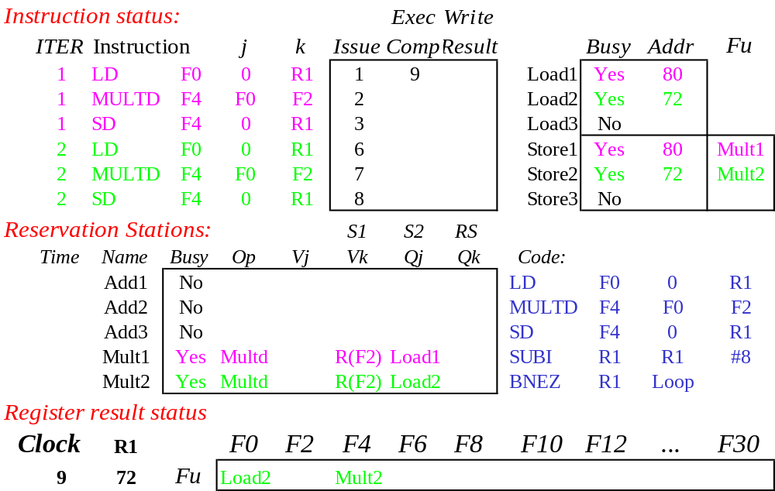
Loop Example Cycle 9
Load1 completing: who is waiting?
Note: Dispatching SUBI

Slide 56
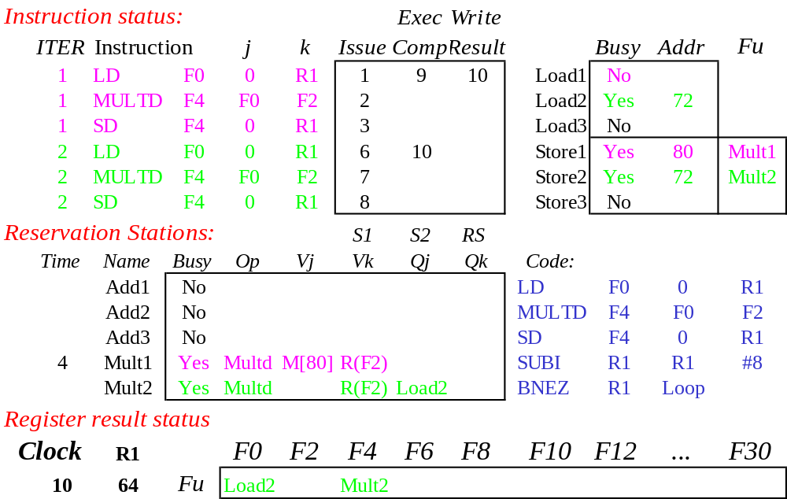
Loop Example Cycle 10
Load2 completing: who is waiting?
Note: Dispatching BNEZ

Slide 57
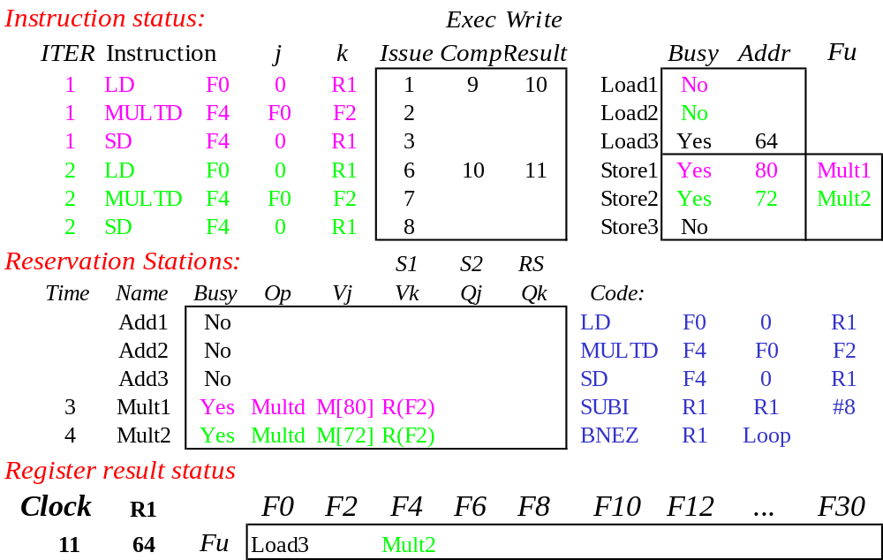
Loop Example Cycle 11
Next load in sequence

Slide 58

Loop Example Cycle 12
Why not issue third multiply?

Slide 59

Loop Example Cycle 13
Why not issue third store?

Slide 60
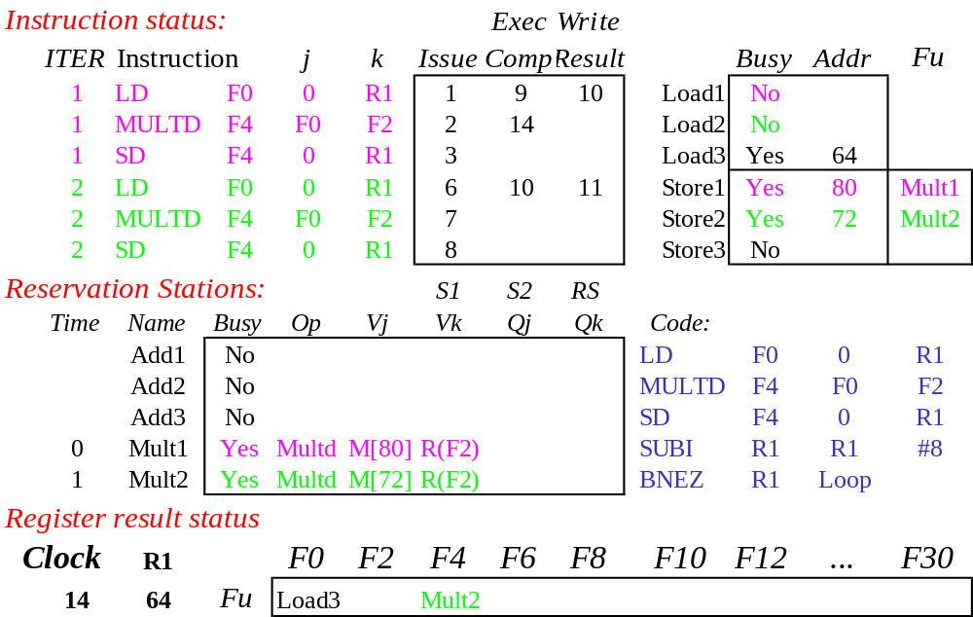
Loop Example Cycle 14
Mult1 completing. Who is waiting?

Slide 61
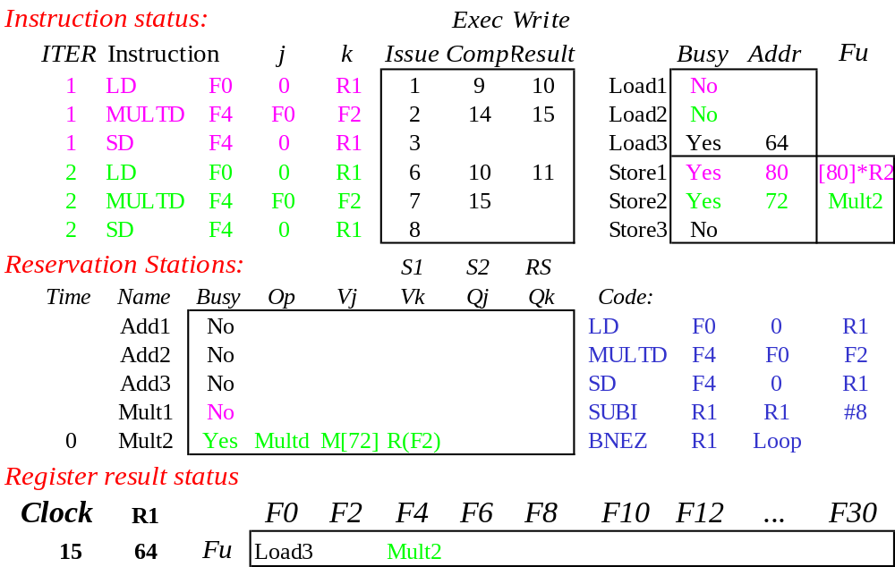
Loop Example Cycle 15
Mult2 completing. Who is waiting?

Slide 62
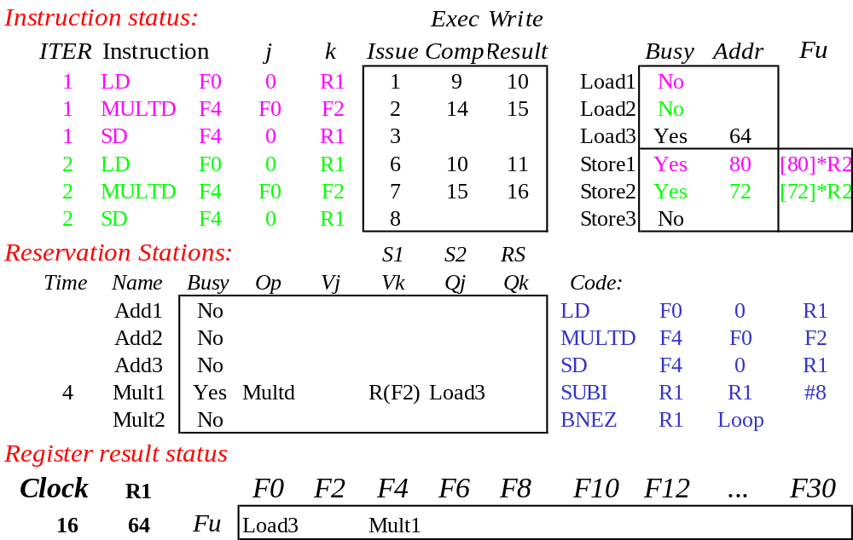
Loop Example Cycle 16

Slide 63
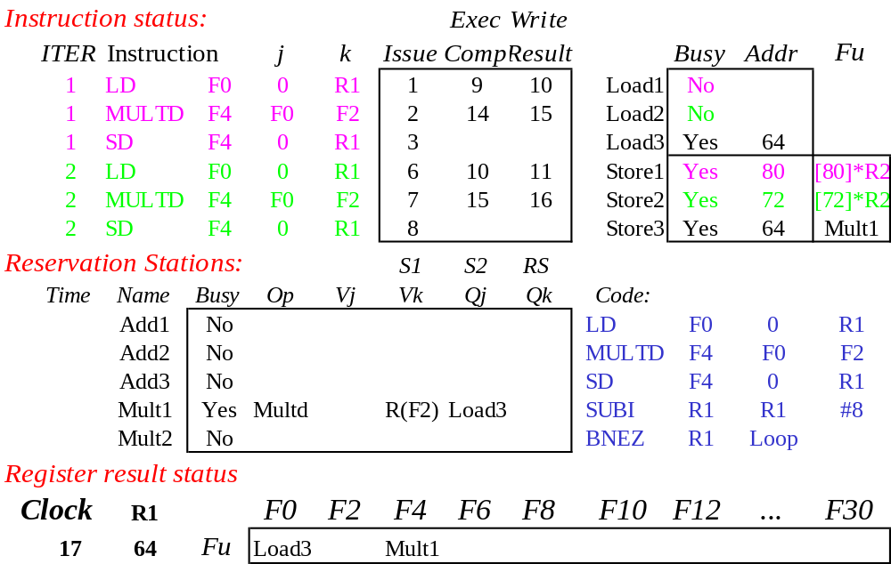
Loop Example Cycle 17

Slide 64

Loop Example Cycle 18

Slide 65
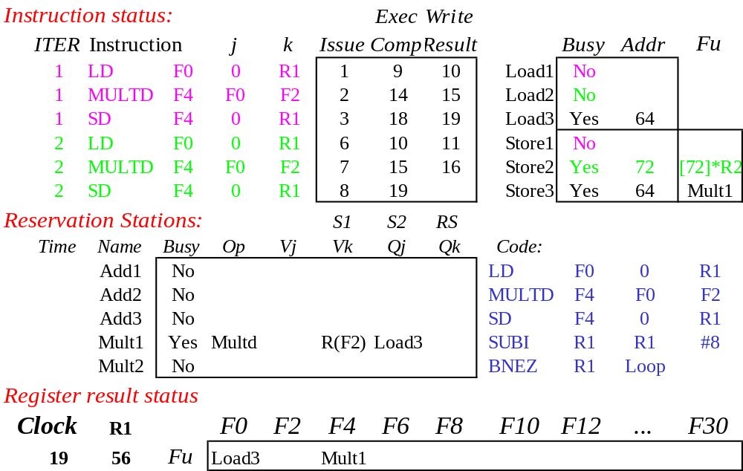
Loop Example Cycle 19

Slide 66
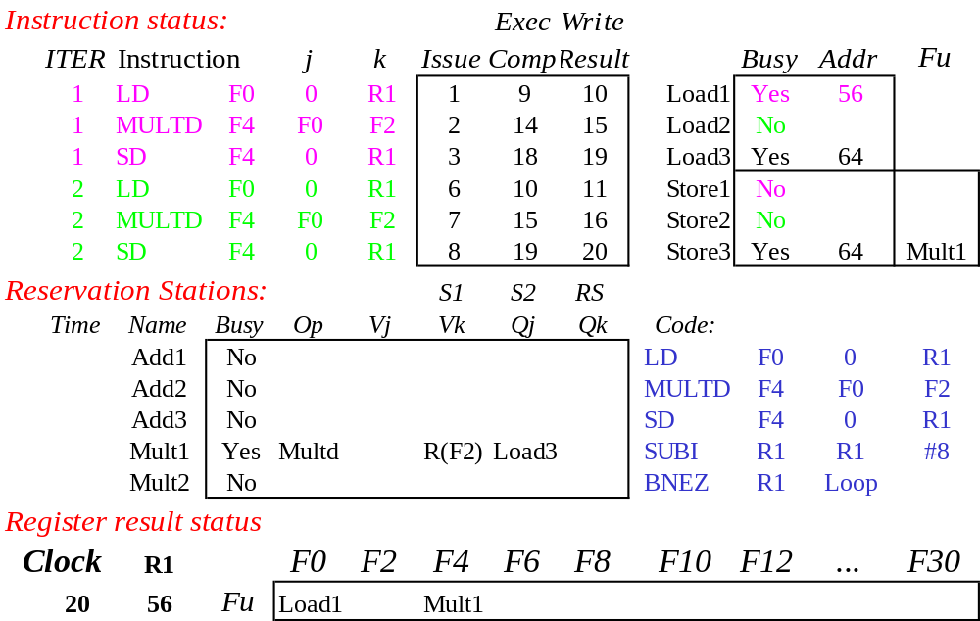
Loop Example Cycle 20
Once again: In-order issue, out-of-order execution and out-of-order completion.

Slide 67
Why can Tomasulo overlap iterations of loops?
Register renaming
  Multiple iterations use different physical destinations for registers (dynamic loop unrolling).
Reservation stations
  Permit instruction issue to advance past integer control flow operations
  Also buffer old values of registers - totally avoiding the WAR stall that we saw in the scoreboard.
Other perspective: Tomasulo building data flow dependency graph on the fly.

Slide 68
Tomasulo’s scheme offers 2 major advantages
the distribution of the hazard detection logic
  distributed reservation stations and the CDB
  If multiple instructions waiting on single result, & each instruction has other operand, then instructions can be released simultaneously by broadcast on CDB
  If a centralized register file were used, the units would have to read their results from the registers when register buses are available.
(2) the elimination of stalls for WAW and WAR hazards

Slide 69
What about Precise Interrupts?
Tomasulo had:
In-order issue, out-of-order execution, and out-of-order completion
Need to “fix” the out-of-order completion aspect so that we can find precise breakpoint in instruction stream.

Slide 70
Relationship between precise interrupts and specultation:
Speculation is a form of guessing.
Important for branch prediction:
  Need to “take our best shot” at predicting branch direction.
If we speculate and are wrong, need to back up and restart execution to point at which we predicted incorrectly:
  This is exactly same as precise exceptions!
Technique for both precise interrupts/exceptions and speculation: in-order completion or commit

Slide 71
HW support for precise interrupts
Need HW buffer for results of uncommitted instructions: reorder buffer
  3 fields: instr, destination, value
  Use reorder buffer number instead of reservation station when execution completes
  Supplies operands between execution complete & commit
  (Reorder buffer can be operand source => more registers like RS)
  Instructions commit
  Once instruction commits,
  result is put into register
  As a result, easy to undo speculated instructions
  on mispredicted branches
  or exceptions
Reorder
Buffer
FP
Op
Queue
FP Regs
Res Stations
Res Stations
FP Adder
FP Adder

Slide 72
Four Steps of Speculative Tomasulo Algorithm
1. Issue—get instruction from FP Op Queue
  If reservation station and reorder buffer slot free, issue instr & send operands & reorder buffer no. for destination (this stage sometimes called “dispatch”)
2. Execution—operate on operands (EX)
  When both operands ready then execute; if not ready, watch CDB for result; when both in reservation station, execute; checks RAW (sometimes called “issue”)
3. Write result—finish execution (WB)
  Write on Common Data Bus to all awaiting FUs
  & reorder buffer; mark reservation station available.
4. Commit—update register with reorder result
  When instr. at head of reorder buffer & result present, update register with result (or store to memory) and remove instr from reorder buffer. Mispredicted branch flushes reorder buffer (sometimes called “graduation”)

Slide 73
What are the hardware complexities with reorder buffer (ROB)?
Compar network
Reorder
Buffer
FP
Op
Queue
Program Counter
Exceptions?
Dest Reg
FP Regs
Result
Valid
Reorder Table
Res Stations
Res Stations
FP Adder
FP Adder
How do you find the latest version of a register?
  (As specified by Smith paper) need associative comparison network
  Could use future file or just use the register result status buffer to track which specific reorder buffer has received the value
Need as many ports on ROB as register file

Slide 74
Summary
Reservations stations: implicit register renaming to larger set of registers + buffering source operands
  Prevents registers as bottleneck
  Avoids WAR, WAW hazards of Scoreboard
  Allows loop unrolling in HW
Not limited to basic blocks
(integer units gets ahead, beyond branches)
Today, helps cache misses as well
  Don’t stall for L1 Data cache miss (insufficient ILP for L2 miss?)
Lasting Contributions
  Dynamic scheduling
  Register renaming
  Load/store disambiguation
360/91 descendants are Pentium III; PowerPC 604; MIPS R10000; HP-PA 8000; Alpha 21264

