Slide 1
CS252
Graduate Computer Architecture
Lecture 17:
ILP and Dynamic Execution #2: Branch Prediction, Multiple Issue
March 23, 2001
Prof. David A. Patterson
Computer Science 252
Spring 2001

Slide 2
Review Tomasulo
Reservations stations: implicit register renaming to larger set of registers + buffering source operands
  Prevents registers as bottleneck
  Avoids WAR, WAW hazards of Scoreboard
  Allows loop unrolling in HW
Not limited to basic blocks
(integer units gets ahead, beyond branches)
Today, helps cache misses as well
  Don’t stall for L1 Data cache miss (insufficient ILP for L2 miss?)
Lasting Contributions
  Dynamic scheduling
  Register renaming
  Load/store disambiguation
360/91 descendants are Pentium III; PowerPC 604; MIPS R10000; HP-PA 8000; Alpha 21264

Slide 3
Tomasulo Algorithm and Branch Prediction
360/91 predicted branches, but did not speculate: pipeline stopped until the branch was resolved
  No speculation; only instructions that can complete
Speculation with Reorder Buffer allows execution past branch, and then discard if branch fails
  just need to hold instructions in buffer until branch can commit

Slide 4
Case for Branch Prediction when
Issue N instructions per clock cycle
Branches will arrive up to n times faster in an n-issue processor
Amdahl’s Law => relative impact of the control stalls will be larger with the lower potential CPI in an n-issue processor

Slide 5
7 Branch Prediction Schemes
1-bit Branch-Prediction Buffer
2-bit Branch-Prediction Buffer
Correlating Branch Prediction Buffer
Tournament Branch Predictor
Branch Target Buffer
Integrated Instruction Fetch Units
Return Address Predictors

Slide 6
Dynamic Branch Prediction
Performance = ƒ(accuracy, cost of misprediction)
Branch History Table: Lower bits of PC address index table of 1-bit values
  Says whether or not branch taken last time
  No address check (saves HW, but may not be right branch)
Problem: in a loop, 1-bit BHT will cause
2 mispredictions (avg is 9 iterations before exit):
  End of loop case, when it exits instead of looping as before
  First time through loop on next time through code, when it predicts exit instead of looping
  Only 80% accuracy even if loop 90% of the time

Slide 7
Dynamic Branch Prediction
(Jim Smith, 1981)
Solution: 2-bit scheme where change prediction only if get misprediction twice: (Figure 3.7, p. 249)
Red: stop, not taken
Green: go, taken
Adds hysteresis to decision making process
T
NT
Predict Taken
Predict Taken
T
T
NT
NT
Predict Not
Taken
Predict Not
Taken
T
NT

Slide 8
Correlating Branches
Idea: taken/not taken of recently executed branches is related to behavior of next branch (as well as the history of that branch behavior)
  Then behavior of recent branches selects between, say, 4 predictions of next branch, updating just that prediction
(2,2) predictor: 2-bit global, 2-bit local
  Branch address (4 bits)
2-bits per branch
local predictors
Prediction
2-bit global
branch history
(01 = not taken then taken)

Slide 9
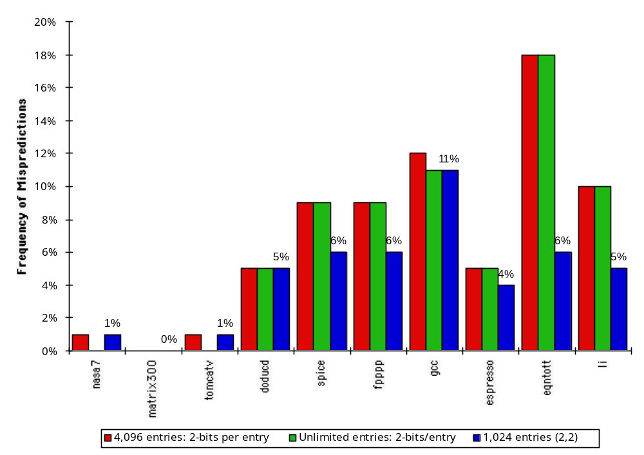
Accuracy of Different Schemes
(Figure 3.15, p. 257)
18%
4096 Entries 2-bit BHT
Unlimited Entries 2-bit BHT
1024 Entries (2,2) BHT
Frequency of Mispredictions
0%

Slide 10
Re-evaluating Correlation
Several of the SPEC benchmarks have less than a dozen branches responsible for 90% of taken branches:
  program branch % static # = 90%
  compress 14% 236 13
  eqntott 25% 494 5
  gcc 15% 9531 2020
  mpeg 10% 5598 532
  real gcc 13% 17361 3214
Real programs + OS more like gcc
Small benefits beyond benchmarks for correlation? problems with branch aliases?

Slide 11
Predicated Execution
Avoid branch prediction by turning branches into conditionally executed instructions:
if (x) then A = B op C else NOP
  If false, then neither store result nor cause exception
  Expanded ISA of Alpha, MIPS, PowerPC, SPARC have conditional move; PA-RISC can annul any following instr.
  IA-64: 64 1-bit condition fields selected
  so conditional execution of any instruction
  This transformation is called “if-conversion”
Drawbacks to conditional instructions
  Still takes a clock even if “annulled”
  Stall if condition evaluated late
  Complex conditions reduce effectiveness;
  condition becomes known late in pipeline
x
A =
B op C

Slide 12
BHT Accuracy
Mispredict because either:
  Wrong guess for that branch
  Got branch history of wrong branch when index the table
4096 entry table programs vary from 1% misprediction (nasa7, tomcatv) to 18% (eqntott), with spice at 9% and gcc at 12%
For SPEC92,
4096 about as good as infinite table

Slide 13
Administratrivia
Project meetings on Wednesday
  Lots of interesting projects
  A few a little behind, need to catchup soon and meet again
Spring Break next week
When return, 3rd (last) Homework on Ch 3

Slide 14
Tournament Predictors
Motivation for correlating branch predictors is 2-bit predictor failed on important branches; by adding global information, performance improved
Tournament predictors: use 2 predictors, 1 based on global information and 1 based on local information, and combine with a selector
Hopes to select right predictor for right branch

Slide 15
Tournament Predictor in Alpha 21264
4K 2-bit counters to choose from among a global predictor and a local predictor
Global predictor also has 4K entries and is indexed by the history of the last 12 branches; each entry in the global predictor is a standard 2-bit predictor
  12-bit pattern: ith bit 0 => ith prior branch not taken;
  ith bit 1 => ith prior branch taken;
Local predictor consists of a 2-level predictor:
  Top level a local history table consisting of 1024 10-bit entries; each 10-bit entry corresponds to the most recent 10 branch outcomes for the entry. 10-bit history allows patterns 10 branches to be discovered and predicted.
  Next level Selected entry from the local history table is used to index a table of 1K entries consisting a 3-bit saturating counters, which provide the local prediction
Total size: 4K*2 + 4K*2 + 1K*10 + 1K*3 = 29K bits!
(~180,000 transistors)

Slide 16
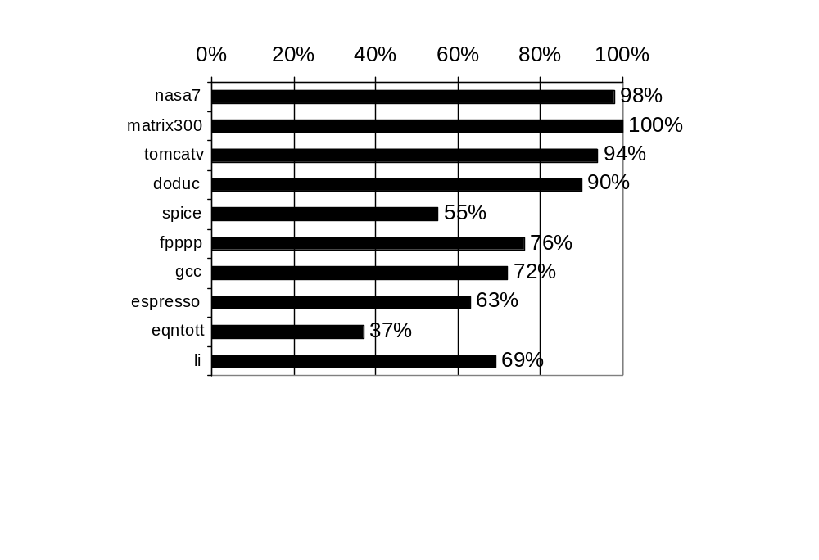
% of predictions from local predictor in Tournament Prediction Scheme

Slide 17
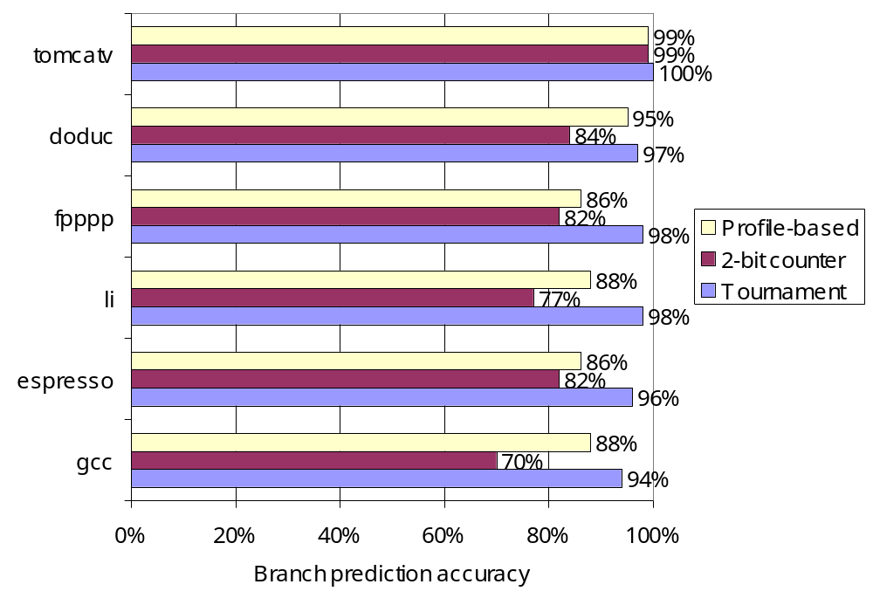
Accuracy of Branch Prediction
Profile: branch profile from last execution
(static in that in encoded in instruction, but profile)

Slide 18
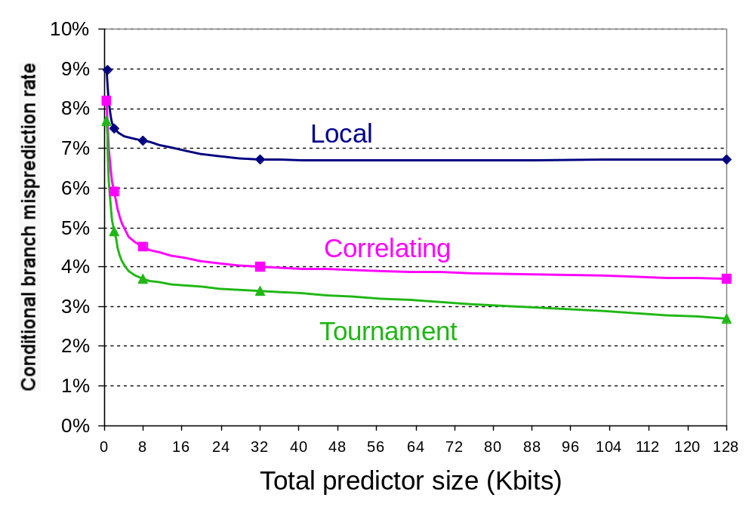
Accuracy v. Size (SPEC89)

Slide 19
Need Address at Same Time as Prediction
Branch Target Buffer (BTB): Address of branch index to get prediction AND branch address (if taken)
  Note: must check for branch match now, since can’t use wrong branch address (Figure 3.19, p. 262)
Branch PC
Predicted PC
PC of instruction
FETCH
=?
Extra
prediction state
bits
Yes: instruction is branch and use predicted PC as next PC
No: branch not
predicted, proceed normally
(Next PC = PC+4)

Slide 20
Special Case Return Addresses
Register Indirect branch hard to predict address
SPEC89 85% such branches for procedure return
Since stack discipline for procedures, save return address in small buffer that acts like a stack: 8 to 16 entries has small miss rate

Slide 21
Pitfall: Sometimes bigger and dumber is better
21264 uses tournament predictor (29 Kbits)
Earlier 21164 uses a simple 2-bit predictor with 2K entries (or a total of 4 Kbits)
SPEC95 benchmarks, 21264 outperforms
  21264 avg. 11.5 mispredictions per 1000 instructions
  21164 avg. 16.5 mispredictions per 1000 instructions
Reversed for transaction processing (TP) !
  21264 avg. 17 mispredictions per 1000 instructions
  21164 avg. 15 mispredictions per 1000 instructions
TP code much larger & 21164 hold 2X branch predictions based on local behavior (2K vs. 1K local predictor in the 21264)

Slide 22
Dynamic Branch Prediction Summary
Prediction becoming important part of scalar execution
Branch History Table: 2 bits for loop accuracy
Correlation: Recently executed branches correlated with next branch.
  Either different branches
  Or different executions of same branches
Tournament Predictor: more resources to competitive solutions and pick between them
Branch Target Buffer: include branch address & prediction
Predicated Execution can reduce number of branches, number of mispredicted branches
Return address stack for prediction of indirect jump

Slide 23
Getting CPI < 1:
Issuing Multiple Instructions/Cycle
Vector Processing: Explicit coding of independent loops as operations on large vectors of numbers
  Multimedia instructions being added to many processors
Superscalar: varying no. instructions/cycle (1 to 8), scheduled by compiler or by HW (Tomasulo)
  IBM PowerPC, Sun UltraSparc, DEC Alpha, Pentium III/4
(Very) Long Instruction Words (V)LIW:
fixed number of instructions (4-16) scheduled by the compiler; put ops into wide templates (TBD)
  Intel Architecture-64 (IA-64) 64-bit address
    Renamed: “Explicitly Parallel Instruction Computer (EPIC)”
  Will discuss in 2 lectures
Anticipated success of multiple instructions lead to
Instructions Per Clock cycle (IPC) vs. CPI

Slide 24
Getting CPI < 1: Issuing
Multiple Instructions/Cycle
Superscalar MIPS: 2 instructions, 1 FP & 1 anything
  – Fetch 64-bits/clock cycle; Int on left, FP on right
  – Can only issue 2nd instruction if 1st instruction issues
  – More ports for FP registers to do FP load & FP op in a pair
Type Pipe Stages
Int. instruction IF ID EX MEM WB
FP instruction IF ID EX MEM WB
Int. instruction IF ID EX MEM WB
FP instruction IF ID EX MEM WB
Int. instruction IF ID EX MEM WB
FP instruction IF ID EX MEM WB
1 cycle load delay expands to 3 instructions in SS
  instruction in right half can’t use it, nor instructions in next slot

Slide 25
Multiple Issue Issues
issue packet: group of instructions from fetch unit that could potentially issue in 1 clock
  If instruction causes structural hazard or a data hazard either due to earlier instruction in execution or to earlier instruction in issue packet, then instruction does not issue
  0 to N instruction issues per clock cycle, for N-issue
Performing issue checks in 1 cycle could limit clock cycle time: O(n²-n) comparisons
  => issue stage usually split and pipelined
  1st stage decides how many instructions from within this packet can issue, 2nd stage examines hazards among selected instructions and those already been issued
  => higher branch penalties => prediction accuracy important

Slide 26
Multiple Issue Challenges
While Integer/FP split is simple for the HW, get CPI of 0.5 only for programs with:
  Exactly 50% FP operations AND No hazards
If more instructions issue at same time, greater difficulty of decode and issue:
  Even 2-scalar => examine 2 opcodes, 6 register specifiers, & decide if 1 or 2 instructions can issue; (N-issue ~O(N²-N) comparisons)
  Register file: need 2x reads and 1x writes/cycle
  Rename logic: must be able to rename same register multiple times in one cycle! For instance, consider 4-way issue:
  add r1, r2, r3 add p11, p4, p7
  sub r4, r1, r2 ⇒ sub p22, p11, p4
  lw r1, 4(r4) lw p23, 4(p22)
  add r5, r1, r2 add p12, p23, p4
  Imagine doing this transformation in a single cycle!
  Result buses: Need to complete multiple instructions/cycle
    So, need multiple buses with associated matching logic at every reservation station.
    Or, need multiple forwarding paths

Slide 27
Dynamic Scheduling in Superscalar
The easy way
How to issue two instructions and keep in-order instruction issue for Tomasulo?
  Assume 1 integer + 1 floating point
  1 Tomasulo control for integer, 1 for floating point
Issue 2X Clock Rate, so that issue remains in order
Only loads/stores might cause dependency between integer and FP issue:
  Replace load reservation station with a load queue;
  operands must be read in the order they are fetched
  Load checks addresses in Store Queue to avoid RAW violation
  Store checks addresses in Load Queue to avoid WAR,WAW

Slide 28
Register renaming, virtual registers versus Reorder Buffers
Alternative to Reorder Buffer is a larger virtual set of registers and register renaming
Virtual registers hold both architecturally visible registers + temporary values
  replace functions of reorder buffer and reservation station
Renaming process maps names of architectural registers to registers in virtual register set
  Changing subset of virtual registers contains architecturally visible registers
Simplifies instruction commit: mark register as no longer speculative, free register with old value
Adds 40-80 extra registers: Alpha, Pentium,…
  Size limits no. instructions in execution (used until commit)

Slide 29
How much to speculate?
Speculation Pro: uncover events that would otherwise stall the pipeline (cache misses)
Speculation Con: speculate costly if exceptional event occurs when speculation was incorrect
Typical solution: speculation allows only low-cost exceptional events (1st-level cache miss)
When expensive exceptional event occurs, (2nd-level cache miss or TLB miss) processor waits until the instruction causing event is no longer speculative before handling the event
Assuming single branch per cycle: future may speculate across multiple branches!

Slide 30
Limits to ILP
Conflicting studies of amount
  Benchmarks (vectorized Fortran FP vs. integer C programs)
  Hardware sophistication
  Compiler sophistication
How much ILP is available using existing mechanisms with increasing HW budgets?
Do we need to invent new HW/SW mechanisms to keep on processor performance curve?
  Intel MMX, SSE (Streaming SIMD Extensions): 64 bit ints
  Intel SSE2: 128 bit, including 2 64-bit Fl. Pt. per clock
  Motorola AltaVec: 128 bit ints and FPs
  Supersparc Multimedia ops, etc.

Slide 31
Limits to ILP
Initial HW Model here; MIPS compilers.
Assumptions for ideal/perfect machine to start:
1. Register renaming – infinite virtual registers
=> all register WAW & WAR hazards are avoided
2. Branch prediction – perfect; no mispredictions
3. Jump prediction – all jumps perfectly predicted
2 & 3 => machine with perfect speculation & an unbounded buffer of instructions available
4. Memory-address alias analysis – addresses are known & a store can be moved before a load provided addresses not equal
Also:
unlimited number of instructions issued/clock cycle; perfect caches;
1 cycle latency for all instructions (FP *,/);

Slide 32
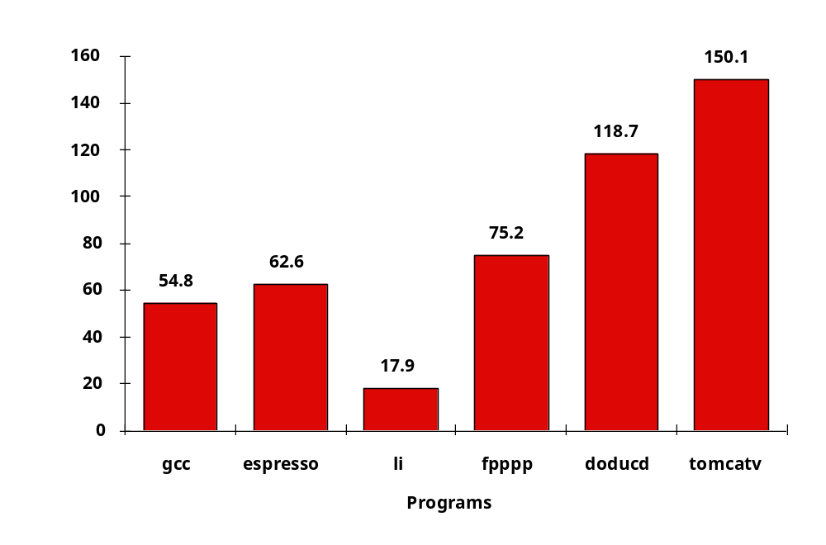
Upper Limit to ILP: Ideal Machine
(Figure 3.34, page 294)
FP: 75 - 150
Integer: 18 - 60
IPC

Slide 33
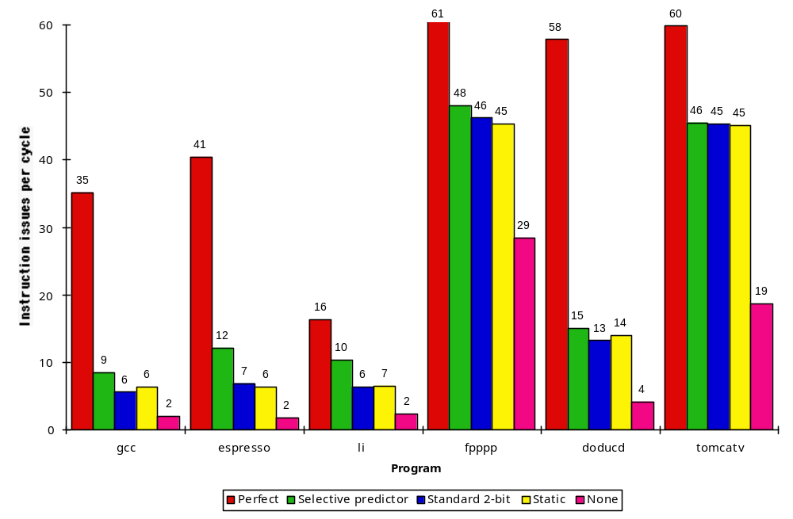
More Realistic HW: Branch Impact
Figure 3.38, Page 300
Change from Infinite window to examine to 2000 and maximum issue of 64 instructions per clock cycle
FP: 15 - 45
Integer: 6 - 12
IPC
Perfect
Tournament
BHT (512)
Profile
No prediction

Slide 34
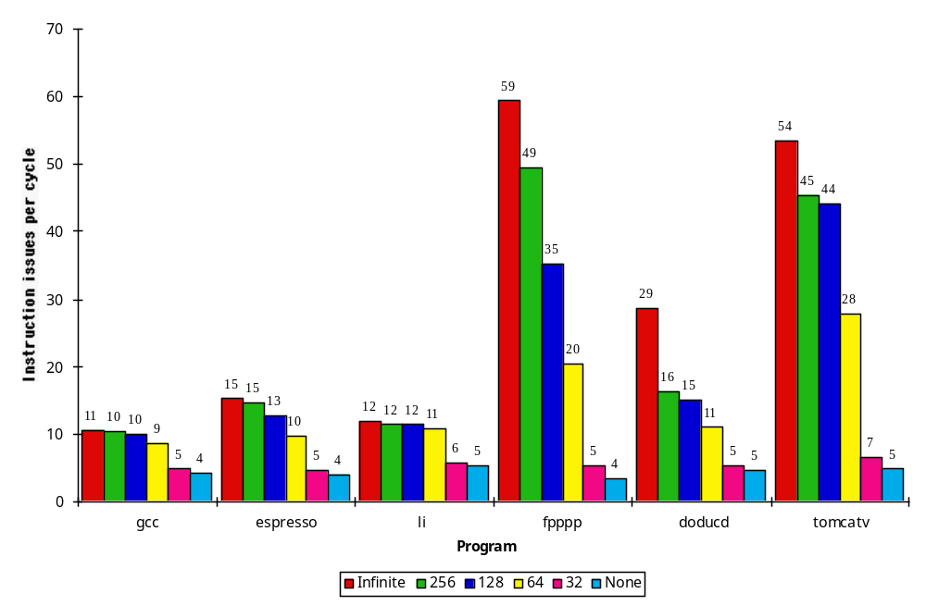
More Realistic HW:
Renaming Register Impact
Figure 3.41, Page 304
FP: 11 - 45
Change 2000 instr window, 64 instr issue, 8K 2 level Prediction
Integer: 5 - 15
IPC
Infinite
256
128
64
32
None

Slide 35
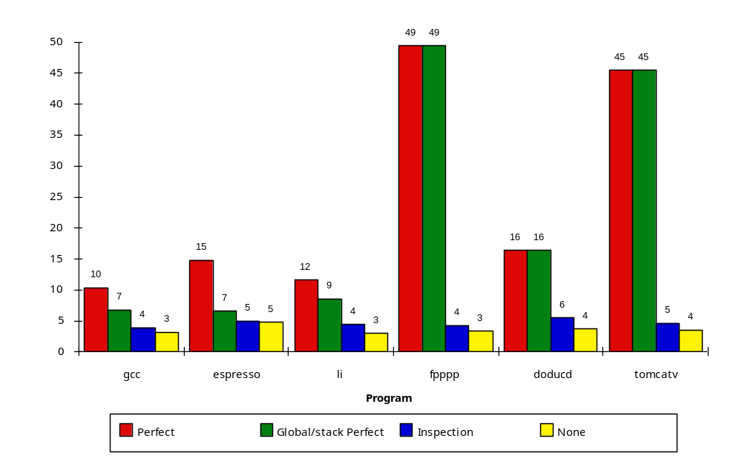
More Realistic HW:
Memory Address Alias Impact
Figure 3.43, Page 306
Change 2000 instr window, 64 instr issue, 8K 2 level Prediction, 256 renaming registers
FP: 4 - 45
(Fortran,
no heap)
Integer: 4 - 9
IPC
Perfect
Global/Stack perf;
heap conflicts
Inspec.
Assem.
None

Slide 36
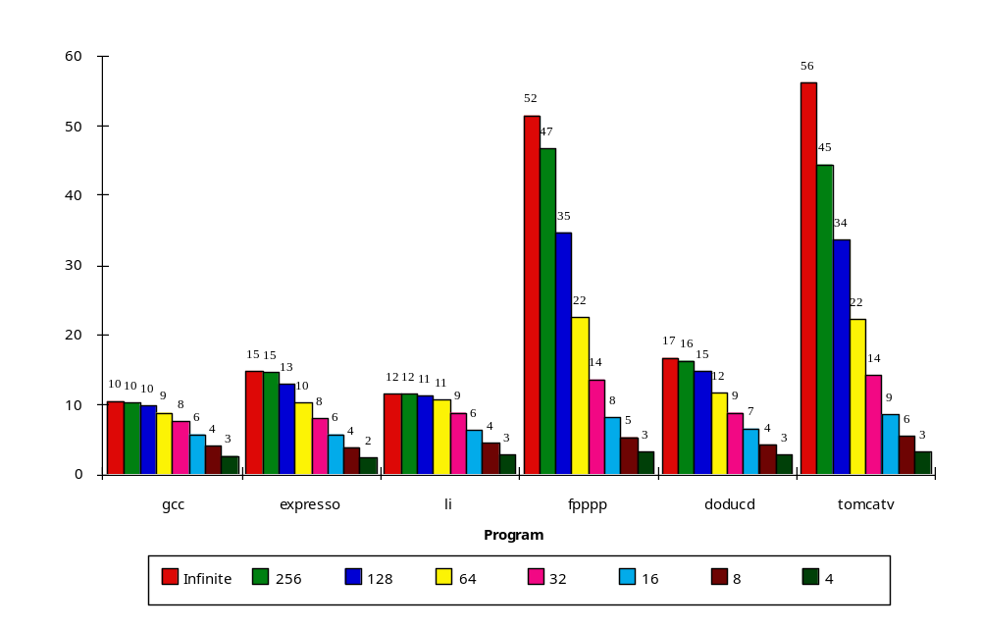
Realistic HW for ‘00: Window Impact
(Figure 3.45, Page 309)
Perfect disambiguation (HW), 1K Selective Prediction, 16 entry return, 64 registers, issue as many as window
FP: 8 - 45
IPC
Integer: 6 - 12
Infinite
256
128
64
32
16
8
4

Slide 37
How to Exceed ILP Limits of this study?
WAR and WAW hazards through memory: eliminated WAW and WAR hazards through register renaming, but not in memory usage
Unnecessary dependences (compiler not unrolling loops so iteration variable dependence)
Overcoming the data flow limit: value prediction, predicting values and speculating on prediction
  Address value prediction and speculation predicts addresses and speculates by reordering loads and stores; could provide better aliasing analysis, only need predict if addresses =

Slide 38
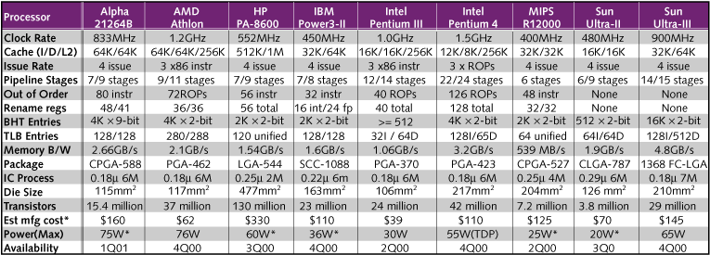
Workstation Microprocessors 3/2001
Max issue: 4 instructions (many CPUs)
Max rename registers: 128 (Pentium 4)
Max BHT: 4K x 9 (Alpha 21264B), 16Kx2 (Ultra III)
Max Window Size (OOO): 126 intructions (Pent. 4)
Max Pipeline: 22/24 stages (Pentium 4)
Source: Microprocessor Report, www.MPRonline.com

Slide 39
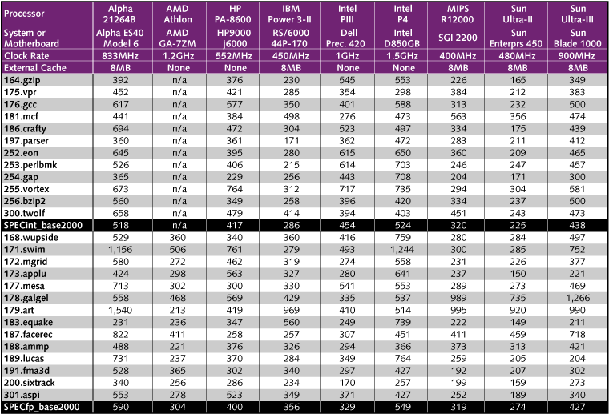
SPEC 2000 Performance 3/2001 Source: Microprocessor Report, www.MPRonline.com
1.5X
3.8X
1.2X
1.6X
1.7X

Slide 40
If time permits: "A Language for Describing Predictors and its Application to Automatic Synthesis”, by Emer and Gloy
What was dynamic branch mechanisms they looked at?
How did they explore space?
Did they improve upon current practice?
How was did they choose between options?

Slide 41
Conclusion
1985-2000: 1000X performance
  Moore’s Law transistors/chip => Moore’s Law for Performance/MPU
Hennessy: industry been following a roadmap of ideas known in 1985 to exploit Instruction Level Parallelism and (real) Moore’s Law to get 1.55X/year
  Caches, Pipelining, Superscalar, Branch Prediction, Out-of-order execution, …
ILP limits: To make performance progress in future need to have explicit parallelism from programmer vs. implicit parallelism of ILP exploited by compiler, HW?
  Otherwise drop to old rate of 1.3X per year?
  Less than 1.3X because of processor-memory performance gap?
Impact on you: if you care about performance,
better think about explicitly parallel algorithms
vs. rely on ILP?

