Slide 1
CS252
Graduate Computer Architecture
Lecture 19:
Intro to Static Pipelining
April 6, 2001
Prof. David A. Patterson
Computer Science 252
Spring 2001

Slide 2
Review: Dynamic Examples
P6 (Pentium Pro, II, III) successful micro-architecture, even with imitator (AMD Athlon)
  Translate most 80x86 instructions to micro-operations
    Longer pipeline than RISC instructions
  Dynamically execute micro-operations
“Netburst” (Pentium 4, …) success not clear
  Much longer pipeline, higher clock rate in same technology as P6
  Trace Cache to capture micro-operations, avoid hardware translation
Multithreading to increase performance for servers, parallel programs written to use threads
  Extra copies of PCs, Registers per thread; e.g., IBM AS/400
Simultaneous Multithreading (SMT) exploit underutilized Dynamic Execution HW to get higher throughput at low extra cost?

Slide 3
Overview
Last 3 lectures: binary compatibility and exploiting ILP in hardware: BTB, ROB, Reservation Stations, ...
How far can you go in compiler?
What if you can also change instruction set architecture?
Will see multi billion dollar gamble by two Bay Area firms for the future of computer architecture: HP and Intel to produce IA-64
  7 years in the making?

Slide 4
Static Branch Prediction
Simplest: Predict taken
  average misprediction rate = untaken branch frequency, which for the SPEC programs is 34%.
  Unfortunately, the misprediction rate ranges from not very accurate (59%) to highly accurate (9%)
Predict on the basis of branch direction?
  choosing backward-going branches to be taken (loop)
  forward-going branches to be not taken (if)
  SPEC programs, however, most forward-going branches are taken => predict taken is better
Predict branches on the basis of profile information collected from earlier runs
  Misprediction varies from 5% to 22%

Slide 5
Running Example
This code, a scalar to a vector:
for (i=1000; i>0; i=i–1)
x[i] = x[i] + s;
Assume following latency all examples
Instruction Instruction Execution Latency
producing result using result in cycles in cycles
FP ALU op Another FP ALU op 4 3
FP ALU op Store double 3 2
Load double FP ALU op 1 1
Load double Store double 1 0
Integer op Integer op 1 0

Slide 6
FP Loop: Where are the Hazards?
First translate into MIPS code:
  -To simplify, assume 8 is lowest address
Loop: L.D F0,0(R1) ;F0=vector element
ADD.D F4,F0,F2 ;add scalar from F2
S.D 0(R1),F4 ;store result
DSUBUI R1,R1,8 ;decrement pointer 8B (DW)
BNEZ R1,Loop ;branch R1!=zero
NOP ;delayed branch slot
Where are the stalls?

Slide 7
FP Loop Showing Stalls
1 Loop: L.D F0,0(R1) ;F0=vector element
2 stall
3 ADD.D F4,F0,F2 ;add scalar in F2
4 stall
5 stall
6 S.D 0(R1),F4 ;store result
7 DSUBUI R1,R1,8 ;decrement pointer 8B (DW)
8 BNEZ R1,Loop ;branch R1!=zero
9 stall ;delayed branch slot
Instruction Instruction Latency in
producing result using result clock cycles
FP ALU op Another FP ALU op 3
FP ALU op Store double 2
Load double FP ALU op 1
9 clocks: Rewrite code to minimize stalls?

Slide 8
Revised FP Loop Minimizing Stalls
1 Loop: L.D F0,0(R1)
2 stall
3 ADD.D F4,F0,F2
4 DSUBUI R1,R1,8
5 BNEZ R1,Loop ;delayed branch
6 S.D 8(R1),F4 ;altered when move past DSUBUI
Swap BNEZ and S.D by changing address of S.D
Instruction Instruction Latency in
producing result using result clock cycles
FP ALU op Another FP ALU op 3
FP ALU op Store double 2
Load double FP ALU op 1
6 clocks, but just 3 for execution, 3 for loop overhead; How make faster?
Notes:
3 clocks doing work, 3 overhead (stall, branch, sub)

Slide 9
Unroll Loop Four Times (straightforward way)
1 cycle stall
1 Loop: L.D F0,0(R1)
2 ADD.D F4,F0,F2
3 S.D 0(R1),F4 ;drop DSUBUI & BNEZ
4 L.D F6,-8(R1)
5 ADD.D F8,F6,F2
6 S.D -8(R1),F8 ;drop DSUBUI & BNEZ
7 L.D F10,-16(R1)
8 ADD.D F12,F10,F2
9 S.D -16(R1),F12 ;drop DSUBUI & BNEZ
10 L.D F14,-24(R1)
11 ADD.D F16,F14,F2
12 S.D -24(R1),F16
13 DSUBUI R1,R1,#32 ;alter to 4*8
14 BNEZ R1,LOOP
15 NOP
15 + 4 x (1+2) = 27 clock cycles, or 6.8 per iteration
Assumes R1 is multiple of 4
Rewrite loop to minimize stalls?
2 cycles stall

Slide 10
Unrolled Loop Detail
Do not usually know upper bound of loop
Suppose it is n, and we would like to unroll the loop to make k copies of the body
Instead of a single unrolled loop, we generate a pair of consecutive loops:
  1st executes (n mod k) times and has a body that is the original loop
  2nd is the unrolled body surrounded by an outer loop that iterates (n/k) times
  For large values of n, most of the execution time will be spent in the unrolled loop

Slide 11
Unrolled Loop That Minimizes Stalls
1 Loop: L.D F0,0(R1)
2 L.D F6,-8(R1)
3 L.D F10,-16(R1)
4 L.D F14,-24(R1)
5 ADD.D F4,F0,F2
6 ADD.D F8,F6,F2
7 ADD.D F12,F10,F2
8 ADD.D F16,F14,F2
9 S.D 0(R1),F4
10 S.D -8(R1),F8
11 S.D -16(R1),F12
12 DSUBUI R1,R1,#32
13 BNEZ R1,LOOP
14 S.D 8(R1),F16 ; 8-32 = -24
14 clock cycles, or 3.5 per iteration
What assumptions made when moved code?
  OK to move store past DSUBUI even though changes register
  OK to move loads before stores: get right data?
  When is it safe for compiler to do such changes?

Slide 12
Compiler Perspectives on Code Movement
Compiler concerned about dependencies in program
Whether or not a HW hazard depends on pipeline
Try to schedule to avoid hazards that cause performance losses
(True) Data dependencies (RAW if a hazard for HW)
  Instruction i produces a result used by instruction j, or
  Instruction j is data dependent on instruction k, and instruction k is data dependent on instruction i.
If dependent, can’t execute in parallel
Easy to determine for registers (fixed names)
Hard for memory (“memory disambiguation” problem):
  Does 100(R4) = 20(R6)?
  From different loop iterations, does 20(R6) = 20(R6)?

Slide 13
Where are the name dependencies?
1 Loop: L.D F0,0(R1)
2 ADD.D F4,F0,F2
3 S.D 0(R1),F4 ;drop DSUBUI & BNEZ
4 L.D F0,-8(R1)
5 ADD.D F4,F0,F2
6 S.D -8(R1),F4 ;drop DSUBUI & BNEZ
7 L.D F0,-16(R1)
8 ADD.D F4,F0,F2
9 S.D -16(R1),F4 ;drop DSUBUI & BNEZ
10 L.D F0,-24(R1)
11 ADD.D F4,F0,F2
12 S.D -24(R1),F4
13 DSUBUI R1,R1,#32 ;alter to 4*8
14 BNEZ R1,LOOP
15 NOP
How can remove them?
Notes:
L.D F0 to output to next L.D F0
ADD F0 input to L.D F0

Slide 14
Where are the name dependencies?
1 Loop: L.D F0,0(R1)
2 ADD.D F4,F0,F2
3 S.D 0(R1),F4 ;drop DSUBUI & BNEZ
4 L.D F6,-8(R1)
5 ADD.D F8,F6,F2
6 S.D -8(R1),F8 ;drop DSUBUI & BNEZ
7 L.D F10,-16(R1)
8 ADD.D F12,F10,F2
9 S.D -16(R1),F12 ;drop DSUBUI & BNEZ
10 L.D F14,-24(R1)
11 ADD.D F16,F14,F2
12 S.D -24(R1),F16
13 DSUBUI R1,R1,#32 ;alter to 4*8
14 BNEZ R1,LOOP
15 NOP
The Orginal“register renaming”

Slide 15
Compiler Perspectives on Code Movement
Name Dependencies are Hard to discover for Memory Accesses
  Does 100(R4) = 20(R6)?
  From different loop iterations, does 20(R6) = 20(R6)?
Our example required compiler to know that if R1 doesn’t change then:
0(R1) ≠ -8(R1) ≠ -16(R1) ≠ -24(R1)
There were no dependencies between some loads and stores so they could be moved by each other

Slide 16
Steps Compiler Performed to Unroll
Check OK to move the S.D after DSUBUI and BNEZ, and find amount to adjust S.D offset
Determine unrolling the loop would be useful by finding that the loop iterations were independent
Rename registers to avoid name dependencies
Eliminate extra test and branch instructions and adjust the loop termination and iteration code
Determine loads and stores in unrolled loop can be interchanged by observing that the loads and stores from different iterations are independent
  requires analyzing memory addresses and finding that they do not refer to the same address.
Schedule the code, preserving any dependences needed to yield same result as the original code

Slide 17
Administratrivia
3rd (last) Homework on Ch 3 due Saturday
3rd project meetings 4/11: signup today
Project Summary due Monday night
Quiz #2 4/18 310 Soda at 5:30

Slide 18
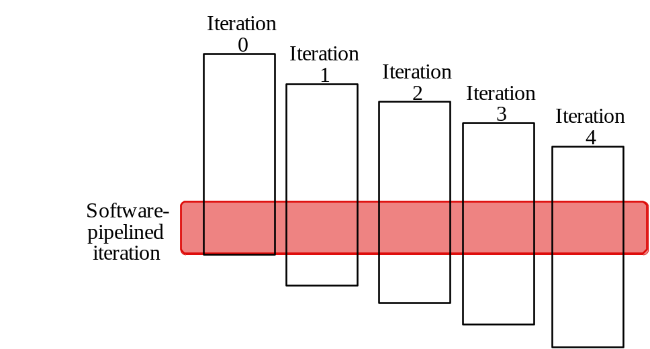
Another possibility:
Software Pipelining
Observation: if iterations from loops are independent, then can get more ILP by taking instructions from different iterations
Software pipelining: reorganizes loops so that each iteration is made from instructions chosen from different iterations of the original loop (~ Tomasulo in SW)

Slide 19
Software Pipelining Example
Before: Unrolled 3 times
1 L.D F0,0(R1)
2 ADD.D F4,F0,F2
3 S.D 0(R1),F4
4 L.D F6,-8(R1)
5 ADD.D F8,F6,F2
6 S.D -8(R1),F8
7 L.D F10,-16(R1)
8 ADD.D F12,F10,F2
9 S.D -16(R1),F12
10 DSUBUI R1,R1,#24
11 BNEZ R1,LOOP
After: Software Pipelined
1 S.D 0(R1),F4 ; Stores M[i]
2 ADD.D F4,F0,F2 ; Adds to M[i-1]
3 L.D F0,-16(R1); Loads M[i-2]
4 DSUBUI R1,R1,#8
5 BNEZ R1,LOOP
SW Pipeline
overlapped ops
Time
Loop Unrolled
Symbolic Loop Unrolling
Maximize result-use distance
Less code space than unrolling
Fill & drain pipe only once per loop
vs. once per each unrolled iteration in loop unrolling
Time
5 cycles per iteration

Slide 20
When Safe to Unroll Loop?
Example: Where are data dependencies?
(A,B,C distinct & nonoverlapping)
for (i=0; i<100; i=i+1) {
A[i+1] = A[i] + C[i]; /* S1 */
B[i+1] = B[i] + A[i+1]; /* S2 */
}
1. S2 uses the value, A[i+1], computed by S1 in the same iteration.
2. S1 uses a value computed by S1 in an earlier iteration, since iteration i computes A[i+1] which is read in iteration i+1. The same is true of S2 for B[i] and B[i+1].
This is a “loop-carried dependence”: between iterations
For our prior example, each iteration was distinct
Implies that iterations can’t be executed in parallel, Right????

Slide 21
Does a loop-carried dependence mean there is no parallelism???
Consider:
for (i=0; i< 8; i=i+1) {
A = A + C[i]; /* S1 */
}
Could compute:
“Cycle 1”: temp0 = C[0] + C[1];
temp1 = C[2] + C[3];
temp2 = C[4] + C[5];
temp3 = C[6] + C[7];
“Cycle 2”: temp4 = temp0 + temp1;
temp5 = temp2 + temp3;
“Cycle 3”: A = temp4 + temp5;
Relies on associative nature of “+”.
See “Parallelizing Complex Scans and Reductions” by Allan Fisher and Anwar Ghuloum (handed out next week)

Slide 22
Hardware Support for Exposing
More Parallelism at Compile-Time
Conditional or Predicated Instructions
  Discussed before in context of branch prediction
  Conditional instruction execution
First instruction slot Second instruction slot
  LW R1,40(R2) ADD R3,R4,R5
  ADD R6,R3,R7
  BEQZ R10,L
  LW R8,0(R10)
  LW R9,0(R8)
Waste slot since 3rd LW dependent on result of 2nd LW

Slide 23
Hardware Support for Exposing
More Parallelism at Compile-Time
Use predicated version load word (LWC)?
  load occurs unless the third operand is 0
First instruction slot Second instruction slot
  LW R1,40(R2) ADD R3,R4,R5
  LWC R8,20(R10),R10 ADD R6,R3,R7
  BEQZ R10,L
  LW R9,0(R8)
If the sequence following the branch were short, the entire block of code might be converted to predicated execution, and the branch eliminated

Slide 24
Exception Behavior Support
Several mechanisms to ensure that speculation by compiler does not violate exception behavior
  For example, cannot raise exceptions in predicated code if annulled
  Prefetch does not cause exceptions

Slide 25
Hardware Support for Memory Reference Speculation
To compiler to move loads across stores, when it cannot be absolutely certain that such a movement is correct, a special instruction to check for address conflicts can be included in the architecture
  The special instruction is left at the original location of the load and the load is moved up across stores
  When a speculated load is executed, the hardware saves the address of the accessed memory location
  If a subsequent store changes the location before the check instruction, then the speculation has failed
  If only load instruction was speculated, then it suffices to redo the load at the point of the check instruction

Slide 26
What if Can Chance Instruction Set?
Superscalar processors decide on the fly how many instructions to issue
  HW complexity of Number of instructions to issue O(n²)
Why not allow compiler to schedule instruction level parallelism explicitly?
Format the instructions in a potential issue packet so that HW need not check explicitly for dependences

Slide 27
VLIW: Very Large Instruction Word
Each “instruction” has explicit coding for multiple operations
  In IA-64, grouping called a “packet”
  In Transmeta, grouping called a “molecule” (with “atoms” as ops)
Tradeoff instruction space for simple decoding
  The long instruction word has room for many operations
  By definition, all the operations the compiler puts in the long instruction word are independent => execute in parallel
  E.g., 2 integer operations, 2 FP ops, 2 Memory refs, 1 branch
    16 to 24 bits per field => 7*16 or 112 bits to 7*24 or 168 bits wide
  Need compiling technique that schedules across several branches

Slide 28
Recall: Unrolled Loop that Minimizes Stalls for Scalar
1 Loop: L.D F0,0(R1)
2 L.D F6,-8(R1)
3 L.D F10,-16(R1)
4 L.D F14,-24(R1)
5 ADD.D F4,F0,F2
6 ADD.D F8,F6,F2
7 ADD.D F12,F10,F2
8 ADD.D F16,F14,F2
9 S.D 0(R1),F4
10 S.D -8(R1),F8
11 S.D -16(R1),F12
12 DSUBUI R1,R1,#32
13 BNEZ R1,LOOP
14 S.D 8(R1),F16 ; 8-32 = -24
14 clock cycles, or 3.5 per iteration
L.D to ADD.D: 1 Cycle
ADD.D to S.D: 2 Cycles

Slide 29
Loop Unrolling in VLIW
Memory Memory FP FP Int. op/ Clock
reference 1 reference 2 operation 1 op. 2 branch
L.D F0,0(R1) L.D F6,-8(R1) 1
L.D F10,-16(R1) L.D F14,-24(R1) 2
L.D F18,-32(R1) L.D F22,-40(R1) ADD.D F4,F0,F2 ADD.D F8,F6,F2 3
L.D F26,-48(R1) ADD.D F12,F10,F2 ADD.D F16,F14,F2 4
ADD.D F20,F18,F2 ADD.D F24,F22,F2 5
S.D 0(R1),F4 S.D -8(R1),F8 ADD.D F28,F26,F2 6
S.D -16(R1),F12 S.D -24(R1),F16 7
S.D -32(R1),F20 S.D -40(R1),F24 DSUBUI R1,R1,#48 8
S.D -0(R1),F28 BNEZ R1,LOOP 9
Unrolled 7 times to avoid delays
7 results in 9 clocks, or 1.3 clocks per iteration (1.8X)
Average: 2.5 ops per clock, 50% efficiency
Note: Need more registers in VLIW (15 vs. 6 in SS)

Slide 30
Recall: Software Pipelining
Observation: if iterations from loops are independent, then can get more ILP by taking instructions from different iterations
Software pipelining: reorganizes loops so that each iteration is made from instructions chosen from different iterations of the original loop (~ Tomasulo in SW)

Slide 31
Recall: Software Pipelining Example
Before: Unrolled 3 times
1 L.D F0,0(R1)
2 ADD.D F4,F0,F2
3 S.D 0(R1),F4
4 L.D F6,-8(R1)
5 ADD.D F8,F6,F2
6 S.D -8(R1),F8
7 L.D F10,-16(R1)
8 ADD.D F12,F10,F2
9 S.D -16(R1),F12
10 DSUBUI R1,R1,#24
11 BNEZ R1,LOOP
After: Software Pipelined
1 S.D 0(R1),F4 ; Stores M[i]
2 ADD.D F4,F0,F2 ; Adds to M[i-1]
3 L.D F0,-16(R1); Loads M[i-2]
4 DSUBUI R1,R1,#8
5 BNEZ R1,LOOP
SW Pipeline
overlapped ops
Time
Loop Unrolled
Symbolic Loop Unrolling
Maximize result-use distance
Less code space than unrolling
Fill & drain pipe only once per loop
vs. once per each unrolled iteration in loop unrolling
Time

Slide 32
Software Pipelining with
Loop Unrolling in VLIW
Memory Memory FP FP Int. op/ Clock
reference 1 reference 2 operation 1 op. 2 branch
L.D F0,-48(R1) ST 0(R1),F4 ADD.D F4,F0,F2 1
L.D F6,-56(R1) ST -8(R1),F8 ADD.D F8,F6,F2 DSUBUI R1,R1,#24 2
L.D F10,-40(R1) ST 8(R1),F12 ADD.D F12,F10,F2 BNEZ R1,LOOP 3
Software pipelined across 9 iterations of original loop
  In each iteration of above loop, we:
    Store to m,m-8,m-16 (iterations I-3,I-2,I-1)
    Compute for m-24,m-32,m-40 (iterations I,I+1,I+2)
    Load from m-48,m-56,m-64 (iterations I+3,I+4,I+5)
9 results in 9 cycles, or 1 clock per iteration
Average: 3.3 ops per clock, 66% efficiency
Note: Need fewer registers for software pipelining
(only using 7 registers here, was using 15)

Slide 33
Trace Scheduling
Parallelism across IF branches vs. LOOP branches?
Two steps:
  Trace Selection
    Find likely sequence of basic blocks (trace)
    of (statically predicted or profile predicted)
    long sequence of straight-line code
  Trace Compaction
    Squeeze trace into few VLIW instructions
    Need bookkeeping code in case prediction is wrong
This is a form of compiler-generated speculation
  Compiler must generate “fixup” code to handle cases in which trace is not the taken branch
  Needs extra registers: undoes bad guess by discarding
Subtle compiler bugs mean wrong answer
vs. poorer performance; no hardware interlocks

Slide 34
Advantages of HW (Tomasulo) vs. SW (VLIW) Speculation
HW advantages:
  HW better at memory disambiguation since knows actual addresses
  HW better at branch prediction since lower overhead
  HW maintains precise exception model
  HW does not execute bookkeeping instructions
  Same software works across multiple implementations
  Smaller code size (not as many nops filling blank instructions)
SW advantages:
  Window of instructions that is examined for parallelism much higher
  Much less hardware involved in VLIW (unless you are Intel…!)
  More involved types of speculation can be done more easily
  Speculation can be based on large-scale program behavior, not just local information

Slide 35
Superscalar v. VLIW
Smaller code size
Binary compatibility across generations of hardware
Simplified Hardware for decoding, issuing instructions
No Interlock Hardware (compiler checks?)
More registers, but simplified Hardware for Register Ports (multiple independent register files?)

Slide 36
Problems with First Generation VLIW
Increase in code size
  generating enough operations in a straight-line code fragment requires ambitiously unrolling loops
  whenever VLIW instructions are not full, unused functional units translate to wasted bits in instruction encoding
Operated in lock-step; no hazard detection HW
  a stall in any functional unit pipeline caused entire processor to stall, since all functional units must be kept synchronized
  Compiler might prediction function units, but caches hard to predict
Binary code compatibility
  Pure VLIW => different numbers of functional units and unit latencies require different versions of the code

Slide 37
Intel/HP IA-64 “Explicitly Parallel Instruction Computer (EPIC)”
IA-64: instruction set architecture; EPIC is type
  EPIC = 2nd generation VLIW?
Itanium™ is name of first implementation (2001)
  Highly parallel and deeply pipelined hardware at 800Mhz
  6-wide, 10-stage pipeline at 800Mhz on 0.18 µ process
128 64-bit integer registers + 128 82-bit floating point registers
  Not separate register files per functional unit as in old VLIW
Hardware checks dependencies
(interlocks => binary compatibility over time)
Predicated execution (select 1 out of 64 1-bit flags)
=> 40% fewer mispredictions?

Slide 38
IA-64 Registers
The integer registers are configured to help accelerate procedure calls using a register stack
  mechanism similar to that developed in the Berkeley RISC-I processor and used in the SPARC architecture.
  Registers 0-31 are always accessible and addressed as 0-31
  Registers 32-128 are used as a register stack and each procedure is allocated a set of registers (from 0 to 96)
  The new register stack frame is created for a called procedure by renaming the registers in hardware;
  a special register called the current frame pointer (CFM) points to the set of registers to be used by a given procedure
8 64-bit Branch registers used to hold branch destination addresses for indirect branches
64 1-bit predict registers

Slide 39
IA-64 Registers
Both the integer and floating point registers support register rotation for registers 32-128.
Register rotation is designed to ease the task of allocating of registers in software pipelined loops
When combined with predication, possible to avoid the need for unrolling and for separate prologue and epilogue code for a software pipelined loop
  makes the SW-pipelining usable for loops with smaller numbers of iterations, where the overheads would traditionally negate many of the advantages

Slide 40
Intel/HP IA-64 “Explicitly Parallel Instruction Computer (EPIC)”
Instruction group: a sequence of consecutive instructions with no register data dependences
  All the instructions in a group could be executed in parallel, if sufficient hardware resources existed and if any dependences through memory were preserved
  An instruction group can be arbitrarily long, but the compiler must explicitly indicate the boundary between one instruction group and another by placing a stop between 2 instructions that belong to different groups
IA-64 instructions are encoded in bundles, which are 128 bits wide.
  Each bundle consists of a 5-bit template field and 3 instructions, each 41 bits in length
3 Instructions in 128 bit “groups”; field determines if instructions dependent or independent
  Smaller code size than old VLIW, larger than x86/RISC
  Groups can be linked to show independence > 3 instr

Slide 41
5 Types of Execution in Bundle
Execution Instruction Instruction Example
Unit Slot type Description Instructions
I-unit A Integer ALU add, subtract, and, or, cmp
I Non-ALU Int shifts, bit tests, moves
M-unit A Integer ALU add, subtract, and, or, cmp
M Memory access Loads, stores for int/FP regs
F-unit F Floating point Floating point instructions
B-unit B Branches Conditional branches, calls
L+X L+X Extended Extended immediates, stops
5-bit template field within each bundle describes both the presence of any stops associated with the bundle and the execution unit type required by each instruction within the bundle (see Fig 4.12 page 271)

Slide 42
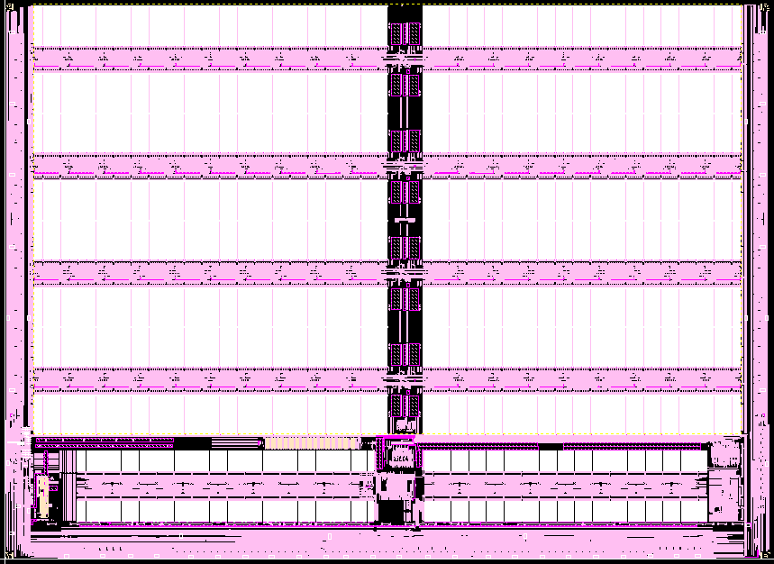
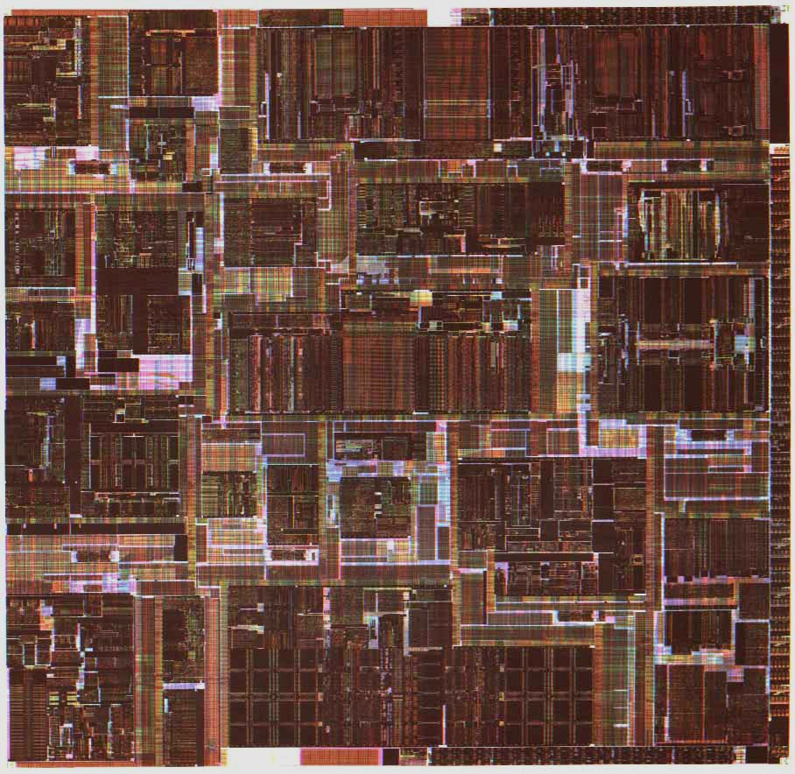
Itanium™ Processor Silicon
(Copyright: Intel at Hotchips ’00)
IA-32
Control
FPU
IA-64 Control
TLB
Integer Units
Cache
Instr.
Fetch &
Decode
Cache
Bus
Core Processor Die
4 x 1MB L3 cache

Slide 43
Itanium™ Machine Characteristics
(Copyright: Intel at Hotchips ’00)
Frequency
800 MHz
Transistor Count
25.4M CPU; 295M L3
Process
0.18u CMOS, 6 metal layer
Package
Organic Land Grid Array
Machine Width
6 insts/clock (4 ALU/MM, 2 Ld/St, 2 FP, 3 Br)
Registers
14 ported 128 GR & 128 FR; 64 Predicates
Speculation
32 entry ALAT, Exception Deferral
Branch Prediction
Multilevel 4-stage Prediction Hierarchy
FP Compute Bandwidth
3.2 GFlops (DP/EP); 6.4 GFlops (SP)
Memory -> FP Bandwidth
4 DP (8 SP) operands/clock
Virtual Memory Support
64 entry ITLB, 32/96 2-level DTLB, VHPT
L2/L1 Cache
Dual ported 96K Unified & 16KD; 16KI
L2/L1 Latency
6 / 2 clocks
L3 Cache
4MB, 4-way s.a., BW of 12.8 GB/sec;
System Bus
2.1 GB/sec; 4-way Glueless MP
Scalable to large (512+ proc) systems

Slide 44
Itanium™ EPIC Design Maximizes SW-HW Synergy
(Copyright: Intel at Hotchips ’00)
Architecture Features programmed by compiler:
Branch
Hints
Explicit
Parallelism
Register Stack
& Rotation
Data & Control
Speculation
Memory
Hints
Predication
Micro-architecture Features in hardware:
Fetch
Issue
Register
Handling
Control
Parallel Resources
Memory
Subsystem
4 Integer +
4 MMX Units
Instruction
Cache
& Branch
Predictors
128 GR &
128 FR,
Register
Remap
&
Stack
Engine
2 FMACs
(4 for SSE)
Three levels of cache:
L1, L2, L3
Fast, Simple 6-Issue
Bypasses & Dependencies
2 L.D/ST units
32 entry ALAT
Speculation Deferral Management

Slide 45
10 Stage In-Order Core Pipeline
(Copyright: Intel at Hotchips ’00)
Front End
Pre-fetch/Fetch of up to 6 instructions/cycle
Hierarchy of branch predictors
Decoupling buffer
Execution
4 single cycle ALUs, 2 ld/str
Advanced load control
Predicate delivery & branch
Nat/Exception//Retirement
EXPAND
RENAME
WORD-LINE
DECODE
REGISTER READ
IPG
FET
ROT
EXP
REN
WL.D
REG
EXE
DET
WRB
INST POINTER
GENERATION
FETCH
ROTATE
EXECUTE
EXCEPTION
DETECT
WRITE-BACK
Instruction Delivery
Dispersal of up to 6 instructions on 9 ports
Reg. remapping
Reg. stack engine
Operand Delivery
Reg read + Bypasses
Register scoreboard
Predicated dependencies

Slide 46
Itanium processor 10-stage pipeline
Front-end (stages IPG, Fetch, and Rotate): prefetches up to 32 bytes per clock (2 bundles) into a prefetch buffer, which can hold up to 8 bundles (24 instructions)
  Branch prediction is done using a multilevel adaptive predictor like P6 microarchitecture
Instruction delivery (stages EXP and REN): distributes up to 6 instructions to the 9 functional units
  Implements registers renaming for both rotation and register stacking.

Slide 47
Itanium processor 10-stage pipeline
Operand delivery (WLD and REG): accesses register file, performs register bypassing, accesses and updates a register scoreboard, and checks predicate dependences.
  Scoreboard used to detect when individual instructions can proceed, so that a stall of 1 instruction in a bundle need not cause the entire bundle to stall
Execution (EXE, DET, and WRB): executes instructions through ALUs and load/store units, detects exceptions and posts NaTs, retires instructions and performs write-back
  Deferred exception handling for speculative instructions is supported by providing the equivalent of poison bits, called NaTs for Not a Thing, for the GPRs (which makes the GPRs effectively 65 bits wide), and NaT Val (Not a Thing Value) for FPRs (already 82 bits wides)

Slide 48
Comments on Itanium
Remarkably, the Itanium has many of the features more commonly associated with the dynamically-scheduled pipelines
  strong emphasis on branch prediction, register renaming, scoreboarding, a deep pipeline with many stages before execution (to handle instruction alignment, renaming, etc.), and several stages following execution to handle exception detection
Surprising that an approach whose goal is to rely on compiler technology and simpler HW seems to be at least as complex as dynamically scheduled processors!

Slide 49
Peformance of IA-64 Itanium?
Despite the existence of silicon, no significant standard benchmark results are available for the Itanium
Whether this approach will result in significantly higher performance than other recent processors is unclear
The clock rate of Itanium (733 MHz) is competitive but slower than the clock rates of several dynamically-scheduled machines, which are already available, including the Pentium III, Pentium 4 and AMD Athlon

Slide 50
Summary#1: Hardware versus Software Speculation Mechanisms
To speculate extensively, must be able to disambiguate memory references
  Much easier in HW than in SW for code with pointers
HW-based speculation works better when control flow is unpredictable, and when HW-based branch prediction is superior to SW-based branch prediction done at compile time
  Mispredictions mean wasted speculation
HW-based speculation maintains precise exception model even for speculated instructions
HW-based speculation does not require compensation or bookkeeping code

Slide 51
Summary#2: Hardware versus Software Speculation Mechanisms cont’d
Compiler-based approaches may benefit from the ability to see further in the code sequence, resulting in better code scheduling
HW-based speculation with dynamic scheduling does not require different code sequences to achieve good performance for different implementations of an architecture
  may be the most important in the long run?

Slide 52
Summary #3: Software Scheduling
Instruction Level Parallelism (ILP) found either by compiler or hardware.
Loop level parallelism is easiest to see
  SW dependencies/compiler sophistication determine if compiler can unroll loops
  Memory dependencies hardest to determine => Memory disambiguation
  Very sophisticated transformations available
Trace Sceduling to Parallelize If statements
Superscalar and VLIW: CPI < 1 (IPC > 1)
  Dynamic issue vs. Static issue
  More instructions issue at same time => larger hazard penalty
  Limitation is often number of instructions that you can successfully fetch and decode per cycle

