Slide 1
CS252
Graduate Computer Architecture
Lecture 20:
Static Pipelining #2 and
Goodbye to Computer Architecture
April 13, 2001
Prof. David A. Patterson
Computer Science 252
Spring 2001

Slide 2
Review #1: Hardware versus Software Speculation Mechanisms
To speculate extensively, must be able to disambiguate memory references
  Much easier in HW than in SW for code with pointers
HW-based speculation works better when control flow is unpredictable, and when HW-based branch prediction is superior to SW-based branch prediction done at compile time
  Mispredictions mean wasted speculation
HW-based speculation maintains precise exception model even for speculated instructions
HW-based speculation does not require compensation or bookkeeping code

Slide 3
Review #2: Hardware versus Software Speculation Mechanisms cont’d
Compiler-based approaches may benefit from the ability to see further in the code sequence, resulting in better code scheduling
HW-based speculation with dynamic scheduling does not require different code sequences to achieve good performance for different implementations of an architecture
  may be the most important in the long run?

Slide 4
Review #3: Software Scheduling
Instruction Level Parallelism (ILP) found either by compiler or hardware.
Loop level parallelism is easiest to see
  SW dependencies/compiler sophistication determine if compiler can unroll loops
  Memory dependencies hardest to determine => Memory disambiguation
  Very sophisticated transformations available
Trace Sceduling to Parallelize If statements
Superscalar and VLIW: CPI < 1 (IPC > 1)
  Dynamic issue vs. Static issue
  More instructions issue at same time => larger hazard penalty
  Limitation is often number of instructions that you can successfully fetch and decode per cycle

Slide 5
VLIW in Embedded Designs
VLIW: greater parallelism under programmer, compiler control vs. hardware in superscalar
Used in DSPs, Multimedia processors as well as IA-64
What about code size?
Effectiveness, Quality of compilers for these applications?

Slide 6
Example VLIW for multimedia:
Philips Trimedia CPU
Every instruction contains 5 operations
Predicated with single register value;
if 0 => all 5 operations are canceled
128 64-bit registers, which contain either integer or floating point data
Partitioned ALU (SIMD) instructions to compute on multiple instances of narrow data
Offers both saturating arithmetic (DSPs) and 2’s complement arithmetic (desktop)
Delayed Branch with 3 branch slots

Slide 7
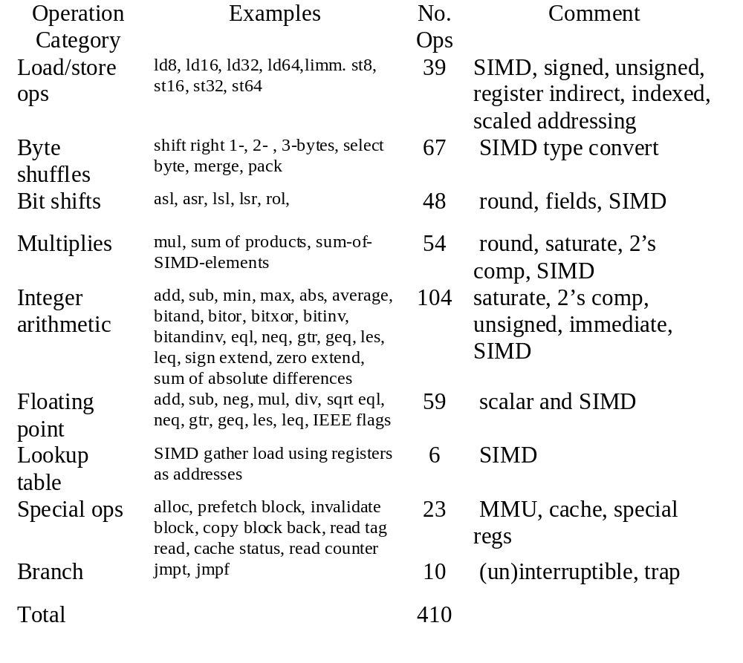
Trimedia Operations
large number of ops because used retargetable compilers, multiple machine descriptions, and die size estimators to explore the space to find the best cost-performance design
  Verification time,
  manufacturing test, design time?

Slide 8
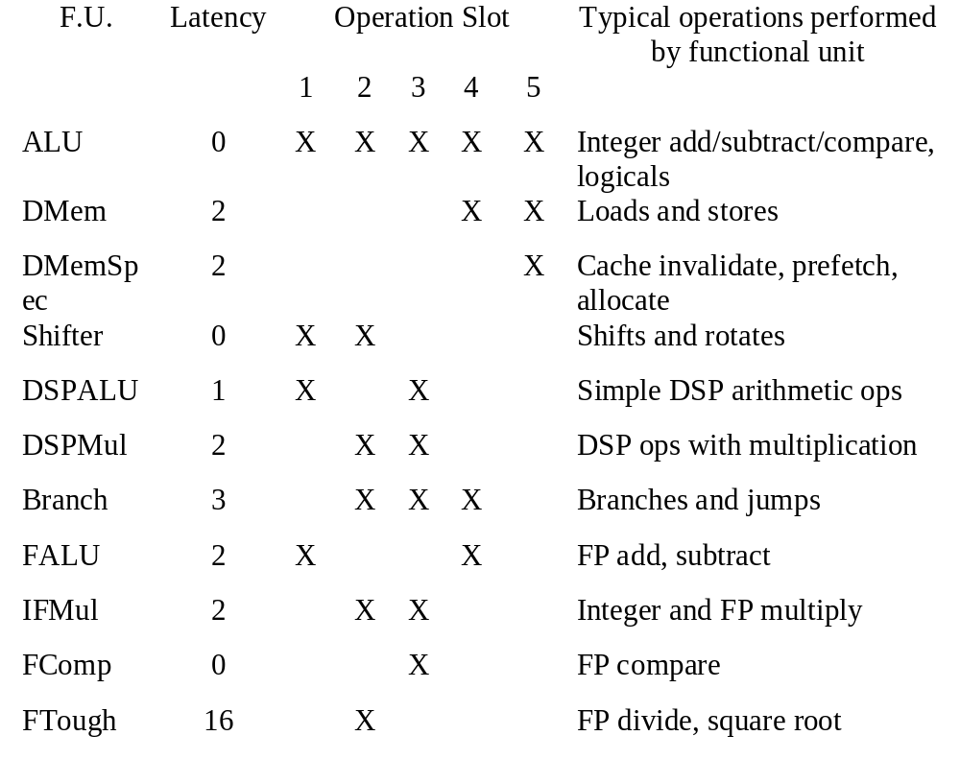
Trimedia Functional Units, Latency, Instruction Slots
23 functional units of 11 types,
which of 5 slots can issue (and hence number of functional units)

Slide 9
Philips Trimedia CPU
Compiler responsible for including no-ops
  both within an instruction-- when an operation field cannot be used--and between dependent instructions
  processor does not detect hazards, which if present will lead to incorrect execution
Code size? compresses the code (~ Quiz #1)
  decompresses after fetched from instruction cache

Slide 10
Example
Using MIPS notation, look at code for
void sum (int a[], int b[], int c[], int n)
{ int i;
for (i=0; i<n; i++)
c[i] = a[i]+b[i];

Slide 11
Example
MIPS code for loop
Loop: LD R11,R0(R4) # R11 = a[i]
LD R12,R0(R5) # R12 = b[i]
DADDU R17,R11,R12 # R17 = a[i]+b[i]
SD R17,0(R6) # c[i] = a[i]+b[i]
DADDIU R4,R4,8 # R4 = next a[] addr
DADDIU R5,R5,8 # R5 = next b[] addr
DADDIU R6,R6,8 # R6 = next c[] addr
BNE R4,R7,Loop # if not last go to Loop
Then unroll 4 times and schedule

Slide 12
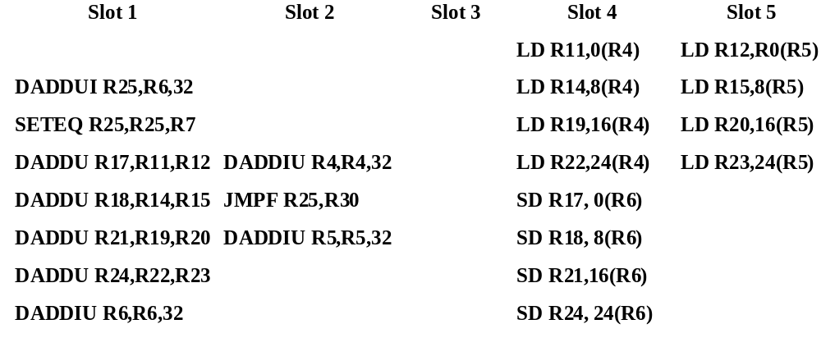
Tridmedia Version
Loop address in register 30
Conditional jump (JMPF) so that only jump is conditional, not whole instruction predicated
DADDUI (1st slot, 2nd instr) and SETEQ (1st slot, 3rd instr) compute loop termination test
  Duplicate last add early enough to schedule 3 instruction branch delay
24/40 slots used (60%) in this example

Slide 13
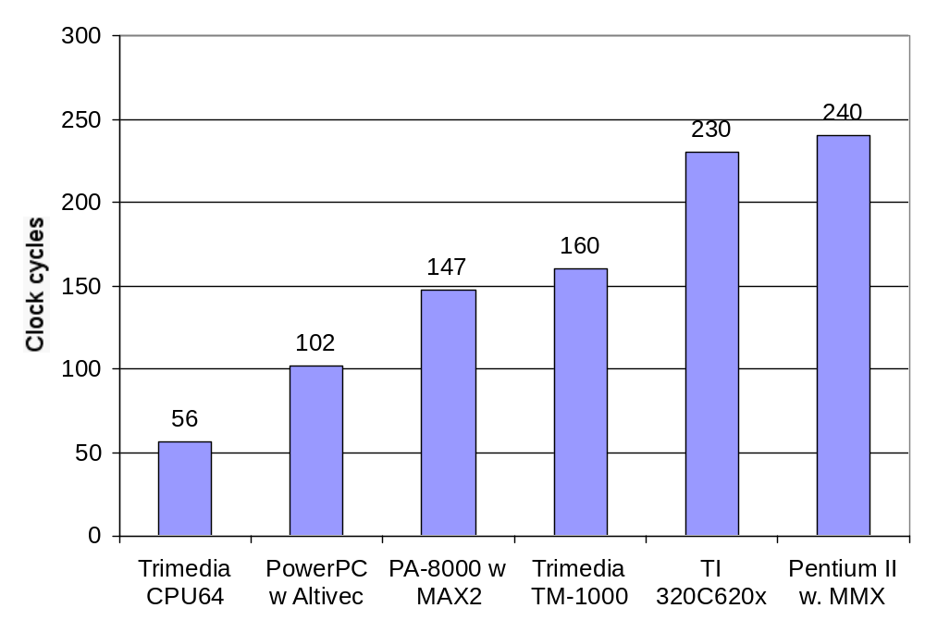
Clock cycles to execute 2D iDCT
Note that the Trimedia results are based on compilation, unlike many of the others. The year 2000 clock rate of the CPU64 is 300 MHz . The 1999 clock rates of the others are about 400 MHz for the PowerPC, PA-8000, and Pentium II, with the TM-1000 at 100 MHz and the TI 320620x at 200 MHz.

Slide 14
Administratrivia
3rd project meetings 4/11: good progress!
  Meet with some on Friday
4/18 Wed Quiz #2 310 Soda at 5:30
Pizza at La Val’s at 8:30
What’s left:
  4/20 Fri, “How to Have a Bad Academic Career” (Career/Talk Advice); signup for talks
  4/25 Wed, Oral Presentations (8AM to 2 PM) 611 Soda (no lecture)
  4/27 Fri (no lecture)
  5/2 Wed Poster session (noon - 2); end of course

Slide 15
Transmeta Crusoe MPU
80x86 instruction set compatibility through a software system that translates from the x86 instruction set to VLIW instruction set implemented by Crusoe
VLIW processor designed for the low-power marketplace

Slide 16
Crusoe processor: Basics
VLIW with in-order execution
64 Integer registers
32 floating point registers
Simple in-order, 6-stage integer pipeline:
2 fetch stages, 1 decode, 1 register read,
1 execution, and 1 register write-back
10-stage pipeline for floating point, which has 4 extra execute stages
Instructions in 2 sizes: 64 bits (2 ops) and 128 bits (4 ops)

Slide 17
Crusoe processor: Operations
5 different types of operation slots:
ALU operations: typical RISC ALU operations
Compute: this slot may specify any integer ALU operation (2 integer ALUs), a floating point operation, or a multimedia operation
Memory: a load or store operation
Branch: a branch instruction
Immediate: a 32-bit immediate used by another operation in this instruction
For 128-bit instr: 1st 3 are Memory, Compute, ALU; last field either Branch or Immediate

Slide 18
80x86 Compatability
Initially, and for lowest latency to start execution, the x86 code can be interpreted on an instruction by instruction basis
If a code segment is executed several times, translated into an equivalent Crusoe code sequence, and the translation is cached
  The unit of translation is at least a basic block, since we know that if any instruction is executed in the block, they will all be executed
  Translating an entire block both improves the translated code quality and reduces the translation overhead, since the translator need only be called once per basic block
Assumes 16MB of main memory for cache

Slide 19
Exception Behavior during Speculation
Crusoe support for speculative reordering consists of 4 major parts:
1. shadowed register file
  Shadow discarded only when x86 instruction has no exception
2. program-controlled store buffer
  Only store when no exception; keep until OK to store
3. memory alias detection hardware with speculative loads
4. conditional move instruction (called select) that is used to do if-conversion on x86 code sequences

Slide 20
Crusoe Performance?
Crusoe depends on realistic behavior to tune the code translation process, it will not perform in a predictive manner when benchmarked using simple, but unrealistic scripts
  Needs idle time to translate
  Profiling to find hot spots
To remedy this factor, Transmeta has proposed a new set of benchmark scripts
  Unfortunately, these scripts have not been released and endorsed by either a group of vendors or an independent entity

Slide 21
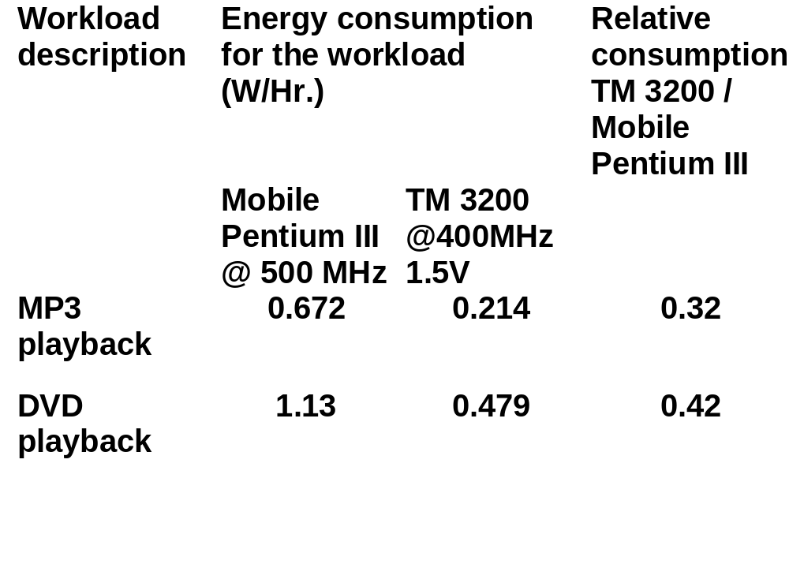
Real Time, so comparison is Energy

Slide 22
Crusoe Applications?
Notebook: Sony, others
Compact Servers: RLX technologies

Slide 23
VLIW Readings
Josh Fisher 1983 Paper + 1998 Retrospective
What are characteristics of VLIW?
Is ELI-512 the first VLIW?
  How many bits in instruction of ELI-512?
What is breakthrough?
What expected speedup over RISC?
What is wrong with vector?
What benchmark results on code size, speedup?
What limited speedups to 5X to 10X?
What other problems faced ELI-512?
In retrospect, what wished changed?
In retrospect, what naïve about?
Notes:
What are characteristics of VLIW?
1) Single control unit issuing 1 long instruction per clock cycle
2) Each long instruction has many independent operations
3) Each operation requires small number of cycles to execute
Is ELI-512 the first VLIW?
No: many efore, including Stanford MIPS, horizontal microcode
How many bits in instruction of ELI-512?
1200! Goal is 512
What is breakthrough?
Trace scheduling to go beyond basic blocks
What expected speedup over RISC?
10X to 30X
What is wrong with vector?
Too hard to prograam; limited to inner loops; at most 10X
What benchmark results?
None
What limited speedups to 5X to 10X?
Memory disambiguation problem
What other problems faced ELI-512?
Jump: n+1 locations based on n tests; memory bank prediction
Retrospective
Inspired by Trace Scheduling to reveal lots of ILP
Today called Regional Scheduling, with specific techniques: Percolation, Superblock, Hyperblock, Trace-2
Alas, proposed weird 512 bit instructions vs. simpler straightforward 2-issue LIW, which made it it seem flaky
Paper introduced memory disambiguation, VLIW
Naïve about
importance of object code compatibility (Multiflow company Trace 7 compatible with Trace 14, but not to trace 28)
Later runtime translation to solve binary compatability
Didn’t differentiate architecture and implementation
VLIW really a design philosophy: trivial to put operations in parallel vs. OOO designs; doesn’t need to be LIW
Exceptions
Weird memory design (back door)

Slide 24
Review of Course
Review and Goodbye to Computer Architecture, topic by topic + follow-on courses
Future Directions for Computer Architecture?

Slide 25
Chapter 1: Performance and Cost
Amdahl’s Law:
CPI Law:
Designing to Last through Trends
      Capacity Speed
Logic 2x in 3 years 2x in 3 years
DRAM 4x in 4 years 2x in 10 years
Disk 4x in 3 years 2x in 5 years
Processor 2x every 1.5 years?
1
ExTime_{old}
ExTime_{new}
Speedup_{overall} =
=
(1 - Fraction_{enhanced}) + Fraction_{enhanced}
Speedup_{enhanced}
CPU time = Seconds = Instructions x Cycles x Seconds
Program Program Instruction Cycle

Slide 26
Chapter 1: Performance and Cost
Die Cost goes roughly
with die area⁴
  Microprocessor with 1B
  transistors in 2005?
Cost vs. Price
  Can PC industry support engineering/research investment?
For better or worse, benchmarks shape a field
Interested in learning more on integrated circuits?
EE 241 “Advanced Digital Integrated Circuits”
Interested in learning more on performance?
CS 266 “Introduction to Systems Performance”

Slide 27
Goodbye to
Performance and Cost
Will sustain 2X every 1.5 years?
  Can integrated circuits improve below 1.8 micron in speed as well as capacity?
5-6 yrs to PhD =>
16X CPU speed, 10XDRAM Capacity, 25X Disk capacity?
(10 GHz CPU, 1GB DRAM, 2TB disk?)

Slide 28
Chapter 5: Memory Hierarchy
MPU
60%/yr.
Processor-DRAM Performance gap
1/3 to 2/3 die area for caches, TLB
Alpha 21264: 108 clock to memory
⇒ 648 instruction issues during miss
3 Cs: Compulsory, Capacity, Conflict
4 Questions: where, who, which, write
Applied recursively to create multilevel caches
Performance = f(hit time, miss rate, miss penalty)
  danger of concentrating on just one when evaluating performance
DRAM
7%/yr.

Slide 29
Cache Optimization Summary
Technique MR MP HT Complexity
Larger Block Size + – 0
Higher Associativity + – 1
Victim Caches + 2
Pseudo-Associative Caches + 2
HW Prefetching of Instr/Data + 2
Compiler Controlled Prefetching + 3
Compiler Reduce Misses + 0
Priority to Read Misses + 1
Subblock Placement + + 1
Early Restart & Critical Word 1st + 2
Non-Blocking Caches + 3
Second Level Caches + 2
Small & Simple Caches – + 0
Avoiding Address Translation + 2
Pipelining Writes + 1
miss rate
miss
penalty
hit time
memory hierarchy art: taste in selecting between alternatives
to find combination that fits well together

Slide 30
Goodbye to
Memory Hierarchy
Will L2 cache keep growing? (e.g, 64 MB L2 cache?)
Will multilevel hierarchy get deeper? (L4 cache?)
Will DRAM capacity/chip keep going at 4X / 4 years? (e.g., 16 Gbit chip?)
Will processor and DRAM/Disk be unified?
For which apps?
Out-of-order CPU hides L1 data cache miss
(3–5 clocks), but hide L2 miss? (>100 clocks)
Memory hierarchy likely overriding issue in algorithm performance: do algorithms and data structures of 1960s work with machines of 2000s?

Slide 31
Chapter 6: Storage I/O
Disk BW 40%/yr, areal density 60%/ yr, $/MB faster?
Little’s Law: Length_{system} = rate x Time_{system}
(Mean number customers = arrival rate x mean service time)
  Througput vs. response time
  Value of faster response time on productivity
Benchmarks: scaling, cost, auditing,
response time limits
RAID: performance and reliability
Queueing theory? IEOR 161, 267, 268
SW storage systems? CS 286
“Implementation of Data Base Systems”
System
Queue
server
1
Proc
IOC
Device
3
5

Slide 32
Summary: I/O Benchmarks
Scaling to track technological change
TPC: price performance as nomalizing configuration feature
Auditing to ensure no foul play
Throughput with restricted response time is normal measure
Benchmarks to measure Availability, Maintainability?

Slide 33
Goodbye to
Storage I/O
Disks attached directly to networks, avoiding the file server? (“Network Attached Storage Devices”)
Disks:
  Extraodinary advance in capacity/drive, $/GB
  Currently 17 Gbit/sq. in. ; can continue past 100 Gbit/sq. in.?
  Bandwidth, seek time not keeping up: 3.5 inch form factor makes sense? 2.5 inch form factor in near future? 1.0 inch form factor in long term?
Tapes
  No investment, must be backwards compatible
  Are they already dead?
  What is a tapeless backup system?

Slide 34
Goodbye to
Storage I/O
Terminology of Fault/Error/Failure
Is Availability the killer metric for Service oriented world?
Can we construct systems that will actually achieve 99.999% availability, including software and people?
Disks growing at 2X/ 1 years recently:
Will Patterson continue get email messages to reduce file storage for the rest of my career?
Heading towards a personal terabyte:
hierarchical file systems vs. database to organize personal storage?
What going to do when can have video record of entire life on line?

Slide 35
Chapter 7: Networks
Sender
Overhead
Transmission time
(size ÷ bandwidth)
Sender
(processor
busy)
Time of
Flight
Transmission time
(size ÷ bandwidth)
Receiver
Overhead
Receiver
Transport Latency
(processor
busy)
Total Latency
Total Latency = Sender Overhead + Time of Flight +
Message Size ÷ BW + Receiver Overhead
High BW networks + high overheads violate of Amdahl’s Law
Notes:
Easy to get these things confused! Colors should help
Min (link BW, bisection BW)
Assumes no congestion
Receiver usually longer
Better to send then receive
Store Like send
Read like Receive

Slide 36
Chapter 7: Networks
Similarities of SANs, LANs, WANs
Integrated circuit revolutionizing networks as well as processors
Switch is a specialized computer
Protocols allow hetereogeneous networking ,
handle normal and abnormal events
Interested in learning more on networks?
EE 122 “Introduction to Computer Networks” (Stoika)
CS 268 “Computer Networks” (Stoika)

Slide 37
Review: Networking
Clusters +: fault isolation and repair, scaling, cost
Clusters -: maintenance, network interface performance, memory efficiency
Google as cluster example:
  scaling (6000 PCs, 1 petabyte storage)
  fault isolation (2 failures per day yet available)
  repair (replace failures weekly/repair offline)
  Maintenance: 8 people for 6000 PCs
Cell phone as portable network device
  # Handsets >> # PCs
  Univerisal mobile interface?
Is future services built on Google-like clusters delivered to gadgets like cell phone handset?

Slide 38
Goodbye to
Networks
Will network interfaces follow example of graphics interfaces and become first class citizens in microprocessors, thereby avoiding the I/O bus?
Will Ethernet standard keep winning the LAN wars? e.g., 1 Gbit/sec, 10 Gbit/sec, wireless (802.11B)...

Slide 39
Chapter 8: Multiprocessors
  Programming Model
  Communication Abstraction
  Interconnection SW/OS
  Interconnection HW
Layers:
  Programming Model:
    Multiprogramming : lots of jobs, no communication
    Shared address space: communicate via memory
    Message passing: send and recieve messages
    Data Parallel: several agents operate on several data sets simultaneously and then exchange information globally and simultaneously (shared or message passing)
  Communication Abstraction:
    Shared address space: e.g., load, store, atomic swap
    Message passing: e.g., send, recieve library calls
    Debate over this topic (ease of programming, scaling)
    => many hardware designs 1:1 programming model
Interested in learning more on multiprocessors:
CS 258 “Parallel Computer Architecture”
E 267 “Programming Parallel Computers”

Slide 40
Goodbye to
Multiprocessors
Successful today for file servers, time sharing, databases, graphics; will parallel programming become standard for production programs?
If so, what enabled it: new programming languauges, new data structures, new hardware, new coures, ...?
Which won large scale number crunching, databases:
Clusters of independent computers connected via switched LAN vs. large shared NUMA machines? Why?

Slide 41
Chapter 2:
Instruction Set Architecture
What ISA looks like to pipeline?
  Cray: load/store machine; registers; simple instr. format
RISC: Making an ISA that supports pipelined execution
80x86: importance of being their first
VLIW/EPIC: compiler controls Instruction Level Parallelism (ILP)
Interested in learning more on compilers and ISA?
CS 264/5 “Advanced Programming Language Design and Optimization”

Slide 42
Goodbye to
Instruction Set Architecture
What did IA-64/EPIC do well besides floating point programs?
  Was the only difference the 64-bit address v. 32-bit address?
  What happened to the AMD 64-bit address 80x86 proposal?
What happened on EPIC code size vs. x86?
Did Intel Oregon increase x86 performance so as to make Intel Santa Clara EPIC performance similar?

Slide 43
Goodbye to Dynamic Execution
Did Transmeta-like compiler-oriented translation survive vs. hardware translation into more efficient internal instruction set?
Did ILP limits really restrict practical machines to 4-issue, 4-commit?
Did we ever really get CPI below 1.0?
Did value prediction become practical?
Branch prediction: How accurate did it become?
  For real programs, how much better than 2 bit table?
Did Simultaneous Multithreading (SMT) exploit underutilized Dynamic Execution HW to get higher throughput at low extra cost?
  For multiprogrammed workload (servers) or for parallelized single program?

Slide 44
Goodbye to Static, Embedded
Did VLIW become popular in embedded? What happened on code size?
Did vector become popular for media applications, or simply evolve SIMD?
Did DSP and general purpose microprocessors remain separate cultures, or did ISAs and cultures merge?
  Compiler oriented?
  Benchmark oriented?
  Library oriented?
  Saturation + 2’s complement

Slide 45
Goodbye to Computer Architecture
Did emphasis switch from cost-performance to cost-performance-availability?
What support for improving software reliability? Security?

Slide 46
Goodbye to Computer Architecture
1985-2000: 1000X performance
  Moore’s Law transistors/chip => Moore’s Law for Performance/MPU
Hennessy: industry been following a roadmap of ideas known in 1985 to exploit Instruction Level Parallelism to get 1.55X/year
  Caches, Pipelining, Superscalar, Branch Prediction, Out-of-order execution, …
ILP limits: To make performance progress in future need to have explicit parallelism from programmer vs. implicit parallelism of ILP exploited by compiler, HW?
Did Moore’s Law in transistors stop predicting microprocessor performance? Did it drop to old rate of 1.3X per year?
  Less because of processor-memory performance gap?

