Slide 1
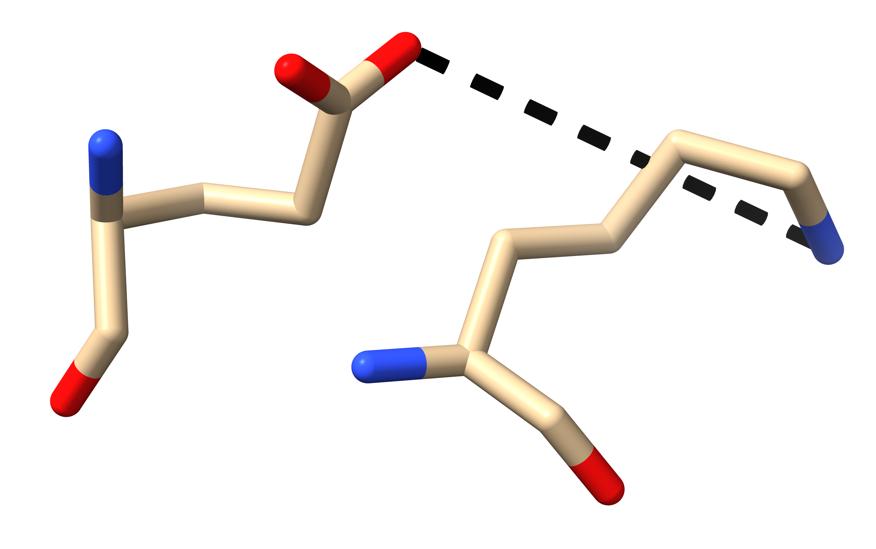
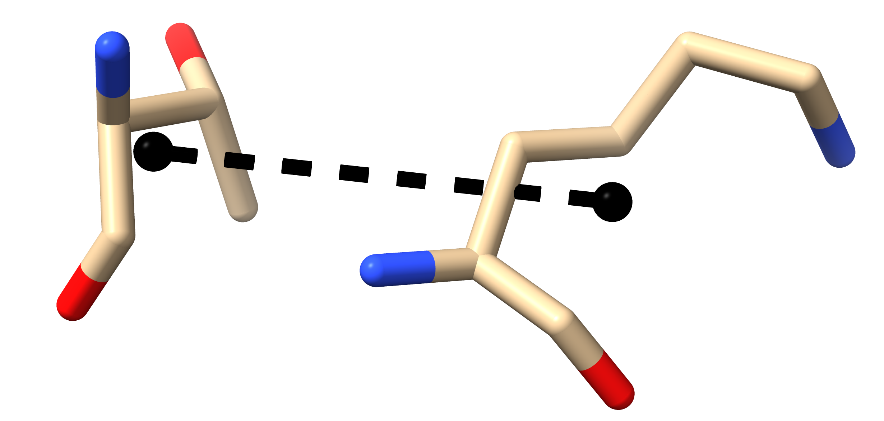
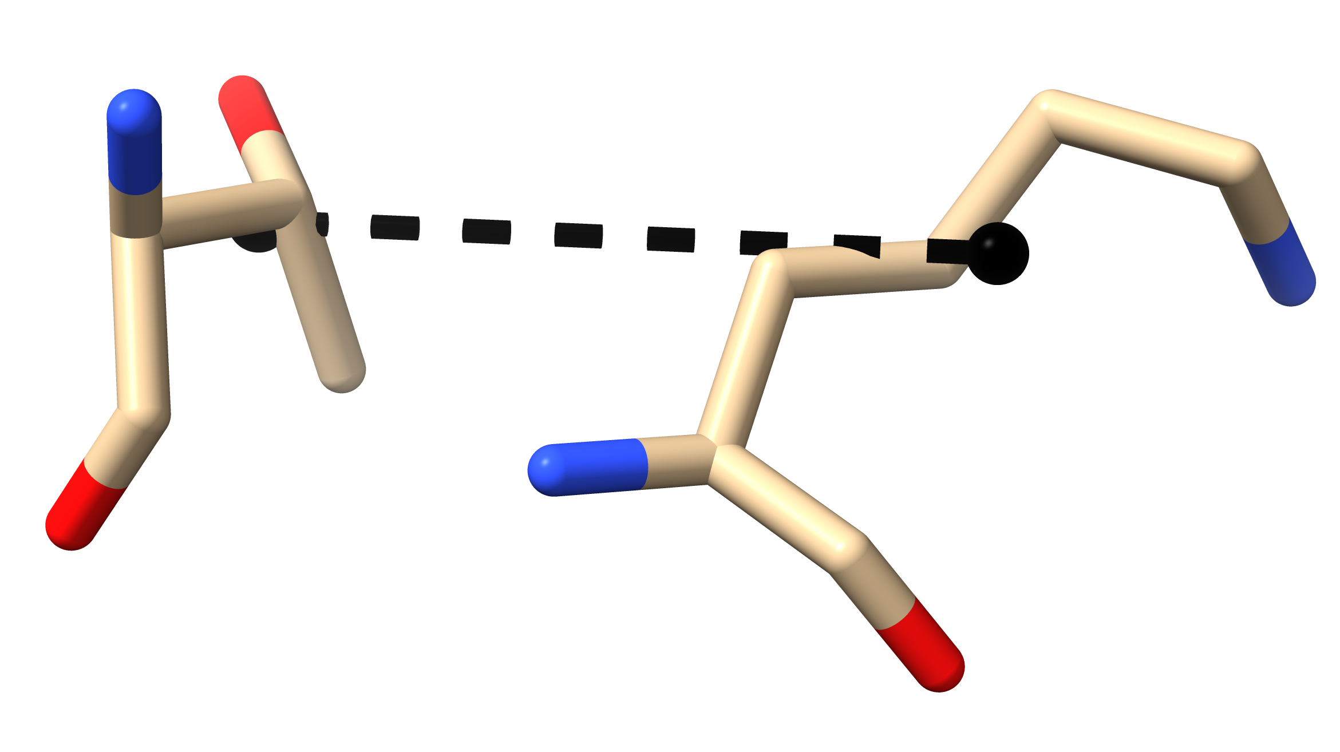
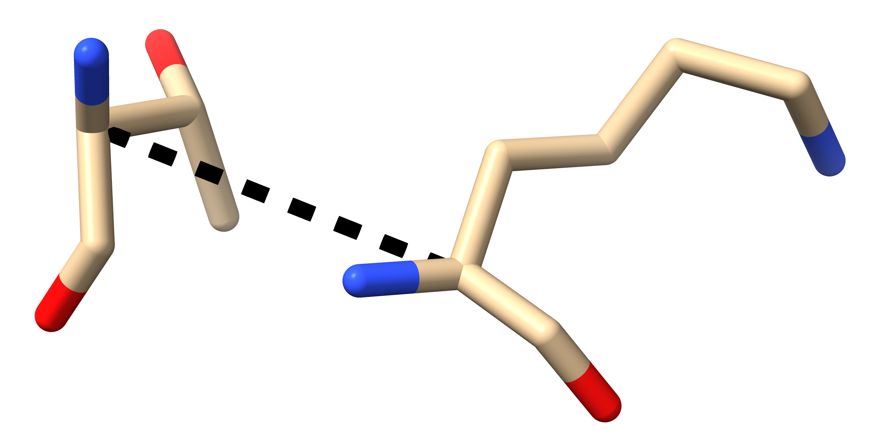
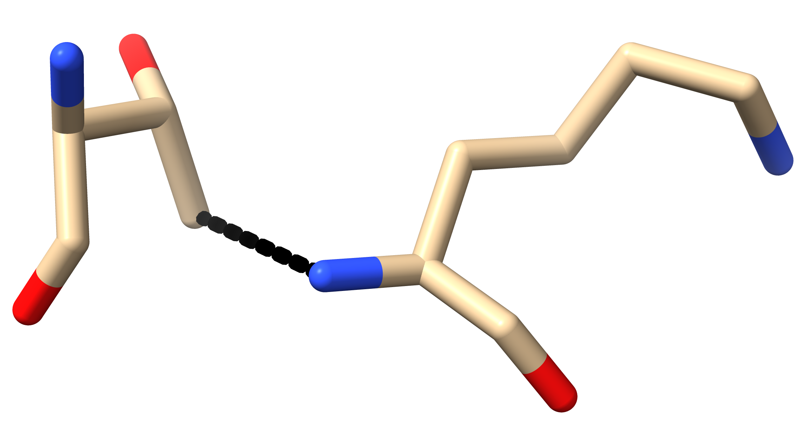
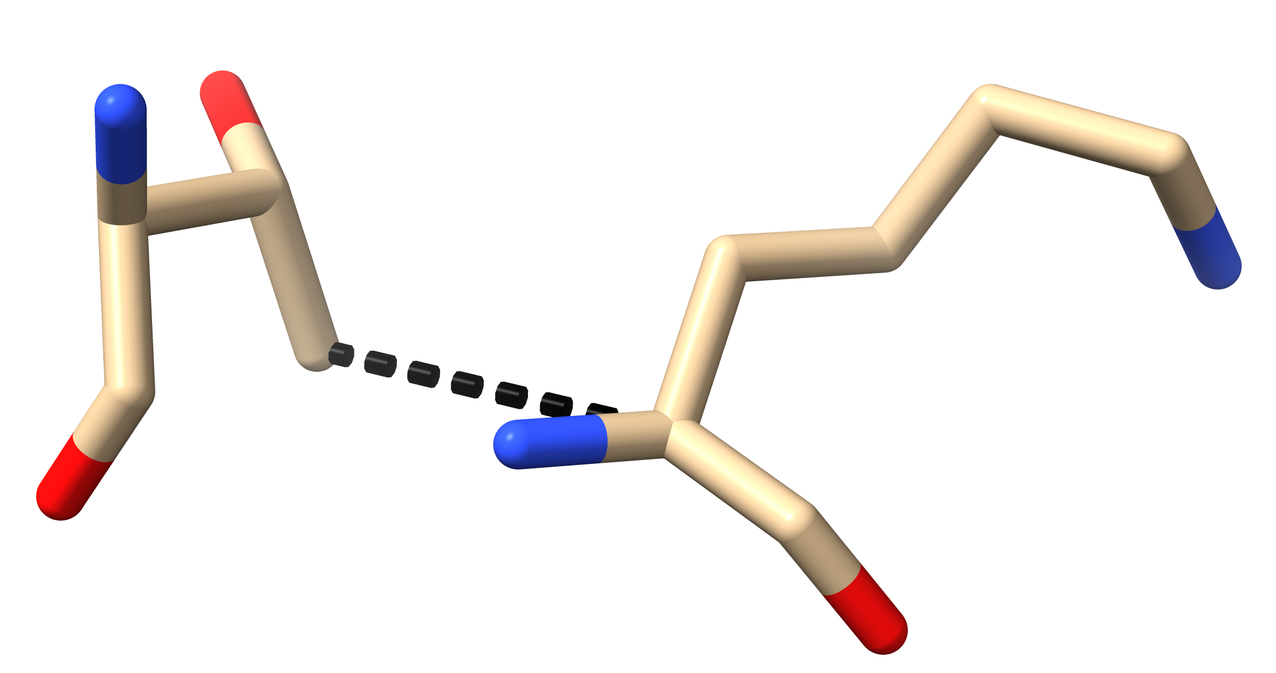
A
B
C
Nitrogen-Oxygen Distance
Centroid Distance
Side Chain Centroid Distance
D
E
F
⍺-Carbon Distance
Minimum Distance
Side Chain Distance

Slide 2
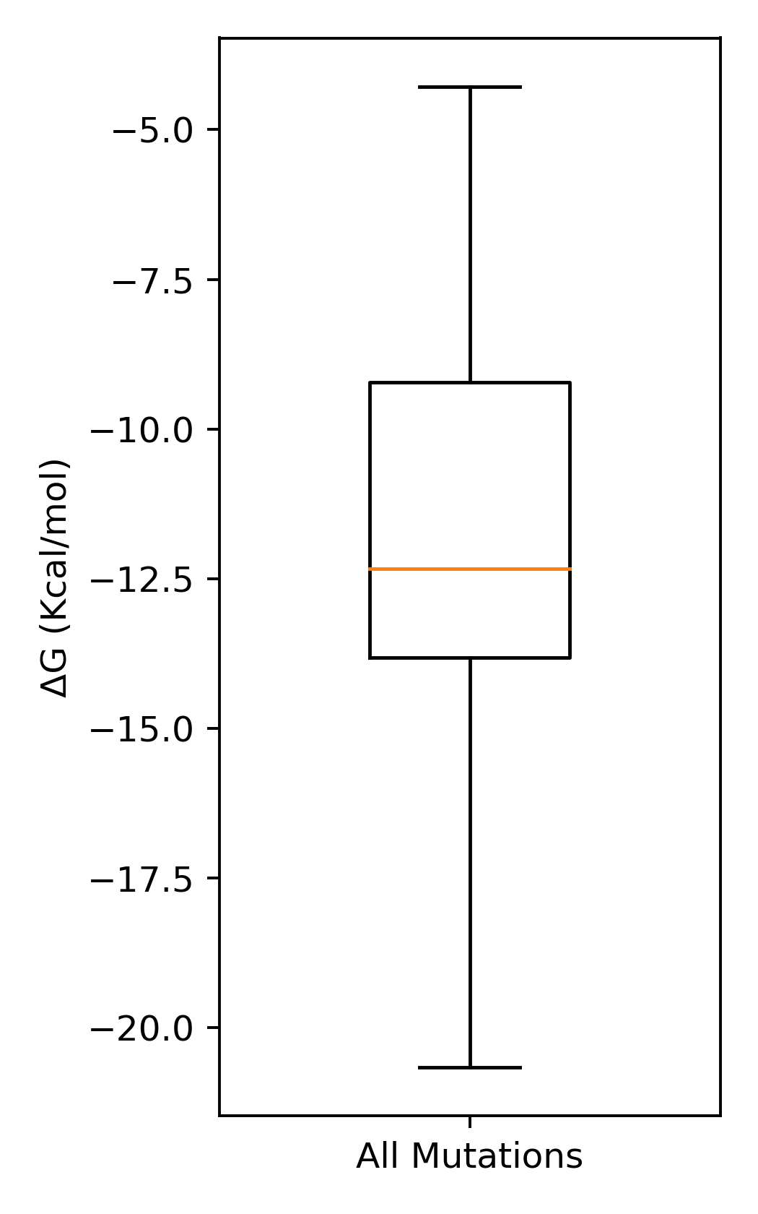
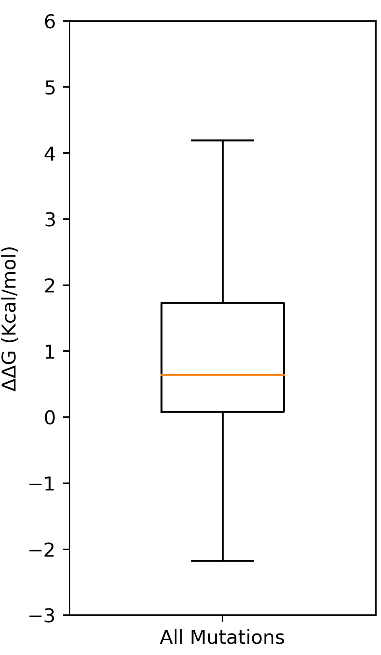
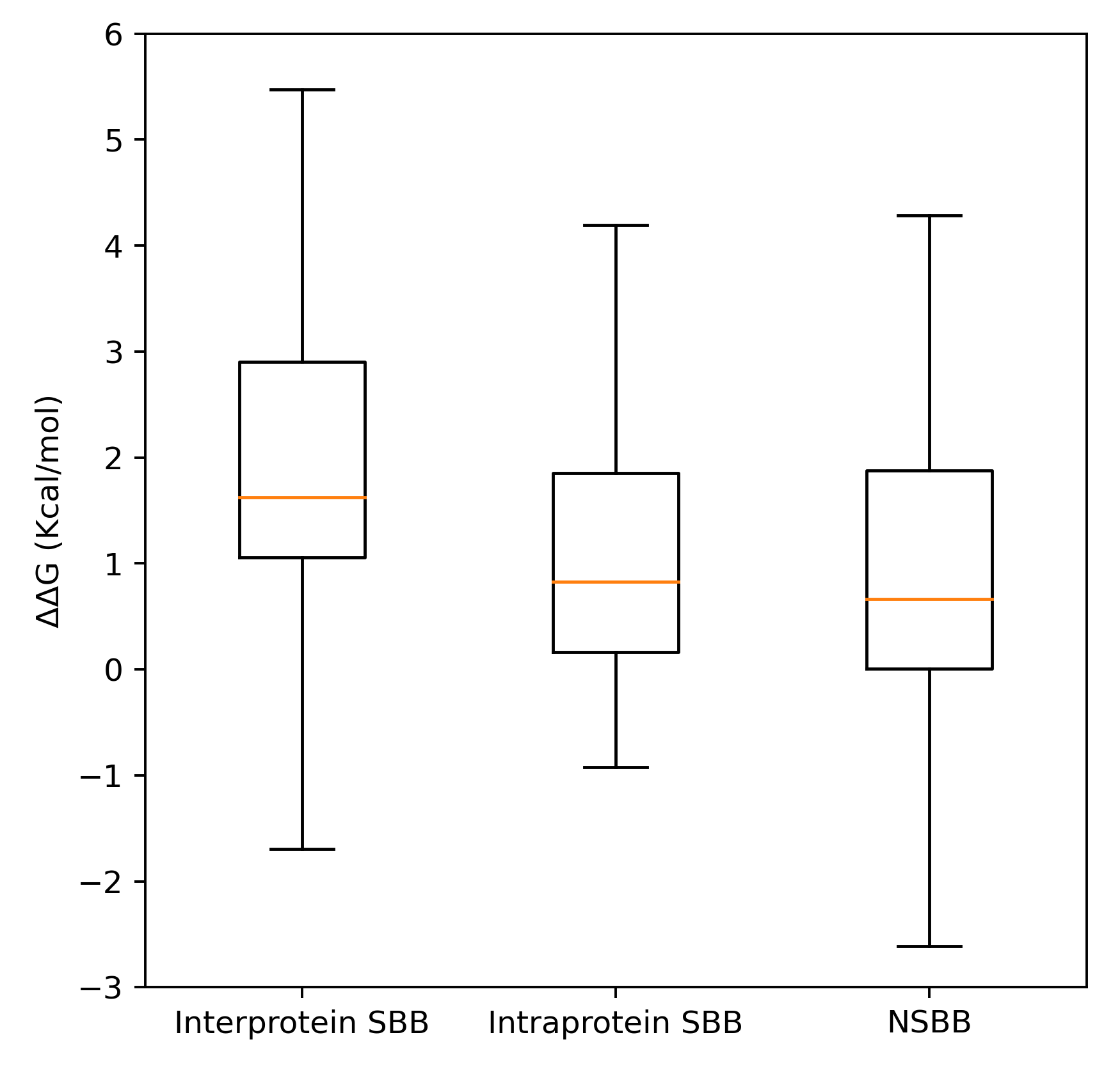
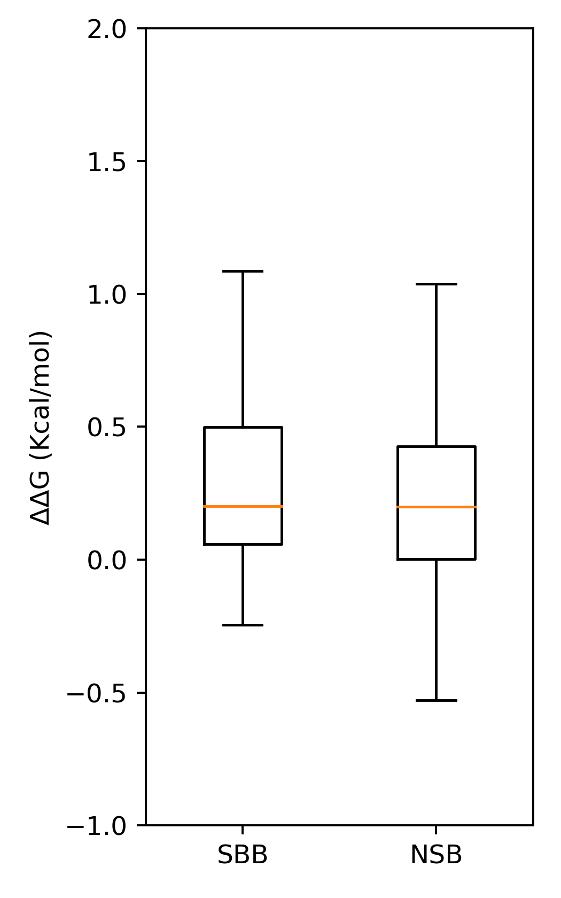
A
B
C
D
CTU
Free Energy Change
Interface CTU
Free Energy Change
Non-interface CTU
Free Energy Change
CTU WT Free Energy
N = 913
N = 913
N = 131
N = 82
N = 509
N = 41
N = 150

Slide 3
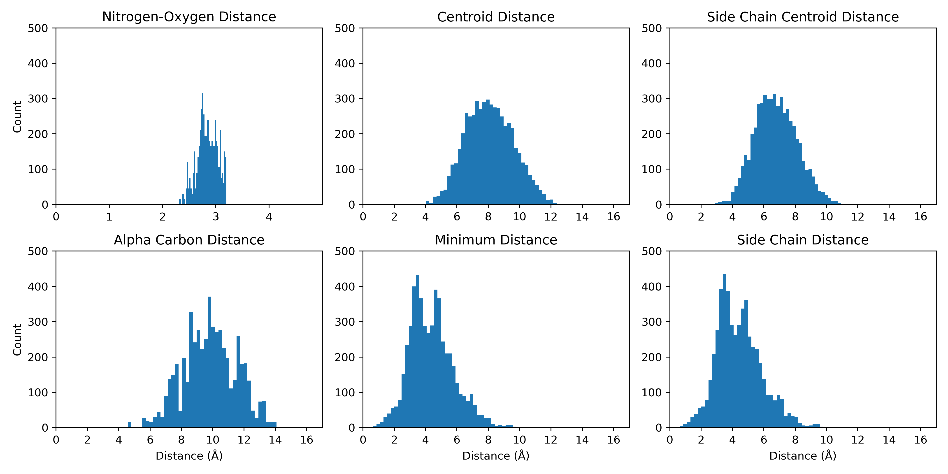
A
B
C
N = 5325
N = 5325
N = 5325
D
E
F
N = 5325
N = 5325
N = 5325

Slide 4
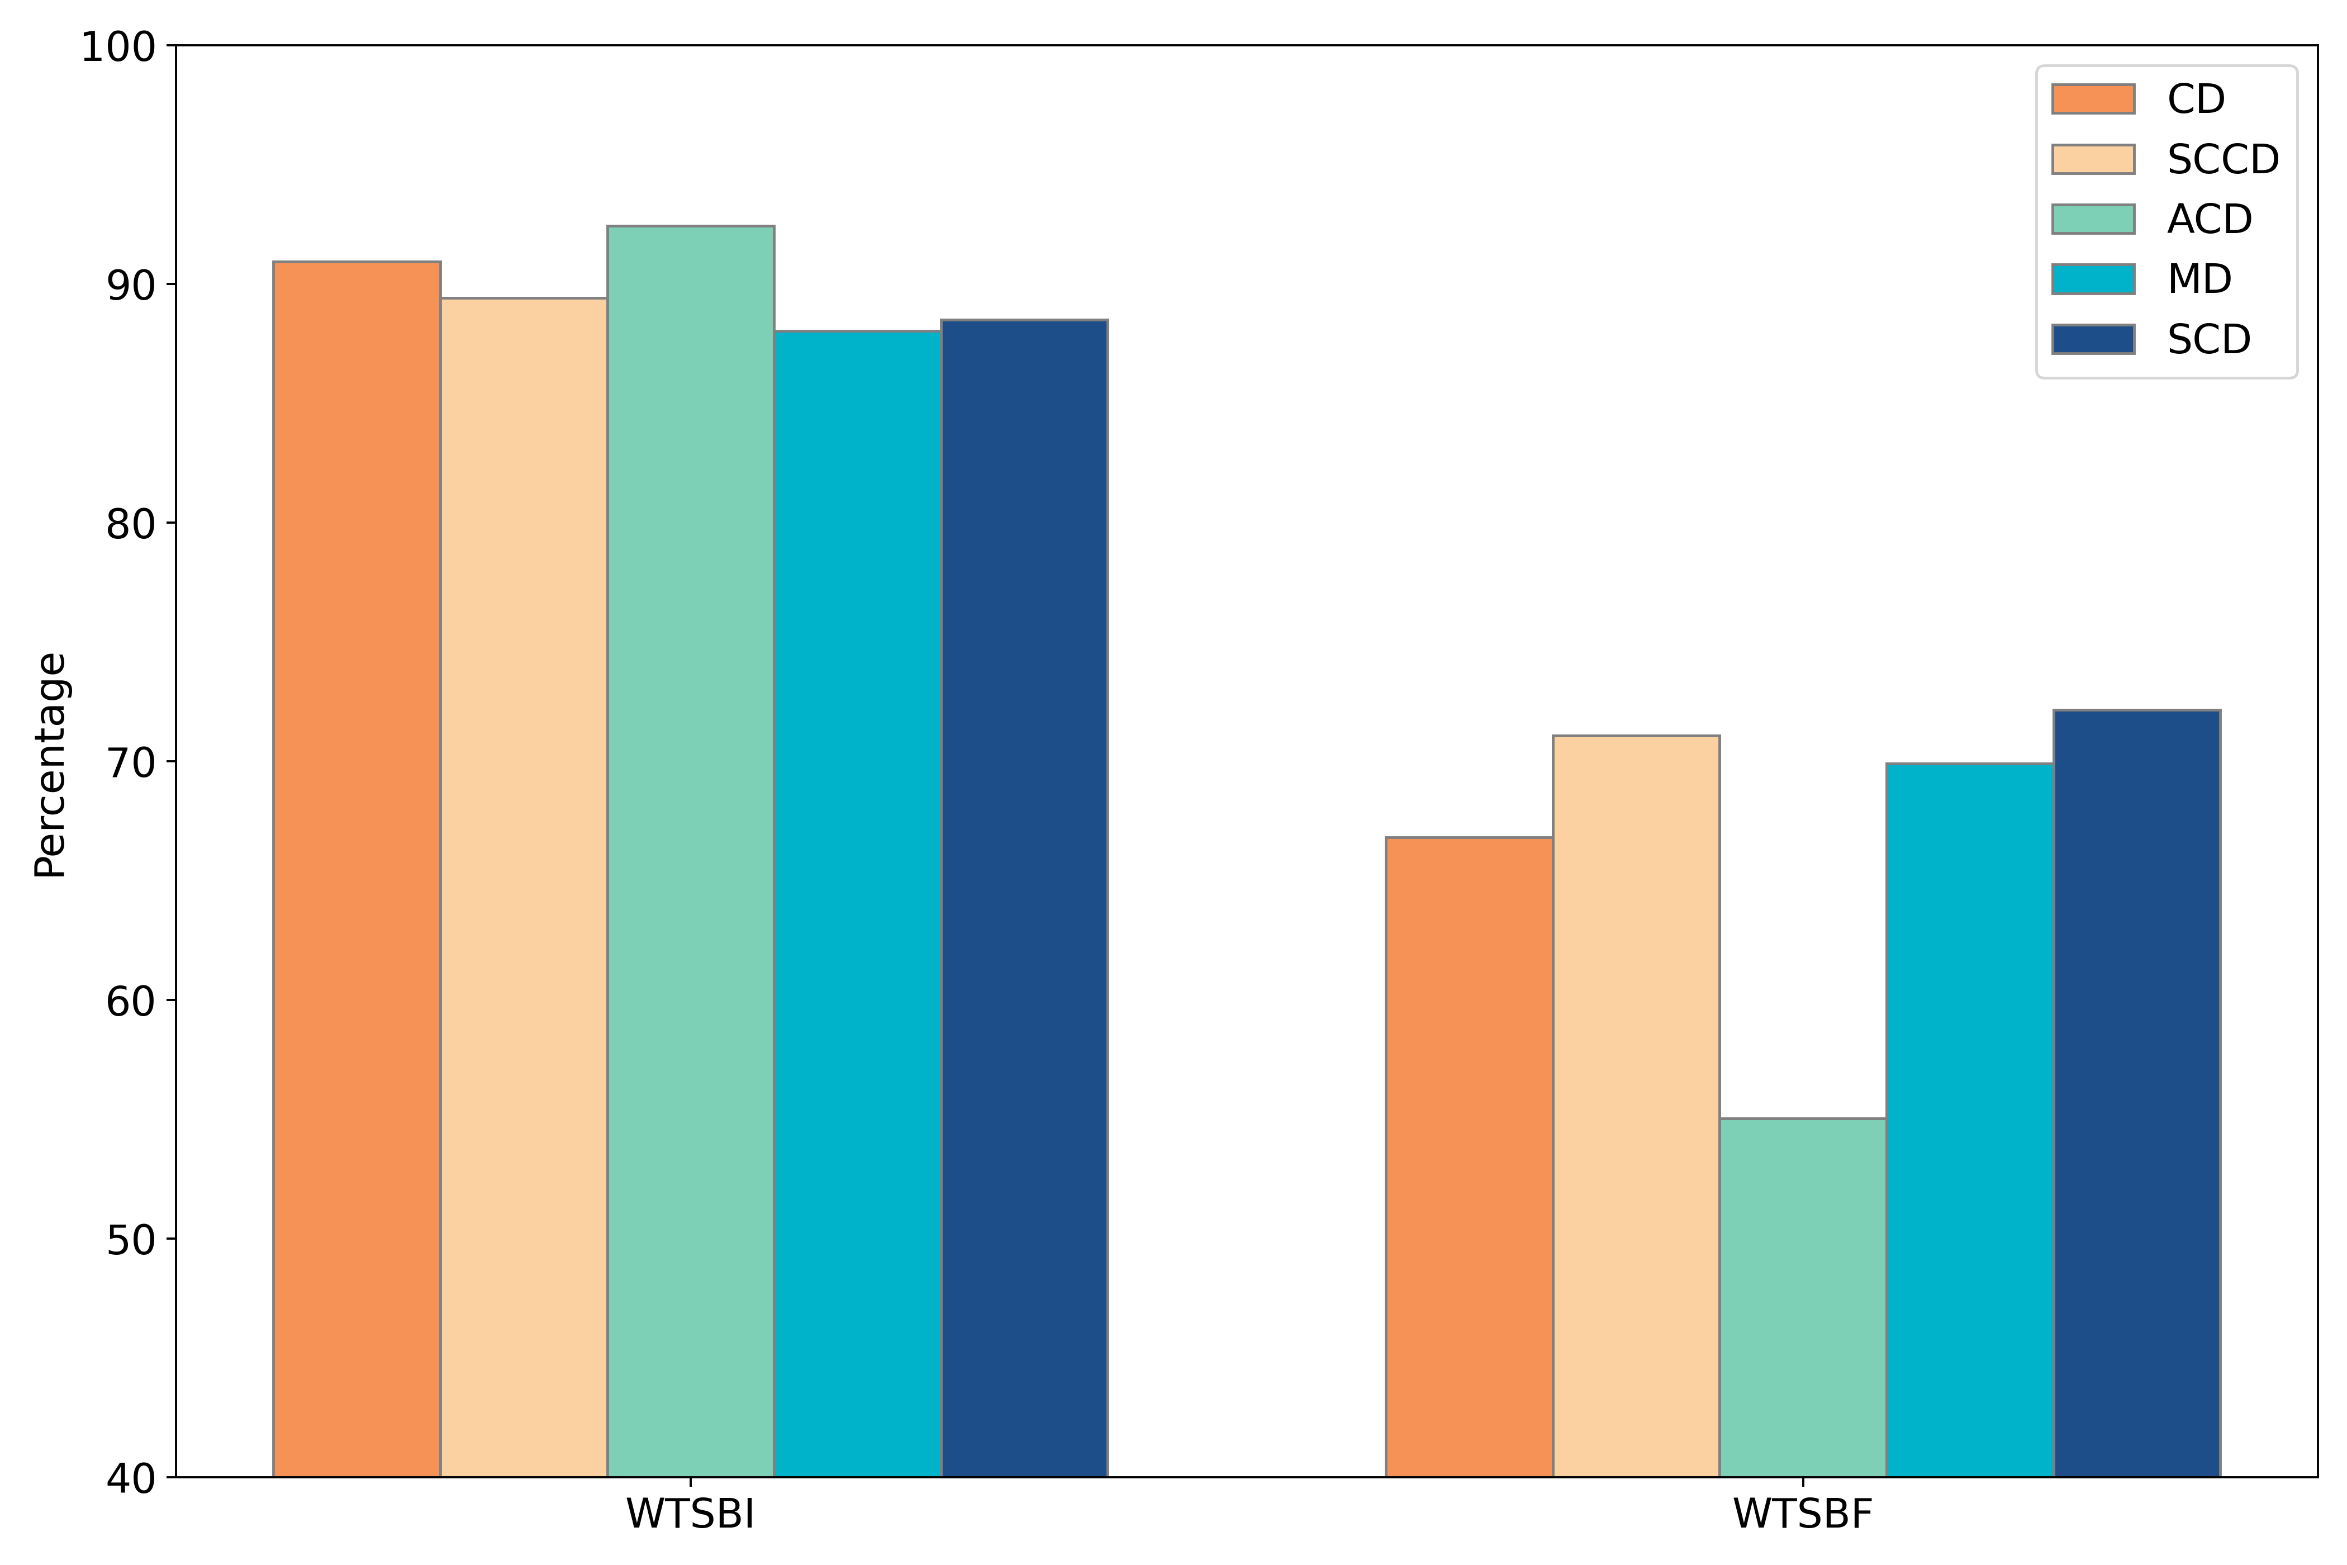
92.4
91.0
89.4
88.0
88.5
71.1
72.2
70.0
66.8
55.0

Slide 5
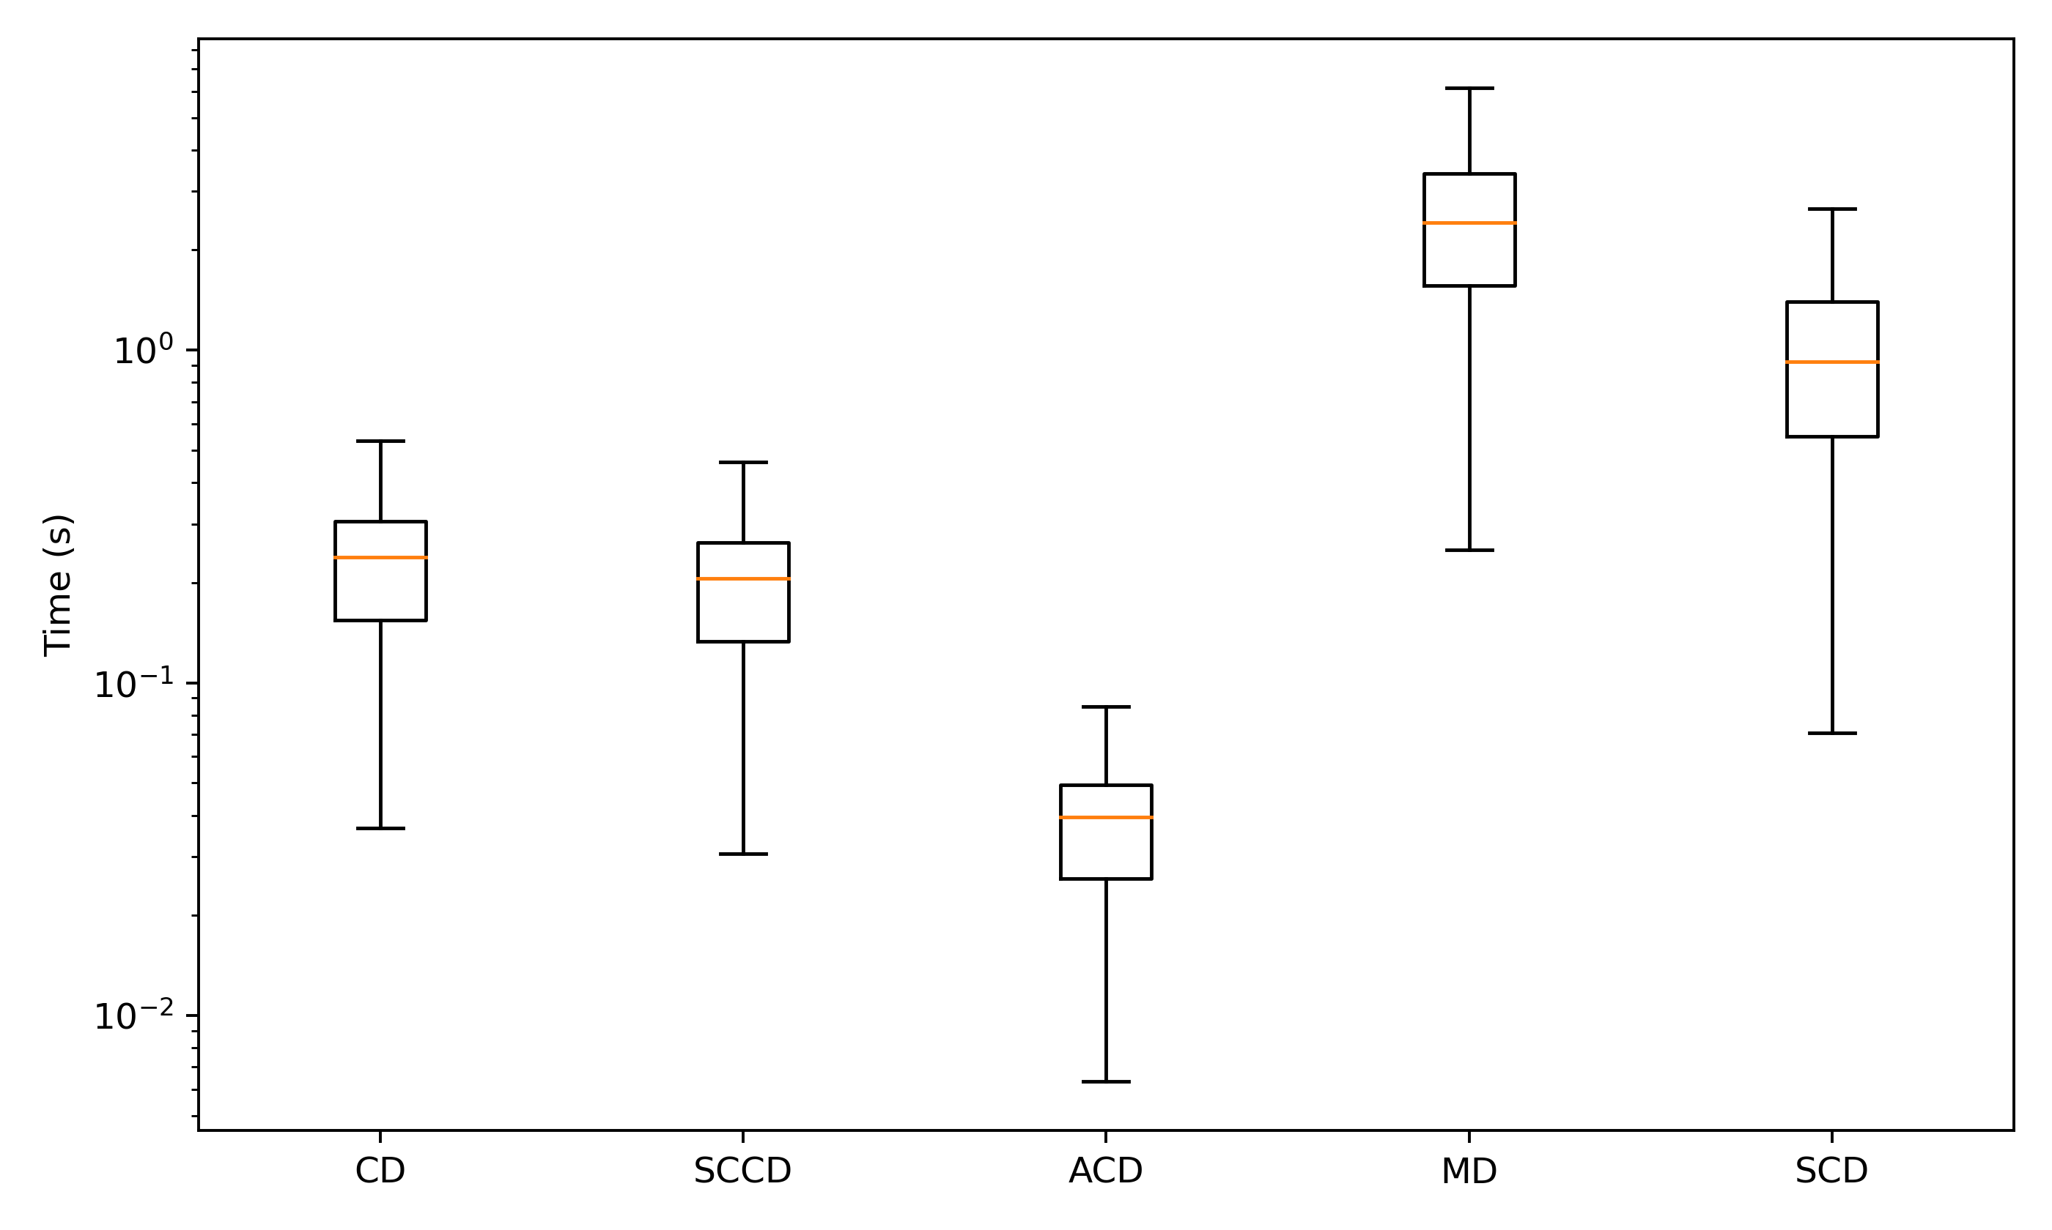
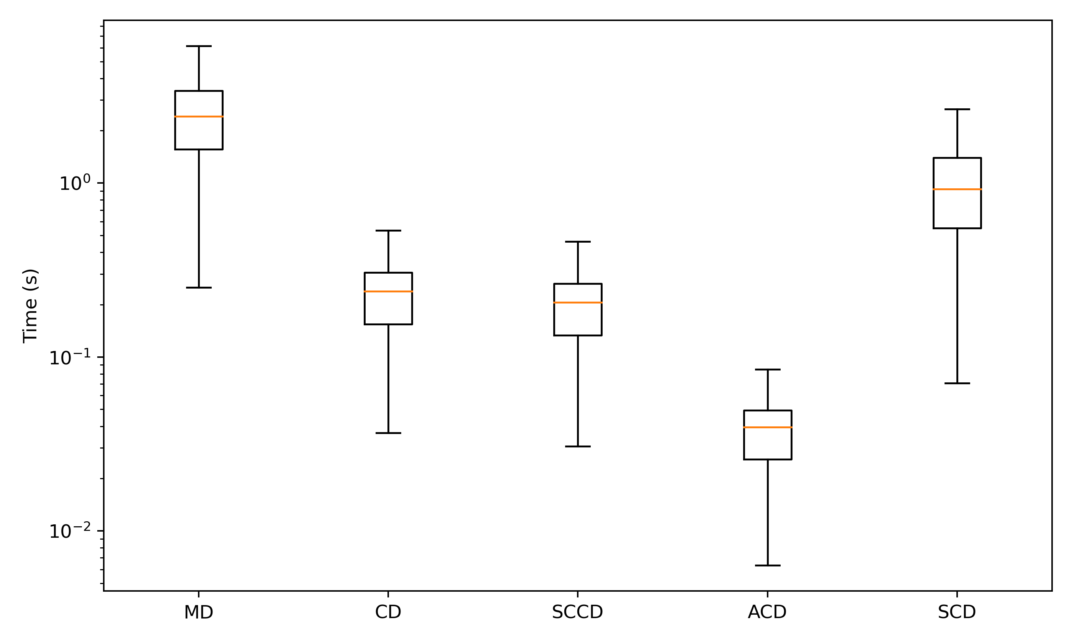
N = 4720
N = 4641
N = 4798
N = 4569
N = 4594

Slide 6
A
B
Target
Target
Interfacial Residues
L
L
R
D
R
D
K
K
Query
Query

