Slide 1
Machine Learning Based Modulation Classification Method
Usman Muhammad
20197724
Computer System lab

Slide 2
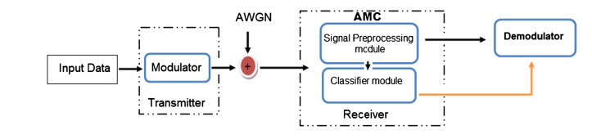
Introduction
An essential part of the noncooperative communication systems is the automatic modulation classification (AMC).
In the intelligent communication systems, including cognitive radio, adaptive communication etc., the transmitter can freely choose the modulation type of the signals, the knowledge of which is necessary for the receivers so that the demodulation could be performed for a successful transmission.
AMC is an effective way to solve this problem without effecting the spectrum efficiency.

Slide 3
Types of AMC
Likelihood-based (LB)
Feature-based (FB)
LB methods are based on the likelihood function of the received signal.
LB methods can theoretically achieve the optimal solution.
They suffer from high computational complexity.
Require prior information from transmitters.
FB methods depends upon the feature extraction and classifier design.
They can obtain suboptimal solution.
The computational complexity is much less.
Does not require prior information
Since the prior information required by the LB methods is often unavailable, researchers have paid
more attention to FB methods.
The two important parts of FB methods are:
Feature extraction
Classifier

Slide 4
Feature Extraction
Various features have been studied supervised and unsupervised algorithms:
Signal spectral based features
Wavelet transforms
Multi cumulants
K-means clustering
K-center
Fuzzy k-means

Slide 5
Classifier
Several machine learning algorithms have been proposed for the problem of AMC.
Support vector machines (SVM)
K-nearest neighbor (KNN)
Genetic programming
Convolutional neural networks
Sparse autoencoders

Slide 6
DNN Overview
Deep neural networks have shown to outperform algorithms with decades of expert feature searches for radio modulation.
DNNs are large function approximators, comprised of series of layers.
Each layer represents some transform from input to output activations based on a parametric transfer function with some set of learned weights.
Function parameters in the DNNs are typically trained with a gradient descent optimizer from some loss function.
For multiclass classification task such as modulation recognition the objective function is often categorical cross-entropy, which measures the difference between two probability distributions.
For classification tasks the probability distribution is usually a softmax of the output of the classifier network.

Slide 7
Proposed Approach

Slide 8
Dataset
5G modulation techniques include OFDM, QAM, PSK etc.
The dataset is obtained from “Radio Machine Learning Dataset Generation with GNU Radio” which contains both analog and digital modulations.
For analog modulations publicly available copy of Serial Episode#1 which consists of acoustic voice and speech signals.
For digital modulation Gutenberg work of Shakespeare in ASCII is used.
The signals are then simulated through a channel including a number of required steps such as random processes for center frequency offset, additive white Gaussian noise, multipath, and fading.
The output data is normalized and stored in an N-dimensional array.
Some studies have used In-phase (I) and Quadrature (Q) constellation points of the received signal as the training example.

Slide 9
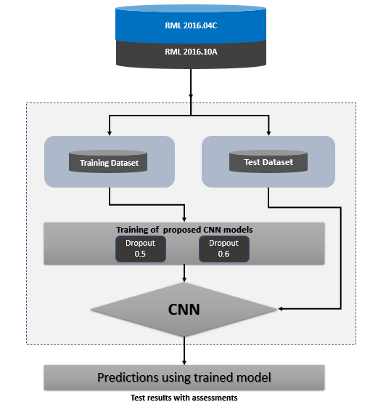
Workflow

Slide 10
Classifier
Output
11
Convolution
ReLU
80 x 1 x 3
Zeropadding
Dropout 0.6
Convolution
ReLU
128 x 1 x 3
Zeropadding
Dropout 0.6
Dense
ReLU
128
Dropout 0.6
Dense
ReLU
80
Dropout 0.6
Convolution
ReLU
512 x 1 x 3
Zeropadding
Input
2 x 128

Slide 11
Results

Slide 12
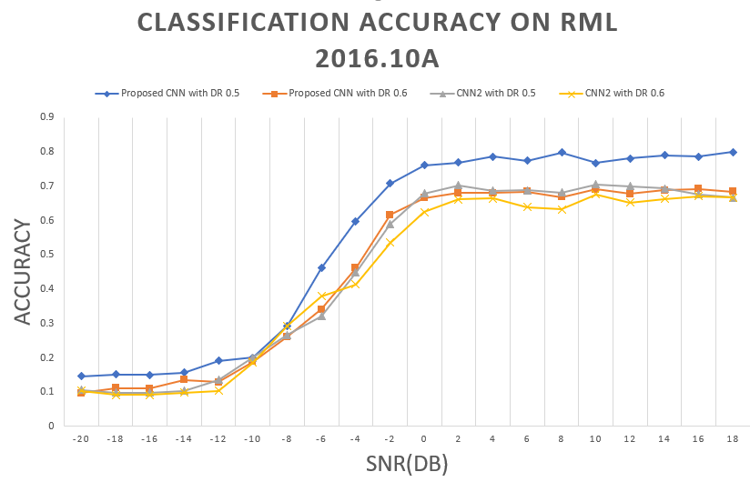
Classification Accuracy

Slide 13
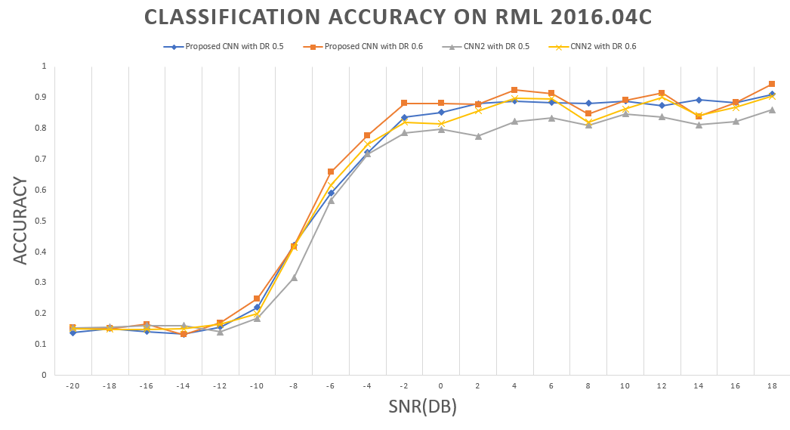
Classification Accuracy

Slide 14
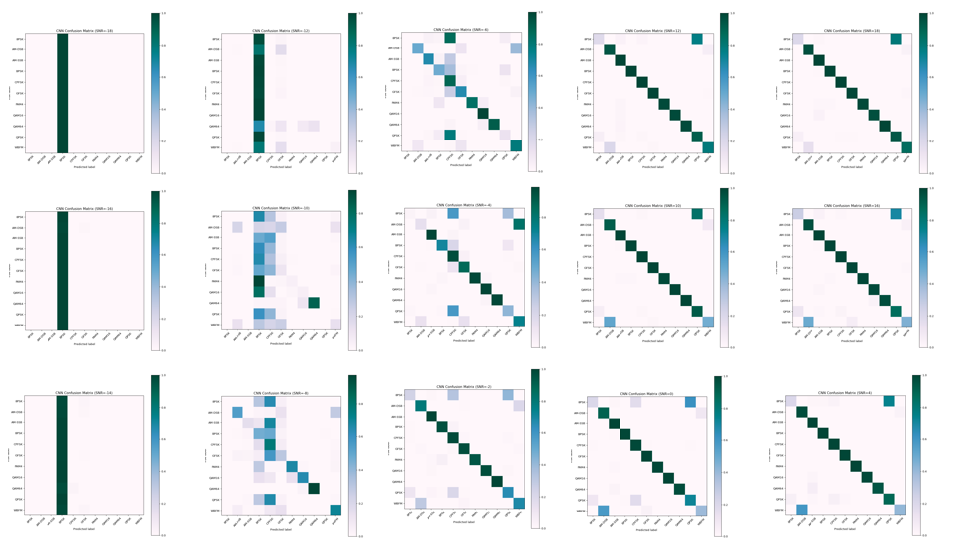
Classification Accuracy

Slide 15
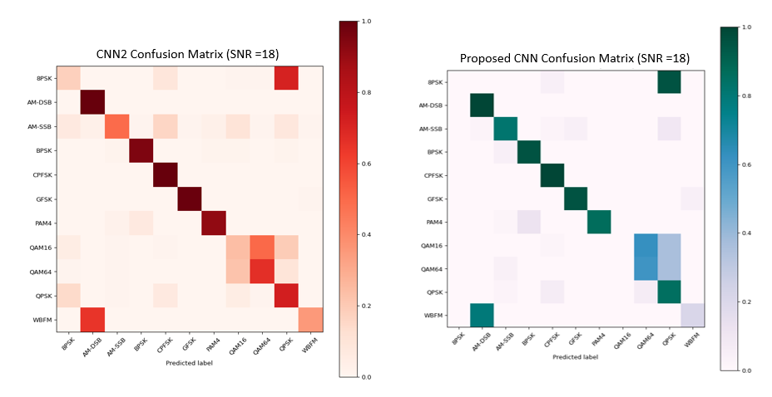
Classification Accuracy

Slide 16
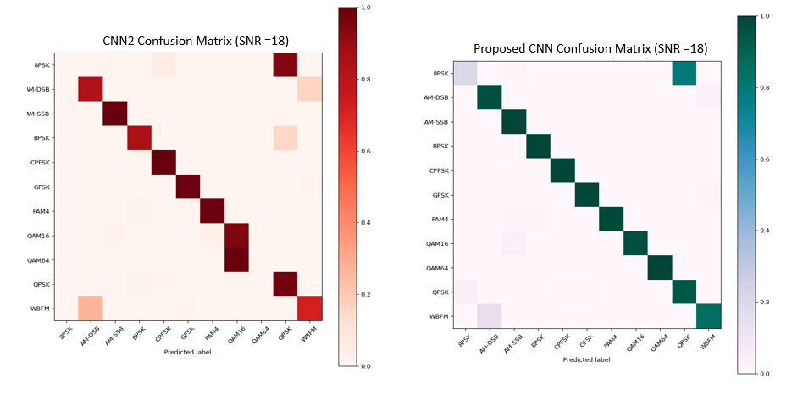
Classification Accuracy

Slide 17
Conclusion
In this correspondence, we proposed a modified convolutional neural network architecture for the classification of the modulation schemes.
The results show that the proposed framework performs better than the existing model in terms of accuracy.
Since the model complexity have been compromised, in future we would like to propose a classifier that offers superior classification performance by keeping the low complexity of the model.

Slide 18
Thank you

