Slide 1
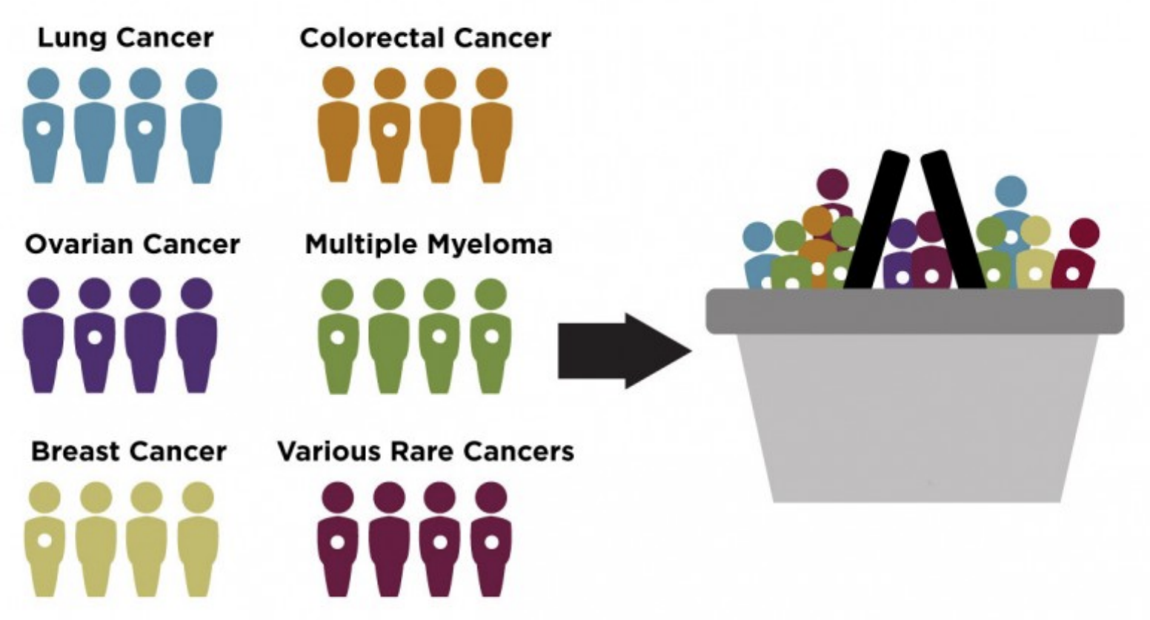
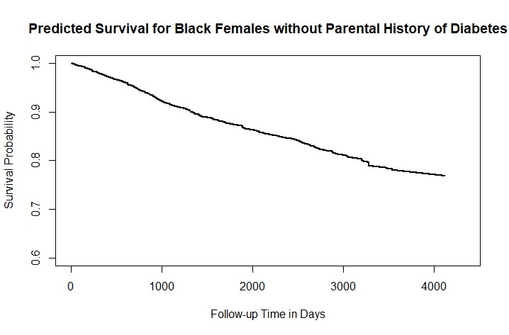
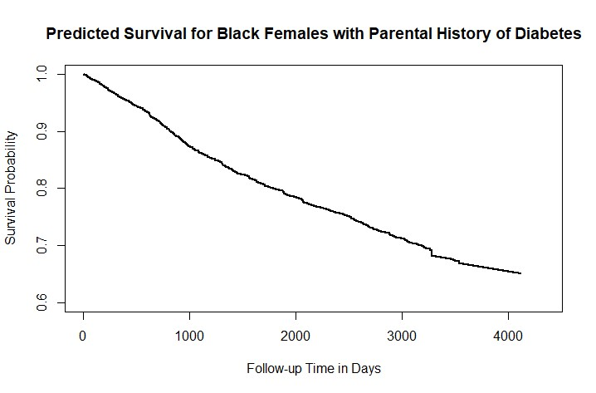
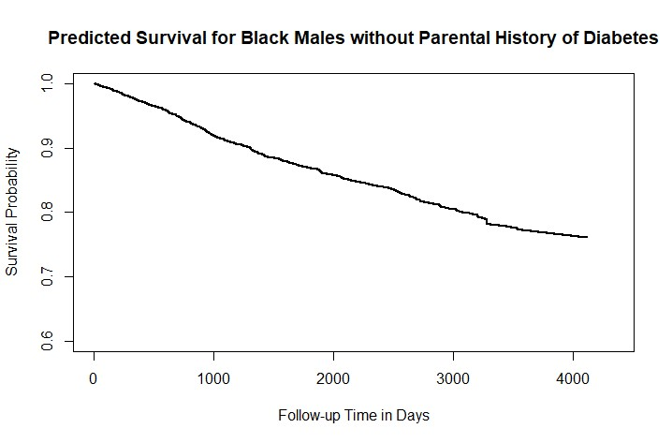
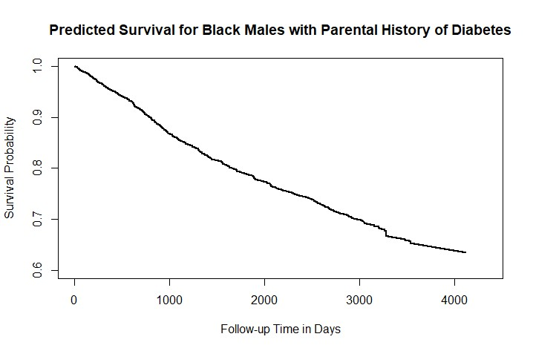
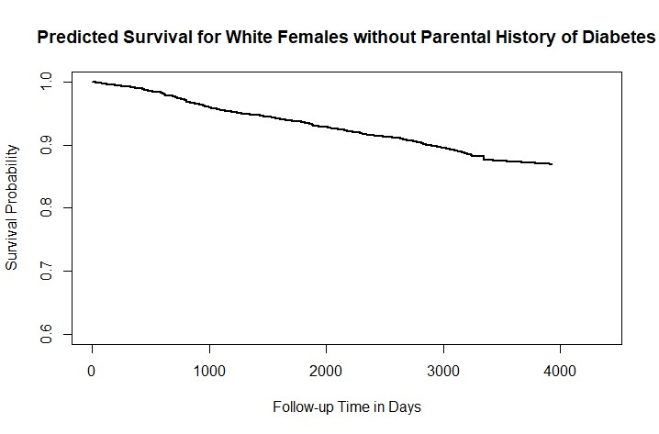
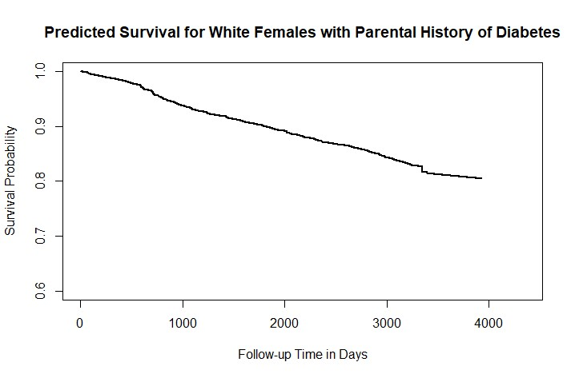
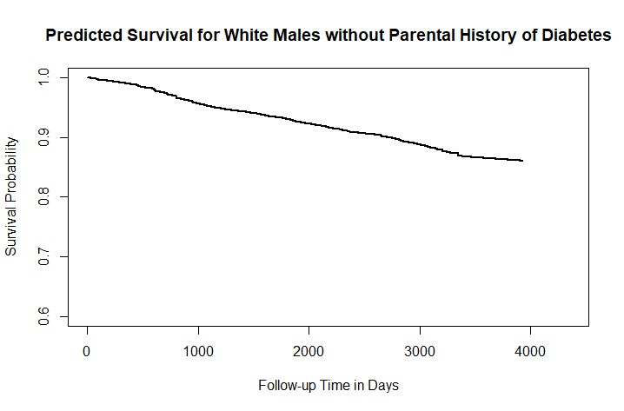
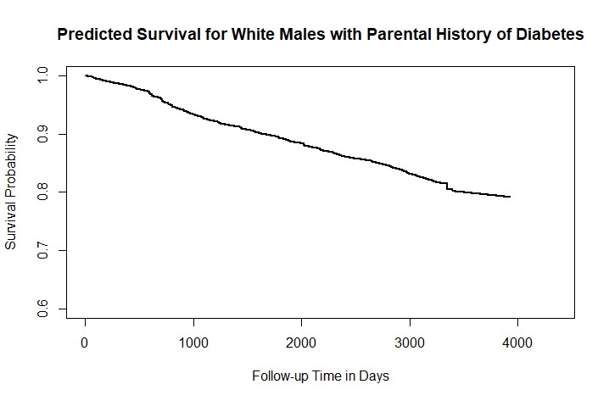
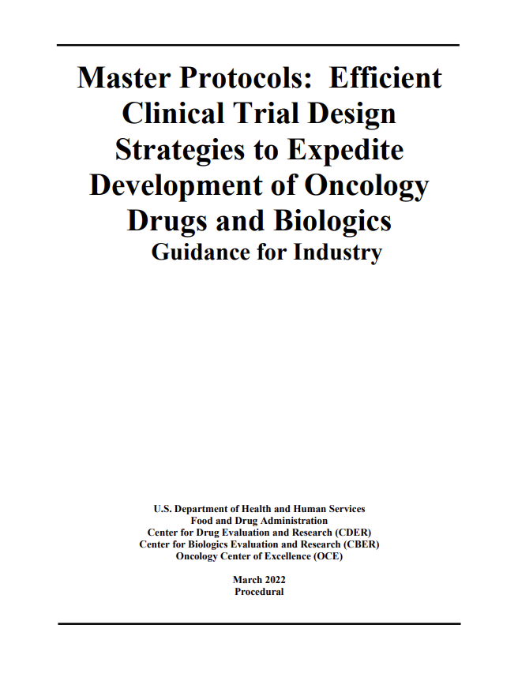
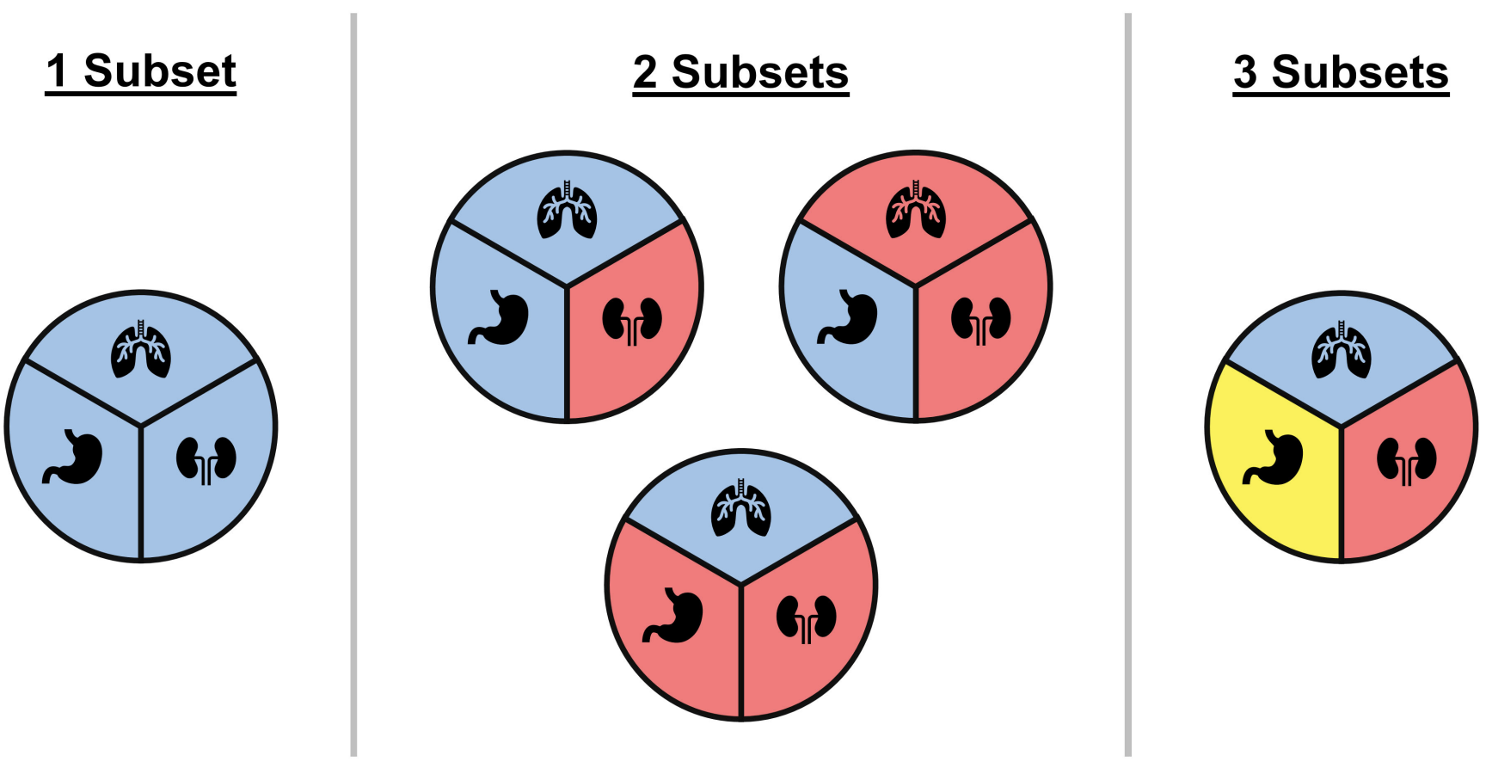
Review and Comparison of Statistical Methods for Basket Trials
Haolin Li, Qiqi Deng, Michelle Brown, Peijie Hou, Huzhang Mao, Lili Zhu. Moderna Inc.
Introduction
Analysis Methods (Cont.)
Applications
Basket Trial: single investigational drug across multiple populations
Population often defined by histology, prior therapies, genetic, biomarkers, or other demographic characteristics
Design: often single-arm, activity-estimating trials.
Primary Endpoint: often overall response rate.
Interim Analysis: futility and efficacy.
Motivations: shared genetic, molecular, immunologic mutations and biomarkers; target therapies; precision medicine.
Example Basket Trials:
NCT02648724: a phase Ia/IIa trial investigating a monoclonal antibody mixture targeting MET in patients with advanced solid tumor malignancies.
NCT01885195: a modular phase II study to link targeted therapy to patients with RAS/RAF/MEK activated tumors.
NCT00918320: studies of temozolomide in combination with topotecan in refractory and relapsed pediatric solid tumors.
REFERENCE LIST:
Category 1:
BHM: Berry, S. M., et al. "Bayesian hierarchical modeling of patient subpopulations: efficient designs of phase II oncology clinical trials." Clinical Trials 10.5 (2013): 720-734.
Correlated BHM: Jin, J., et al. "Bayesian methods for the analysis of early‐phase oncology basket trials with information borrowing across cancer types." Statistics in Medicine 39.25 (2020): 3459-3475.
EXNEX: Neuenschwander, B., et al. "Robust exchangeability designs for early phase clinical trials with multiple strata." Pharmaceutical statistics 15.2 (2016): 123-134.
DEXNEX: Chen, C., et al. "Bayesian hierarchical models for adaptive basket trial designs." Pharmaceutical Statistics 22.3 (2023): 531-546.
Calibrated BHM: Chu, Y., et al. "A Bayesian basket trial design using a calibrated Bayesian hierarchical model." Clinical Trials 15.2 (2018): 149-158.
BHMM: Liu, R., et al. "Increasing the efficiency of oncology basket trials using a Bayesian approach." Contemporary clinical trials 63 (2017): 67-72.
BLAST: Chu, Y., et al. "BLAST: Bayesian latent subgroup design for basket trials accounting for patient heterogeneity." Journal of the Royal Statistical Society Series C: Applied Statistics 67.3 (2018): 723-740.
BCHM: Chen, N., et al. "Bayesian cluster hierarchical model for subgroup borrowing in the design and analysis of basket trials with binary endpoints." Statistical Methods in Medical Research 29.9 (2020): 2717-2732.
Category 2:
Cunanan, K. M., et al. "An efficient basket trial design." Statistics in medicine 36.10 (2017): 1568-1579.
Zhou, Heng, et al. "Optimal two-stage designs for exploratory basket trials." Contemporary Clinical Trials 85 (2019): 105807.
Category 3:
Simon’s Bayesian basket design: Simon, R., et al. "The Bayesian basket design for genomic variant-driven phase II trials." Seminars in Oncology. Vol. 43. No. 1. WB Saunders, 2016.
MEM: Hobbs, B. P., et al. "Bayesian basket trial design with exchangeability monitoring." Statistics in medicine 37.25 (2018): 3557-3572.
Local-MEM: Liu, Y., et al. "Bayesian local exchangeability design for phase II basket trials." Statistics in medicine 41.22 (2022): 4367-4384.
BMA: Psioda, M. A., et al. "Bayesian adaptive basket trial design using model averaging." Biostatistics 22.1 (2021): 19-34.
Category 4:
RoBoT: Zhou, T., et al. "RoBoT: a robust Bayesian hypothesis testing method for basket trials." Biostatistics 22.4 (2021): 897-912.
BART: Pan, J., et al. "Bayesian Additive Regression Trees (BART) with covariate adjusted borrowing in subgroup analyses." Journal of Biopharmaceutical Statistics 32.4 (2022): 613-626.
ALASSO: Kanapka, L., et al. "A frequentist design for basket trials using adaptive lasso." Statistics in Medicine 43.1 (2024): 156-172.
In the Atherosclerosis Risk in Communities (ARIC) Study, a case-cohort study was conducted to study the incident diabetes.
The case-cohort sample consists of 228 controls and 261 cases for black adults, and 284 controls and 282 cases for white adults.
Biomarkers such as inflammation score, leptin, and carboxymethyl lysine are available only for the case-cohort sample.
A super learner is constructed by the exponential model, Cox model, Gamma AFT model, and random survival forest.
Conclusions
The proposed super learner has superior performance of survival prediction in case-cohort and generalized case-cohort studies.
The proposed super learners trained by case-cohort and generalized case-cohort samples outperform those trained by a simple random sample of equal sample size in terms of prediction accuracy.
Analysis Methods
TAXOMOMY:
Category 1: Bayesian hierarchical modeling (BHM)
Under exchangeability assumption (e.g., BHM, correlated BHM)
EXNEX and its variations (e.g., DEXNEX)
Testing for homogeneity (e.g., calibrated BHM, BHMM)
Clustering approach (e.g., BLAST, BCHM)
Category 2: Pruning-and-pooling approach
Category 3: Model averaging approach (e.g., Simon’s Bayesian basket design, MEM, local-MEM, BMA)
Category 4: Other methods (e.g., RoBoT, BART, ALASSO)
ADDITIONAL RESOURCES:
Review papers:
Kaizer, A. M., et al. "Basket designs: statistical considerations for oncology trials." JCO Precision Oncology 3 (2019): 1-9.
Kasim, A., et al. "Basket trials in oncology: a systematic review of practices and methods, comparative analysis of innovative methods, and an appraisal of a missed opportunity." Frontiers in Oncology 13 (2023): 1266286.
FDA Guidance: “Master Protocols: Efficient Clinical Trial Design Strategies to Expedite Development of Oncology Drugs and Biologics.”

