Slide 1

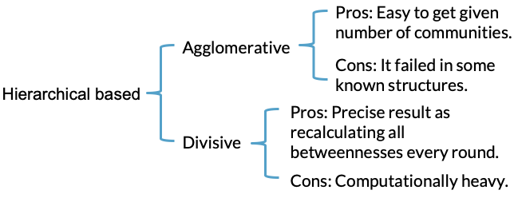
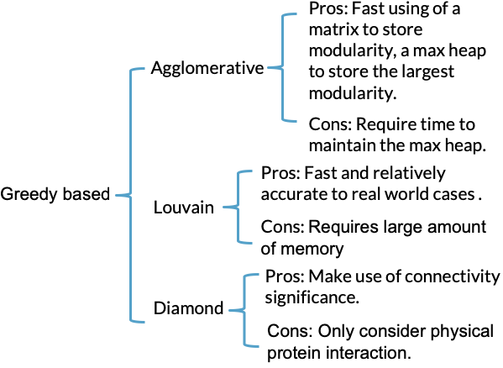
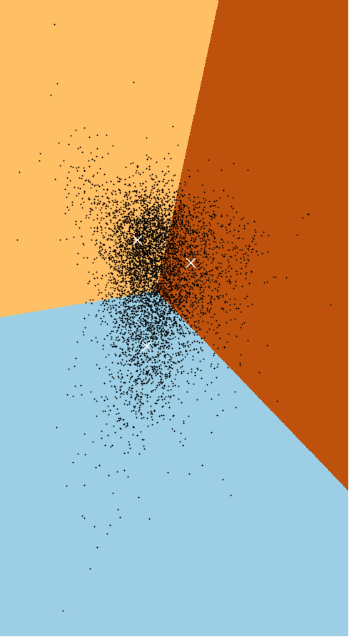
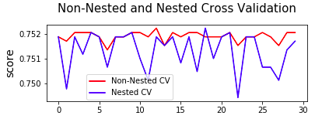
Disease Module Detection From Machine Learning Approach
Objective
Result & Discussion
The purpose of the research is to first evaluate and cross compare the state-of-art module detection algorithm and second to introduce a new way to detecting modules especially disease modules using machine learning techniques.
Comparison between two types of module detection algorithms
Introduction
There are handful of module detection algorithms in the previous studies. Two types namely Hierarchical based and greedy based are specifically studied. A cross comparison result on their advantages and disadvantages are shown clearly in the next section.
Inspired by an integrative drug target detection method¹ based on multi-relational association mining, the method described in this poster takes all topological features, sequential features and functional features into consideration and will be tested using several mature machine learning techniques.
Methodology
Data Set
Mendelian Disease Dataset² (with labelled target): known disease genes, essential non-disease genes and non-essential non-disease genes
K-Means with Principle Component Analysis for the Dataset
Feature Creation
 | Disease Module 1 | Disease Module 2 | Disease Module 3
F1 score | 0.35 | 0.29 | 0.19
Accuracy | 0.54 | 0.63 | 0.58
As the conventional algorithms can be biased to detect module based on topological features only, for example, clusters with higher modularity may not function together³, thus we use the integrative method of combining the following features.
Topological Features | Sequential Features | Functional Features
Average shortest path | Amino acids percentage | Semantic Similarity among Gene Ontology terms based on Biological Processes
Local clustering coefficient | Aromaticity | Semantic Similarity among Gene Ontology terms based on Cellular Components
Centrality: degree centrality, closeness centrality, betweenness centrality, eigenvector centrality, PageRank, harmonic centrality (implemented using Python NetworkX package) | Isoelectric | Semantic Similarity among Gene Ontology terms based on molecular functions
Modularity | SS fraction: helix, turn, sheet
Support Vector Machine on the Dataset
The highest accuracy score(0.75) occurs with nested cross validation.
Conclusion
Through observation, we find that Support Vector Machine provides a much higher F1 score than K-Means with PCA. Next step is to first tuning the parameters using Support Vector Machine and then study the performance by using other machine learning models.
References
Machine learning model
K-Means Clustering with Principle Component Analysis
Support Vector Machine with nested cross validation
Random Forest
[1] Nguyen, T. P., Priami, C., & Caberlotto, L. (2015). Novel drug target identification for the treatment of dementia using multi-relational association mining. Scientific reports, 5, 11104.
[2] Spataro, N., Rodríguez, J. A., Navarro, A., & Bosch, E. (2017). Properties of human disease genes and the role of genes linked to Mendelian disorders in complex disease aetiology. Human molecular genetics, 26(3), 489-500.
[3] Ghiassian SD, Menche J, Barabási A-L (2015) A DIseAse MOdule Detection (DIAMOnD) Algorithm Derived from a Systematic Analysis of Connectivity Patterns of Disease Proteins in the Human Interactome. PLoS Comput Biol 11(4): e1004120.
Category: Engineering and Technology Student: Li Mengyang
School of Computer Science and Engineering Project ID: SCSE18042
Supervisor: Prof Rajapakse Jagath Chandana Collaborators*/Co-supervisors*: Dr. Rama Kaalia

