Slide 1
Prediction of disease/drug targets and modules

Slide 2
Disease/drug network
Disease-gene associations
Protein/gene networks (target network)

Slide 3
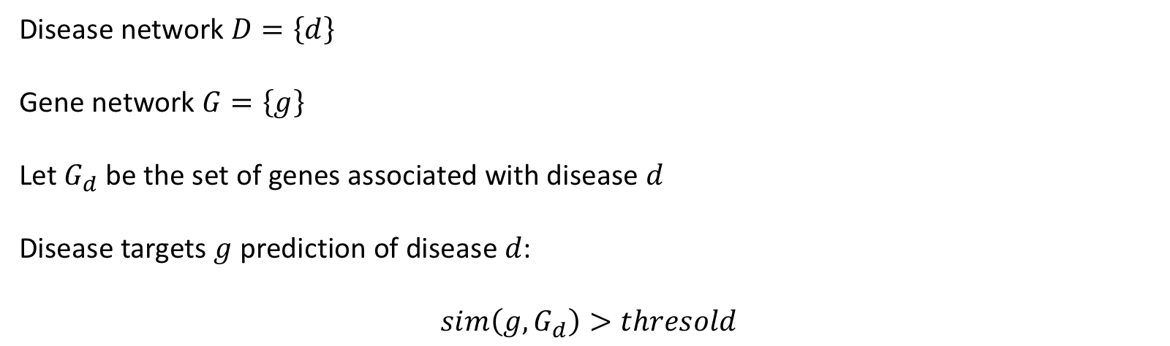
Disease targets prediction
Disease network $D=\left\{d\right\}$
Gene network $G=\left\{g\right\}$
Let $G_{d}$ be the set of genes associated with disease $d$
Disease targets $g$ prediction of disease $d$:
$$sim\left(g,G_{d}\right)>thresold$$

Slide 4
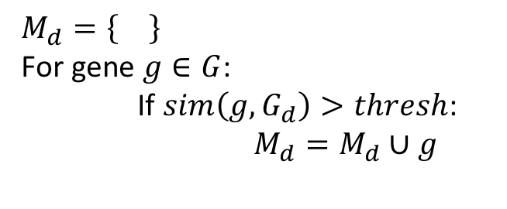
Disease module prediction
$$M_{d}=\left\{\right\}$$
For gene $g∈G$:
If $sim\left(g,G_{d}\right)>thresh$:
$M_{d}=M_{d}∪g$

Slide 5
DiaMond

