Slide 1
Module Detection Using Machine Learning Approach
Group Meeting I
Notes:
Please click on “Present” for getting the full content.

Slide 2
Agenda
Milestone 1 -- Understand Commonly Used Network Properties
Milestone 2 - - Understand Main Existing Module Detection Algorithms
Milestone 3 -- Basic Hands-On Practice on Networkx
Milestone 4 -- Build Machine Learning Model
Notes:
Here are the highlights for what we have been doing for this semester, each of them took around 2-3 weeks

Slide 3
Milestone 1: Understand Commonly Used Network Properties
Commonly Used Topological Properties
i) Local Properties
Clustering Coefficient: Identify the centralized level of a node in its neighbour
Centraility: Identify the most important node in a connected component
ii) Global Properties
Modularity: Represents the possibility difference with the observed edges and the expected edges
Notes:
Start from the most basic math preliminary, I get myself familiar with most of the commonly used network topological properties.
They are mainly subdivided into local properties, that means properties for each individual nodes or edges, and global properties, that means the properties for the overall graph.
(Briefly write down equations for clustering coefficient, three types of centraility, many forms of modularity)
We should not only examine the topological property of Protein-Protein network, but also the relationship between topological property and functional property.

Slide 4
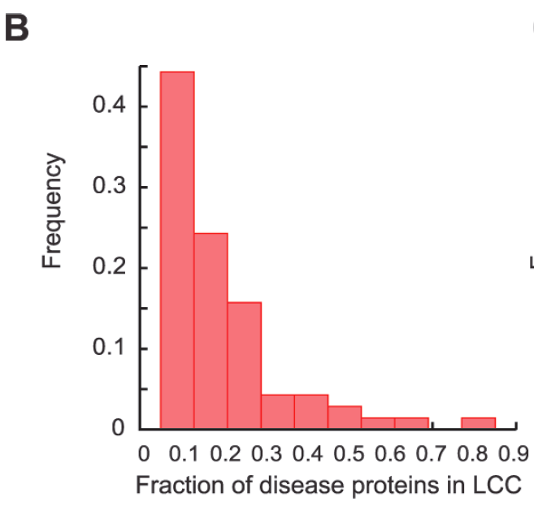
2. Relationship between topological module, functional module and disease module
Only 10-15% disease proteins are in the largest
connected component, clustering coefficient may
not be complex enough to represent
Figure source: [1]
Notes:
Associating with the first property - clustering coefficient, largest connected component will have higher clustering coefficient than its neighbours, while it’s been shown that actually only 10-15% of the disease proteins are inside LCC

Slide 5
2. Relationship between topological module, functional module and disease module [1]
Type | Meaning | Objection
Degree centrality | Higher, more likely to be involved in a more important functional module[2] | Evolutionary rate should decrease with higher importance [3], while centrality should be in positive relationship [4]
Closeness centrality | Higher, more functionally important as needs to be communicated quickly. | May also be used to less trivial purpose like transfer.
Betweenness centrality | An important node will lie on a higher proportion of the paths. | Real world cases are not always following the shortest path
Notes:
Mentioned in one paper about examining the nodes importance, these three centralities were discussed.
Degree centrality objection: In a paper shown as reference 4, they found that the position of a gene within the transcription network affects the rate of protein evolution such that more central transcription factors tend to evolve faster.

Slide 6
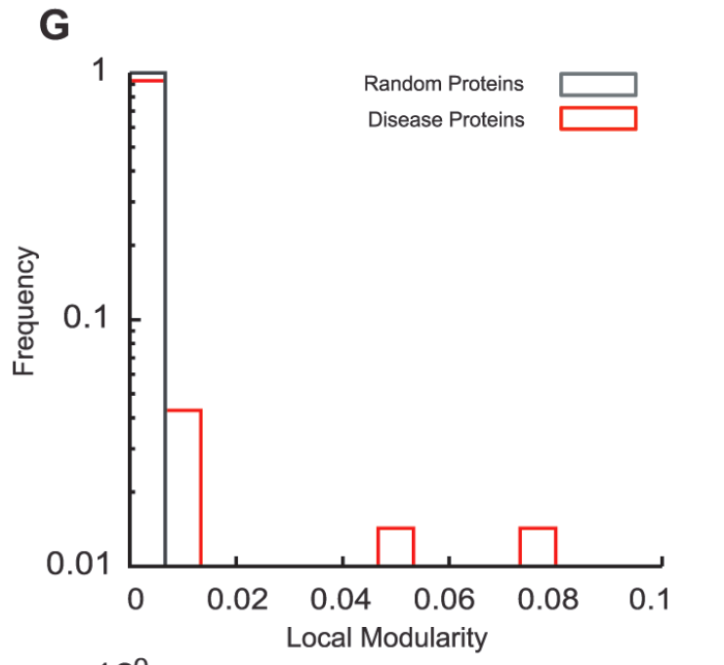
2. Relationship between topological module, functional module and disease module
While the modularity for disease associated
Proteins is between [0.00 , 0.07], higher
modularity may not be the real world case
Figure source: [1]
Notes:
Disease modules don’t have a very high modularity. Even when the incompleteness increases, modularity increases a little / remains almost the same, found in paper source [1]

Slide 7
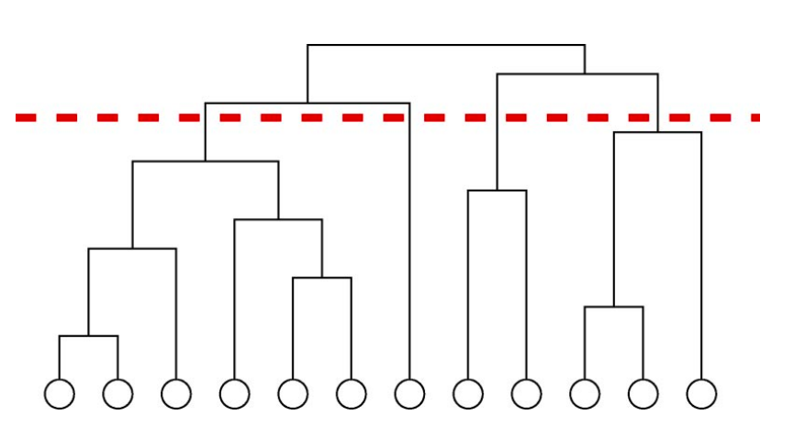
Milestone 2: Understand Main Existing Module Detection Algorithms
Hierarchical clustering based
i) Agglomerative (Bottom-Up)
Find a pair that is closest and
merge them
Figure source: [5]
Notes:
All the above properties are helpful to understand the following module detection algorithms. There are mainly three types of algorithms to detect community in a network from my perspective, first is hierarchical clustering based, second is greedy based, third is random flow based. While there are more algorithms to be examined, I only chose the most popular ones.
First type has two subtypes, one is bottom-up approach, the other is top-down approach. Agglomerative has a graphical representation of the process of module detecting shown as a dendrogram. This algorithm mainly found the pair of nodes with lowest geodesic distance, and merge the pair into a community.
The height of the branch represents the distance, and this dendrogram can be cut half-way to get desired amount of communities.

Slide 8
Hierarchical clustering based
ii) Divisive (Top-Down) [6]
Remove the edges between two nodes that have the largest betweenness/least similarity
Commonly used betweenness:
Shortest Path Betweenness
Can be found using BFS or DFS
Random walk betweenness
How often on average random walks starting at vertex s will pass down a particular edge from vertex v to vertex w before reaching the target t.
Notes:
Second type of hierarchical clustering algo is divisive approach, that is basically remove the edge between two nodes that have the least similarity, or here the paper examines with largest betweenness.
Shortest path betweenness is encouraged as it’s easy and fast
We abandon the resistor betweenness as that is less relevant.
Random walk betweenness calculation requires relatively larger memory (briefly explain formula)

Slide 9
Greedy Based
i) Agglomerative [7]
A matrix to store ΔQij: ∆Qij =1/2m − kikj/(2m)² if i, j are connected.
Find the largest ΔQij, group them into a community
Update the rest of the nodes
∆Qjk = ∆Qik+∆Qij , If k is connected to i and j
∆Qjk = ∆Qik-2ajak, If k is connected to i not j
∆Qjk = ∆Qjk-2aiak, If k is connected to j not i
Notes:
Second main algorithm type is modularity based, and they are greedy algorithm.
First subtype is using agglomerative approach to maximize the modularity of the network. Here the change in modularity is calculated as the equation shown in the slides, after get the delta Q for all node pairs, we will find the pair that gives the largest delta Q and group them into a community, then update the rest of the matrix.
Here a is a vector array that each entry is equal to ki/2m

Slide 10
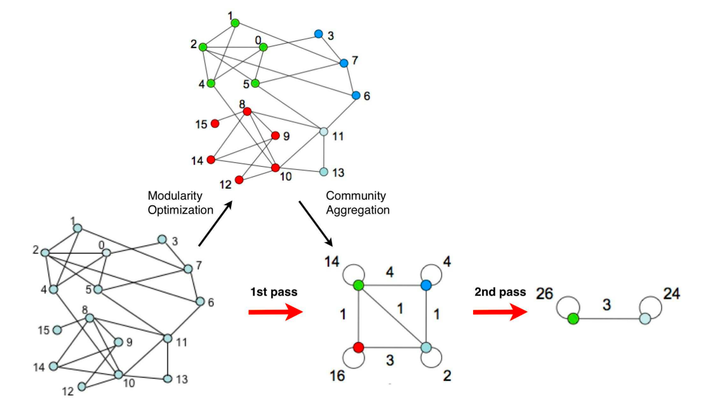
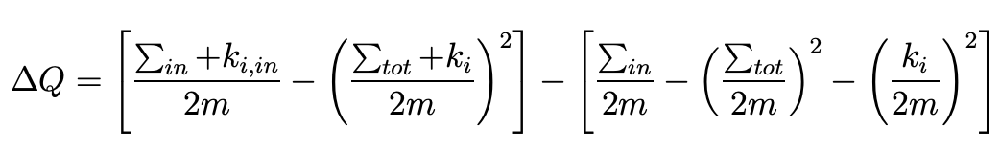
Greedy Based
ii) Louvain Algorithm
Merge group into communities according to which kind of grouping will give the largest increase in modularity
Change in modularity is calculated by:
Figures retrieved from [8]
Notes:
Second subtype is louvain algorithm, which is one of the most popular algorithm as it can execute very fast.
Similar to agglomerative greedy algo, Louvain also aims to maximize the modularity of the network. While the previous algo used the concept of local modularity, louvain used global modularity, and every iteration, Louvain will find a way to divide the whole graph which gives the maximum change in global modularity, and aggregate into a simpler graph.
Later we will do comparison of all algorithms, and we will found that Louvain provides the least time complexity.

Slide 11
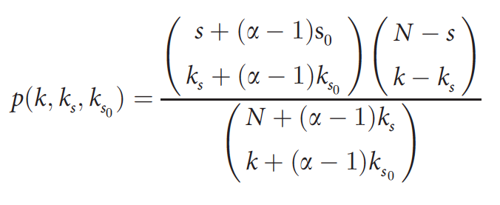
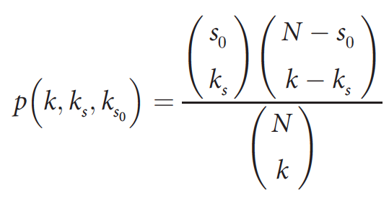
Greedy Based
iii) Diamond Algorithm [1]
Find connectivity significance for all nodes:
Rank proteins according to p-value, the protein with the highest rank will be added to the seed protein set
Can also be tuned into:
Notes:
Third subtype is Diamond, I group diamond into the greedy based algorithm as Diamond aims to find the nodes with highest p-value and add into the seed protein set. Diamond algorithm can be tuned to be more accurate by adding weight to edges, represented by alpha.
The major difference for Diamond algo between other algorithms is that:
Diamond algo needs a set a seed genes, then Diamond will expand the seed gene set with newly found possible disease gene, which means requires more input that is difficult to get, but will also provide more biologically accurate result.
This is my personal perspective.

Slide 12
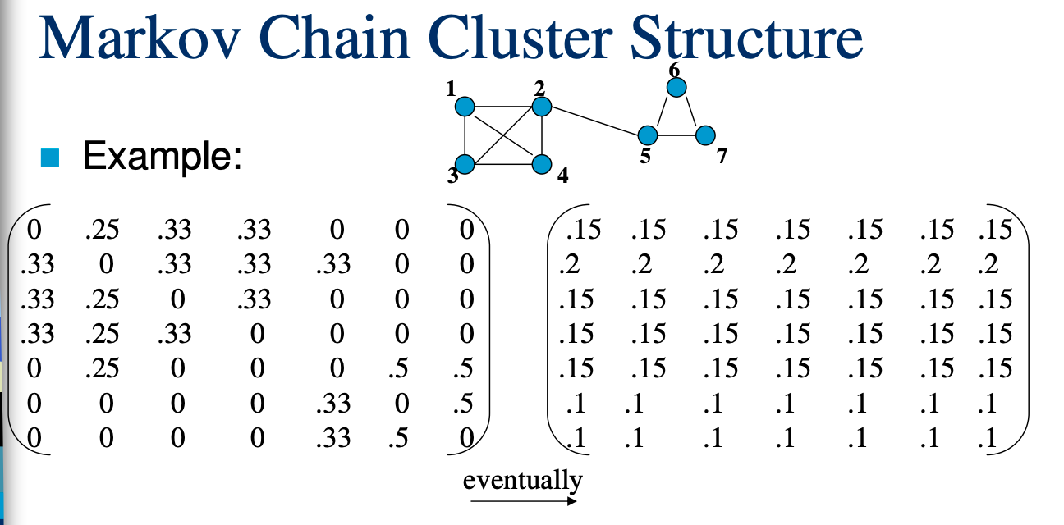
Random Flow Based
Markov Chain Algorithm
Assumption: if start traversing from a random node, it is more likely to traverse inside a cluster instead of traverse between clusters.
Re-normalize the matrix until it becomes stable
Figure retrieved from [9]
Notes:
Random flow based algorithm is more like a mathematical manipulation. The representative for this type is Markov Chain Cluster algorithm.
The main algorithm is
Get the matrix
Normalize it
Do inflation
Repeat until a threshold, which is the convergent stable point

Slide 13
Comparison between several algorithms
 | Advantage | Disadvantage | Complexity
Hierarchical Agglomerative | Easy to get given number of communities. Height of tree represents the Euclidean distance | It failed in some known structures Tendency to leave out Peripherals Only consider topological distance | O(n²) for space O(n³) for time
Divisive | Recalculate all betweennesses every round | Computationally heavy | O(mn²) for time
Greedy Agglomerative | Make use of a matrix to store ΔQij, a max heap to store the largest ΔQij Fast | Require time to maintain the max heap ΔQij matrix is sparse, space is not efficiently used | O(mdlogn) for time
Notes:
Some hierarchical agglomerative algorithms[1][2] are able to reach O(n²logn) for time, while requires more space.
[1] R. Sibson (1973). "SLINK: an optimally efficient algorithm for the single-link cluster method" (PDF). The Computer Journal. British Computer Society. 16 (1): 30–34. doi:10.1093/comjnl/16.1.30.
[2] D. Defays (1977). "An efficient algorithm for a complete-link method". The Computer Journal. British Computer Society. 20 (4): 364–366. doi:10.1093/comjnl/20.4.364.

Slide 14
Comparison between several algorithms
 | Advantage | Disadvantage | Complexity
Louvain | Fast Relatively accurate to real world cases e.g. citations, sub-network of internet | Requires large amount of memory | O(nlogn)
MCL | Robust against noise Scalable |  | O(n³)
Diamond | Use the concept of connectivity significance Higher precision and recall than Random Walk based |  | O(n²) worst case

Slide 15
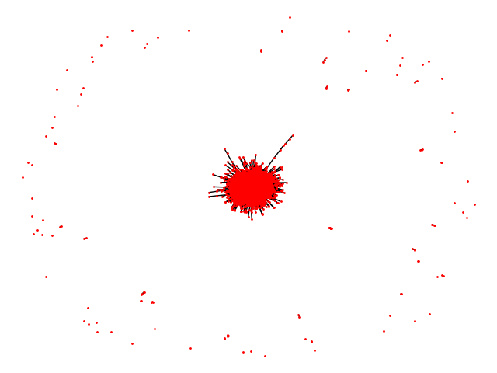
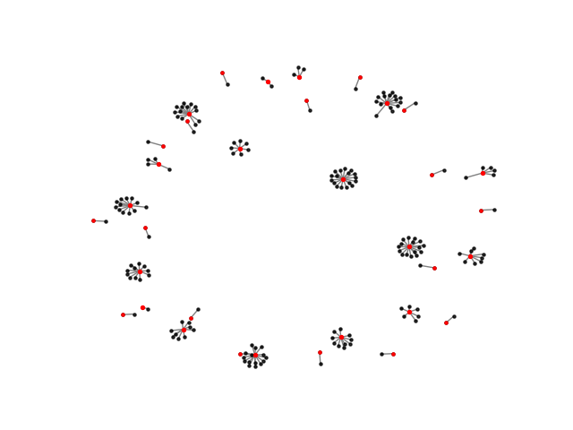
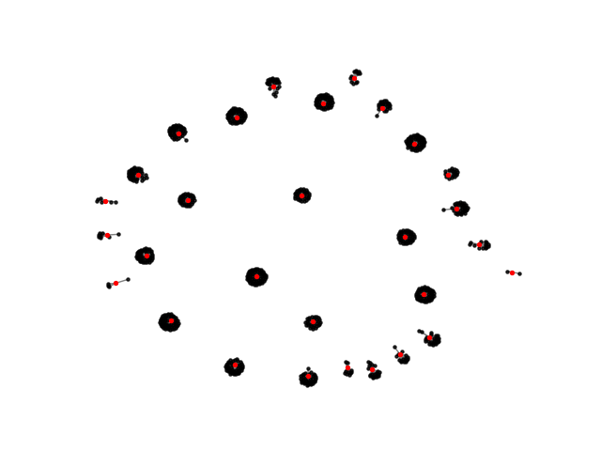
Milestone 3: Basic Hands-On Practice on Networkx
Visualization of 70 diseases [source code: https://github.com/LiMengyang990726/Module-Detection/blob/master/gene-gene-visualization.py]
Overview
Disease 1
Disease 2
Notes:
Questions
Difficulty in visualization networkx by drawing a static graph
Cannot install certain packages, e.g.xlsxwriter

Slide 16
2. Replication of the Experiment Result[https://github.com/LiMengyang990726/Module-Detection/blob/master/duplicateExperiment]
First 200 DIAMOnD genes are found with filling in the following parameters:
G_original = nx.read_edgelist("./gene-network.tsv")
max_number_of_added_nodes = 200
alpha = 2

Slide 17
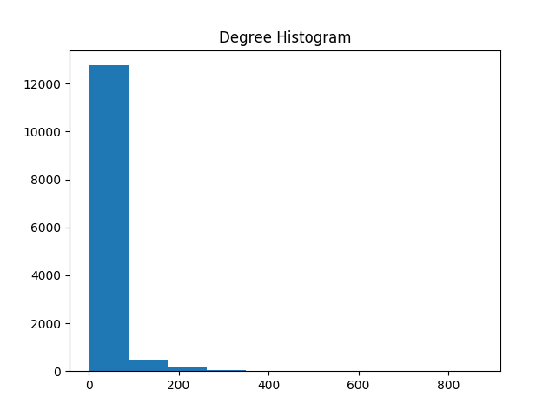
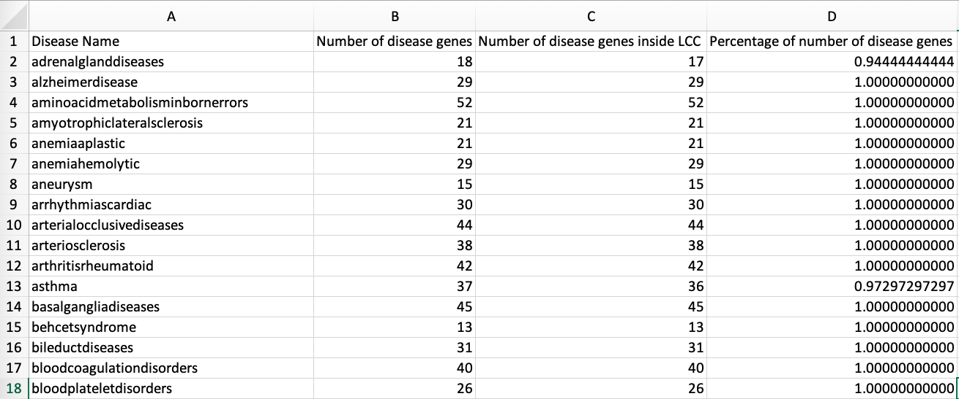
3. Network Analysis [source code: https://github.com/LiMengyang990726/Module-Detection/blob/master/PPIData.py]
Number of nodes: 13460
Number of edges: 141296
Average degree: 20.9949
Average clustering coefficient 0.173149862608986
Largest degree 872
The largest connected component
Number of nodes 13329
Number of edges 141150
Average shortest path length 3.5823263809237402

Slide 18
Milestone 5: Building Machine Learning Model
for key in disease_dic:
l = len(disease_dic[key])
nodes = []
for i in range(l):
if disease_dic[key][i] in Gc.nodes:
nodes.append(int(disease_dic[key][i]))
sub = Gc.subgraph(nodes)
n = nx.number_connected_components(sub)
print("number of connected components is " + str(n) + "\n")
Output: “number of connected components is 0”
…
Convert data into Features
Approach 1: Find the union set of all connected components of seed genes,
Make a matrix for checking if a disease gene g is inside each connected components
Current result: The disease nodes are sparsely connected, and for each disease, the number of connected component is 0, found by the following code:

Slide 19
Acknowledgements
I would like to express my deep gratitude to Professor Rajapakse for providing me the opportunity to dive into this very charming research field, and Ms Rama, my research supervisors, for the patient guidance,and useful critiques of this research work.

Slide 20
References
[1] Ghiassian SD, Menche J, Barabási A-L (2015) A DIseAse MOdule Detection (DIAMOnD) Algorithm Derived from a Systematic Analysis of Connectivity Patterns of Disease Proteins in the Human Interactome. PLoS Comput Biol 11(4): e1004120.
[2] Mason, O., & Verwoerd, M. (2007). Graph theory and networks in biology. IET systems biology, 1(2), 89-119.
[3] Zhang, J., & Yang, J. R. (2015). Determinants of the rate of protein sequence evolution. Nature reviews. Genetics, 16(7), 409-20.
[4] Jovelin, R., & Phillips, Patrick C.(2009). Evolutionary rates and centrality in the yeast gene regulatory network. Genome Biology, 10(4), 1474-760X.
[5] Newman, M. E., & Girvan, M. (2004). Finding and evaluating community structure in networks. Physical review E, 69(2), 026113.
[6] Newman, M. E., & Girvan, M. (2004). Finding and evaluating community structure in networks. Physical review E, 69(2), 026113.
[7] Clauset, A., Newman, M. E., & Moore, C. (2004). Finding community structure in very large networks. Physical review E, 70(6), 066111.
[8] Blondel, V. D., Guillaume, J. L., Lambiotte, R., & Lefebvre, E. (2008). Fast unfolding of communities in large networks. Journal of statistical mechanics: theory and experiment, 2008(10), P10008.
[9] Retrieved from https://www.cs.ucsb.edu/~xyan/classes/CS595D-2009winter/MCL_Presentation2.pdf

Slide 21
Github Repo Link for all mentioned
https://github.com/LiMengyang990726/Module-Detection
Notes:
All the deliverables and the process are shown in this github repo. Please feel free to leave comments and suggestions.

