Slide 1
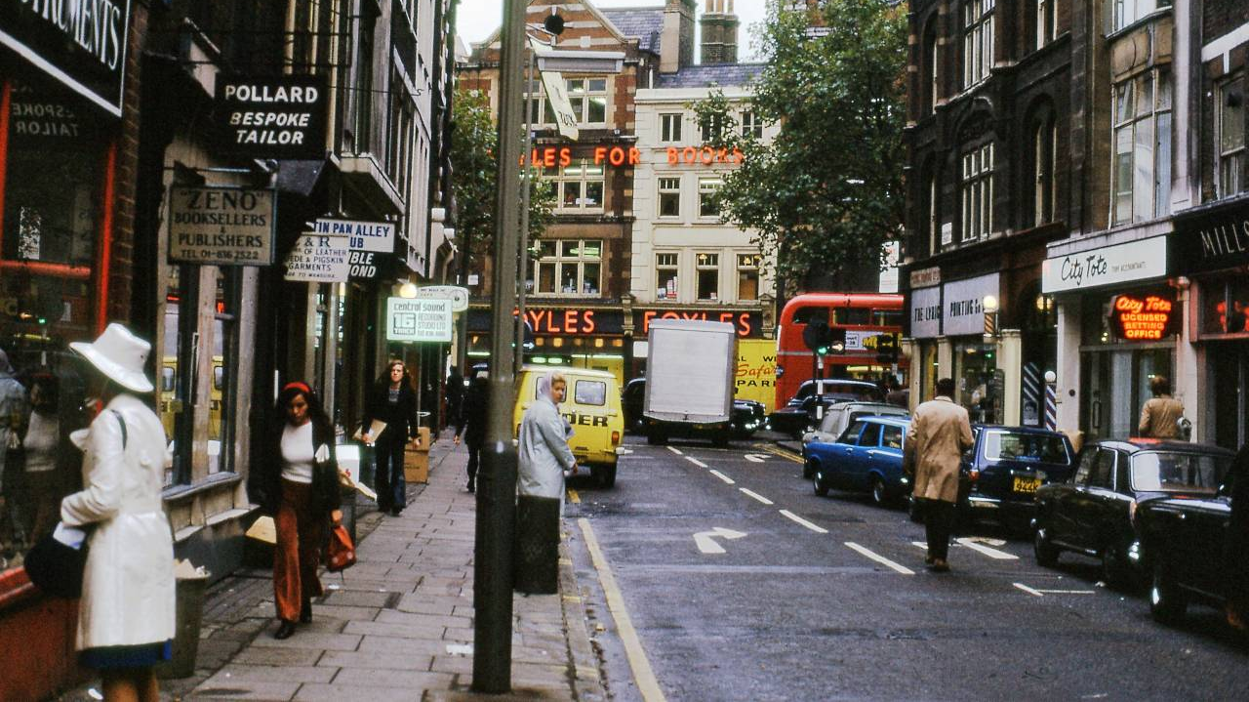
Shakey
First autonomous mobile robot
Perception, Planning and Action
STRIPS

Slide 2
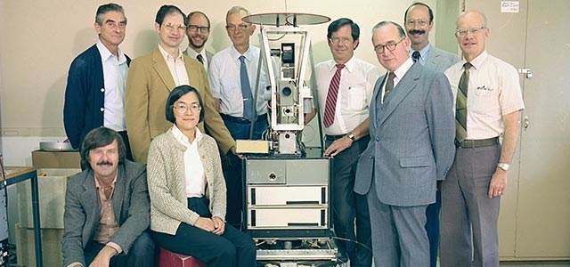

Slide 3
