Slide 1
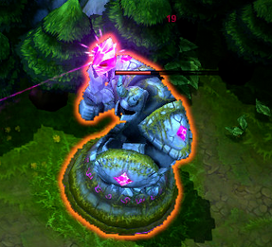
模型描边
1: LOL里面的模型描边效果:
2: 可以找到模型描边的Shader,推荐大家使用:
一组第三方的Shader, 帮我们解决了模型描边的问题
Toony

Slide 2
代码里面切换Shader
1: 关联要切换Shader的材质
2: 代码加载对应的Shader: Shader.Find(“Shader的名字”);
3: 切换材质对应的Shader; Matrix.shader = Shader
4: 将最常用的Shader, 放到Unity的Always Include里 --> 优化检查
5: Edit--> ProjectSetting --> Graphics --> Always-included Shaders
Specify a list of Shaders that will always be stored along with the project, even if nothing in your scenes actually uses them. It is important to add shaders used by streamed AssetBundles to this list to ensure they can be accessed. 让这些Shader很重要，在开始的时候加载，常驻内存;

