Slide 1
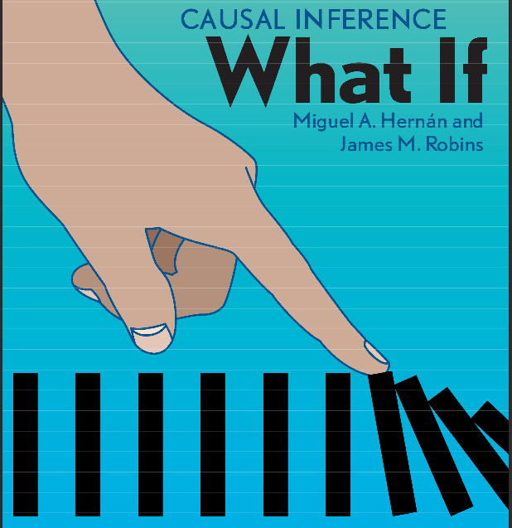
book club – chapter 6.3 and 6.4
motivation
quick tour on counterfactuals
causal graphs 6.1-6.4
d-seperation

Slide 2

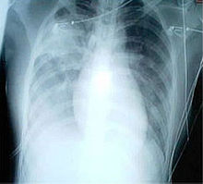
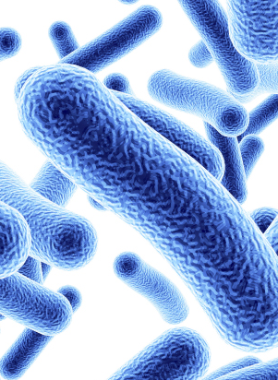
Why causal concepts matter...
SARS-CoV-2
severe atypic respiratory syndrome
SARS-CoV-2
severe atypic respiratory syndrome
Source: Causal Inference; Hernan and Robins; 2019

Slide 3
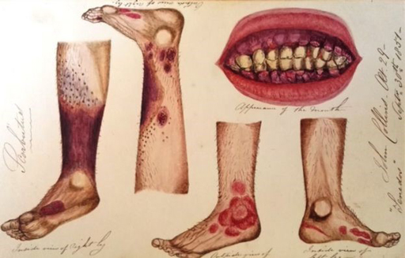
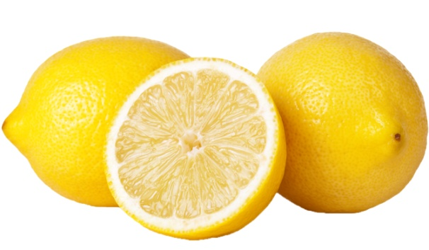
scurvy – the wrong mediator
Spanish lemons
citrus fruits
James Lind; 1747
scurvy: gum disease, bleeding from skin, infections
Source: The book of Why; Pearl and MacKenzie 2018;

Slide 4
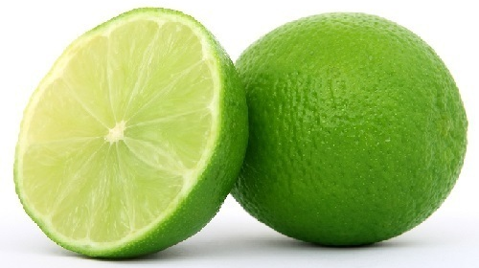
scurvy – the wrong mediator
West Indian limes
acidity
Arctic expedition, e.g. Scott 1903;
citrus fruits
James Lind; 1747
scurvy: gum disease, bleeding from skin, infections
Source: The book of Why; Pearl and MacKenzie 2018;

Slide 5
scurvy – the wrong mediator
Spanish lemons
ascorbic
acid
(Vitamin C)
Szent-Gyorgyi;
Nobel Prize 1937
citrus fruits
James Lind; 1747
scurvy: gum disease, bleeding from skin, infections
Source: The book of Why; Pearl and MacKenzie 2018;

Slide 6
6.1 Causal diagrams
a translation of our counterfactual statement:
Pr[Yª=1|A=1,L=1] = Pr[Yª=1|A=0,L=1]
Yª A|L=1
into a graph representation:
L
A
Y
covariate:
disease
severity
treatment:
heart
transplant
outcome:
survival
Def.: „causal DAG“: ..conditional on its direct causes, any variable on the DAG is independent of any other variable for which it is not a cause...
Source: Causal Inference; Hernan and Robins; 2019

Slide 7
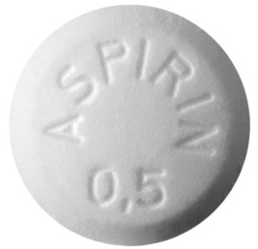

6.2 Causal diagrams and marginal independence
assume: randomized trial -> unconditional exchangeability
Yª A
counterfactual causal statement:
Pr[Y^{a=1} = 1] ≠ Pr[Y^{a=0} = 1]
graphical translation:
A
Y
treatment:
Aspirin
outcome:
heart disease
associations: causation implies association
Pr[Y = 1 | A = 1] ≠ Pr[Y = 1 | A = 0]
Source: Causal Inference; Hernan and Robins; 2019

Slide 8
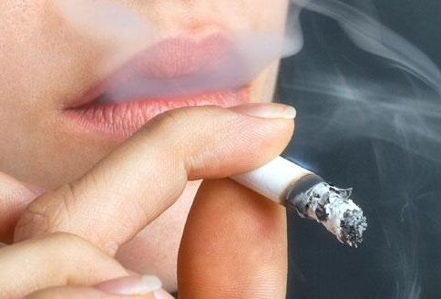
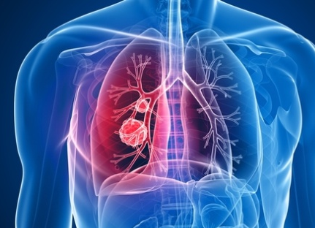

6.2 Causal diagrams and marginal independence
assume: observational study, we know smoking causes cancer & carrying a ligther doesn‘t cause cancer
counterfactual causal statement:
Pr[Y^{a=1} = 1] = Pr[Y^{a=0} = 1]
graphical translation:
L
A
Y
smoking
carrying
lighter
lung cancer
associations: common cause results in spurious correlation
Pr[Y = 1 | A = 1] ≠ Pr[Y = 1 | A = 0]
Source: Causal Inference; Hernan and Robins; 2019

Slide 9
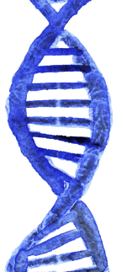
6.2 Causal diagrams and marginal independence
assume: we know that a genetic preposition has no causal effect on becoming smoker, but causes a heart condition as does smoking
counterfactual causal statement:
Pr[Y^{a=1} = 1] = Pr[Y^{a=0} = 1]
graphical translation:
A
Y
L
haplotype
genetic pattern
cigarette smoking
heart
disease
associations: common effect (collider blocks association)
Pr[Y = 1 | A = 1] = Pr[Y = 1 | A = 0]
Source: Causal Inference; Hernan and Robins; 2019

Slide 10
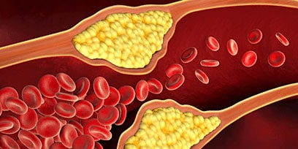
6.3 Causal diagrams and conditional independence
assume: we know that aspirin affects the risk of heart disease because
it reduces platelet aggregation
graphical translation:
mediator
A
B
Y
treatment:
aspirin
platelet aggregation
outcome:
heart
disease
associations: A and Y marg. associated, but condit. independent
Pr[Y=1 | A=1, B=b] = Pr[Y=1 | A=0, B=b]
effect: conditioning on a mediator B blocks the flow
A Y|B
Source: Causal Inference; Hernan and Robins; 2019

Slide 11
6.3 Causal diagrams and conditional independence
assume: observational study, we know smoking causes cancer & carrying a ligther doesn‘t cause cancer
graphical translation:
L
A
Y
smoking
carrying
lighter
lung cancer
associations: A and Y marg. associated, but condit. independent
Pr[Y=1 | A=1, L=l] = Pr[Y=1 | A=0, L=l]
effect: conditioning on common cause L interrupts the flow
A Y|L
Source: Causal Inference; Hernan and Robins; 2019

Slide 12
6.3 Causal diagrams and conditional independence
assume: we know that a genetic preposition has no causal effect on becoming smoker, but causes a heart condition as does smoking
graphical translation:
A
Y
L
haplotype
genetic pattern
cigarette smoking
heart
disease
associations: A and Y are marg. independent, but cond. associated
Pr[Y=1 | A=1, L=l] ≠ Pr[Y=1 | A=0, L=l]
effect: conditioning on common effect (collider) L opens the flow
A Y|L
Source: Causal Inference; Hernan and Robins; 2019

Slide 13
6.3 Causal diagrams and conditional independence
3+1 reasons why two variables may be associated:
one causes the other A → Y
they share common causes A ← L → Y
they share a common effect (or of its descendants)
A → L ← Y
random variability (becomes smaller with increasing n)
formalized and mathematically proven by d-seperation (Pearl, 1995) and the faithfullness assumption.
structural reasons
Source: Causal Inference; Hernan and Robins; 2019

Slide 14
6.3 summary
causal diagrams – a simple way to...
encode your subject-matter knowledge
present your assumptions
identify conceptual problems
enhance communication & guide data analysis
simultaneously represent associations
L
A
Y
covariate:
disease
severity
treatment:
heart
transplant
outcome:
survival
Source: Causal Inference; Hernan and Robins; 2019

Slide 15
6.4 positivity and consistency in causal diagrams
positivity condition:
... we must ensure that there is a probability greater than zero –
a positive probability – of being assigned to each of the
treatment levels (p30).
... in graphs (p76): ...arrows from nodes L to treatment A are not deterministic
L
A
Y
covariate:
disease
severity
treatment:
heart
transplant
outcome:
survival
Source: Causal Inference; Hernan and Robins; 2019

Slide 16
Fine Point 6.1: d-seperation
The relationship between statistical independence and the purely graphical concept of d-separation relies on the causal Markov assumption.
Pearl proved (1988):
..the causal Markov assumption implies that, given any three disjoint sets A, B, C of variables, if A is d-separated from B conditional on C, then A is statistically independent of B given C.
Definition „causal DAG“: ...conditional on its direct causes, any variable on the DAG is independent of any other variable for which it is not a cause...
Source: Causal Inference; Hernan and Robins; 2019

Slide 17
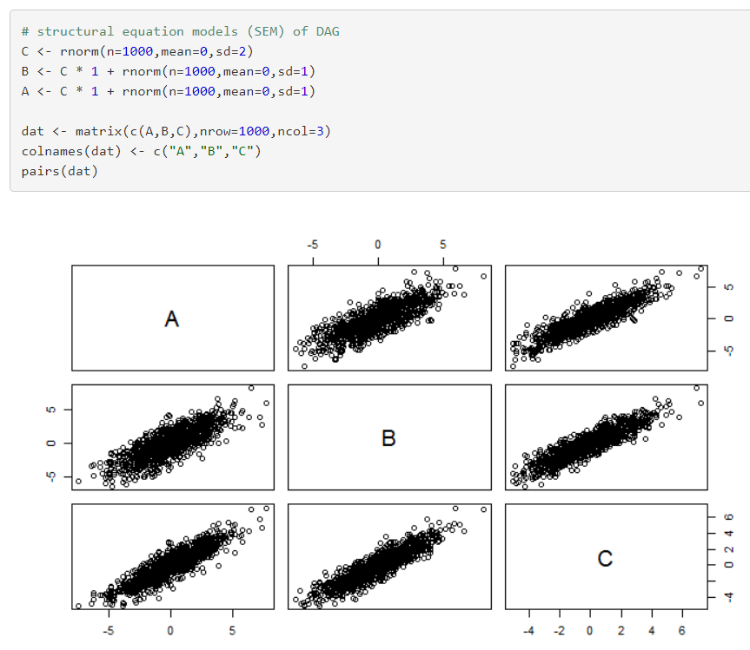
Fine Point 6.1: d-seperation
C
A
B
Source: Causal Inference; Hernan and Robins; 2019

Slide 18
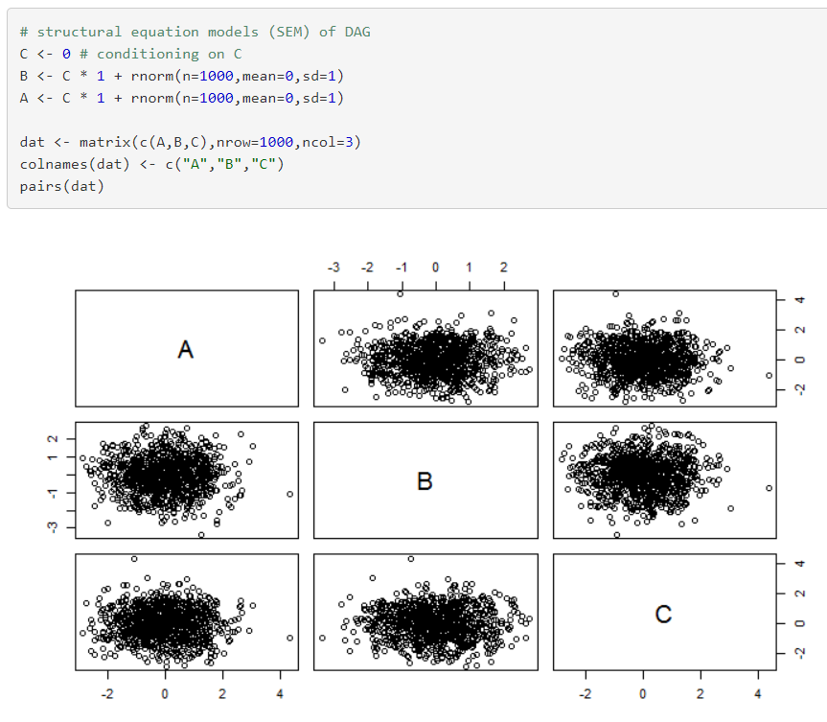
Fine Point 6.1: d-seperation
C
A
B
Source: Causal Inference; Hernan and Robins; 2019

