Slide 1
Causal Inference: What if
Chapter 2 – Randomized Experiments

Slide 2
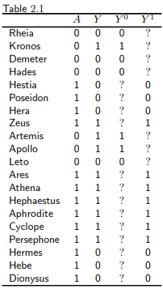
Recap
Only one of the two counterfactual outcomes is known for each individual → the one corresponding to the treatment level he received.
Other counterfactual outcomes are missing.
Problem: we need both counterfactual outcomes to compute causal effect measures.
Data in Table 2.1 is only good to compute association measures.

Slide 3

Randomization
Randomized experiments generate data with missing values of the counterfactual outcomes.
Randomization ensures the missing values occurred by chance → causal effect measures can be estimated.
When group membership is randomized it is irrelevant which group received the treatment → Groups are exchangeable:
* where a is the potential treatment

Slide 4
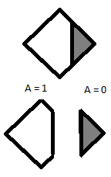
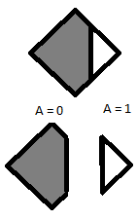
Randomization
Mortality Risk = Pr[Y=1|A=0] = 0.6
Pr[Y=0|A=1]= 0.3
Associational Risk Ratio = 0.3 / 0.6 = 0.5
Associational Risk Difference = 0.3 – 0.6 = -0.3
→ Association measures do not change

Slide 5
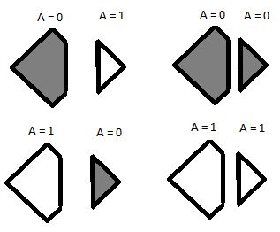
Randomization
Following this conclusion due to exchangeability it is allowed to calculate the risks in the population.
Therefore in ideal randomized experiments association is causation.
But ideal randomized experiments are unrealistic.

Slide 6

Randomization
Exchangeability is defined as independence between the counterfactual outcome and the observed treatment. → The treated proband would have experienced the same risk of death if they had received the same treatment level (a = 0 or a = 1).
But this does not imply independence between the observed outcome and the observed treatment

Slide 7
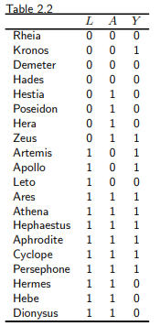
Conditional randomization
In contrast to marginal randomized experiments, conditionally randomized experiments assign probands randomly to groups depending on a third variable (L) by chance.
75 % chance in critical condition (L = 1)
50 % chance in non-critical condition (L = 0)
Marginal randomized experiments are expected to result in exchangeability of treated and untreated.

Slide 8
Conditional randomization
Conditionally randomized experiments will NOT generally result in exchangeability of the treated and the untreated.
By Design each group may have a different proportion of individuals with bad prognosis.
The shown conditionally randomized experiment is a combination of two separate marginally randomized experiments:
Subset of individuals in critical condition (L=1)
Subset of individuals in non-critical condition (L=0)
Notes:
The risk of death of the treated – had they remained untreated – would have been higher than the risk of death in the untreated. → Exchangeability does not hold

Slide 9

Conditional randomization
Within the subsets the treated and untreated are exchangeable:
Outcome under potential treatment and given treatment are independent in subset L = 1.
Notes:
The risk of death of the treated – had they remained untreated – would have been higher than the ris of death in the untreated. → Exchangeability does not hold

Slide 10
Conditional randomization
Causal risk ratio in a conditionally randomized experiment:
Compute average causal effect for each strata (its equal to the associational risk ratio) → stratification. Effect of treatment can be modified by L. Difference between causal risk ratio in subset L = 1 and L = 0.
Compute average causal effect for the entire population → standardization / inverse probability weighting
Notes:
The risk of death of the treated – had they remained untreated – would have been higher than the ris of death in the untreated. → Exchangeability does not hold

Slide 11
Standardization
Subset L=0: Risk of Death (treated) = ¼ Risk of Death (untreated) = ¼
Subset L=1: Risk of Death (treated) = 6/9 = 2/3 Risk of Death (untreated) = 2/3
Risk if all individuals in the population had been treated = =
Risk if all individuals in the population had been untreated = = 0.5
Causal Risk Ratio = 0.5 / 0.5 = 1

Slide 12

Standardization
The standardized risk can be interpreted as the counterfactual risk that would have been observed had all the individuals in the population been treated.
The standardized risks in the treated and the untreated are equal to the counterfactual risks under treatment and no treatment, respectively.
Causal risk ratio can be computed by standardization as:

Slide 13
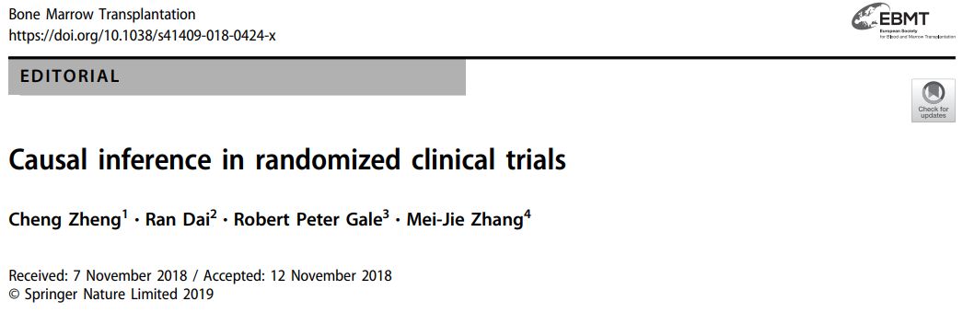
Further Reading

Slide 14

Further Reading

