Slide 1

MVR Positive Spike Alerts

Slide 2

Overview
In general, the MVR Spike Alerts model will monitor each report on a weekly basis:
Criteria: reports with prior 7 weeks total units above 400 units
Trend & Threshold: calculate a high value alert threshold based on prior 12 weeks transaction trend
Alerts: detect unexpected high transaction unit spikes
Decide: 4σ or 5σ?
Our Brand Essence
We believe in the power
of data and advanced analytics for better risk management.
Our Brand Promise
Transform your risk decision-making.

Slide 3
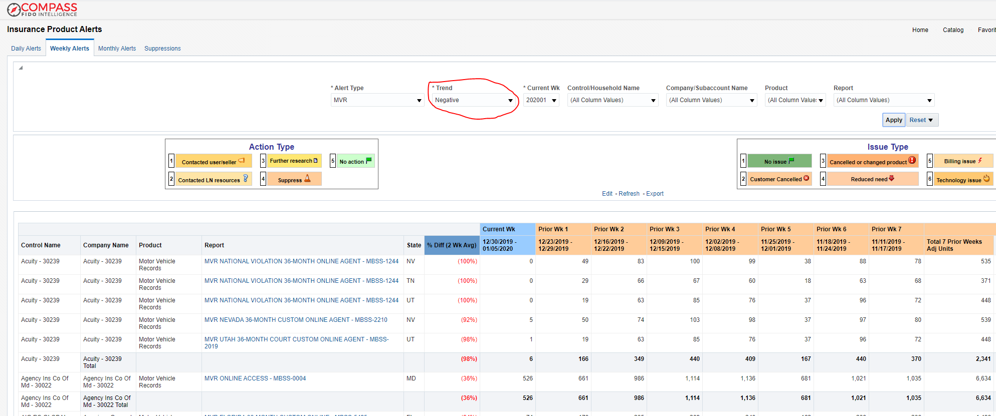
Compass Dashboard Overview

Slide 4

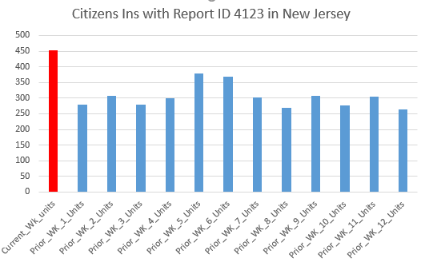
Statistics Behind the Model
Decide: 4σ or 5σ?
μ + 5σ
Our Vision
To inspire insightful decisions in a world of hidden risks and opportunities.
Our Mission
To provide essential insights to advance and protect people, industry and society.
μ + 4σ
μ
4 times of standard deviation above average: 446.8
5 times of standard deviation above average:482.87
Please note: current week is 10/21/2019 to 10/27/2019
Prior 12 week is 7/29/2019 to 8/4/2019

