Slide 1
Low Pass Filter Design (ADS)

Slide 2
Process
Specifications/Goal
2. Design topology
{
problem-solving, based on experience, knowledge
Possible area of interest for AI application
}
3. Initial design result
4. Tuning and Optimization => Yield tuning and Yield Optimization
5. Saturation point => go back to topology to improve.

Slide 3
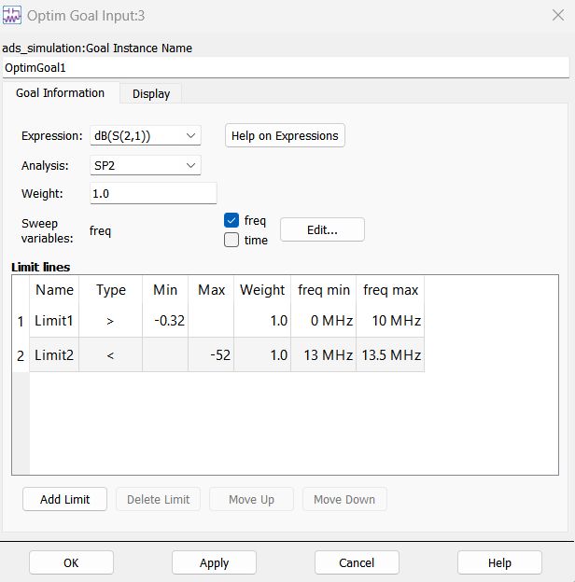
Example Specifications:

Slide 4
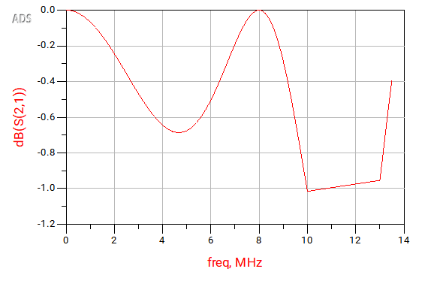
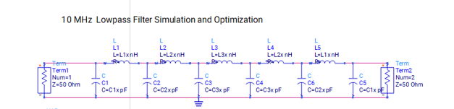
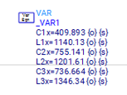
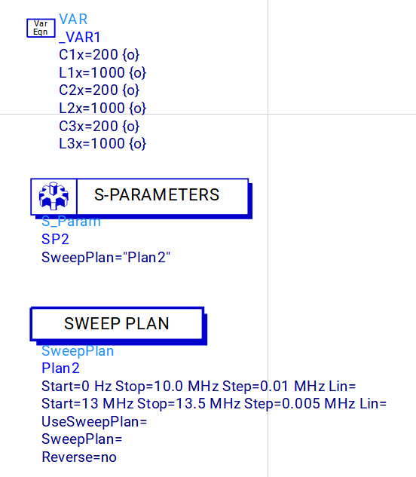
Circuit
Initial Design Parameters and their resulting dB(S(2,1)).
S(I,j) = V-_i/ V+_j.
S(2,1) corresponds to the ratio of the signal incident on the input port to its output.
Ideally, For Low pass filters, as the frequency increases, there will be a gradual decrease in the amount of signal V_2- coming outward. V_1+ remains the same => S_21 goes to 0.
Here, our specification would like for dB(S(2,1)) > -0.032 for 0 <= freq <= 10.
Similarly, we would like for dB(S(2,1)) < -52 for all 13 <= freq <= 13.5
This is clearly not the case, as shown by the graph

Slide 5
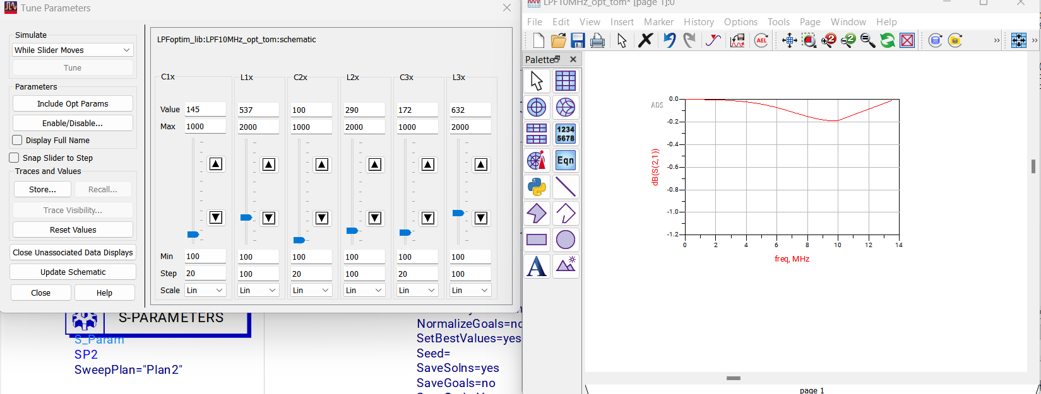
Initial Tuning
We can immediately see the impact of the changes of our input parameters on the Nominal Simulations

Slide 6
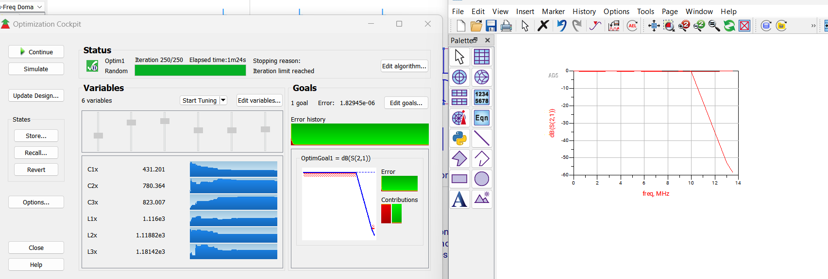
Optimization of the nominal simulation
We achieve the optimized parameters meeting the specifications of the nominal simulation

Slide 7
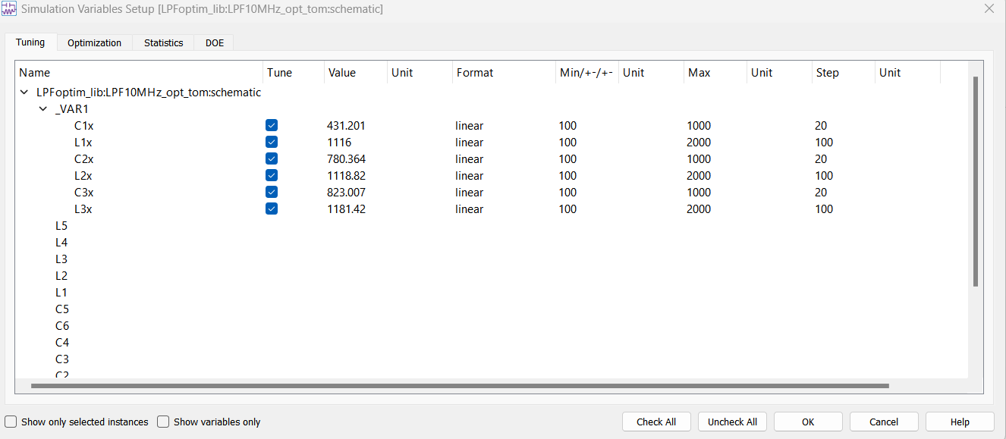
Yield Simulations: Setting up the variables and approximate SD’s

Slide 8
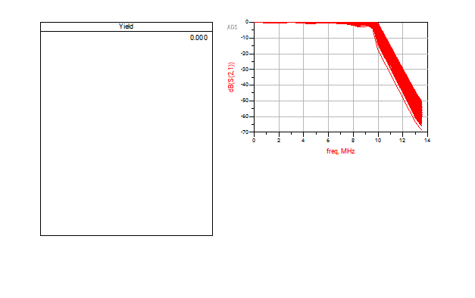
Yield Simulation Results
☹

Slide 9
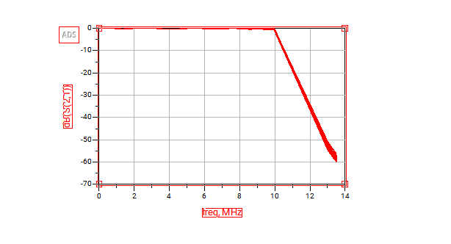
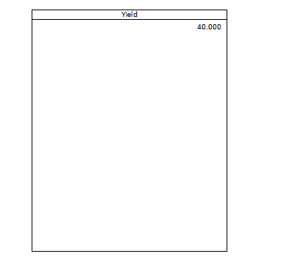
Yield Optimization
Because the error function cannot reach 0 as a result of a poor designed model circuit, the yield also is quite poor

Slide 10
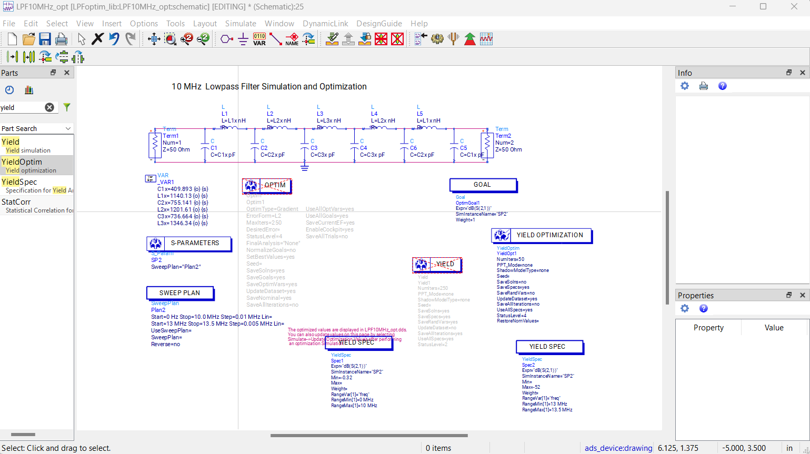

Slide 11
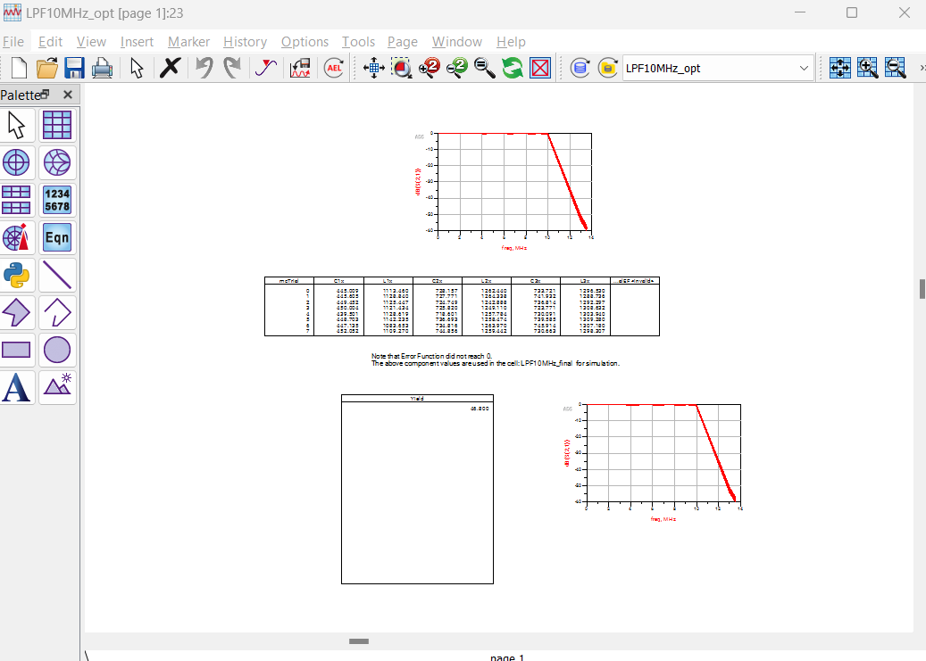
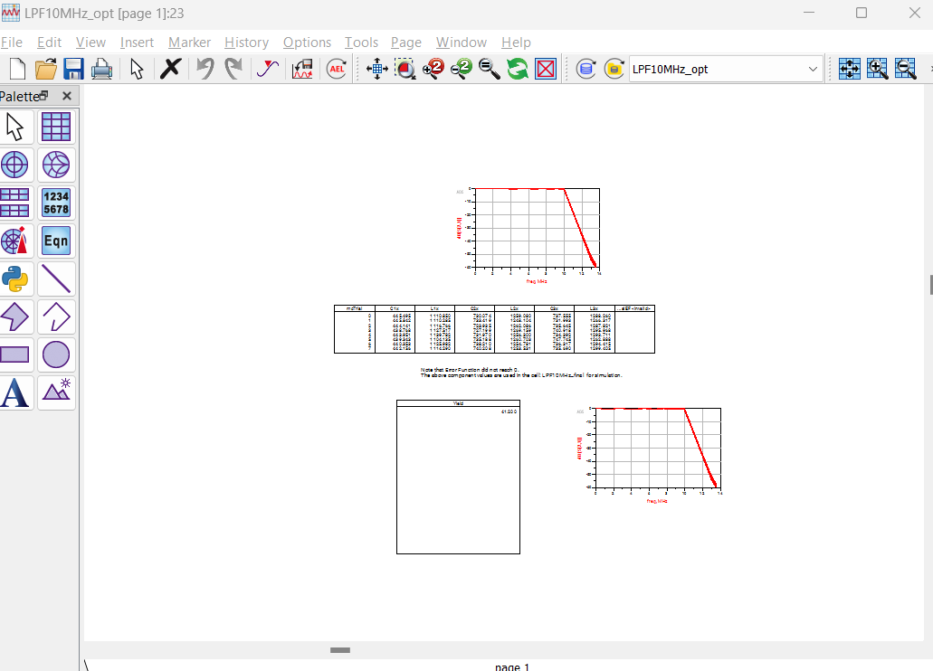
Saturation point => Yield Optim + Change Optim Var => Yield Sim => repeat; Yield stops increasing

Slide 12
Key Points
Nominal Optimization supposedly gives the optimal solution for the input parameters, under the assumption of 0 variation. However, when even small variation is introduced…say 5%, this has tremendous impact on yield results (especially if the model is incorrect or bad in itself).
Pairing Yield Simulations and Yield Optimization together: Why must we continue performing yield optimizations as opposed to just one?
Some intuition: When the yield optimizer algorithm attempts to alter a parameter, it slowly changes it, looking at its effects on the yield. It starts with very small sample sizes (which are not very accurate) and builds up. Because the algorithm is recurrent (relies on past information), this inaccuracy could affect the ending result, which may not be optimal in the end.
Can AI be implemented to find the best topologies possible for the circuit? Can the AI perform the yield simulations and optimizations together? Can they provide a set of possible best yields.

