Slide 1
MMIC Low-noise Amplifier (ADS)

Slide 2
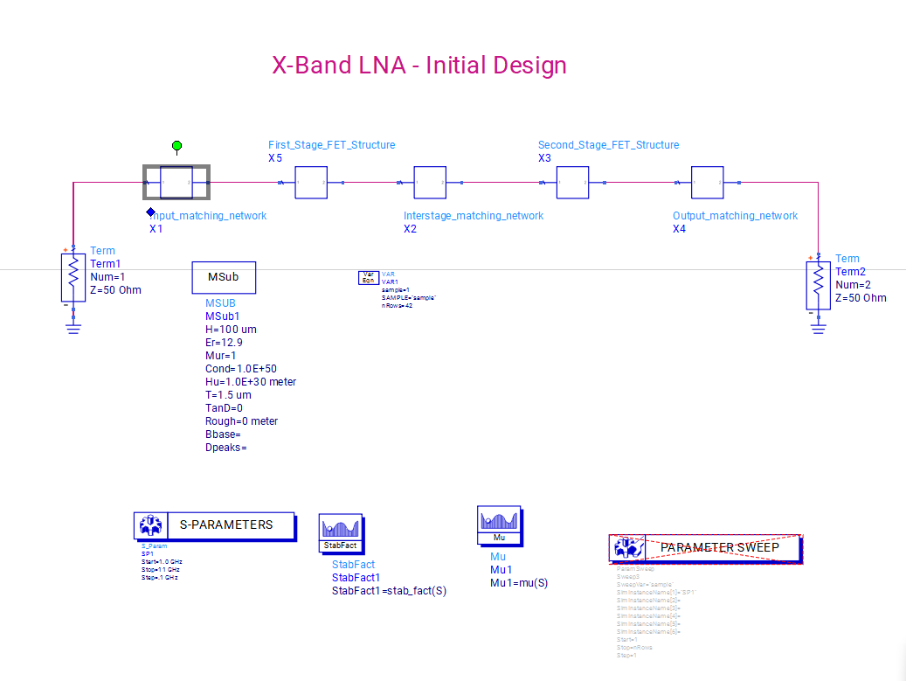
Initial X-band LNA Design
Initial X-band LNA Design
The circuit has 3 main factors:
The input matching network,
The Interstage matching network,
And the Output matching network.

Slide 3
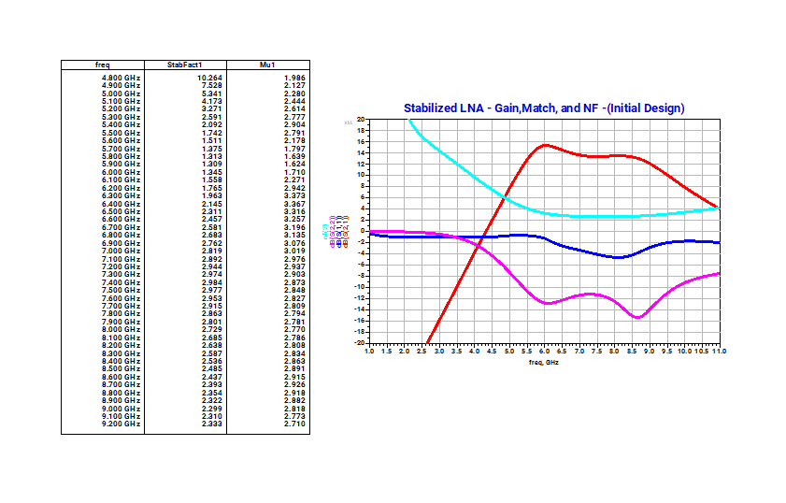
Initial X-band LNA Design
We look at the initial design results for a nominal case. We look at the NF (noise figure or factor) of the design in the simulation, the gain (S(2,1)), and the S(2,2) and S(1,1) specs.
A few things that stand out:
The S(1,1) curve dips a bit from 6.0 to 9.5 GHz, indicating that the input reflection was not completely constant through the period
Similar but more pronounced phenomenon can be seen in the S(2,2) curve, which also dips, indicating the output reflection was not constant throughout the period.
It still looks like a decent starting point, however.

Slide 4
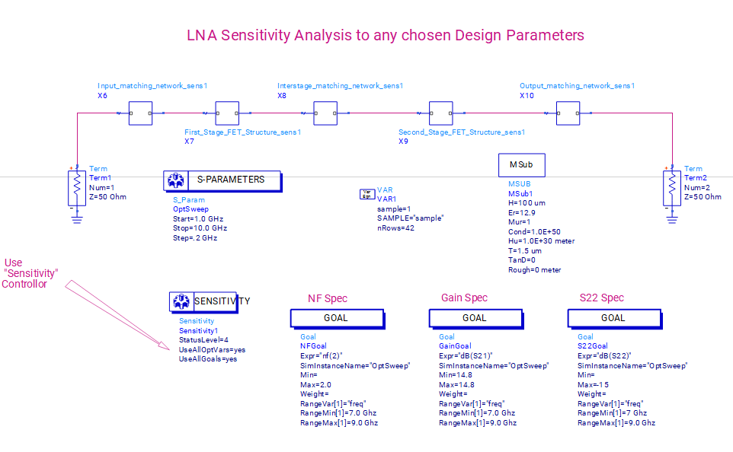
Specifications and performin the initial sensitivity analysis of the specs
Nf(2) <= 2.0; 7.0 GHz <= freq <= 9.0 GHz
dB(S21) = 14.8; 7.0 GHz <= freq <= 9.0GHz
dB(S22) <= -15; 7.0 GHz <= freq <= 9.0GHz

Slide 5
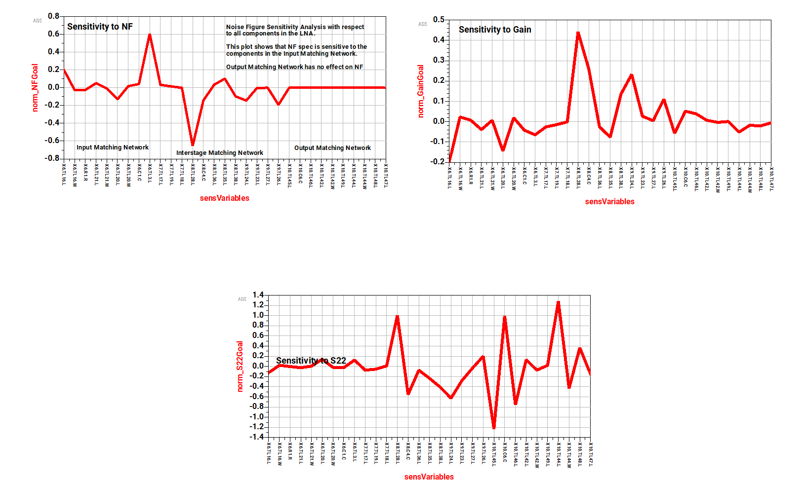



Here are the sensitivity analysis results for the component values. Localized procedure. We can see the percent variation of each parameter on the normalized goal specifications. For instance, for Sensitivity to NF, the high and low peaks clearly indicate the key contributing parameters to the variation of the NF Goal. We see similar behavior for the S21 and S22 sensitivity. We will select these troubling parameters to deal with in optimization.
No change
Maybe we look at these 5 parameters for optimization

Slide 6
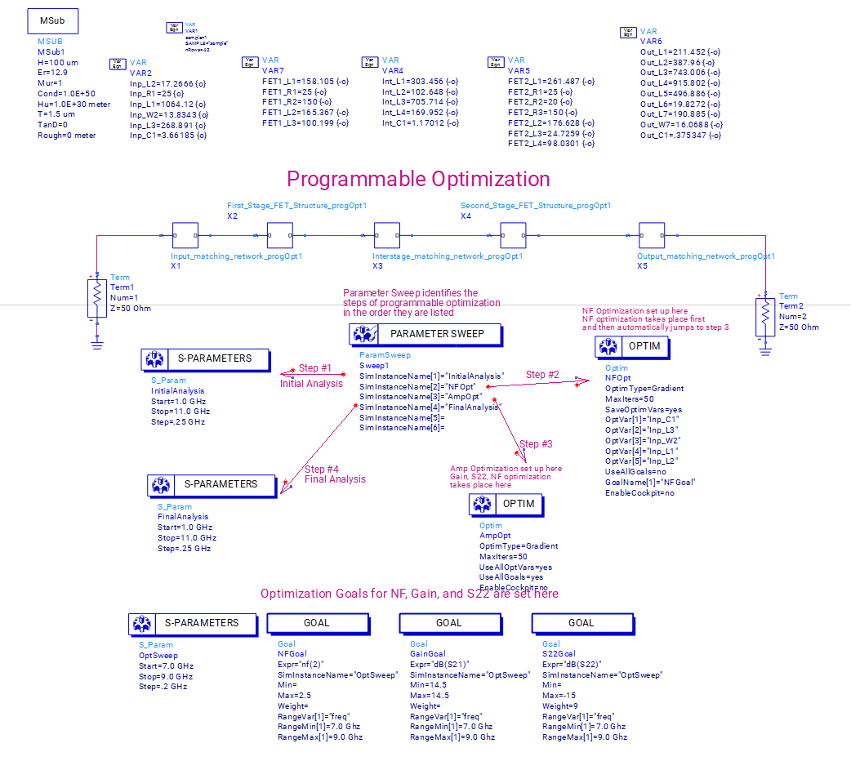


Perform the Optimization
Optimization Variables
We perform the optimization using the ADS feature.
Begin with an optimization on the 5 pesky parameters (based on the initial sensitivity analysis) for the noise figure.
Then a second optimization is run using the rest of the parameters
Parameters based on the initial sens analysis

Slide 7
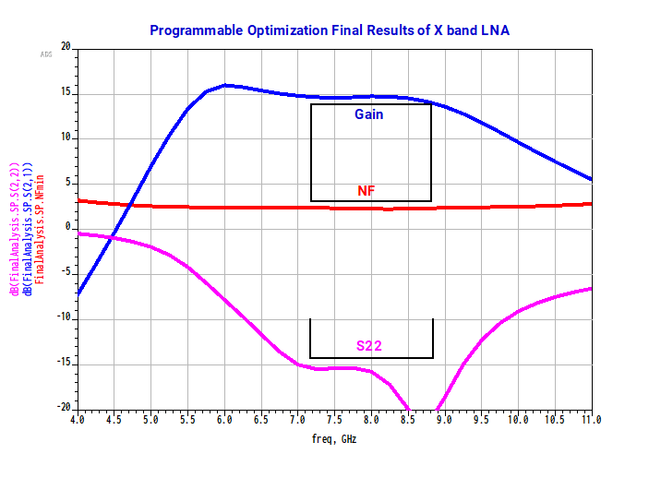
Final Optimization results
Original Specifications:
Nf(2) <= 2.0; 7.0 GHz <= freq <= 9.0 GHz
dB(S21) = 14.8; 7.0 GHz <= freq <= 9.0GHz
dB(S22) <= -15; 7.0 GHz <= freq <= 9.0GHz

Slide 8
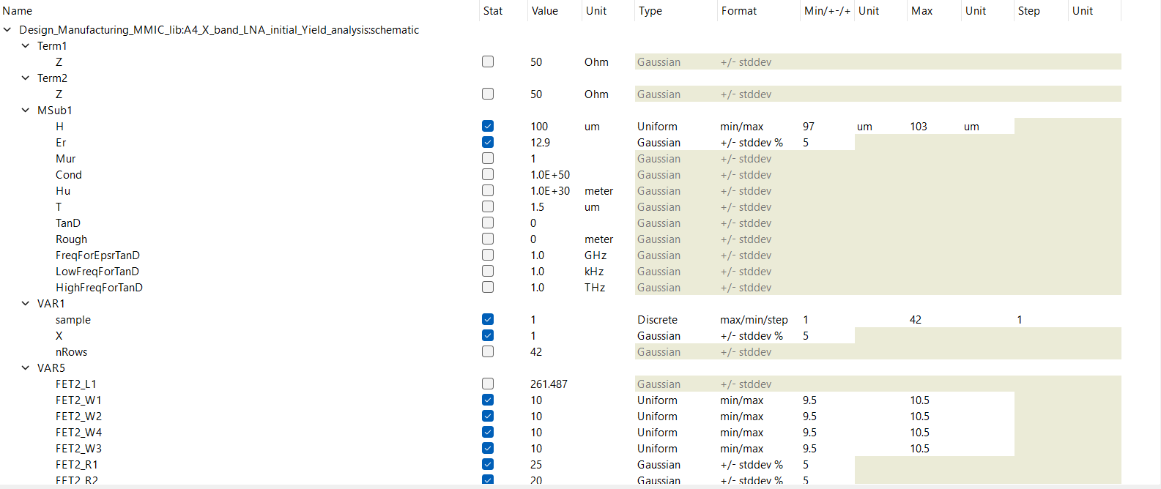
Notice our optimization and simulation variables are not all gaussian. These details are provided by the manufacturer or other guidelines.

Slide 9
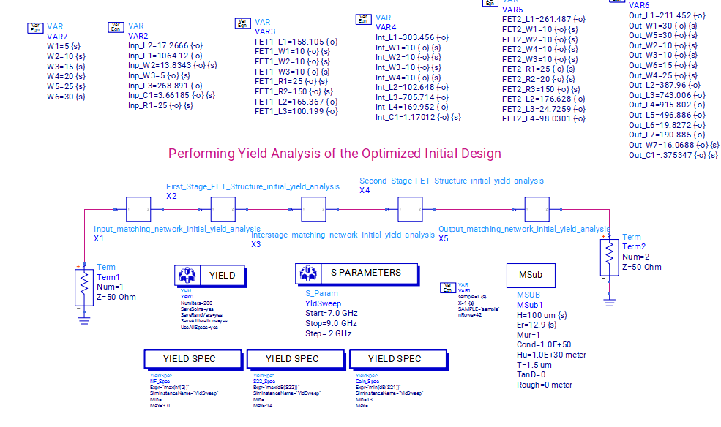
Yield Analysis
We simply run the simulation and obtain the results on the next slide

Slide 10
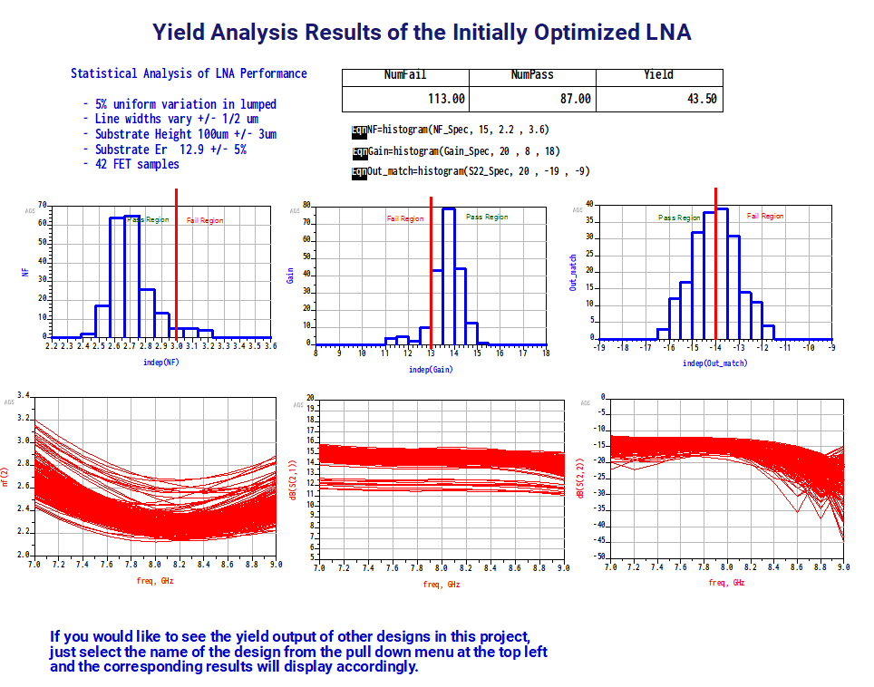
Yield Results
Yield is ~40%, which is not very good. We need to pinpoint why this is happening using Design of Experiment as an ADS feature.
Some intuition: If we look at the distributions for Nf, Gain, and Out_match, we would like to shift them so that more data points lie in the pass region.

Slide 11
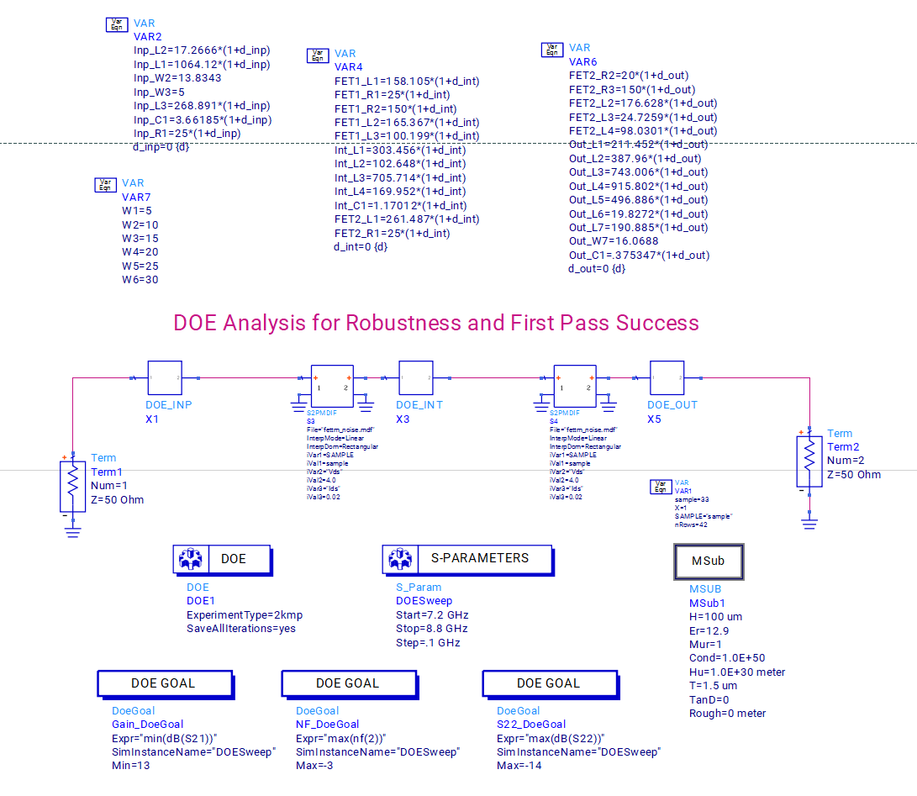
DOE Analysis
For intuition, let NF = a_1x_1 + a_2x_2 + a_3x_3. Clearly, each x_i has an effect on the final Nf. Variations in Nf are dependent on variations on each of the parameters.
DOE considers the entire distribution in optimization, not just nominal values (It takes in more sample points and their distrs for instance)

Slide 12
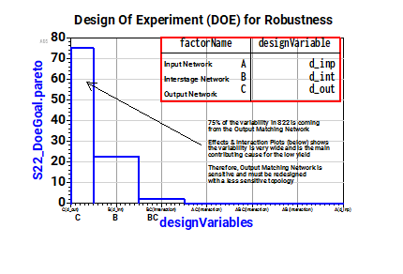
Doe analysis
We see that the variability is mostly from the Output Matching Network.
This tells us that its topology must be redesigned.

Slide 13
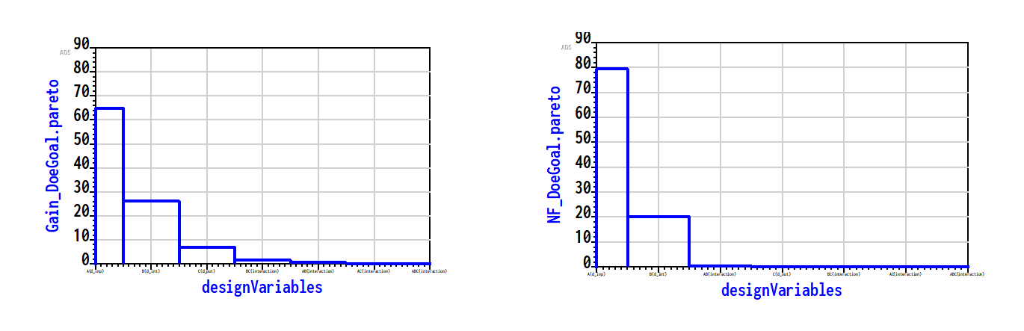
It is clear that A also plays some role in the variability of NF and Gain. We could also look into redesigning the topologies of these too: Input Network.

Slide 14
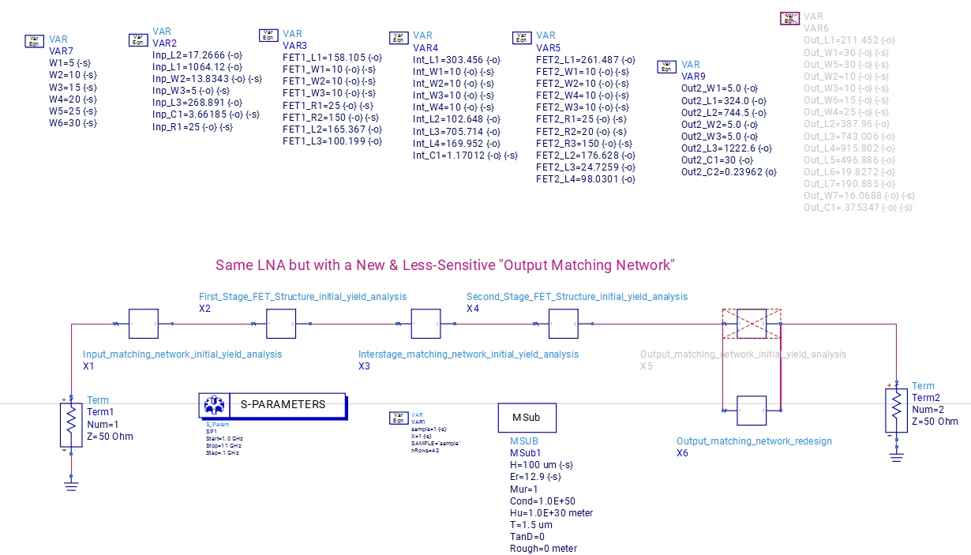
Redesigning
Redesigned Output Matching Network

Slide 15
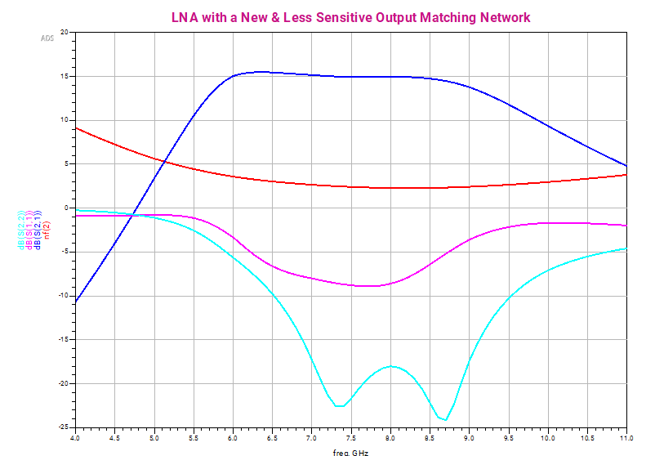
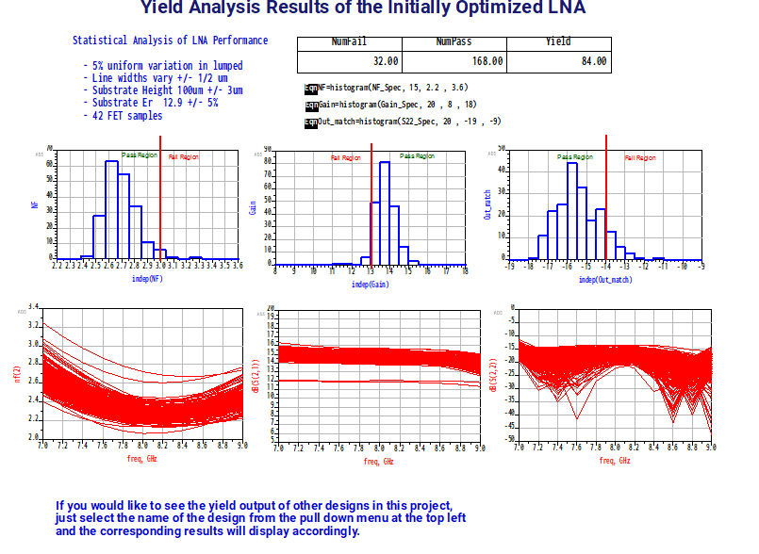
Result of redesign and Yield
We now have a higher yield (~80%) => yield optimization

Slide 16
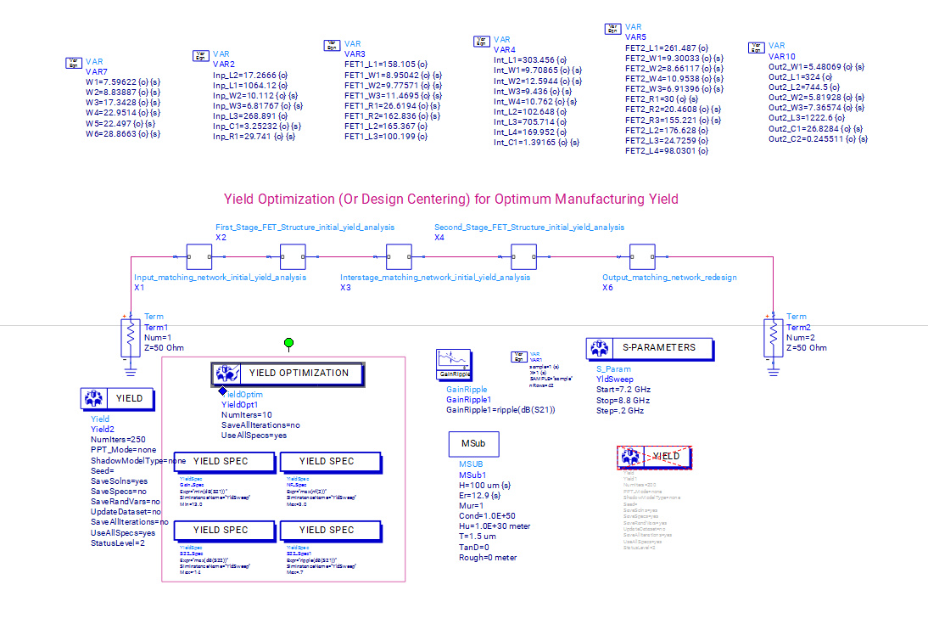
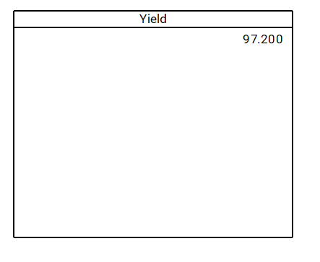
Yield Optim and final results

Slide 17
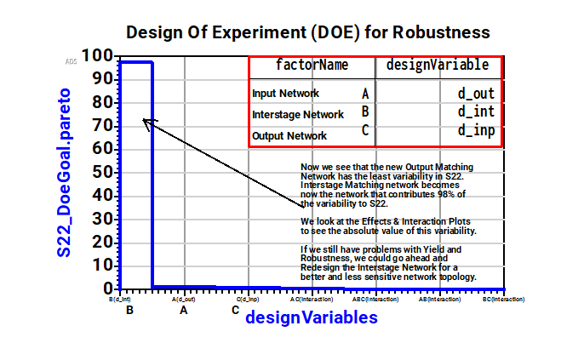
Further DOE analysis
Our Output Matching Network has little variability in S22. The Interstage Network is now the main contributor to S22 variability. We could redesign this for a better topology, if unsatisfied with yield results

