Slide 1
STAT 524 Foliage classification using PCA Fall 2017 Behrokh Siamak

Slide 2
Introduction
LiDAR* point cloud can be classified based on geometric characteristic.
Many applications are interested in tree detection using point cloud.
Objective
To separate the points corresponding to foliage from other scanned points (point cloud).
* LiDAR: Light Detection and Ranging
Notes:
Agriculture – Urban designing – Environmental – Transportation

Slide 3
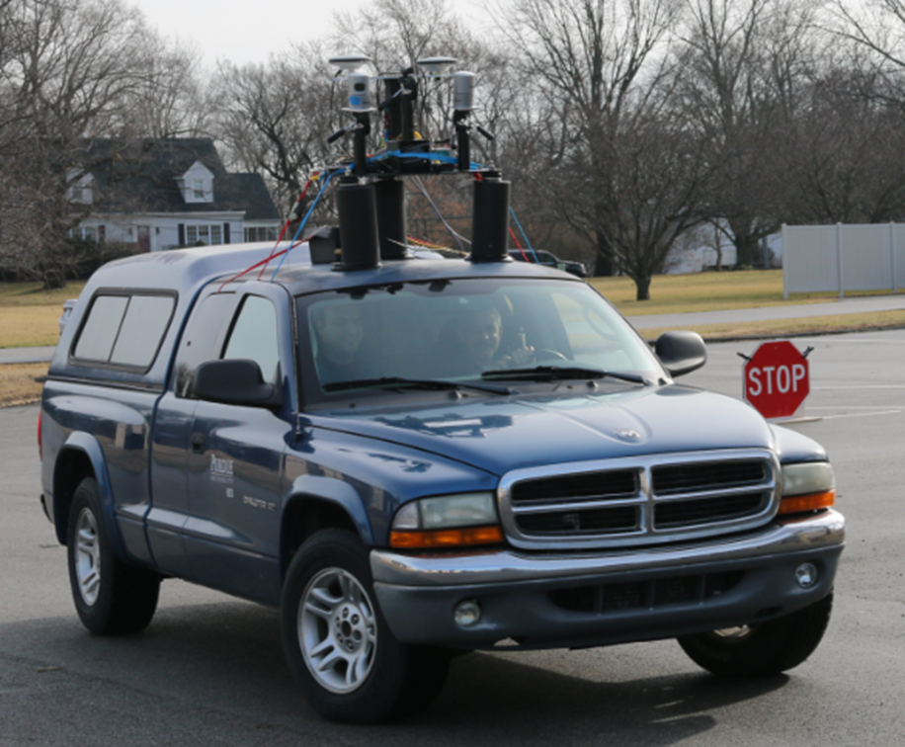
Data collection platform
Stationary lasers scanners
Airborne platform
Mobile mapping platform
provides an efficient/accurate way to sample the 3D road surrounding including notable roadside trees
Notes:
Unmanned Aerial Vehicle – Manned Aerial Vehicle

Slide 4
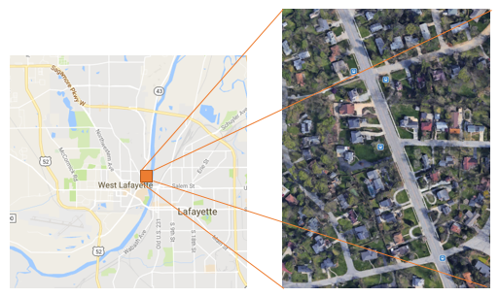
Study Area
Northwestern Ave, West Lafayette
Length: 300 meters
Northwestern Ave West Lafayette
(Google map)

Slide 5
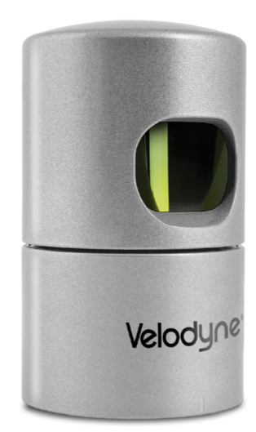
Instrument specification
The dataset are acquired by HDL-32E
± 2 cm accuracy
32 Channels
80m-100m Range
700,000 Points per Second
360° Horizontal FOV
+10° to -30° Vertical FOV
HDL-32E

Slide 6
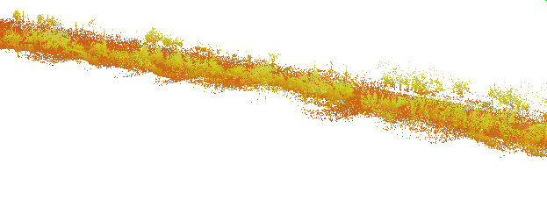
Data
Data were collected on Oct 2016 by Digital Photogrammetry Research Group(DPRG)
Return type: Single return
Point number: 9,000,000 points
Point density: 500 points/m^2
Point cloud

Slide 7
Methodology
This method works based on geometric characteristics of features
Point clouds were classified to ground/ non-ground
Using LASTools
N-nearest neighbors using Kd-tree
N= 70 (Lin, Benziger, and Habib, 2016)
Point Cloud
Ground/Non-ground
Kd-tree
N Nearest Neighbor
Notes:
Linear – planner – volumetric

Slide 8
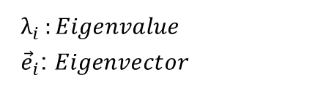
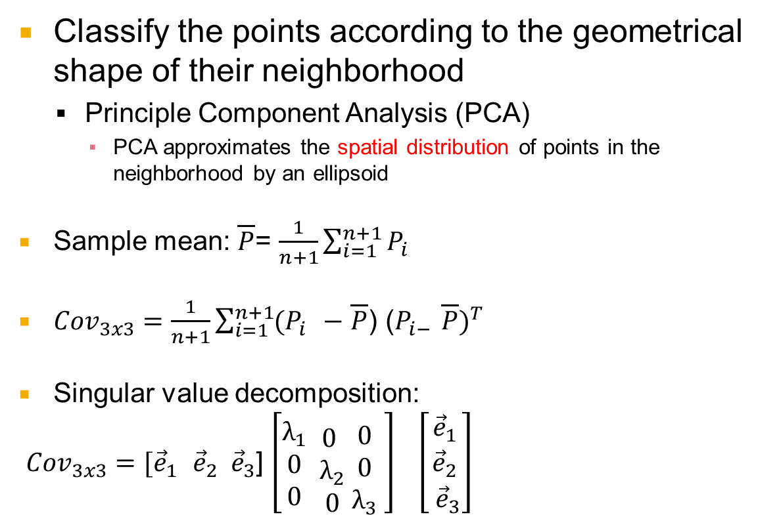
Methodology _ Cont’d
Classify the points according to the geometrical shape of their neighborhood
Principle Component Analysis (PCA)
PCA approximates the spatial distribution of points in the neighborhood by an ellipsoid
Sample mean: $\overline{P}$= $\frac{1}{n+1}\sum_{i=1}^{n+1}{P_{i }}$
${Cov}_{3x3}=\frac{1}{n+1}\sum_{i=1}^{n+1}{(P_{i }}−$ $\overline{P}$) (${P_{i− }\overline{P})}^{T}$
Singular value decomposition:
${Cov}_{3x3}=[{\vec{e}}_{1}$ ${\vec{e}}_{2} {\vec{e}}_{3}$] $\left[\begin{aligned}λ_{1} \\ 0 \\ 0\end{aligned} \begin{aligned} \\ 0 \\ λ_{2} \\ 0\end{aligned} \begin{aligned} \\ 0 \\ 0 \\ λ_{3}\end{aligned} \right]$ $\left[\begin{aligned}{\vec{e}}_{1} \\ {\vec{e}}_{2} \\ {\vec{e}}_{3}\end{aligned}\right]$
$λ_{i }:Eigenvalue$
${\vec{e}}_{i}$: $Eigenvector$

Slide 9
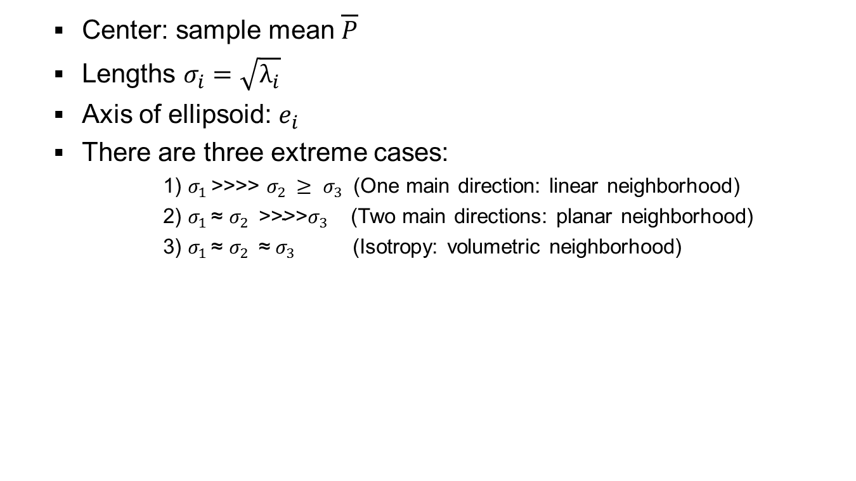
Methodology _ Cont’d
Center: sample mean $\overline{P}$
Lengths $σ_{i}$ $=\sqrt{λ_{i}}$
Axis of ellipsoid: $e_{i}$
There are three extreme cases:
1) $σ_{1 }$>>>> $σ_{2 }{≥ σ}_{3 }$ (One main direction: linear neighborhood)
2) $σ_{1 }$≈ $σ_{2 }{\text{>>>>}σ}_{3 }$ (Two main directions: planar neighborhood)
3) $σ_{1 }$≈ $σ_{2 }{\text{≈} σ}_{3 }$ (Isotropy: volumetric neighborhood)
(1)
(2)
(3)

Slide 10

Methodology _ Cont’d
Three dimensionality descriptor:
(Demantké et al., 2011)
Linear descriptor : $D_{1 }$ = ($σ_{1 }$- $σ_{2 }$)/$σ_{1 }$
(Responds on linear objects)
Planar descriptor : $D_{2 }$ = ($σ_{2 }$- $σ_{3 }$)/$σ_{1 }$
(Responds on planer objects)
Volumetric descriptor : $D_{3 }$ = $σ_{3 }$/$σ_{1 }$
(Responds on volumetric objects)
$D_{1 }$+ $D_{2 }$+ $D_{3 }$ =1
PCA
Linear
Planar
Volumetric

Slide 11
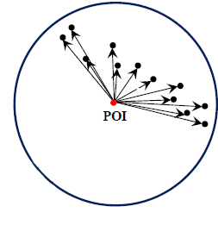
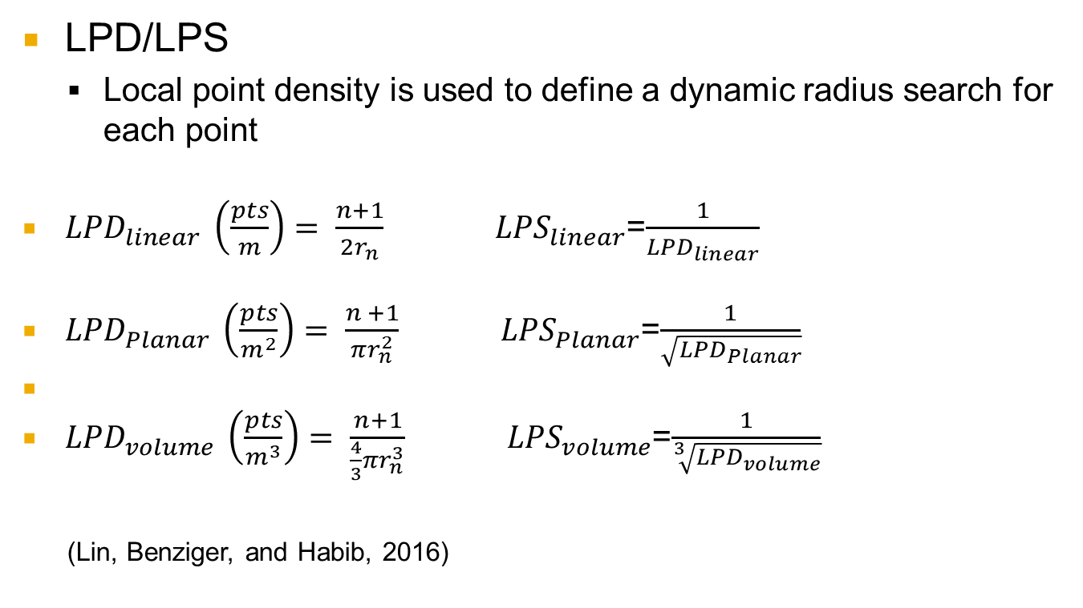
Methodology _ Cont’d
LPD/LPS
Local point density is used to define a dynamic radius search for each point
${LPD}_{linear} \left(\frac{pts}{m}\right)= \frac{n+1}{2r_{n}}$ ${LPS}_{linear}$=$\frac{1}{{LPD}_{linear}}$
${LPD}_{Planar} \left(\frac{pts}{m^{2}}\right)= \frac{n +1}{πr_{n}^{2}}$ ${LPS}_{Planar}$=$\frac{1}{\sqrt{{LPD}_{Planar}}}$
${LPD}_{volume} \left(\frac{pts}{m^{3}}\right)= \frac{n+1}{\frac{4}{3}πr_{n}^{3}}$ ${LPS}_{volume}$=$\frac{1}{\sqrt[3]{{LPD}_{volume}}}$
(Lin, Benziger, and Habib, 2016)
Courtesy of Prof. Habib slides

Slide 12
Methodology _ Cont’d
Run PCA again by a new neighborhood search radius based on LPD/LPS (r = 4 * LPS)
Same criteria for classifying features
Output from First PCA
Linear
Planar
Volumetric
Calculate
LPD/LPS
LPD/LPS
LPD/LPS
r = 4 x LPS
PCA (again)
Linear
Planar
Volumetric

Slide 13
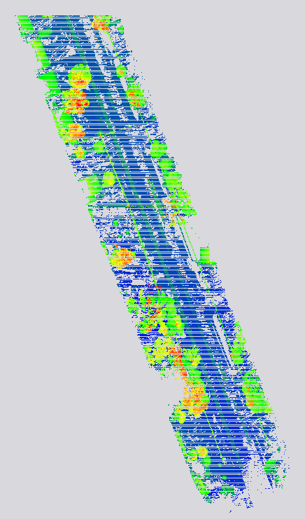
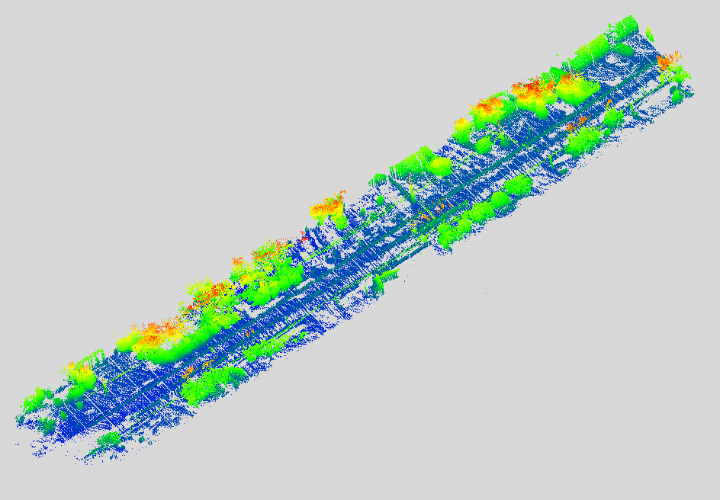
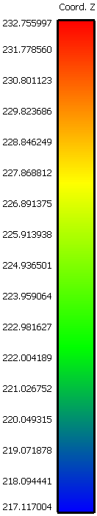
Result
Top View
Side View
Original Data

Slide 14
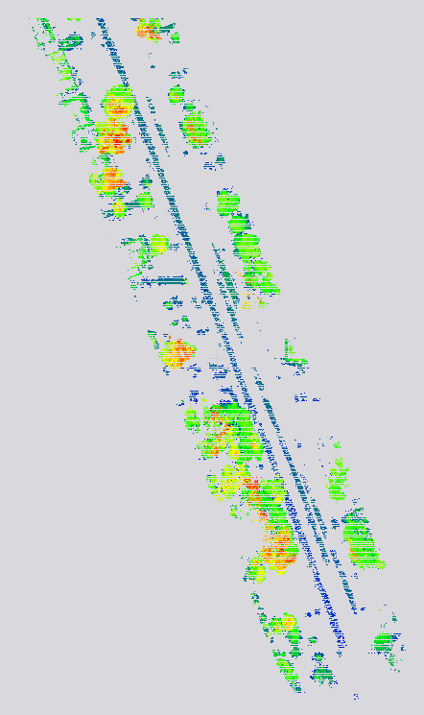
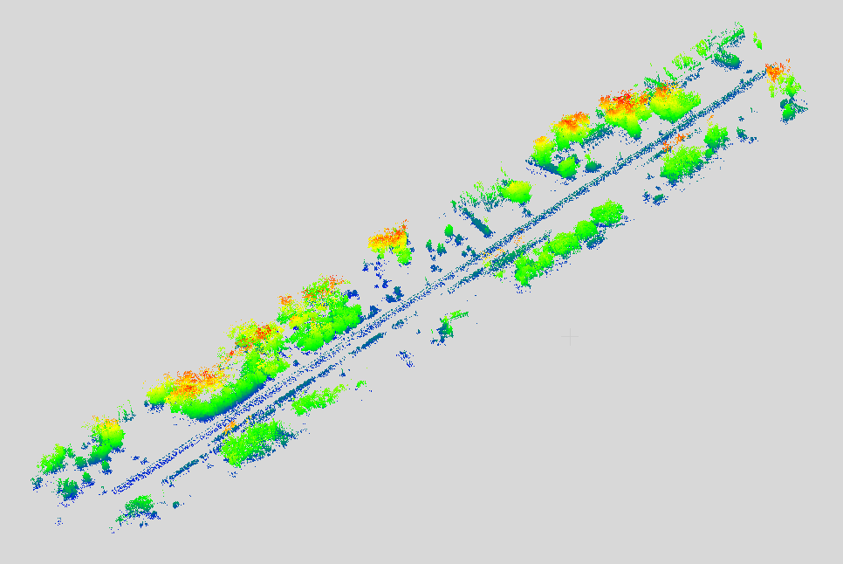
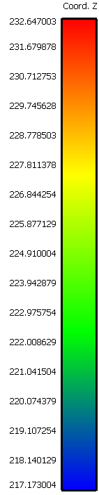
Result _ Cont’d
Top View
Side View
Fix 70 - NN

Slide 15
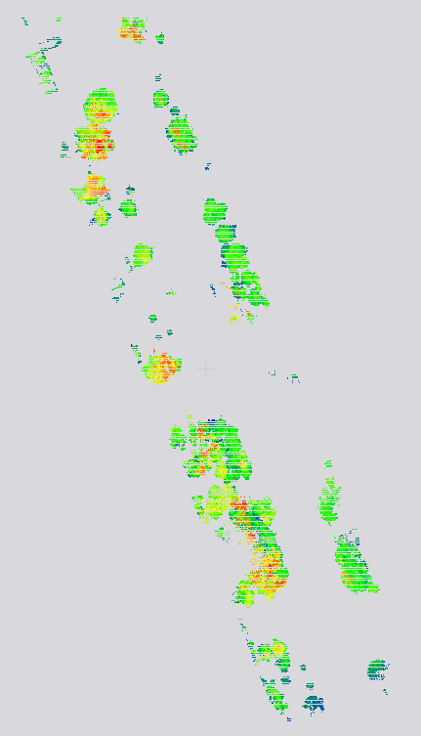
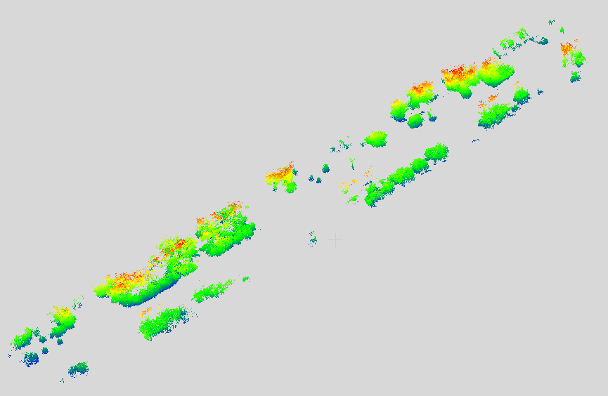
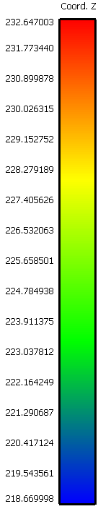
Result _ Cont’d
Top View
Side View
Dynamic radius (Considering LPS)

Slide 16
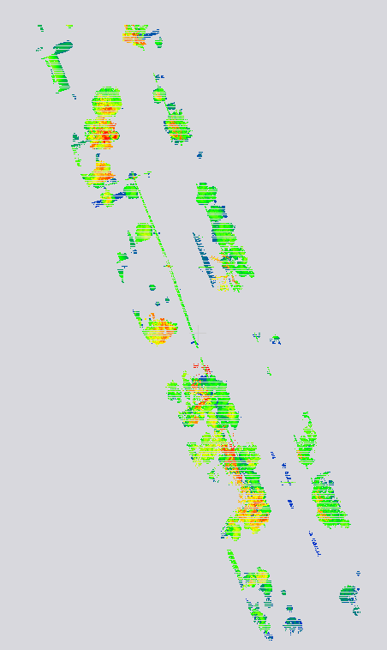
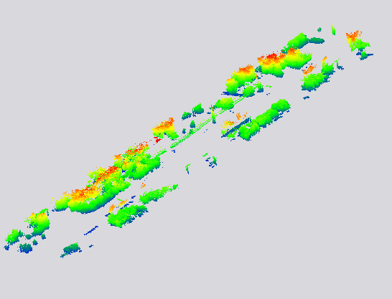
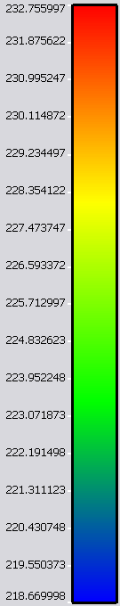
Result _ Cont’d
Top View
Side View
LAStools

Slide 17
Conclusion
Detecting volumetric features using dimensionality PCA and considering LPD/LPS
Fix number in NN has noise
Some planar or linear classified as volumetric features
LAStools seems is not proper to process ground mobile mapping data

Slide 18
Limitation and Future work
Running algorithm is expensive in MATLAB
Having no ground truth
Developing
Segmentation of the individual foliage
To detect trunks

Slide 19
Thank You!!

Slide 20
Related Work
Demantké et al. (2011) used dimensionality PCA on a spherical neighborhood at various radius sizes to classify features to linear, planar, and rough (volumetric).
Lin, Benziger, and Habib (2016) applied threshold and dimensionality PCA to do planar based adaptive down-sampling using point local density (LPD) and local point spacing (LPS).

