Slide 1
LiTeCAB
Life Cycle Assessment & Techno-Economic Analysis
for Battery Processes
A desktop tool for evaluating environmental impacts, costs, and material circularity of lithium-ion battery manufacturing and recycling processes. This walkthrough reflects the current startup, inventory, and analysis workflow.

Slide 2
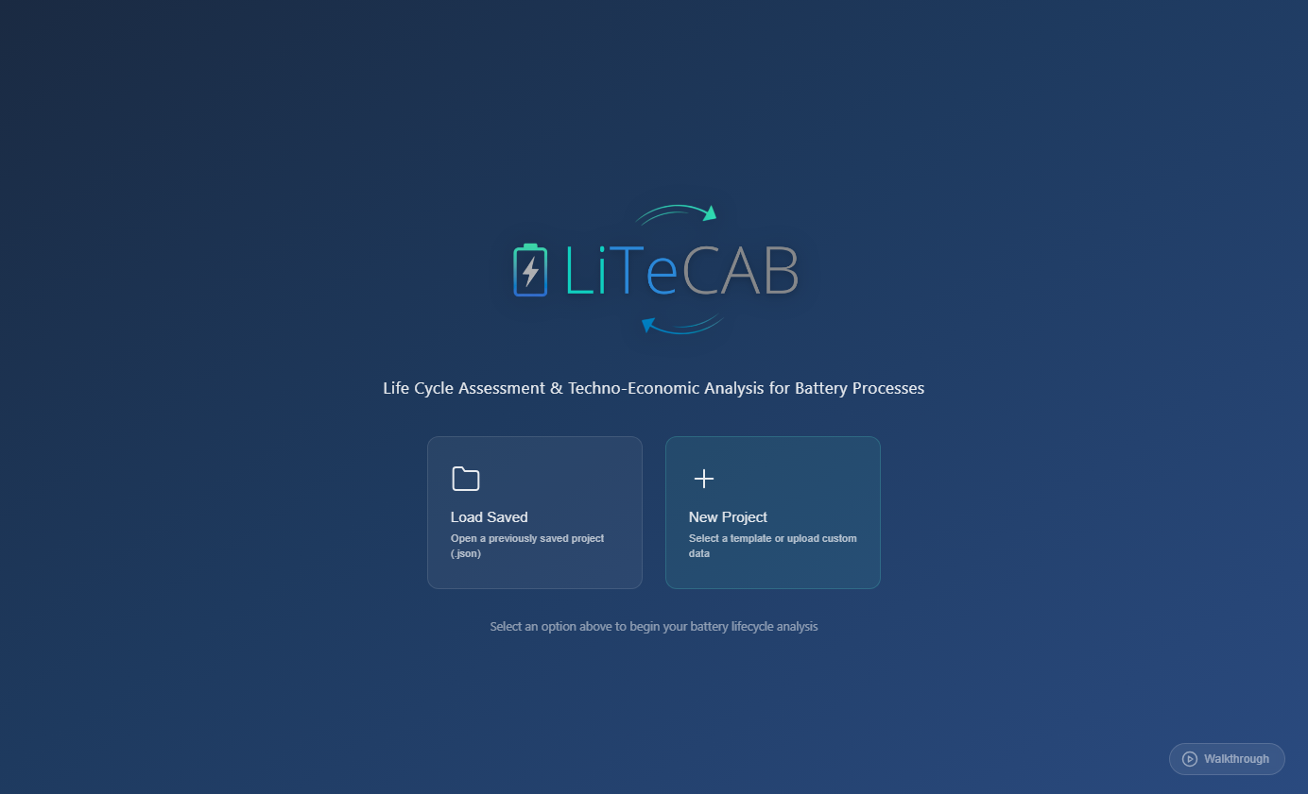
STEP 1
Welcome Screen
• Open LiTeCAB to the startup screen.
• Use Load Saved for an existing .json project.
• Use New Project for template or upload-based setup.

Slide 3
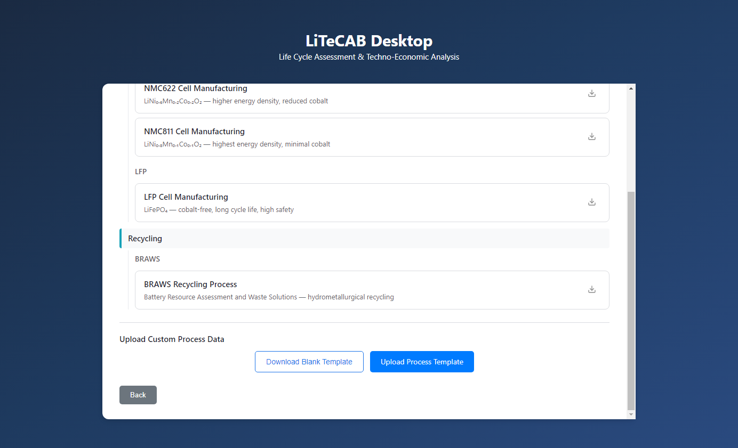
STEP 2
Select a Template
• Choose a built-in manufacturing or recycling template.
• Browse categories before making a selection.
• Use Download Blank Template / Upload Process Template for custom data.

Slide 4
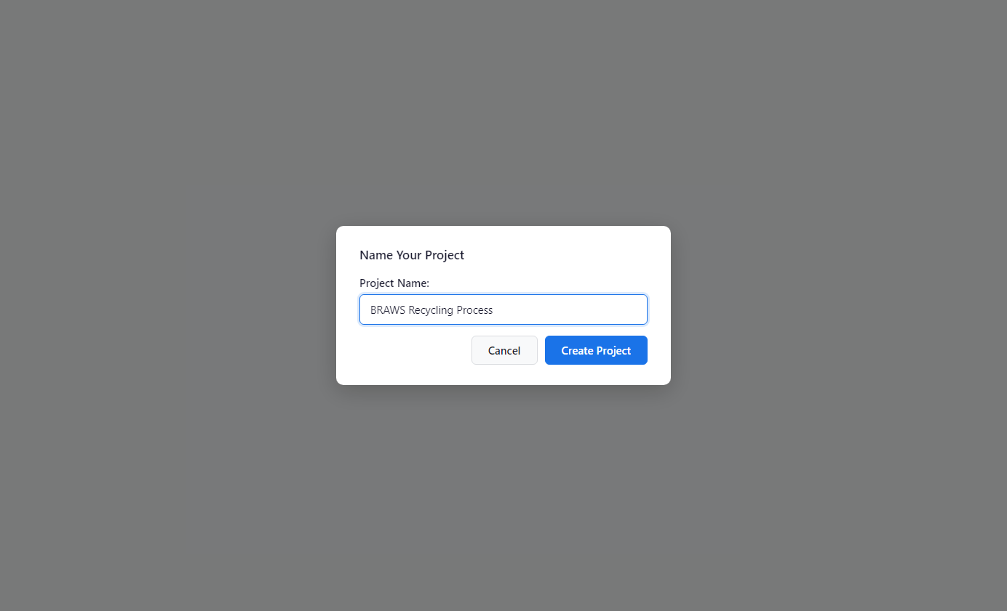
STEP 3
Create Project
• Enter a project name and confirm chemistry/category if prompted.
• Click Create Project to load the model.
• LiTeCAB prompts before overwriting an existing project name.

Slide 5
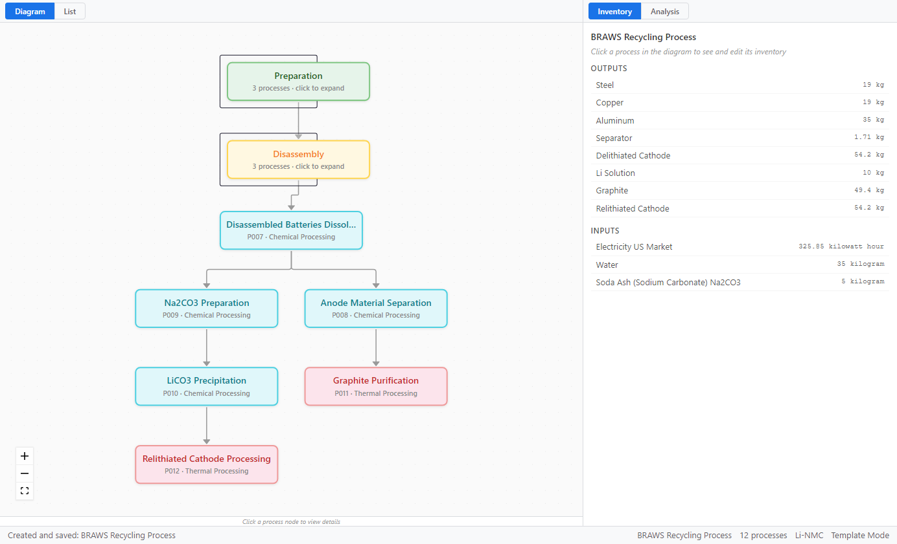
STEP 4
Workspace Overview
• Left panel: process view. Right panel: Inventory and Analysis tabs.
• Select a node to inspect inputs, outputs, and parameters.
• Status bar shows project details and run/save messages.

Slide 6
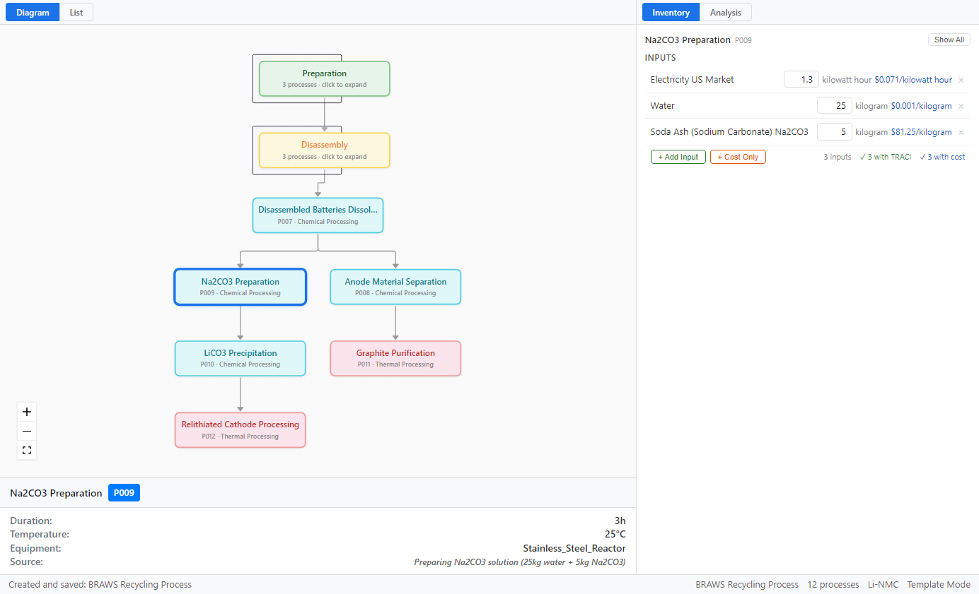
STEP 5
Select a Process to Edit
• Click a process node to focus its inventory.
• Right panel updates to process-specific inputs.
• Bottom specs show duration, temperature, equipment, and source.

Slide 7
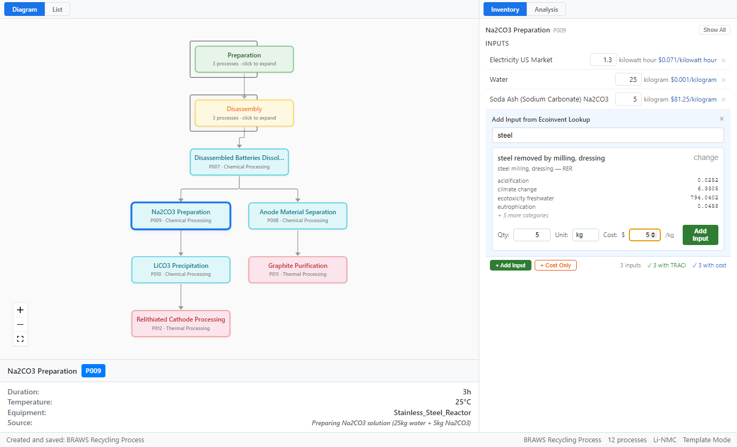
STEP 6
Add Input from Ecoinvent Lookup
• Click + Add Input and search the lookup dataset.
• Select an activity, then set quantity, unit, and cost.
• Added items include TRACI data for LCA calculations.

Slide 8
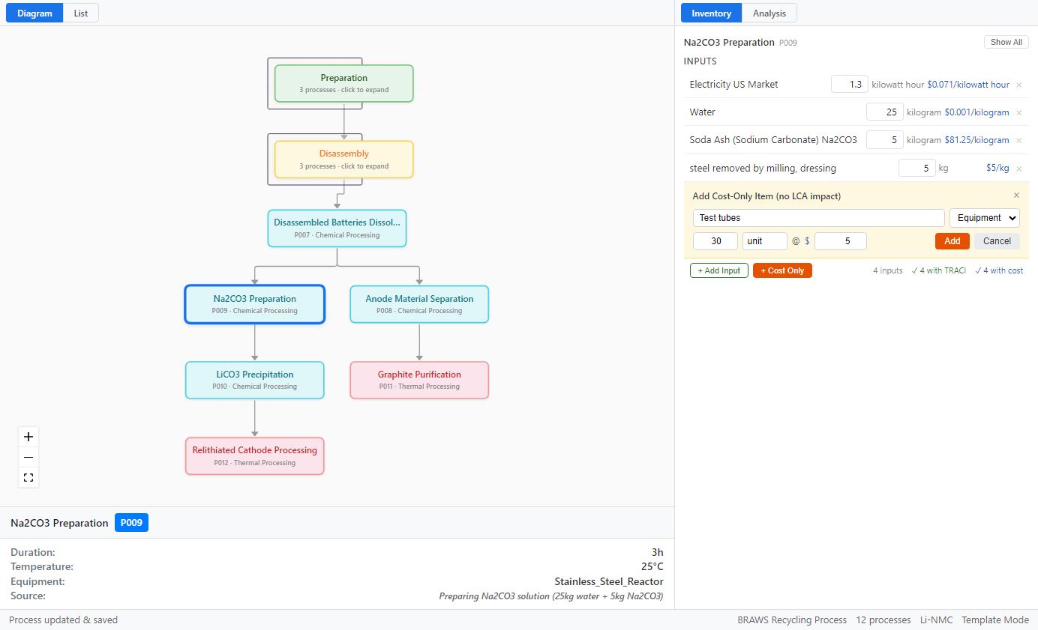
STEP 7
Add Cost-Only Items
• Use + Cost Only for non-LCA cost entries.
• Typical items: equipment, labor, and transport.
• These affect TEA totals without changing LCA impacts.

Slide 9
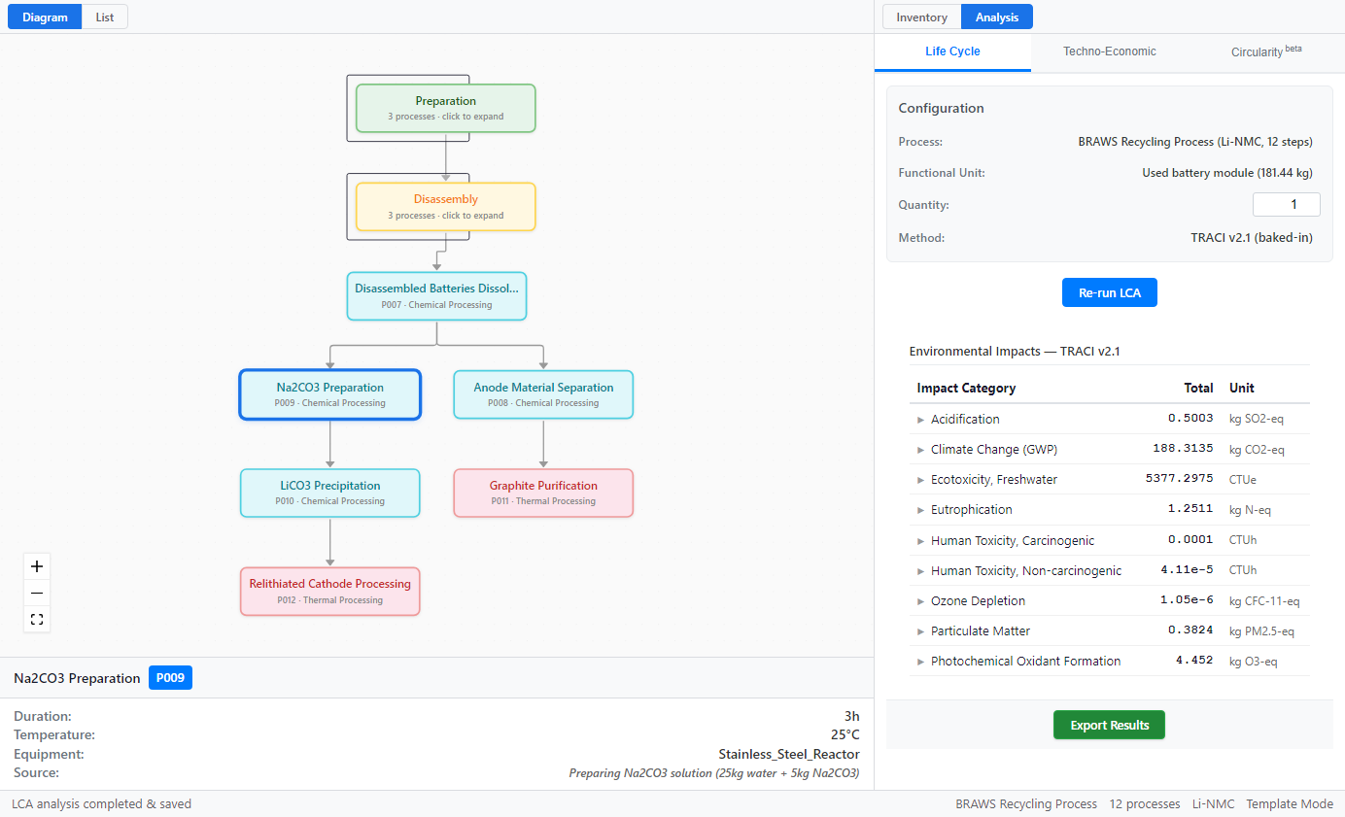
STEP 8
Run LCA
• Open Analysis and run Life Cycle Assessment (LCA).
• TRACI v2.1 impacts are computed for the selected project.
• Expand categories to review process-level contributions.

Slide 10
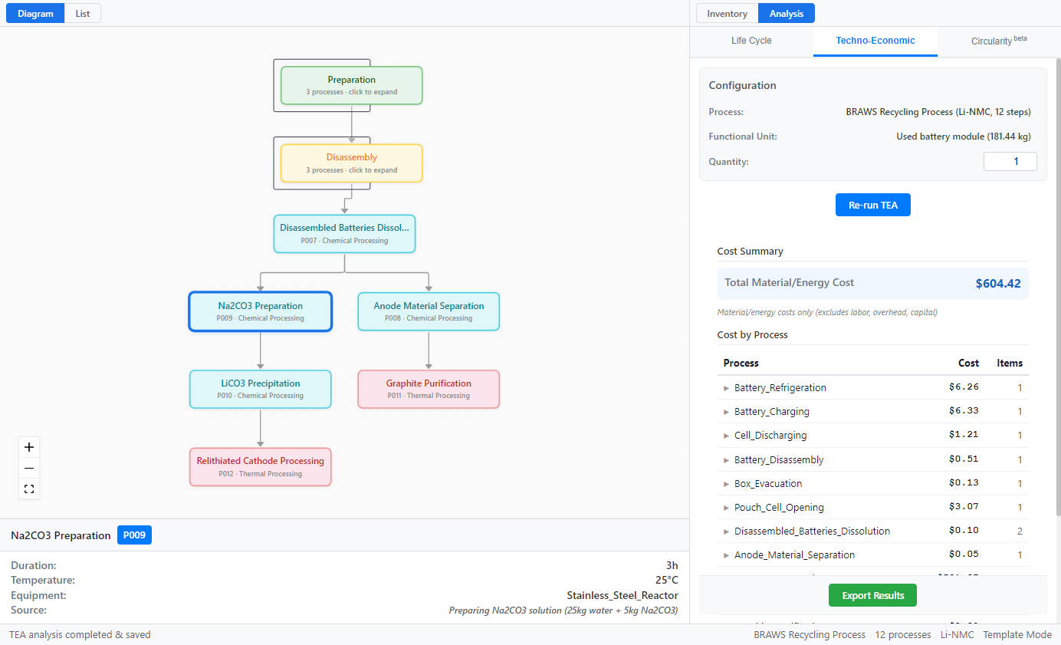
STEP 9
Run TEA
• Run Techno-Economic Analysis (TEA) for cost totals.
• Review per-process breakdowns in the results panel.
• Inventory edits flow directly into TEA outputs.

Slide 11
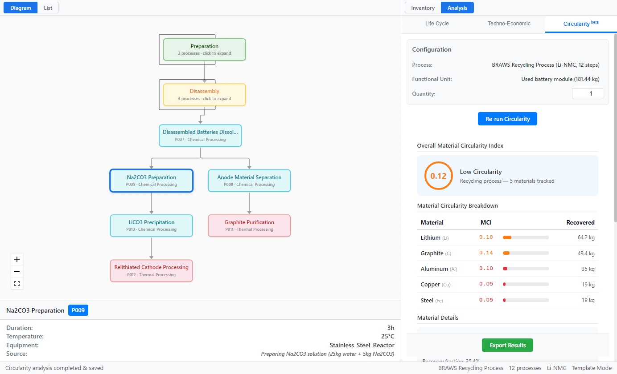
STEP 10
Circularity Metrics
• Run Circularity to evaluate key battery material loops.
• Compare circularity performance across scenarios.
• Export consolidated results to Excel for reporting.

Slide 12
Ready to Get Started?
LiTeCAB Desktop is a standalone application — no internet, database, or Python installation required. Download, install, and start analyzing.

