Slide 1
Fulva: Efficient Live Migration for In-memory Key-Value Stores with Zero Downtime
Jiewen Hai¹, Cheng Wang¹, Xusheng Chen¹, Tsz On Li¹, Heming Cui¹, Sen Wang²
The University of Hong Kong¹, Huawei²
Notes:
Hello everyone, I am Li Tsz On from the University of Hong Kong. Today I will present Fulva, an efficient live migration technique for in-memory key value store. This work is done with my colleagues Jiewen, Cheng, Xusheng, an Huawei researcher, Sen Wang, and our supervisor Heming Cui.

Slide 2
Background: Distributed In-memory Key-value Stores
A Data Center
Client 1
Client 2
Client 3
Client 4
Client 5
Client 6
Applications:
E-commerce’s backend
Graph computing
Computer 1
Computer 2
key-value store
key-value store
e.g., RAMCloud (with DPDK between servers and clients in a datacenter) achieves:
Millions of requests/sec
Low latency of ~9.4 µs
<1, V>
<400, V>
....
....
....
<200, V>
....
<500, V>
....
....
....
<300, V>
<600, V>
....
....
<400, V>
<700, V>
Notes:
Distributed in-memory key-value stores are an essential building block in data center. These key-value stores systems distribute data tuples into multiple partitions, with each partitions running on one computer in order to achieve high performance. For instance, a key-value store RAMCloud, which runs both servers and clients in the same datacenter, using DPDK, achieves millions operations per second with tens of microseconds latency.

Slide 3
Background: Skewed Workload
A Data Center
Client 1
Client 2
Client 3
Client 4
Client 5
Client 6
Example of skewed workloads:
E-commerce daily deals
Flash Sales
First/last 10 minutes
of stock trading date
Computer 1
Computer 2
In typical YCBS workloads, when 80% clients’ requests go to the tuples stored on one computer (e.g., Computer 1), the latency of the computer increases from 9.4 µs to 19.5 µs.
key-value store
key-value store
<1, V>
<400, V>
....
....
<200, V>
....
<500, V>
....
....
....
<300, V>
<600, V>
....
....
<400, V>
<700, V>
Notes:
However, in Key value store, the access pattern over the key space is often uneven (!) and such skewed workload degrades the performance of the key-value store. For example, in typical YCSB workloads, when 80% clients’ requests go to the tuples stored on one computer, which are the tuples of key 1 to 400 colored in red in this slide, such skewed workload causes one computer overloaded while another computer idle, hence the latency of the overloaded computer increases from 9.4 µs to 19.5 µs.

Slide 4
Background: Live migration – a powerful technique to re-balance load across computers
A Data Center
Client 1
Client 2
Client 3
Client 4
Client 5
Client 6
The overall performance of the two computers will be improved.
Source
Destination
key-value store
key-value store
<1, V>
<1, V>
....
....
<200, V>
....
<200, V>
....
....
....
<300, V>
<400, V>
....
....
<400, V>
<500, V>
....
Notes:
To rebalance load between these computers, live migration technique (!) moves half of the workloads from an overloaded computer (which we call it source) to an idle computer (which we call it destination), while continuously serving the incoming client requests. After the migration, the overall performance of the Key-value store will be improved

Slide 5
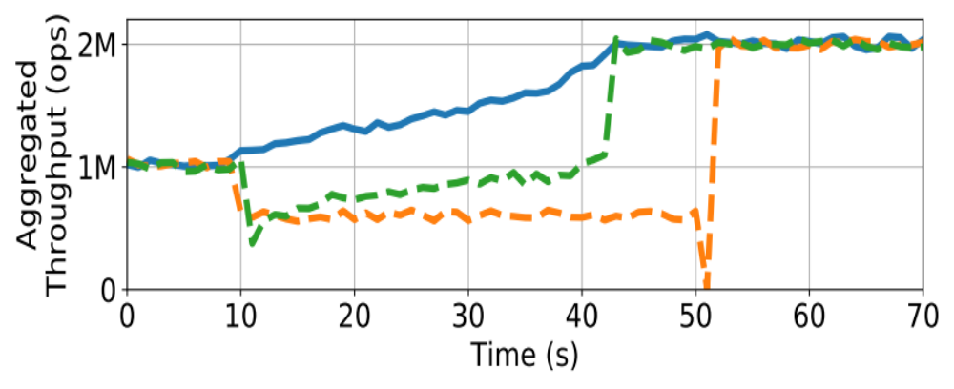
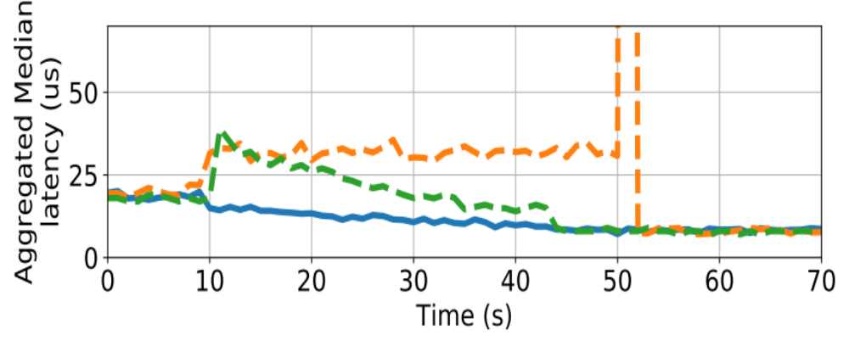
Existing live migration approaches and Fulva
Source-driven approach (orange line)
Albatross (VLDB’11)
Slacker (EDBT’12)
Drtmb (ATC’17)
RAMCloud-migration (SIGOPS’10)
Destination-driven approach (green line)
Zephyr (SIGMOD’11)
ProRea (EDBT’12)
Squall (VLDB’14)
Rocksteady (SOSP’17)
Fulva
Destination-driven approach
Fulva (blue line)
Source-driven approach
Fulva’s latency decreases when migration starts
Fulva does not have service downtime
Fulva is a near-optimal live migration technique
Workload: YCSB-B (95% read and 5% write)
Notes:
Existing live migration approaches can be divided into 3 categories: source-driven, destination-driven and our work, Fulva. In both figures on the left, x-axis is the timeline in seconds, and the migration starts at the 10th second. For the first figure, the y-axis is the aggregated throughput of both the source and destination. For the second figure, the y-axis is the aggregated median latency of both source and destination. After all the migration approaches finish, the aggregated throughput of both source and destination will increase from about 1 million requests per second to 2 million, and median latency of the two computers will reduce from about 19 microseconds to 9.
Overall, both source-driven approach (the orange line) and the destination-driven approach (the green line)’s throughput decreases when migration starts, and source-driven approach has a downtime near the end of migration (!). While Fulva’ throughput increases when migration starts and it does not have downtime. Therefore, Fulva is a near-optimal live migration technique.

Slide 6
Outline
The workflow and limitations of source-driven approach
The workflow and limitations of destination-driven approach
The workflow and challenge of Fulva
Fulva’s architecture
Fulva’s two detailed techniques
Evaluation
Conclusion and future work
Notes:
Here shows the outline of this presentation, we first talk about the workflow and limitations of source-driven and destination driven approach, then we present you Fulva’s workflow, challenge, architecture, and Fulva’s two detailed techniques. We then talk about the evaluation result and finally we conclude.

Slide 7
The workflow and limitations of source-driven approach
Workflow:
  Source handles client’s requests during migration
  Sources iteratively copies updated tuple to destination
Limitations:
  Source is even more overloaded during migration
  A service downtime has to be triggered near the end of migration
Client 1
Client 2
Client 3
Set(1,V2)
Set(1,V3)
Set(1,V1)
Source
Destination
key-value store
key-value store
<1, V2>
<1, V>
<1, V1>
<1, V2>
<1, V1>
<1, V3>
<1, V3>
<1, V>
....
....
<200, V>
<100, V>
....
<300, V>
<400, V>
....
....
<400, V>
<500, V>
....
Notes:
To re-balance load between computers while handle client’s request, source-driven approach lets source (!) handle client’s read request and write request during migration.
The main challenge for source driven approach is to make sure destination has the latest version of tuple when migration completes. Existing source-driven approach incrementally copies the updated tuple from source to destination during migration. For instance (!), as shown in this slide, suppose the clients keep updating the tuple of key 1 by sending write request to source, after the source commits the update, it has to send a copy to the destination
Unfortunately (!), letting source handle client’s requests makes source even more overloaded during migration than before migration, which degrades the KV store’s overall performance during migration. Moreover, in order to make sure all updated tuples are completely copied from source to destination before a migration terminates, a service downtime up to two seconds has to be triggered near the end of migration.

Slide 8
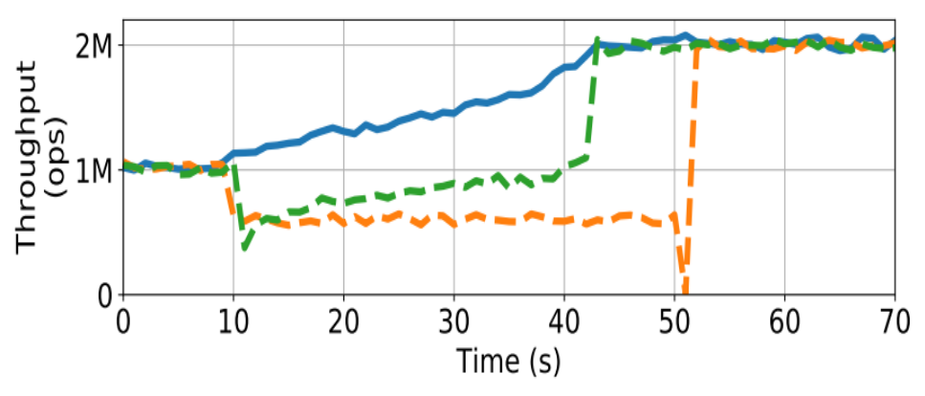
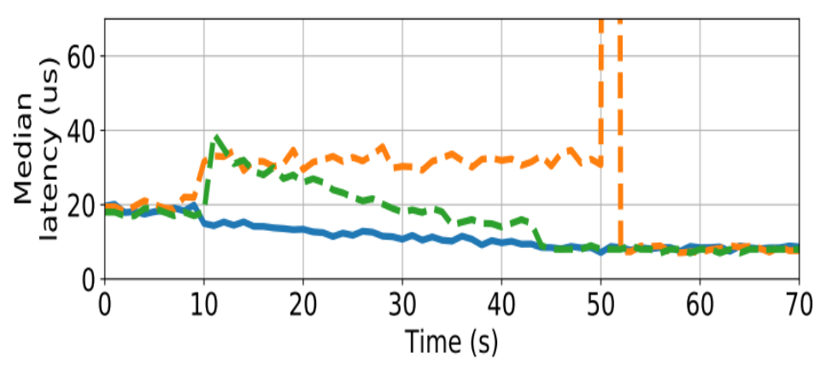
The workflow and limitations of source-driven approach (Focus on Orange line)
Pros:
Implementation is simple.
Cons:
Source is even more overloaded during migration
A service downtime has to be triggered near the end of migration
Fulva
 | Read Mean Latency (µs) |  | Write Mean Latency (µs)
 | source | destination | source | destination
Before Migration | 18.14 (1-400) | N/A | 42.57 (1-400) | N/A
Source-driven approach | 34.79 (1-400) | N/A | 73.16 (1-400) | N/A
Destination-driven approach
Source-driven approach
8
Notes:
Overall, source driven approach is easy to implement, but it degrades key value store’s performance during migration. It is because during the migration, source not only needs to handle requests of all tuples that are originally stored on source, which have the key 1 to 400 in the examples of this presentation, but it also needs to migrate tuples from source to destination and iteratively copies updated tuples to destination, which causes source more overloaded and having higher read and write latency (!) during migration than before migration. Moreover, source-driven approach has to trigger a service downtime time (!) near the end of migration

Slide 9
The workflow and limitation of destination-driven approach
Workflow:
  Destination handles client’s requests during migration
  Destination pulls tuples from source on demand
Limitations:
  The extra round-trip between source and destination for a read request incurs notable latency
Client1
Client2
Client3
Get (180)
<180,V>
Source
Get (180)
Destination
key-value store
key-value store
<1, V>
<1, V>
....
....
<180, V>
<100, V>
<200, V>
....
<300, V>
<500, V>
....
....
<400, V>
<600, V>
....
Notes:
To avoid the problem of further overloading source during migration and the problem of trigging a downtime near the end of migration, destination-driven approach lets destination (!) handles client’s write request and read requests.
The main challenge for destination driven approach is to handle read request for those tuples that have not been migrated to destination. Existing destination-driven approach lets destination pull the tuples from source on demand. For example, suppose the client sends a read request to destination for reading the tuple of key 180 (!), which has not been migrated to destination yet, instead of aborting the request, the destination pulls (!) the tuple from source and reply (!) the client with the pulled tuple
Unfortunately (!), the extra round-trip between source and destination due to on demand pulling for read request incurs notable latency. This round trip latency is especially enormous to the client’s perceived read latency when the servers and clients communicate with high-speed network such as DPDK.

Slide 10
The workflow and limitations of destination-driven approach (Focus on Green line)
Pros:
The latency of write request is reduced
No service down time has to be incurred near the end of migration
Cons:
High latency for read requests
Fulva
 | Read Mean Latency (µs) |  | Write Mean Latency (µs)
 | source | destination | source | destination
Before Migration | 18.14 (1-400) | N/A | 42.57 (1-400) | N/A
Destination-driven approach | 10.12 (201-400) | 62.97 (1-200) | 33.28 (201-400) | 24.22 (1-200)
Destination-driven approach
Source-driven approach
Notes:
Overall, destination-driven approach’s on-demand pulling incurs enormous read latency (!), even though halve of all tuples originally stored on source are offloaded to destination when migration starts. Moreover, destination-driven approach casuses the KV store’s overall latency increases (!) significantly when migration starts. It is because most KV tuples are not available on destination for read request when migration starts, so on-demand pull is frequent.

Slide 11
Fulva: Efficient Live Migration for In-memory Key-Value Stores with Zero Downtime
Key idea: let source and destination collaboratively handle clients’ requests together during migration to efficiently balance load between computers
Challenge: how Fulva ensures linearizability (every read request read on a tuple reads the latest write request on the tuple)?
  Solution: lets client sends read requests to both source and destination for tuples that have not been migrated
Client 1
Client 2
Client 3
Set(1,V1)
Set(1,V2)
Set(1,V3)
<1,V>
Get(1)
Get(1)
<1,V3>
Source
Destination
key-value store
key-value store
<1, V>
<1,V3>
<1,V2>
<1, V>
<1,V1>
....
....
<200, V>
<100, V>
....
<300, V>
<500, V>
....
....
<400, V>
<600, V>
....
Notes:
To avoid the on-demand pulling problem of destination-driven approach, and downtime problem of source-driven approach, Fulva lets source and destination collaboratively handle clients’ requests during migration to efficiently balance load between computers. To be specific, Fulva lets destination to handle write request (!), so that the downtime problem of source-driven approach can be avoided, and lets source handle read (!) request, so that the on-demand pulling problem of destionation-drive approach can be avoided.
However, client may not always get the latest value of a tuple when clients only send read request to source (!), as write request is always handled by destination. For instance, after three clients send their write requests to destination, the latest value of tuple of key 1 is V3 (!). So the client who sends read request to source for the tuple of key 1 will get the outdated value.
To ensure linearizability, Fulva lets client send read request to both source and destination (!) for the tuples that have not been migrated to destination. Therefore, client can always get the latest value from destination (!) for the tuple has been migrated or updated on destination. For the tuple that has not been migrated or updated on destination, the destination simply replies client an empty value, so that the client accepts the tuple replied by source. Under both cases, the client always get the latest value of the tuple from either the source or the destination. The challenge of this approach is that client needs to send two read request to source and destination respectively, which increases Fulva’s bandwidth usage. We will present two techniques to reduce Fulva’s bandwidth usage in the following slides

Slide 12
Fulva’s architecture
Client program N
data-
center
Client program 2
Client program 1
(…)
get(…)
get(…)
read(…)
write(…)
Fulva RPC library provides standard API, such as read, so that the client program logic does not need to be modiﬁed.
Migration Controller starts concurrent streams to migrate tuples from source to destination
Each stream migrates the tuples sequentially based on the order of the tuples’ key
Fulva RPC Library
Migration Completion Ranges
Sampling Pulled Hashes
Source
Destination
sampling puller
key-value store
Migration
controller
Migration
controller
key-value store
<1, V>
<1, V>
....
....
<100, V>
....
....
<50, V>
....
<51,V>
....
....
<100, V>
<301, V>
....
....
<500, V>
<400, V>
....
<600,V>
Notes:
We first look into the high-level architecture of Fulva. Client applications access the key-value stores over a datacenter network using an RPC library (!) provided by Fulva, so that the client program logic does not need to be modiﬁed. Fulva also has a “Migration Controller” (!) to start several concurrent streams to migrate tuples from source to destination. Each stream migrates the tuples sequentially based on the order of the tuples’ key

Slide 13
How does Fulva track the migrated KV tuples
Client program N
Client program 2
data-
center
Client program 1
(…)
get(…)
get(…)
read(…)
write(…)
Fulva maintains a simple data structure called “migration completion ranges” (MCR)
Key idea: Destination periodically piggybacks the metadata of the latest key of migrated tuple to its reply to the clients
MCR stores the key range of migrated tuple in each client’s RPC library
Fulva RPC Library
Migration Completion Ranges: [1-50]
Migration Completion Ranges: Empty
migrated?
Get(1)
<1,V>;[1-50]
Source
Destination
key-value store
Migration
controller
Migration
controller
key-value store
<1, V>
<1, V>
....
<1,V> - <50,V>
....
<100, V>
....
....
....
<50, V>
....
<301, V>
....
<500, V>
<400, V>
....
<600,V>
Notes:
Fulva keeps track of migrated tuple by maintaining a lightweight data structure (!) called “migration completion ranges” (MCR) in each Fulva client's RPC library.
MCR’s key idea is to let destination periodically piggybacks the metadata of the migrated tuple to the reply to the clients who sent the read requests. The MCR in each client’s RPC library then updates the key range of migrated tuple. MCR in each client’s programme has little memory footprint because it only needs to record the key of the latest tuple migrated to destination in each concurrent migration stream. This is because the migration in each stream is done sequentially based on the order of tuples’ key.
Suppose the tuples of key 1-50 (!) is migrated to destination, when the client send (!) a read request to destination, the destination replies (!) both the tuple value and the metadata telling the client that the tuples of key 1-50 is migrated to destination. (!) Then, the MCR updates (!) the key range of migrated tuples, which is 1 to 50.

Slide 14
Migration Completion Ranges : Reduce Fulva’s extra bandwidth usage
Client program N
Client program 2
Client needs only send read request to destination for tuples whose key is in MCR
Client program 1
get(…)
get(…)
data-
center
read(…)
write(…)
Fulva RPC Library
Get(200)
Get(100)
Migration Completion Ranges: [1-100]
migrated?
Yes
Suppose a client sends a read quest for the tuple of key 100, which is in MCR
No
Source
Destination
Suppose a client sends a read quest for the tuple of key 200, which is not in MCR
key-value store
Migration
controller
Migration
controller
key-value store
<1, V>
<1, V>
....
....
<100, V>
....
<50, V>
MCR is effective in reducing the number of double-read requests from client.
....
....
<51,V>
....
....
<100, V>
<301, V>
....
....
<500, V>
<400, V>
....
<600,V>
Notes:
With MCR, clients only need to send read request to destination for migrated tuple, suppose MCR stores the key range of one to one hundred, which implies the tuple of keys one to one hundreds have been migrated.
For example, suppose (!), a client programme wants to read a tuple of key 100, it first checks if the key is within the MCR (!). Since the key 100 is within the MCR, the client only needs to send read request to destination. If the client want to read a tuple of key 200 (!), since key 200 is not within MCR (!), the client needs to send read request to both source and destination.
One should note that MCR does not have to be perfectly up-to-date in each client’s library, because it only provides hint for the client to reduce extra bandwidth usage without affecting Fulva’s linearizability and end-to-end performance. Since MCR does not have to be up-to-date, destination piggybacks the meta to the reply to client for each 1000 client's requests, instead of for each client's request, in order to reduce Fulva’s extra bandwidth usage. Overall, MCR (!) is effective in reducing the number of double read request from clients for the tuples that have been migrated to destination

Slide 15
However, MCR may not be effective in reducing extra bandwidth usage for high skew workload
Client
The keys of hot tuples
(accessed by most requests)
The keys of migrated tuples
Source
Destination
key-value store
key-value store
MCR
<1, V>
<1, V>
....
....
0
100
200
<200, V>
<100, V>
....
<300, V>
<500, V>
....
....
Key space that needs to be migrated
<400, V>
<600, V>
15
....
Notes:
However, if hot tuple is not migrated in the beginning of the migration, MCR maybe ineffective in reducing the number of double-read request. To be specific (!), hot tuple may located near the end of key space. Since migration is done sequentially based on tuple’s key, those hot tuple will only be included in MCR near the end of migration. Therefore (!), clients need to send double read request to source and destination during most of the time in migration.

Slide 16
Sample Puller’s workflow
Key idea of SampPull: Hot tuples can be efficiently identified through sampling incoming requests on destination.
SampPull: sample a small faction p (1% by default) of incoming requests
Fulva’s end-to-end performance is insensitive to the choice of p.
Client program N
data-
center
Client program 2
Client program 1
get(…)
get(…)
read(…)
write(…)
Fulva RPC Library
Migration Completion Ranges: [1-100]
Sampling Pulled Hashes: Empty
Migration Completion Ranges: [1-100]
Sampling Pulled Hashes: [200]
migrated?
200
1
200
200
Source
Destination
sampling puller {200}
key-value store
Migration
controller
Migration
controller
key-value store
<1, V>
<1, V>
SampPull is light-weight and efficient
....
....
<50, V>
<100, V>
....
....
....
<51,V>
<200, V>
....
....
SampPull does not affect the linearizability of Fulva
<100, V>
<301, V>
....
....
sampling pull
<500, V>
<400, V>
....
<600,V>
Notes:
We propose SampPull, a light-weight technique to identify and migrate hot tuples through sampling incoming requests. SampPull is effective because hot tuples are accessed by much more clients request than other tuples, hence hot tuples have high probability to be sampled from these requests.
For instance (!), suppose the tuple of key 200 is hot and most clients send read requests for this tuple, the sampPull identified (!) this key by sampling incoming requests and pulls the tuple of key 200 from source to destination. Then sampPull then periodically piggyback (!) a meta data to the reply to client to update Sampling Pulled Hashes in the client’s RPC library, like MCR. Compared with MCR, the memory footprint of these hashes in each client program consumes more memory, and we will introduce techniques to reduce this memory footprint on each client later.
Overall (!), SampPull is lightweight and efficient because it uses simple sampling technique to identify hot tuples and does not affect the end to end performance of Fulva. Lastly (!), similar to MCR, SampPull does not need to be up-to-date in each client’s RPC library because it only provides hint for client to reduce bandwidth, therefore it does not affect Fulva’s linearizability.

Slide 17
Evaluation Setup (1)
A cluster of 12 computers
  Intel Xeon E5-2690 v3 server, with 60GB DRAM on each
  Connected with 40Gbps NIC
  All hosts used DPDK for kernel-bypass support
Implemented Fulva on RAMCloud, a popular in-memory key-value store
Compared Fulva with two live migration systems
  RAMCloud Migration: builtin source-driven approach of RAMCloud
  Rocksteady (SOSP’17): a state-of-the-art destination-driven live migration approach tailored for RAMCloud
Notes:
For the evaluation, we use a cluster of 12 computers. We have implemented Fulva on RAMCloud, a popular in-memory key-value store, and we have compared our system with two related sytems, the first one is RAMCloud-migration, the builtin source-driven approach of RAMCloud. And the second one is Rocksteady, a state-of-the-art destination-driven approach tailored for RAMCloud

Slide 18
Evaluation Setup (2)
Workload: YCSB and TPC-C
  YCSB-A (50% read and 50% write) and YCSB-B (95% read and 5% write)
  High Skew (80% requests access 20% records) and Low Skew (66% requests access 25% records), same as Rocksteady’s setting
Dataset: 300 million 100-byte record payloads (values) with 30-byte keys.
  Dataset size: 40GB on the source
  All evaluated systems migrate 20GB of the dataset to Destination
Metrics
  Throughput: the aggregated throughput of source and destination
  Median latency: the median latency of all clients’ requests
  Tail latency: the 99th percentile of the latency of all clients’ requests
Notes:
We evaluated all the three systems with two benchmarks: YCSB and TPC-C. Our dataset comprised of 300 million records on source, which has total size of 40GB. All the systems migrated 20GB from source to destination. For our evaluation metric throughput and median latency, we use standard definition, for tail latecy, we mesaure the 99 percentile of the latency of all requests in one second

Slide 19
We conducted extensive evaluation
What are Fulva’s performance compared to RAMCloud-Migration and RockSteady on YCSB (High Skew) ?
What is the effectiveness of Fulva’s components?
What are Fulva’s performance compared to RAMCloud-Migration and RockSteady on YCSB (Low Skew) ?
What is Fulva’s performance on TPC-C compared to RAMCloud-Migration?
Notes:
In this presentation, we mainly focus on Fulva’s performance on YCSB under high skew setting and effectiveness of Fulva’s component. For the rest of the questions such as Fulva’s performance on low skew workload and TPC-C workload, you may refer to our paper

Slide 20
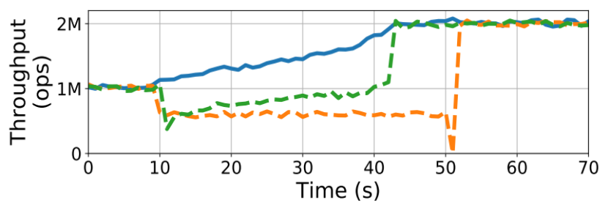
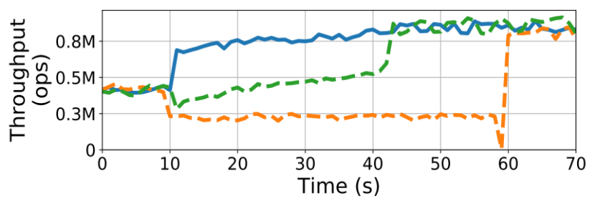
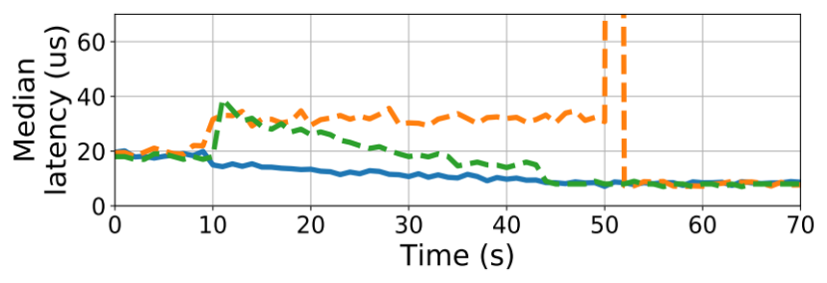
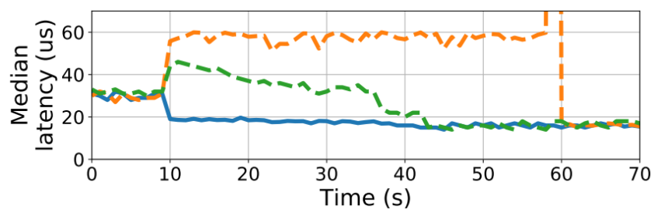
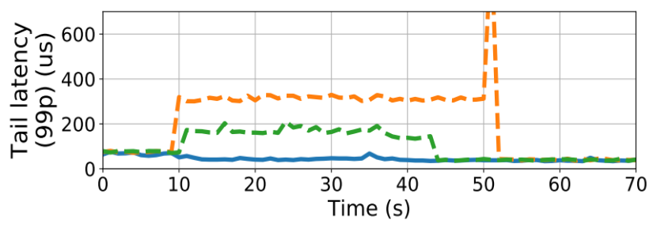
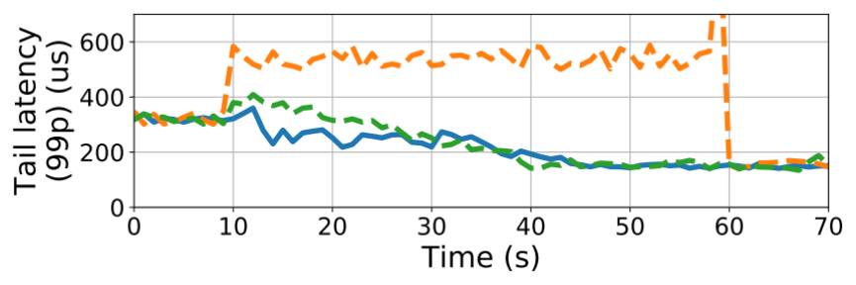
The three systems’ performance on YCSB (High Skew)
Fulva
Destination-driven approach
Source-driven approach
YCSB-B (95% read) and High Skew
YCSB-A (50% read) and High Skew
Notes:
We first show the throughput, median latency and tail latency of the three systems for YCSB-B under high skew setting. We can see that Fulva, the blue line, has the best performance that it has highest throughput and the lowest median and tail latency. One major concern is that a key-value store migration system may have high tail latency in high skew workload. Surprisingly, Fulva’s tail latency (!) during migration was much lower than the tail latency before migration, and it was also much lower than RAMCloud and RockSteady’s because Fulva offloads write request to destination, which makes source less overloaded, and always replies client the latest write value without an extra latency. In constrast, RAMCLoud migration causes source more overloaded and Rocksteady incurs an extra round trip latency between source and destination, which result in a high tail latency during migration.
Besides, Fulva in YCSB-A (!) has even greater performance improvement comparing to Fulva in YCSB-B. Fulva in YCSB-A 's throughput increase more significantly when migration starts because for write-heavy workload, more client’s requests are offloaded from source to destination when migration starts, which implies source is even less overloaded.

Slide 21
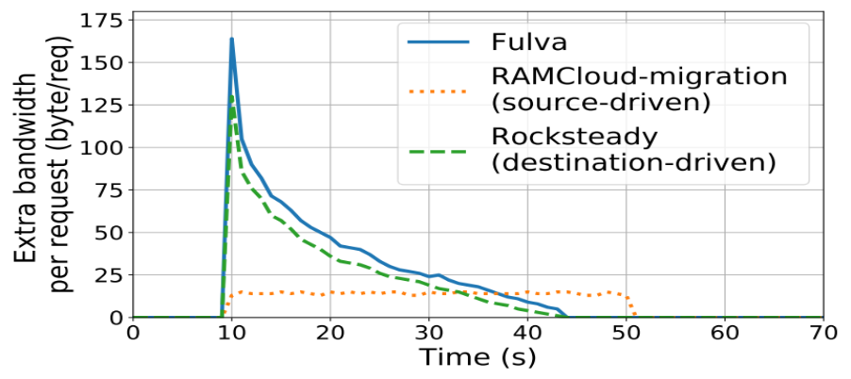
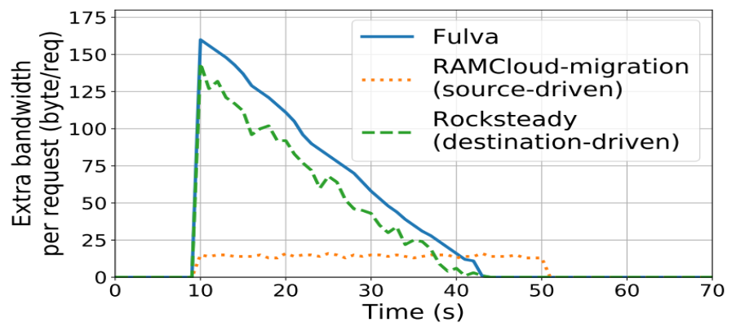
Fulva’s Extra Bandwidth on YCSB-B
 | Total extra bandwidth usage (GB)
 | Between source/destination and clients | Between source and destination
Fulva | 0.91 | 0.63
RockSteady (destination-driven) | 0 | 0.72
RAMCloud-Migration (source-driven) | 0 | 0.35
High Skew
* Extra bandwidth usage: the bandwidth usage for functions other than migrating the 20GB, such as double read from clients.
Thanks to MCR and SampPull, Fulva’s extra bandwidth per request is comparable to Rocksteady’s
Low Skew
High Skew
Notes:
On major concern about Fulva is that Fulva has notable extra bandwidth usage, which is the bandwidth usage for functions other than migrating the 20GB data. Fulva incurs extra bandwidth usage because of double read request and sampPull. Rocksteady incurs extra bandwidth usage because of the on demand pull for read request, and RAMCloud migration incurs extra bandwidth usage because source iteratively compies the updated tuple to destionation. Fulva and Rocksteady incurs twice (!) more total extra bandwidth usage than RAMCloud-migration because Fulva and Rocksteady have higher average throughput than RAMCloud-migration during migration so they handled twice more clients’ requests, result in higher total extra bandwidth usage.
To analyze (!) the extra bandwidth usage of the three systems, we look into their extra bandwidth usage per request. Thanks to MCR and SampPull, Fulva (!) does not use significantly more bandwidth usage per request than Rocksteady. Although Fulva and Rocksteady uses more extra bandwidth per request than RAMCloud-migration, RAMCloud-migration takes longer time (!) to do the migration because it makes source more overloaded so it has lower migration throughput than Fulva and RockSteady.

Slide 22
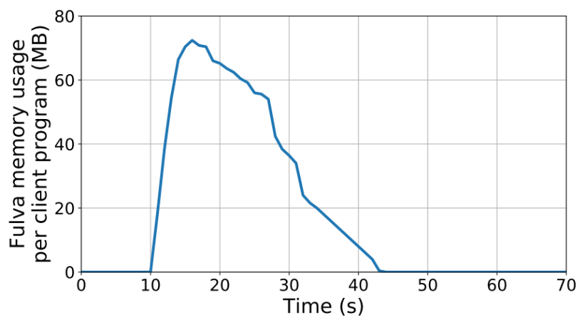
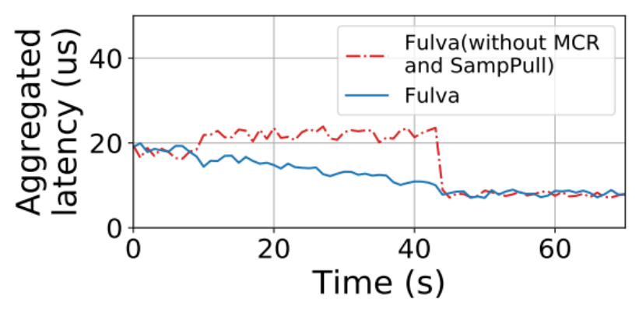
Effectiveness of Fulva’s component
Effectiveness of Fulva’s MCR and SampPull technique
Fulva’s per client memory footprint
The lookup time of MCR (Migration Completion Ranges) and SPH (Sample Pulled Hashes) table on each client program is less than 0.18 µs
MCR and SPH’s memory footprint per client is effectively controlled:
  In the earlier phase of a migration, the SPH table is small
  In the later phase of the migration, the MCR covers most keys, and the SPH table is trimmed
Notes:
Lastly, we show the effectiveness of Fulva’s MCR and SampPull, the left figure shows that MCR and SampPull is effective in reducing Fulva’s latency. Our evaluation also shows that MCR and SampPull’s lookup latency is less than 0.18 microseconds, which is negligible. For each client programme, the memory footprint of MCR and the SampPull Hashes table was up to 70 MB and decreased quickly during the migration. This is because in the earlier phase of a migration, the SPH table is small. Besides, the lookup time and the memory footprint of MCR is always neglible during the entire migration. In the later phase of the migration, the MCR covers most keys, and the SPH table is trimmed because it only needs to contain the hot keys not covered by MCR.

Slide 23
Conclusion and Future work
Fulva: a source and destination hybrid-driven, near-optimal live migration technique
Which KV stores are suitable for Fulva?
  Both clients and servers run in the same datacenter, and their performance is sensitive to workloads’ skewness
  The KV store needs to ensure linearizability (read latest write)
  These two requirements are common to all existing live migration approaches for KV stores
    e.g., Rocksteady (SOSP’17), Drtmb (ATC’17) etc.
  e.g., RAMCloud (SOSP’11), Redis, Mica (NSDI’14) etc.
Recent development on Fulva:
  Integrating Fulva to more KV stores (e.g., Redis)
Fulva’s code is open source on http://github.com/hku-systems/fulva
Notes:
So, to conclude, we present a near-optimal live migration technique, based on our source and destination hybrid-driven design. Fulva is applicable to the key value store that has both clients and servers run in the same datacenter, which implies the key value store is sensitive to workloads' skewness, and needs to enforce linearizability, These two requirements are common to all exisiting live migration approaches, such as Rocksteady and Drtmb. The example of these key value stores are RAMCloud, Redis and Mica etc. Our recent development on Fulva include integrating Fulva to more key value stores, such as Redis, other than RAMCloud. And Fulva’s source code can be found in this github link

Slide 24
Thank you!
Notes:
That's all about Fulva. Please feel free to ask questions
What if no DPDK? Fulva can always also improve the key value store’s performance during migration, as long as the client-server/server-server network’s latency is similar. If the client-server network latency is large, for instance, the clients are outside the datacenter, the client-server network latency will dominate the end-to-end latency of the key-value store, so all live migration techniques tend to have the same performance
What if client run outside? All live migration systems have similar performance. The KV store’s end-to-end performance will be less sensitive to live migration, depends on the difference between client-server/server-server network’s latency, the larger, the less sensitive.
Fulva’s performance on low skew workload? We also have evaluated low skewed setting on YCSB. Fulva’s performance in low-skew workload similar as Fulva’s performance in high skew workload
Is Fulva only applicable to linearizable KV store? Fulva can apply to non-linearizable KV store as well. One should note that ensuring linearizability is a challenge for live migration technique to improve a KV store’s performance. Without this challenge, the live migration mechanism can be much simpler
Can Fulva apply to RDBMS? Although Fulva is designed for KV stores, Fulva is also applicable to RDBMS. However, Fulva may not be the optimal live migration technique for RDBMS because live migration techniques in RDBMS also consider the optimization technique for SQL such as functional dependency, while Fulva does not consider these optimizations.
How do u overload the servers? We increase the number of client programmes, each client programme sends requests to servers with the same setting such as the key-space distribution. We stop increasing the number of clients until we observe the server’s throughput cannot further increase.
Why the servers are overloaded, is it because of the hardware capacity? We found the reasons for the servers to be overloaded is because the software processing capability of RAMCloud. RAMCloud only uses one dispatch thread to receive client’s requests and assign those requests to idle worker threads. Therefore, when the number of clients increase, the dispatch thread is busier and the throughput of the RAMCloud server reach the peak
Why only evaluate YCSB-A and YCSB-B but not others? We follow the evaluation setting of the latest two works, Rocksteady and Drtmb
How many clients are used in the evaluation: 8 clients, with 4 microseconds latency between server and clients
How is Fulva’s performance on read-only workload? Fulva is still the most efficient live migration system. Fulva is more efficient than source-driven approach because by using Fulva, more tuples are offloaded to destination as migration preceeds, so source’s load is reduced. Moreover, Fulva is more efficient than destination driven approach because Fulva does not incur extra round-trip latency between source and destination.
Does Fulva has any fault-tolerance mechanism? Yes, Fulva’s fault tolerance mechanism is the same as Rocksteady’s, which relies on server called coordinator to record which tuples have been migrated to destination.
SPH MCR Data per client? SPH and MCR are maintained in each RPC client’s library
How to compare with Drtmb? Backup is not synchronized with primary & our performance is better based on the paper

Slide 25
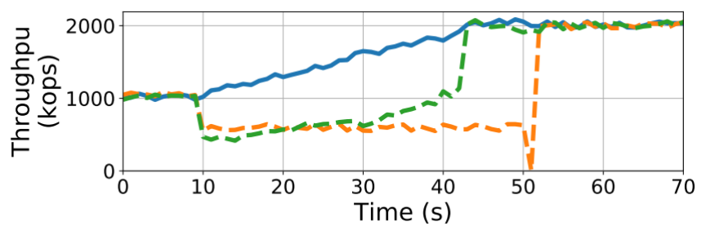
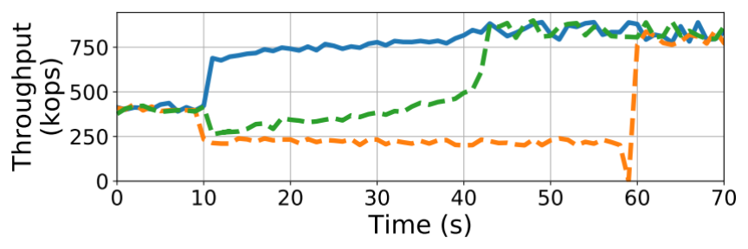
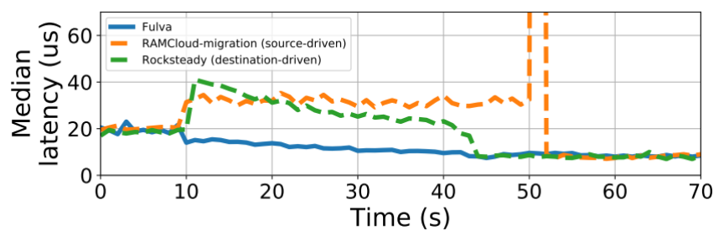
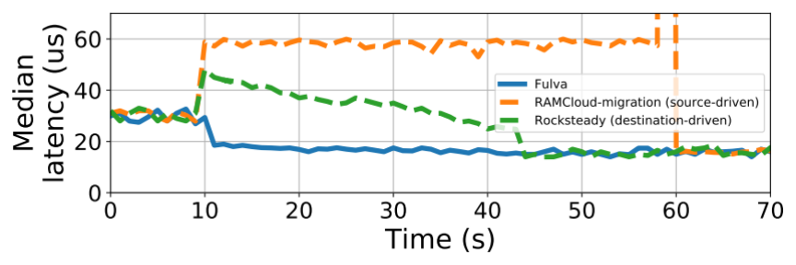
The three systems’ performance on YCSB (Low Skew)
Fulva
Destination-driven approach
Source-driven approach
YCSB-B (95% read) and Low Skew
YCSB-A (50% read) and Low Skew
Notes:
Similar to High Skew workload, Fulva's performance during migration is better than before migraion's. Moreover, Fulva is also the most efficient system among the three evaluated systems. Therefore, Fulva's performance is insensitive to workload's skewness

