Slide 1
软件构件与中间件
第一章 预备知识
1.Java Annotation; 2.JDBC; 3. JNDI
第二章 中间件导论
第三章 远程方法调用RMI
第四章 RMI/IIOP
第五章 CORBA基本概念
第六章 J2EE EJB 3.0
第七章 DCOM
附录：DCOM与CORBA

Slide 2
第一章 预备知识
第一节 Java Annotation
第二节 JDBC

Slide 3
第一节 Java Annotations
Java Annotations for Types and Expressions

Slide 4

Comments are Discarded
Parser
Abstract Syntax
Tree (AST)
Source File
// never null
// p never null
// never null
class C {
Object field;
C(Object p) {
field = p;
}
Object get() {
return field;
}
}
C
Program
Program
with
comments
Object
field
Object
get()
C(Object p)
Comments
=
return
field
p
field

Slide 5
Annotations are Retained
Parser
Abstract Syntax
Tree
Source File
class C {
@NonNull
Object field;
C(@NonNull
Object p) {
field = p;
}
@NonNull
Object get() {
return field;
}
}
C
Program
with
annotations
@NonNull
Program
with
annotations
Object
field
Object
get()
C(Object p)
@NonNull
@NonNull
=
return
field
p
field
Annotations are part of the AST
  Can be processed automatically

Slide 6
Annotation Definition
Structured Data
  Comparable to records in OCaml
@interface MyAnnotation {
String value(); // member
int i() default 123; // member w. default value
}
@interface MarkerAnnotation {
// annotation without any members
}
Notes:
Annotations are Structured

Slide 7
Annotation Usage
@MyAnnotation(value="text", i=456)
void method() { … }
// default value for i: 123
@MyAnnotation(value="text")
void method2() { … }
// special case for members called "value"
@MyAnnotation("text")
void method3() { … }
// parenthesis can be omitted if no members
@MarkerAnnotation
void method4() { … }

Slide 8
Annotation Members
@interface MyAnnotation {
int intMember(); // primitives
String stringMember(); // strings
Class classMember(); // class literals
SomeEnum enumMember(); // enums
// annotions
OnlyThreadWithName annotMember();
// arrays of the above
OnlyThreadWithName[] arrayMember();
}

Slide 9
Annotation Targets in Java 5
@A package some.package.name;
@B class MyClass {
@C Object field;
@D MyClass(@E Object param) {
field = param;
}
@F Object method() {
@G Object localVar = field;
return localVar;
}
}

Slide 10
New Annotation Targets in JSR308
Types
  Type parameters
HashMap<@A String, Object> m;
  Inheritance, bounds
class MyClass<T extends @B Number>
implements @C SuperClass { … }
  Object creation
new @D Integer(5);
  Class literals
Class<@E String> c = @E String.class;
  Static fields
@F MyClass.field
  Type casts
String s = (@G String) myObject;

Slide 11
New Annotation Targets in JSR308
All Type Occurrences
HashMap<@A String, Object> m;
Arrays
String @B[][] a = new String @B[10][2];
Method Receivers
public String toString() @C { … }
  As opposed to return type
public @D String toString() { … }
Backward-Compatible to pre-JSR308
  Annotations can be written as comments
public String toString() /*@C*/ { … }

Slide 12
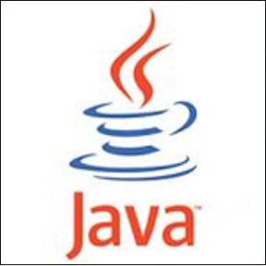
Structure of Java Compiler
Parser
Type
Checker
Class File
Writer
Source File
class C {
@NonNull
Object field;
C(@NonNull
Object p) {
field = p;
}
@NonNull
Object get() {
return field;
}
}
Class
File
AST
p
Error

Slide 13
Structure of JSR308 Compiler
Parser
Type
Checker
Annotation
Checker
Class File
Writer
Source File
class C {
@NonNull
Object field;
C(@NonNull
Object p) {
field = p;
}
@NonNull
Object get() {
return field;
}
}
Class
File
AST
p
Error
Error
Annotation
Checker
Plugins

Slide 14
Annotation Checker Plugins
Nullness checker
  @NonNull Object foo = null; // error: null!
Mutability checkers (Javari, IGJ)
  @ReadOnly int i = 0; i = 1; // error: mutation!
Interning checker
  @Interned String a = "x".intern();
  String b = "x";
  if (a==b) … // error: identity vs. equality
Defined using extensible framework

Slide 15
Nullness Checker
Define type hierarchy
@TypeQualifier
@SubtypeOf( {} )
@interface Nullable { }
@TypeQualifier
@SubtypeOf( { Nullable.class } )
@interface NonNull { }
@Nullable Object
@NonNull Object
@Nullable Date
@NonNull Date

Slide 16
Nullness Checker
Override processing for certain AST nodes
Flow analysis
  Recognizes assignment of constants
  Integer i = null; // i always null from here on
  Integer j = 1; // j never null from here on
  i = 2; // i never null from here on
  Recognizes simple conditionals
  if (i==null) { /* i must be null */ }
  else { /* i can't be null */ }

Slide 17
Suggested Extensions
Annotations on Block Statements
  @A { … }
Annotations on Parenthetical Expressions
  @B ( … )
Problem: ambiguous
@interface @Sample { int value() default 0; }
return @Sample(1) +1;
// return @Sample(value=0) (1)+1; or
// return @Sample(value=1) +1; ???

Slide 18
Resolving Ambiguity
Require parentheses for annotations with members
@interface @Sample { int value() default 0; }
@interface @MarkerAnnotation {}
return @Sample (1)+1;
// return @Sample(value=1) +1;
return @Sample() (1)+1;
// return @Sample(value=0) (1)+1;
return @MarkerAnnotation (1)+1;
// return @MarkerAnnotation (1)+1;

Slide 19
Source Code Generation
Parser
Type
Checker
Annotation
Checker
Code
Generator
Class File
Writer
Source File
class C {
@NonNull
Object field;
C(@NonNull
Object p) {
field = p;
}
@NonNull
Object get() {
return field;
}
}
Class
File
Error
Error
Annotation
Checker
Plugins
Code
Generator
Plugins

Slide 20
AST Generation
Parser
Type
Checker
Annotation
Checker
Code
Generator
Class File
Writer
Source File
class C {
@NonNull
Object field;
C(@NonNull
Object p) {
field = p;
}
@NonNull
Object get() {
return field;
}
}
Class
File
Error
Error
Annotation
Checker
Plugins
Code
Generator
Plugins

Slide 21
Multi-Stage Java Programs
@Code double power(@Code double x, int n) {
if (n==0) return @Code (1.0);
else return @Code ( @Escape (x) *
@Escape (power(x, n-1)) );
}
double square(double x) {
return @Run (power(@Code (x), 2));
// generates x * x * 1.0;
}
Java MetaOCaml
@Code generate .<x>.
@Escape splice together .~x
@Run run generated code .!x

Slide 22
Multi-Stage Java Programs
@Code double power(@Code double x, int n) {
if (n==0) return @Code (1.0);
else return @Code ( @Escape (x) *
@Escape (power(x, n-1)) );
}
double square(double x) {
return @Run (power(@Code (x), 2));
// generates x * x * 1.0;
}
let rec power(x, n) =
match n with
0 -> .<1>.
| n -> .<.~x * .~(power (n-1, x))>.;;
let square = .! .<fun x -> .~(power (.<x>., 2))>.;;

Slide 23
Summary
Annotations can be processed automatically
  Checker plugins for enhanced systems
Add annotations on
  Block statements @A { … }
  Parenthetical expressions @A ( … )
Provide code generator stage
  Use for multi-stage programs

Slide 24
第二节 JDBC

Slide 25
What is JDBC ?
JDBC stands for “Java DataBase Connectivity”
The standard interface for communication between a Java application and a SQL database
Allows a Java program to issue SQL statements and process the results.

Slide 26
JDBC Classes and Interfaces
Steps to using a database query:
Load a JDBC “driver”
Connect to the data source
Send/execute SQL statements
Process the results

Slide 27

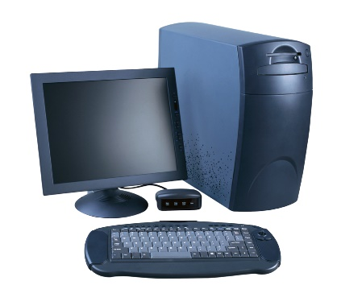
JDBC Driver
Acts as the gateway to a database
Not actually a “driver”, just a .jar file
Java application
Database Server
JDBC Driver

Slide 28
JDBC Driver Installation
Must download the driver, copy it to cobweb then add the .jar file to your $CLASSPATH
To set up your classpath, ssh into cobweb and execute the following command:
  export CLASSPATH=$CLASSPATH:<path to .jar file>:.

Slide 29
JDBC Driver Management
All drivers are managed by the DriverManager class
Example - loading an Oracle JDBC driver:
  In the Java code:
  Class.forName(“oracle.jdbc.driver.OracleDriver”)
Driver class names:
  Oracle: oracle.jdbc.driver.OracleDriver
  MySQL: com.mysql.jdbc.Driver
  MS SQL Server:
  com.microsoft.jdbc.sqlserver.SQLServerDriver

Slide 30
Establishing a Connection
Create a Connection object
Use the DriverManager to grab a connection with the getConnection method
Necessary to follow exact connection syntax
Problem 1: the parameter syntax for getConnection varies between JDBC drivers
Problem 2: one driver can have several different legal syntaxes

Slide 31
Establishing a Connection (cont.)
Oracle Example
Connection con = DriverManager.getConnection(string, “username", “password");
what to supply for string ?
“jdbc:oracle:thin:@augur.seas.gwu.edu:1521:orcl10g2”
Driver
Type
Database URL
Port #
SID
Notes:
Will be using Oracle later in the semester.

Slide 32
Establishing a Connection (cont.)
MySQL Example
Connection con = DriverManager.getConnection(string);
what to supply for string ?
“jdbc:mysql://<URL>:3306/<DB>?user=<user>&password=<pw>”
Driver
URL
Port
DB Name
Username
Password

Slide 33
Executing Statements
Obtain a statement object from the connection:
  Statement stmt = con.createStatement ();
Execute the SQL statements:
  stmt.executeUpdate(“update table set field=‘value’”);
  stmt.executeUpdate(“INSERT INTO mytable VALUES (1, ‘name’)”);
  stmt.executeQuery(“SELECT * FROM mytable”);

Slide 34
Retrieving Data
ResultSet rs = stmt.executeQuery(“SELECT id,name FROM employees where id = 1000”)
Some methods used in ResultSet:
  next()
  getString()
  getInt()

Slide 35
Using the Results
while (rs.next())
{
  float s = rs.getInt("id");
  String n = rs.getString("name");
  System.out.println(s + " " + n);
}
Notes:
No exercise since students need to download a MySQL driver.

Slide 36
Connection Class Interface
public boolean getReadOnly() and
void setReadOnly(boolean b)
Specifies whether transactions in this connection are read-only
public boolean isClosed()
Checks whether connection is still open.
public boolean getAutoCommit() and
void setAutoCommit(boolean b)
If autocommit is set, then each SQL statement is considered its own transaction. Otherwise, a transaction is committed using commit(), or aborted using rollback().
Notes:
Not going to go over transaction processing yet.

Slide 37
Executing SQL Statements
Three different ways of executing SQL statements:
  Statement (both static and dynamic SQL statements)
  PreparedStatement (semi-static SQL statements)
  CallableStatment (stored procedures)
PreparedStatement class:Precompiled, parametrized SQL statements:
  Structure is fixed
  Values of parameters are determined at run-time

Slide 38
Executing SQL Statements (cont.)
String sql=“INSERT INTO Sailors VALUES(?,?,?,?)”;
PreparedStatment pstmt=con.prepareStatement(sql);
pstmt.clearParameters();
pstmt.setInt(1,sid);
pstmt.setString(2,sname);
pstmt.setInt(3, rating);
pstmt.setFloat(4,age);
// we know that no rows are returned, thus we use executeUpdate()
int numRows = pstmt.executeUpdate();

Slide 39
ResultSets
PreparedStatement.executeUpdate only returns the number of affected records
PreparedStatement.executeQuery returns data, encapsulated in a ResultSet object (a cursor)
ResultSet rs=pstmt.executeQuery(sql);
// rs is now a cursor
While (rs.next()) {
// process the data
}
Notes:
Cursor is just a “pointer” to the current row

Slide 40
ResultSets (cont.)
A ResultSet is a very powerful cursor:
previous(): moves one row back
absolute(int num): moves to the row with the specified number
relative (int num): moves forward or backward
first() and last()

Slide 41
Matching Java-SQL Data Types
SQL Type
Java class
ResultSet get method
BIT
Boolean
getBoolean()
CHAR
String
getString()
VARCHAR
String
getString()
DOUBLE
Double
getDouble()
FLOAT
Double
getDouble()
INTEGER
Integer
getInt()
REAL
Double
getFloat()
DATE
java.sql.Date
getDate()
TIME
java.sql.Time
getTime()
TIMESTAMP
java.sql.TimeStamp
getTimestamp()

Slide 42
JDBC: Exceptions and Warnings
Most of java.sql can throw and SQLException if an error occurs (use try/catch blocks to find connection problems)
SQLWarning is a subclass of EQLException; not as severe (they are not thrown and their existence has to be explicitly tested)

Slide 43
JDBC Cobweb example:
import java.sql.*;
public class JDBCexample {
static String url ="jdbc:mysql://cobweb.seas.gwu.edu:3306/<DB>?user=<USERNAME>&password=<PASSWORD>";
public static void main(String[] args) throws Exception {
Connection con=null;
  try {
Class.forName("com.mysql.jdbc.Driver");
} catch(java.lang.ClassNotFoundException e) {
System.err.print("ClassNotFoundException: ");
System.err.println(e.getMessage());
}
try {
con = DriverManager.getConnection(url);
System.out.println("Got Connection.");
} catch(SQLException ex) {
System.err.println("SQLException: " + ex.getMessage());
}
}
}

Slide 44
In class assignment
Download the MySQL JDBC “driver” (Connector/J) from www.mysql.org and copy the .jar file to your cobweb account
Write a java application to run a query on one of your tables and return the results to the command line.

Slide 45
3. Advanced Java Programming：JNDI V2

Slide 46
JNDI - Introduction
JNDI = Java Naming and Directory Interface
JNDI provides a standard way for Java applications to interface with a variety of naming and directory services
JNDI is defined independently of any specific naming or directory service implementation
  Different naming and directory services providers can be plugged in under a common API

Slide 47
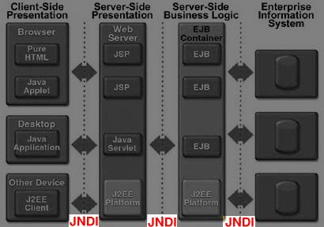
JNDI & J2EE

Slide 48
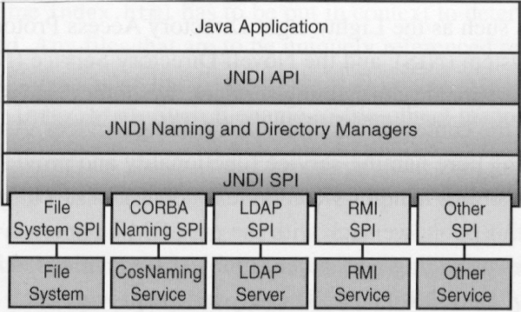
JNDI – Architecture
JNDI is a core component of JDK 1.3 and a fundamental part of J2EE
  JNDI was a Java extension for previous JDKs

Slide 49
JNDI – Packages
JNDI is partitioned into the following packages:
  javax.naming – Core JNDI API classes used by applications accessing naming services
  javax.naming.directory – JNDI API classes for accessing directory services
  javax.naming.event –JNDI API classes providing event notification services for naming and directory systems
  javax.naming.ldap – JNDI API classes supporting advanced features of the LDAP v3 standard when using the LDAP directory SPI
  javax.naming.spi – JNDI SPI (Service Provider Interface) classes used by implementors of SPIs to map JNDI API calls to a particular naming or directory service

Slide 50
Naming vs. Directories
JNDI has two similar but not identical concepts:
  Naming service
  look up an object by name only
  Directory service
  look up an object by a set of properties
Directory services are a superset of name services
They have different uses in J2EE, as we will see

Slide 51
JNDI – Naming Services
A naming service is a mechanism used in distributed and non-distributed applications to refer to objects via a name identifying that object
The name used is generally human readable or easily converted into a human readable String
The association between a name and an object is known as a name binding
A name binding is always relative to a given naming context

Slide 52
Naming & J2EE
J2EE applications need a naming service for finding references to objects
  EJBs need to find container-managed data sources for databases they need to use
    lookup by the data source's JNDI name
  EJBs themselves must be located by name, by servlets, by other EJBs, and even by non-web client apps
    lookup by the EJB's JNDI name

Slide 53
JNDI – Naming Services (cont)
Examples of names and naming services are:
  A filename → file in a filesystem
  A Domain Name Service (DNS) host name
  → a machine on the internet
  An RMI name → RMI server on a remote machine
  A CORBA name → CORBA server on a remote machine
  A URL → web page on a web server
JNDI provides a naming service that maps Java interfaces to various underlying naming systems

Slide 54
JNDI – Naming Services
JNDI supports naming services through Service Provider Interface (SPI) implementations
JNDI supports a number of naming services by default:
  RMI
  LDAP
  CORBA IIOP/COSNaming service
  DNS
  File system ** NOT IN JAVA SE5/6 **
Vendors of other naming services may create their own SPIs

Slide 55
JNDI – Naming Services
To utilise a particular naming service, an application using JNDI must first obtain an “Initial Context”
  The interface for this is called javax.naming.InitialContext
The Initial Context is then used to look up objects based on their names
When you create an Initial Context you need to specify a number of parameters about the naming service you wish to use, including the SPI implementation for the naming service

Slide 56
Initial Context
JNDI provider
Represents “where am I?”
  eg: Web Application: Your “subdirectory”
    http://localhost:7001/myapp/index.jsp
  eg: file system: Current current directory
    c:\workshop\autodeploy
You need a provider to
determine how to read/find/update
your context
root
context
context
subcontext
subcontext
object
object

Slide 57
JNDI – setting a context
There are 4 main ways to set an Initial Context
1. Create an InitialContext() that references the applications local JNDI environment by creating an InitialContext with no parameters
2. Create system properties by either using the java –D parameter eg:
java -Djava.naming.factory.initial=
com.sun.jndi.fscontext.RefFSContextFactory
-Djava.naming.provider.url=
ldap://ldap.uts.edu.au:389 JNDITest

Slide 58
JNDI – setting a context(2)
3. Create a jndi.properties file in the classpath with the above parameters in it eg
4. Create a Properties object with the above parameters in it (see next slide) and pass this to the InitialContext constructor.
jndi.properties
java.naming.factory.initial=
com.sun.jndi.fscontext.RefFSContextFactory
java.naming.provider.url=
ldap://ldap.uts.edu.au:389

Slide 59
Example – File System Initial Context
/* example.java */
import javax.naming.*;
…
// define props needed to create InitialContext for file system naming service
Properties props = new Properties();
props.setProperty
("INITIAL_CONTEXT_FACTORY",
"com.sun.jndi.fscontext.RefFSContextFactory");
props.setProperty ("PROVIDER_URL", "file:C:\\my_jndi");
// get JNDI initial context
InitialContext ctx = new InitialContext(props);
…

Slide 60
JNDI – Naming Services
Once an InitialContext is obtained, references to objects that are bound to the naming service can be looked up and then used
Object lookup is done using the InitialContext.lookup() method – for example, we could look up our RMI server object if we had obtained a JNDI InitialContext for the RMI naming service by:
Thing t = (Thing) ctx.lookup("ThingService");
The contents of a JNDI naming service can also be listed using the InitialContext.list() and InitialContext.listBinding() methods

Slide 61
JNDI – Directory Services
A directory service can be viewed as a sophisticated naming service that provides the capability of searching for objects based on many different attributes rather than simply a name
Directory services also allow for the modification of object attributes
Directory services typically have a hierarchical structure

Slide 62
Directory Services & J2EE
Two uses in J2EE:
  Writing applications which use directory information as part of their business logic
    e.g. if an organisation runs a directory server storing personnel information, a "staff phone book" application would query the directory server
  Using a directory service as a source of security credentials
    e.g. when a user logs in to a web-based application, look up their username and password in a directory service

Slide 63
JNDI – Hierarchical Contexts
Every entry in a directory belongs to a context
  the InitialContext is at the root of a hierarchy
Each context contains:
  zero or more sub-contexts, and
  zero or more directory entries
A directory entry corresponds to a collection of attributes in the directory representing the object and perhaps the object itself (in serialised form for example)

Slide 64
JNDI – Directory Services
Directory services are used in many enterprise settings where a set of objects are shared between multiple systems
Objects are registered, modified and searched in the directory
Examples of widely used directories are:
  LDAP servers/Active Directory – usually contained user authentication and authorisation information
  Novell Directory Service printing and network services

Slide 65
JNDI – Directory Services
JNDI supports accessing of directory services via the javax.naming.directory package
The JNDI directory service also uses Initial Context objects - the javax.naming.directory.InitialDirContext class
InitialDirContext extends the basic naming InitialContext class, and implements the extended set of directory operations from the javax.naming.directory.DirContext interface

Slide 66
JNDI – Directory Services
Directory searches are done using the DirContext.search() method
  DirContext.search() returns a set of Attributes.
Directory objects can also be obtained directly via a lookup style call if the name of the directory object is known
  In this case, the method is DirContext.getAttributes()
The directory services API also provides methods to add, modify and delete objects from a directory

Slide 67
Example – JNDI Directory Search
Hashtable ldapEnvironment = new Hashtable();
ldapEnvironment.put(Context.INITIAL_CONTEXT_FACTORY, "com.sun.jndi.ldap.LdapCtxFactory");
ldapEnvironment.put(Context.PROVIDER_URL, "ldap://ldap.uts.edu.au:389");
// create LDAP connection
DirContext ldapContext = new InitialDirContext(ldapEnvironment);
// Create LDAP query
SearchControls searchControl = new SearchControls();
searchControl.setSearchScope(SearchControls.SUBTREE_SCOPE);
NamingEnumeration searchResultSet =
ldapContext.search("o=UTS", "(sn=brookes)", searchControl);
// Loop through results and print
while (searchResultSet.hasMore()) {
SearchResult searchResult = (SearchResult) searchResultSet.next();
System.out.println(sr);
}

Slide 68
JNDI & WebLogic
WebLogic contains its own JNDI implementation
  It functions as a naming and directory service
  When EJBs are deployed, they register their "JNDI name" with the app server
  Data Sources also have a "JNDI name"
  Administrators (i.e. YOU!) can view the JNDI tree, showing the contexts and the bindings within a context
  Use:
    java.naming.factory.initial=weblogic.jndi.WLInitialContextFactory
    java.naming.provider.url=t3://127.0.0.1:7001

Slide 69
JNDI and Web applications
By default, there is a top-level context for Web & EJB applications, called "java:comp/env"
Allows web apps (servlets/jsp) to dynamically swap JNDI named resources by changing web.xml parameters
→ avoids namespace clashes/hardcoding when you run more than one web application with the same JNDI resource names

Slide 70
Sample web.xml
We can map a "virtual" named object to a physical object via web.xml "resource-ref" element
(Use <mappedName>realname</mappedName>)
<resource-ref>
<res-ref-name>jdbc/aDataSource</res-ref-name>
<res-type>javax.sql.DataSource</res-type>
<res-auth>Container</res-auth>
</resource-ref>

Slide 71
Sample code to access this
We can then call this via JNDI context lookups:
Or via Dependency Injection (only in managed container ie: JSF or Servlets)
Context ctx = (Context) new InitialContext().
// Look up our data source
DataSource ds = (DataSource)
ctx.lookup("java:comp/env/jdbc/aDataSource");
@Resource DataSource ds;
// or directly via
// @Resource(mappedName="jdbc/aDataSource") …

Slide 72
JNDI - Summary
Naming services fulfill a basic need for obtaining object references in a given context based on a known name for the object
Directory services are a key element in enterprise environments for storing shared enterprise resource information
JNDI is the J2EE API for accessing naming and directory services

Slide 73
第二章 中间件导论
Introduction to Middleware

Slide 74
Introduction to Middleware I
What is Middleware?
  Layer between OS and distributed applications
  Hides complexity and heterogeneity of distributed system
Bridges gap between low-level OS comms and programming language abstractions
  Provides common programming abstraction and infrastructure for distributed applications
Notes:
1、中间件的概念
随着计算机技术的飞速发展，各种各样的应用软件需要在各种平台之间进行移植，或者一个平台需要支持多种应用软件和管理多种应用系统，软、硬件平台和应用系统之间需要可靠和高效的数据传递或转换，使系统的协同性得以保证。
这些，都需要一种构筑于软、硬件平台之上，同时对更上层的应用软件提供支持的软件系统，而中间件正是在这个环境下应孕而生。
由于中间件技术正处于发展过程之中，因此目前尚不能对它进行精确的定义。
比较流行的定义是：中间件是一种独立的系统软件或服务程序，分布式应用软件借助这种软件在不同的技术之间共享资源。中间件位于客户机/ 服务器的操作系统之上，管理计算资源和网络通讯。
从中间件的定义可以看出，中间件是一类软件，而非一种软件 ；中间件不仅仅实现互连，还要实现应用之间的互操作 ；中间件是基于分布式处理的软件，定义中特别强调了其网络通讯功能。

Slide 75
What is Middleware?(1)
application
application
middleware
middleware
OS
OS
network
Notes:
为解决分布异构问题，人们提出了中间件(middleware)的概念。中间件是位于平台(硬件和操作系统)和应用之间的通用服务，如图1所示，这些服务具有标准的程序接口和协议。针对不同的操作系统和硬件平台，它们可以有符合接口和协议规范的多种实现。
Middleware thus makes application distribution transparent to users, effectively hiding the software and hardware details.

Slide 76
Introduction to Middleware II
Middleware provides support for
  Naming, Location, Service discovery, Replication
  Protocol handling, Communication faults, QoS
  Synchronisation, Concurrency, Transactions, Storage
  Access control, Authentication

Slide 77
Software Component & Middleware
Software Component is Request-Oriented
  Focusing on business logic
  Unaware the communication, interoperation, reliability, compatibility,integration in distribute application. (Requisition )
  That is problem which middleware will solve. （Solution)
  Application development based on middleware is Request-Oriented, substantially is in line with the idea of component software.
Notes:
面向需求的构件应用
构件化软件开发应当是面向需求的，即设计者集中精力于业务逻辑本身,不必为分布式应用中的通信、效率、互操作、可靠性、容错性、完整性等大量与业务无直接关系但又非常重要的问题，而耗费大量的精力，理想的构架在这些方面应当为构件软件提供良好的运行环境 (所求）
中间件所要解决的问题 （所需）
基于中间件开发的应用真正是面向需求的，从本质上符合构件化设计的思想。
中间件作为存在于系统软件与应用之间的特殊层次，抽象了典型的应用模式，从而使应用软件制造者可以更多地将思路放在业务逻辑中，并基于标准的形式进行开发，这样就使软件构架化成为可能。一些工业标准的推出，进一步使中间件成为可复用构件的运行框架，加速了软件复用的现实化进程

Slide 78
Software Component & Middleware
Middleware: the sill of software component
  Substantially, middleware is abstraction from the distribute system. It get rid of the business logic detail and remain the typical properties of distribute communication model.
Isolation of encapsulation , design and achievement
  Software component : Interface
  Middleware: Interface mechanism ( IDL)
  应用构件开发者只需要按照中间件规定的模式进行设计开发，不必考虑下层的系统平台。因此可以说，中间件真正提供了与环境隔离的构件开发模式。
Notes:
中间件作为存在于系统软件与应用之间的特殊层次，抽象了典型的应用模式，从而使应用软件制造者可以更多地将思路放在业务逻辑中，并基于标准的形式进行开发，这样就使软件构架化成为可能。一些工业标准的推出，进一步使中间件成为可复用构件的运行框架，加速了软件复用的现实化进程
中间件，从本质上是对分布式应用的抽象，因而抛开了与应用相关的业务逻辑的细节，保留了典型的分布交互模式的关键特征。经过抽象，将纷繁复杂的分布式系统经过提炼和必要的隔离后，以统一的层面形式呈现给应用。应用在中间件提供的环境中可以更好地集中于业务逻辑上，并以构件化的形式存在，最终自然而然地在异构环境中实现良好的协同工作。
构件对外发生作用或构件间的交互，都是通过规范定义的接口进行，构件使用者只需要知道构件的接口，而不关心其内部实现，这是设计与实现分开的关键。构架就应当提供构件交互的规则，并基于这些规则实现类似容器的标准环境。
中间件在分布交互模式上都规定了接口（或类似）机制，如IDL就是描述接口的语言规范，从早期的DCE到现在的CORBA、DCOM、Java RMI等都使用IDL描述接口，所不同的只是语言规范。客户访问服务（或对象方法）均通过接口进行，至于服务采用怎样的内部实现、基于怎样的语言、甚至怎样的操作系统、数据库，开发者都不用关心。类似地，消息队列也可作为分布交互的手段，消息的语法和语义定义保证了使用与实现的分离，使用消息队列的客户或服务是不依赖于对方的。既然中间件能隔离设计与实现，能在分布的环境中封装实现的细节，那么，基于中间件的构件开发也就是可能的。

Slide 79
Software Component & Middleware
Provide the Management for application component
  E.g. Com (Windows system registry)
  Corba (data pool)
Improve the productivity and quality
Notes:
件的体系结构，大大提高了应用构件生产的效率和质量。

Slide 80
Properties of Middleware
Support for distribute computing
Support for multiple hardware and OS
Support for standard protocol
Support for standard interface
Notes:
2、中间件特点及优势
通常意义下，中间件应具有以下的一些特点 ：满足大量应用的需要 ；运行于多种硬件和OS平台 ；支持分布式计算，提供跨网络、硬件和OS平台的透明性的应用或服务的交互功能 ；支持标准的协议 ；支持标准的接口。
程序员通过调用中间件提供的大量API，实现异构环境的通讯，从而屏蔽异构系统中复杂的操作系统和网络协议。
中间件提供客户机与服务器之间的连接服务，这些服务具有标准的程序接口和协议。针对不同的操作系统和硬件平台，它们可以有符合接口和协议规范的多种实现。
由于标准接口对于可移植性和标准协议对于互操作性的重要性，中间件已成为许多标准化工作的主要部分。对于应用软件开发，中间件远比操作系统和网络服务更为重要，中间件提供的程序接口定义了一个相对稳定的高层应用环境，不管底层的计算机硬件和系统软件怎样更新换代，只要将中间件升级更新，并保持中间件对外的接口定义不变，应用软件几乎不需任何修改，从而保护了企业在应用软件开发和维护中的重大投资。
中间件是一种独立的系统软件或服务程序，分布式应用软件借助这种软件在不同的技术之间共享资源。中间件软件管理着客户端程序和数据库或者早期应用软件之间的通讯。
中间件在分布式的客户和服务之间扮演着承上启下的角色，如事务管理、负载均衡以及基于Web的计算等。
利用这些技术有助于减轻应用软件开发者的负担，使他们利用现有的硬件设备、操作系统、网络、数据库管理系统以及对象模型创建分布式应用软件时更加得心应手。由于中间件能够保护企业的投资，保证应用软件的相对稳定，实现应用软件的功能扩展 ；同时中间件产品在很大程度上简化了一个由不同硬件构成的分布式处理环境的复杂性，所以它的出现正日益引起用户的关注。
世界著名的咨询机构The Standish Group 在一份研究报告中归纳了中间件的十大优越性：
建设费用可以减少50%左右。在网络经济大发展、电子商务大发展的今天，从中间件获得利益的不只是IT厂商，IT用户同样是赢家，并且是更有把握的赢家。
中间件作为新层次的基础软件，其重要作用是将不同时期、在不同操作系统上开发应用软件集成起来，彼此像一个天衣无缝的整体协调工作，这是操作系统、数据库管理系统本身做不了的。中间件的这一作用，在技术不断发展之后，使以往在应用软件上的劳动成果仍然物有所用，节约了大量的人力、财力投入。

Slide 81
Top Reasons
The standish Group give the top reasons for using middleware
Lower the system cost
  50%
Lower develop cost
  30% , 70%(Business logic, basic)
  25%~60% (only middleware)
  80%( middleware and software component)
Cut develop time
  50%~75%
Decreased failure rates
  90% (failure rate without middleware)
Notes:
（1） 应用开发：The Standish Group 分析了100个关键应用系统中的业务逻辑程序、应用逻辑程序及基础程序所占的比例；业务逻辑程序和应用逻辑程序仅占总程序量的30%，而基础程序占了70%，使用传统意义上的中间件一项就可以节省25%~60%的应用开发费用。如是以新一代的中间件系列产品来组合应用，同时配合以可复用的商务对象构件，则应用开发费用可节省至80%。
（2） 系统运行：没有使用中间件的应用系统，其初期的资金及运行费用的投入要比同规模的使用中间件的应用系统多一倍。
（3） 开发周期：基础软件的开发是一件耗时的工作，若使用标准商业中间件则可缩短开发周期50%~75%
（4） 减少项目开发风险：研究表明，没有使用标准商业中间件的关键应用系统开发项目的失败率高于90%。企业自己开发内置的基础（中间件）软件是得不偿失的，项目总的开支至少要翻一倍，甚至会十几倍。
（6） 应用集合：依靠标准的中间件可以将现有的应用、新的应用和购买的商务构件融合在一起进行应用集合。
（7） 系统维护：需要一提的是，基础（中间件）软件的自我开发是要付出很高代价的，此外，每年维护自我开发的基础（中间件）软件的开支则需要当初开发费用的15%~25%，每年应用程序的维护开支也还需要当初项目总费用的10%~20%左右。而在一般情况下，购买标准商业中间件每年只需付出产品价格的15%~20%的维护费，当然，中间件产品的具体价格要依据产品购买数量及哪一家厂商而定。
（8） 质量：基于企业自我建造的基础（中间件）软件平台上的应用系统，每增加一个新的模块，就要相应地在基础（中间件）软件之上进行改动。而标准的中间件在接口方面都是清晰和规范的。标准中间件的规范化模块可以有效地保证应用系统质量及减少新旧系统维护开支。
（9） 技术革新：企业对自我建造的基础（中间件）软件平台的频繁革新是极不容易实现的（不实际的）。而购买标准的商业中间件，则对技术的发展与变化可以放心，中间件厂商会责无旁贷地把握技术方向和进行技术革新。
（10） 增加产品吸引力：不同的商业中间件提供不同的功能模型，合理使用，可以让你的应用更容易增添新的表现形式与新的服务项目。从另一个角度看，可靠的商业中间件也使得企业的应用系统更完善，更出众。
具体地说，中间件屏蔽了低层操作系统的复杂性，使程序开发人员面对一个简单而统一的开发环境，减少程序设计的复杂性，将注意力集中在自己的业务上，不必再为程序在不同系统软件上的移植而重复工作，从而大大减少了技术上的负担。
中间件带给应用系统的不只是开发的简单、开发周期的缩短，也减少了系统的维护、运行和管理的工作量，还减少了计算机总体费用的投入。The Standish Group 的调查报告显示，由于采用了中间件技术，应用系统的总

Slide 82
5. Application Integration
  Combine the component from different parties
6. System Maintenance
  15%~25%(develop tools maintain)
  10%~20%(application maintain)
  15%~20%(product)
7. Quality
  New module( homemade middleware changes)
8. Technology Innovation
9. Product Attraction

Slide 83
Outline
Part I: Remote Procedure Call (RPC)
远程过程调用中间件
  Historic interest
Part II: Object-Oriented Middleware (OOM)
对象中间件
  Java RMI
  CORBA
  EJB
  DCOM
Notes:
远程过程调用中间件：通过这种远程过程调用机制，程序员编写客户方的应用，需要时可以调用位于远端服务器上的过程；
对象中间件：在分布、异构的网络计算环境中，可以将各种分布对象有机地结合在一起，完成系统的快速集成，实现对象重用。
面向对象的中间件是对象技术和分布式计算发展的产物，业界普遍认为面向对象是今后中间件发展的主流方向，它提供一种通讯机制，透明地在异构的分布计算环境中传递对象请求，而这些对象可以位于本地或者远程机器。

Slide 84
Outline
Part III: Message-Oriented Middleware (MOM)消息中间件
  Java Message Service
  IBM MQSeries
  Web Services
Part IV: Event-Based Middleware交易中间件
research
research
Notes:
远程过程调用中间件：通过这种远程过程调用机制，程序员编写客户方的应用，需要时可以调用位于远端服务器上的过程；
消息中间件：用来屏蔽掉各种平台及协议之间的特性，进行相互通信，实现应用程序之间的协同；
交易中间件：是在分布、异构环境下提供保证交易完整性和数据完整性的一种环境平台；
对象中间件：在分布、异构的网络计算环境中，可以将各种分布对象有机地结合在一起，完成系统的快速集成，实现对象重用。
面向对象的中间件是对象技术和分布式计算发展的产物，业界普遍认为面向对象是今后中间件发展的主流方向，它提供一种通讯机制，透明地在异构的分布计算环境中传递对象请求，而这些对象可以位于本地或者远程机器。

Slide 85
What Is Distributed Computing All About
Request
Client
Server
Response
Notes:
远程过程调用
远程过程调用是一种广泛使用的分布式应用程序处理方法。一个应用程序使用RPC来“远程”执行一个位于不同地址空间里的过程，并且从效果上看和执行本地调用相同。事实上，一个RPC应用分为两个部分：server和client。server提供一个或多个远程过程；client向server发出远程调用。server和client可以位于同一台计算机，也可以位于不同的计算机，甚至运行在不同的操作系统之上。它们通过网络进行通讯。相应的stub和运行支持提供数据转换和通讯服务，从而屏蔽不同的操作系统和网络协议。在这里RPC通讯是同步的。采用线程可以进行异步调用。
在RPC模型中，client和server只要具备了相应的RPC接口，并且具有RPC运行支持，就可以完成相应的互操作，而不必限制于特定的server。因此，RPC为client/server分布式计算提供了有力的支持。同时，远程过程调用RPC所提供的是基于过程的服务访问，client与server进行直接连接，没有中间机构来处理请求，因此也具有一定的局限性。比如，RPC通常需要一些网络细节以定位server；在client发出请求的同时，要求server必须是活动的等等。

Slide 86
Part I: Remote Procedure Call (RPC)
Masks remote function calls as being local
Client/server model
Request/reply paradigm usually implemented with message passing
Marshalling of function parameters and return value

Slide 87
Caller
RPC Service
RPC Service
Remote
Function
1) Marshal args
2) Generate ID
3) Start timer
message
4) Unmarshal
5) Record ID
call(…)
fun(…)
8) Unmarshal
9) Acknowledge
6) Marshal
7) Set timer

Slide 88
Properties of RPC
Language-level pattern of function call
  easy to understand for programmer
Synchronous request/reply interaction
  natural from a programming language point-of-view
  matches replies to requests
  built in synchronisation
Distribution transparency
  hides the complexity of a distributed system
Various reliability guarantees
  deals with some distributed systems aspects of failure

Slide 89
Disadvantages of RPC
Synchronous request/reply interaction
  tight coupling between client and server
  may block for a long time
Distribution Transparency
  Not possible to mask all problems
Lacks notion of services
  programmer not interested in server but in service
RPC paradigm is not object-oriented
  invoke methods on objects as opposed to functions on servers
fork(…)
remote call
join(…)

Slide 90
Part II: Object-Oriented Middleware (OOM)
Objects can be local or remote
Object references can be local or remote
Remote objects have visible remote interfaces
Masks remote objects as being local using proxy objects
Remote method invocation
Notes:
对象请求代理
随着对象技术与分布式计算技术的发展，两者相互结合形成了分布对象计算，并发展为当今软件技术的主流方向。1990年底，对象管理集团OMG首次推出对象管理结构OMA(Object Management Architecture)，对象请求代理（Object Request Broker）是这个模型的核心组件。它的作用在于提供一个通信框架，透明地在异构的分布计算环境中传递对象请求。CORBA规范包括了ORB的所有标准接口。1991年推出的CORBA 1.1 定义了接口描述语言OMG IDL和支持Client/Server对象在具体的ORB上进行互操作的API。CORBA 2.0 规范描述的是不同厂商提供的ORB之间的互操作。
对象请求代理(ORB)是对象总线，它在CORBA规范中处于核心地位，定义异构环境下对象透明地发送请求和接收响应的基本机制，是建立对象之间client/server关系的中间件。ORB使得对象可以透明地向其他对象发出请求或接受其他对象的响应，这些对象可以位于本地也可以位于远程机器。ORB拦截请求调用，并负责找到可以实现请求的对象、传送参数、调用相应的方法、返回结果等。client对象并不知道同server对象通讯、激活或存储server对象的机制，也不必知道server对象位于何处、它是用何种语言实现的、使用什么操作系统或其他不属于对象接口的系统成分。
值得指出的是client和server角色只是用来协调对象之间的相互作用，根据相应的场合，ORB上的对象可以是client，也可以是server，甚至兼有两者。当对象发出一个请求时，它是处于client角色；当它在接收请求时，它就处于server角色。大部分的对象都是既扮演client角色又扮演server角色。另外由于ORB负责对象请求的传送和server的管理，client和server之间并不直接连接，因此，与RPC所支持的单纯的Client/Server结构相比，ORB可以支持更加复杂的结构。
Perhaps the most popular model is object based middleware in which applications are structured into (potentially distributed) objects that interact via location transparent method invocation. Prime examples of this type of middleware are the OMG's CORBA and Microsoft's Distributed COM. Both of these platforms offer an interface definition language (IDL) which is used to abstract over the fact that objects can be implemented in any suitable programming language, an object request broker which is responsible for transparently directing method invocations to the appropriate target object, and a set of services (e.g. naming, time, transactions, replication etc.) which further enhance the distributed programming environment.
Not all middleware is object based, however. Two other popular paradigms are event based middleware and message oriented middleware both of which mainly employ ‘single shot’ communications rather than the request-reply style communication found in object based middleware. Event based middleware is particularly suited to the construction of non-centralized distributed applications that must monitor and react to changes in their environment. Examples are process control, Internet news channels and stock tracking. It is claimed that event based middleware has potentially better scaling properties for such applications than object based middleware. Message oriented middleware, on the other hand, is biased toward applications in which messages need to be persistently stored and queued. Workflow and messaging applications are good examples.

Slide 91
local
OOM
OOM
remote
object
request
broker
/
object
manager
object
request
broker
/
object
manager
object A
skeleton
object B
proxy
object B
object B

Slide 92
Properties of OOM
Support for object-oriented programming model
  objects, methods, interfaces, encapsulation, …
  exceptions
Location Transparency
  mapping object references to locations
Synchronous request/reply interaction
  same as RPC
Services

Slide 93
Disadvantages of OOM
Synchronous request/reply interaction
  So CORBA oneway semantics added and -
  Asynchronous Method Invocation (AMI)
  But implementations may not be loosely coupled
Distributed garbage collection
  Releasing memory for unused remote objects
OOM rather static and heavy-weight
  Bad for ubiquitous systems and embedded devices

Slide 94

Part III: Message-Oriented Middleware (MOM)
Communication using messages
Messages stored in message queues
Optional message server decouples client and server
Various assumptions about message content
Client App.
Server App.
Message Server
local message
queues
message
queues
local message
queues
Network
Network
Network

Slide 95
Properties of MOM
Asynchronous interaction
  Client and server are only loosely coupled
  Messages are queued
  Good for application integration
Support for reliable delivery service
  Keep queues in persistent storage
Processing of messages by intermediate message server
  Filtering, transforming, logging, …
  Networks of message servers
Natural for database integration

Slide 96
Disadvantages of MOM
Poor programming abstracting
  Rather low-level (cf. Packets)
  Request/reply more difficult to achieve
Message formats unknown to middleware
  No type checking
Queue abstraction only gives one-to-one communication
  Limits scalability

Slide 97
Web Services
Use well-known web standards for distributed computing
Communication
Message content expressed in XML
Simple Object Access Protocol (SOAP)
  Lightweight protocol for sync/async communication
Service Description
Web Services Description Language (WSDL)
  Interface description for web services
Service Discovery
Universal Description Discovery and Integration (UDDI)
  Directory with web service description in WSDL

Slide 98
Properties of Web Services
Language-independent and open standard
SOAP is best of both worlds:
  Synchronous request/reply like OOM
  Asynchronous messaging like MOM
  Supports internet transports (http, smtp, ...)
  Uses XML Schema for marshalling types
WSDL says how to use a web service
UDDI helps to find the right web service
  Exports SOAP API for access
http://api.google.com/GoogleSearch.wsdl

Slide 99
Part IV: Event-Based Middleware
Publishers publish events (messages)
Subscribers express interest in events with subscriptions
Event Service notifies interested subscribers of published events
Events can have arbitrary content or name/value pairs
publish
subscribe
Publisher
notify
Subscriber
Event Service
subscribe
Publisher
publish
notify
Subscriber
subscribe
Publisher
publish
notify
Subscriber

Slide 100
Properties of Publish/Subscribe
Asynchronous communication
  Publishers and subscribers are loosely coupled
Many-to-many interaction between publishers and subscribers
  Scalable scheme for large-scale systems
  Publishers do not need to know subscribers
Content-based pub/sub very expressive
  Information delivered to all interested parties

Slide 101
Summary
Middleware is an important abstraction for building distributed systems
Synchronous vs. asynchronous communication
Scalability, many-to-many communication
Language integration
Ubiquitous systems, mobile systems
Remote Procedure Call
Object-Oriented Middleware
Message-Oriented Middleware
Event-Based Middleware

Slide 102
第三章 RMI
Remote Method Invocation

Slide 103
Java Remote Object Invocation (RMI)
Overview of RMI
Java RMI allowed programmer to execute remote function class using the same semantics as local functions calls.
Local Machine (Client)
SampleServer remoteObject;
int s;
…
s = remoteObject.sum(1,2);
System.out.println(s);
Remote Machine (Server)
public int sum(int a,int b) {
return a + b;
}
1,2
3

Slide 104
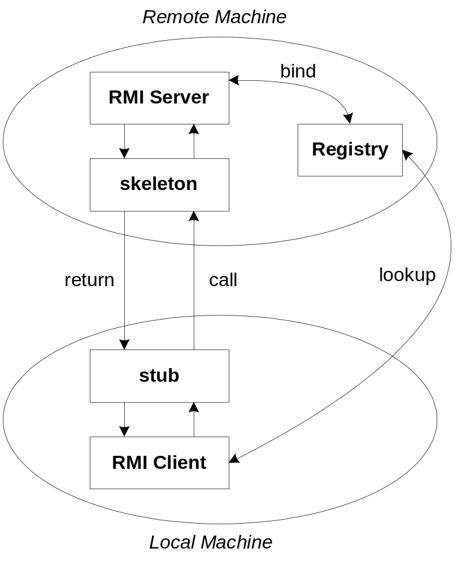
The General RMI Architecture
The server must first bind its name to the registry
The client lookup the server name in the registry to establish remote references.
The Stub serializing the parameters to skeleton, the skeleton invoking the remote method and serializing the result back to the stub.

Slide 105
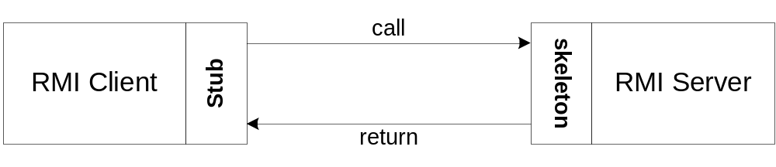
The Stub and Skeleton
A client invokes a remote method, the call is first forwarded to stub.
The stub is responsible for sending the remote call over to the server-side skeleton
The stub opening a socket to the remote server, marshaling the object parameters and forwarding the data stream to the skeleton.
A skeleton contains a method that receives the remote calls, unmarshals the parameters, and invokes the actual remote object implementation.

Slide 106
Steps for Developing an RMI System
1. Define the remote interface
2. Develop the remote object by implementing the remote interface.
3. Develop the client program.
4. Compile the Java source files.
5. Generate the client stubs and server skeletons.
6. Start the RMI registry.
7. Start the remote server objects.
8. Run the client

Slide 107
Step 1: Defining the Remote Interface
To create an RMI application, the first step is the defining of a remote interface between the client and server objects.
/* SampleServer.java */
import java.rmi.*;
public interface SampleServer extends Remote
{
public int sum(int a,int b) throws RemoteException;
}

Slide 108
Step 2: Develop the remote object and its interface
The server is a simple unicast remote server.
Create server by extending java.rmi.server.UnicastRemoteObject.
The server uses the RMISecurityManager to protect its resources while engaging in remote communication.
/* SampleServerImpl.java */
import java.rmi.*;
import java.rmi.server.*;
import java.rmi.registry.*;
public class SampleServerImpl extends UnicastRemoteObject
implements SampleServer
{
SampleServerImpl() throws RemoteException
{
super();
}

Slide 109
Step 2: Develop the remote object and its interface
Implement the remote methods
/* SampleServerImpl.java */
public int sum(int a,int b) throws RemoteException
{
return a + b;
}
}
The server must bind its name to the registry, the client will look up the server name.
Use java.rmi.Naming class to bind the server name to registry. In this example the name call “SAMPLE-SERVER”.
In the main method of your server object, the RMI security manager is created and installed.

Slide 110
Step 2: Develop the remote object and its interface
/* SampleServerImpl.java */
public static void main(String args[])
{
try
{
System.setSecurityManager(new RMISecurityManager());
//set the security manager
//create a local instance of the object
SampleServerImpl Server = new SampleServerImpl();
//put the local instance in the registry
Naming.rebind("SAMPLE-SERVER" , Server);
System.out.println("Server waiting.....");
}
catch (java.net.MalformedURLException me) {
System.out.println("Malformed URL: " + me.toString()); }
catch (RemoteException re) {
System.out.println("Remote exception: " + re.toString()); }
}

Slide 111
Step 3: Develop the client program
In order for the client object to invoke methods on the server, it must first look up the name of server in the registry. You use the java.rmi.Naming class to lookup the server name.
The server name is specified as URL in the from ( rmi://host:port/name )
Default RMI port is 1099.
The name specified in the URL must exactly match the name that the server has bound to the registry. In this example, the name is “SAMPLE-SERVER”
The remote method invocation is programmed using the remote interface name (remoteObject) as prefix and the remote method name (sum) as suffix.

Slide 112
Step 3: Develop the client program
import java.rmi.*;
import java.rmi.server.*;
public class SampleClient
{
public static void main(String[] args)
{
// set the security manager for the client
System.setSecurityManager(new RMISecurityManager());
//get the remote object from the registry
try
{
System.out.println("Security Manager loaded");
String url = "//localhost/SAMPLE-SERVER";
SampleServer remoteObject = (SampleServer)Naming.lookup(url);
System.out.println("Got remote object");
System.out.println(" 1 + 2 = " + remoteObject.sum(1,2) );
}
catch (RemoteException exc) {
System.out.println("Error in lookup: " + exc.toString()); }
catch (java.net.MalformedURLException exc) {
System.out.println("Malformed URL: " + exc.toString()); }
catch (java.rmi.NotBoundException exc) {
System.out.println("NotBound: " + exc.toString());
}
}
}

Slide 113
Step 4 & 5: Compile the Java source files & Generate the client stubs and server skeletons
Assume the program compile and executing at elpis on ~/rmi
Once the interface is completed, you need to generate stubs and skeleton code. The RMI system provides an RMI compiler (rmic) that takes your generated interface class and procedures stub code on its self.
    elpis:~/rmi> set CLASSPATH=”~/rmi”
    elpis:~/rmi> javac SampleServer.java
    elpis:~/rmi> javac SampleServerImpl.java
    elpis:~/rmi> rmic SampleServerImpl
    elpis:~/rmi> javac SampleClient.java

Slide 114
Step 6: Start the RMI registry
The RMI applications need install to Registry. And the Registry must start manual by call rmiregisty.
The rmiregistry us uses port 1099 by default. You can also bind rmiregistry to a different port by indicating the new port number as : rmiregistry <new port>
elpis:~/rmi> rmiregistry
Remark: On Windows, you have to type in from the command line:
> start rmiregistry

Slide 115
Steps 7 & 8: Start the remote server objects & Run the client
Once the Registry is started, the server can be started and will be able to store itself in the Registry.
Because of the grained security model in Java 2.0, you must setup a security policy for RMI by set java.security.policy to the file policy.all
elpis:~/rmi> java –Djava.security.policy=policy.all SampleServerImpl
elpis:~/rmi> java –Djava.security.policy=policy.all SampleClient

Slide 116
Java Policy File
In Java 2, the java application must first obtain information regarding its privileges. It can obtain the security policy through a policy file. In above example, we allow Java code to have all permissions, the contains of the policy file policy.all is:
grant {
permission java.security.AllPermission;
};
Now, we given an example for assigning resource permissions:
grant {
permission java.io.filePermission “/tmp/*”, “read”, “write”;
permission java.net.SocketPermission “somehost.somedomain.com:999”,”connect”;
permission java.net.SocketPermission “*:1024-65535”,”connect,request”;
permission java.net.SocketPermission “*:80”,”connect”;
};

Slide 117
Comment for the Java Policy File
1. allow the Java code to read/write any files only under the /tmp directory, includes any subdirectories
2. allow all java classes to establish a network connection with the host “somehost.somedomain.com” on port 999
3. allows classes to connection to or accept connections on unprivileged ports greater than 1024 , on any host
4. allows all classes to connect to the HTTP port 80 on any host.
You can obtain complete details by following links:
http://java.sun.com/products//jdk/1.2/docs/guide/security/spec/security-spec.doc3.html

Slide 118
第四章 RMI/IIOP

Slide 119
Contents
The CORBA Interface Definition Language (IDL)
Declaring data members, methods, and parameters
The interface compiler
Separating client and server on different machines

Slide 120
CORBA IDL
IDL is used to describe the interfaces that client objects call and that object implementations provide.
It is a specification that enables interoperability by separating interface from implementation.
It is not a programming language – has no constructs
It maps to many programming languages like C, C++, Java, and COBOL via OMG standards

Slide 121
The Interface Definition
The interface is the syntax part of the contract that the server object offers to the clients that invoke it.
Clients access objects only through their advertised interface, invoking only those operations that the object exposes through its IDL interface, with only those parameters (input and output) that are included in the invocation.

Slide 122
The Interface Definition
The IDL interface definition is independent of programming language.
It is mapped to programming languages using the interface compiler.

Slide 123
Example - Calc.idl
module Calc{
interface Calculator {
float calculate(in float val1, in
float val2, in char operator);
}
}
This is an interface for a Calculator with one method – calculate. A module can have many interfaces.

Slide 124
Mapping IDL to Java, C++
IDL | Java | C++
module | package | namespace
interface | interface | abstract class
operation | method | member function
attribute | pair of methods | pair of functions
exception | exception | exception

Slide 125
Declaring Data Members
Data members are declared using the attribute keyword. The declaration must include a name and a type. Attributes are readable and writable by default. To make a readonly attribute, use the readonly keyword. IDL compiler generates public read and write methods for the data member as required.
For example,
attribute long assignable ;
generates,
int assignable();
void assignable (int i);

Slide 126
Declaring Data Members
CORBA const values declared in an IDL map to public static final fields in the corresponding Java interface. Constants not declared inside the interface are mapped to public interface with the same name containing a field value.
const float sample = 2.3;
It is also possible to define your own types using the typedef keyword.
typedef string name;

Slide 127
Declaring Methods
Methods are declared by specifying name, return type, and parameters.
float calculate(in float val1, in float val2, in char operator);
Methods can optionally throw exceptions. User-defined exceptions must be declared in the IDL.

Slide 128
Methods Types
Methods are synchronous by default. The client program will wait for the remote method to execute and return.
Asynchronous methods are defined using the oneway keyword. oneway methods have no return value, can have input parameters only and cannot throw exceptions. The client makes the call to the oneway method and continues processing while the remote object executes it – the client is not blocked.

Slide 129
Declaring Methods (contd.)
module Calc{
interface Calculator{
//User-defined exception
exception MyException{};
//synchronous method
float calculate(in float val1, in float val2, in char operator) raises (MyException);
//asynchronous method
oneway void set_value(in long val);
};
};

Slide 130
More on Exceptions
There are two types of CORBA exceptions:
System Exceptions are thrown when something goes wrong with the system.
User Exceptions are generated if something goes wrong inside the execution of the remote method. They are declared inside the IDL definition for the object, and are automatically generated by the IDL compiler. Implementation of these exceptions depends on the language mapping.

Slide 131
Declaring Parameters
Parameters can be of following types: Basic (char, long, short, float, bool, etc.), Constructed (struct, union, array, sequence), Typed objects, or any.
Parameters can be declared as in, out, or inout.
in parameters are copied from client to server
out parameters are copied from server to client
inout parameters are used both for incoming and outgoing information and are copied both ways.

Slide 132
Declaring Parameters(contd.)
CORBA 2.0 supports only pass-by-value for non-object data types. Objects are passed by reference.
CORBA 3.0 supports pass-by-value for objects by using the valuetype keyword.

Slide 133
Interface Compilers
IDL Compilers implement language mappings in software.
They compile the interface definition (defined using IDL) to produce output that can be compiled and linked with an object implementation and its clients.
Every ORB comes with one or more IDL compilers, one for each language that it supports.

Slide 134
Interface Compilers (contd.)
Many vendors supply their IDL compilers. Because the compilers implement mapping standards, every vendor's IDL compiler produces language code with the same mappings, making the code vendor independent.
Sun’s JDK provides the idlj compiler.
VisiBroker provides idl2cpp and idl2java compilers.

Slide 135
Need for Interface Compiler
The interface compiler converts the language independent IDL to language specific code that C++, Java or other language clients and servers can understand.
For example, the idlj compiler compiles the IDL to Java code.
IDL allows an object implementer to choose the appropriate programming language for the object. Client and server can be developed in parallel.
Clients depend only on the interface and not the implementation of the server code.

Slide 136
Need for Interface Compiler
The interface compiler converts the language independent IDL to language specific code that C++, Java or other language clients and servers can understand.
For example, the idlj compiler compiles the IDL to Java code.
IDL allows an object implementer to choose the appropriate programming language for the object. Client and server can be developed in parallel.
Clients depend only on the interface and not the implementation of the server code.

Slide 137
Need for Interface Compiler
By using IDL and interface compiler, the following can be defined independent of the programming language :
Modularized object interfaces
Operations and attributes that an object supports
Exceptions raised by an operation
Data types of an operation return value, its parameters, and an object's attributes

Slide 138
The idlj compiler
To compile the IDL to java using idlj,
idlj -fall <idl_file_name>
The –fall option creates both server and client files.
-fclient generates client files only (default).
–fserver generates server files only.

Slide 139
Files created by idlj
The following classes are created when Calc.idl is compiled using idlj
Calc.Calculator - The IDL interface represented as a Java interface
Calc.CalculatorHelper - Implements the type operations for the interface
Calc.CalculatorHolder - Used for out and inout parameters

Slide 140
Files created by idlj (contd.)
Calc.CalculatorOperations – The interface that defines the exposed remote methods.
Calc._CalculatorStub - The client stub. Implements a local object representing the remote CORBA object. This object forwards all requests to the remote object. The client does not use this class directly.
Calc._CalculatorImplBase - An abstract class that implements the Calculator interface. It is the server skeleton.

Slide 141
Separating client and server
Client
Server
_CalculatorStub
Calculator
CalculatorHelper
CalculatorHolder
CalculatorOperations
_CalculatorImplBase
Calculator
CalculatorOperations

Slide 142
What next?
Implement the client
Compile the client
Implement the server
Compile the server
Start ORB
Start server
Start client

Slide 143
Running the Application
Define Interface
Compile Interface (idlj)
Client
Server
Client stub
Server Skeleton
Operations
Operations
Holder
Helper
Implement Interface
Implement Client
javac
javac
Start ORB
Start Client
Start Server

Slide 144
References
Client/Server Programming with Java and CORBA – Robert Orfali and Dan Harkey
http://developer.java.sun.com
http://www.omg.org
http://www.infosys.tuwien.ac.at/Research/Corba
http://www.objs.com

Slide 145
第五章CORBA/IDL

Slide 146
CORBA
Common Object Resource Broker Architecture (CORBA)
Interface Definition Language (IDL)
Object Management Group (OMG) (http://www.omg.org) Specification
Java IDL (jdk1.2) use CORBA objects with Java Programming Language

Slide 147
Introduction
Technology for Distributed Objects
Similar in function to Java RMI
Not Java-centric
Any language with IDL specification
IDL is a language-neutral interface definition language
Object Requst Broker (ORB) enables low-level communication between CORBA Objects

Slide 148
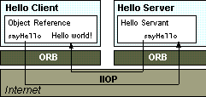
CORBA Architecture

Slide 149
CORBA Architecture
Client and Server Relationships common to CORBA and RMI
Server provides remote interface
Client calls remote interface
Object level interaction rather than application level interaction (sockets)
Objects can fulfill both roles

Slide 150
Client Side
Client has reference to remote object
Object reference has a stub method
Stand-in for remote method
Stub wired into ORB
Call on stub invokes ORB’s low-level communication routines
ORB forwards invocation to server

Slide 151
Server Side
ORB on Server Side uses Skeleton Code to translate remote invocation into call on the local object
Skeleton transforms results or errors and returns to ORB for delivery to client
ORB-ORB communication with IIOP (Internet Inter-ORB Protocol)

Slide 152
ORB
Different Vendors
IIOP based on TCP/IP by OMG
ORB Services
  Look up (JDK1.2)
  Object Persistence
  Transactions
  Messaging

Slide 153
Java IDL Development
Define interface to Remote Object with IDL
idlj compiler generates stub and skeleton source, and code to interface with ORB
IDL interface can be implemented in any CORBA compliant language (C, C++, Smalltalk, COBOL, Ada)

Slide 154
Compile remote interface (idlj)
Implement the server. It should start ORB and wait on invocations from clients, as well as implement remote methods.
Implement client. Start ORB, look up server, obtain remote reference, and call remote method
Start applications.

Slide 155
CORBA supports at least two different server-side mappings for implementing an IDL interface:
  The Inheritance Model: Using the Inheritance Model, you implement the IDL interface using an implementation class that also extends the compiler-generated skeleton.･
  Inheritance models include:
    The OMG-standard, POA. Given an interface My defined in My.idl, the file MyPOA.java is generated by the idlj compiler. You must provide the implementation for My and it must inherit from MyPOA, a stream-based skeleton that extends org.omg.PortableServer.Servant , which serves as the base class for all POA servant implementations.
    ImplBase. Given an interface My defined in My.idl, the file _MyImplBase.java is generated. You must provide the implementation for My and it must inherit from _MyImplBase. NOTE: ImplBase is deprecated in favor of the POA model, but is provided to allow compatibility with servers written in J2SE 1.3 and prior.

Slide 156
The Delegation Model: Using the Delegation Model, you implement the IDL interface using two classes:
  An IDL-generated Tie class that inherits from the compiler-generated skeleton, but delegates all calls to an implementation class.
  A class that implements the IDL-generated operations interface (such as HelloOperations), which defines the IDL function.
The Delegation model is also known as the Tie model, or the Tie Delegation model. It inherits from either the POA or ImplBase compiler-generated skeleton, so the models will be described as POA/Tie or ImplBase/Tie models in this document.

Slide 157
The Tie Model is a delegation model. Use the idlj compiler to first generate server-side bindings. Then, run the idlj compiler a second time with the -fallTie option to generate Tie model server-side bindings. For the interface Hello, HelloPOATie.java is one of the generated files. The constructor to HelloPOATie takes a delegate or a delegate and a poa. You must provide the implementation for delegate and/or the poa, but the delegate does not have to inherit from any other class, only the interface HelloOperations.
You might want to use the Tie model instead of the typical Inheritance model if your implementation must inherit from some other implementation. Java allows any number of interface inheritance, but there is only one slot for class inheritance. If you use the inheritance model, that slot is used up . By using the Tie Model, that slot is freed up for your own use. The drawback is that it introduces a level of indirection: one extra method call occurs when invoking a method.

Slide 158
Hello.idl
module HelloApp
{
interface Hello
{
string sayHello();
oneway void shutdown();
};
}

Slide 159
The HelloServer class has the server's main() method, which:
Creates and initializes an ORB instance
Gets a reference to the root POA and activates the POAManager
Creates a servant instance (the implementation of one CORBA Hello object)
and tells the ORB about it
Creates a tie with the servant being the delegate
Gets a CORBA object reference for a naming context in which to register the tie.
This step also implicitly activates the object.
Gets the root naming context
Registers the new object in the naming context under the name "Hello"
Waits for invocations of the new object from the client from the client_x0001_

Slide 160
HelloServer.java
// Copyright and License
import HelloApp.*;
import org.omg.CosNaming.*;
import org.omg.CosNaming.NamingContextPackage.*;
import org.omg.CORBA.*;
import org.omg.PortableServer.*;
import org.omg.PortableServer.POA;
import java.util.Properties;
class HelloImpl extends HelloPOA{
private ORB orb;
public void setORB(ORB orb_val){
orb = orb_val;
}
public String sayHello(){
return "\nHello world !!\n";
}
public void shutdown(){
orb.shutdown(false);
}
}

Slide 161
public class HelloServer{
public static void main(String args[]){
try{
// create and initialize the ORB
ORB orb = ORB.init(args, null);
// Get reference to rootpoa & activate the POAManager
POA rootpoa = POAHelper.narrow(orb.resolve_initial_references("RootPOA"));
rootpoa.the_POAManager().activate();
// create servant and register it with the ORB
HelloImpl helloImpl = new HelloImpl();
helloImpl.setORB(orb);
// create a tie, with servant being the delegate.
HelloPOATie tie = new HelloPOATie(helloImpl, rootpoa);
// obtain the objectRef for the tie
// this step also implicitly activates the
// the object
Hello href = tie._this(orb);
// get the root naming context
org.omg.CORBA.Object objRef = orb.resolve_initial_references("NameService");
// Use NamingContextExt which is part of the Interoperable
// Naming Service specification.
NamingContextExt ncRef = NamingContextExtHelper.narrow(objRef);

Slide 162
// bind the Object Reference in Naming
String name = "Hello";
NameComponent path[] = ncRef.to_name( name );
ncRef.rebind(path, href);
System.out.println("HelloServer ready and waiting ...");
// wait for invocations from clients
orb.run();
}
catch (Exception e){
System.err.println("ERROR: " + e);
e.printStackTrace(System.out);
}
System.out.println("HelloServer Exiting ...");
}

Slide 163
Creates and initializes an ORB
Obtains a reference to the root naming context
Looks up "Hello" in the naming context and receives a reference to that CORBA object
Invokes the object's sayHello() and shutdown() operations and prints the result
HelloClient.java
import HelloApp.*;
import org.omg.CosNaming.*;
import org.omg.CosNaming.NamingContextPackage.*;
import org.omg.CORBA.*;
public class HelloClient{
public static void main(String args[]){
try{
// create and initialize the ORB
ORB orb = ORB.init(args, null);
// get the root naming context
org.omg.CORBA.Object objRef =
orb.resolve_initial_references("NameService");
// Use NamingContextExt instead of NamingContext. This is
// part of the Interoperable naming Service.
NamingContextExt ncRef = NamingContextExtHelper.narrow(objRef);
// resolve the Object Reference in Naming
String name = "Hello";
Hello helloImpl = HelloHelper.narrow(ncRef.resolve_str(name));

Slide 164
System.out.println("Obtained a handle on server object: " + helloImpl);
System.out.println(helloImpl.sayHello());
helloImpl.shutdown();
}
catch (Exception e) {
System.out.println("ERROR : " + e) ;
e.printStackTrace(System.out);
}
}
}
);
}

Slide 165
CORBA
The notion of having objects distributed across the network has been around for a while.
The Object Management Group (OMG) was formed in 1989 to create a set of standards that would facilitate the development of distributed object-oriented applications.

Slide 166
Buzzword Warning
CORBA is a rich source of acronyms and buzzwords（流行语言）.
OMG is now the largest standards body that has ever existed (on this planet).
First buzzword: Middleware - software that hides the details of network programming from programmers, so they can worry about the application. CORBA is middleware.

Slide 167
Object Management Group
OMG creates specifications, not implementations.
Some Key Specifications:
  OMA: Object Management Architecture.
  CORBA: Common Object Request Broker Architecture.

Slide 168
OMA Object Model
Objects provide services.
Clients makes a request to an object for a service.
Client doesn’t need to know where the object is, or anything about how the object is implemented!
Object interface must be known (public) - provides signature for each object method.

Slide 169
Object References
Clients don’t have objects, they just have object references.
Object references can be persistent (saved for use later).

Slide 170
Accessing Remote Methods
Clients can call remote methods in 2 ways:
  Static Invocation: using stubs built at compile time (just like with RPC).
  Dynamic Invocation: actual method call is created on the fly. It is possible for a client to discover new objects at run time and access the object methods.

Slide 171
Interface Definition Language
IDL is the language used to describe object interfaces, the same basic idea as a protocol definition file for RPC.
IDL is a declarative language, it only describes object interfaces.
IDL is language neutral - there are mappings for many object oriented languages (C++, Smalltalk, Java).

Slide 172
Inheritance
IDL supports interface inheritance
  all operations are effectively virtual.
C++ programmers can get confused
  C++ supports implementation inheritance
  IDL doesn’t say anything about implementation!

Slide 173
Interface Repository
An IR provides persistent storage of IDL interface declarations.
IR serves 2 purposes:
  tool for programmers. Basically a database of object interfaces and inheritance hierarchy.
  Support dynamic invocation interface (DII).

Slide 174
Object Adapters
Object Adapters provide a layer between object method requests and the servers that service the requests. Functions include:
  generation of object references
  starting up the actual server program(s)
  handling security

Slide 175
Basic Object Adapter
Simplest Object Adapter, can support a number of different implementations:
  one server that always is running
  one program that can handle requests for multiple objects.
  one program per object implementation.
  one program for each object method.

Slide 176
Object Request Broker
The ORB is an abstract entity that acts as the middleman in all remote method invocations.
The ORB finds a server that can handle a method invocation, passes the request to the server, receives the response and forwards it to the client.
The functions handled by an ORB are actually implemented in both client and server.

Slide 177
CORBA Terminology
ORB - Object Request Broker
IR – Implementation Repository
IDL – Interface Definition Language
OA,BOA,POA – Object Adaptor, Basic Object Adaptor, Portable Object Adaptor
Object Services

Slide 178
A Description of The ORB http://www.omg.org/corba/whatiscorba.html
"The (ORB) is the middleware that establishes the client-server relationships between objects. Using an ORB, client can transparently invoke a method on a server object, which can be on the same machine or across a network."

Slide 179
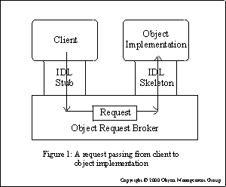
A Picture from OMG www.omg.org/gettingstarted/corbafaq.htm

Slide 180
ORB Differences
The specification of the functionality of an ORB is not a complete implementation description.
Many of the details are left up to the implementor.
Every Vendor does things differently.
You write code to work with a specific ORB.

Slide 181
Inter-ORB Protocol
There is support for connecting ORBs.
The most significant support is the Internet Inter-Orb Protocol (IIOP)
  Specifies the details of communication (bridging) between ORBs.

Slide 182
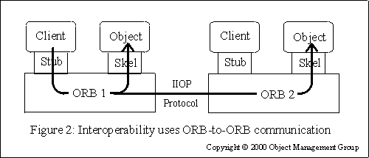
Multiple ORB Picture www.omg.org/gettingstarted/corbafaq.htm

Slide 183
Call Semantics
(part of Corba Object Model - 1.2.8.5 Execution Semantics)
"Two styles of execution semantics are defined by the object model:
At-most-once: if an operation request returns successfully, it was performed exactly once; if it returns an exception indication, it was performed at-most-once.
Best-effort: a best-effort operation is a request-only operation (i.e., it cannot return any results and the requester never synchronizes with the completion, if any, of the request)."

Slide 184
IDL
Used to describe "interfaces"
  similar to RPC .x file
Object Oriented.
Mappings to many languages.

Slide 185
General Layout of IDL File
Organizational group
module identifier {
type,constant & exception declarations
interface identifier : base {
attribute declarations
type identifier(parameters)
raises exception;
type identifier(parameters)
raises exception;
…
}
Corba Class
Corba Methods

Slide 186
Sample IDL
(from Essential Dist. Object Survival Guide)
Module MyAnimals {
interface Dog:Pet,Animal {
attribute integer age;
exception NotInterested(string explanation);
void Bark(in short how_long)
raises(NotInterested);
void Sit(in string where)
raises(NotInterested);
}
interface Cat:Animal {
void Eat();
}
}

Slide 187
IDL from Mico Example
interface Account {
void deposit(in unsigned long amount);
void withdraw(in unsigned long amount);
long balance();
};

Slide 188
Object Adaptors
Corba includes specification of mechanisms for how the server-side ORB should react to requests.
  How to start up the server (or hand the request to the server).
  Create object references.
BOA is simplest OA.

Slide 189
POA
Newer than BOA.
Supports lots of fancy stuff:
  Persistent objects.
  Threads.
So far I haven't heard of TOA, ZOA or
OOA

Slide 190
Today: Distributed Middleware
Middleware concepts
Case study: CORBA

Slide 191
Middleware
Software layer between application and the OS
  Provides useful services to the application
  Abstracts out common functionality required by distributed applications
  Applications use the middleware API to invoke services
Examples:
  CORBA
  DCOM

Slide 192
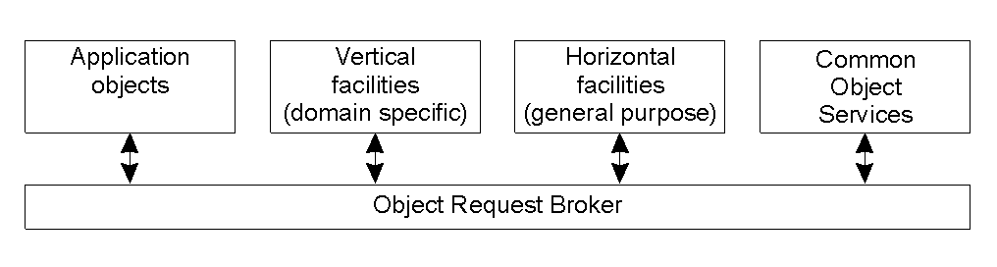
Overview of CORBA
Common Object Request Broker Architecture
  Specification of a distributed middleware
  Specs drawn up by Object Management Group (OMG)
  http://www.omg.org
Goal: Interoperability with distributed applications on various platforms

Slide 193
CORBA Overview
Object request broker (ORB)
  Core of the middleware platform
  Handles communication between objects and clients
  Handles distribution and heterogeneity issues
  May be implemented as libraries
Facilities: composition of CORBA services

Slide 194
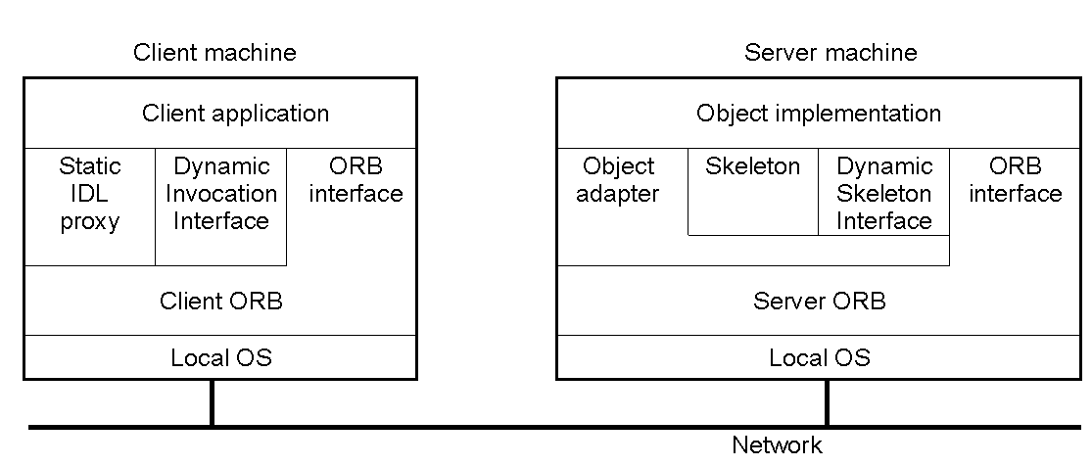
Object Model
Objects & services specified using an Interface Definition language (IDL)
  Used to specify interface of objects and/or services
ORB: run-time system that handles object-client communication
Dynamic invocation interface: allows object invocation at run-time
  Generic invoke operation: takes object reference as input
  Interface repository stores all interface definitions

Slide 195
CORBA Services
Collection service: group objects into lists, queues,..
Query service: use query language to query for service(s)
Concurrency control service: locking services
Event service: interrupt upon a specific event
Many more…

Slide 196
Corba Services
Service | Description
Collection | Facilities for grouping objects into lists, queue, sets, etc.
Query | Facilities for querying collections of objects in a declarative manner
Concurrency | Facilities to allow concurrent access to shared objects
Transaction | Flat and nested transactions on method calls over multiple objects
Event | Facilities for asynchronous communication through events
Notification | Advanced facilities for event-based asynchronous communication
Externalization | Facilities for marshaling and unmarshaling of objects
Life cycle | Facilities for creation, deletion, copying, and moving of objects
Licensing | Facilities for attaching a license to an object
Naming | Facilities for systemwide name of objects
Property | Facilities for associating (attribute, value) pairs with objects
Trading | Facilities to publish and find the services on object has to offer
Persistence | Facilities for persistently storing objects
Relationship | Facilities for expressing relationships between objects
Security | Mechanisms for secure channels, authorization, and auditing
Time | Provides the current time within specified error margins

Slide 197
Object Invocation Models
Request type | Failure semantics | Description
Synchronous | At-most-once | Caller blocks until a response is returned or an exception is raised
One-way | Best effort delivery | Caller continues immediately without waiting for any response from the server
Deferred synchronous | At-most-once | Caller continues immediately and can later block until response is delivered
Invocation models supported in CORBA.
  Original model was RMI/RPC-like
  Current CORBA versions support additional semantics

Slide 198
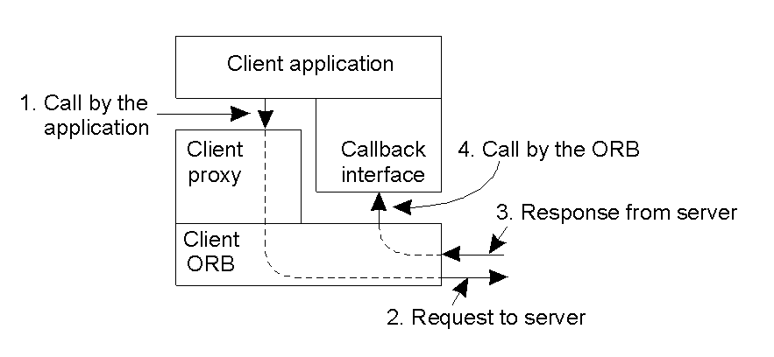
Messaging: Async. Method Invocation
CORBA's callback model for asynchronous method invocation.

Slide 199
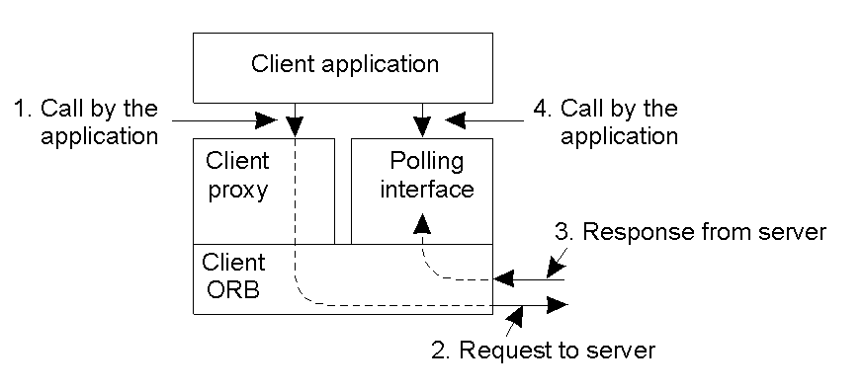
Messaging (2)
CORBA'S polling model for asynchronous method invocation.

Slide 200
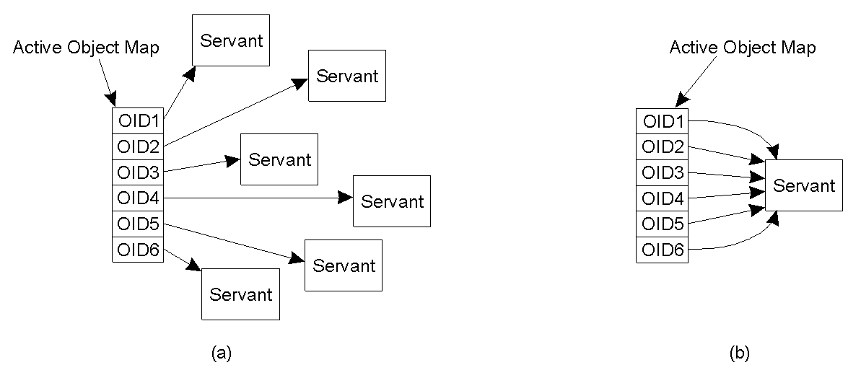
Portable Object Adaptor (1)
POA: Wrappers for server-side code (makes code look like objects)
The POA supports multiple servants.
The POA supports a single servant.

Slide 201
Portable Object Adaptor (2)
My_servant *my_object; // Declare a reference to a C++ object
CORBA::Objectid_var oid; // Declare a CORBA identifier
my_object = new MyServant; // Create a new C++ object
oid = poa ->activate_object (my_object);
// Register C++ object as CORBA OBJECT
Changing a C++ object into a CORBA object.

Slide 202
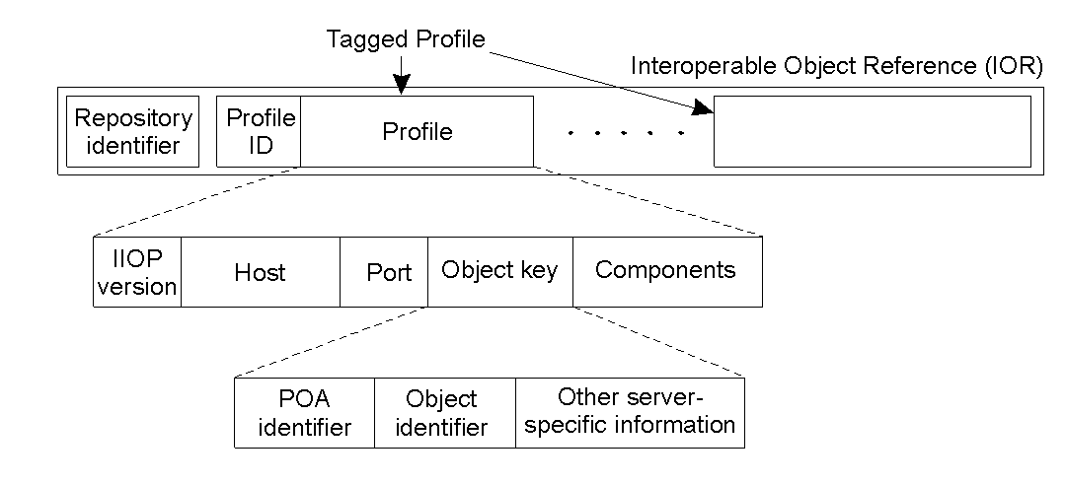
Naming: Object References
Interoperable object reference: language-independent techniques for referring to objects

Slide 203
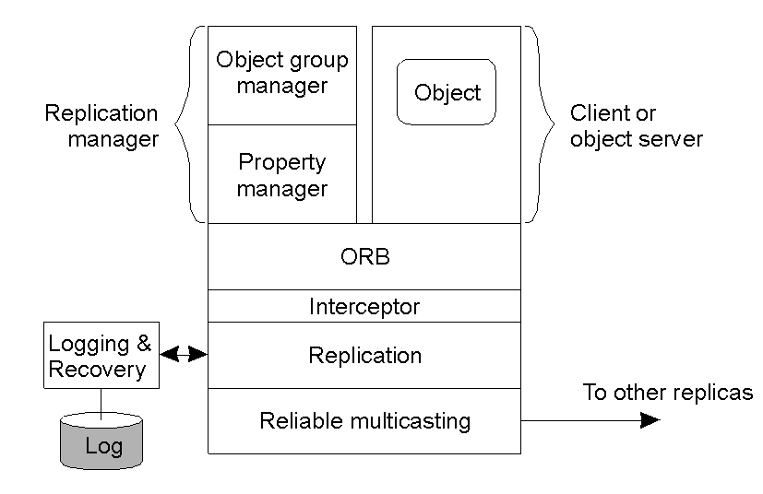
An Example Architecture
An example architecture of a fault-tolerant CORBA system.

Slide 204
Octet sequence 可变长度字节数组

Slide 205
第六章EJB
第一节Session Bean
第二节Entity Bean

Slide 206
J2EE: An overview

Slide 207
J2EE
What is J2EE?
J2EE Technologies
Questions

Slide 208
What is J2EE?
Component-based approach for design, development, assembly & deployment of enterprise applications
Specification, not a product!

Slide 209
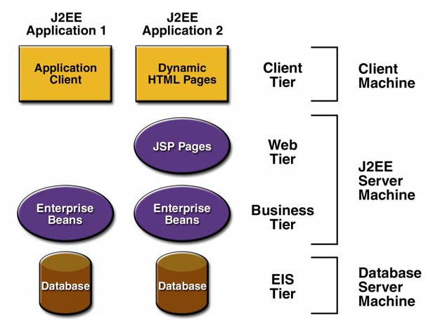
J2EE application

Slide 210
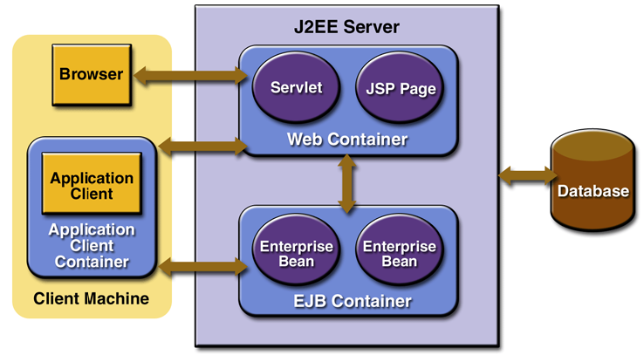
J2EE Containers

Slide 211
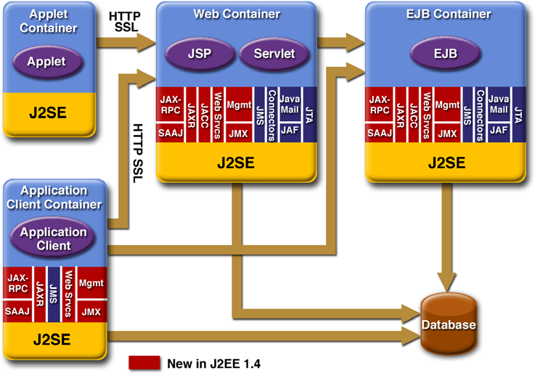
J2EE technologies

Slide 212
J2EE Technologies
Web tier: Servlets and JSP
Enterprise tier: EJB
Data Access Layer: JDBC, JCA
JMS
JTA
JavaMail
XML and Web Services: JAXP, JAX-RPC, JAXR
JNDI

Slide 213
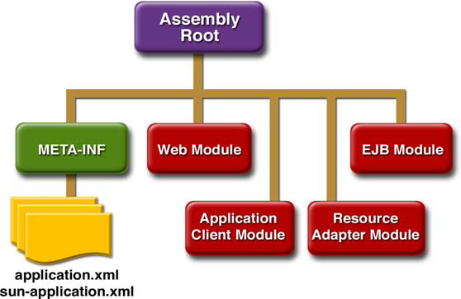
Packaging Structure
Notes:
EAR file.

Slide 214
Useful frameworks
Struts, http://struts.apache.org
Java Server Faces (JSF), http://jsfcentral.org

Slide 215
Resources
J2EE 1.4 tutorial, Sun Microsystems, http://java.sun.com/j2ee/1.4/docs/tutorial/doc/
Free e-books on J2EE design and development, http://www.theserverside.com

Slide 216
Session Beans
Overview
EJB container
Remote Invocation
Represent client's access to app
Local / Remote
speed / flexibility trade-off
when to choose local / remote
Stateless Session Beans
Pro / Con (speed / state)
Stateful Session Beans
Pro / Con (speed / state)
Accessing Session Beans

Slide 217
Overview
Session beans represent a client's interaction with an enterprise application. Unlike servlets or JSP's which run in a web container, session beans require an EJB container.
Enterprise Application Servers like Glassfish and JBOSS have both web containers and EJB containers.
The EJB container provides services like security and transaction management to the enterprise java beans deployed in it.
While servlets and JSP's are meant to be accessed through a web browser, session beans are usually meant to be accessed by other programs or enterprise components. They can be accessed by servlets, other enterprise java beans, or even desktop applications.

Slide 218
Session beans encapsulate business methods and provide an interface for client code. Rather than adding business logic to a client component such as a servlet, the client code needs only to call the business methods of the session bean.
This insulates the client from the details of the application's business logic and allows different types of clients to access the same application without having to reproduce or port a large amount of code.
It also allows the development process to be split up easily. Web designers can focus on creating a web client for an application while Java programmers can concentrate on setting up the business logic

Slide 219
A session bean typically represents a single client's interaction with the application and plays the role of the controller in the MVC design pattern.
This may be a single method call for simple applications or multiple related calls in a session (such as an online shopping cart).
To accommodate the different ways clients interact with applications, session beans come in two varieties: stateful and stateless.

Slide 220
Local and Remote Interfaces
In addition to stateless and stateful varieties, session beans may be defined as local or remote, depending on the requirements of the application.
This gives a Java enterprise application the ability to scale if necessary. Unlike servlets which reside in a specific context on a specific server, an enterprise application may span several servers in different physical locations.
Local beans are meant to be accessed from within the same container.

Slide 221
Remote session beans, as the name implies, may be accessed from remote sources.
Remote session beans can be accessed through the Java Naming and Directory Interface (JNDI), a directory service provided by the EJB container.
Remote beans can also be accessed locally, so they provide a great deal of flexibility and are a good choice if the application needs to be scalable.
The flexibility does come at a price, however, since the JNDI lookups required as well as potentially slow network access can reduce overall performance.

Slide 222
Remote or local access can be defined by the session bean's interface using the @Remote or @Local annotations.
The interface, which is a standard Java interface, defines the methods available to clients.
By implementing a business interface, the session bean becomes more flexible. It can be modified as needed as long as the interface remains unchanged.

Slide 223
Stateless Session Beans
A stateless session bean is a session bean that does not maintain state information across multiple calls. Each call to the session bean's business methods appears (from the bean's point of view) to come from a different client.
It cannot be guaranteed that the stateless session bean object that services the first application request will be the same instance that services future requests. This is because stateless session beans can be pooled by the EJB container.
By maintaining a pool of stateless session beans (SSB's), the EJB container is able to conserve resources since it does not have to maintain a unique instance of the SSB for each client.

Slide 224
The life cycle of a stateless session bean is very simple. It either exists or it doesn't. Once has been created it exists in a pool of stateless session beans ready and waiting to service client requests.
After it services a request it is placed back into the pool where it patiently awaits another request to service.

Slide 225
Stateless session beans have the advantage of being able to be pooled. Since no state is saved with the session, there is no need to match a specific instance of the bean to a particular client.
If subsequent calls are serviced by different instances, the client application does not know (or care).
As a result, the total number of session bean instances may be smaller than the total number of clients accessing the application without impacting performance.

Slide 226
Sample Session Bean Interface:
package com.datavikings.sessionbeans;
import javax.ejb.Remote;
@Remote
public interface HelloSessionRemote {
String hiThere(String name);
}

Slide 227
Sample Stateless Session Bean Implementation:
package com.datavikings.sessionbeans;
import javax.ejb.Stateless;
@Stateless
public class HelloSessionBean implements HelloSessionRemote {
public String hiThere(String name) {
return "Hi there, " + name + "!";
}
}

Slide 228
Sample Servlet Client:
package com.datavikings.servlet;
import com.datavikings.sessionbeans.HelloSessionRemote;
import java.io.IOException;
import java.io.PrintWriter;
import javax.ejb.EJB;
import javax.servlet.ServletException;
import javax.servlet.http.HttpServlet;
import javax.servlet.http.HttpServletRequest;
import javax.servlet.http.HttpServletResponse;

Slide 229
public class HelloServlet extends HttpServlet {
@EJB
HelloSessionRemote greeter;
protected void processRequest(HttpServletRequest request,
HttpServletResponse response)
throws ServletException, IOException {
response.setContentType("text/html;charset=UTF-8");
PrintWriter out = response.getWriter();
if(request.getParameter("name") != null) {
out.println(greeter.hiThere(request.getParameter("name")) + "<br />");
}
out.println("<form method=\"post\" action=\"HelloServlet\">");
out.println("Your name:<input type=\"text\" name=\"name\" />");
out.println("<input type=\"submit\" value=\"Say Hi\" />");
out.println("</form>");
out.close();
}

Slide 230
protected void doGet(HttpServletRequest request,
HttpServletResponse response)
throws ServletException, IOException {
processRequest(request, response);
}
protected void doPost(HttpServletRequest request,
HttpServletResponse response)
throws ServletException, IOException {
processRequest(request, response);
}
}

Slide 231
A session bean is a POJO (plain old Java object) with the annotations, The @Remote annotation in the interface tells the EJB container that the session bean can be accessed remotely with this interface. We could have used @Local, but (as stated previously) the remote interface gives us more flexibility should the application need to scale in the future.
The @Stateless annotation in the session bean implementation tells the EJB container that we are not interested in keeping the state of the session bean and that it should not worry about trying to match it with a particular client.
The @EJB annotation is a signal that the interface we used is actually an enterprise Java bean and as such will be injected by the EJB container. This is the simplest way to access a session bean, by injecting it into a data member of the client object.

Slide 232
Stateful Session Beans
A stateful session bean keeps its internal state between invocations from the client. It seems pretty obvious, but there are some consequences that must be understood.
First, the stateful session beans will be less efficient because the EJB container cannot simply grab the next available session bean and hand it to the client.
The client must be matched with the same bean instance that serviced the last request from the client. If no such bean exists, a new one must be created to handle the client (and only that client). As a result, there will be as many stateful session beans as there are clients.
Contrast this with the stateless bean, which can be pooled, reducing the total number of instantiated objects and thus conserving memory.

Slide 233
The state that the session bean maintains is the internal state of the object. This should not be confused with the Java Persistence API, which makes data persistent by writing it to a database.
If the application is shut down or the server running the EJB container loses power, the session bean ceases to exist. It is not a long-term storage solution. Rather, it is a way to keep track of the conversational state between the application and a client.
It is sort of like remembering someone's name for the duration of a phone call rather than writing their name down in your address book to keep permanently.

Slide 234
Sample Stateful Session Bean Implementation:
package com.datavikings.sessionbeans;
import javax.ejb.Stateful;
@Stateful(mappedName=”HelloSessionBean”)
public class HelloSessionBean implements HelloSessionRemote {
String name = null;
public String hiThere(String n) {
if(name == null) {
name = n;
return "Hi there, " + name + ". It's nice to meet you";
}
else {
return "Hey, I remember you! Your name is " + name + "!";
}
}
}

Slide 235
Sample Servlet Client:
package com.datavikings.servlet;
import com.datavikings.sessionbeans.HelloSessionRemote;
import java.io.IOException;
import java.io.PrintWriter;
import javax.naming.InitialContext;
import javax.naming.NamingException;
import javax.servlet.ServletException;
import javax.servlet.http.HttpServlet;
import javax.servlet.http.HttpServletRequest;
import javax.servlet.http.HttpServletResponse;

Slide 236
public class HelloServlet extends HttpServlet {
protected void processRequest(HttpServletRequest request, HttpServletResponse response)
throws ServletException, IOException {
response.setContentType("text/html;charset=UTF-8");
PrintWriter out = response.getWriter();
HelloSessionRemote greeter = null;
try {
InitialContext ctx = new InitialContext();
if(request.getSession().getAttribute("greeter") == null) {
greeter = (HelloSessionRemote)
ctx.lookup("HelloSessionBean");
request.getSession().setAttribute("greeter", greeter);
}
else { // Otherwise, get reference from session
greeter = (HelloSessionRemote)
request.getSession().getAttribute("greeter");
}
}

Slide 237
catch(NamingException e) {
e.printStackTrace();
}
if(request.getParameter("name") != null) {
out.println(greeter.hiThere(request.getParameter("name")) + "<br />");
}
out.println("<form method=\"post\" action=\"HelloServlet\">");
out.println("Your name:<input type=\"text\" name=\"name\" />");
out.println("<input type=\"submit\" value=\"Say Hi\" />");
out.println("</form>");
out.close();
}

Slide 238
protected void doGet(HttpServletRequest request,
HttpServletResponse response)
throws ServletException, IOException {
processRequest(request, response);
}
protected void doPost(HttpServletRequest request,
HttpServletResponse response)
throws ServletException, IOException {
processRequest(request, response);
}
}

Slide 239
The sample stateful session bean is based on the previous example, so it can use the same remote interface as the stateless bean. The session bean used the @Stateful annotation this time, marking it as a stateful session bean.
This lets the EJB container know that it must match the client with the same bean instance every time in order to keep the right state information with the right client.
The client servlet needed more code added in order to make the example work in a useful manner.

Slide 240
The @EJB annotation that was used in the stateless session bean example was not used for the stateful session bean. The annotation could have been used here as well, but it would have produced an unwanted side-effect.
The @EJB annotation is for injecting beans as data members of an object. Because servlets are multi-threaded, every client that accessed the servlet would get the same session bean because the servlet would keep the reference from one invocation to the next. It would make the session bean a little too stateful for what we want.

Slide 241
The first client to use the servlet would get a reference to a session bean and every client afterwards would have access to that same instance. Instead of using the annotation the servlet performs a JNDI lookup to locate the bean.
The name used in the JNDI lookup matches the name specified with the @Stateful annotation in the session bean implementation. This parameter to the annotation gives the code a way to locate the session bean without having to rely on injection, which would essentially break the way the example servlet is supposed to work.

Slide 242
Thank you
Questions?

Slide 243
Session Beans
Overview
EJB container
Remote Invocation
Represent client's access to app
Local / Remote
speed / flexibility trade-off
when to choose local / remote
Stateless Session Beans
Pro / Con (speed / state)
Stateful Session Beans
Pro / Con (speed / state)
Accessing Session Beans

Slide 244
Overview
Session beans represent a client's interaction with an enterprise application. Unlike servlets or JSP's which run in a web container, session beans require an EJB container.
Enterprise Application Servers like Glassfish and JBOSS have both web containers and EJB containers.
The EJB container provides services like security and transaction management to the enterprise java beans deployed in it.
While servlets and JSP's are meant to be accessed through a web browser, session beans are usually meant to be accessed by other programs or enterprise components. They can be accessed by servlets, other enterprise java beans, or even desktop applications.

Slide 245
Session beans encapsulate business methods and provide an interface for client code. Rather than adding business logic to a client component such as a servlet, the client code needs only to call the business methods of the session bean.
This insulates the client from the details of the application's business logic and allows different types of clients to access the same application without having to reproduce or port a large amount of code.
It also allows the development process to be split up easily. Web designers can focus on creating a web client for an application while Java programmers can concentrate on setting up the business logic

Slide 246
A session bean typically represents a single client's interaction with the application and plays the role of the controller in the MVC design pattern.
This may be a single method call for simple applications or multiple related calls in a session (such as an online shopping cart).
To accommodate the different ways clients interact with applications, session beans come in two varieties: stateful and stateless.

Slide 247
Local and Remote Interfaces
In addition to stateless and stateful varieties, session beans may be defined as local or remote, depending on the requirements of the application.
This gives a Java enterprise application the ability to scale if necessary. Unlike servlets which reside in a specific context on a specific server, an enterprise application may span several servers in different physical locations.
Local beans are meant to be accessed from within the same container.

Slide 248
Remote session beans, as the name implies, may be accessed from remote sources.
Remote session beans can be accessed through the Java Naming and Directory Interface (JNDI), a directory service provided by the EJB container.
Remote beans can also be accessed locally, so they provide a great deal of flexibility and are a good choice if the application needs to be scalable.
The flexibility does come at a price, however, since the JNDI lookups required as well as potentially slow network access can reduce overall performance.

Slide 249
Remote or local access can be defined by the session bean's interface using the @Remote or @Local annotations.
The interface, which is a standard Java interface, defines the methods available to clients.
By implementing a business interface, the session bean becomes more flexible. It can be modified as needed as long as the interface remains unchanged.

Slide 250
Stateless Session Beans
A stateless session bean is a session bean that does not maintain state information across multiple calls. Each call to the session bean's business methods appears (from the bean's point of view) to come from a different client.
It cannot be guaranteed that the stateless session bean object that services the first application request will be the same instance that services future requests. This is because stateless session beans can be pooled by the EJB container.
By maintaining a pool of stateless session beans (SSB's), the EJB container is able to conserve resources since it does not have to maintain a unique instance of the SSB for each client.

Slide 251
The life cycle of a stateless session bean is very simple. It either exists or it doesn't. Once has been created it exists in a pool of stateless session beans ready and waiting to service client requests.
After it services a request it is placed back into the pool where it patiently awaits another request to service.

Slide 252
Stateless session beans have the advantage of being able to be pooled. Since no state is saved with the session, there is no need to match a specific instance of the bean to a particular client.
If subsequent calls are serviced by different instances, the client application does not know (or care).
As a result, the total number of session bean instances may be smaller than the total number of clients accessing the application without impacting performance.

Slide 253
Sample Session Bean Interface:
package com.datavikings.sessionbeans;
import javax.ejb.Remote;
@Remote
public interface HelloSessionRemote {
String hiThere(String name);
}

Slide 254
Sample Stateless Session Bean Implementation:
package com.datavikings.sessionbeans;
import javax.ejb.Stateless;
@Stateless
public class HelloSessionBean implements HelloSessionRemote {
public String hiThere(String name) {
return "Hi there, " + name + "!";
}
}

Slide 255
Sample Servlet Client:
package com.datavikings.servlet;
import com.datavikings.sessionbeans.HelloSessionRemote;
import java.io.IOException;
import java.io.PrintWriter;
import javax.ejb.EJB;
import javax.servlet.ServletException;
import javax.servlet.http.HttpServlet;
import javax.servlet.http.HttpServletRequest;
import javax.servlet.http.HttpServletResponse;

Slide 256
public class HelloServlet extends HttpServlet {
@EJB
HelloSessionRemote greeter;
protected void processRequest(HttpServletRequest request,
HttpServletResponse response)
throws ServletException, IOException {
response.setContentType("text/html;charset=UTF-8");
PrintWriter out = response.getWriter();
if(request.getParameter("name") != null) {
out.println(greeter.hiThere(request.getParameter("name")) + "<br />");
}
out.println("<form method=\"post\" action=\"HelloServlet\">");
out.println("Your name:<input type=\"text\" name=\"name\" />");
out.println("<input type=\"submit\" value=\"Say Hi\" />");
out.println("</form>");
out.close();
}

Slide 257
protected void doGet(HttpServletRequest request,
HttpServletResponse response)
throws ServletException, IOException {
processRequest(request, response);
}
protected void doPost(HttpServletRequest request,
HttpServletResponse response)
throws ServletException, IOException {
processRequest(request, response);
}
}

Slide 258
A session bean is a POJO (plain old Java object) with the annotations, The @Remote annotation in the interface tells the EJB container that the session bean can be accessed remotely with this interface. We could have used @Local, but (as stated previously) the remote interface gives us more flexibility should the application need to scale in the future.
The @Stateless annotation in the session bean implementation tells the EJB container that we are not interested in keeping the state of the session bean and that it should not worry about trying to match it with a particular client.
The @EJB annotation is a signal that the interface we used is actually an enterprise Java bean and as such will be injected by the EJB container. This is the simplest way to access a session bean, by injecting it into a data member of the client object.

Slide 259
Stateful Session Beans
A stateful session bean keeps its internal state between invocations from the client. It seems pretty obvious, but there are some consequences that must be understood.
First, the stateful session beans will be less efficient because the EJB container cannot simply grab the next available session bean and hand it to the client.
The client must be matched with the same bean instance that serviced the last request from the client. If no such bean exists, a new one must be created to handle the client (and only that client). As a result, there will be as many stateful session beans as there are clients.
Contrast this with the stateless bean, which can be pooled, reducing the total number of instantiated objects and thus conserving memory.

Slide 260
The state that the session bean maintains is the internal state of the object. This should not be confused with the Java Persistence API, which makes data persistent by writing it to a database.
If the application is shut down or the server running the EJB container loses power, the session bean ceases to exist. It is not a long-term storage solution. Rather, it is a way to keep track of the conversational state between the application and a client.
It is sort of like remembering someone's name for the duration of a phone call rather than writing their name down in your address book to keep permanently.

Slide 261
Sample Stateful Session Bean Implementation:
package com.datavikings.sessionbeans;
import javax.ejb.Stateful;
@Stateful(mappedName=”HelloSessionBean”)
public class HelloSessionBean implements HelloSessionRemote {
String name = null;
public String hiThere(String n) {
if(name == null) {
name = n;
return "Hi there, " + name + ". It's nice to meet you";
}
else {
return "Hey, I remember you! Your name is " + name + "!";
}
}
}

Slide 262
Sample Servlet Client:
package com.datavikings.servlet;
import com.datavikings.sessionbeans.HelloSessionRemote;
import java.io.IOException;
import java.io.PrintWriter;
import javax.naming.InitialContext;
import javax.naming.NamingException;
import javax.servlet.ServletException;
import javax.servlet.http.HttpServlet;
import javax.servlet.http.HttpServletRequest;
import javax.servlet.http.HttpServletResponse;

Slide 263
public class HelloServlet extends HttpServlet {
protected void processRequest(HttpServletRequest request, HttpServletResponse response)
throws ServletException, IOException {
response.setContentType("text/html;charset=UTF-8");
PrintWriter out = response.getWriter();
HelloSessionRemote greeter = null;
try {
InitialContext ctx = new InitialContext();
if(request.getSession().getAttribute("greeter") == null) {
greeter = (HelloSessionRemote)
ctx.lookup("HelloSessionBean");
request.getSession().setAttribute("greeter", greeter);
}
else { // Otherwise, get reference from session
greeter = (HelloSessionRemote)
request.getSession().getAttribute("greeter");
}
}

Slide 264
catch(NamingException e) {
e.printStackTrace();
}
if(request.getParameter("name") != null) {
out.println(greeter.hiThere(request.getParameter("name")) + "<br />");
}
out.println("<form method=\"post\" action=\"HelloServlet\">");
out.println("Your name:<input type=\"text\" name=\"name\" />");
out.println("<input type=\"submit\" value=\"Say Hi\" />");
out.println("</form>");
out.close();
}

Slide 265
protected void doGet(HttpServletRequest request,
HttpServletResponse response)
throws ServletException, IOException {
processRequest(request, response);
}
protected void doPost(HttpServletRequest request,
HttpServletResponse response)
throws ServletException, IOException {
processRequest(request, response);
}
}

Slide 266
The sample stateful session bean is based on the previous example, so it can use the same remote interface as the stateless bean. The session bean used the @Stateful annotation this time, marking it as a stateful session bean.
This lets the EJB container know that it must match the client with the same bean instance every time in order to keep the right state information with the right client.
The client servlet needed more code added in order to make the example work in a useful manner.

Slide 267
The @EJB annotation that was used in the stateless session bean example was not used for the stateful session bean. The annotation could have been used here as well, but it would have produced an unwanted side-effect.
The @EJB annotation is for injecting beans as data members of an object. Because servlets are multi-threaded, every client that accessed the servlet would get the same session bean because the servlet would keep the reference from one invocation to the next. It would make the session bean a little too stateful for what we want.

Slide 268
The first client to use the servlet would get a reference to a session bean and every client afterwards would have access to that same instance. Instead of using the annotation the servlet performs a JNDI lookup to locate the bean.
The name used in the JNDI lookup matches the name specified with the @Stateful annotation in the session bean implementation. This parameter to the annotation gives the code a way to locate the session bean without having to rely on injection, which would essentially break the way the example servlet is supposed to work.

Slide 269
Entity Beans
Representing Data

Slide 270
Entity Beans
Entity beans represent (persistent) data
Every application has data
  It is often the case that this data naturally exists as objects
    e.g. In a Banking application: Account, Customer, Transaction
  Applications need a way to map these objects to their database (often an RDBMS)
    They can write code themselves (e.g. JDBC)
    They can use an Object-Relational Mapping (ORM) framework

Slide 271
Object-Relational Mapping (ORM)
There are several ORM frameworks available for Java:
  Hibernate (JBoss)
  TopLink (Oracle)
  ObJect-relational Bridge - OJB (Apache)
  Java Data Objects – JDO (Sun)
  Java Persistence (Sun) – The ORM technology used by EJB

Slide 272
Object-Relational Mapping (ORM)
There are several ORM frameworks available for Java:
  Hibernate (JBoss)
    Open source framework released by JBoss in 2001
    Ported for .NET as NHibernate
    Uses an object-based query language called Hibernate-QL
  TopLink (Oracle)
  ObJect-relational Bridge - OJB (Apache)
  Java Data Objects – JDO (Sun)
  Java Persistence (Sun) – The ORM technology used by EJB

Slide 273
Object-Relational Mapping (ORM)
There are several ORM frameworks available for Java:
  Hibernate (JBoss)
  TopLink (Oracle)
    TopLink was released by The Object People (TOP) in 1994 for SmallTalk
    TopLink was re-released in 1997 for Java
    Oracle acquired TopLink in 2002
    TopLink uses expressions for querying
  ObJect-relational Bridge - OJB (Apache)
  Java Data Objects – JDO (Sun)
  Java Persistence (Sun) – The ORM technology used by EJB

Slide 274
Object-Relational Mapping (ORM)
There are several ORM frameworks available for Java:
  Hibernate (JBoss)
  TopLink (Oracle)
  ObJect-relational Bridge - OJB (Apache)
    OJB is an implementation of JDO provided for free by Apache
  Java Data Objects – JDO (Sun)
  Java Persistence (Sun) – The ORM technology used by EJB

Slide 275
Object-Relational Mapping (ORM)
There are several ORM frameworks available for Java:
  Hibernate (JBoss)
  TopLink (Oracle)
  ObJect-relational Bridge - OJB (Apache)
  Java Data Objects – JDO (Sun)
    An ORM standard developed by Sun (released: 2002)
    Can be used in any JVM
    Use an object-based query language called JDO-QL
  Java Persistence (Sun) – The ORM technology used by EJB

Slide 276
Object-Relational Mapping (ORM)
There are several ORM frameworks available for Java:
  Hibernate (JBoss)
  TopLink (Oracle)
  ObJect-relational Bridge - OJB (Apache)
  Java Data Objects – JDO (Sun)
  Java Persistence (Sun) – The ORM technology used by EJB
    This technology grew out of the previous technologies
      Thus, it is very similar in API to the other technologies discussed
    The aim is to provide a transparent framework for persisting entities (that are Plain Old Java Objects – POJOs)
    Java Persistence uses an object-based query language called EJB-QL (also called Java Persistence Query Language)

Slide 277
Object-Relational Mapping
An application has instances of classes (entities):
public class Customer {
private String firstName;
private String lastName;
… other fields omitted …
}
…which need to be stored in RDBMSs:
FirstName | LastName | BirthDate | Company | Balance
Robert | Smith | 02/16/1956 | IBM | 1500.00
Susan | Jones | 06/07/1968 | BEA | 0.00
Felicia | Alvarez | 12/31/1977 | Sun | 100.00

Slide 278
Java Persistence Features
When using Java Persistence, the container handles:
  Relationships between entities
  Persistence of the entity’s data
All this is in addition to the container’s responsibilities for all EJBs:
  Transactions
  Security

Slide 279
Entity: The Bean
import javax.persistence.Entity;
import javax.persistence.Id;
@Entity
public class Customer {
@Id public int customerID; // primary key
public String firstName;
public String lastName;
… other fields omitted …
}
The @Entity annotation marks this class as an entity
The @Id annotation marks the customerID field as the primary key for the entity (mapped directly to the database primary key)
The data will be persisted to a table with the same name, and the fields will be persisted to columns with the same name

Slide 280
Entity: The Bean (Alternative #1)
import javax.persistence.*;
@Entity
@Table(name=“CustomerData”)
public class Customer {
@Id
@Column(name=“CustID”, primaryKey=true)
public int customerID;
@Column(name=“FName”)
public String firstName;
@Column(name=“LName”)
public String lastName;
… other fields omitted …
}
Here, the mapped table and column names are explicitly declared
This example uses public fields for the entity’s properties

Slide 281
Entity: The Bean (Alternative #2)
import javax.persistence.*;
@Entity
@Table(name=“CustomerData”)
public class Customer {
@Id
@Column(name=“CustID”, primeyKey=true)
public int getCustomerID() { … };
public void setCustomerID(int value) { … };
private int customerID;
@Column(name=“FName”)
public String getFirstName() { … };
public void setFirstName(String value) { … };
private String firstName;
… other fields omitted …
}
Here, the entity’s properties are accessed using get/set methods
  The actual fields used can now be private, preserving encapsulation

Slide 282
Entity Clients
Entity clients, since EJB 3.0, are most often session beans
  Sometimes, developers create a session façade for the entity
    This is a session bean whose sole purpose is to act as the CRUD (Create/Read/Update/Destroy) for the entity
The core of the entity client is the EntityManager
  This object can be used to acquire, search for, update, create, and delete entities
  An EntityManager can be injected into a session façade

Slide 283
CRUDs
Objects whose purpose is to provide the following functions on an entity:
  Create – Create and persist new instances of entities
  Read – Find individual entities (by primary key) and search for groups of entities (querying)
  Update – Modify entities (locally and in the persistent store)
  Destroy – Delete entities (locally and in the persistent store)
In Java EE, CRUD functions are provided by the EntityManager class

Slide 284
EntityManager: Create
An entity is pretty much a POJO
  It can, therefore, be created in the normal way
  However, the entity is not persistent until the EntityManager is told to persist the object:
@PersistenceContext EntityManager entityManager;
public Customer createCustomer(String fn, String ln) {
Customer customer = new Customer();
customer.setFirstName(fn);
customer.setLastName(ln);
// customer is not persistent here
entityManager.persist(customer);
// customer is persistent here
return customer;
}

Slide 285
EntityManager: Read #1 (Individual)
A specific entity can be found using its primary key:
@PersistenceContext EntityManager entityManager;
public Customer getCustomer(int customerID) {
return entityManager.find(Customer.class, customerID);
}

Slide 286
EntityManager: Read #2 (Search)
A search can be performed using a query:
@PersistenceContext EntityManager entityManager;
public List<Customer> getAllCustomers() {
// this query is EJB-QL, which is similar to SQL
String queryString = “select c from Customer c”;
Query query = entityManager.createQuery(queryString);
return query.getResultList();
}

Slide 287
EntityManager: Read #3 (Search)
Queries can also take parameters:
@PersistenceContext EntityManager entityManager;
public List<Customer> getCustomersWithLastName(String lastName) {
// this query is EJB-QL, which is similar to SQL
String queryString = “select c from Customer c where c.lastName = :lastName”;
Query query = entityManager.createQuery(queryString);
query.setParameter(“lastName”, lastName);
return query.getResultList();
}

Slide 288
EntityManager: Read #4 (Search)
The EJB-QL is sophisticated, and has many features of SQL (e.g. group by/having):
@PersistenceContext EntityManager entityManager;
public List<Customer> getCustomersByNameKeyword(String keyword) {
// this query is EJB-QL, which is similar to SQL
String queryString = “select c from Customer c where c.lastName like :keyword1 or c.firstName like :keyword2”;
Query query = entityManager.createQuery(queryString);
query.setParameter(“keyword1”, keyword);
query.setParameter(“keyword2”, keyword);
return query.getResultList();
}

Slide 289
EntityManager: Read #5 (Entity)
A developer can also create named queries in the EJB itself:
import javax.persistence.*;
@Entity
@Table(name=“CustomerData”)
@NamedQueries({
@NamedQuery(name="FindByCity",
queryString=" select c from Customer c where c.city = ?1")
})
public class Customer {
@Id
@Column(name=“CustID”, primeyKey=true)
public int getCustomerID() { … };
… the remainder is no different from previous versions …

Slide 290
EntityManager: Read #5 (Search)
The named queries can be referenced from the client
  Notice that no EJB-QL needs to be embedded in this client, which is good for maintenance
@PersistenceContext EntityManager entityManager;
public List<Customer> getCustomersByCity(String city) {
Query query = entityManager.createNamedQuery(“FindByCity”);
query.setParameter(0, city);
return query.getResultList();
}

Slide 291
EntityManager: Update
Once an entity is persisted, it becomes managed
  Changes to managed entities are automatically recorded to the persistent store
  Changes will no doubt be cached for efficiency, but you can flush() an entityManager to force the changes to be carried out immediately
    Usually, this is unnecessary
entityManager.flush(); // flush all updates
The latest database data can also be retrieved into an entity, using the refresh() method:
entityManager.refresh(customer1); // update customer1

Slide 292
EntityManager: Destroy
The EntityManager can also be used to delete an entity
@PersistenceContext EntityManager entityManager;
public void deleteCustomer(int customerID) {
Customer customer = manager.find(Customer.class, customerID);
manager.remove(customer);
}

Slide 293
Pooling Entities
An entity container will pool entities
  This kind of pool is similar to a data cache
Entities are retrieved by their primary key
If the entity does not exist, a new instance is created and filled with the correct database data
  It is much faster if a pooled entity exists, since no database accesses are required

Slide 294
Local Entities vs. Remote Entities
Entities can have a remote interface like session EJBs
  However, this is considered a bad idea
Entities are fine-grained
  Each method does very little
    e.g. get or set a customer’s first name
  The performance/network costs are not worthwhile
Session EJBs are coarse-grained
  Each method (typically) does quite a bit
    e.g. transfer funds between two accounts, with transaction record
  The performance/network costs are not really a factor

Slide 295
Local Entities vs. Remote Entities
An alternative is to create a session EJB which provides a coarse-grained interface
  This is called a session façade
  A coarse-grained interface simply means that a session façade method typically turns into multiple local calls on the entity
Session façades (and other session EJBs) typically are deployed on the same server as entities
  Session EJB clients (e.g. JSPs) are typically deployed on separate servers, and clustered

Slide 296
第三节JPQL

Slide 297
JPQL
Java Persistence Query Language

Slide 298
Introduction
The Java Persistence API specifies a query language that allows to define queries over entities and their persistent state
JPQL is an extension of EJB QL
More robust flexible and object-oriented than SQL
The persistence engine parse the query string, transform the JPQL to the native SQL before executing it

Slide 299
Creating Queries
Query instances are obtained using:
  EntityManager.createQuery (dynamic query)
  EntityManager.createNamedQuery (static query)
Query API:
getResultList() – execute query returning multiple results
getSingleResult() – execute query returning single result
executeUpdate() – execute bulk update or delete
setFirstResult() – set the first result to retrieve
setMaxResults() – set the maximum number of results to retrieve
setParameter() – bind a value to a named or positional parameter
setHint() – apply a vendor-specific hint to the query
setFlushMode()– apply a flush mode to the query when it gets run

Slide 300
Static (Named) Queries
Defined statically with the help of @NamedQuery annotation together with the entity class
@NamedQuery elements:
  name - the name of the query that will be used with the createNamedQuery method
  query – query string
@NamedQuery(name="findAllCustomers",
query="SELECT c FROM Customer")
Query findAllQuery =
entityManager.createNamedQuery(“findAllCustomers”);
List customers = findAllQuery.getResultList();

Slide 301
Multiple Named Queries
Multiple named queries can be logically defined with the help of @NamedQueries annotation
@NamedQueries( {
@NamedQuery(name = “Mobile.selectAllQuery”
query = “SELECT M FROM MOBILEENTITY”),
@NamedQuery(name = “Mobile.deleteAllQuery”
query = “DELETE M FROM MOBILEENTITY”)
} )

Slide 302
Named Parameters
Named parameters are parameters in a query that are prefixed with a colon (:)
To bound parameter to an argument use method:
  Query.setParameter(String name, Object value)
public List findWithName(String name) {
return em.createQuery(
"SELECT c FROM Customer c WHERE c.name LIKE :custName")
.setParameter("custName", name)
.getResultList();
}

Slide 303
Positional Parameters
Positional parameters are prefixed with a question mark (?) followed the numeric position of the parameter in the query
To set parameter values use method:
  Query.setParameter(integer position, Object value)
public List findWithName(String name) {
return em.createQuery(
“SELECT c FROM Customer c WHERE c.name LIKE ?1”)
.setParameter(1, name)
.getResultList();
}

Slide 304
Dynamic Queries
Dynamic queries are queries that are defined directly within an application’s business logic
Worse efficiency and slower query execution, as the persistence engine has to do all the parsing and validation stuffs, along with mapping the JPQL to the SQL at the run-time
public List findAll(String entityName){
return entityManager.createQuery(
"select e from " + entityName + " e")
.getResultList();
}

Slide 305
Native Queries
Queries may be expressed in native SQL
Support for cases where it is necessary to use the native SQL of the target database in use
Query q = em.createNativeQuery(
"SELECT o.id, o.quantity, o.item " +
"FROM Order o, Item i " +
"WHERE (o.item = i.id) AND (i.name = 'widget')",
com.acme.Order.class);
@SqlResultSetMapping annotaton is used for more advanced cases

Slide 306
Query Operations – Multiple Results
Query.getResultList() will execute a query and may return a List object containing multiple entity instances
Will return a non-parameterized List object
Can only execute on select statements as opposed to UPDATE or DELETE statements
  For a statement other than SELECT run-time IllegalStateException will be thrown
Query query = entityManager.createQuery(“SELECT C FROM CUSTOMER”);
List<MobileEntity> mobiles = (List<MobileEntity>)query.getResultList();

Slide 307
Query Operations – Single Result
A query that returns a single entity object
If the match wasn’t successful, then EntityNotFoundException is returned
If more than one matches occur during query execution a run-time exception NonUniqueResultException will be thrown
Query singleSelectQuery = entityManager.createQuery(
“SELECT C FROM CUSTOMER WHERE C.ID = ‘ABC-123’”);
Customer custObj = singleSelectQuery.getSingleResult();

Slide 308
Paging Query Results
int maxRecords = 10; int startPosition = 0;
String queryString = “SELECT M FROM MOBILEENTITY”;
while(true){
Query selectQuery = entityManager.createQuery(queryString);
selectQuery.setMaxResults(maxRecords);
selectQuery.setFirstResult(startPosition);
List<MobileEntity> mobiles = entityManager.getResultList(queryString);
if (mobiles.isEmpty()){ break; }
process(mobiles); // process the mobile entities
entityManager.clear(); // detach the mobile objects
startPosition = startPosition + mobiles.size();
}

Slide 309
Flushing Query Objects
Two modes of flushing query objects
  AUTO (default) and COMMIT
AUTO - any changes made to entity objects will be reflected the very next time when a SELECT query is made
COMMIT - the persistence engine may only update all the state of the entities during the database COMMIT

Slide 310
JPQL Statement Language
JPQL statement types:
  SELECT, UPDATE, DELETE
Supported clauses:
  FROM
  WHERE
  GROUP_BY
  HAVING
  ORDER BY
  …
Conditional expressions, aggregate functions,…

Slide 311
JPQL Enhancements over EJBQL 2.x
Simplified query syntax
JOIN operations
Group By and Having Clause
Subqueries
Dynamic queries
Named parameters
Bulk update and delete

Slide 312
OO-style vs. SQL-style queries
The main difference is that you query the application model, i.e. the entities, rather than any database tables
Productivity can be increased if OO-style quries, e.g.
employeeXYZ.getManager().getAddress()
are automatically translated by the ORM engine into correct SQL code, e.g.
SELECT t3.* FROM EMP t1, EMP t2, ADDR t3
WHERE t1.EMP_ID = “XYZ” AND t1.MGR_ID = t2.EMP_ID
AND t2.ADDR_ID = t3.ADDR_ID
Notice that the two-step object traversal was packed into a single DB query

Slide 313
Reference
JPQL Language Reference http://edocs.bea.com/kodo/docs41/full/html/ejb3_langref.html
JPA Query API http://www.javabeat.net/javabeat/ejb3/articles/2007/04/introduction_to_java_persistence_api_jpa_ejb_3_0_6
Standardizing Java Persistence with the EJB3 Java Persistence API – Query API http://www.onjava.com/pub/a/onjava/2006/05/17/standardizing-with-ejb3-java-persistence-api.html?page=last&x-showcontent=text

Slide 314
第七章DCOM Technology

Slide 315
What is DCOM?
DCOM is just COM with a longer wire
DCOM extends COM to support communication among objects on different computers

Slide 316
Component Object Model
COM is a platform-independent, distributed, object-oriented system for creating binary software components that can interact.
COM objects can be created with a variety of programming languages. Object-oriented languages, such as C++, provide programming mechanisms that simplify the implementation of COM objects.

Slide 317
Understanding COM
not an object-oriented language but a binary standard
COM specifies an object model and programming requirements that enable COM objects (also called COM components) to interact with other objects

Slide 318
COM Design Principles
Binary components
  Any programming language
  Any location(in-process, cross-process, cross-machine)
Zero sacrifice in-proc performance
Simplest model possible
  Enable extensibility and adaptability

Slide 319
COM Design Principles..
Encapsulation
  Black box - no leakage of implementation details
  All object manipulation through strict interfaces
Polymorphism
  via multiple interfaces per class
  “Discoverable”: QueryInterface
IUnknown
IDispatch
COM
Object
IRobot

Slide 320
Interfaces
IUnknown
  AddRef
  Release
  QueryInterface
IDispatch
  GetIDsOfNames
  GetTypeInfo
  GetTypeInfoCount
  Invoke
Custom Interfaces
Notes:
Your application may have as much as classes as you need. It should implement at least the IUnknown interface. AddRef increments the objects usage count, and Release decrements it. Object may unload itself when the reference count reaches to zero. QueryInterface helps you to query any interface using another one. If you create and object and get the IUnknown interface you can easily access other interfaces. Applications usually query objects whether they have a certain interface. For example the COM runtime queries and object of IMarshall to decide whether custom marshalling or universal marshaller. Internet Explorer searches some certain registry keys, and loads the objects under those keys. It then queries the object of IObjectWithSite interface to decide the object will be run as a plugin. The object queries the IUnknown interface of the loader module for IWebBrowser2. When a page is loaded the plugin asks the browser the IUnknown of the document. The IHTMLDocument2 and IHTMLElement interfaces are queried using the IUnknown interface that we have.
IDispatch interface has to be implemented if the object is to be used from scripting languages through automation. The script languages accessed the methods in vtable by name using the methods of IDispatch interface. COM objects also implement their custom interfaces for direct access.

Slide 321
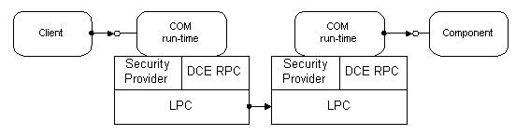
COM Architecture
Communication details handled by the COM run-time
Notes:
In today's operating systems, processes are shielded from each other. A client that needs to communicate with a component in another process has to use some form of inter-process communication provided by the operating system. COM provides this communication in a completely transparent fashion: it intercepts calls from the client and forwards them to the component in another process.
LPC (Local Procedure Call) is used for interprocess communcation. LPC is a system service in the Win32 subsystem. For example all the Win32 API calls are done using LPC. An application that calls the CreateWindow actually packs all of the parameters and send them to the Win32 subsystem.
COM uses DCE’s (Distributed Computing Environment specified by Open Software Foundation) RPC (Remote Procedure Call) protocol. DCE was implemented for Windows platform by Digital Equipment Corporation.

Slide 322
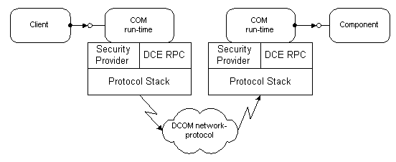
DCOM Architecture
Notes:
The only difference between COM and DCOM is the connection between the client and the server.

Slide 323
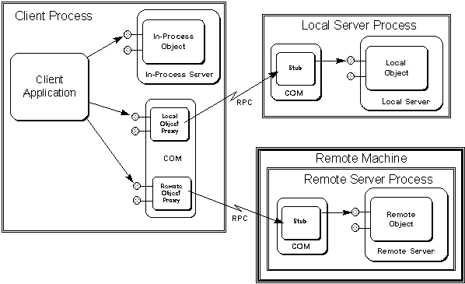
Proxy & Stub
Notes:
COM uses a mechanism to pass parameters and return values accross process boundaries. The client calls the functions of the interface proxy, but the application need not worry about the details of the process. The proxy has exactly the same functions as the target interface. The proxy marshalls the data and sends to the server side. The stub gets the data sent from the client proxy and unmarshalls the data. The parameters are extracted and passed to the actual interface. The server implementation feels that the request comes from a real client. In fact the stub calls the function on the server. But the server need not have to worry about these details. The server processes the parameters and returns the parameters to the stub. The stub marshalls the return values and send to the client proxy. The proxy unmarshalls the return values and passed to the client.
When an in-process object is involved, COM can simply pass the pointer directly from the object to the client, because that pointer is valid in the client's address space. Calls through that pointer end up directly in the object code, as they should, making the in-process case a fast calling model—just as fast as using raw DLLs
This "marshalling" sequence creates a "proxy" object and a "stub" object that handle the cross-process communication details for that interface. COM creates the "stub" in the object's process and has the stub manage the real interface pointer. COM then creates the "proxy" in the client's process, and connects it to the stub. The proxy then supplies the interface pointer that is given to the client.
Users may choose to implement their own custom marshalling by implementing the IMarshall interface. The COM runtime first queried the IMarshall interface. If it cannot find one, it uses the universal type library marshalling.

Slide 324
DCOM Wire Protocol
Client Machine
Server Machine
TCP, UDP
COM
Client
Component
COM Runtime
SPX,IPX
COM Runtime
Proxy
Net BUI
HTTP
Other
Component

Slide 325
DCOM Security
Secure - Security is designed and built in. Not an option.
DCOM uses the extensible security framework provided by Windows NT.
Security configurable
  DCOM stores Access Control Lists for components
  ACLs can be configured using the DCOM configuration tool (DCOMCNFG) or programmatically using the Windows NT registry and Win32 security functions.

Slide 326

COM Security Architecture
Client Machine
Server Machine
NTLM
COM
Client
SSL, Certs.
Component
COM Runtime
COM Runtime
Proxy
NT Kerberos
DCE
Other
Component

Slide 327
Components & Reuse
Use existing tools and components
Reduce development time and cost
COM components easily configured as DCOM components
COM can use many other components
COM components are usable by many technologies
Notes:
DCOMCNFG configures remote access to COM components.
COM can use Java Beans.
COM components can be used by scripting languages in Web pages, XML documents, ASP pages, .NET framework, many programming languages even by COBOL.

Slide 328
Location Transparency
COM Object locations are stored in registry
Applications make calls using the globally unique CLSID.
Path to COM server, or remote computer to run DCOM server is not needed by the application.

Slide 329
Language Neutrality
Various languages can be used to create components.
  VB, Delphi for rapid development
  VC++, Java for advanced development
  Micro Focus COBOL
Even more languages can be used to use COM components
  Additionally scripting languages like VB Script, JScript

Slide 330
Connection Management
Low Bandwidth
  Header is 28 bytes over DCE-RPC
  Keep-Alive Messages bundled for all connections between Machines
COM employs an efficient pinging protocol to detect if clients are active
COM uses reference counting mechanism to do garbage collection

Slide 331
Efficient and Scalable
Multiplexing - Single Port per-protocol, per server process, regardless of # of objects
Scalable - Connection-Less Protocols like UDP Preferred
Established Connection-Oriented (TCP) Sessions Reused by same client
Server
Client
Client

Slide 332
Load Balancing
DCOM does not transparently provide load balancing
Makes it easy to implement load balancing
  Static load balancing
  Dynamic load balancing by means of a dedicated referral component

Slide 333
Platform Neutrality
DCOM run-time is available for various platforms
  Win32 platforms, Solaris, DEC UNIX, HPUX, Linux, MVS, VMS, Mac
  Cross-Platform Interoperability Standard
Per-Platform binary standard
  Unlike java, DCOM can utilize powerful platform-specific services and optimizations
  Less abstraction layers prevents additional overheads

Slide 334
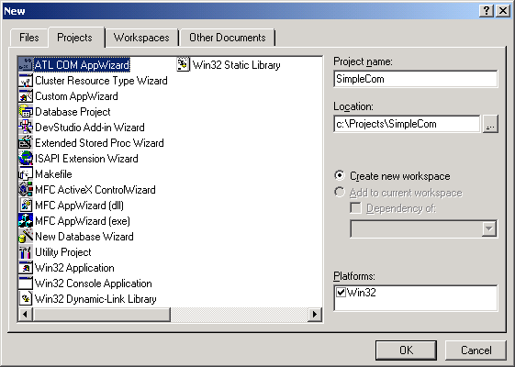
Creating a simple COM server
Notes:
Location constraints like ODBC access, faster computers.

Slide 335
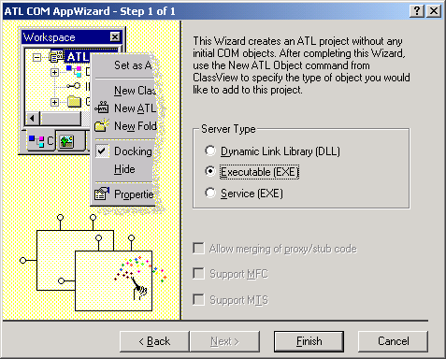
ATL COM AppWizard

Slide 336
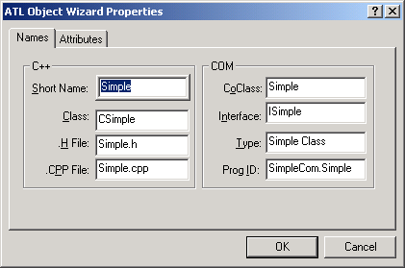
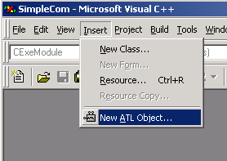
New ATL Object

Slide 337
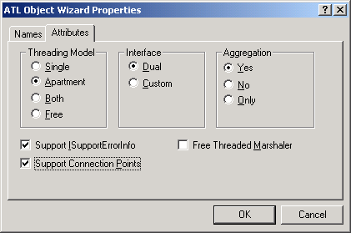
ATL Object Attributes

Slide 338
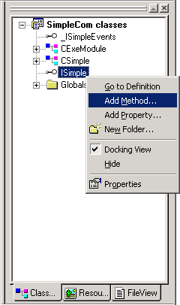
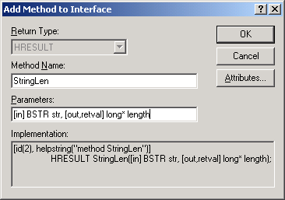
Add New Method

Slide 339
Interface Definition Language
...
[
object,
uuid(79522A15-BA3D-46A5-92D6-DA4BE60646F4),
dual,
helpstring("ISimple Interface"),
pointer_default(unique)
]
interface ISimple : IDispatch
{
[id(1), helpstring("method StringLen")] HRESULT StringLen([in] BSTR str, [out,retval] long* length);
};
...

Slide 340
Source & Header File
Source:
STDMETHODIMP CSimple::StringLen(BSTR str, long* length)
{
*length = SysStringLen(str);
return S_OK;
}
Header:
...
public:
STDMETHOD(StringLen)(/*[in]*/ BSTR str, /*[out,retval]*/ long* length);
...

Slide 341
Creating a Simple COM Client
#include <stdio.h>
#import "SimpleCom.exe"
int main(int argc, char* argv[])
{
SIMPLECOMLib::ISimplePtr pSimple;
long len;
CoInitialize(NULL);
pSimple.CreateInstance(__uuidof(SIMPLECOMLib::Simple));
len = pSimple->StringLen("sample");
printf("Length = %d\n", len);
CoUninitialize();
return 0;
}

Slide 342
Exception Handling
try
{
len = pSimple->StringLen("sample");
}
catch (_com_error &e)
{
printf(“%s\n”, e.Description());
}

Slide 343
Registering COM Objects
COM dll
  To register: regsvr32 mycom.dll
  To un-register: regsvr32 –u mycom.dll
COM exe
  To register: mycom.exe /regserver
  To un-register: mycom.exe /unregserver

Slide 344
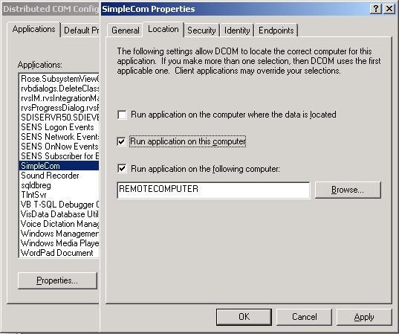
Configure as DCOM

Slide 345
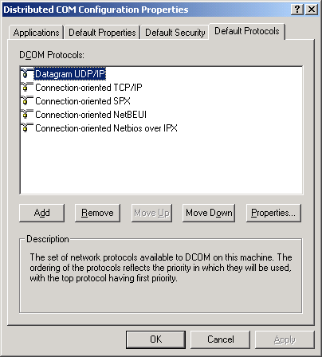
Protocols for DCOM

Slide 346
Referances
MSDN Library Online
Professional ATL COM programming , Richard Grimes, Wrox Publishing

Slide 347
附录：DCOM Vs. CORBA

Slide 348
INDEX
1. Terminology Used
2. About DCOM
3. About CORBA
4. Features
5. Interaction Between Server and Client
6. DCOM Architecture
7. CORBA Architecture

Slide 349
Index Cont’d
8. Different Layers
9. Sample Application
10. Top Layer - Basic Programming Architecture
11. Middle Layer - Remoting Architecture
12. Bottom Layer - WIRE Protocol Architecture
13. Summary
14. References

Slide 350
Terminology Used
Interface - A named collection of abstract operations (or methods) that represent one functionality.
Object class (or class) - A named concrete implementation of one or more interfaces.
Object (or object instance) -An instantiation of some object class.
Object server - A process responsible for creating and hosting object instances.
Client - A process that invokes a method of an object.

Slide 351
About DCOM
DCOM is the distributed extension to COM (Component Object Model) that builds an object RPC layer to support remote objects.
A COM server can create object instances of multiple classes and also supports multiple interfaces allowing client-server communication.
A COM client interacts with a COM object by acquiring a pointer to the object’s interface and invoking methods through that pointer.
It is the product of Microsoft people.

Slide 352
About CORBA
CORBA (Common Object Request Broker Architecture), is a distributed object framework proposed by a consortium of nearly 800 companies called the Object Management Group (OMG) but developed by Sun people.
The core of CORBA is the Object Request Broker (OB) that acts as the object bus over which objects transparently interact with other objects located locally or remotely.
A CORBA object is represented by an interface with a set of methods and the instances are identified bye object reference
Object implementation interacts with the ORB through either an Object Adaptor or thru ORB interface.

Slide 353
FEATURES
Both DCOM and CORBA provide client-server type of communication.A client invokes a method implemented by a remote object (i.e., server).
The service provided by the server is encapsulated as an object and the interface of an object is described in an Interface Definition Language (IDL).

Slide 354
Features Cont’d
These interfaces serve as a contract between a server and its clients.
Some OOP features such as data encapsulation,polymorphism and single inheritance are present at the IDL level.
CORBA also support multiple inheritance but DCOM does not support. But DCOM can have multiple interfaces

Slide 355
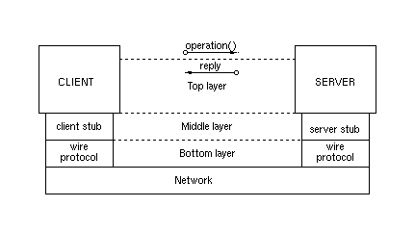
Interaction Between Server & Client
The interaction between a client process and an object server are implemented as OO RPC style communications.

Slide 356
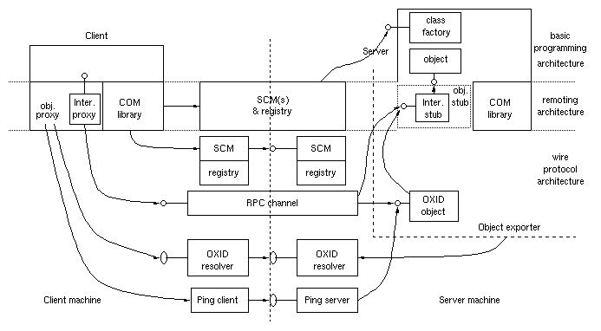
DCOM ARCHITECTURE

Slide 357
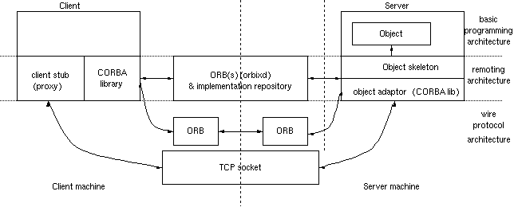
CORBA ARCHITECTURE

Slide 358
Different Layers
The top layer is the “basic programming architecture”, which is visible to the developers of the client and object server programs.
The middle layer is the “remoting architecture”, which transparently makes the interface pointers or objects references meaningful across different processes.
The bottom layer is the “wire protocol architecture”, which further extends the remoting architecture to work across different machines.

Slide 359
Sample Application
There are two groups of methods.
First group has
get() – to get the value at a point
set() – to set the value at a point
Second group has
reset() – sets values at each point to the supplied value

Slide 360
DCOM IDL
// definition of IGrid1
[ object, uuid(3CFDB283-CCC5-11D0-BA0B-00A0C90DF8BC),
helpstring("IGrid1 Interface"), pointer_default(unique)
]
interface IGrid1 : IUnknown {
import "unknwn.idl";
HRESULT get([in] SHORT n, [in] SHORT m, [out] LONG *value);
HRESULT set([in] SHORT n, [in] SHORT m, [in] LONG value);
};
// definition of IGrid2
[ object, uuid(3CFDB284-CCC5-11D0-BA0B-00A0C90DF8BC),
helpstring("IGrid2 Interface"), pointer_default(unique)
]
interface IGrid2 : IUnknown {
import "unknwn.idl";
HRESULT reset([in] LONG value);
};
//uuid and definition of type library
[ uuid(3CFDB281-CCC5-11D0-BA0B-00A0C90DF8BC),
version(1.0), helpstring("grid 1.0 Type Library)
]
library GRIDLib
{
importlib("stdole32.tlb");
// definition of the component
[ uuid(3CFDB287-CCC5-11D0-BA0B-00A0C90DF8BC),
helpstring("Grid Class")
]
coclass CGri
{ [default] interface IGrid1;
interface IGrid2;
};
};
CORBA IDL
interface grid1
{
long get(in short n, in short m);
void set(in short n, in short m, in long value);
};
interface grid2
{
void reset(in long value);
};
interface grid: grid1, grid2

Slide 361
Server Class Definition
Cgrid.h
#include "grid.h" // IDL-generated interface header file
class CClassFactory : public IClassFactory {
public: // IUnknown
STDMETHODIMP QueryInterface(REFIID riid, void** ppv);
STDMETHODIMP_(ULONG) AddRef(void) { return 1; };
STDMETHODIMP_(ULONG) Release(void) { return 1; }
// IClassFactory
STDMETHODIMP CreateInstance(LPUNKNOWN punkOuter,
REFIID iid, void **ppv);
STDMETHODIMP LockServer(BOOL fLock)
{ return E_FAIL; };
};
class CGrid : public IGrid1, public IGrid2 {
public: // IUnknown
STDMETHODIMP QueryInterface(REFIID riid, void** ppv);
STDMETHODIMP_(ULONG) AddRef(void)
{ return InterlockedIncrement(&m_cRef); }
STDMETHODIMP_(ULONG) Release(void)
{ if (InterlockedDecrement(&m_cRef) == 0)
{ delete this; return 0; }
return 1; }
// IGrid1
STDMETHODIMP get(IN SHORT n, IN SHORT m,
OUT LONG *value);
STDMETHODIMP set(IN SHORT n, IN SHORT m, IN LONG value);
// IGrid2
STDMETHODIMP reset(IN LONG value);
CGrid();
~CGrid();
private: LONG m_cRef, **m_a;
};
Grid_I.h
#include "grid.hh" // IDL-generated interface header file
class grid1_i : public grid1BOAImpl {
public:
grid1_i(CORBA::Short h, CORBA::Short w);
virtual ~grid1_i();
virtual void set(CORBA::Short n, CORBA::Short m,
CORBA::Long value, CORBA::Environment &env);
virtual CORBA::Long get(CORBA::Short n, CORBA::Short m,
CORBA::Environment &env);
protected:
CORBA::Long **m_a;
CORBA::Short m_height, m_width;
};
class grid2_i : public grid2BOAImpl {
public:
grid2_i() {};
~grid2_i() {};
virtual void reset(CORBA::Long value, CORBA::Environment &env)=0;
};
class grid_i : public grid1_i, grid2_i, gridBOAImpl {
public:
virtual void reset(CORBA::Long value,
CORBA::Environment &env);
grid_i(CORBA::Short h, CORBA::Short w) : grid1_i(h, w) {};
~grid_i() {};
};

Slide 362
Server Main Program
void main()
{
// Event used to signal this main thread
hevtDone = CreateEvent(NULL, FALSE, FALSE, NULL);
hr = CoInitializeEx(NULL, COINIT_MULTITHREADED);
CClassFactory* pcf = new CClassFactory;
hr = CoRegisterClassObject(CLSID_CGrid, pcf,
CLSCTX_SERVER, REGCLS_MULTIPLEUSE , &dwRegister);
// Wait until the event is set by CGrid::~CGrid()
WaitForSingleObject(hevtDone, INFINITE);
CloseHandle(hevtDone);
CoUninitialize();
}
int main()
{
// create a grid object using the implementation class grid_i
grid_i ourGrid(100,100);
try {
// tell Orbix that we have completed the server's initialization:
CORBA::Orbix.impl_is_ready("grid");
} catch (...) {
}

Slide 363
Client Main Program
#include "grid.h"
void main(int argc, char**argv)
{
IGrid1 *pIGrid1;
IGrid2 *pIGrid2;
LONG value;
CoInitialize(NULL); // initialize COM
CoCreateInstance(CLSID_CGrid, NULL, CLSCTX_SERVER, IID_IGrid1, (void**) &pIGrid1);
pIGrid1->get(0, 0, &value);
pIGrid1->QueryInterface(IID_IGrid2, (void**) pIGrid2);
pIGrid1->Release();
pIGrid2->reset(value+1);
pIGrid2->Release();
CoUninitialize();
}
#include "grid.hh"
void main (int argc, char **argv)
{
grid_var gridVar;
CORBA::Long value;
// bind to "grid" object; returns object reference
gridVar = grid::_bind(":grid");
value = gridVar->get(0, 0);
gridVar->reset(value+1);
}

Slide 364
Top Layer
Describes how a client requests an object and invokes its methods, and how a server creates an object instance and makes it available.
Main differences
  Specification of interface by a client, COM’s class factories and the Iunknown methods
  Performance of Exceptional Handling

Slide 365
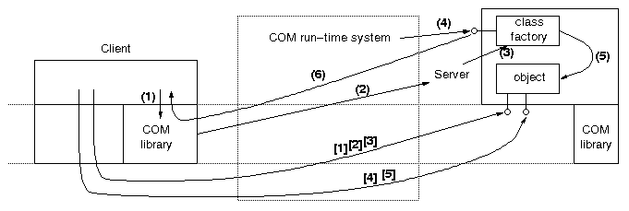
TOP LAYER
PROGRAMMER’S VIEW OF DCOM

Slide 366
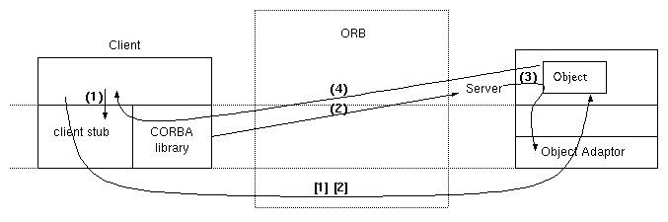
TOP LAYER
PROGRAMMER’S VIEW OF CORBA

Slide 367
Middle Layer
Consists of infrastructure necessary for providing the client and the server with the illustion that they are in the same address space.
Main differences include
  how server objects are registered.
  when the proxy/stub/skeleton instances are created.

Slide 368
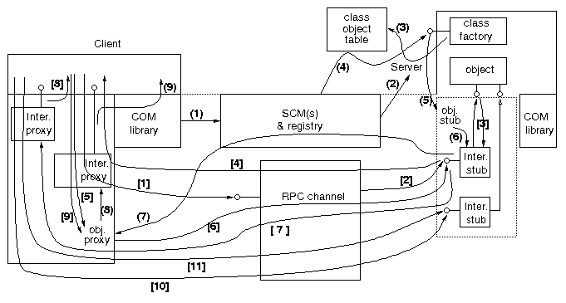
MIDDLE LAYER
PROGRAMMER’S VIEW OF DCOM

Slide 369
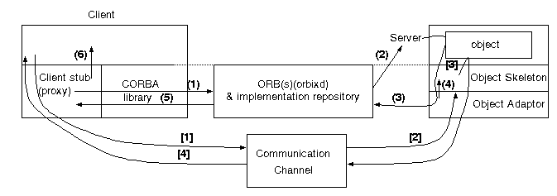
MIDDLE LAYER
PROGRAMMER’S VIEW OF CORBA

Slide 370
Bottom Layer
Specifies the wire protocol for supporting the client and the server running on different machines.
Main differences
  how remote interface pointers or object references are represented to convey server endpoint representation to client
  standard format in which the data is marshaled for transmission in heterogeneous environment

Slide 371
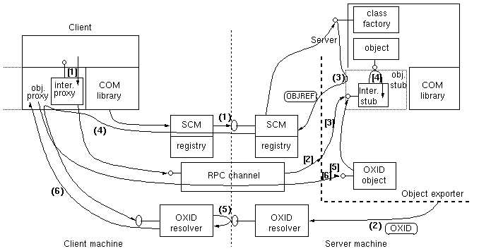
BOTTOM LAYER
PROGRAMMER’S VIEW OF DCOM

Slide 372
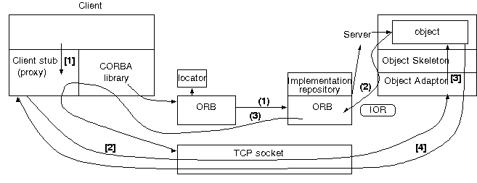
BOTTOM LAYER
PROGRAMMER’S VIEW OF CORBA

Slide 373
Summary
The three-layer step-by-step descriptions have shown that the architectures of DCOM and CORBA are basically similar.
They both provide the distributed objects infrastructure for transparent activation and accessing of remote objects.
  First,DCOM supports objects with multiple interfaces and provides a standard QueryInterface() method to navigate among the interfaces. This also introduces the notion of an object proxy/stub dynamically loading multiple interface proxies/stubs in the remoting layer. Such concepts do not exist in CORBA.
  Second, every CORBA interface inherits from CORBA::Object, the constructor of which implicitly performs such common tasks as object registration, object reference generation, skeleton instantiation, etc. In DCOM, such tasks are either explicitly performed by the server programs or handled dynamically by DCOM run-time system.

Slide 374
Summary Cont’d
  Third, DCOM's wire protocol is strongly tied to RPC, but CORBA's is not. Finally, we would like to point out that DCOM specification contains many details that are considered as implementation issues and not specified by CORBA.

Slide 375
References
http://www.omg.org/corba/beginners.html
http://www.microsoft.com/ntserver/guide/dcom/asp
http://www.bell-labs.com/~emerald/dcom_corba/Paper.html

