Slide 1
Middleboxes
Xin Jin
Fall 2019 (TTh 1:30-2:45 in Hodson 316)
EN.601.714 Advanced Computer Networks
https://github.com/xinjin/course-adv-net

Slide 2
Course Project
Project presentation (Dec. 3 and 5): Sign up for project presentation (only two weeks away)
Project demo (Dec. 6): Schedule a demo with TA
Project report (Dec. 9): Submit 6-page report

Slide 3
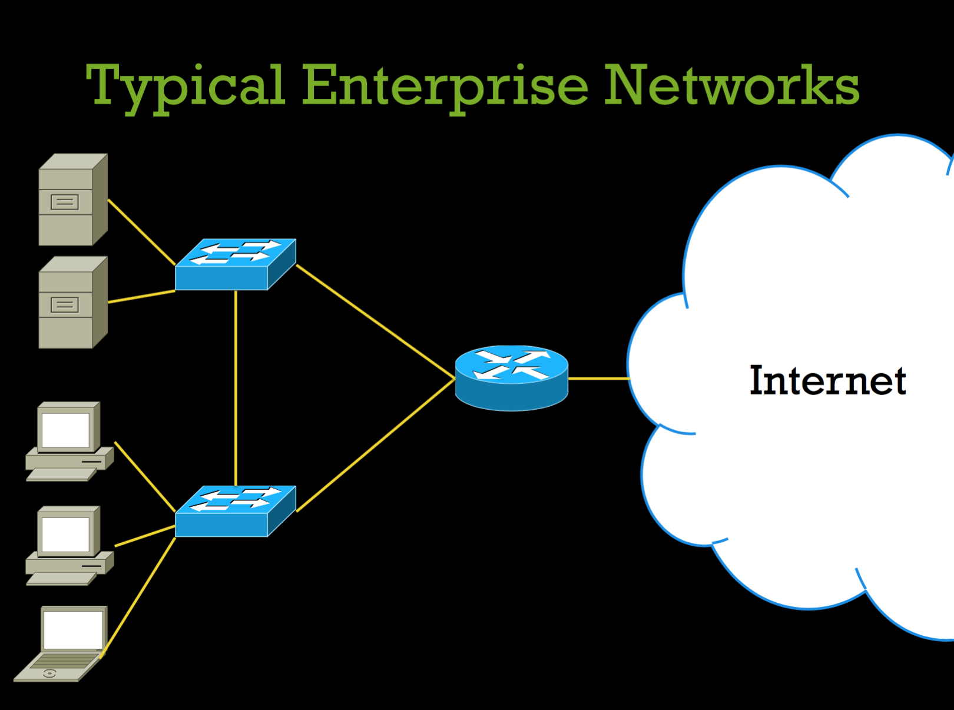
Notes:
Slides from ”making middleboxes someone else’s problem” in SIGCOMM’12

Slide 4
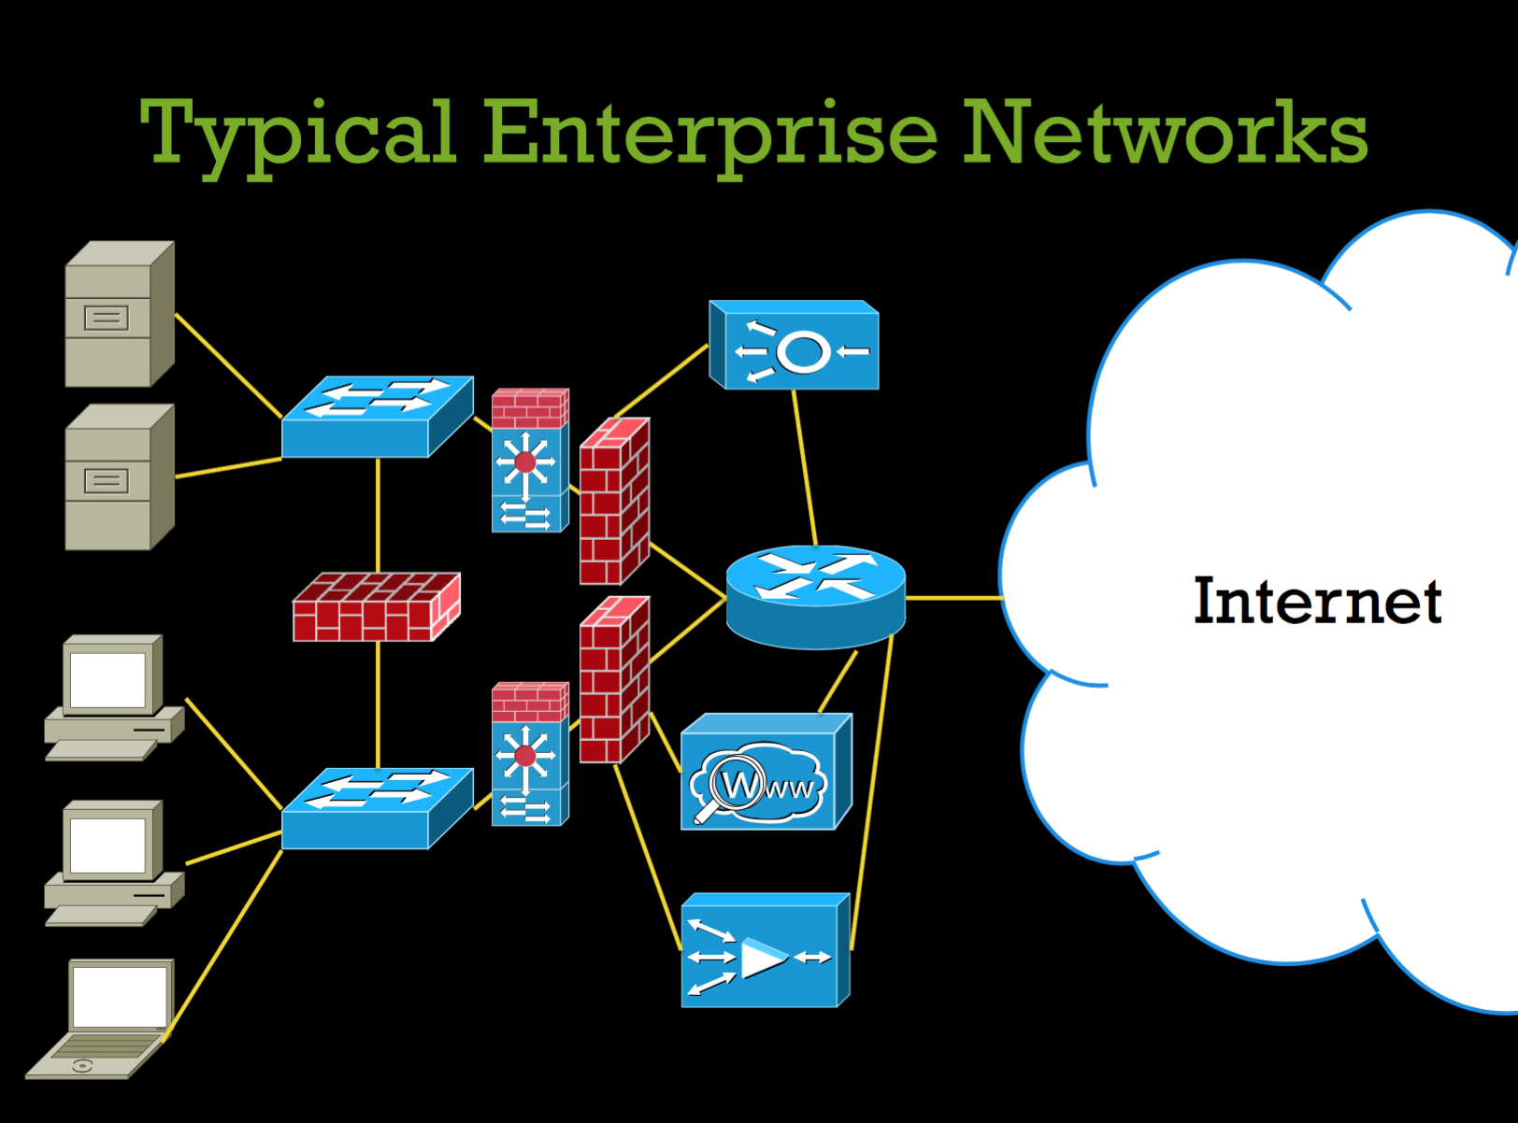

Slide 5
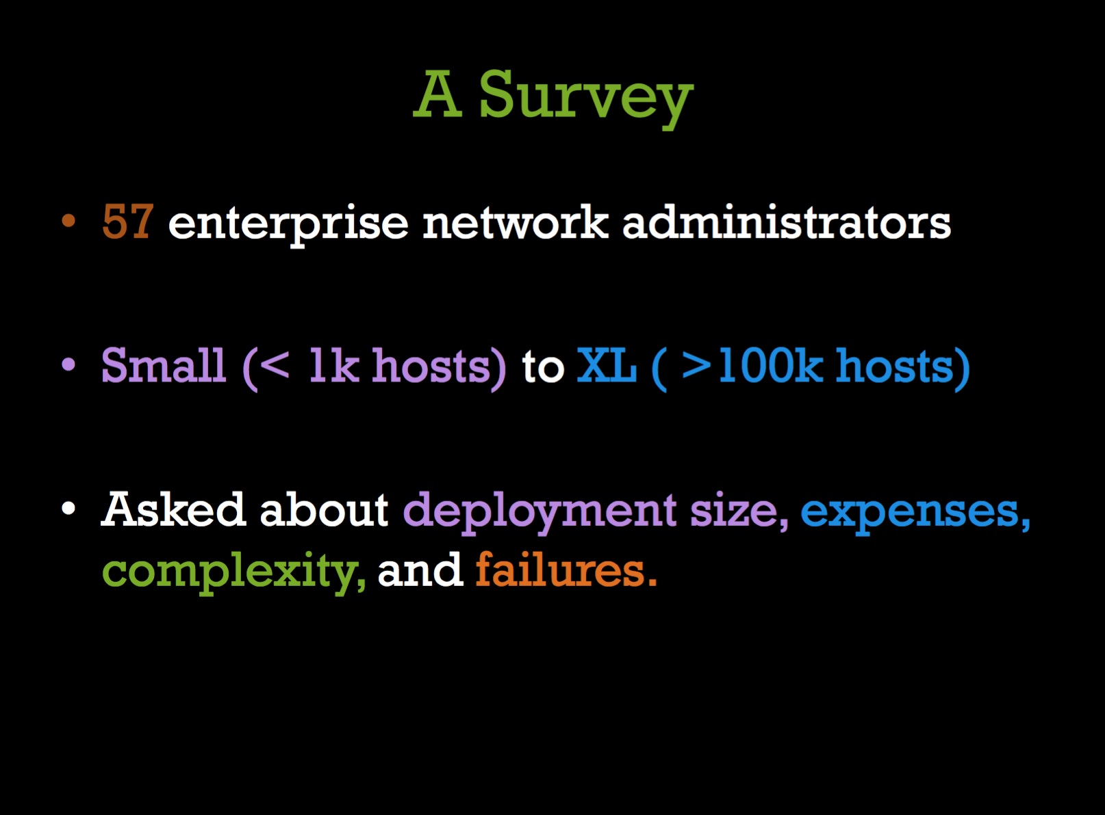

Slide 6
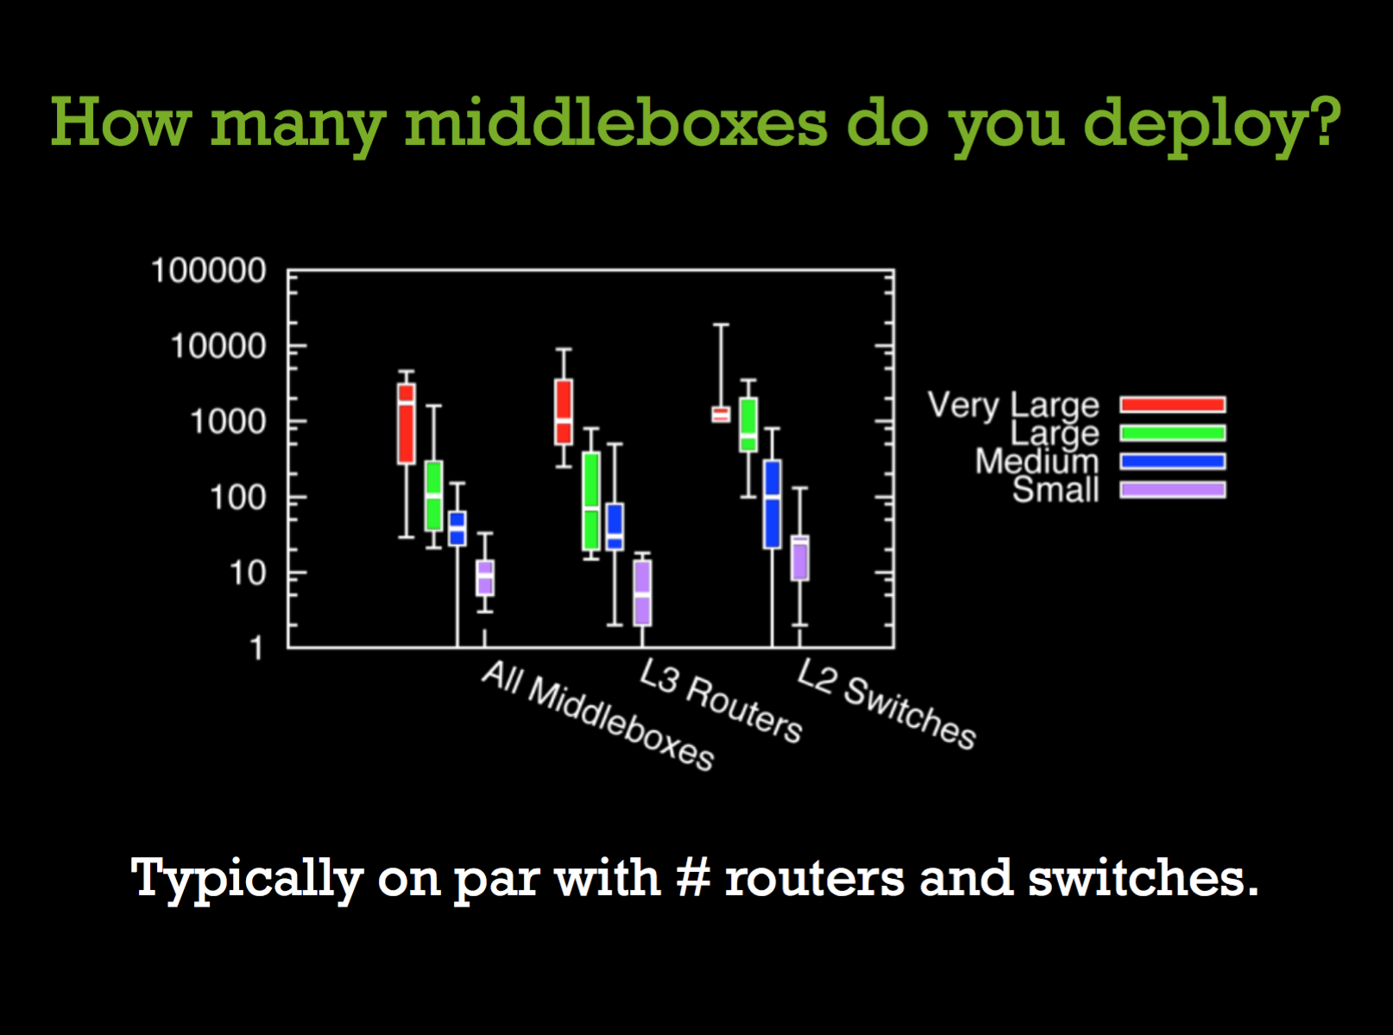

Slide 7
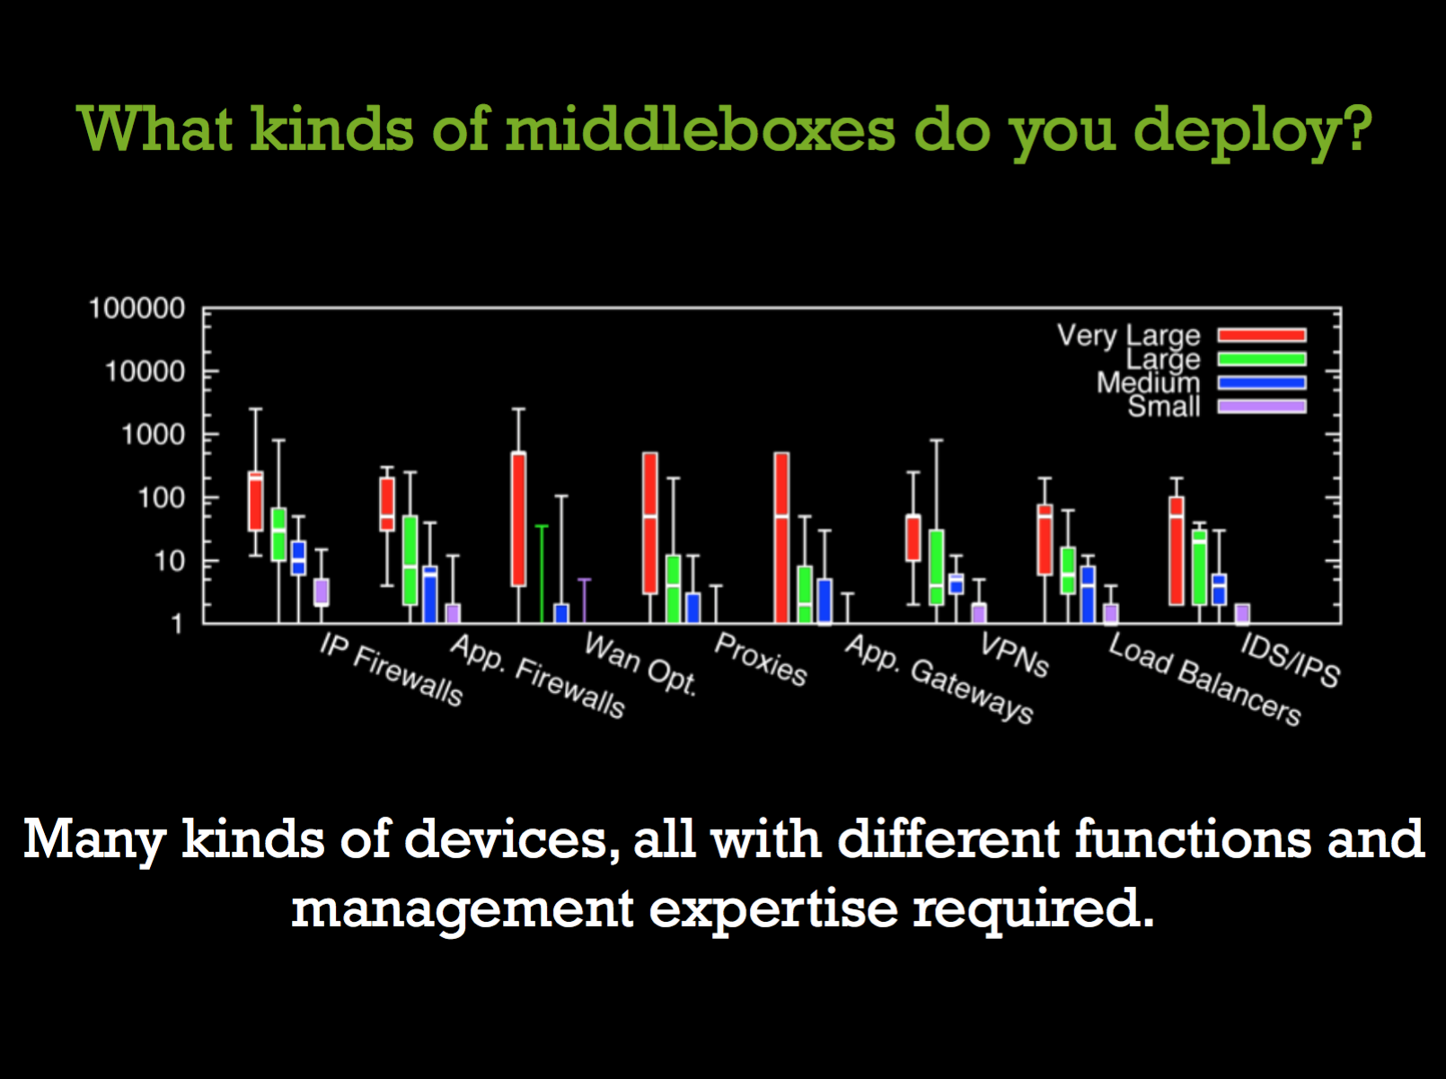

Slide 8
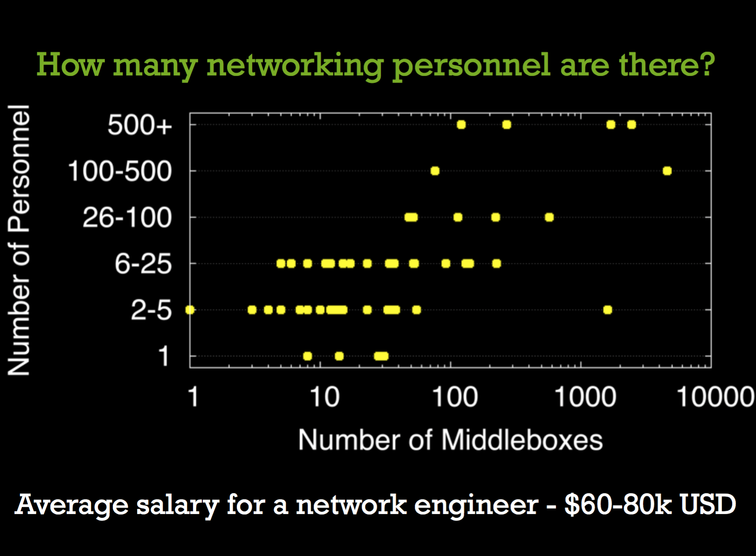

Slide 9
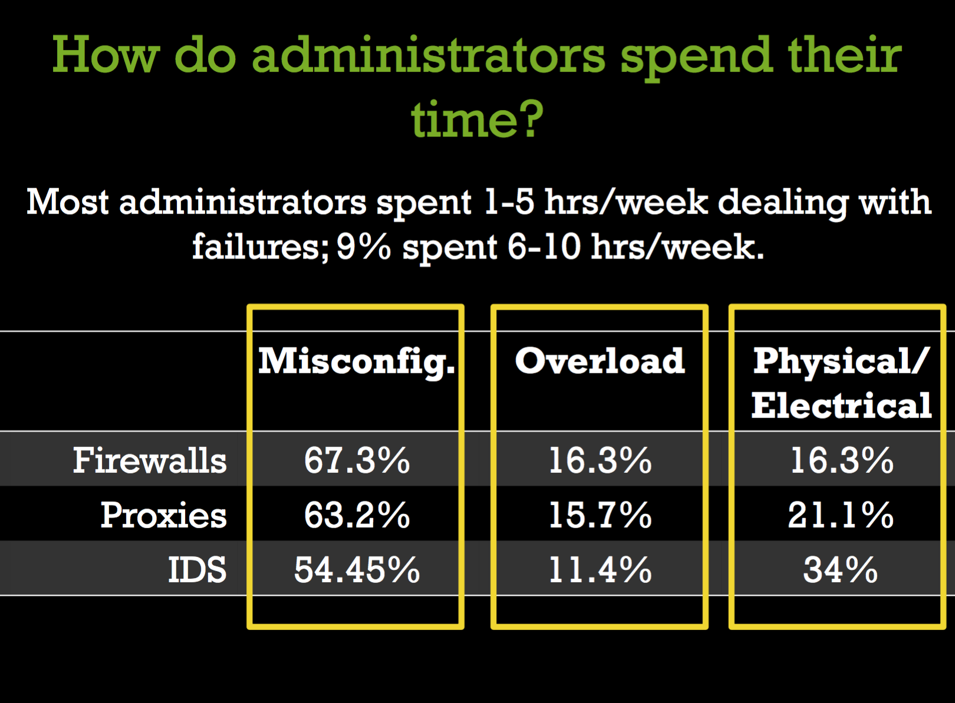

Slide 10
Summary
High capital and operating expense
Time consuming and error-prone
Physical and overload failures

Slide 11
Now the papers…
E2, SOSP’15
NFV control plane
NetBricks, OSDI’16
NFV data plane

Slide 12
Discussion
How to compare the two papers, i.e., their pros and cons?
How are middleboxes different from switches?

Slide 13
Load Balancing
Network load balancing
Choose a path between multiple paths
Balance the traffic on network links
Server load balancing
Choose a destination between multiple destinations
Balance the traffic on destinations

Slide 14
Now the papers…
Ananta, SIGCOMM’13
Software load balancer
SilkRoad, SIGCOMM’17
Hardware load balancer

Slide 15
Discussion
How to compare the two papers, i.e., their pros and cons?
How can we design better load balancers?

Slide 16
Thanks! Q&A

