Slide 1
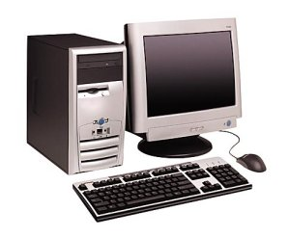
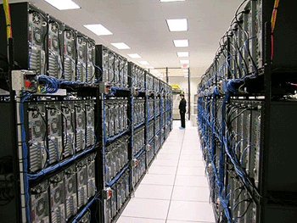


The Host
Xin Jin
Fall 2017 (TTh 1:30-2:45 in Malone 228）
EN.601.714 Advanced Computer Networks
https://github.com/xinjin/course-adv-net
Notes:
Slides adapted from Princeton COS 561 Advanced Computer Networks

Slide 2
Host-Network Division of Labor
Network
Best-effort packet delivery
Between two (or more) end-point addresses
Hosts
Everything else
host
host
network

Slide 3
The Role of the End Host
Network discovery and bootstrapping
How does the host join the network?
How does the host get an address?
Interface to networked applications
What interface to higher-level applications?
How does the host realize that abstraction?
Distributed resource sharing
What roles does the host play in network resource allocation decisions?

Slide 4
Network Discovery and Bootstrapping

Slide 5
Relationship Between Layers
name
link
session
address
path

Slide 6
Three Kinds of Identifiers
 | Host Name | IP Address | MAC Address
Example | www.cs.jhu.edu | 128.112.7.156 | 00-15-C5-49-04-A9
Size | Hierarchical, human readable, variable length | Hierarchical, machine readable, 32 bits (in IPv4) | Flat, machine readable, 48 bits
Read by | Humans, hosts | IP routers | Switches in LAN
Allocation, top-level | Domain, assigned by registrar (e.g., for .edu) | Variable-length prefixes, assigned by ICANN, RIR, or ISP | Fixed-sized blocks, assigned by IEEE to vendors (e.g., Dell)
Allocation, low-level | Host name, local administrator | Interface, by DHCP or an administrator | Interface, by vendor

Slide 7
Learning a Host’s Address
me
you
adapter
adapter
Who am I?
Hard-wired: MAC address
Static configuration: IP interface configuration
Dynamically learned: IP address configured by DHCP
Who are you?
Hard-wired: IP address in a URL, or in the code
Dynamically looked up: ARP or DNS

Slide 8
Mapping Between Identifiers
Dynamic Host Configuration Protocol (DHCP)
Given a MAC address, assign a unique IP address
… and tell host other stuff about the Local Area Network
To automate the boot-strapping process
Address Resolution Protocol (ARP)
Given an IP address, provide the MAC address
To enable communication within the Local Area Network
Domain Name System (DNS)
Given a host name, provide the IP address
Given an IP address, provide the host name

Slide 9
Dynamic Host Configuration Protocol
DHCP discover
(broadcast)
arriving client
DHCP offer
DHCP server
Host learns IP address,
Subnet mask, Gateway address, DNS server(s), and a lease time.
DHCP request
(broadcast)
DHCP ACK

Slide 10
Address Resolution Protocol (ARP)
Every host maintains an ARP table
(IP address, MAC address) pair
Consult the table when sending a packet
Map destination IP address to destination MAC address
Encapsulate and transmit the data packet
But, what if the IP address is not in the table?
Sender broadcasts: “Who has IP address 1.2.3.156?”
Receiver responds: “MAC address 58-23-D7-FA-20-B0”
Sender caches the result in its ARP table

Slide 11
Domain Name System
root DNS server
Host at cis.poly.edu wants IP address for gaia.cs.umass.edu
2
3
TLD DNS server
4
local DNS server
dns.poly.edu
5
7
6
1
8
authoritative DNS server
dns.cs.umass.edu
requesting host
cis.poly.edu
Recursive query: #1
Iterative queries: #2, 4, 6
gaia.cs.umass.edu

Slide 12
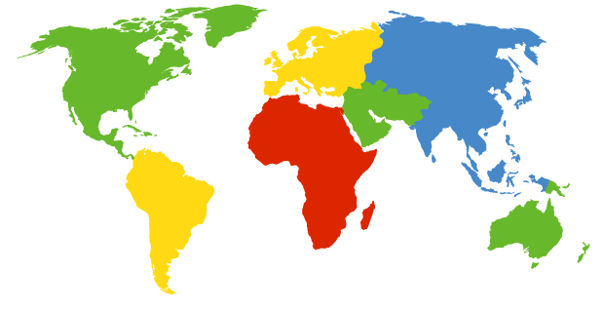
DNS Root Servers
13 root servers (see http://www.root-servers.org/)
Labeled A through M
A Verisign, Dulles, VA
C Cogent, Herndon, VA (also Los Angeles)
D U Maryland College Park, MD
G US DoD Vienna, VA
H ARL Aberdeen, MD
J Verisign, ( 11 locations)
K RIPE London (also Amsterdam, Frankfurt)
I Autonomica, Stockholm (plus 3 other locations)
E NASA Mt View, CA
F Internet Software C. Palo Alto, CA (and 17 other locations)
m WIDE Tokyo
B USC-ISI Marina del Rey, CA
L ICANN Los Angeles, CA

Slide 13
TLD and Authoritative DNS Servers
Top-level domain (TLD) servers
Generic domains (e.g., com, org, edu)
Country domains (e.g., uk, fr, ca, jp)
Managed professionally (e.g., Educause for “edu”)
Authoritative DNS servers
Provide public records for hosts at an organization
For the organization’s servers (e.g., Web and mail)
Can be maintained locally or by a service provider

Slide 14
Questions
Should addresses correspond to the interface (point of attachment) or to the host?
Why do we have all three identifiers? Do we need all three?
What should be done to prevent spoofing of addresses?

Slide 15
Interface to Applications

Slide 16
Socket Abstraction
Best-effort packet delivery is a clumsy abstraction
Applications typically want higher-level abstractions
Messages, uncorrupted data, reliable in-order delivery
Applications communicate using “sockets”
Stream socket: reliable stream of bytes (like a file)
Message socket: unreliable message delivery
User process
User process
socket
socket
Operating
System
Operating
System

Slide 17
Two Basic Transport Features
Demultiplexing: port numbers
Error detection: checksums
Server host 128.2.194.242
Service request for
128.2.194.242:80
(i.e., the Web server)
Client host
Web server
(port 80)
Client
OS
Echo server
(port 7)
IP
payload
detect corruption

Slide 18
Two Main Transport Layers
User Datagram Protocol (UDP)
Just provides demultiplexing and error detection
Header fields: port numbers, checksum, and length
Low overhead, good for query/response and multimedia
Transmission Control Protocol (TCP)
Adds support for a “stream of bytes” abstraction
Retransmitting lost or corrupted data
Putting out-of-order data back in order
Preventing overflow of the receiver buffer
Adapting the sending rate to alleviate congestion
Higher overhead, good for most stateful applications

Slide 19
Questions
Is a socket between two IP addresses the right abstraction?
Mobile hosts?
Replicated services?
What does the network know about the traffic?
Inferring the application from the port numbers?
Is end-to-end error detection and correction the right model?
High loss environments?
Expense of retransmitting over the entire path?

Slide 20
Distributed Resource Sharing

Slide 21
Resource Allocation Challenges
Best-effort network easily becomes overloaded
No mechanism to “block” excess calls
Instead excess packets are simply dropped
Examples
Shared Ethernet medium: frame collisions
Ethernet switches and IP routers: full packet buffers
Quickly leads to congestion collapse
“congestion
collapse”
Increase in load that results in a decrease in useful work done.
Goodput
Load

Slide 22
End Hosts Adjusting to Congestion
End hosts adapt their sending rates
In response to network conditions
Learning that the network is congested
Shared Ethernet: carrier sense multiple access
Seeing your own frame collide with others
IP network: observing your end-to-end performance
Packet delay or loss over the end-to-end path
Adapting to congestion
Slowing down the sending rate, for the greater good
But, host doesn’t know how bad things might be…

Slide 23
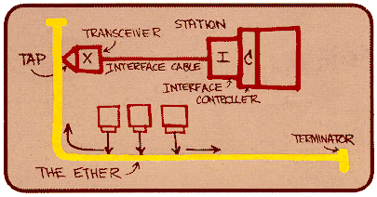
Ethernet Back-off Mechanism
Carrier sense: wait for link to be idle
If idle, start sending; if not, wait until idle
Collision detection: listen while transmitting
If collision: abort transmission, and send jam signal
Exponential back-off: wait before retransmitting
Wait random time, exponentially larger on each retry

Slide 24
Transmission Control Protocol (TCP)
Stream-of-bytes service
Sends and receives a stream of bytes
Reliable, in-order delivery
Corruption: checksums
Detect loss/reordering: sequence numbers
Reliable delivery: acknowledgments and retransmissions
Connection oriented
Explicit set-up and tear-down of TCP connection
Flow control
Prevent overflow of the receiver’s buffer space
Congestion control
Adapt to network congestion for the greater good

Slide 25
Breaking a Stream of Bytes into TCP Segments

Slide 26
TCP “Stream of Bytes” Service
Host A
Byte 0
Byte 1
Byte 2
Byte 3
Byte 80
Host B
Byte 0
Byte 1
Byte 2
Byte 3
Byte 80

Slide 27
…Emulated Using TCP “Segments”
Host A
Byte 0
Byte 1
Byte 2
Byte 3
Byte 80
Segment sent when:
Segment full (Max Segment Size),
Not full, but times out, or
“Pushed” by application.
TCP Data
TCP Data
Host B
Byte 0
Byte 1
Byte 2
Byte 3
Byte 80

Slide 28
TCP Segment
IP Data
TCP Data (segment)
TCP Hdr
IP Hdr
IP packet
No bigger than Maximum Transmission Unit (MTU)
E.g., up to 1500 bytes on an Ethernet link
TCP packet
IP packet with a TCP header and data inside
TCP header is typically 20 bytes long
TCP segment
No more than Maximum Segment Size (MSS) bytes
E.g., up to 1460 consecutive bytes from the stream

Slide 29
Sequence Number
Host A
ISN (initial sequence number)
Byte 81
Sequence number = 1st byte
TCP Data
TCP Data
Host B

Slide 30
Reliable Delivery on a Lossy Channel With Bit Errors

Slide 31
Challenges of Reliable Data Transfer
Over a perfectly reliable channel
Easy: sender sends, and receiver receives
Over a channel with bit errors
Receiver detects errors and requests retransmission
Over a lossy channel with bit errors
Some data are missing, and others corrupted
Receiver cannot always detect loss
Over a channel that may reorder packets
Receiver cannot distinguish loss from out-of-order

Slide 32
TCP Support for Reliable Delivery
Detect bit errors: checksum
Used to detect corrupted data at the receiver
…leading the receiver to drop the packet
Detect missing data: sequence number
Used to detect a gap in the stream of bytes
... and for putting the data back in order
Recover from lost data: retransmission
Sender retransmits lost or corrupted data
Two main ways to detect lost packets

Slide 33
TCP Acknowledgments
Host A
ISN (initial sequence number)
Sequence number = 1st byte
TCP Data
ACK sequence number = next expected byte
TCP Data
Host B

Slide 34
Automatic Repeat reQuest (ARQ)
ACK and timeouts
Receiver sends ACK when it receives packet
Sender waits for ACK and times out
Simplest ARQ protocol
Stop and wait
Send a packet, stop and wait until ACK arrives
Sender
Receiver
Packet
Timeout
ACK
Time

Slide 35
Flow Control: TCP Sliding Window

Slide 36
Motivation for Sliding Window
Stop-and-wait is inefficient
Only one TCP segment is “in flight” at a time
Especially bad for high “delay-bandwidth product”
bandwidth
delay

Slide 37
Numerical Example
1.5 Mbps link with 45 msec round-trip time (RTT)
Delay-bandwidth product is 67.5 Kbits (or 8 KBytes)
Sender can send at most one packet per RTT
Assuming a segment size of 1 KB (8 Kbits)
8 Kbits/segment at 45 msec/segment ➔ 182 Kbps
That’s just one-eighth of the 1.5 Mbps link capacity

Slide 38
Sliding Window
Allow a larger amount of data “in flight”
Allow sender to get ahead of the receiver
… though not too far ahead
Sending process
Receiving process
TCP
TCP
Last byte written
Last byte read
Next byte expected
Last byte ACKed
Last byte sent
Last byte received

Slide 39
Receiver Buffering
Receive window size
Amount that can be sent without acknowledgment
Receiver must be able to store this amount of data
Receiver tells the sender the window
Tells the sender the amount of free space left
Window Size
Data ACK’d
Outstanding
Un-ack’d data
Data OK
to send
Data not OK
to send yet

Slide 40
Optimizing Retransmissions

Slide 41
Reasons for Retransmission
Packet
Packet
Packet
Timeout
Timeout
ACK
Timeout
ACK
Packet
Packet
Packet
ACK
Timeout
Timeout
Timeout
ACK
ACK
Packet lost
ACK lost
DUPLICATE PACKET
Early timeout
DUPLICATE PACKETS
Notes:
Application may get duplicates in the case of early timeouts

Slide 42
How Long Should Sender Wait?
Sender sets a timeout to wait for an ACK
Too short: wasted retransmissions
Too long: excessive delays when packet lost
TCP sets timeout as a function of the RTT
Expect ACK to arrive after an “round-trip time”
… plus a fudge factor to account for queuing
But, how does the sender know the RTT?
Running average of delay to receive an ACK

Slide 43
Example RTT Estimation

Slide 44
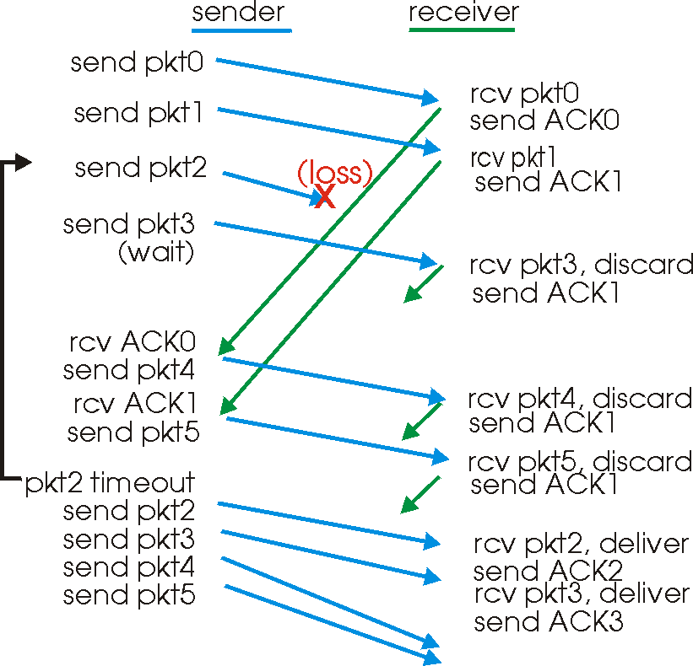
Still, Timeouts are Inefficient

Slide 45
Fast Retransmission
When packet n is lost…
… packets n+1, n+2, and so on may get through
Exploit the ACKs of these packets
ACK says receiver is still awaiting nth packet
Duplicate ACKs suggest later packets arrived
Sender uses “duplicate ACKs” as a hint
Fast retransmission
Retransmit after “triple duplicate ACK”

Slide 46
Effectiveness of Fast Retransmit
When does Fast Retransmit work best?
High likelihood of many packets in flight
Long data transfers, large window size, …
Implications for Web traffic
Most Web transfers are short (e.g., 10 packets)
So, often there aren’t many packets in flight
Making fast retransmit is less likely to “kick in”
Forcing users to click “reload” more often… ☺

Slide 47
TCP Congestion Control

Slide 48
TCP Congestion Control
Additive increase, multiplicative decrease
On packet loss, divide congestion window in half
On success for last window, increase window linearly
Window
Loss
halved
t
Other mechanisms: slow start, fast retransmit vs. timeout loss, etc.

Slide 49
Congestion in a Drop-Tail FIFO Queue
Access to the bandwidth: first-in first-out queue
Packets transmitted in the order they arrive
Access to the buffer space: drop-tail queuing
If the queue is full, drop the incoming packet
✗

Slide 50
How it Looks to the End Host
Delay: Packet experiences high delay
Loss: Packet gets dropped along path
How does TCP sender learn this?
Delay: Round-trip time estimate
Loss: Timeout and/or duplicate acknowledgments
✗

Slide 51
TCP Congestion Window
Each TCP sender maintains a congestion window
Max number of bytes to have in transit (not yet ACK’d)
Adapting the congestion window
Decrease upon losing a packet: backing off
Increase upon success: optimistically exploring
Always struggling to find right transfer rate
Tradeoff
Pro: avoids needing explicit network feedback
Con: continually under- and over-shoots “right” rate

Slide 52
Additive Increase, Multiplicative Decrease
How much to adapt?
Additive increase: On success of last window of data, increase window by 1 Max Segment Size (MSS)
Multiplicative decrease: On loss of packet, divide congestion window in half
Much quicker to slow than speed up!
Over-sized windows (causing loss) are much worse than under-sized windows (causing lower thruput)
AIMD: A necessary condition for stability of TCP

Slide 53
Leads to the TCP “Sawtooth”
Window
Loss
halved
t

Slide 54
Receiver Window vs. Congestion Window
Flow control
Keep a fast sender from overwhelming a slow receiver
Congestion control
Keep a set of senders from overloading the network
Different concepts, but similar mechanisms
TCP flow control: receiver window
TCP congestion control: congestion window
Sender TCP window =
min { congestion window, receiver window }

Slide 55
Questions
What role should the network play in resource allocation?
Explicit feedback to the end hosts?
Enforcing an explicit rate allocation?
What is a good definition of fairness?
What about hosts who cheat to hog resources?
How to detect cheating? How to prevent/punish?
What about wireless networks?
Difficulty of detecting collisions
Loss caused by interference, not just congestion

Slide 56
A Protocol for Packet Network Intercommunication
(IEEE Trans. on Communications, May 1974)
Vint Cerf and Bob Kahn
Written when Vint Cerf was an assistant professor at Stanford, and Bob Kahn was working at ARPA.

Slide 57
Life in the 1970s…
Multiple unconnected networks
ARPAnet, data-over-cable, packet satellite (Aloha), packet radio, …
Heterogeneous designs
Addressing, max packet size, handling of lost/corrupted data, fault detection, routing, …
ARPAnet
satellite net

Slide 58
Handling Heterogeneity
Where to handle heterogeneity?
Application process? End hosts? Packet switches?
Compatible process and host conventions
Obviate the need to support all combinations
Retain the unique features of each network
Avoid changing the local network components
Introduce the notion of a gateway

Slide 59
Internetwork Layer and Gateways
Internetwork Layer
Gateway
Internetwork appears as a single, uniform entity
Despite the heterogeneity of the local networks
Network of networks
“Embed internetwork packets in local packet format or extract them”
Route (at internetwork level) to next gateway
gateway
ARPAnet
satellite net

Slide 60
Internetwork Packet Format
internetwork header
local
header
source
address
dest.
address
seq.
#
byte
count
flag
field
text
checksum
Internetwork header in standard format
Interpreted by the gateways and end hosts
Source and destination addresses
Uniformly and uniquely identify every host
Ensure proper sequencing of the data
Include a sequence number and byte count
Enable detection of corrupted text
Checksum for an end-to-end check on the text

Slide 61
Process-Level Communication
Enable pairs of processes to communicate
Full duplex
Unbounded but finite-length messages
E.g., keystrokes or a file
Key ideas
Port numbers to (de)multiplex packets
Breaking messages into segments
Sequence numbers and reassembly
Retransmission and duplicate detection
Window-based flow control

Slide 62
Discussion
What did they get right?
Which ideas were key to the Internet’s success?
Which decisions still seem right today?
What did they miss?
Which ideas had to be added later?
Which decisions seem wrong in hindsight?
What would you do in a clean-slate design?
If your goal wasn’t to support communication between disparate packet-switched networks
Would you do anything differently?

Slide 63
End-to-End Arguments in System Design
(ACM Trans. on Computer Systems, November 1984)
J. Saltzer, D. Reed, and D. Clark

Slide 64
End-to-End Argument
Operations should occur only at the end points
… unless needed for performance optimization
2
4
3
1
5
Many things can go wrong: disk errors, software errors, hardware errors, communication errors, …

Slide 65
Trade-Offs
Put functionality at each hop
All applications pay the price
End systems still need to check for errors
Place functionality only at the ends
Slower error detection
End-to-end retransmission wastes bandwidth
Compromise solution?
Reliable end-to-end transport protocol (TCP)
Plus file checksums to detect file-system errors

Slide 66
Discussion
When should the network support a function anyway?
E.g., link-layer retransmission in wireless networks?
Who’s interests are served by the e2e argument?
How does a network operator influence the network without violating the e2e argument?
Does the design of IP and TCP make it hard to violate the e2e argument?
E.g., middlebox functionality like NATs, firewalls, proxies
Should the e2e argument apply to routing?

Slide 67
Thanks! Q&A

