Slide 1
Control Plane
Xin Jin
Fall 2017 (TTh 1:30-2:45 in Malone 228）
EN.601.714 Advanced Computer Networks
https://github.com/xinjin/course-adv-net
Notes:
Slides adapted from Princeton COS 561 Advanced Computer Networks

Slide 2
Data, Control, and Management Planes
 | Data | Control | Management
Time-scale | Packet (ns) | Event (10 ms to sec) | Human (min to hours)
Tasks | Forwarding, buffering, filtering, scheduling | Routing, signaling | Analysis, configuration
Location | Line-card hardware | Router software | Humans or scripts

Slide 3
Routing vs. Forwarding
Routing: control plane
Computing paths the packets will follow
Routers talking amongst themselves
Individual router creating a forwarding table
Forwarding: data plane
Directing a data packet to an outgoing link
Individual router using a forwarding table

Slide 4
Data and Control Planes
Processor
control plane
data plane
Switching
Fabric
Line card
Line card
Line card
Line card
Line card
Line card

Slide 5
Routing Protocols
What does the protocol compute?
Spanning tree, shortest path, local policy, arbitrary end-to-end paths
What algorithm does the protocol run?
Spanning-tree construction, distance vector, link-state routing, path-vector routing, source routing, end-to-end signaling
How do routers learn end-host locations?
Learning/flooding, injecting into the routing protocol, dissemination using a different protocol, and directory server

Slide 6
What Does the Protocol Compute?

Slide 7
Different Ways to Represent Paths
Static model
What is computed, i.e., what is the outcome
Not how the (distributed) computation is performed
Trade-offs
State required to represent the paths
Efficiency of the resulting paths
Ability to support multiple paths
Complexity of computing the paths
Which nodes are in charge
Applied in different settings
LAN, intradomain, interdomain

Slide 8
Spanning Tree
One tree that reaches every node
Single path between each pair of nodes
No loops, so can support broadcast easily
Disadvantages
Paths are sometimes long
Some links are not used at all

Slide 9
Shortest Paths
Shortest path(s) between each pair of nodes
Separate shortest-path tree rooted at each node
Minimum hop count or minimum sum of edge weights
Disadvantages
All nodes need to agree on the link metrics
Multipath routing is limited to Equal Cost MultiPath

Slide 10
Local Policy at Each Hop
Locally best path
Local policy: each node picks the path it likes best
… among the paths chosen by its neighbors
Disadvantages
More complicated to configure and model
2 1 d
2 d
2 1 d
2 d
3 2 d
3 4 d
2
3 2 d
3 4 d
2
1 d
1 2 d
1 d
1 2 d
3
1
3
4 d
1
4 d
5 4 d
4
5 4 d
4
5
5
6 4 d
6 5 4 d
d
6 4 d
6 5 4 d
d
6
6

Slide 11
End-to-End Path Selection
End-to-end path selection
Each node picks its own end to end paths
… independent of what other paths other nodes use
Disadvantages
More state and complexity in the nodes
Hop-by-hop destination-based forwarding is not enough

Slide 12
How to Compute Paths?

Slide 13
Spanning Tree Algorithm
Elect a root
The switch with the smallest identifier
And form a tree from there
Algorithm
Repeatedly talk to neighbors
“I think node Y is the root”
“My distance from Y is d”
Update info based on neighbors
Smaller id as the root
Smaller distance d+1
Don’t use interfaces not in path
Used in Ethernet-based LANs
root
One hop
Three hops

Slide 14
Spanning Tree Example: Switch #4
Switch #4 thinks it is the root
Sends (4, 0, 4) message to 2 and 7
Switch #4 hears from #2
Receives (2, 0, 2) message from 2
… and thinks that #2 is the root
And realizes it is just one hop away
Switch #4 hears from #7
Receives (2, 1, 7) from 7
And realizes this is a longer path
So, prefers its own one-hop path
And removes 4-7 link from the tree
root
1
3
5
2
4
6
7

Slide 15
Shortest-Path Problem
Compute: path costs to all nodes
From a given source u to all other nodes
Cost of the path through each outgoing link
Next hop along the least-cost path to s
2
3
1
1
4
u
2
1
5
4
3
6
s

Slide 16
Link State: Dijkstra’s Algorithm
Flood the topology information to all nodes
Each node computes shortest paths to other nodes
Initialization
Loop
S = {u}
for all nodes v
if (v is adjacent to u)
D(v) = c(u,v)
else D(v) = ∞
add w with smallest D(w) to S
update D(v) for all adjacent v:
D(v) = min{D(v), D(w) + c(w,v)}
until all nodes are in S
Used in OSPF and IS-IS

Slide 17
Link-State Routing Example
2
2
3
1
3
1
1
1
4
4
2
1
2
1
5
5
4
3
4
3
2
2
3
1
3
1
1
1
4
4
2
1
2
1
5
5
4
3
4
3

Slide 18
Link-State Routing Example (cont.)
2
2
3
1
3
1
1
1
4
4
2
1
2
1
5
5
4
3
4
3
2
2
3
1
3
1
1
1
4
4
2
1
2
1
5
5
4
3
4
3

Slide 19
Link State: Shortest-Path Tree
Shortest-path tree from u
Forwarding table at u
v
2
y
link
3
1
1
x
4
v
(u,v)
u
z
2
1
w
(u,w)
5
t
x
(u,w)
w
4
3
y
(u,v)
s
z
(u,v)
s
(u,w)
t
(u,w)

Slide 20
Distance Vector: Bellman-Ford Algorithm
Define distances at each node x
d_{x}(y) = cost of least-cost path from x to y
Update distances based on neighbors
d_{x}(y) = min {c(x,v) + d_{v}(y)} over all neighbors v
v
2
y
3
1
1
x
4
u
z
2
1
5
t
d_{u}(z) = min{c(u,v) + d_{v}(z),
c(u,w) + d_{w}(z)}
w
4
3
s
Used in RIP and EIGRP

Slide 21
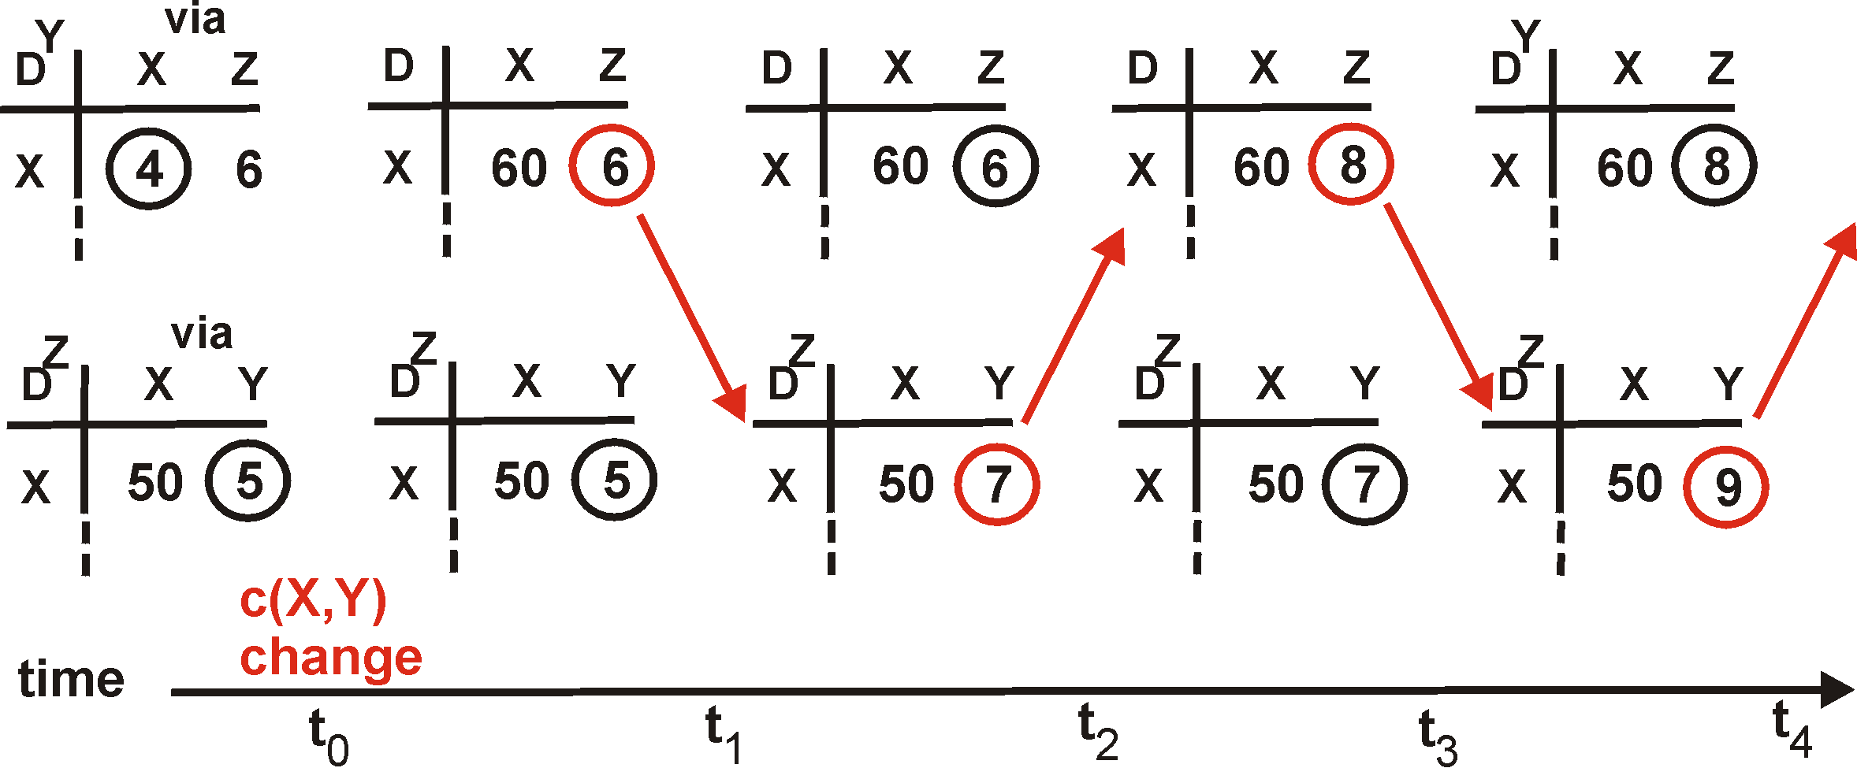
Distance Vector: Count to Infinity
Link cost changes:
Good news travels fast
Bad news travels slow: “count to infinity” problem!
60
Y
4
1
X
Z
50
algorithm
continues
on!

Slide 22

Path-Vector Routing
Extension of distance-vector routing
Support flexible routing policies
Avoid count-to-infinity problem
Key idea: advertise the entire path
Distance vector: send distance metric per dest d
Path vector: send the entire path for each dest d
“d: path (2,1)”
“d: path (1)”
3
2
1
data traffic
data traffic
d
Used in BGP

Slide 23
Path-Vector: Faster Loop Detection
Node can easily detect a loop
Look for its own node identifier in the path
E.g., node 1 sees itself in the path “3, 2, 1”
Node can simply discard paths with loops
E.g., node 1 simply discards the advertisement
“d: path (2,1)”
“d: path (1)”
3
2
1
“d: path (3,2,1)”

Slide 24
Path-Vector: Flexible Policies
Each node can apply local policies
Path selection: Which path to use?
Path export: Which paths to advertise?
Examples
Node 2 may prefer the path “2, 3, 1” over “2, 1”
Node 1 may not let node 3 hear the path “1, 2”
2
3
2
3
1
1

Slide 25
End-to-End Signaling
Establish end-to-end path in advance
Learn the topology (as in link-state routing)
End host or router computes and signals a path
Routers support virtual circuits
Signaling: install entry for each circuit at each hop
Forwarding: look up the circuit id in the table
1: 7
2: 7
link 7
1: 14
2: 8
1
link 14
2
link 8
Used in MPLS with RSVP

Slide 26
Source Routing
Similar to end-to-end signaling
But the data packet carries the hops in the path
… rather than the routers storing big tables
End-host control
Tell the end host the topology
Let the end host select the end-to-end path
Variations of source routing
Strict: specify every hop
Loose: specify intermediate points
Used in IP source routing (but almost always disabled)

Slide 27
Questions
Compare link-state routing, distance-vector routing, path-vector routing, end-to-end signaling, and source routing
Notes:
Link-state: disseminate topology information to all nodes, each node has the entire view and needs to run shortest path algorithms
Distance-vector: only know the distance to neighbors and neighbors’ path, do not have the global view
Only one entity computes and disseminate to all nodes?

Slide 28
Learning Where the Hosts Are

Slide 29
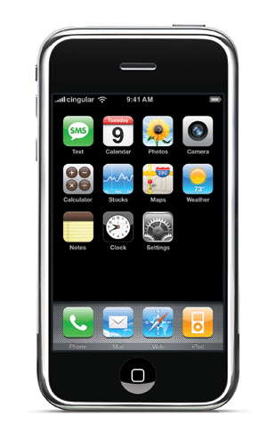

Finding the Hosts
Building a forwarding table
Computing paths between network elements
… and figuring out where the end-hosts are
… to map a destination address to an outgoing link
How to find the hosts?
Learning/flooding
Injecting into routing protocol
Dissemination via different protocol
Directory service

Slide 30

Learning and Flooding
When a frame arrives
Inspect the source address
Associate address with the incoming interface
When the frame has an unfamiliar destination
Forward out all interfaces
… except for the one where the frame arrived
B
B
A
C
A
C
Switch learns how to reach A.
When in doubt, shout!
D
D
Used in Ethernet LANs

Slide 31
Inject into Routing Protocol
Treat the end host (or subnet) as a node
And disseminate in the routing protocol
E.g., flood information about where addresses attach
2
3
1
1
4
u
2
1
5
4
3
6
s
Used in OSPF and
IS-IS, especially in enterprise networks
. . .

Slide 32
Disseminate With Another Protocol
Distribute using another protocol
One router learns the route
… and shares the information with other routers
disseminate route to other routers
learn a route to d
(e.g., via BGP)
Internal BGP (iBGP) used in backbone networks

Slide 33
Directory Service
Contact a service to learn the location
Lookup the end-host or subnet address
… and learn the label to put on the packet
… to get the traffic to the right egress point
directory
e
“Host d is at egress e”
d
Used in some data centers
i
s
Encapsulate packet to send to egress e.

Slide 34
Conclusion
Routing is challenging
Distributed computation
Challenges with scalability and dynamics
Many different solutions for different environments
Ethernet LAN: spanning tree, MAC learning, flooding
Enterprise: link-state routing, injecting subnet addresses
Backbone: link-state routing inside, path-vector routing with neighboring domains, and iBGP dissemination
Data centers: many different solutions, still in flux
E.g., link-state routing or multiple spanning trees
E.g., directory service or injection of subnets into routing protocol

Slide 35
Design Philosophy of the DARPA Internet Protocols (ACM SIGCOMM, 1988)
David Clark

Slide 36
Design Goals
Primary goal
Effective technique for multiplexed utilization of existing interconnected networks (e.g., ARPAnet, packet radio)
Important goals
Survivability in the face of failure
Multiple types of communication service
Wide variety of network technologies
Less important goals
Distributed management of resources
Cost effectiveness
Host attachment with low level of effort
Accountability of resources

Slide 37
Consequences of the Goals
Effective multiplexed utilization of existing networks
Packet switching, not circuit switching
Continued communication despite network failures
Routers don’t store state about ongoing transfers
End hosts provide key communication services
Support for multiple types of communication service
Multiple transport protocols (e.g., TCP and UDP)
Accommodation of a variety of different networks
Simple, best-effort packet delivery service
Packets may be lost, corrupted, or delivered out of order
Distributed management of network resources
Multiple institutions managing the network
Intradomain and interdomain routing protocols

Slide 38
Questions
What if we started with different goals?
Network management
Less concern about backwards compatibility
More concern about security
Can we address new challenges
Management, security, privacy, sensor nets, …
Without sacrificing the other goals?
Without a major change to the architecture?

Slide 39
End-to-End Routing Behavior in the Internet (ACM SIGCOMM, 1996; ToN, 1997)
Vern Paxson

Slide 40
Measurement With Traceroute
Traceroute tool to measure the forwarding path
Send packets with TTL=1, 2, 3…
Record the source of the “time exceeded” message
Useful, but introduces many challenges
Path changes
Non-participating nodes
Inaccurate, two-way measurements
Time
exceeded
TTL=1
source
destination
TTL=2

Slide 41
Questions
Why can’t we measure the Internet more directly?
What can we do about it?
Right division of labor between host and network?
For path selection
For network monitoring
How do we fix these routing problems, e.g., forwarding loops, path fluttering, and route asymmetry?
In a decentralized, federated network
How to incentivize better network management

Slide 42
Backup Slides on Paxson Paper

Slide 43
Paxson Study: Forwarding Loops
Forwarding loop
Packet returns to same router multiple times
May cause traceroute to show a loop
If loop lasted long enough
So many packets traverse the loopy path
Traceroute may reveal false loops
Path change that leads to a longer path
Causing later probe packets to hit same nodes
Heuristic solution
Require traceroute to return same path 3 times

Slide 44
Paxson Study: Causes of Loops
Transient vs. persistent
Transient: routing-protocol convergence
Persistent: likely configuration problem
Challenges
Appropriate time boundary between the two?
What about flaky equipment going up and down?
Determining the cause of persistent loops?
Anecdote on recent study of persistent loops
Provider has static route for customer prefix
Customer has default route to the provider

Slide 45
Paxson Study: Path Fluttering
Rapid changes between paths
Multiple paths between a pair of hosts
Load balancing policies inside the network
Packet-based load balancing
Round-robin or random
Multiple paths for packets in a single flow
Flow-based load balancing
Hash of some fields in the packet header
E.g., IP addresses, port numbers, etc.
To keep packets in a flow on one path

Slide 46
Paxson Study: Routing Stability
Route prevalence
Likelihood of observing a particular route
Relatively easy to measure with sound sampling
Poisson arrivals see time averages (PASTA)
Most host pairs have a dominant route
Route persistence
How long a route endures before a change
Much harder to measure through active probes
Look for cases of multiple observations
Typical host pair has path persistence of a week

Slide 47
Paxson Study: Route Asymmetry
Hot-potato routing
Other causes
Asymmetric link weights in intradomain routing
Cold-potato routing, where AS requests traffic enter at particular place
Consequences
Lots of asymmetry
One-way delay is not necessarily half of the round-trip time
Customer B
Provider B
multiple
peering
points
Early-exit
routing
Provider A
Customer A

Slide 48
Thanks! Q&A

