Slide 1
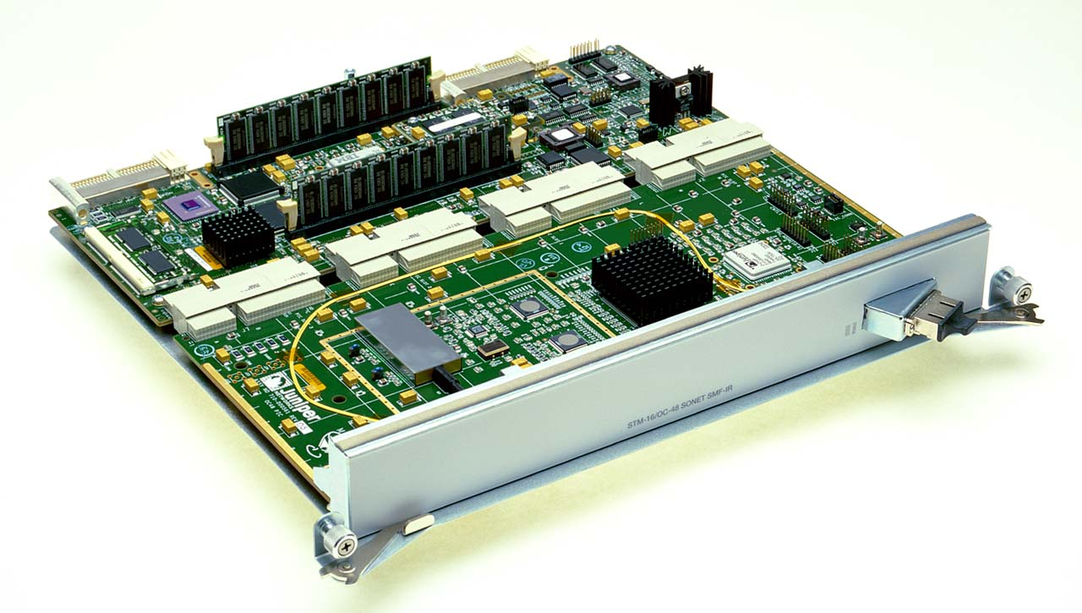
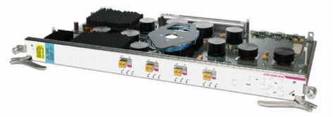
Data Plane
Xin Jin
Fall 2017 (TTh 1:30-2:45 in Malone 228）
EN.601.714 Advanced Computer Networks
https://github.com/xinjin/course-adv-net
Notes:
Slides adapted from Princeton COS 561 Advanced Computer Networks

Slide 2
Data Plane
Streaming algorithms that act on packets
Matching on some bits, taking a simple action
… at behest of control and management plane
Wide range of functionality
Forwarding
Access control
Mapping header fields
Traffic monitoring
Buffering and marking
Shaping and scheduling
Deep packet inspection
Notes:
Question to keep in mind: is there a common way to think about all of these data-plane operations

Slide 3
Packet Forwarding

Slide 4
Packet Forwarding
Control plane computes a forwarding table
Maps destination address(es) to an output link
Handling an incoming packet
Match: destination address
Action: direct the packet to the chosen output link
Switching fabric
Directs packet from input link to output link
Processor
Switching
Fabric

Slide 5
Switch: Match on Destination MAC
MAC addresses are location independent
Assigned by the vendor of the interface card
Cannot be aggregated across hosts in the LAN
mac1
mac2
mac3
host
host
...
host
mac1
mac2
mac3
mac4
mac5
host
switch
mac4
host
mac5

Slide 6
IP Routers: Match on IP Prefix
IP addresses grouped into common subnets
Allocated by ICANN, regional registries, ISPs, and within individual organizations
Variable-length prefix identified by a mask length
1.2.3.4
1.2.3.7
1.2.3.156
5.6.7.8
5.6.7.9
5.6.7.212
host
host
...
host
host
host
...
host
LAN 1
LAN 2
router
router
router
WAN
WAN
1.2.3.0/24
Prefixes may be nested. Routers identify the longest matching prefix.
5.6.7.0/24
forwarding table

Slide 7
Switch Fabric: From Input to Output
Data
1
1
Hdr
Header Processing
Queue
Packet
Lookup
Address
Update
Header
Address
Table
Buffer
Memory
Data
2
2
Hdr
Header Processing
Queue
Packet
Lookup
Address
Update
Header
Address
Table
Buffer
Memory
Data
Hdr
Header Processing
N
N
Queue
Packet
Lookup
Address
Update
Header
Address
Table
Buffer
Memory

Slide 8
Access Control

Slide 9
Access Control: Packet Filtering
“Five tuple” for access control lists (ACLs)
Source and destination IP addresses
TCP/UDP source and destination ports
Protocol (e.g., UDP vs. TCP)
Can be more sophisticated
E.g., block all TCP SYN packets from outside hosts
E.g., stateful
Should arriving packet be allowed in? Departing packet let out?

Slide 10
Applying Access Control Lists
Ordered list of “accept/deny” clauses
A clause can have wild cards
Clauses can overlap
… so order matters
Packet classification
Given all of the fields
… identify the match with the highest priority
Two approaches
Clever algorithms for multi-dimensional classification
Ternary Content Addressable Memories (TCAMs)
Src=1.2.3.4, Dest=5.6.7.8 | Deny
Dest=1.2.3.* | Allow
Dest=1.2.3.8, Dport!=53 | Deny
Src=1.2.3.7, Dport=100 | Allow
Dport=100 | Deny

Slide 11
Mapping Header Fields

Slide 12
Network Address Translation (NAT)
138.76.29.7
10.0.0.1
outside
NAT
inside
10.0.0.2

Slide 13
Mapping Addresses and Ports
Remap IP addresses and TCP/UDP port numbers
Addresses: between end-host and NAT addresses
Port numbers: to ensure each connection is unique
Create table entries as packets arrive
Src 10.0.0.1, Sport 1024, Dest 1.2.3.4, Dport 80
Map to Src 138.76.29.7, Sport 1024, Dest 1.2.3.4, Dport 80
Src 10.0.0.2, Sport 1024, Dest 1.2.3.4, Dport 80
Map to Src 138.76.29.7, Sport 1025, Dest 1.2.3.4, Dport 80
Challenges
When to remove the entries
Running services behind a NAT
What if both ends of a connection are behind NATs

Slide 14
Traffic Monitoring

Slide 15
Observing Traffic Passing Through
source
dest
input
output
source
prefix
dest
prefix
source AS
intermediate AS
dest AS
Applications of traffic measurement
Usage-based billing
Network engineering
Detecting anomalous traffic

Slide 16
Passive Traffic Monitoring
Counting the traffic
Match based on fields in the packet header
… and update a counter of #bytes and #packets
Examples
Link
IP prefixes
TCP/UDP ports
Individual “flows”
Challenges
Identify traffic aggregates in advance vs. reactively
Summarizing other information (e.g., time, TCP flags)
Not knowing if you see all packets in a connection
Dest Prefix | #Packets | #Bytes
1.2.3.0/24 | 3 | 1500
7.8.0.0/16 | 10 | 13000
8.0.0.0/8 | 100 | 85020
7.7.6.0/23 | 1 | 40

Slide 17
Resource Allocation: Buffering, Scheduling, Shaping, and Marking

Slide 18
Buffering
Drop-tail FIFO queue
Packets served in the order they arrive
… and dropped if queue is full
Random Early Detection (RED)
When the buffer is nearly full
… drop or mark some packets to signal congestion
Multiple classes of traffic
Separate FIFO queue for each flow or traffic class
… with a link scheduler to arbitrate between them

Slide 19
Link Scheduling
Strict priority
Assign an explicit rank to the queues
… and serve the highest-priority backlogged queue
Weighted fair scheduling
Interleave packets from different queues
…in proportion to weights
50% red, 25% blue, 25% green

Slide 20
Traffic Shaping
Force traffic to conform with a profile
To avoid congesting downstream resources
To enforce a contract with the customer
Leaky-bucket shaping
Can send at rate r and intermittently burst
Parameters: token rate r and bucket depth d
Tokens arrive (rate r)
Max # of tokens
(d tokens)
tokens
A leaky-bucket shaper for each flow or traffic class
packets

Slide 21
Traffic Classification and Marking
Mark a packet to influence handling downstream
Early Congestion Notification (ECN) flag
Type-of-Service (ToS) bits
Ways to set the ToS bits
End host sets the bits based on the application
But, then the network must trust (or bill!) the end host
Network sets the bits based on traffic classes
But, then the network needs to know how to classify packets
Identifying traffic classes
Packet classification based on the “five tuple”
Rate limits, with separate mark for “out of profile” traffic

Slide 22
Generalizing the Data Plane
Software-Defined Networking (SDN)

Slide 23
Many Boxes, But Similar Functions
Router
Forward on destination IP address
Access control on the “five tuple”
Link scheduling and marking
Monitoring traffic
Deep packet inspection
Switch
Forward on destination MAC address
Firewall
Access control on “five tuple” (and more)
NAT
Mapping addresses and port numbers
Shaper
Classify packets
Shape or schedule
Packet sniffer
Monitoring traffic

Slide 24
OpenFlow
Match
Match on a subset of bits in the packet header
E.g., key header fields (addresses, port numbers, etc.)
Well-suited to capitalize on TCAM hardware
Action
Perform a simple action on the matching packet
E.g., forward, flood, drop, rewrite, count, etc.
srcip=1.2.*.*, dstip=3.4.5.* → drop
srcip=*.*.*.*, dstip=3.4.*.* → forward(2)
3. srcip=10.1.2.3, dstip=*.*.*.* → send to controller

Slide 25



(Logically) Centralized Controller
Controller Platform

Slide 26
Protocols → Applications
Controller Application
Controller Platform

Slide 27
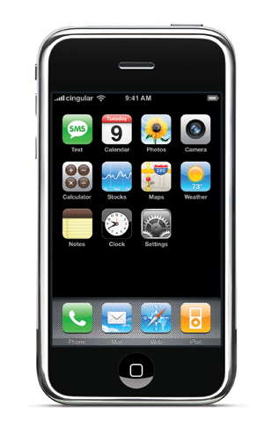

Seamless Mobility
See host sending traffic at new location
Modify rules to reroute the traffic

Slide 28
Server Load Balancing
Pre-install load-balancing policy
Split traffic based on source IP
10.0.0.1
src=0*,
dst=1.2.3.4
10.0.0.2
src=1*,
dst=1.2.3.4

Slide 29
Programmable Data Plane
Programmable data plane
Arbitrary customized packet-handling functionality
Building a new data plane, or extending existing one
Speed is important
Data plane in hardware or in the kernel
Streaming algorithms the handle packets as they arrive
Three open platforms
Click: software data plane in user space or the kernel
NetFPGA: hardware data plane based on FPGAs
Mininet: software emulator on your laptop
Lots of ongoing research activity…

Slide 30
An Observation…
Click is widely used
And the paper on Click is widely cited
Click elements are created by others
Enabling an ecosystem of innovation
Take-away lesson
Creating useful systems that others can use and extend has big impact in the research community
And brings tremendous professional value
Compensating amply for the time and energy ☺

Slide 31
Discussion
Trade-offs between customizability and performance?
What data-plane model would be “just enough” for most needs, but still fast and inexpensive?
Ways the Internet architecture makes data-plane functionality more challenging?

Slide 32
Click Modular Router
Backup Slides

Slide 33
Click Motivation
Flexibility
Add new features and enable experimentation
Openness
Allow users/researchers to build and extend
(In contrast to most commercial routers)
Modularity
Simplify the composition of existing features
Simplify the addition of new features
Speed/efficiency
Operation (optionally) in the operating system
Without the user needing to grapple with OS internals

Slide 34
Router as a Graph of Elements
Large number of small elements
Each performing a simple packet function
E.g., IP look-up, TTL decrement, buffering
Connected together in a graph
Elements inputs/outputs snapped together
Beyond elements in series to a graph
E.g., packet duplication or classification
Packet flow as main organizational primitive
Consistent with data-plane operations on a router
(Larger elements needed for, say, control planes)

Slide 35
Click Elements: Push vs. Pull
Packet hand-off between elements
Directly inspired by properties of routers
Annotations on packets to carry temporary state
Push processing
Initiated by the source end
E.g., when an unsolicited packet arrives (e.g., from a device)
Pull processing
Initiated by the destination end
E.g., to control timing of packet processing (e.g., based on a timer or packet scheduler)

Slide 36
Click Language
src :: FromDevice(eth0);
ctr :: Counter;
sink :: Discard;
src -> ctr;
ctr -> sink;
Declarations
Create elements
Connections
Connect elements
Compound elements
Combine multiple smaller elements, and treat as single, new element to use as a primitive class
Language extensions through element classes
Configuration strings for individual elements
Rather than syntactic extensions to the language

Slide 37
Handlers and Control Socket
Access points for user interaction
Appear like files in a file system
Can have both read and write handlers
Examples
Installing/removing forwarding-table entries
Reporting measurement statistics
Changing a maximum queue length
Control socket
Allows other programs to call read/write handlers
Command sent as single line of text to the server
http://read.cs.ucla.edu/click/elements/controlsocket?s=llrpc

Slide 38
Example: EtherSwitch Element
Ethernet switch
Expects and produces Ethernet frames
Each input/output pair of ports is a LAN
Learning and forwarding switch among these LANs
Element properties
Ports: any # of inputs, and same # of outputs
Processing: push
Element handlers
Table (read-only): returns port association table
Timeout (read/write): returns/sets TIMEOUT
http://read.cs.ucla.edu/click/elements/etherswitch

Slide 39
Thanks! Q&A

