Slide 1
Middleboxes
Xin Jin
Fall 2019 (TTh 1:30-2:45 in Hodson 316)
EN.601.714 Advanced Computer Networks
https://github.com/xinjin/course-adv-net

Slide 2
Course Project
Project presentation (Dec. 3 and 5): Sign up for project presentation (only two weeks away)
Project demo (Dec. 6): Schedule a demo with TA
Project report (Dec. 9): Submit 6-page report

Slide 3
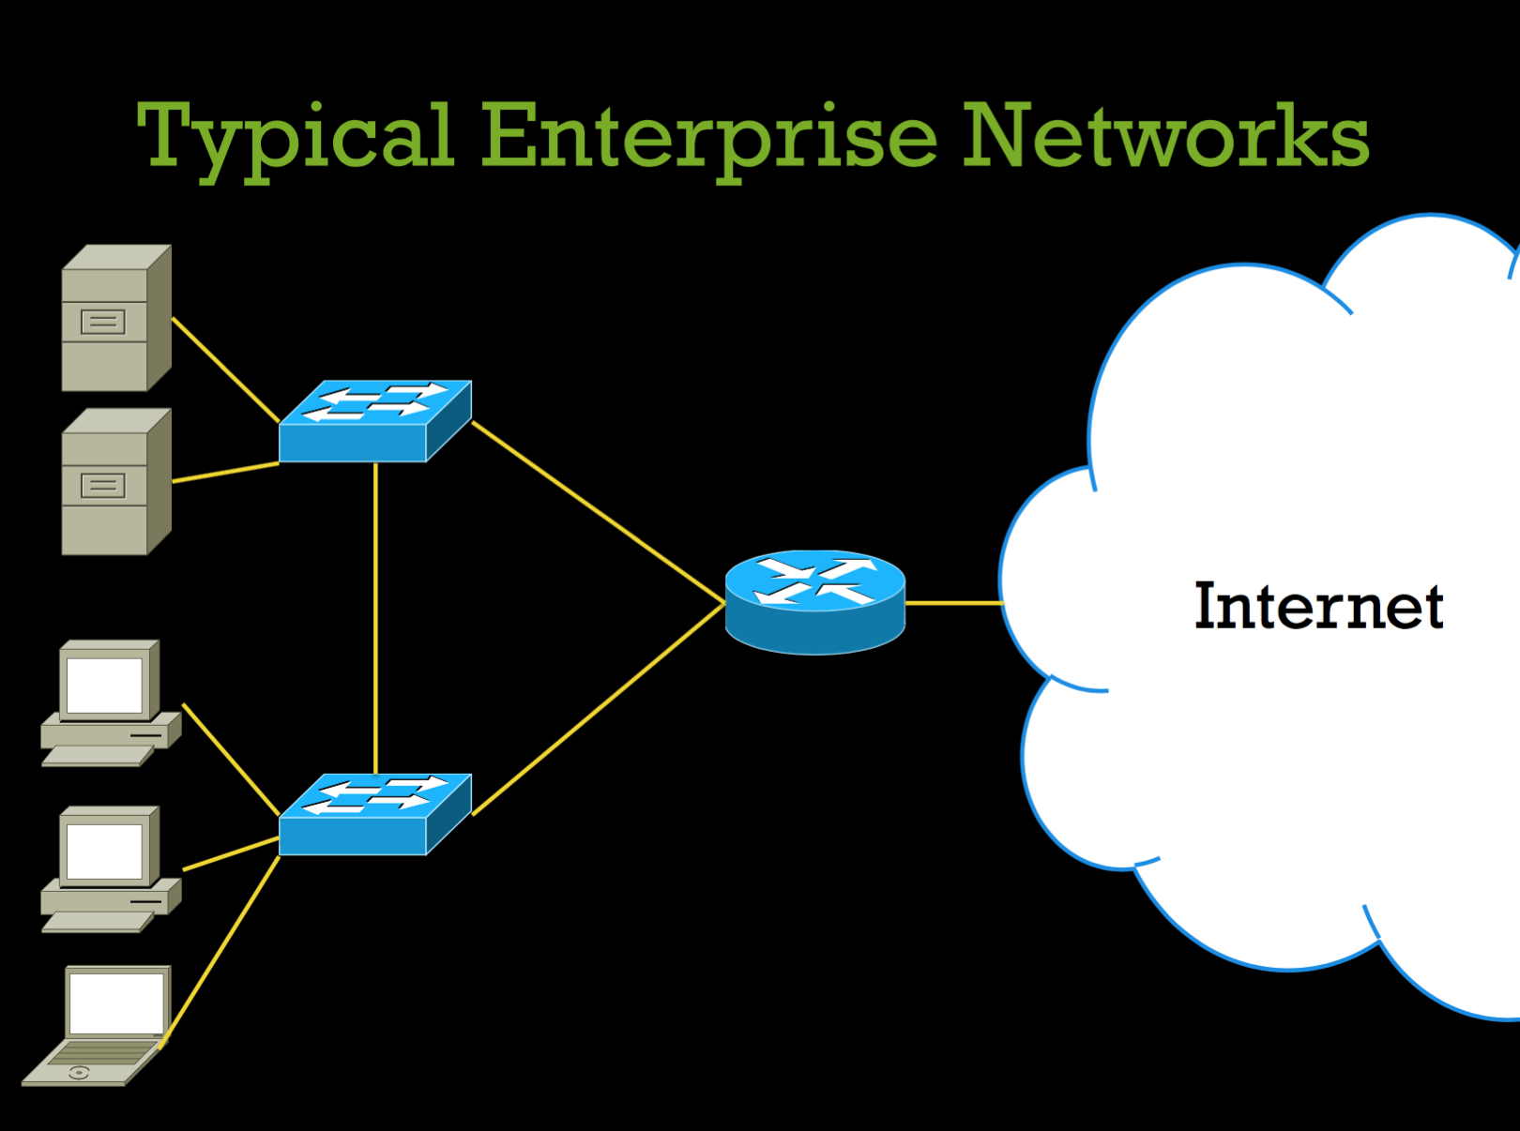
Notes:
Slides from ”making middleboxes someone else’s problem” in SIGCOMM’12

Slide 4
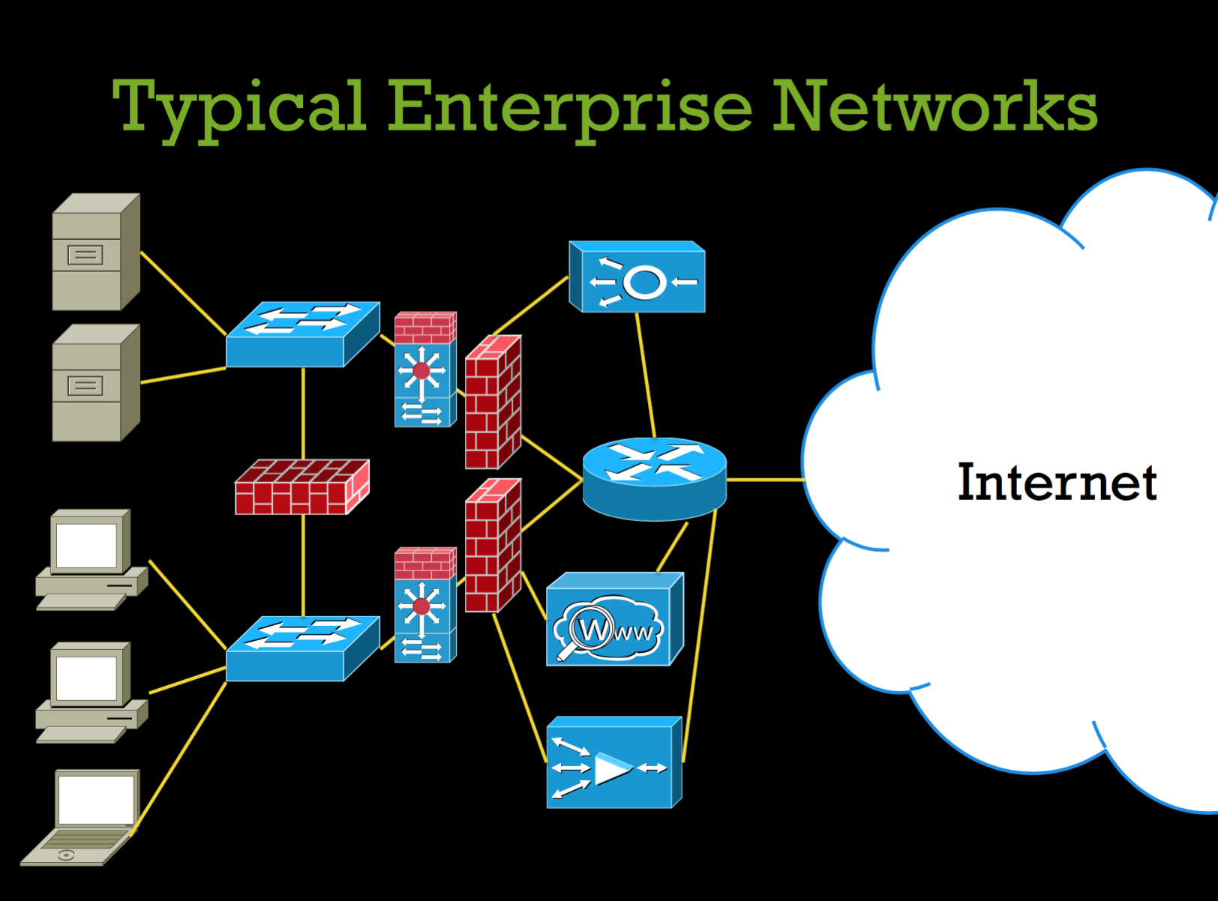

Slide 5
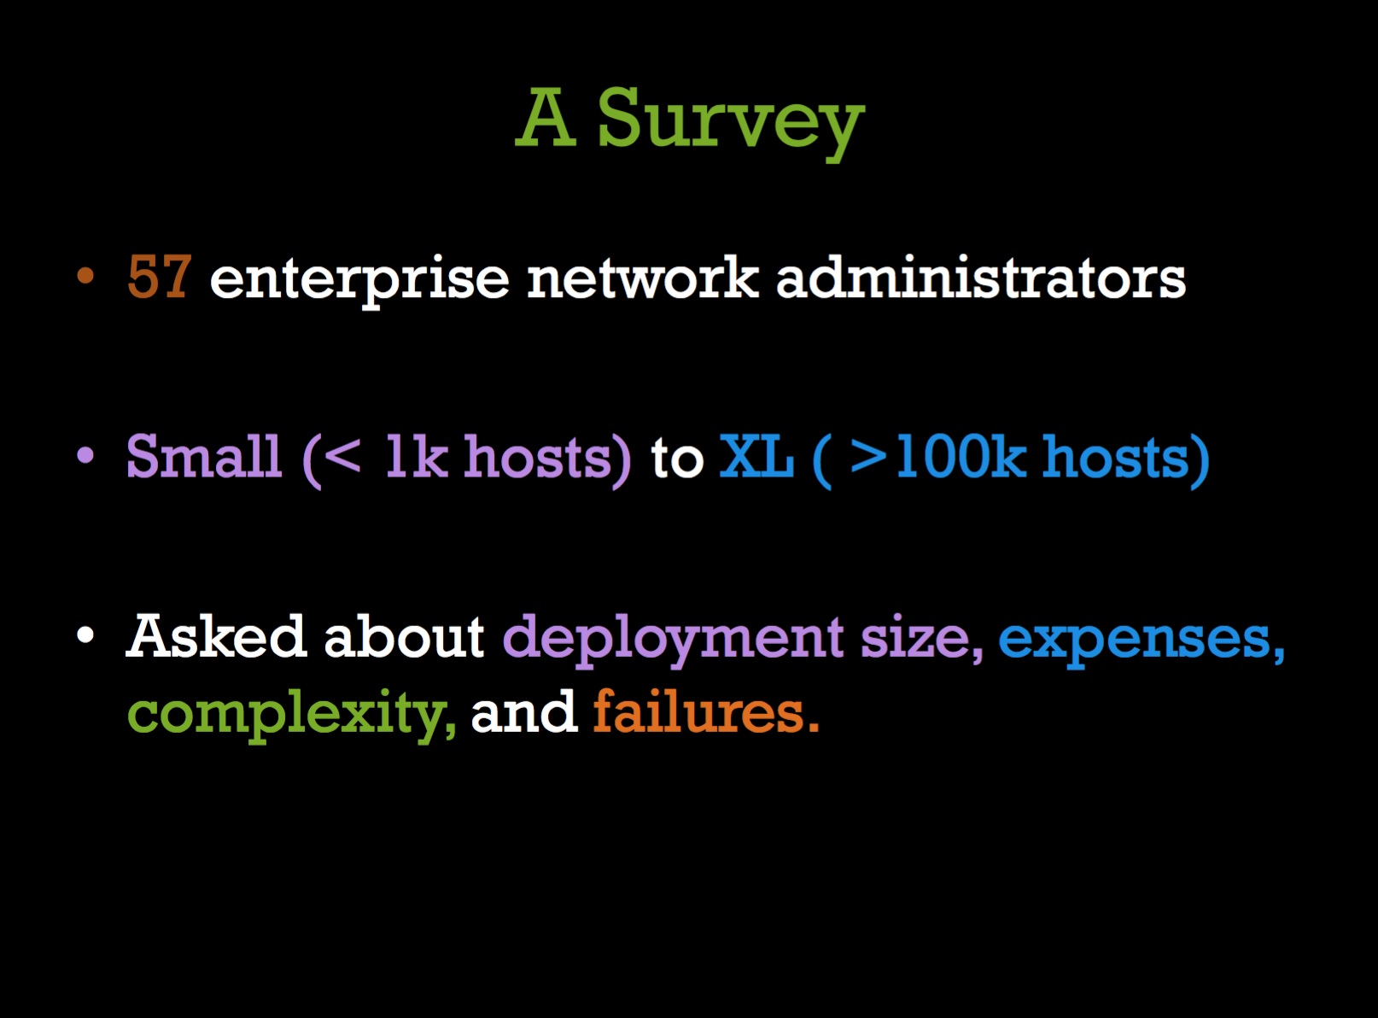

Slide 6
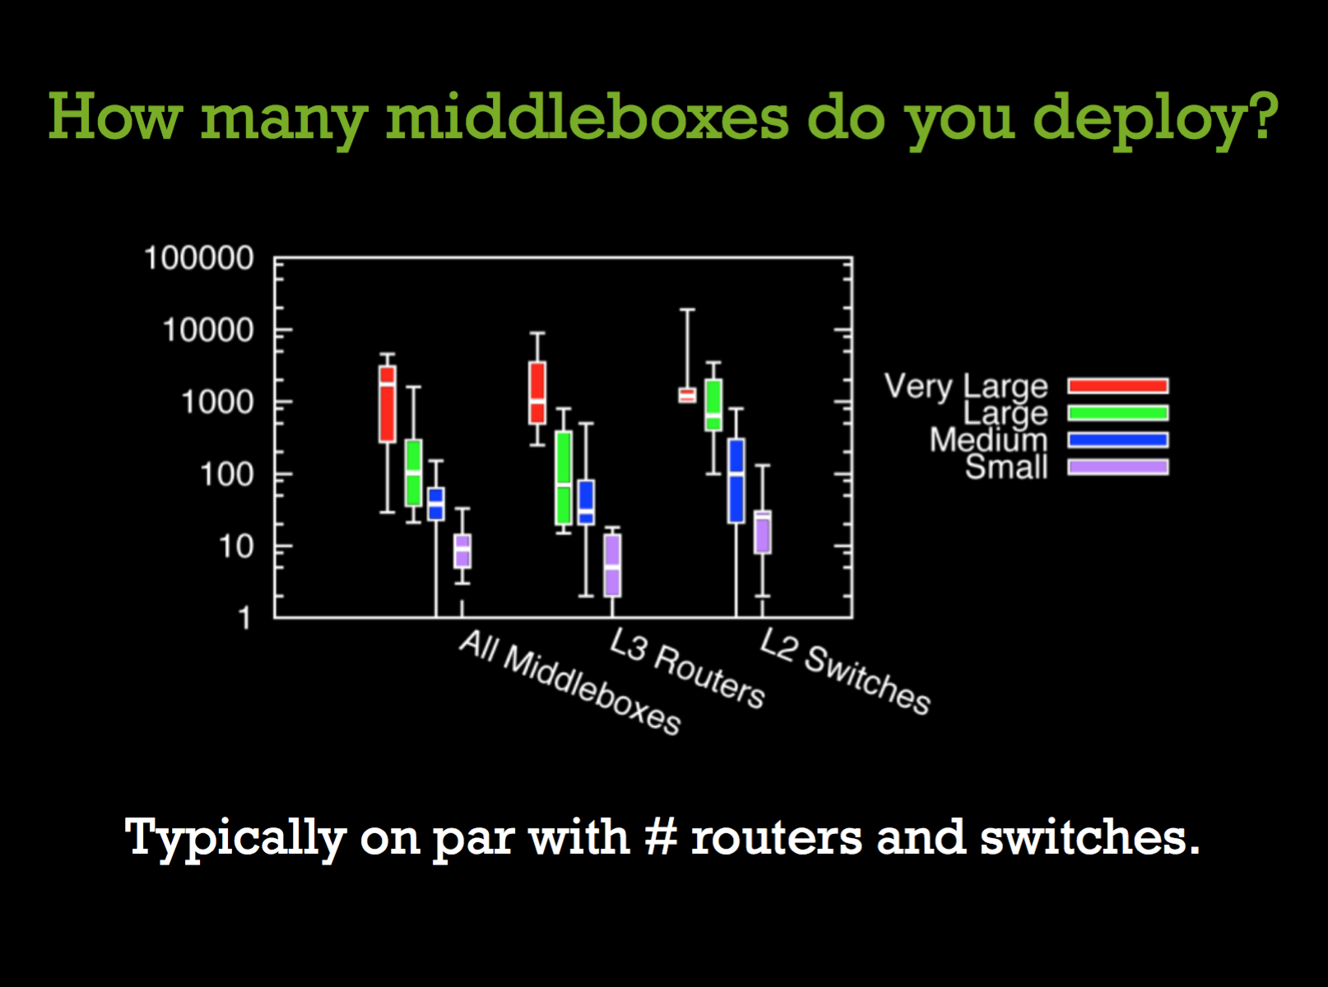

Slide 7
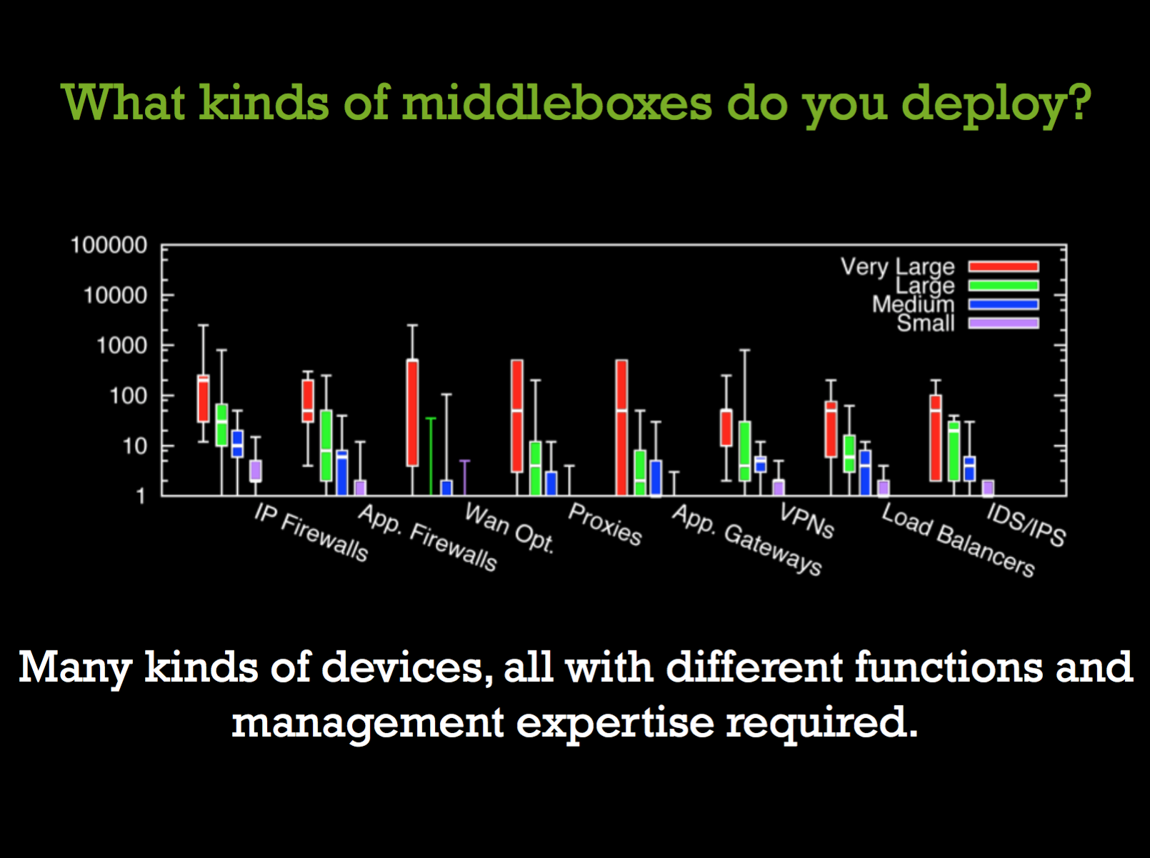

Slide 8
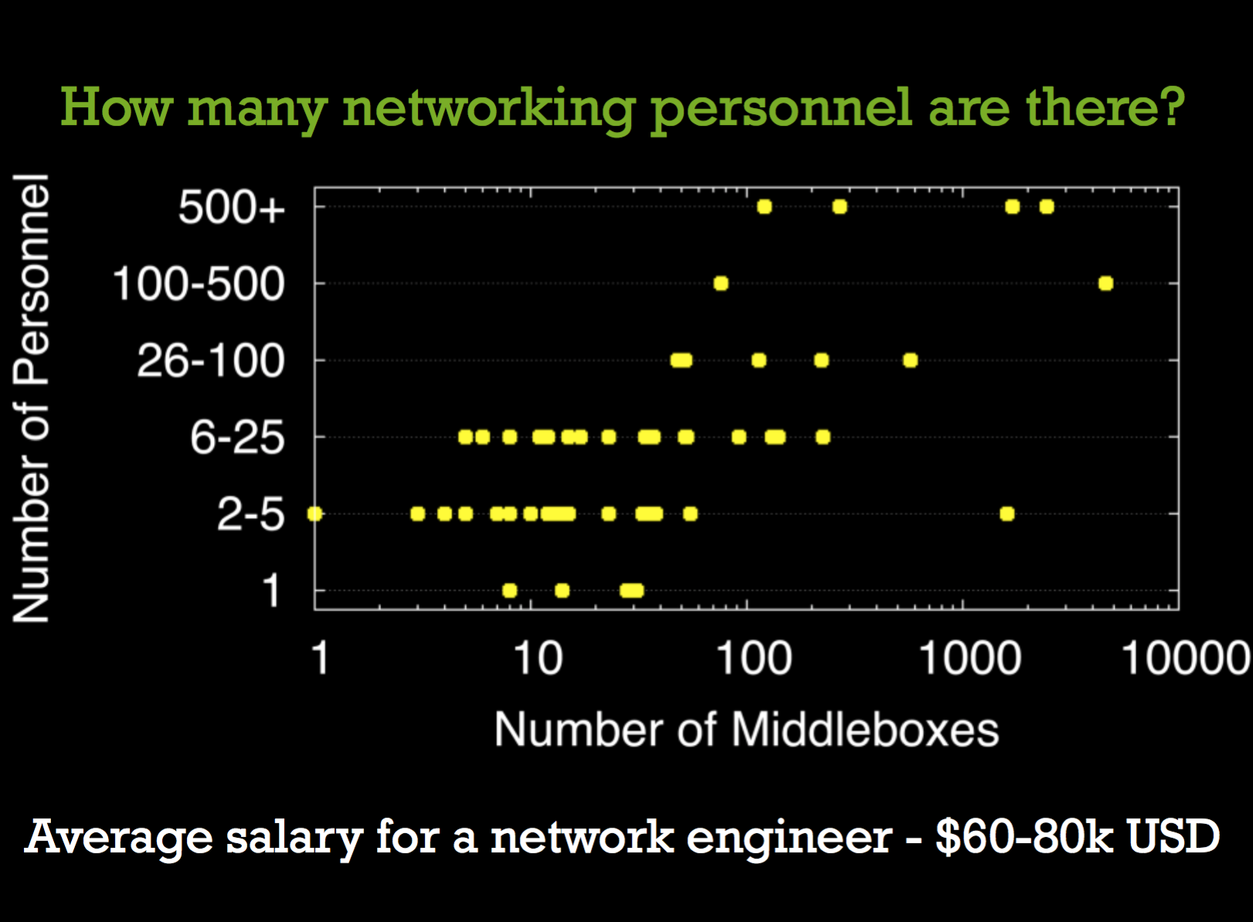

Slide 9
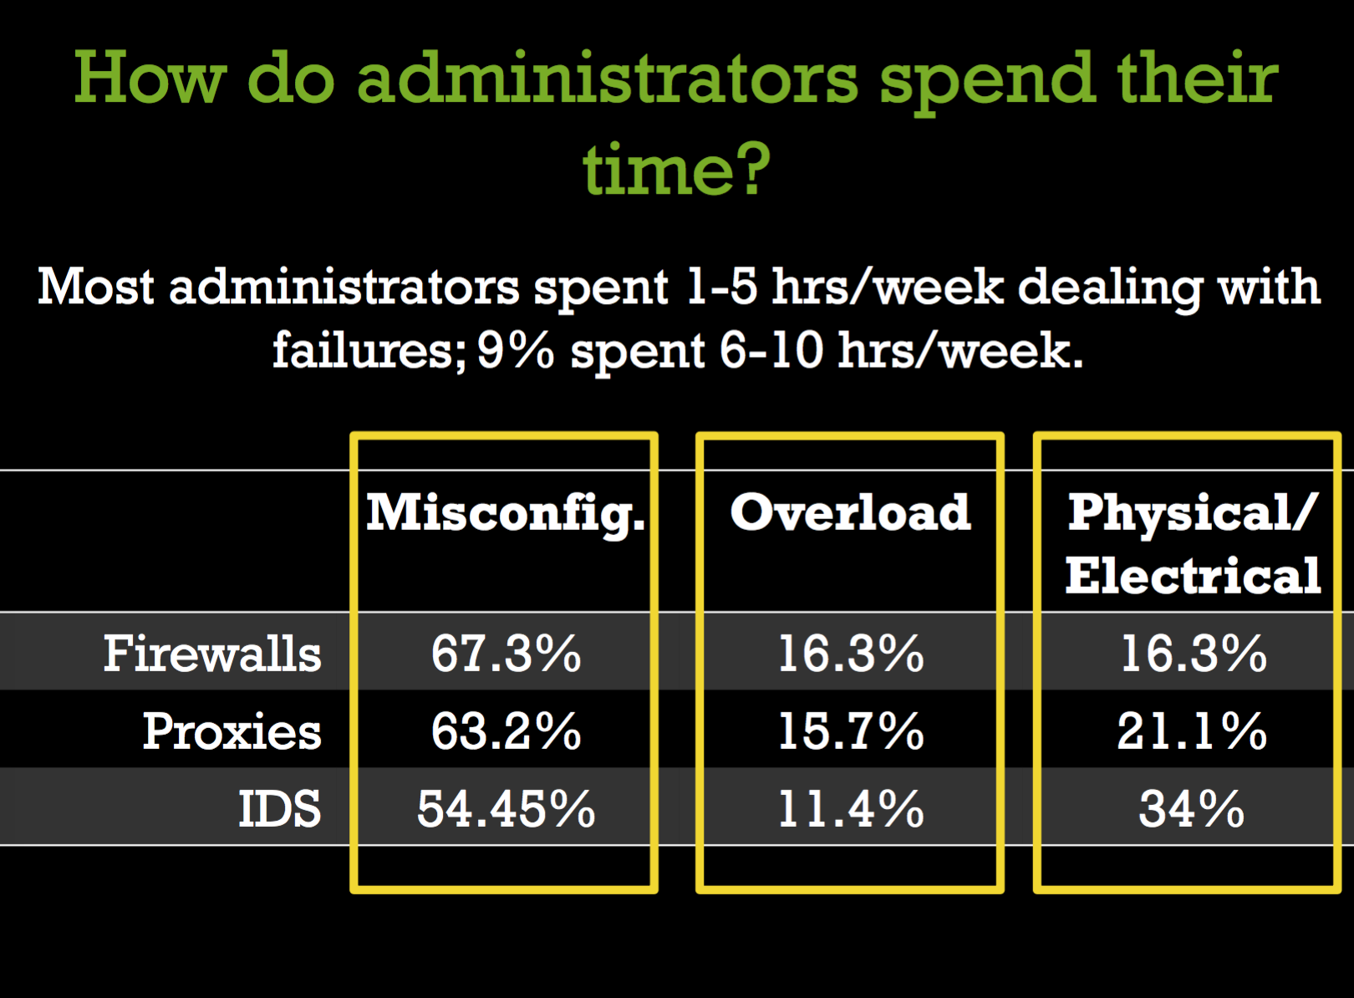

Slide 10
Summary
High capital and operating expense
Time consuming and error-prone
Physical and overload failures

Slide 11
Now the papers…
E2, SOSP’15
NFV control plane
NetBricks, OSDI’16
NFV data plane

Slide 12
Discussion
How to compare the two papers, i.e., their pros and cons?
How are middleboxes different from switches?

Slide 13
Now the papers…
Ananta, SIGCOMM’13
Software load balancer
SilkRoad, SIGCOMM’17
Hardware load balancer

Slide 14
Discussion
How to compare the two papers, i.e., their pros and cons?
How can we design better load balancers?

Slide 15
Thanks! Q&A

