Slide 1
Principles and Applications of Data Science Project Proposal
Name: Li-Wei Yeh
StudentID: 108012047
Date: Dec 18, 2019
National Taipei University of Technology

Slide 2
Outline
Introduction
Motivation
Objectives
Plan and Deadlines
Related Work and Resources
Methodology and Tools
Expected Results
Timeline

Slide 3
Introduction
Motivation
Objectives

Slide 4
Heart Disease UCI
Clients with (or without) heart disease
Predict heart disease

Slide 5
Project Plan and Deadlines
Related Work and Resources
Methodology and Tools
Expected Results
Timeline

Slide 6
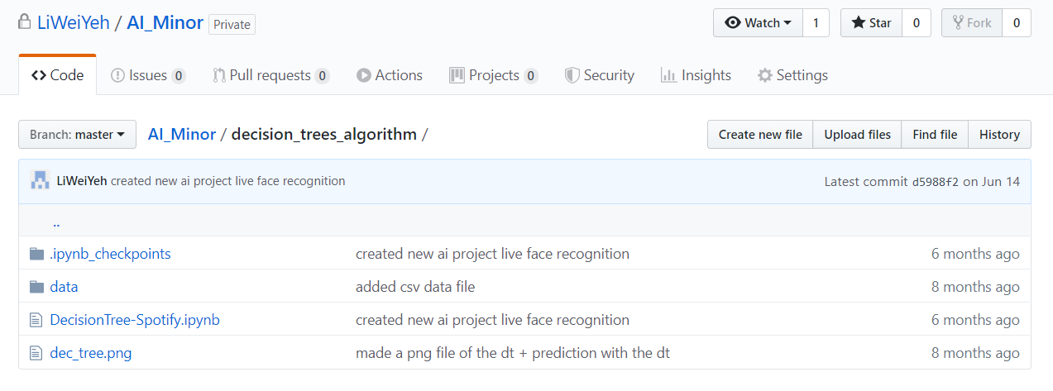
Related work

Slide 7
Methodology
Scrum
Work in sprints
Python
Anaconda
Numpy
Sklearn
Graphviz

Slide 8
Expected Results
Heart disease:
Chest pain high
Sex is male

