Slide 1
Simulating the Green-beard effect with selective altruism
Li-Wei Yeh
0540013

Slide 2
What is altruism?
Biological definition
“Behaviour by an individual that aims to increase the fitness of another individual while decreasing the fitness of the actor”
Green-beard effect
Thought experiment in biology
Perceptible trait
Recognition of said trait
Preferential treatment of being with said trait

Slide 3
The simulation
Types of blobs
Regular
Greenbeard <- has altruism
Objective -> Food!!!

Slide 4
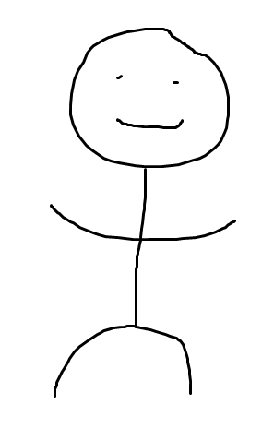
The simulation
Types of blobs
Regular
Greenbeard <- has altruism
Objective -> Food!!!

Slide 5
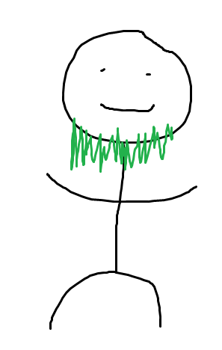
The simulation
Types of blobs
Regular
Greenbeard <- has altruism
Objective -> Food!!!

Slide 6

The simulation
Types of blobs
Regular
Greenbeard <- has altruism
Objective -> Food!!!

Slide 7
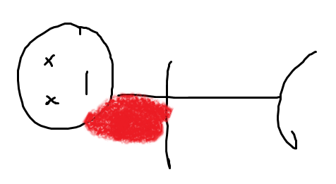
The simulation
Types of blobs
Regular
Greenbeard <- has altruism
Objective -> Food!!!

Slide 8
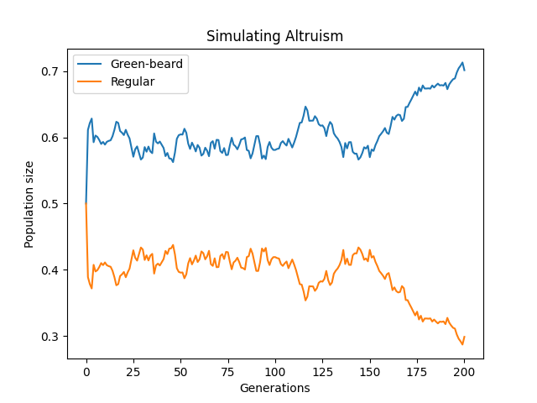
Results
Ran for 200 generations
1000 Green-beards
1000 Regulars
2000 food

Slide 9
Conclusion
Having Altruistic behaviour towards blobs with the same gene increases the chance of getting a higher population.

